Slide 1



Fast scintillators for time measurement
Junfeng Chen² and Xiaolong Wang¹
¹Fudan University, Shanghai
²Shanghai Institute of Ceramics, CAS
International Workshop on the high energy Circular Electron-Positron Collider Online，Oct. 27, 2022

Slide 2
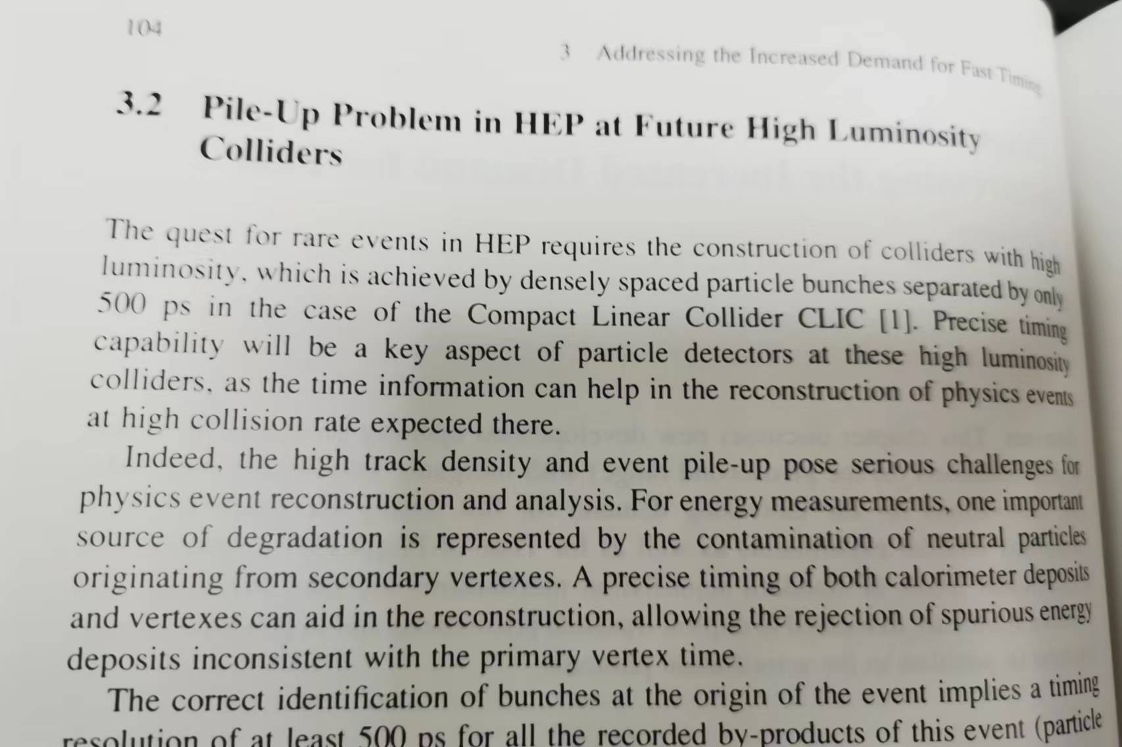
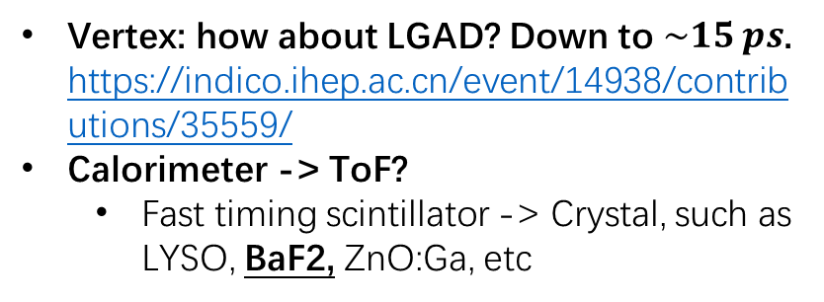
Read book…
Vertex: how about LGAD? Down to $\sim 15 ps$. https://indico.ihep.ac.cn/event/14938/contributions/35559/
Calorimeter -> ToF?
  Fast timing scintillator -> Crystal, such as LYSO, BaF2, ZnO:Ga, etc

Slide 3
Inorganic scintillator
Fast decay time, and the rising time is much faster!
Organic scintillator for TOF has been studied well.

Slide 4
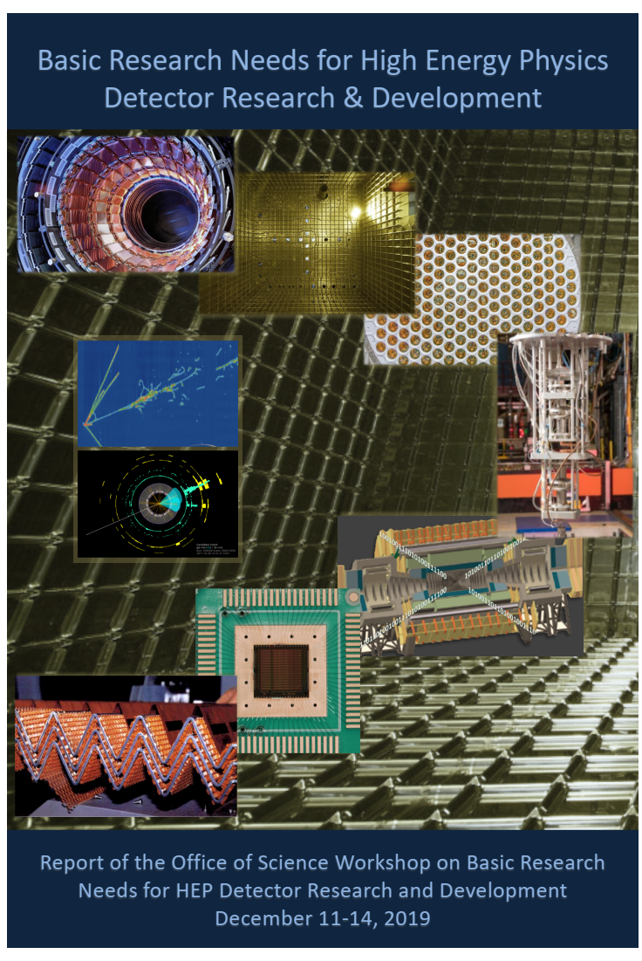
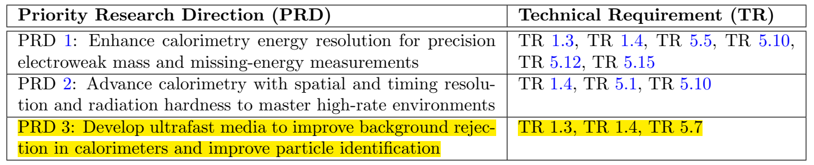
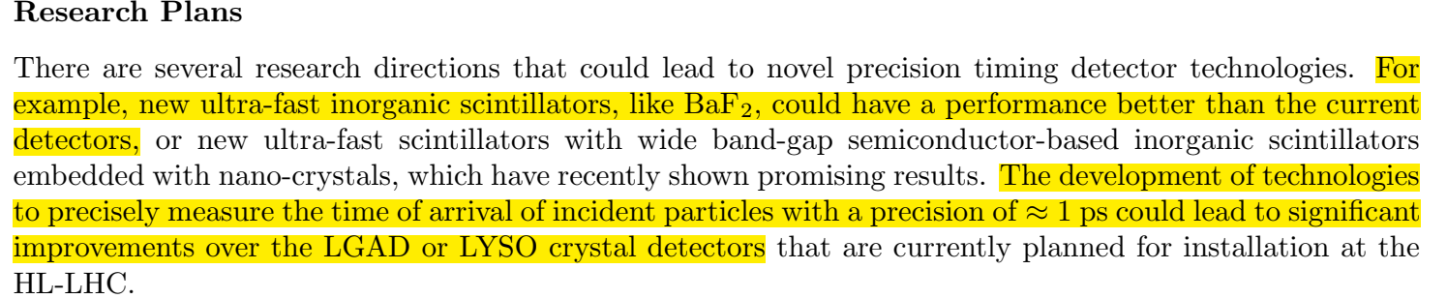
Reference
For example, new ultra-fast inorganic scintillators, like BaF₂ could have a performance better than the current detectors,…
The development of technologies to precisely measure the time of arrival of incident particle with a precision of ≈ 1ps could lead to significant improvements over LGAD or LYSO crystal detectors.

Slide 5
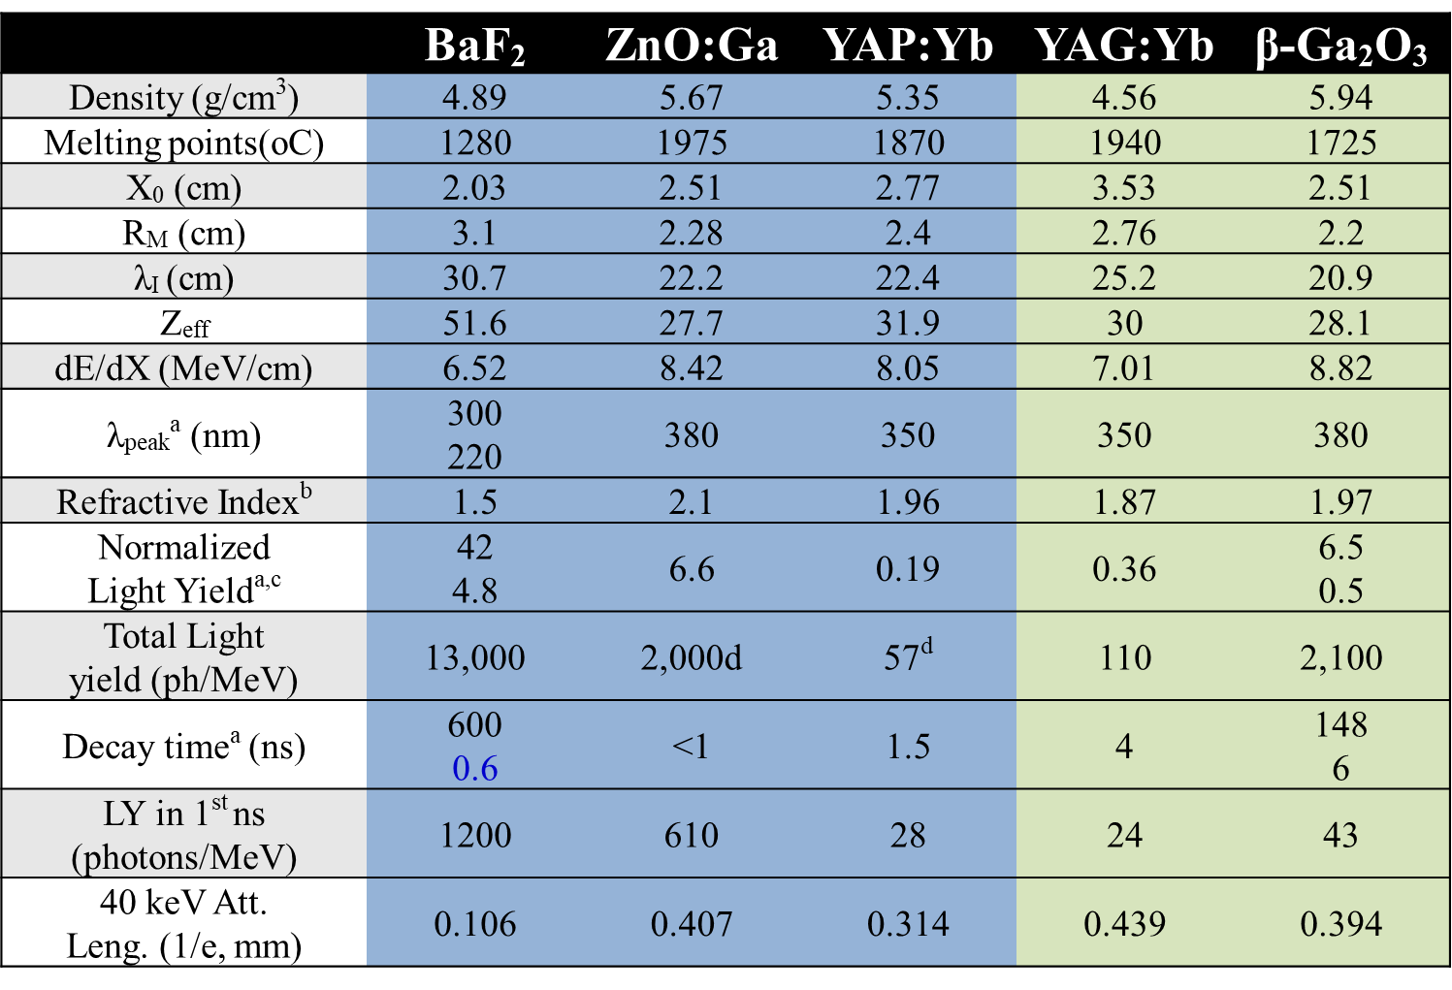
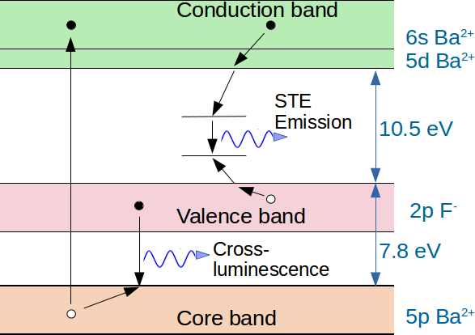
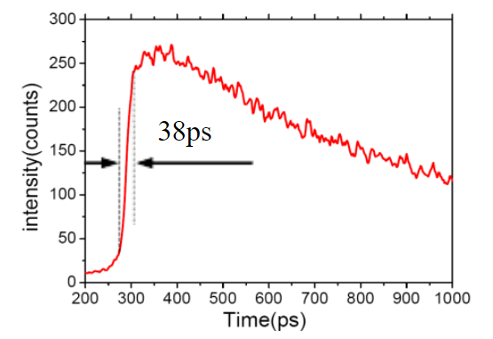
Comparison

Slide 6
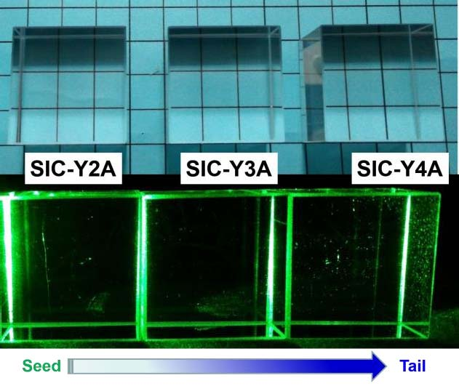
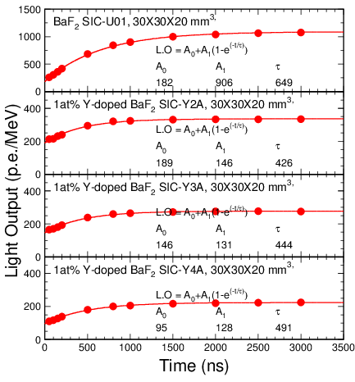
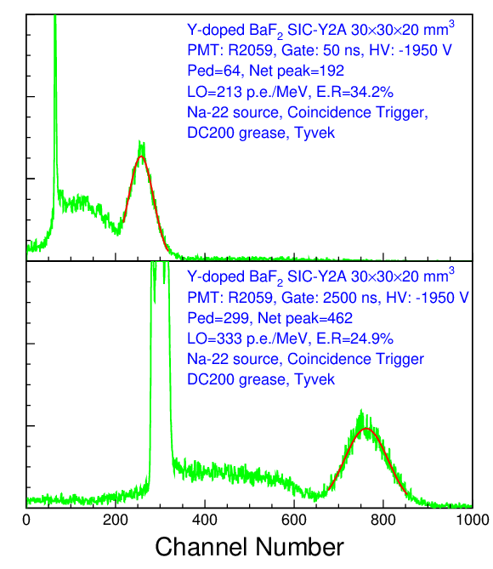
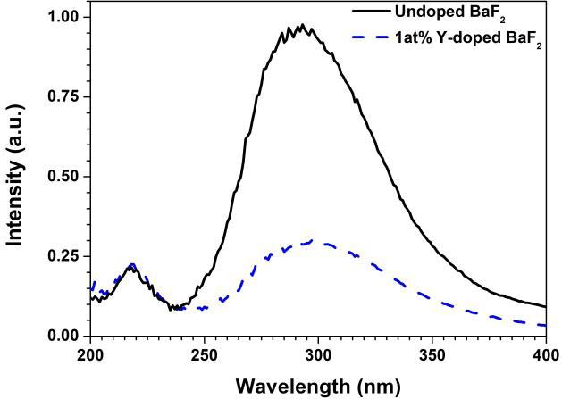
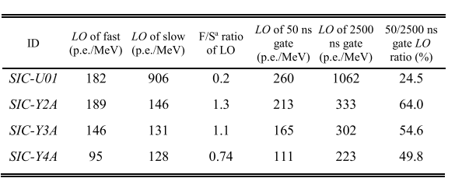
Suppress slow component with Y-adoped
J. Chen, et al., IEEE Trans. Nucl. Sci. IEEE Trans. Nucl. Sci. 65, 2147 (2018).

Slide 7
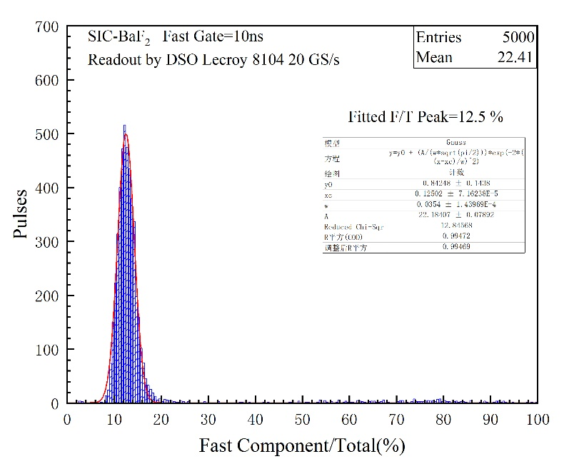
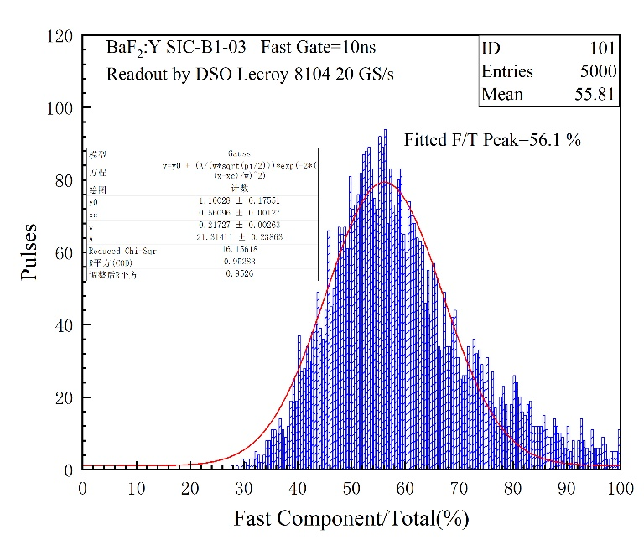
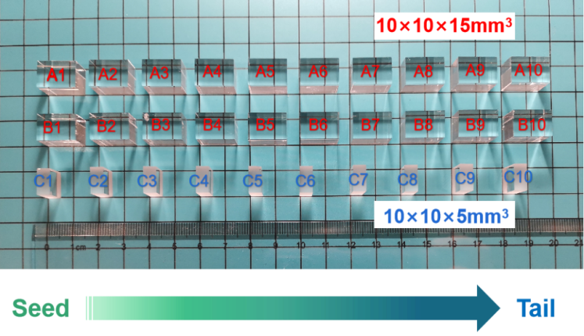
Suppress slow component with Y-adoped
Sample ID | F/S ratio
Pure BaF₂ | 0.22
B1 | 1.96
B2 | 1.94
B3 | 1.98
B4 | 2.03
B5 | 2.15
B6 | 2.32
B7 | 2.37
B8 | 2.54
B9 | 2.60
B10 | 2.60
Gate setup
Y-doped
Undoped
Correlation Coefficients

Slide 8
Fast light output
Sample ID | F/S ratio | LO_{fast} (photons/MeV) | Ratio_{fast} | LO_{slow} (photons/MeV) | Ratio_{slow} | Y (at%)
B1 | 1.407 | 1617 | 0.805 | 1153 | 0.095 | 8.34
B2 | 1.459 | 1625 | 0.809 | 1117 | 0.092 | 8.72
B3 | 1.495 | 1586 | 0.790 | 1056 | 0.087 | 9.01
B4 | 1.606 | 1602 | 0.798 | 1000 | 0.083 | 9.16
B5 | 1.678 | 1594 | 0.794 | 949 | 0.078 | 9.43
B6 | 1.776 | 1492 | 0.743 | 842 | 0.070 | 10.31
B7 | 1.879 | 1469 | 0.732 | 781 | 0.065 | 10.48
B8 | 1.981 | 1398 | 0.696 | 709 | 0.059 | 10.52
B9 | 2.021 | 1375 | 0.685 | 679 | 0.056 | 11.58
B10 | 2.055 | 1328 | 0.661 | 648 | 0.054 | 11.86
Pure BaF₂ | 0.167 | 2008 | 1.000 | 12092 | 1.000 | 0.00
Keep LO_{fast}≥66%， LO_{slow} is reduced to 5.4%；
Keep LO_{fast}≥81%， LO_{slow} is reduced to 9.5%；
B10: Lo_{fast}=1328 !

Slide 9
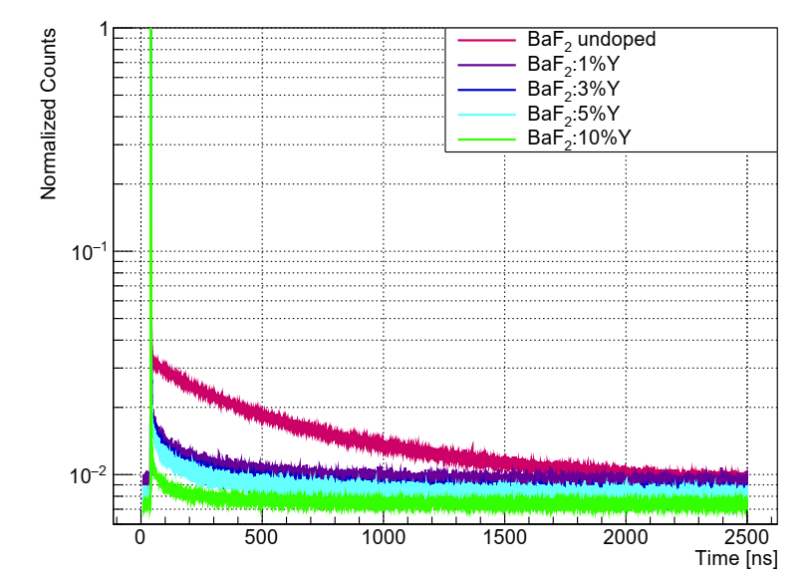
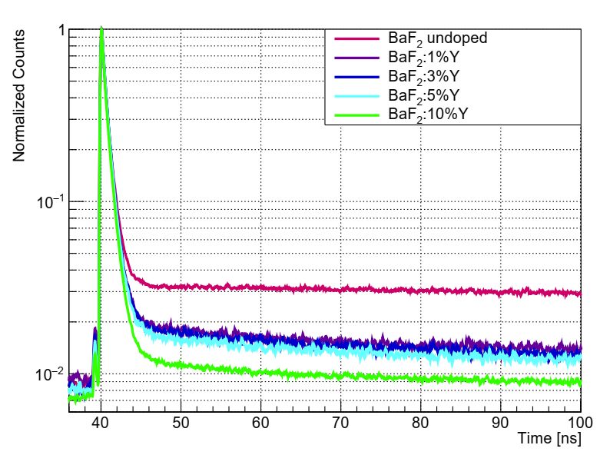

Time distribution after Y-adoped
2500 ns range
100 ns range
Good shape, like a pulse.
But need a new photosensor for the $220 nm$ photos!

Slide 10
VUV MPPC for short wavelength

Slide 11
Performance of VUV MPPC

Slide 12
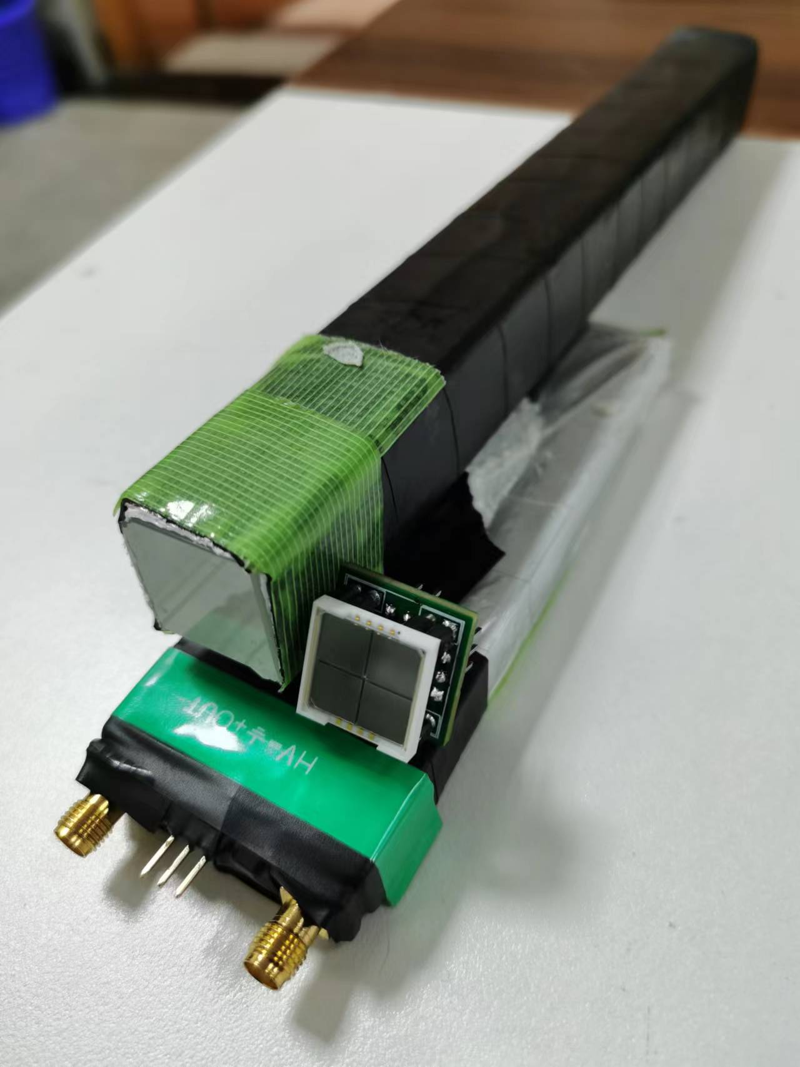
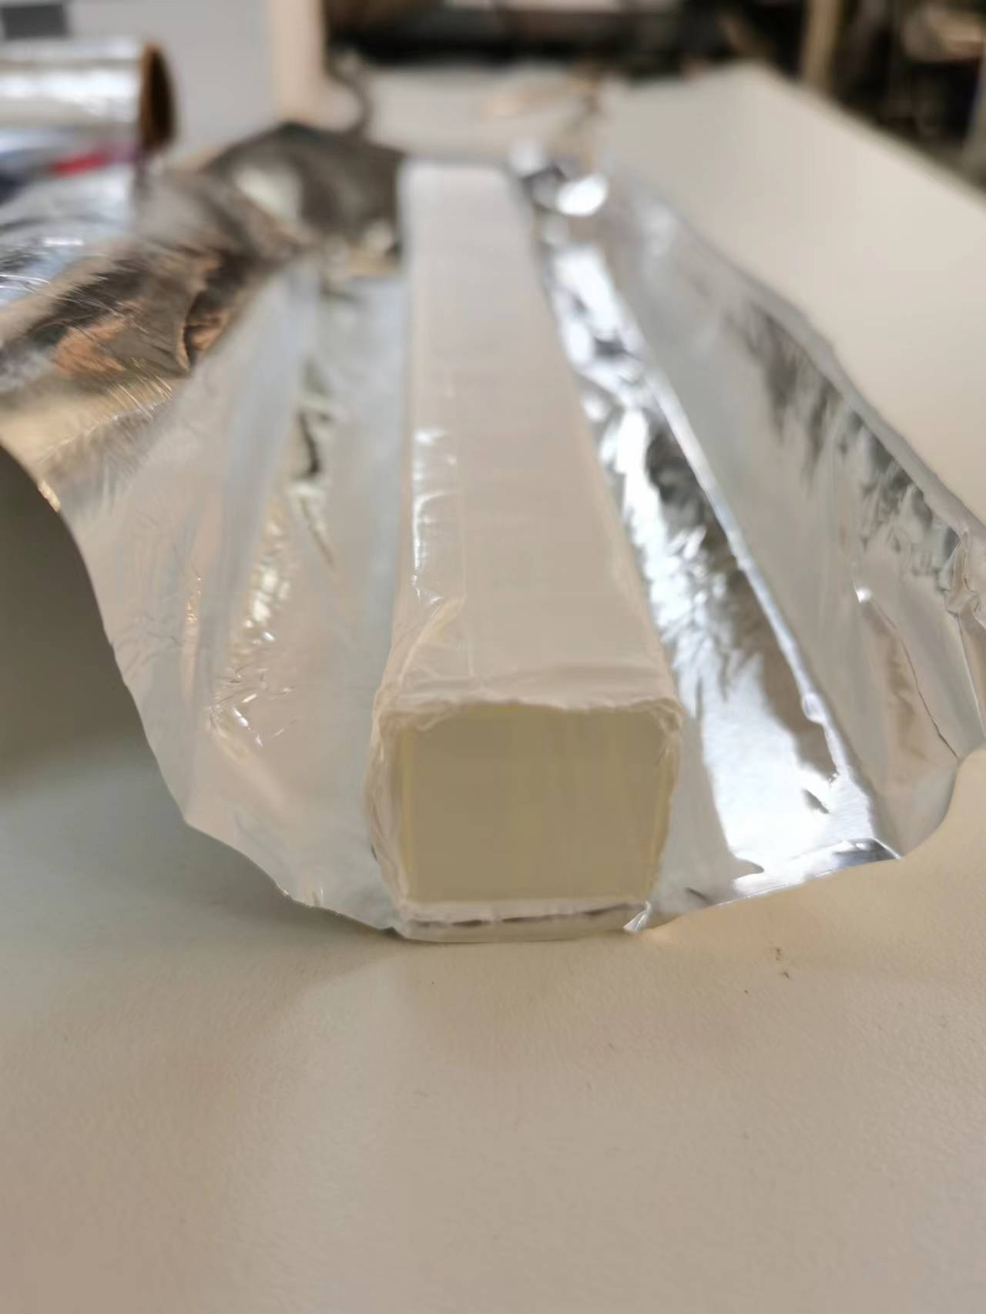
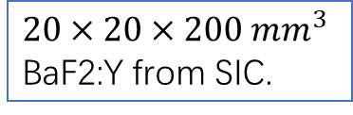
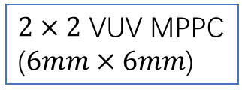
Setup for measurements
BaF2:Y
$2×2$ VUV MPPC ($6mm×6mm$)
$20×20×200 mm^{3}$ BaF2:Y from SIC.
Plastic scintillator for good timing, see the next talk by Hongyu

Slide 13
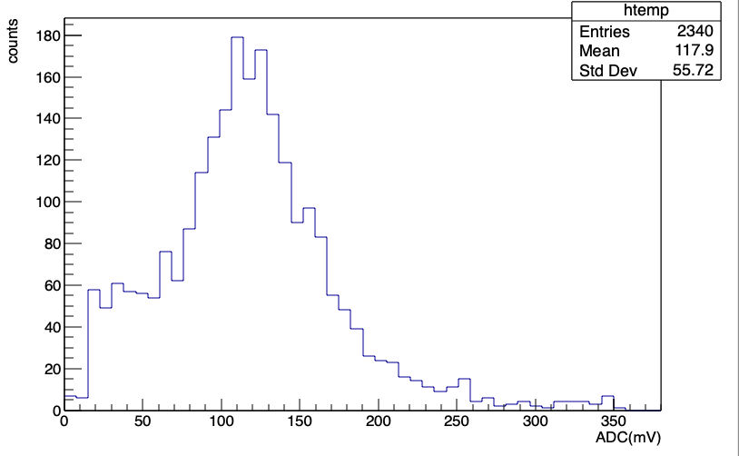

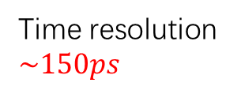
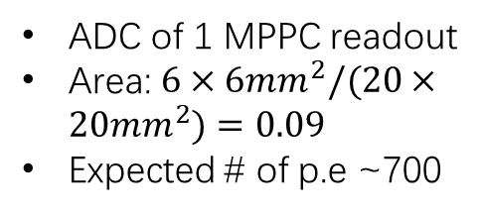
Results from the testing
$$1 p.e.=1.8mV$$
ADC of 1 MPPC readout
Area: $6×6mm^{2}/(20×20mm^{2})=0.09$
Expected # of p.e ~700
Time difference of the two triggers
Time resolution $\sim 150ps$
Time difference between trigger and 4VUV SiPM + BaF2
Preliminary result, need more improvements!

Slide 14
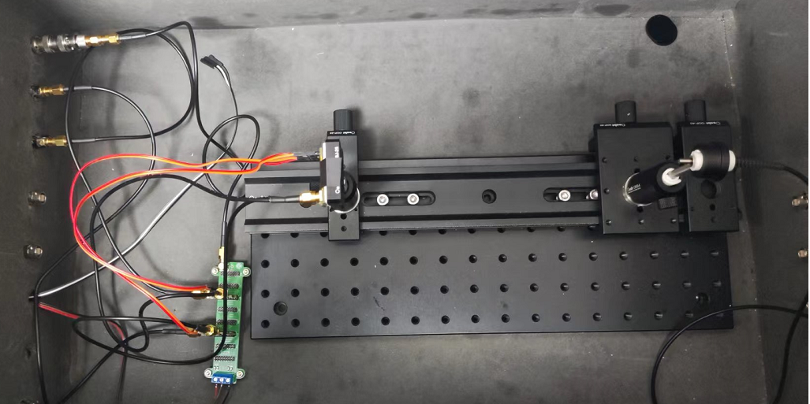
Testing for the time resolution of VUV MPPC
laser
SiPM
Pre-AMP

Slide 15
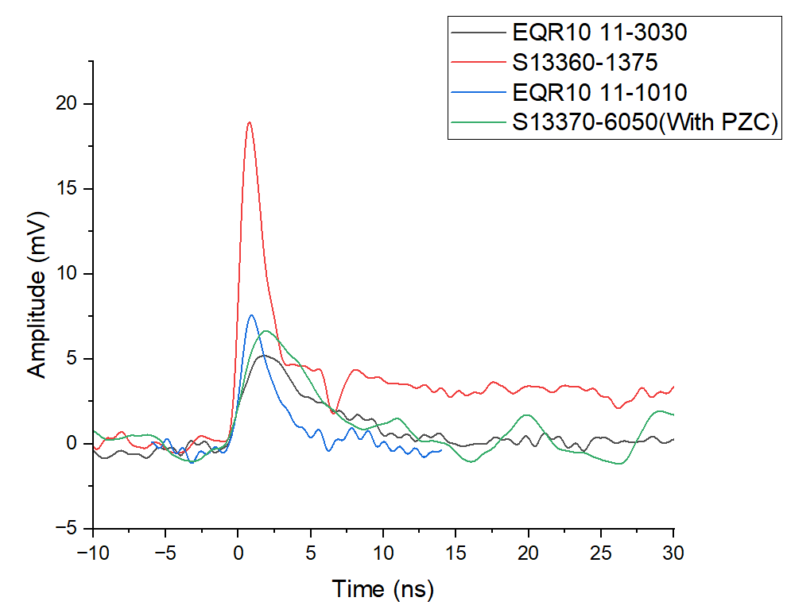
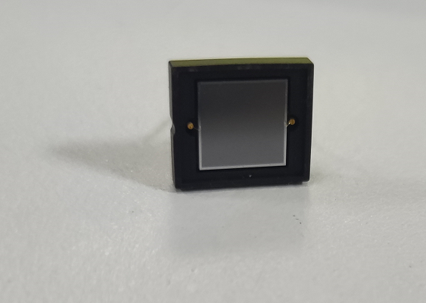
Single photon signal of different SiPM

Slide 16
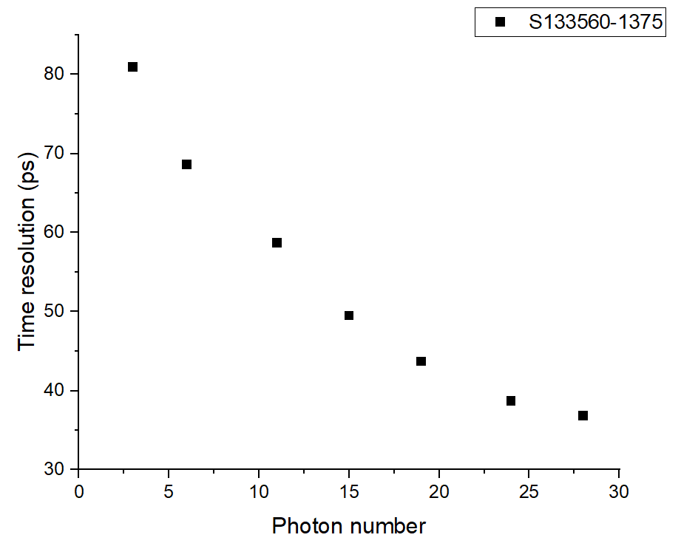
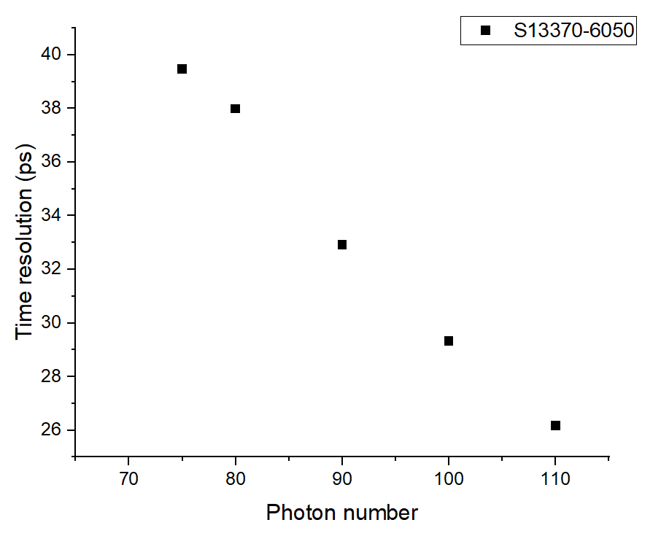
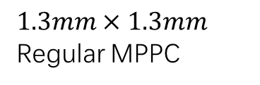

Time resolution vs # of photons
$$1.3mm×1.3mm$$
Regular MPPC
VUV MPPC
$$6mm×6mm$$

Slide 17
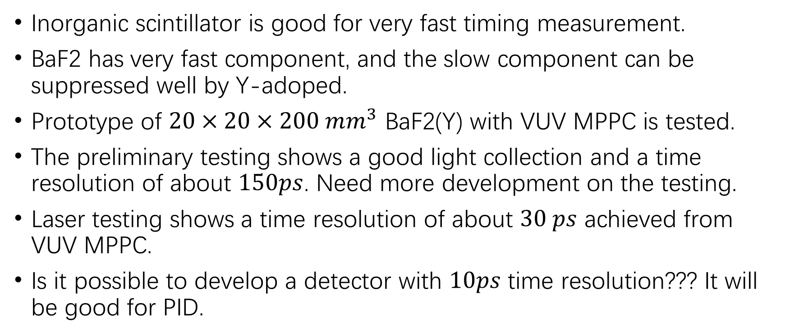
Summary
Inorganic scintillator is good for very fast timing measurement.
BaF2 has very fast component, and the slow component can be suppressed well by Y-adoped.
Prototype of $20×20×200 mm^{3}$ BaF2(Y) with VUV MPPC is tested.
The preliminary testing shows a good light collection and a time resolution of about $150ps$. Need more development on the testing.
Laser testing shows a time resolution of about $30 ps$ achieved from VUV MPPC.
Is it possible to develop a detector with $10ps$ time resolution??? It will be good for PID.
Thank you!

Slide 18
Backup

