Slide 1
EW Amplitudes without Gauge Cancellation
Junmou Chen (Jinan University(Guangdong))
At CEPC 2022
Based mainly on 2203.10440
In collaboration with Kaoru Hagiwara, Junichi Kanzaki, Kentarou Mawatari
See also 1611.00788, 1902.06738

Slide 2
1. Motivation: subtle gauge cancellation
Longitudinal Vector boson: $ε_{L}^{μ}\sim k^{μ}/m$ ~ $E/$m
Ex: WW>WW
Final Amplitude:
Unphysical energy increase for single (Feynman) diagrams
Large cancellation between diagrams.

Slide 3
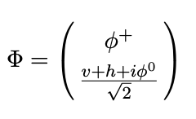
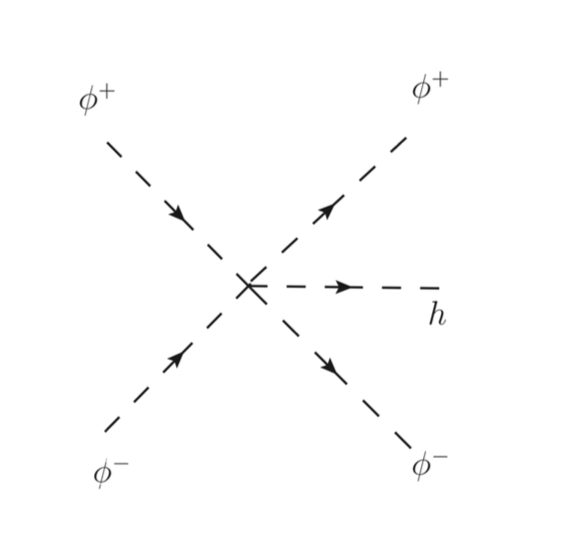
1. Motivation: subtle gauge cancellation
Theoretical Problems
Ex: SMEFT and Higgs Couplings Measurement
Measuring Higgs self-couplings through
(Mainstream: double Higgs production)
Importance is of the same level as hh production in muon colliders
Junmou Chen, Chih-Ting Ting, Yongcheng Wu, Tong Li
Chang-Yuan Yao
PhysRevD.105.053009
JHEP10(2021)099

Slide 4
1. Motivation: subtle gauge cancellation
Theoretical Problems
Ex.: SMEFT and Higgs Couplings Measurement
At what exactly range is on this picture(GET) valid? Corrections?
Even simpler amplitude WW>WW？
We need a method that manifests GET, but computes amplitudes exactly.

Slide 5
1. Motivation: subtle gauge cancellation
Numerical Problem
Cancellation between large numbers(diagrams) easily leads to errors
Total cross section of WW > ZZ
when t/u channel propagators are
given physical decay width
(Madgraph before v3_** versions)

Slide 6
1. Motivation: subtle gauge cancellation
Numerical Problem: Cancellation between large numbers(diagrams)
Computing efficiency
Madgraph v3_2_0
pp > jj w+{0}w-{0}h:
Event no: 147/10000
pp > jj w+{T}w-{T}h:

Slide 7
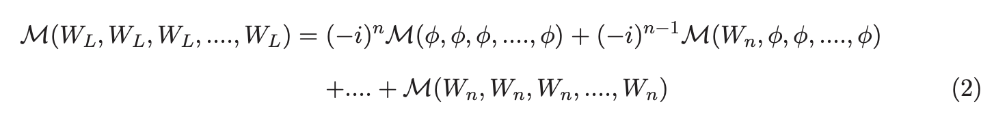
2. Solution: “New Feynman Diagram”
Goldstone equivalence theorem(GET)
See, e.g. Nucl. Phys. B 261, 379 (1985)
Can be extended to full equality
M. S. Chanowitz and M. K. Gaillard
(From gauge symmetry)
:
GET
N-point amplitudes:
The terms (diagrams) on the RH are $2^{N}$ times of LH (Naïve est.)

Slide 8

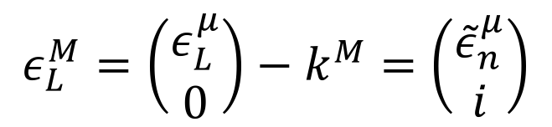
2. Solution: “New Feynman Diagram”
5-component formalism
$$g_{MN}=diag(1,−1,−1,−1,−1)$$
$$k^{M}=\left(\begin{matrix}k^{μ} \\ im_{V}\end{matrix}\right)$$
GET
Polarization vector
$$ε_{L}^{M}=\left(\begin{matrix}ε_{L}^{μ} \\ 0\end{matrix}\right)−k^{M}=\left(\begin{matrix}{\tilde{ε}}_{n}^{μ} \\ i\end{matrix}\right)$$
Well behaved in high energy and a single object
Gauge and Goldstone components combined together
N-point amplitudes(pol.vec., propagators, vertices)

Slide 9
2. Solution: “New Feynman Diagram”
Gauge Choice and Propagator: 5-components formalism
Gauge cancellation exists also on the propagator (Rxi gauge)
Degrees of freedom in Feynman gauge
energy increase
Physical degrees of freedom
Even Feynman gauge gives unphysical energy increase!

Slide 10
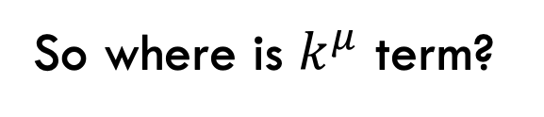
2. Solution: “New Feynman Diagram”
Gauge Choice and Propagators: 5-components formalism
Goldstone equivalence gauge(GEG)
proposed in JHEP11(2017)093
Junmou Chen, Tao Han & Brock Tweedie
Gauge condition:
or
Transverse:
Longitudinal:
satisfies
does not satisfy
with
So where is $k^{μ}$ term?
“Scalarized” into Goldstone mode!

Slide 11
2. Solution: “New Feynman Diagram”
Gauge Choice and Propagators: 5-components formalism
Goldstone equivalence gauge(GEG)
When on-shell,
Gauge-Goldstone mixing terms
Pol. Vec. :

Slide 12
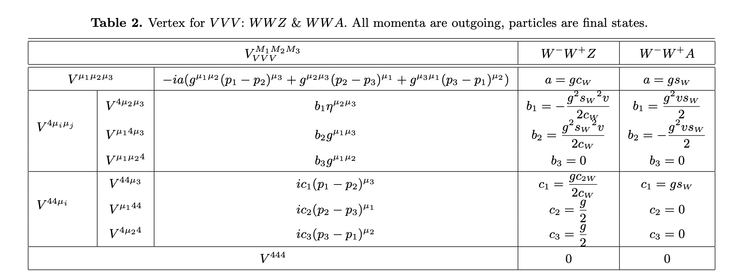
2. Solution: “New Feynman Diagram”
Vertices(SM)
Full List see 2203.10440

Slide 13
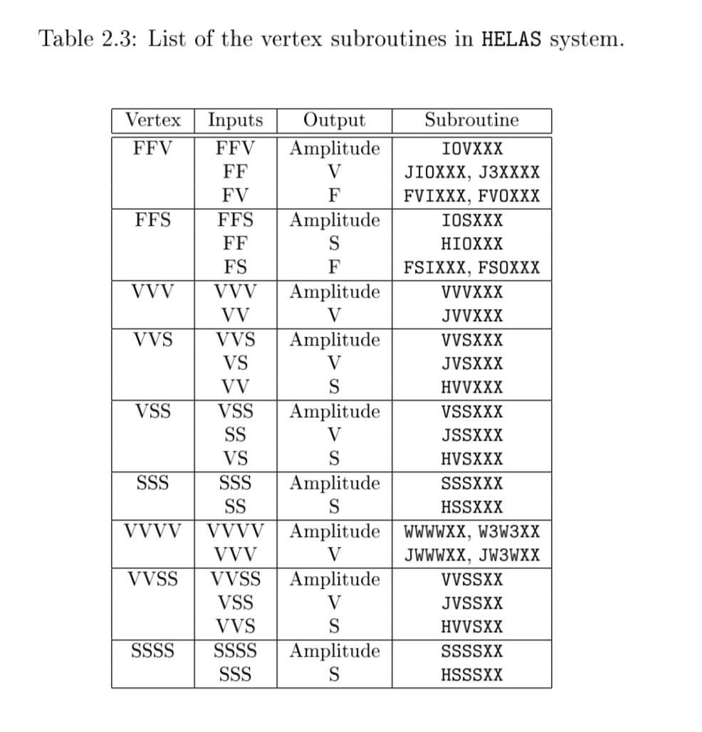
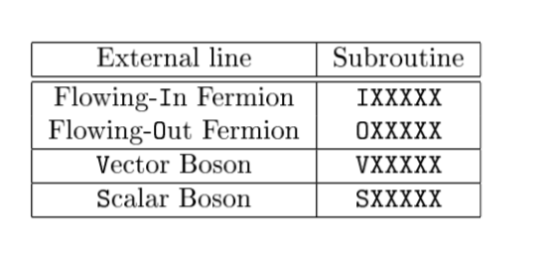
3.1 Numerical Implementation
(Old) HELAS(HELicity Amplitudes Subroutines) Introduction
HELAS compute amplitudes for Madgraph
See e.g. 1106.0522
HELAS Basic setup: subroutines
Vertices
External Lines

Slide 14
3.1 Numerical Implementation
New HELAS (implementing “New Feynman Diagrams”)
1. Replace polarization vectors of W/Z to 5-component form
2. Replace propagators of W/Z to GEG in 5-component form
3. Extend vertices involving W/Z to incorporate Goldstone components
(4). Replace propagators of photon and gluons to parton shower gauge (counter part of GEG for massless case.)
5. Add vertices not existing in Old Feynman Rules(ZZZZ, WWZh,WWAh)
Codes can be found in https://madgraph.ipmu.jp/IPMU/Softwares/HELAS/index.html(HELAS V42)

Slide 15
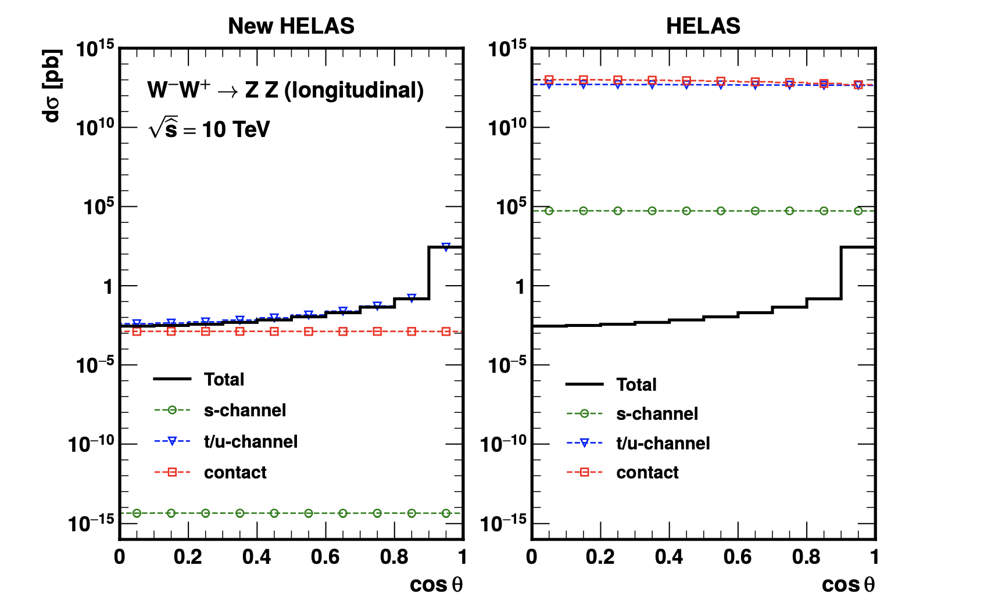
3.2 Numerical Results
New HELAS Results: 2→2 VBS
WW>ZZ

Slide 16
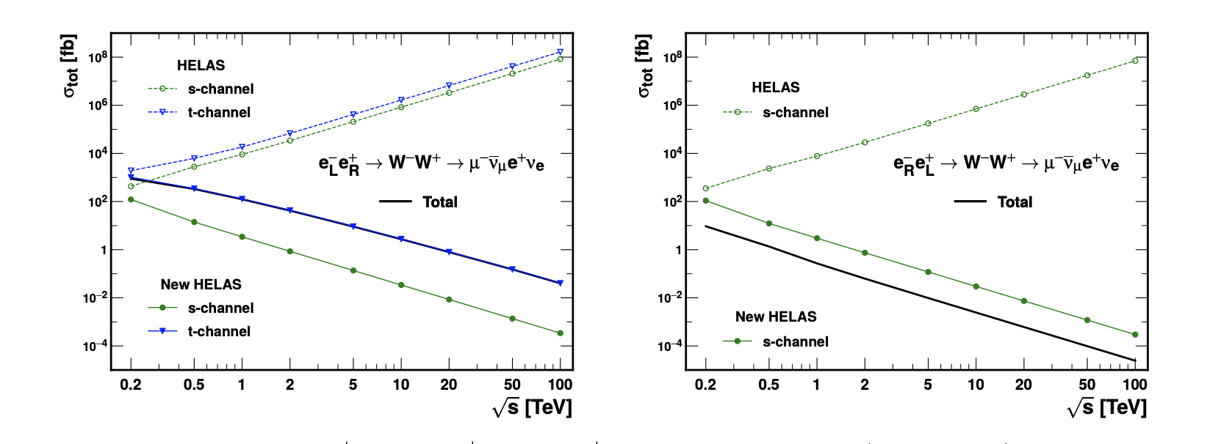
3.2 Numerical Results
New HELAS Results: WW production at lepton colliders
: total cross section

Slide 17
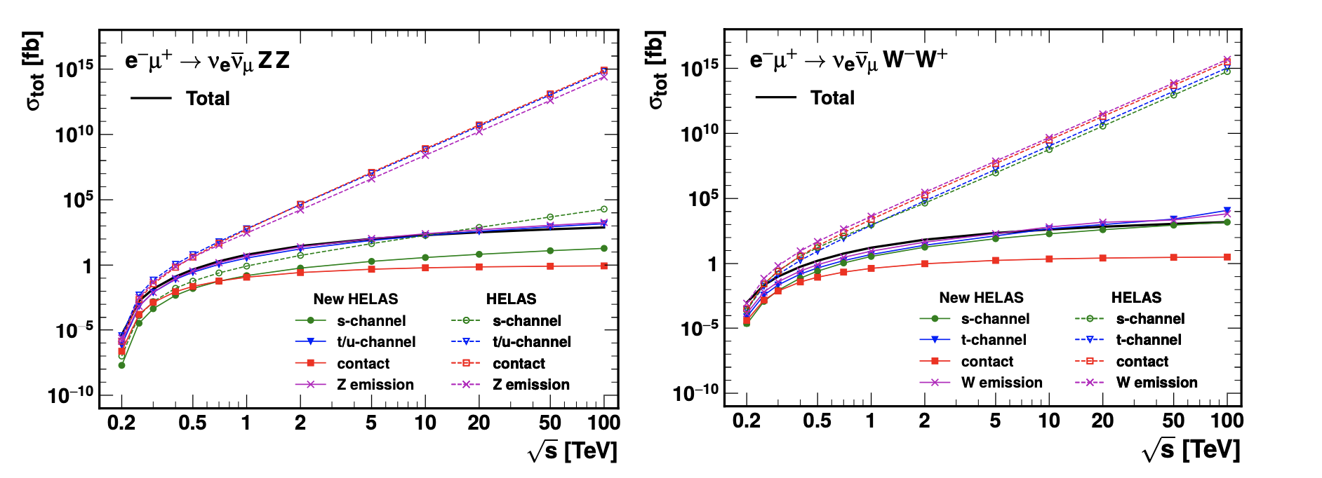
3.2 Numerical Results
New HELAS Results: VBS at lepton colliders
: total cross section

Slide 18
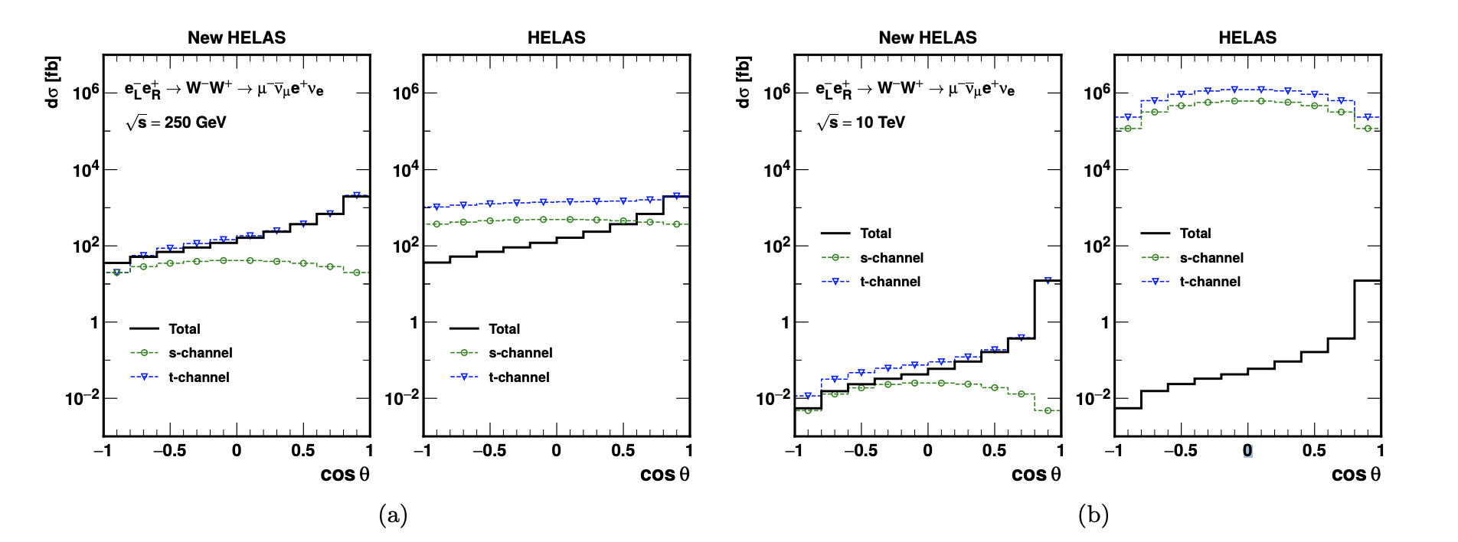
3.2 Numerical Results
New HELAS Results: WW production at lepton colliders
: angular distribution

Slide 19
Conclusion
We propose a formalism (New Feynman Diagram) to solve gauge cancellation of weak scattering amplitudes, including:
5-component pol. vec. , propagators (in GEG), vertices
2. We implement NFD to HELAS(SM), and demonstrate some numerical
results
3. Future: Needing deeper understanding, integrated into Madgraph(? ), Other models(?)

Slide 20
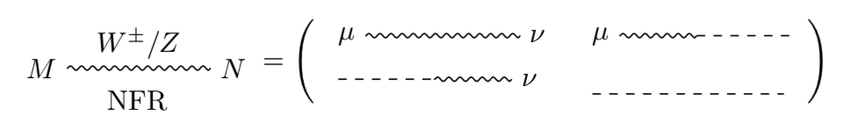
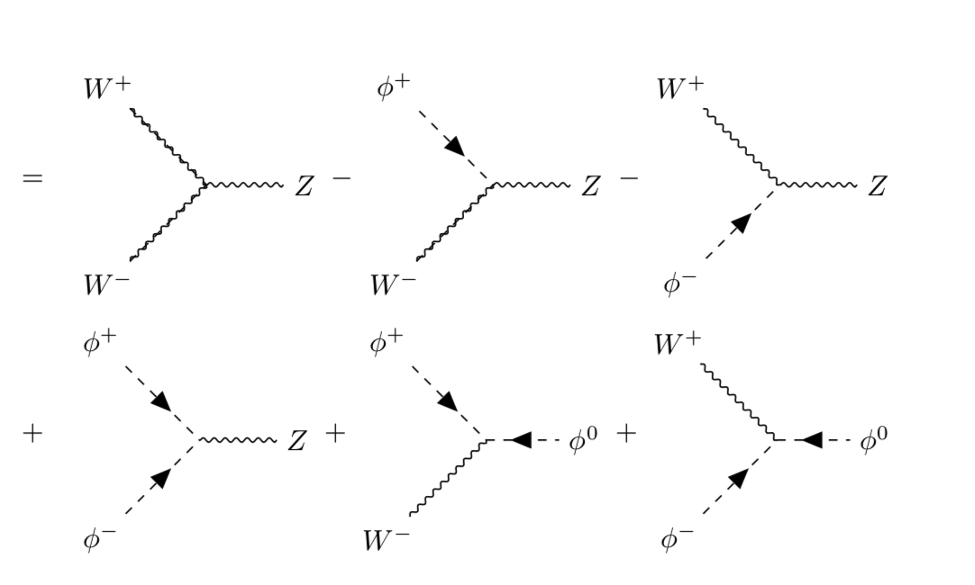
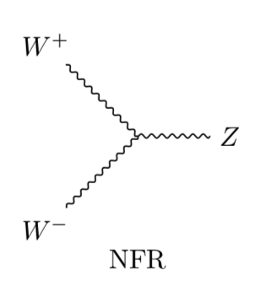

2. Solution: “New Feynman Diagram”
New Feynman Rule(SM)
Propagator:
WWZ:
NFR=New Feynman Rule
“wave function” of $φ$: $i$ for initial, $−i$ for final

Slide 21
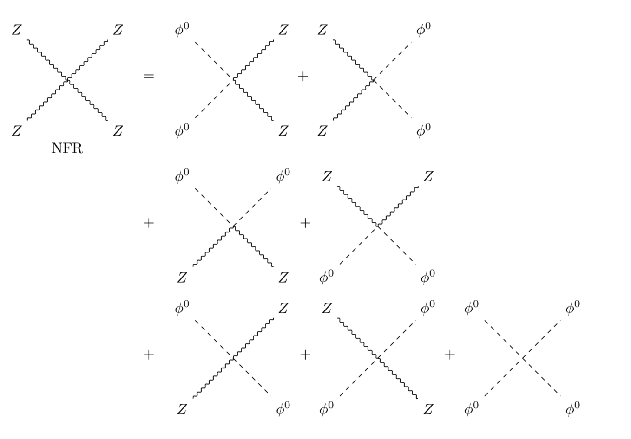
2. Solution: “New Feynman Diagram”
New Feynman Rule(SM)
Vertices doesn’t exist in “Old” Feynman Diagrams
ZZZZ:
NFR=New Feynman Rule

Slide 22
2. Solution: “New Feynman Diagram”
New Feynman Rule(SM)
Ex2: ZZ>ZZ
Doesn’t exist in
“Old” Feynman Rules
NFR=New Feynman Rule

Slide 23
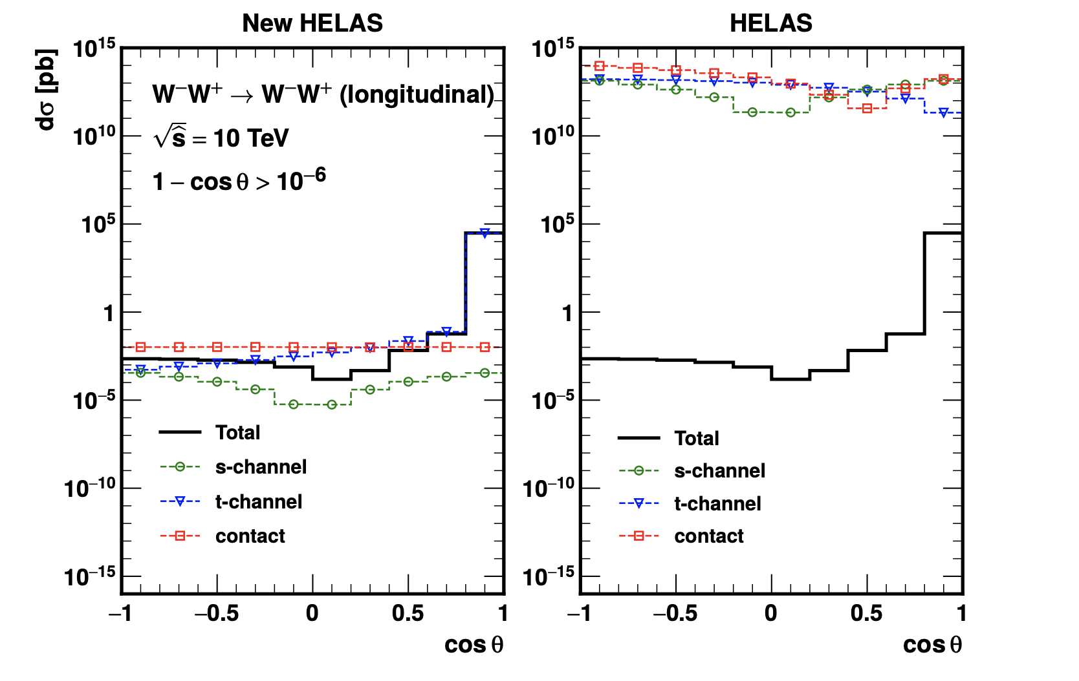
4. Numerical Results
New HELAS Results: 2→2 VBS
WW>WW

Slide 24
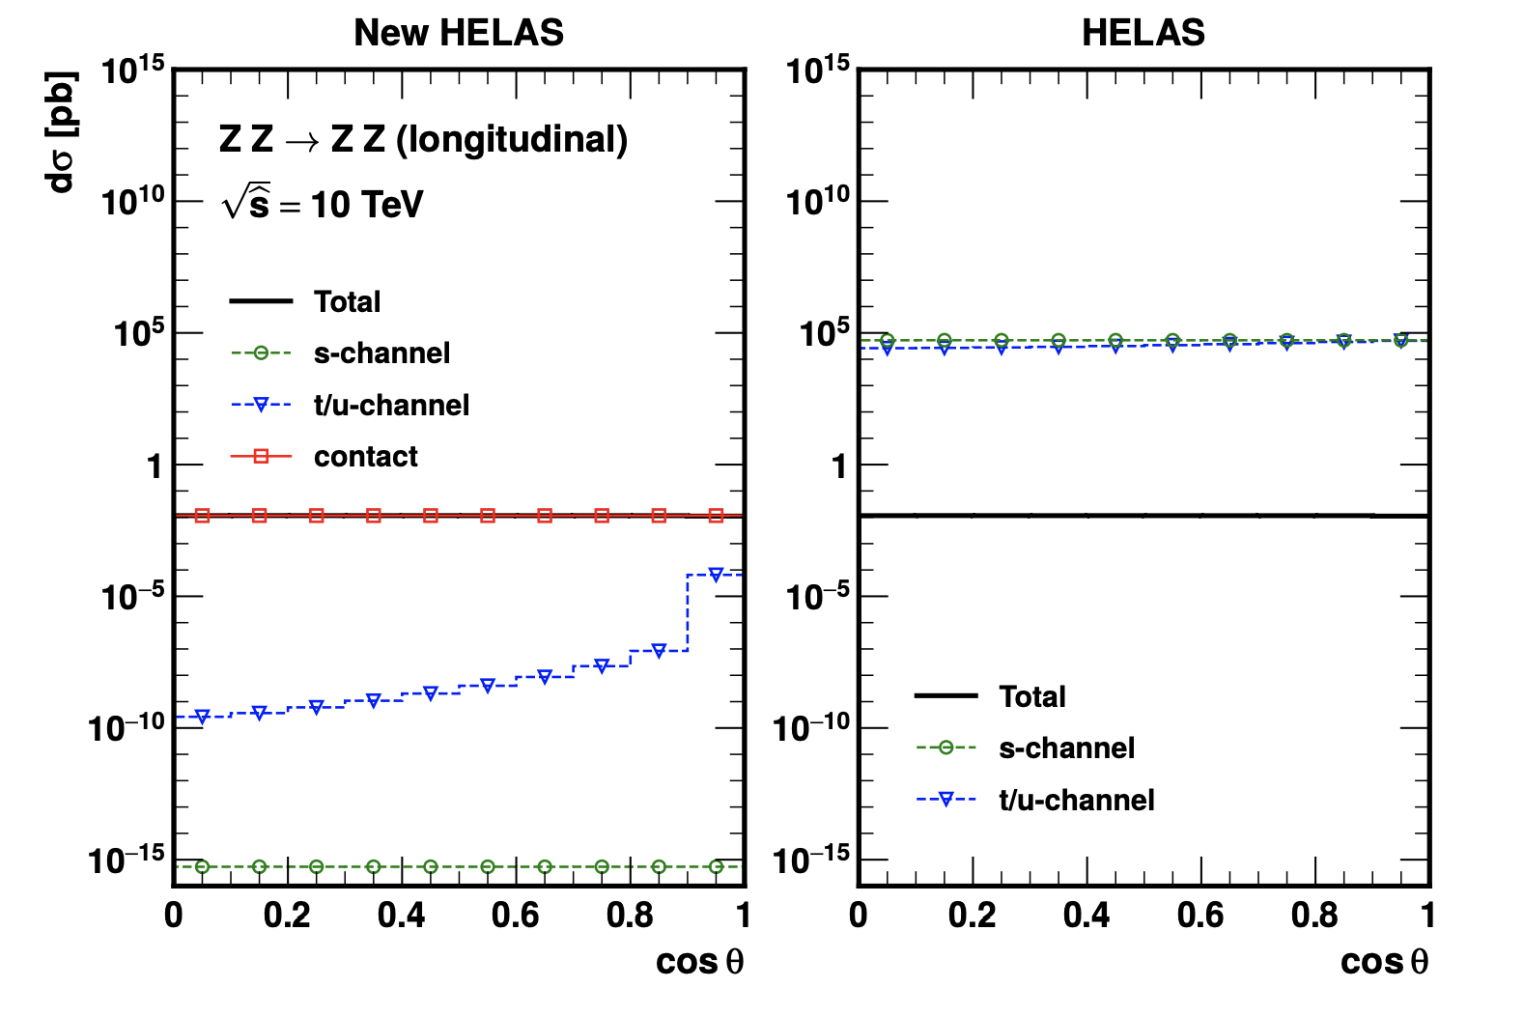
4. Numerical Results
New HELAS Results: 2→2 VBS
ZZ>ZZ

