Slide 1
Intrinsic resonance in CEPC Booster
2022-6-14
ChenTao

Slide 2
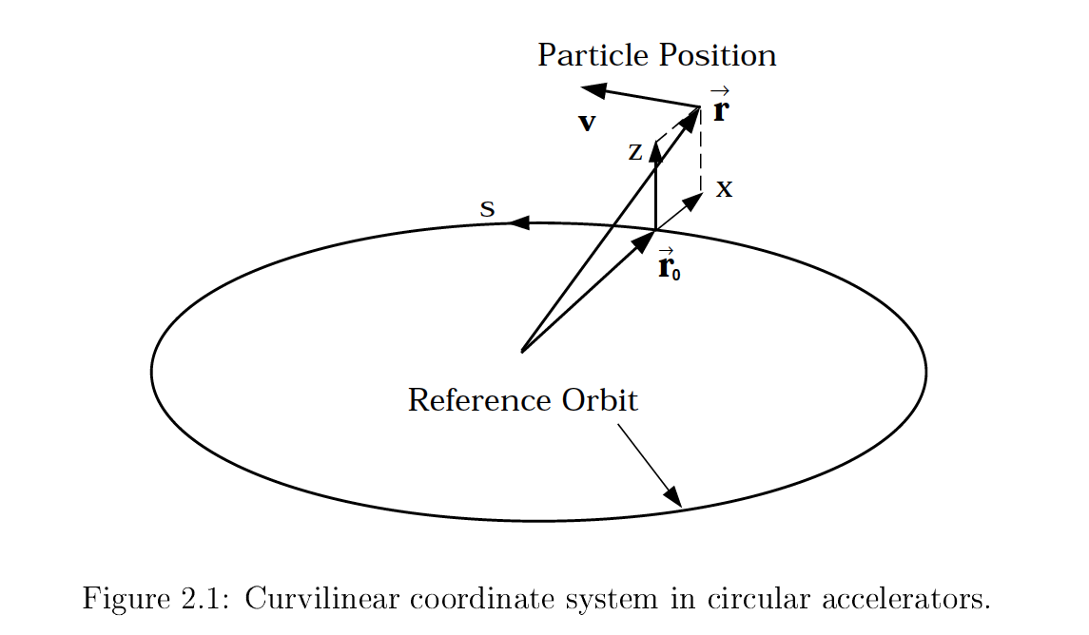
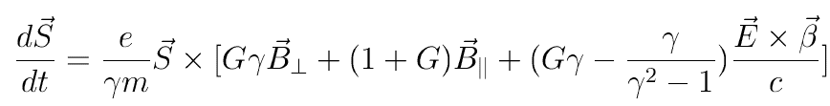
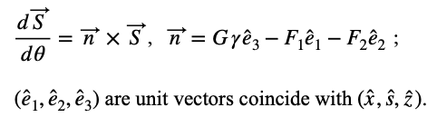



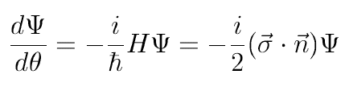


Spin motion in Synchrotron
Tomas-BMT equation:
Use the motion parameter to replace the magnetic field
Use wave function to express the equation in which
Solve for one revolution around the accelerator

Slide 3

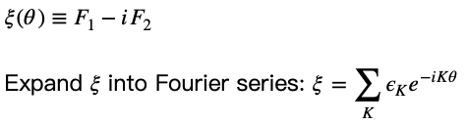

Spin motion in Synchrotron
In perfect planar ring:
  No transverse motion;
  $F_{1}=F_{2}=0$ ;
  $\frac{dψ}{dθ}=−\frac{i}{2}\left(\begin{matrix}Gγ & 0 \\ 0 & Gγ\end{matrix}\right)ψ$
  ${\hat{n}}_{co}={\hat{e}}_{3}, ν_{s}=Gγ$ ;
  Polarization on vertical direction preserved.
In real ring:
  $F_{1},F_{2}≠0 ;$
  $\frac{dψ}{dθ}=−\frac{i}{2}\left(\begin{matrix}Gγ & −ξ \\ −ξ^{∗} & Gγ\end{matrix}\right)ψ$ , the off-diagonal element is the source of depolarization
Choose a certain K , the equation can be solved :
Compare the 2 terms we can get
We can conclude: only when K close to $Gγ$, the spin closed orbit obviously deviate from vertical direction,
Thus the depolarization terms with different K can be treat separately .They are so-called spin resonances ,
K is the location of spin resonance.

Slide 4
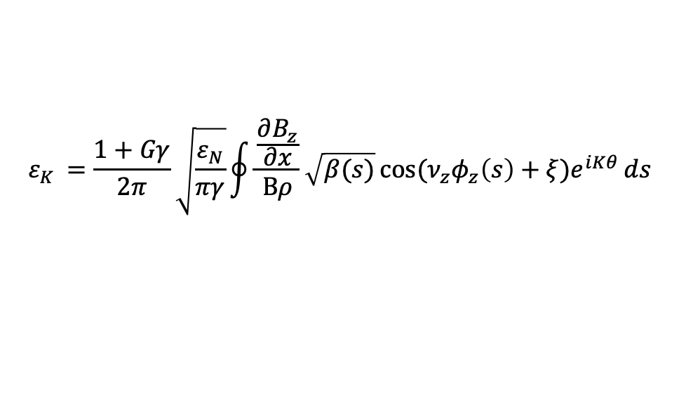
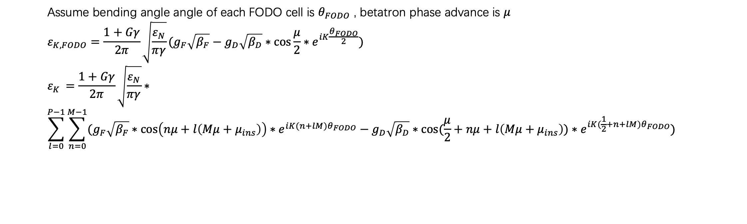
Analytical analysis of intrinsic resonance
$$ε_{K }=\frac{1+Gγ}{2π}\sqrt{\frac{ε_{N}}{πγ}}\oint{\frac{\frac{∂B_{z}}{∂x}}{Bρ}\sqrt{β(s)}\cos{(ν_{z}φ_{z}\left(s\right)+ξ)e^{iKθ}}ds}$$
M * FODO Cell
…
1/P of the ring
QF
B
QD
B
Straight section
1 FODO Cell
Assume bending angle angle of each FODO cell is $θ_{FODO}$ , betatron phase advance is $μ$
$$ε_{K,FODO}=\frac{1+Gγ}{2π}\sqrt{\frac{ε_{N}}{πγ}}(g_{F}\sqrt{β_{F}}−g_{D}\sqrt{β_{D}}∗\cos{\frac{μ}{2}}∗e^{iK\frac{θ_{FODO}}{2}})$$
$$ε_{K }=\frac{1+Gγ}{2π}\sqrt{\frac{ε_{N}}{πγ}}∗$$
$$\sum_{l=0}^{P−1}{\sum_{n=0}^{M−1}{(g_{F}\sqrt{β_{F}}∗\cos\left(nμ+l\left(Mμ+μ_{ins}\right)\right)∗e^{iK(n+lM)θ_{FODO}}−g_{D}\sqrt{β_{D}}∗\cos{(\frac{μ}{2}+nμ+l\left(Mμ+μ_{ins}\right))}∗e^{iK(\frac{1}{2}+n+lM)θ_{FODO}}) }}$$

Slide 5
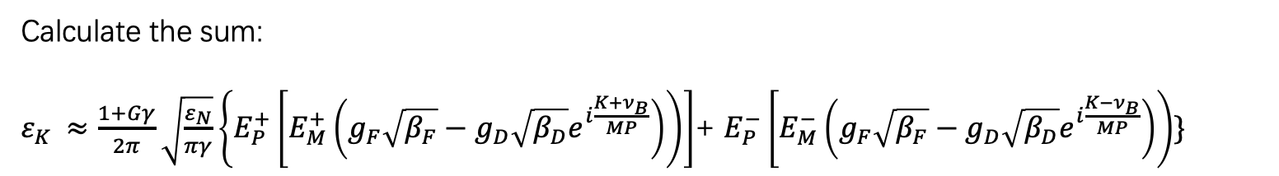

Analytical analysis of intrinsic resonance
Calculate the sum:
$ε_{K }≈\frac{1+Gγ}{2π}\sqrt{\frac{ε_{N}}{πγ}}\left\{E_{P}^{+}\left[E_{M}^{+}\left(g_{F}\sqrt{β_{F}}−g_{D}\sqrt{β_{D}}e^{i\frac{{K+ν}_{B}}{MP}}\right)\right)\right]$+ $E_{P}^{−}\left[E_{M}^{−}\left(g_{F}\sqrt{β_{F}}−g_{D}\sqrt{β_{D}}e^{i\frac{{K−ν}_{B}}{MP}}\right)\right)\}$
Enhancement factor: $E_{P}^{±}≈ζ_{P}(\frac{K±ν_{z}}{P})$ ; $E_{M}^{±}≈ζ_{M}(\frac{K±ν_{B}}{PM})$
$${plot of ζ}_{9}(x)$$

Slide 6













Intrinsic resonance structure in CEPC Booster
In CEPC Booster: $P=8;M=99;ν_{B}=198$ , Calculated by DEPOL
$$3PM+ν_{B}$$
$$5PM+ν_{B}$$
$$3PM−ν_{B}$$
$$ε_{N}=10 mm∙mrad$$
$$5PM−ν_{B}$$
$$PM+ν_{B}$$
$$6PM−ν_{B}$$
$$PM−ν_{B}$$
$$4PM−ν_{B}$$
$$4PM+ν_{B}$$
$$2PM+ν_{B}$$
$$2PM−ν_{B}$$
$$ν_{B}$$

Slide 7
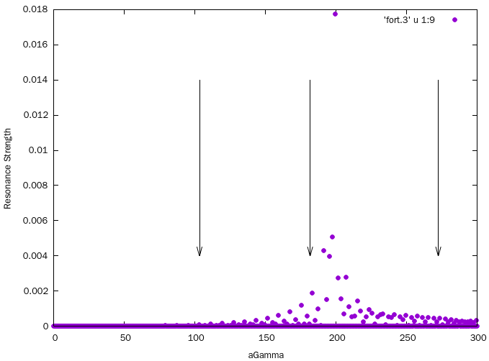
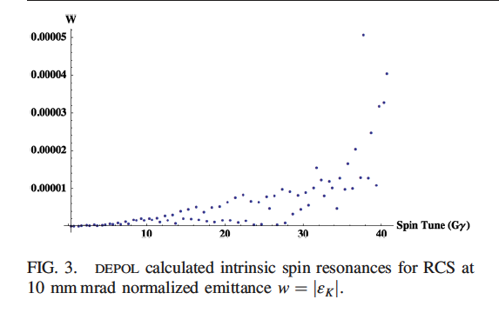
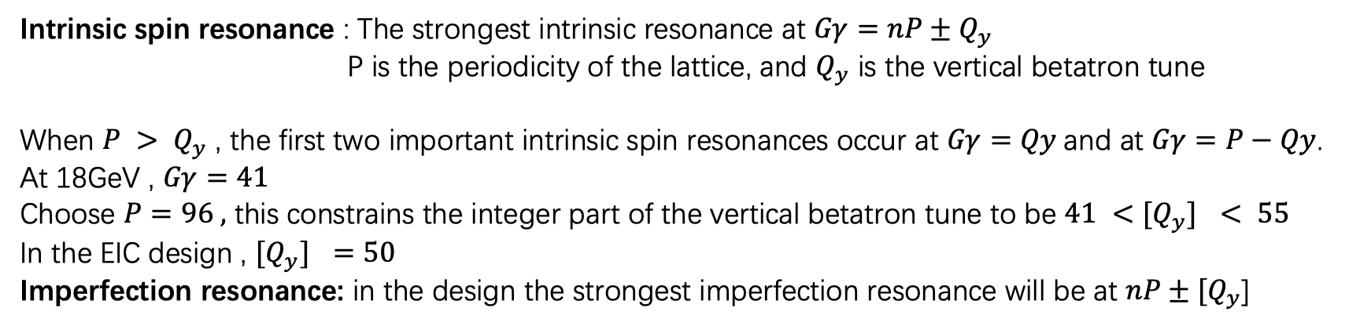

RESONANCE FREE DESIGN
Intrinsic spin resonance : The strongest intrinsic resonance at $Gγ=nP±Q_{y}$
P is the periodicity of the lattice, and $Q_{y}$ is the vertical betatron tune
When $P > Q_{y}$ , the first two important intrinsic spin resonances occur at $Gγ=Qy$and at $Gγ=P−Qy$.
At 18GeV , $Gγ=41$
Choose $P=96 ,$ this constrains the integer part of the vertical betatron tune to be $41 <{[Q}_{y}] < 55$
In the EIC design , ${[Q}_{y}] =50$
Imperfection resonance: in the design the strongest imperfection resonance will be at $nP±{[Q}_{y}$]
Intrinsic resonance in CEPC Booster
45.5GeV
80GeV
120GeV
$$ε_{N}=10 mm∙mrad$$
REF: PHYSICAL REVIEW ACCELERATORS AND BEAMS 21, 111003 (2018)

Slide 8
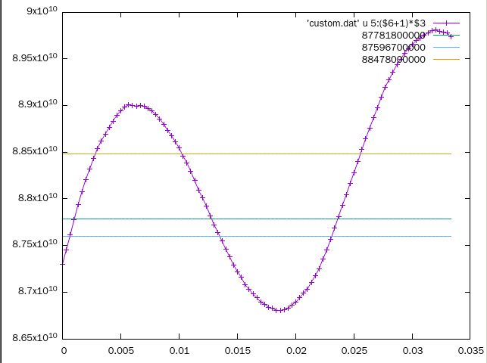
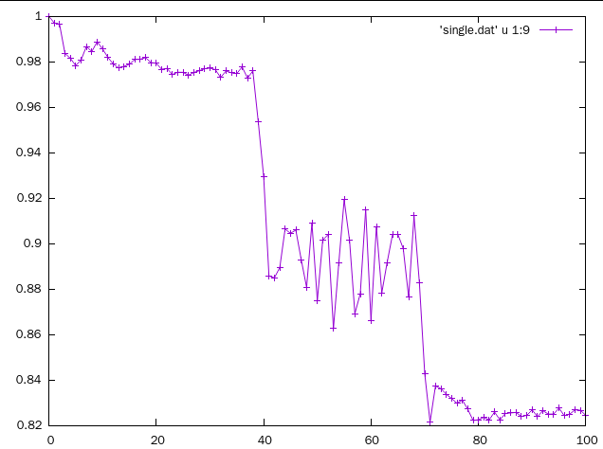
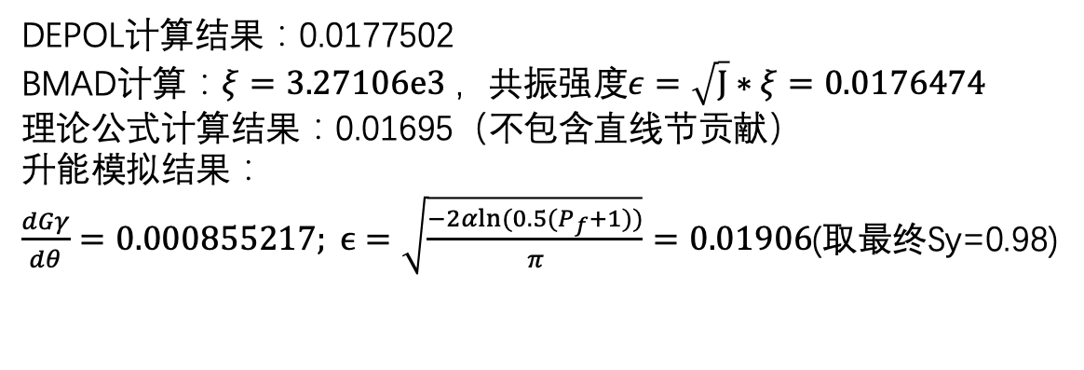
K=199.21
K=198.79,energy=8.75967e10,strength= 0.00002270
K=199.21 ,Energy =8.77818 e10 eV ,strength= 0.01775020
K=200.79,energy=8.8478e10,strength= 0.00002104
electron; CEPC Booster; K=199.21 ; normalized emittance = 10mmmrad
DEPOL计算结果：0.0177502
BMAD计算：$ξ=3.27106e3 ，$共振强度$ε=\sqrt{J}∗ξ=0.0176474$
理论公式计算结果：0.01695（不包含直线节贡献）
升能模拟结果：
$\frac{dGγ}{dθ}=0.000855217; ϵ=\sqrt{\frac{−2αln⁡(0.5(P_{f}+1))}{π}}=0.01906$(取最终Sy=0.98)

Slide 9

多粒子跟踪结果-ZMode
200个粒子
$$ε_{N}=10 mm mrad$$
45.5GeV

Slide 10

多粒子跟踪结果-HMode
$$ε_{N}=10 mm mrad$$
200个粒子
120GeV

