Slide 1
MOST2 Vertex Ladder Assembly Procedures Sharing: Learn from Mu3e Ladder Assembly
Hao Zeng
June 16, 2022

Slide 2
Current assembly procedures
From Jinyu’s talk
Advantages: easy to align the sensors, gluing all the sensor on the flex at the same time
Disadvantages: need to design many tools (at least 5), development cycle is too long

Slide 3
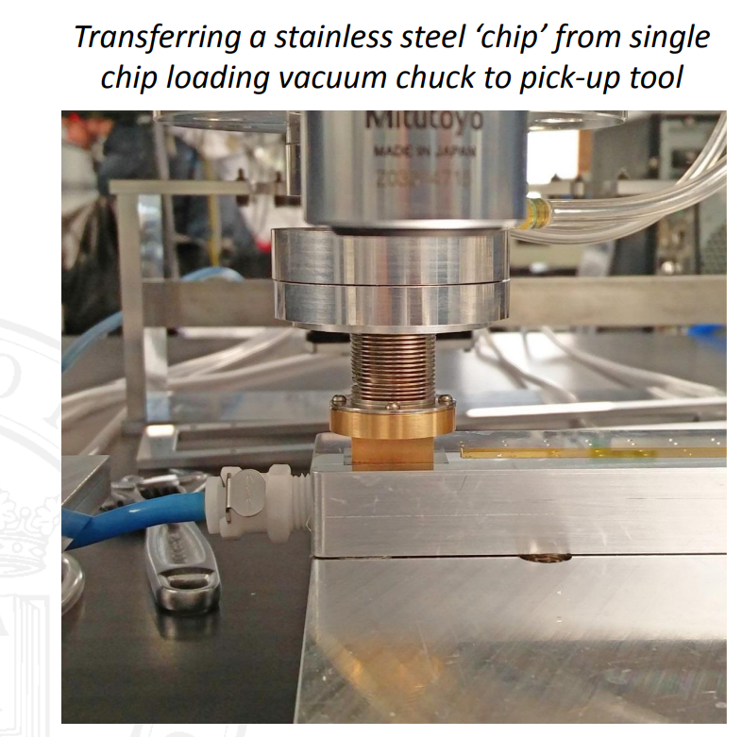
Mu3e Ladder Assembly Procedures
Setup
Pick-and-place tool
More details
videos

Slide 4
Summary
Mu3e ladder assembly is a good example for us to learn the assembly procedures and tools design
4-5 tools is needed for the whole automatic assembly
1-2 pick-and-place tools (flex on sensor: 1, sensor on flex: 2)
3 chucks for sensor and flex fixation

