Slide 1
HVP contributions to g-2: electron-positron annihilation into two body final states
Shi-Jia Wang
with Ling-Yun Dai and Zhen Fang
Hunan University
粒子物理天问论坛
August 6,2022
Notes:
报告主题是：关于正负电子对湮灭到两体末态过程对g-2的强子真空极化的贡献。

Slide 2
Background
01
$χEFT$
02
Numerical results
03
Summary
04
Notes:
从以下三个方面做简要的介绍:首先简要介绍研究g-2的一个动机，也就是背景，其次是我研究的内容的结果的一些讨论，最后进行一个简要的总结

Slide 3
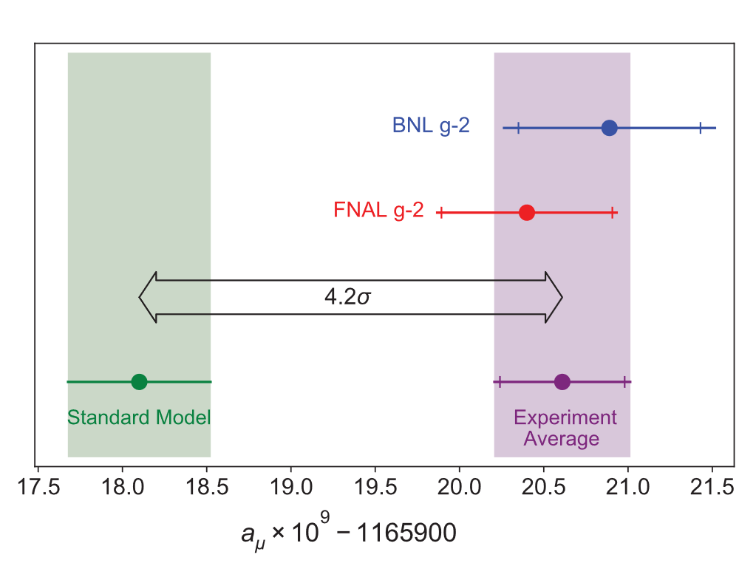
01 Background
Comparison to SM prediction
What is the abnormal magnetic moment of the muon?
$$a_{μ}\left(Exp\right)−a_{μ}\left(SM\right)=0.00000000251\left(59\right)→4.2σ$$
Notes:
2021年4月7号，美国费米国家加速器实验室公布了mu子g-2实验组对于mu子反常磁矩的首个测量结果，结果与标准模型语言之间有4.2倍的σ，吸引了广泛的关注。那么什么是mu子的反常磁矩呢？

Slide 4
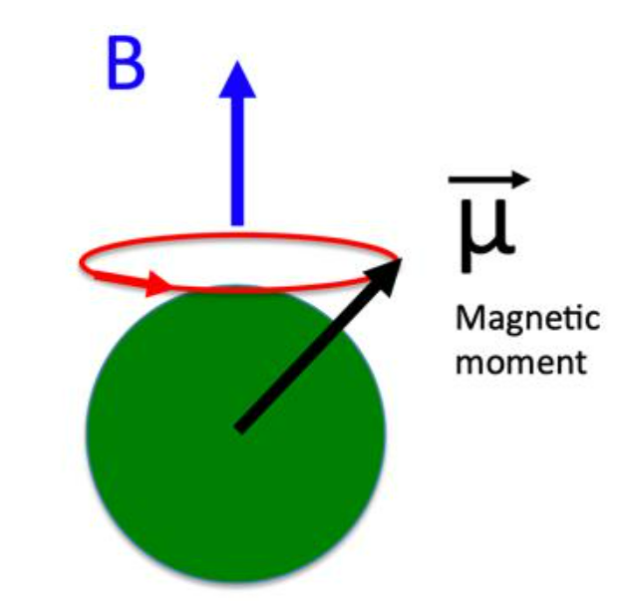
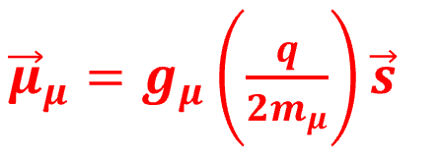
01 Background
The anomalous magnetic moment,$a_{μ}$
(a) The value of g factor was first given by Dirac. He used relativistic quantum mechanics to calculate that a particle with a spin of 1/2 should be strictly equal to 2.
Schematic diagram of measuring
abnormal magnetic moment($a_{μ}$) in experiment
(b) $a_{μ}=\frac{(g−{2)}_{μ}}{2}$
Notes:
具有自旋的粒子具有磁偶极矩，可以通过实验手段观察(如右图所示，是$μ$子的实验测量的原理图)，一个基本粒子(电荷q,质量m,自旋s)，其内禀磁矩如右图公式所示，g因子最初的值是由狄拉克通过狄拉克方程计算出一个自旋为1/2的粒子其g因子应该是严格等于2的，但是实验上的测量值与狄拉克预言的值有微小的偏差，它们之前微小的差值就是反常磁矩。在1948年，施温格通过QED重新计算出了电子的反常磁矩，很好地解释了电子反常

Slide 5
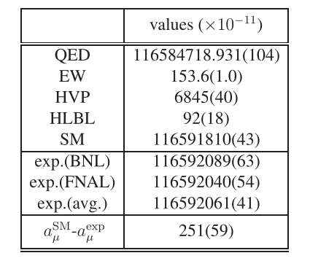
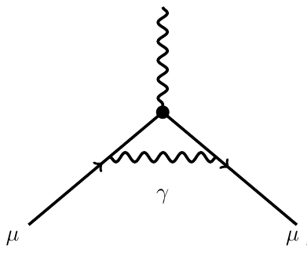
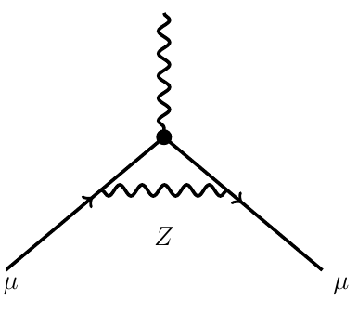
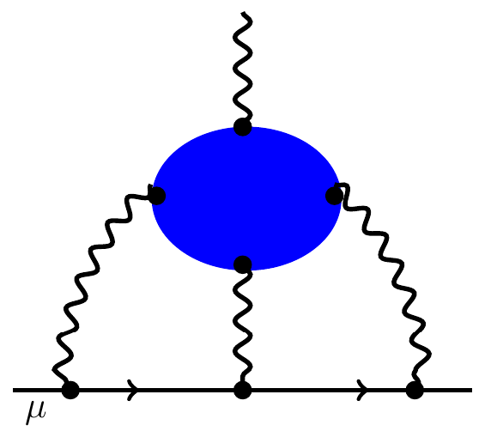
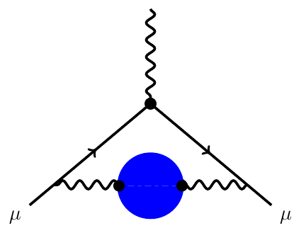
01 Background
QED
+ $⋯$
Weak
+ $⋯$
Hadronic Light-by-Light (HLBL)
Hadronic Vacuum Polarization(HVP)
+ $⋯$
+ $⋯$
Phys.Rev.Lett.126, 141801 (2021)
Phys.Rev.D 73, 072003 (2006).
Phys.Rept.887(2020)1
$$α^{3}$$
$$α^{2}$$
(Contributions)$a_{μ}=a_{μQED}+a_{μWeak}+a_{μHardronic}$

Slide 6
Background
01
$χEFT$
02
Numerical results
03
Summary
04
Notes:
从以下三个方面做简要的介绍:首先简要介绍研究g-2的一个动机，也就是背景，其次是我研究的内容的结果的一些讨论，最后进行一个简要的总结

Slide 7
02 $χEFT$
$$χEFT$$
The structure of lagrangian
Quantum Chromodynamics (QCD)
low energy region
χPT
RχT
high energy region
perturbative QCD

Slide 8
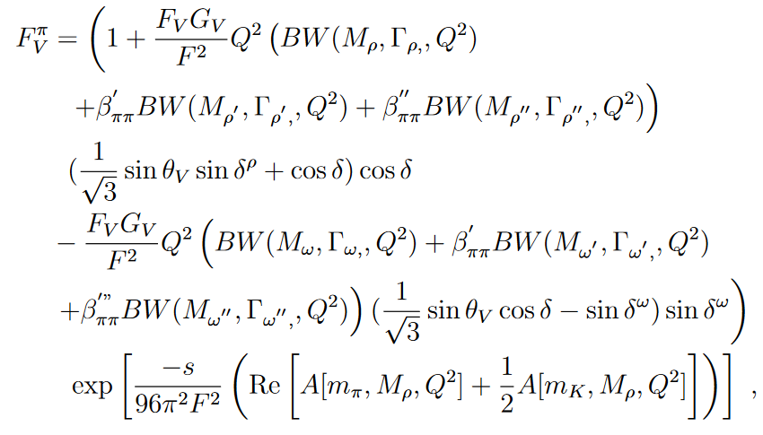
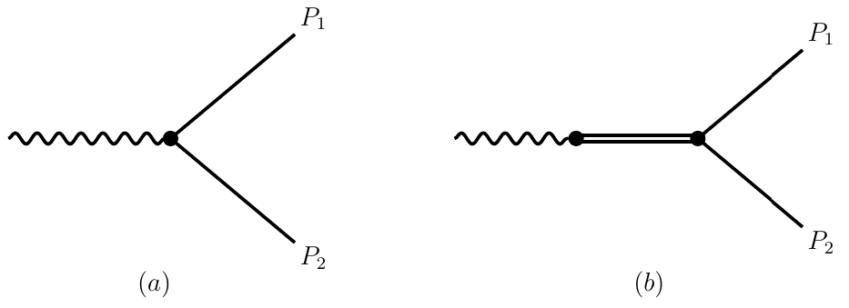
02 $χEFT$
The cross sections for two final states
The Feynman diagrams of ${ e}^{+}e^{−}→PP$($ππ/K^{+}K^{−}/K_{L}^{0}$ $K_{S}^{0}$)
Guerrero & Pich, PLB 412 (1997) 382
$$σ_{PP}=α_{e}^{2}\frac{π}{3Q^{2}}{\left(1−4\frac{m_{P}^{2}}{Q^{2}}\right)}^{3/2}{\left|F_{V}^{P}(Q^{2})\right|}^{2}$$
Isospin symmetry breaking caused by Rho Omega mixing (Gasser & Leutwyler, Phys.Rept.87 (1982) 77)

Slide 9
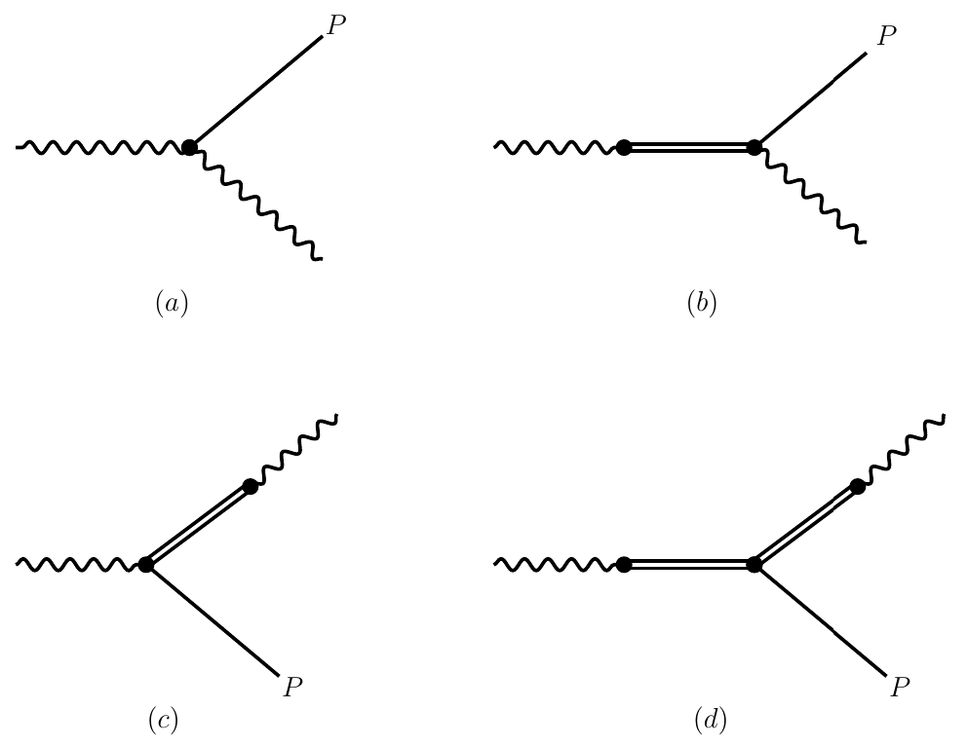
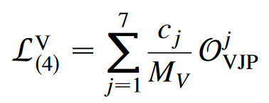
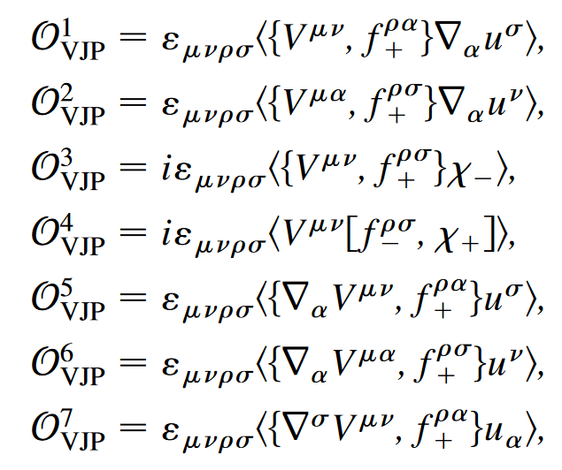
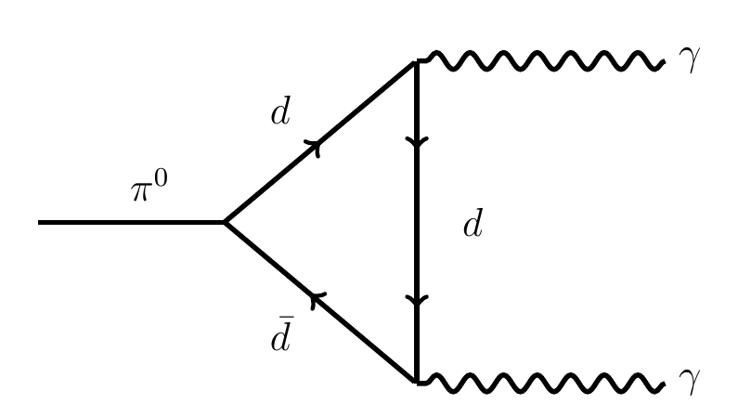
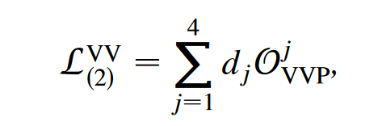
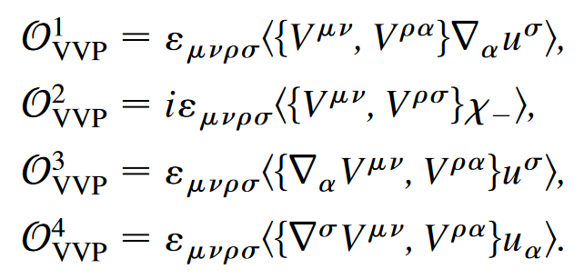
02 $χEFT$
The cross section of electron-positron annihilation into two body final states
The Feynman diagrams of${ e}^{+}e^{−}→P(π^{0},η)γ$
By matching the perturbative Green functions of QCD currents with those constructed in the $RχT$ framework.
$$σ_{e^{+}e^{−}→Pγ}^{0}=\frac{2π^{2}α_{e}^{3}}{3}\frac{{\left(Q^{2}−m_{P}^{2}\right)}^{3}}{Q^{6}}|F_{Pγ^{∗}γ^{∗}}(Q^{2})|^{2}$$

Slide 10
Background
01
$χEFT$
02
Numerical results
03
Summary
04
Notes:
从以下三个方面做简要的介绍:首先简要介绍研究g-2的一个动机，也就是背景，其次是我研究的内容的结果的一些讨论，最后进行一个简要的总结

Slide 11
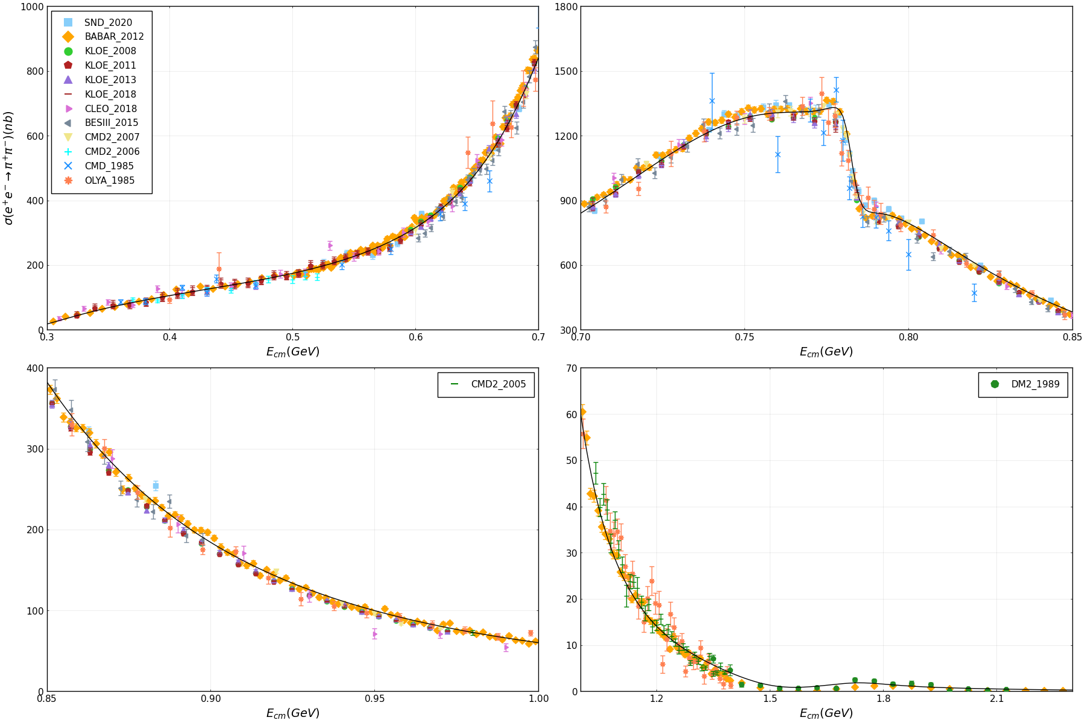
03 Numerical results
$$e^{+}e^{−}→π^{+}π^{−}$$
now closer to KLOE and BESIII’s

Slide 12
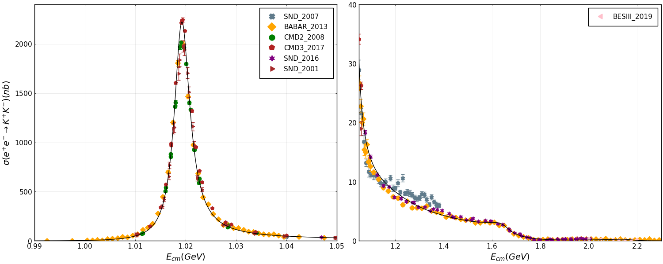
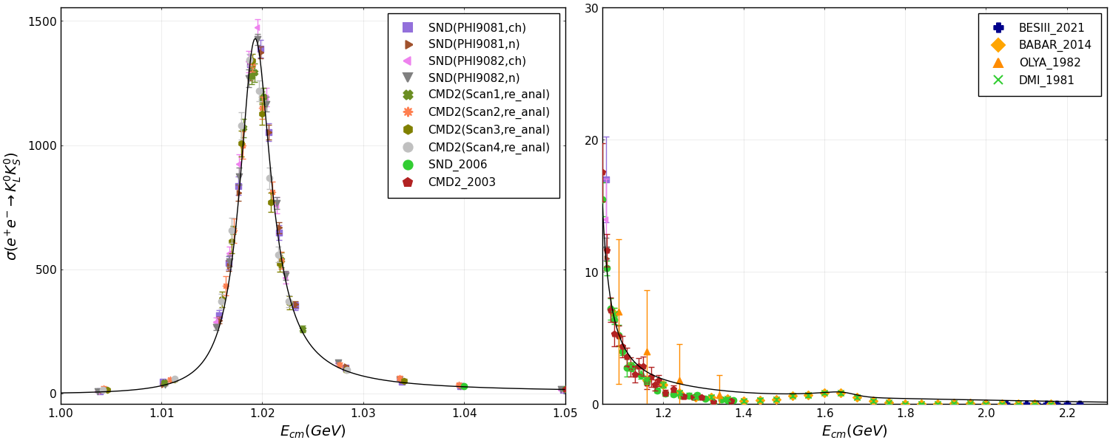
03 Numerical results
$$e^{+}e^{−}→K^{+}K^{−}$$
Preliminary results
data in the $ϕ$ 'peak' have large discrepancy
$$e^{+}e^{−}→K_{L}^{0}K_{s}^{0}$$
Preliminary results
further direct constraints on ππ, KK channels

Slide 13
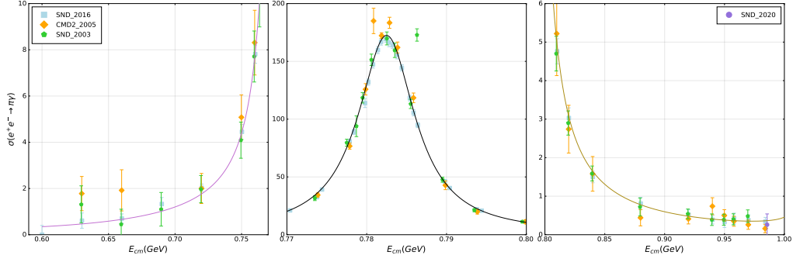
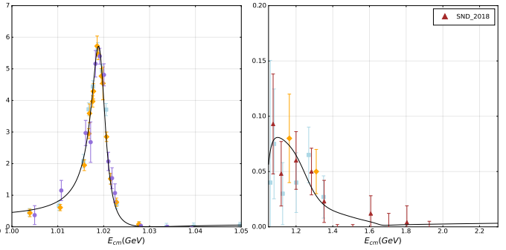
03 Numerical results
$$e^{+}e^{−}→π^{0}γ$$
Preliminary results
helps to constrain ππ, KK channels

Slide 14
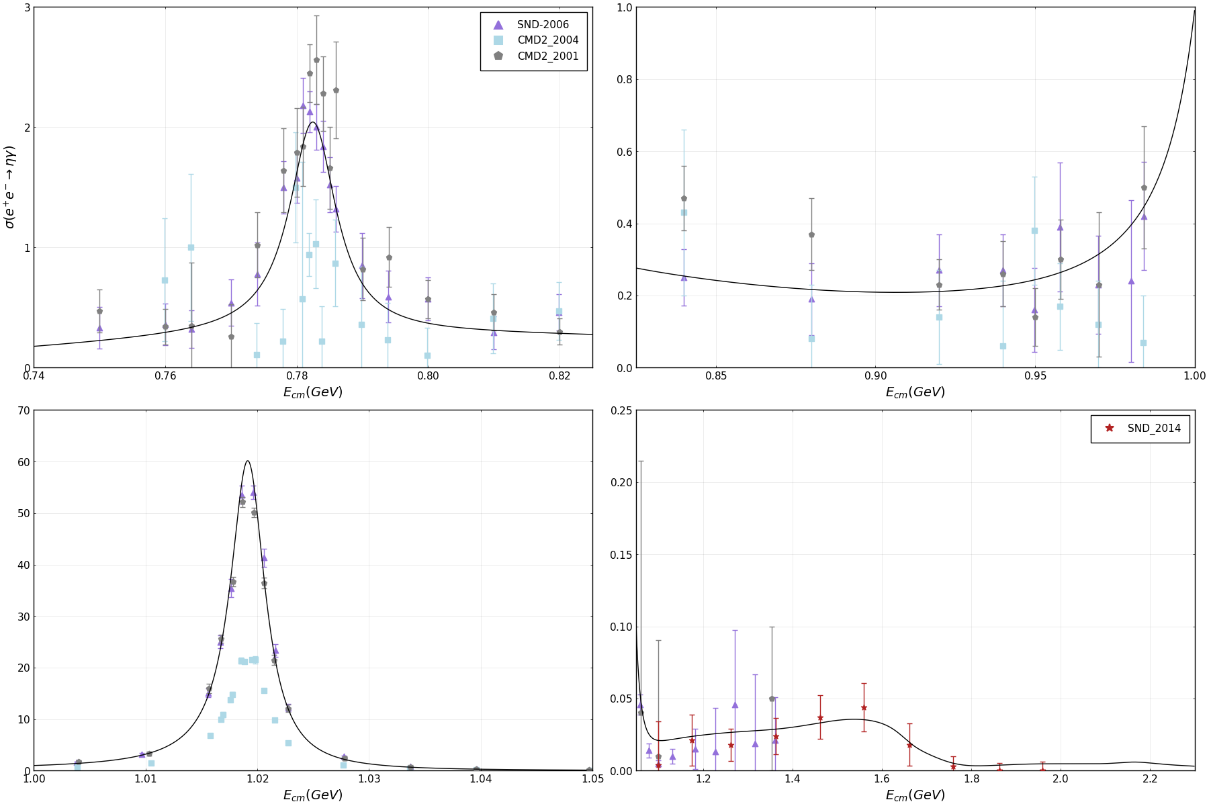
03 Numerical results
$$e^{+}e^{−}→ηγ$$
Preliminary results
helps to constrain KK channels

Slide 15
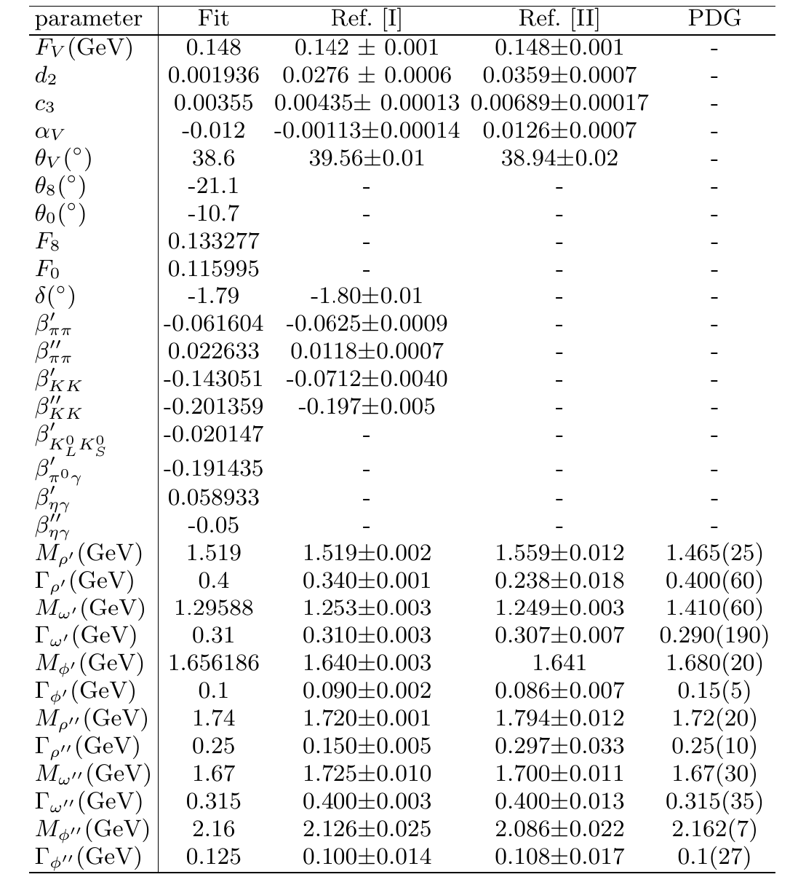
03 Numerical results
Results of preliminary fitting parameters
The leading order HVP correction can be expressed as
where
The kernel function is defined as
with
[1] W. Qin, L. Y. Dai and J. Portoles, JHEP 03 (2021), 092
[2] L. Dai, J. Portolés, and O. Shekhovtsova, Phys. Rev. D 88, 056001 (2013)

Slide 16
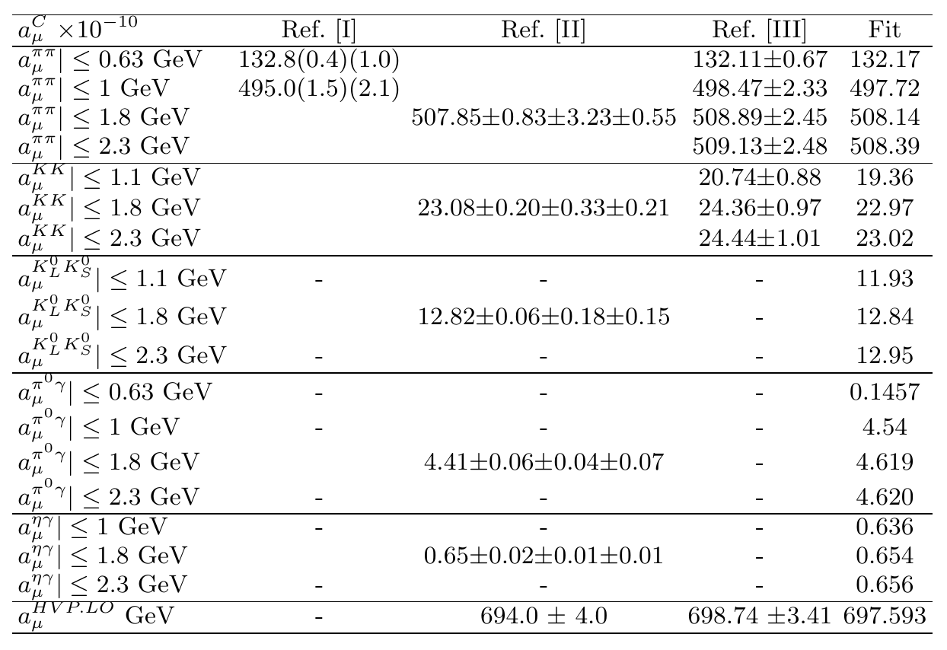
03 Numerical results
Our predictions of muon anomalous magnetic moment
Combined with the other contributions from the standard model , the preliminary theoretical prediction is between the two .
[I] G. Colangelo, M. Hoferichter, and P. Stoffer, JHEP 02, 006 (2019)
[II] M. Davier, A. Hoecker, B. Malaescu, and Z. Zhang, Eur. Phys. J. C 80, 241 (2020)
[III] W. Qin, L. Y. Dai and J. Portoles, JHEP 03 (2021), 092

Slide 17
Background
01
$χEFT$
02
Numerical results
03
Summary
04
Notes:
从以下三个方面做简要的介绍:首先简要介绍研究g-2的一个动机，也就是背景，其次是我研究的内容的结果的一些讨论，最后进行一个简要的总结

Slide 18
04 Summary
We perform a careful amplitude analysis on the study the process of $e^{+}e^{−}→PP$ and $e^{+}e^{−}→P\left(π^{0},η\right)γ$ and calculate their hadronic contribution to muon anomalous magnetic moment .
Main hadronic contribution to muon anomalous magnetic moment come from the lower energy region $E≤1.05$ GeV of the hadronic vacuum polarization input , where few parameters are dominant. Hence, reliable predictions can be made within our theoretical framework from our previous analyses of the two pseudoscalar contributions to the $e^{+}e^{−}$ cross section.

Slide 19
Thank you for your patience!

