Slide 1
Experimental Activities at University of Tokyo
K. Ozawa
(University of Tokyo)

Slide 2
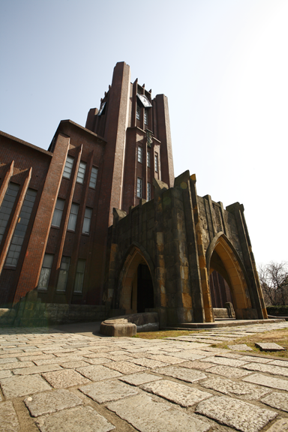
Nuclear Physics Experiment group @ University of Tokyo
Prof. H. Sakai
  Moved to RIKEN
  3 bodies force
  EPR paradox
Prof. R.S. Hayano
  Chiral Symmetry
  Deeply bound Kaon
  CPT symmetry
  Exotic atom
Prof. K. Ozawa
  Quark confinement
  Chiral symmetry
  Hadron mass spectroscopy

Slide 3
Hadron mass spectroscopy

Slide 4
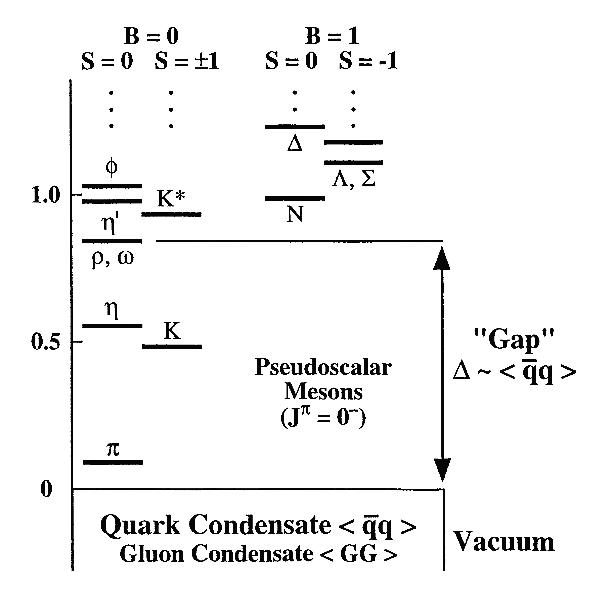
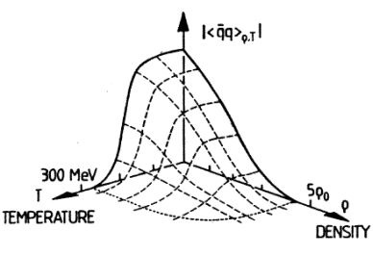
Hadron mass spectroscopy
In terms of QCD, hadron can be undestood as an excitation of “the QCD vacuum.“
Precise measurements of hadron property at nuclear medium can provide QCD information
Cold matter experiments
Hot matter experiments
heavy ion reactions:
A+A→V+X
m_{V}(ρ>>ρ₀;T>>0)
At Nuclear Density
SPS
elementary reaction:
γ, p, π → V+X
m_{V}(ρ=ρ₀;T=0)
RHIC
Especially, Vector meson mass is important as a signal of chiral symmetry restoration.
J-PARC
CLAS
LHC
T.Hatsuda and S.H. Lee, PRC 46 (1992) R34

Slide 5

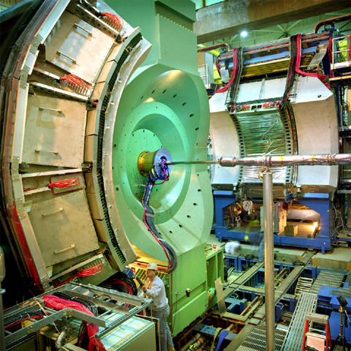
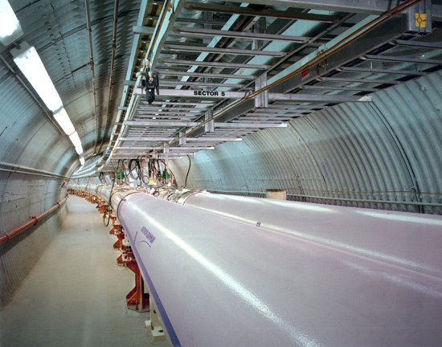
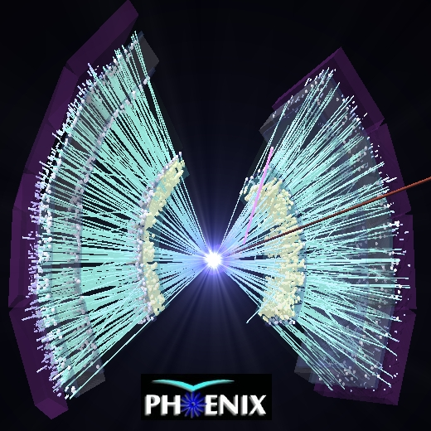
RHIC&PHENIX

Slide 6
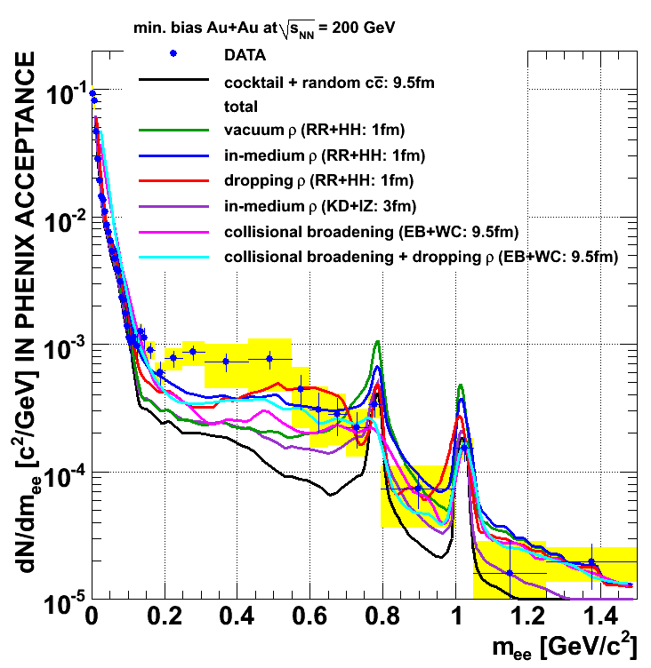
Results @ RHIC
  Electron pair invariant mass in Au-Au at √s_{NN}=200 GeV
PRC81(2010) 034911
Black Line
  Baseline calculations
Colored lines
  Several models
Models
M>0.4GeV/c²:
  some calculations OK
M<0.4GeV/c²:
not reproduced
  Mass modification
  Thermal Radiation
No concluding remarks at this moment.
New data with New detector (HBD) can answer it.

Slide 7
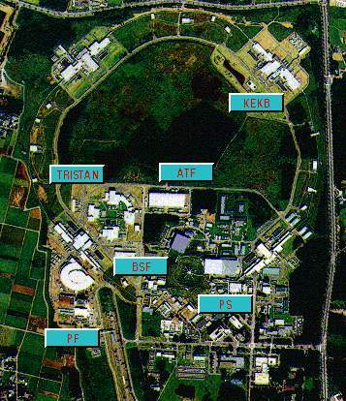
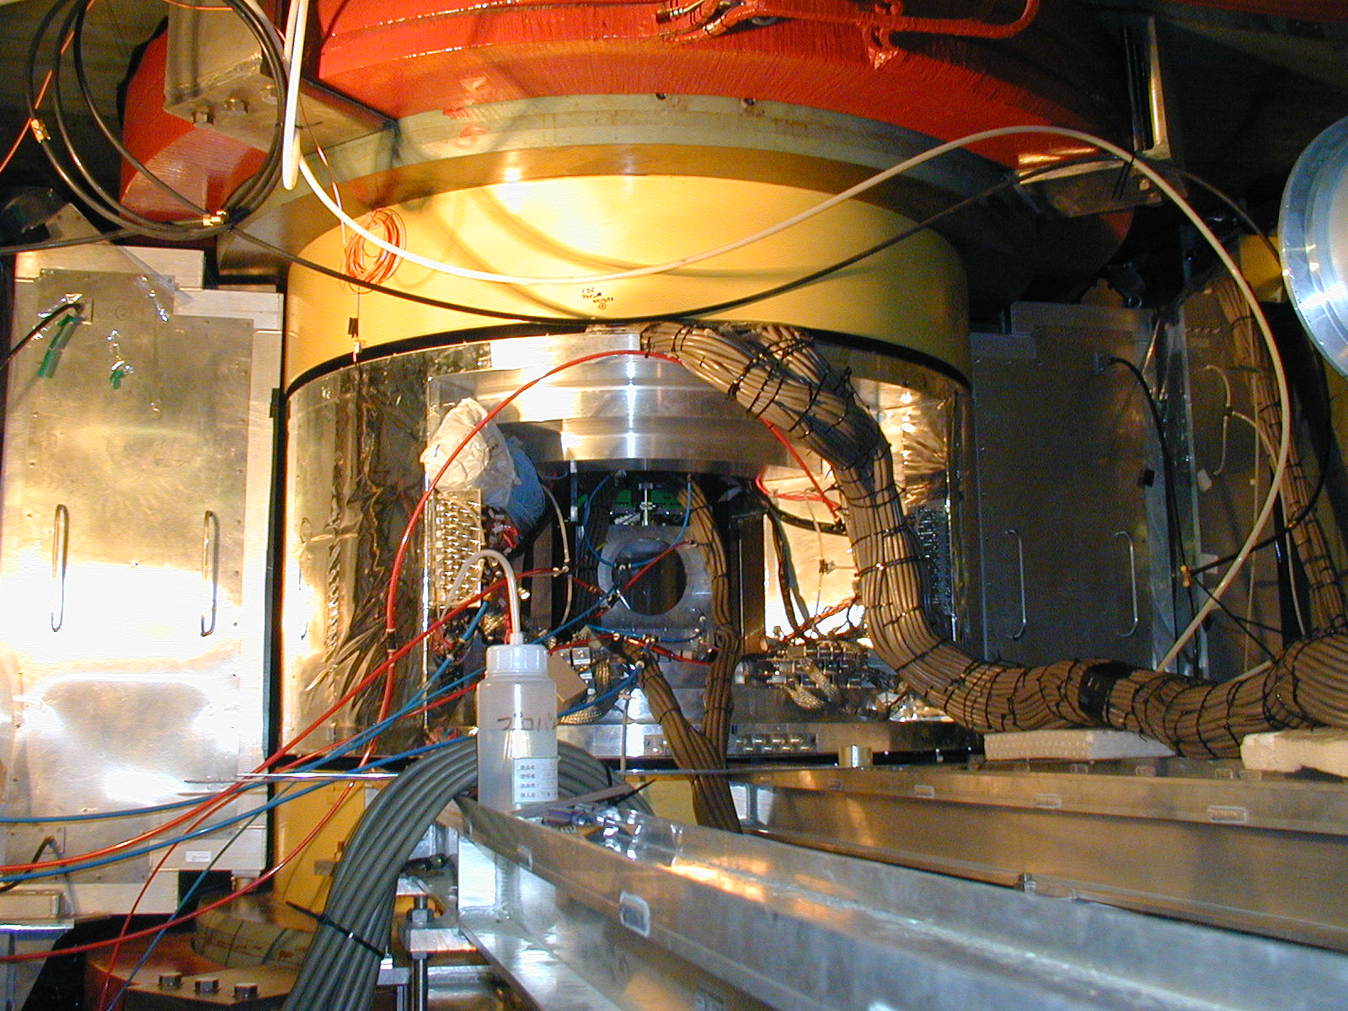
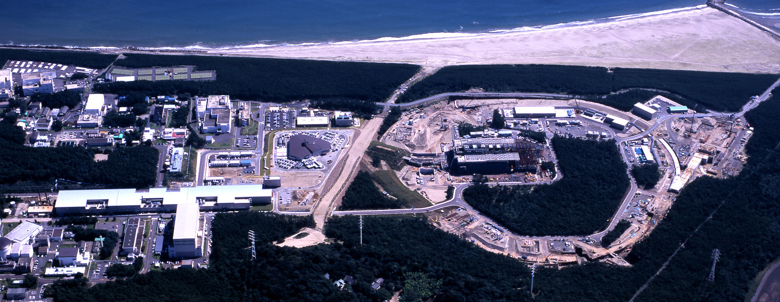
KEK & J-PARC
KEK
J-PARC

Slide 8
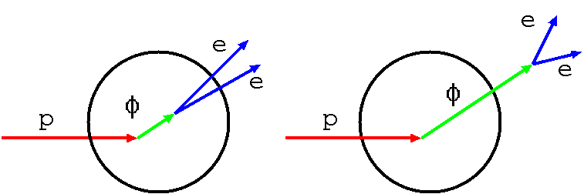
KEK-E325: φ → e⁺e⁻ in pA
βγ<1.25 (Slow)
R. Muto et al., PRL 98(2007) 042581
Invariant mass spectra are measured in pA reactions. Measured distribution contains both modified and un-modified mass spectra. So, modified mass spectrum is shown as a tail.
Cu
Excess!!
Invariant mass spectrum for slow φ mesons of Cu target shows a excess at low mass side of φ.
First measurement of φ meson mass spectral modification in nucleus.

Slide 9
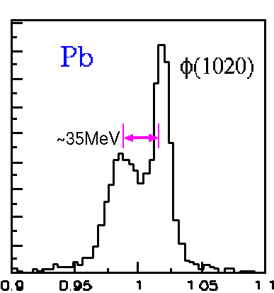
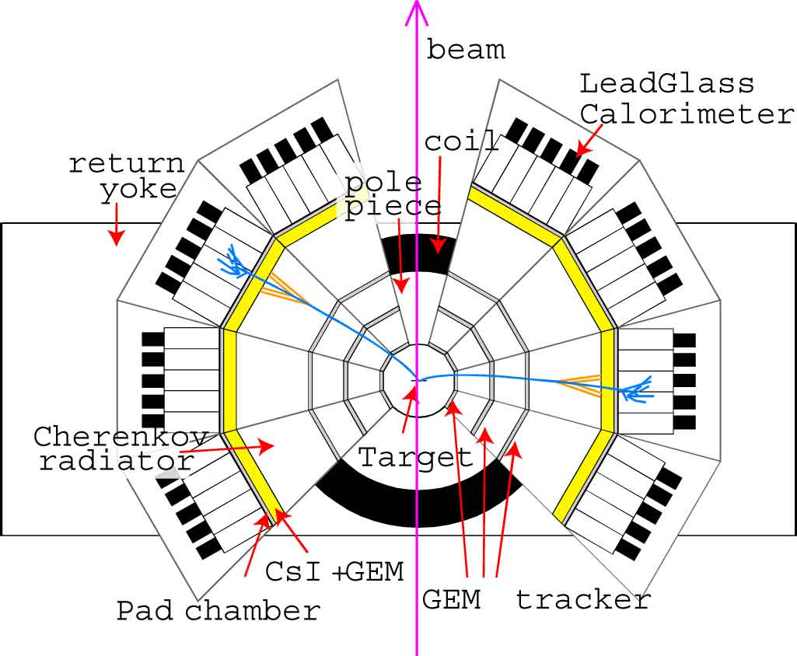
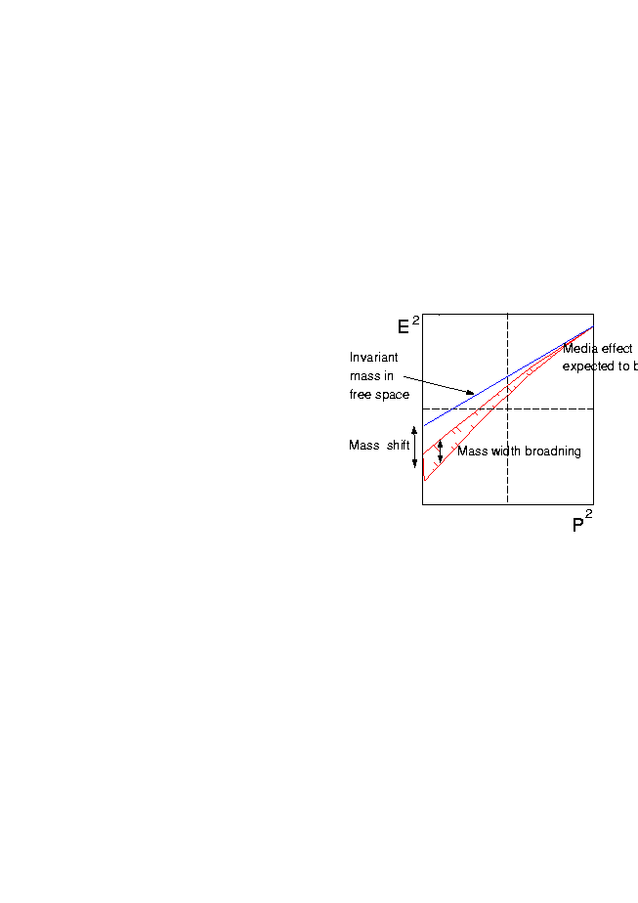
New experiment @ J-PARC
Large acceptance (x5 for pair )
Cope with high intensity (x10)
Good mass resolution ~ 5 MeV/c²
Good electron ID capability
High resolution
100 times higher statistics!!
J-PARC E16
Dispersion relation

Slide 10
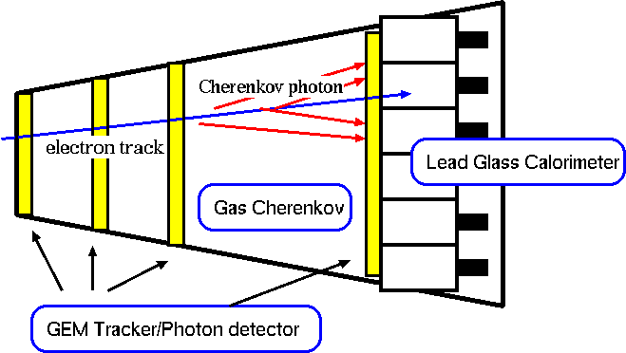
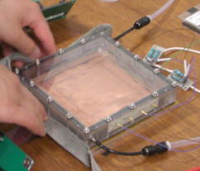
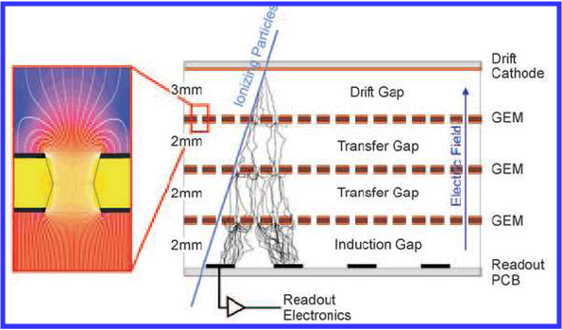
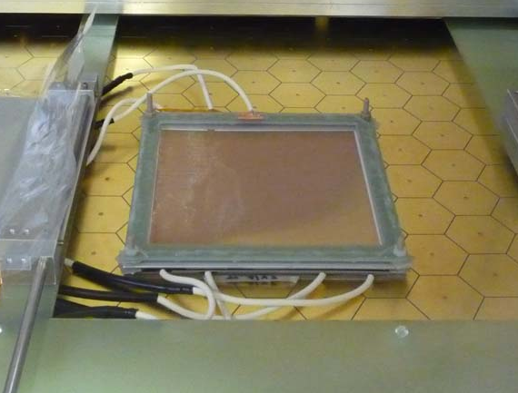
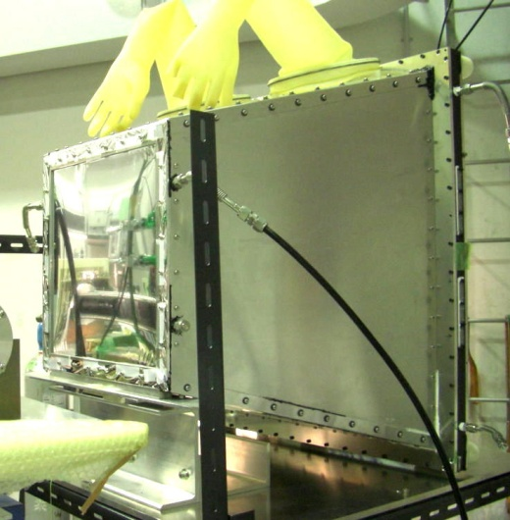
R&D is on-going
Total 26 detector units.
① GEM Tracker
CsI + GEM
photo-cathode
50cm gas(CF₄) radiator
  ~ 32 p.e. expected
CF4 also for multiplication in GEM
Ionization (Drift gap)
+ Multiplication (GEM)
  High rate capability
+ 2D strip readout
② Hadron Blind detector
  Gas Cherenkov for electron-ID

Slide 11


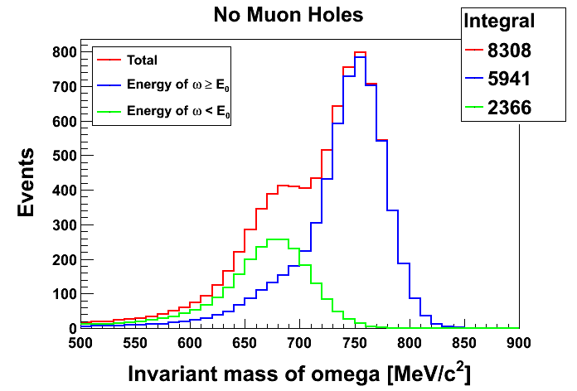
Another Exp.: stopped ω meson
J-PARC E26
Generate ω meson using π beam.
Emitted neutron is detected at 0°.
Decay of ω meson is detected.
π
n
γ
ω
π⁰
If π momentum is chosen carefully, momentum transfer will be ~ 0.
Focus on forward neutron (~2°).
π⁻A → ω + n+X
γ
π⁰γ
γ
Expected Invariant mass spectrum
γγ
Stopped ω meson can show clear modified mass spectrum in nucleus.

Slide 12
Exotic Atom

Slide 13
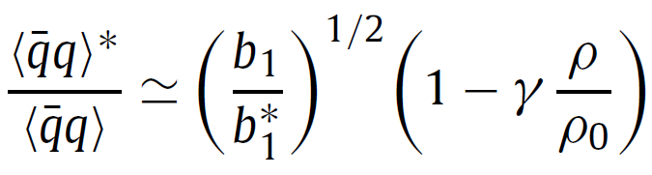

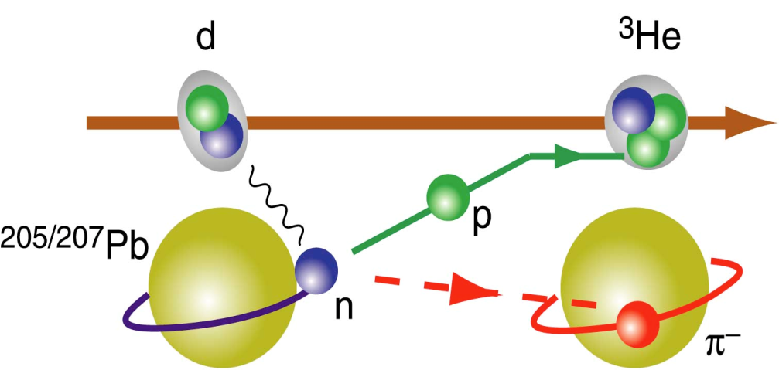
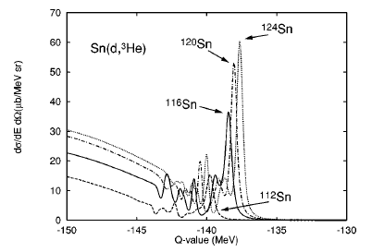
Pionic Atom
Chiral symmetry in medium
π-nucleus scattering length (b₁) is directly connected to quark condensate in the medium.
D. Jido et al., PL B670(2008) 109
The scattering length can be measured using energy and width of π 1s bound state.
The bound state can be generated using the following reaction.
Y. Umemoto et al., PR C62(2004) 024606

Slide 14
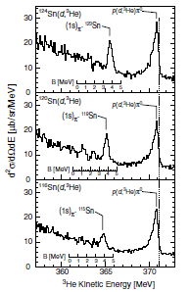
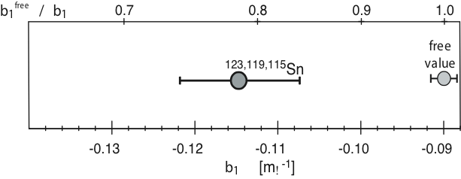
Results
K. Suzuki et al., Phys. Rev. Let., 92(2004) 072302
deeply bound state is observed in
Sn(d, ³He) pion transfer reaction.
In medium
vacuum
3.5 σ difference
Reduction of the chiral order parameter, f*_{π}(ρ)²/f_{π}²=0.64 at the normal
nuclear density (ρ = ρ₀ ) is indicated.
New exp is being prepared at RIKEN BigRIPS.

Slide 15
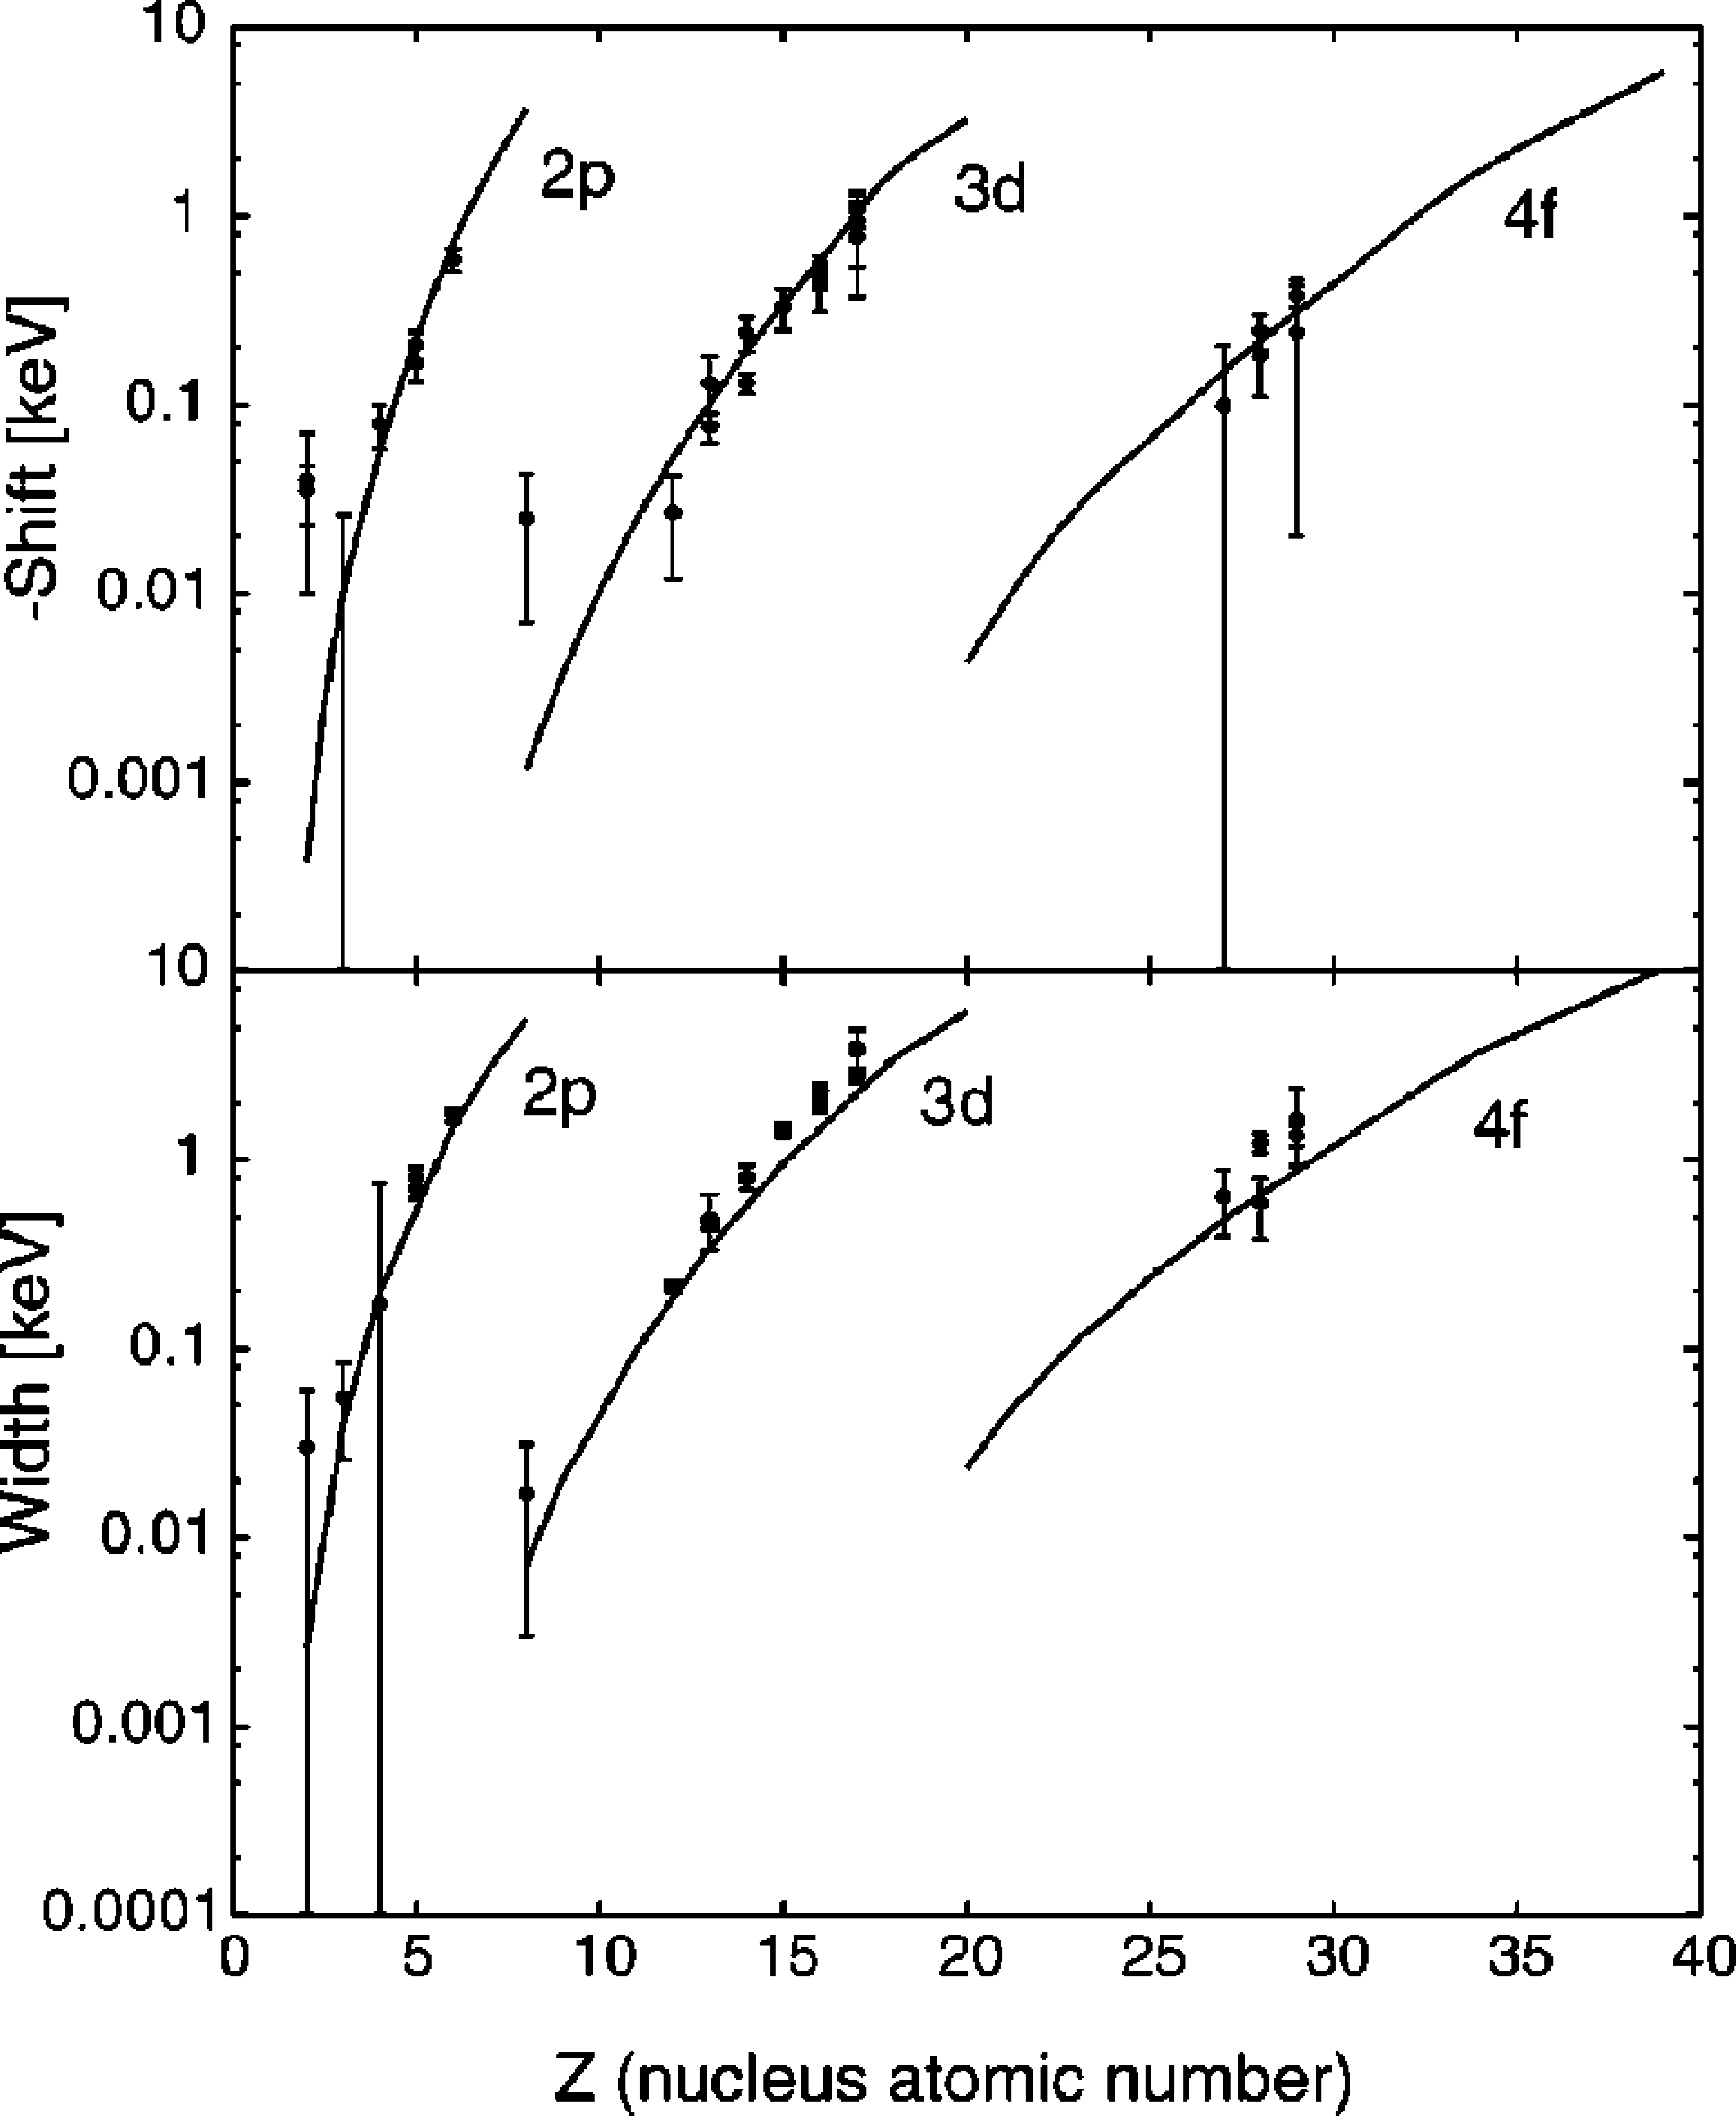
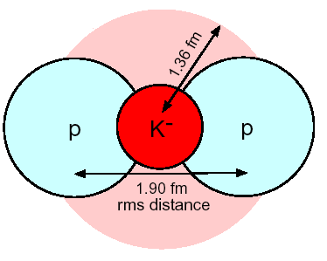
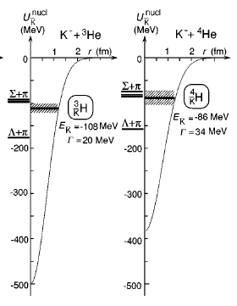
Kaonic ⁴He - Puzzle
⁴He
● Exp.
Theory
10
20
30
Atomic number Z
Akaishi, Yamazaki PRC 65(2002) 044005
(chiral unitary+ optical model):
~0.2eV
Batty (1990),
Hirenzaki et al (2000),
Friedman (2007)

Slide 16
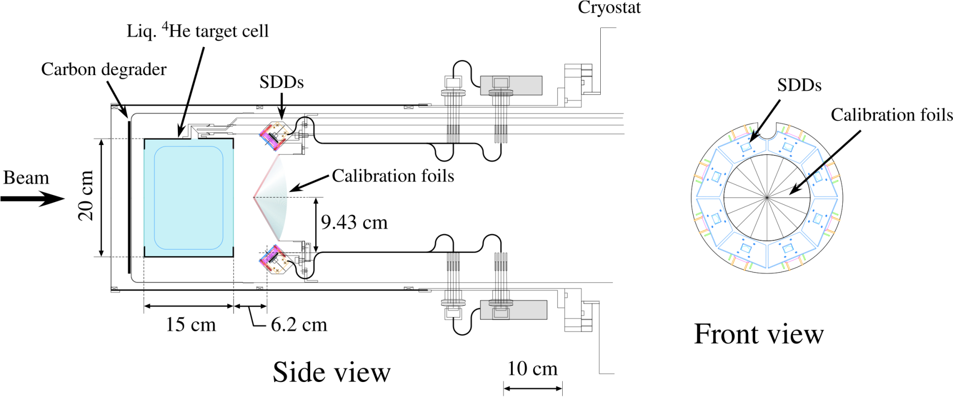
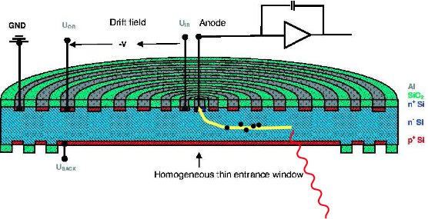
Kaonic ⁴He – exp @ KEK-PS
electrons drift to a small anode (small capacitance)
high resolution
(185 eV FWHM @ 6.4 keV),
despite large area (100 mm²)
8 such SDDs used in E570
In-situ calibration method

Slide 17
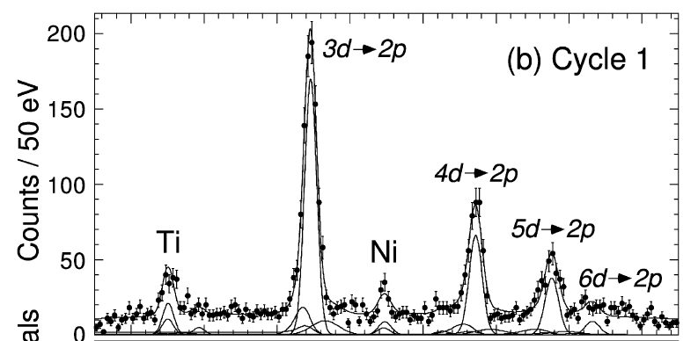
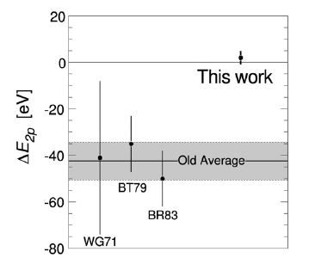
Kaonic ⁴He - Results
S. Okada et al., Phys. Let., B653(2007) 387
Compare to old experiment
statistics | x3
S/N ratio | x6
resolution | x2
4
5
6
7
8
9
10
11
Energy [keV]
New results show no shift and consistent with theoretical calculations

Slide 18
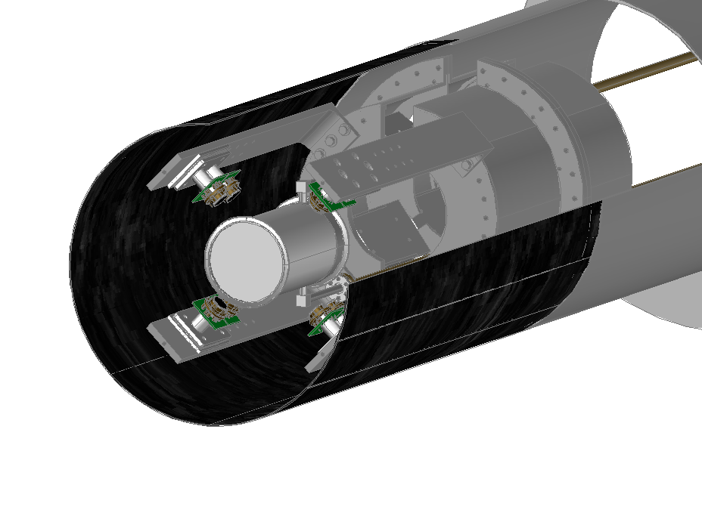
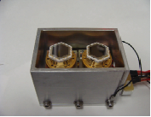
Kaonic ³He @ J-PARC
J-PARC E17
vacuum chamber (CFRP t=0.9 mm)
preamplifiers
K⁻
SDD
³He target cell
(Be, t=0.3 mm)

Slide 19
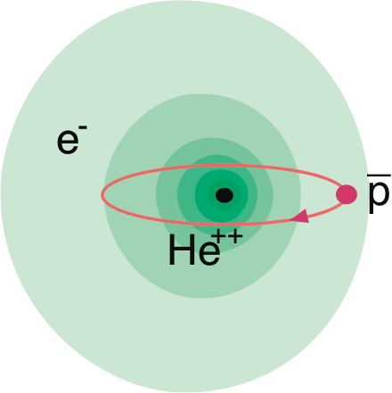
Antiprotonic Helium
Originally, it is discovered at KEK-PS as a long lived antiprotons in helium.
(Iwasaki et al., PRL 67 (1991) 1246)
antiproton is in a highly excited (n~40) orbit
electron is in ~ 1s (slightly polarized to the opposite side of‾p)
Precise measurements of anti-proton mass
  Test CPT conservation
  Basic physics parameter, if CPT is conserved

Slide 20
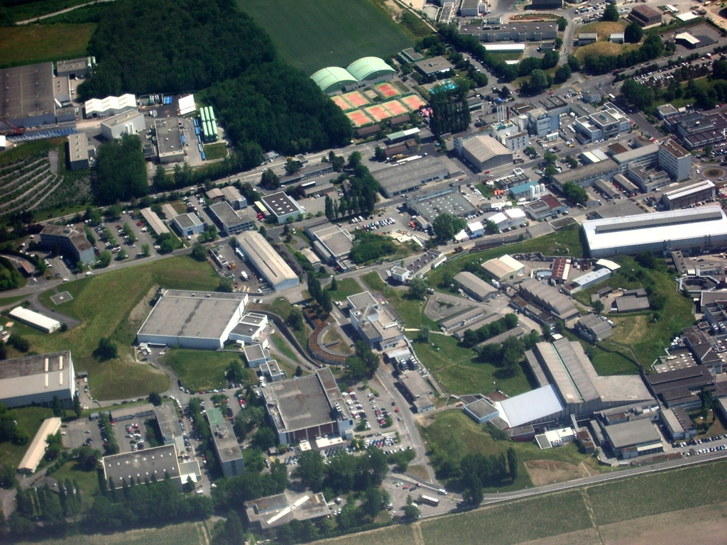
3x10⁷ antiprotons@5 MeV
100ns pulse
every ~90 seconds
Proton Synchrotron
Antiproton Decelerator
photo © ryu hayano

Slide 21



Experiment @ CERN-AD
p̅
n~40
ASAKUSA Experiment:
Spokes person: Prof. R.S. Hayano
Change anti-proton orbit by LASER
Resonance detection using annihilation as a signal.
Resonance frequency
Precise determination of LASER frequency is essential.
Anti-proton electron mass ratio
Theoretical calculation

Slide 22
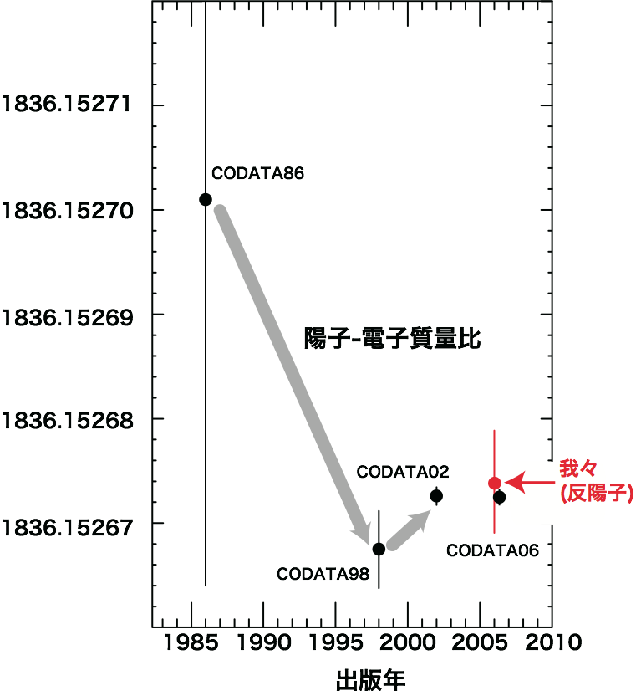
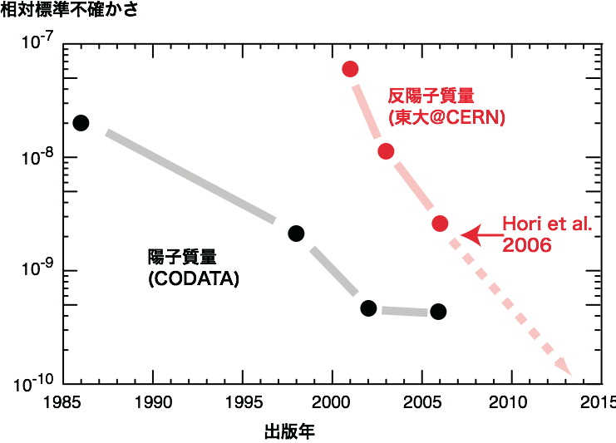
Results
Mass Ratio
Uncertainty
Anti-Proton
Proton-electron mass ratio
Proton
Published year
Anti-Proton
Result contributes the latest CODATA!
Published year

Slide 23
Summary
At university of Tokyo, there is a large group to study nuclear physics experimentally. The group covers large variety of physics topics.
Several activities for hadron physics are on-going to study chiral symmetry, nuclear bound state and so on.
Experiments for hadron mass spectroscopy are being prepared at J-PARC.
Study of exotic atom is performed at J-PARC, RIKEN, and CERN.

Slide 24
Back up

Slide 25
Target/Momentum dep.
βγ<1.25 (Slow)
1.25<βγ<1.75
1.75<βγ (Fast)
Mass modification is seen only at heavy nuclei and slowly moving φ
Mass Shift:
m_{φ} = m₀ (1 - α ρ/ρ₀) for α = 0.03

Slide 26
Performance of the 50-GeV PS
Numbers in parentheses are ones for the Phase 1.
Beam Energy： 50ＧｅＶ
  (30GeV for Slow Beam)
  (40GeV for Fast Beam)
Repetition: 3.4 ~ 5-6s
Flat Top Width： 0.7 ~ 2-3s
Beam Intensity: 3.3x10¹⁴ppp, 15μA
(2×10¹⁴ppp, 9μA)
E_{Linac} = 400MeV (180MeV)
Beam Power: 750kW (270kW)

Slide 27
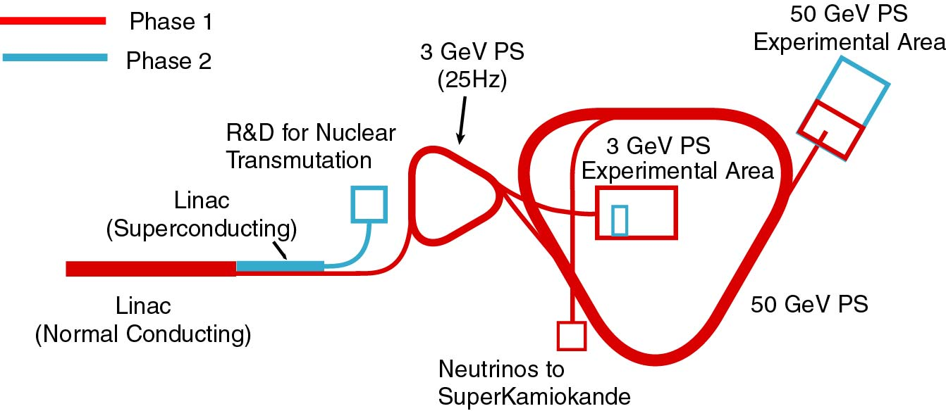
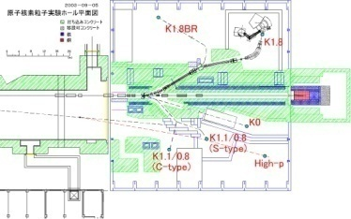
J-PARC
Cascaded Accelerator Complex:
Hadron Hall (Slow Extracted Beams)
Materials and Life Science Facility
3GeV Rapid Cycling (25Hz) Synchrotron
Hadron Hall
Linac
Neutrino Beamline to Super-Kamiokande
50GeV Synchrotron
Notes:
The facility is a cascaded accelerator complex. There are a linear accelerator as an injector, 3-GeV rapid cycling synchrotron, and 50-GeV main synchrotron.
We will have major experimental facilities, the materials and life science facility which uses 3-GeV beams and the nuclear and particle physics facility and the neutrino beamline which uses 50-GeV beams.

