Slide 1
国家重点研发计划
高能环形正负电子对撞机关键技术研发和验证
课题2：硅径迹探测器关键技术验证
报告人： 梁志均
项目负责人： João Guimarães da Costa
项目承担单位：中国科学院 高能物理研究所

Slide 2
国家重点研发计划
R&D and Verification of Key Technologies for a High Energy Circular Electron-Positron Collider
课题2：硅径迹探测器关键技术验证
报告人： 梁志均
项目负责人： João Guimarães da Costa
项目承担单位：中国科学院 高能物理研究所

Slide 3
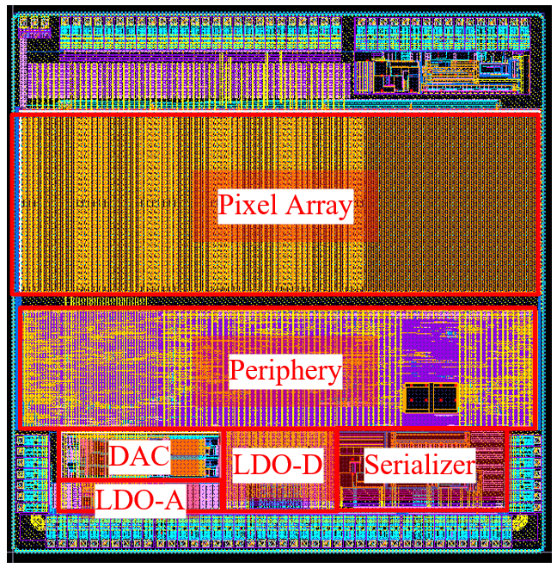
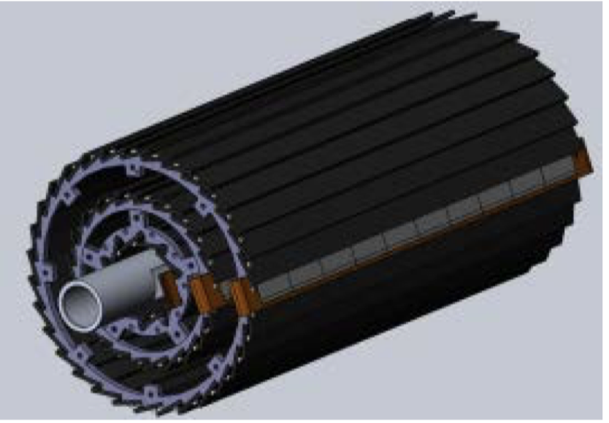
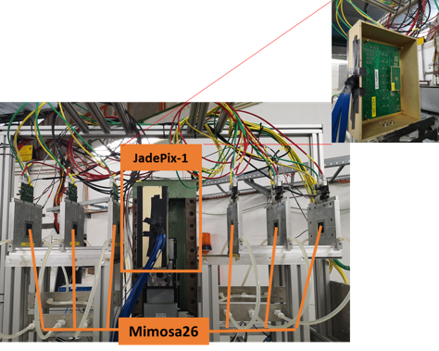
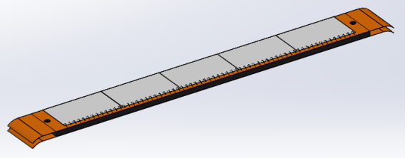
Overview of task2： vertex detector R & D
Can break down into sub-tasks:
CMOS imaging sensor chip R & D
Detector layout optimization, Ladder and vertex detector support structure R & D
Detector assembly
Data acquisition system R & D
CMOS imaging
sensor prototyping
Detector module (ladder)
Prototyping
Full size vertex detector Prototype
Beam test to
verify its spatial resolution
Notes:
Full size vertex detector

Slide 4
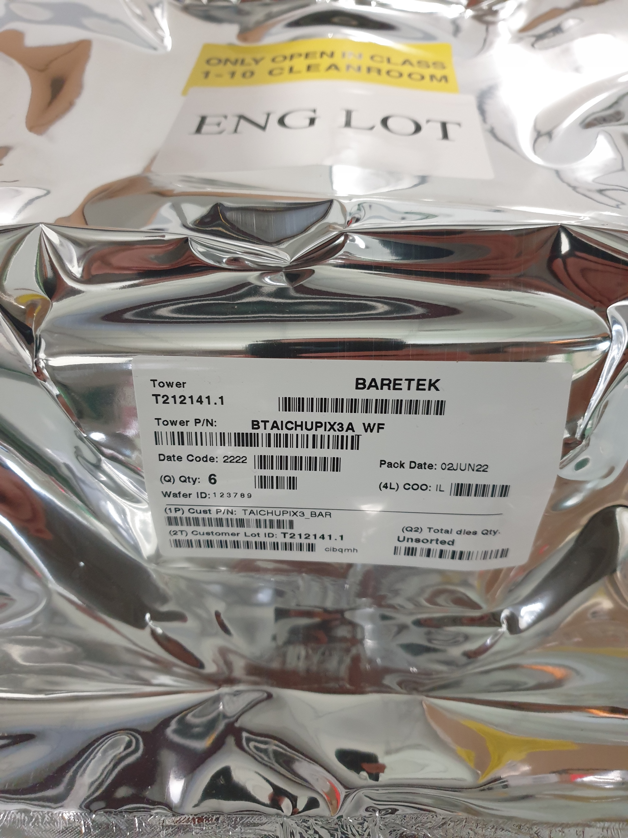
News
6 Taichu3 wafers are ready.
IFAE sent to IHEP，custom clearance now, will 13% pay taxes
COVID19 (10 days policy) for international package.
Expect wafer arrival at IHEP in 1st week in July
3 wafers (standard process) + 3 wafers (modified process)
Dice one wafer of standard process
Whether we try dicing two wafers ?
Check top debug pad (200~300um wide)
Modified process, better resolution ?
Before irradiation, modified process is not better
After irradiation, modified process will give better resolution
Make sure modified process into the ladder making
Need a quick test of the Taichu3 ASIC
Another 6 wafers waiting for production
If there is issue, can modify the metal layer for next batch

Slide 5
Timeline
ASIC
ASICs arrive to IHEP (June)
Dicing and Thinning (one wafer dicing before wafer-level tests) (June)
Single ASIC testing
PCB under production ( by Jun 24th )
Wire-bonding on test PCB … (June)
Functional Tests … (June)
Laser, beta source test (July)
Irradiation test (July )
Wafer level testing
Wafer level test of ASICs (End of June)
Dicing , (thinning ?)

Slide 6
Timeline
Ladders Mechanics:
Now: Carbon support samples available
May: Pre-production carbon support ladders available
August: Production of final carbon support ladders (if needed)
Ladders Assembly:
May: Flex cable available
May: Test of wire bonding and gluing on carbon support
Tooling design and production (June)
Dummy sensor (Glass) assembly on flex (JUNE)
Jig tool , Wire bonding tests on flex (July)
Assembly of ladders with chips (August )

Slide 7
DAQ and multi-ASIC testing
Item | Time
TAICHU test board v1.1 | 6.9 - 6.23 (done)
TAICHU standalone test | 6.24 - ？
Bonding and test with flex4 v1.1 | 6.30 – 7.23
Interposer board production | 6.13 - 7.11
Power board (light interposer) production | 6.13 – 6.30 (done)
Flex2 v1.3 production | 6.13 – 7.4
Flex2 v1.3+interposer+fpga test (first prototype) | 7.23 – 8.23
Optimize and batch production | 8.23-？
Final system test
DAQ status report today

Slide 8
Time line
Barrel Prototype:
June: Installation mock-up (3D printed)
Received large part of 3D models from Jinyu today, printing now
July: Barrel support parts fabricated
August: Assembly first Barrel with ladder support only
Update from Xinghui today
September: mounting readout ladders
October: finished mounting the ladders, and readout tests
Earlier November: Finish assembly of prototype
November: Cosmic ray testing or BEPC beam test
December: DESY test beam

Slide 9
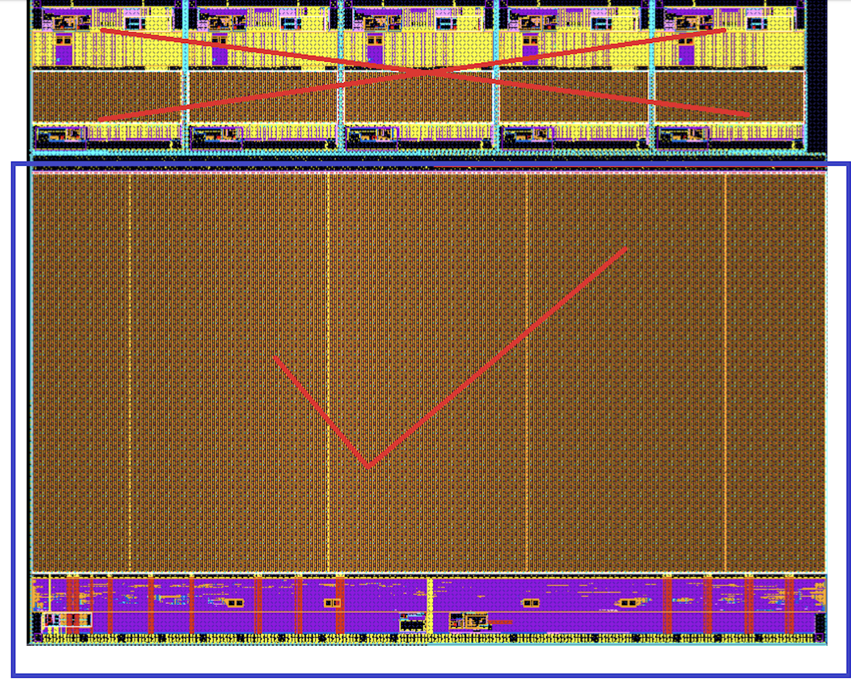
Minute of last meeting discussion
Dicing lines, try to have two dicing for first wafer ( w/wo top debug pad )
One dicing with top metal for the first wafer
Discuss the dicing for the second wafer after testing
Use final module to test Chip to –chip slow control communication
→ changing firmware

