Slide 1

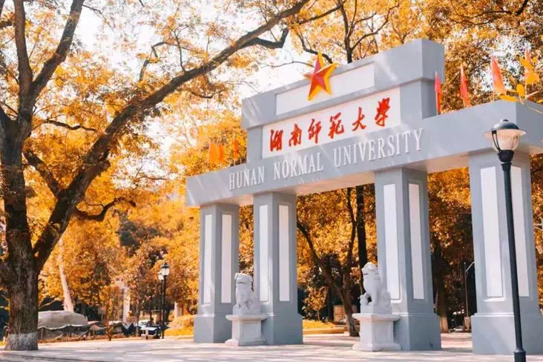
BESIII实验上粲强子、QCD及新物理研讨会
Generation of SU(3) sum rule for charmed baryon decay
报告人： 王 迪
单 位：湖南师范大学

Slide 2
BESIII实验上粲强子、QCD及新物理研讨会
Contents
1
Motivation
2
Generation of SU(3) sum rule
3
Other decay modes
4
Conclusion

Slide 3
BESIII实验上粲强子、QCD及新物理研讨会
Contents
1
Motivation
2
Generation of SU(3) sum rule
3
Other decay modes
4
Conclusion

Slide 4
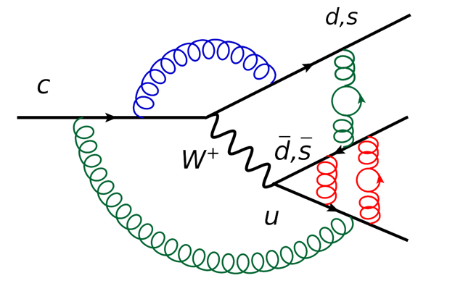
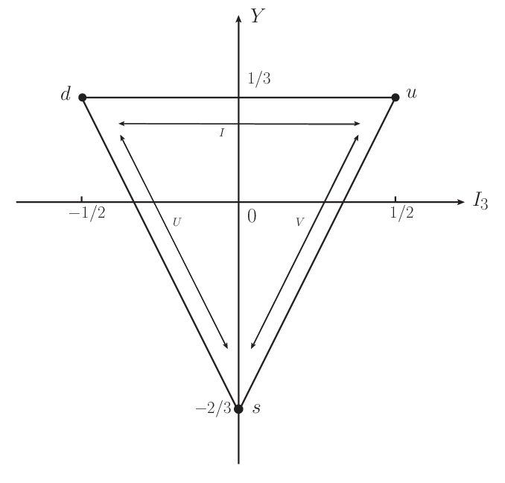
BESIII实验上粲强子、QCD及新物理研讨会
Nonleptonic weak decay of charm baryon
Charm baryon decay
Non-perturbative
Three quarks, complex system
After 2016
Lu:2016ogy, Wang:2017azm, Shi:2017dto, Geng:2017esc, Geng:2017mxn, Wang:2017gxe, He:2018php, Wang:2018utj, He:2018joe, Geng:2018plk, Geng:2018bow, Jia:2019zxi, Geng:2019bfz, Wang:2020gmn, Li:2021rfj, He:2021qnc, Wang:2022wrb …
SU(3) symmetry
4

Slide 5
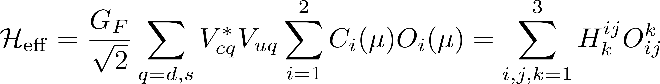
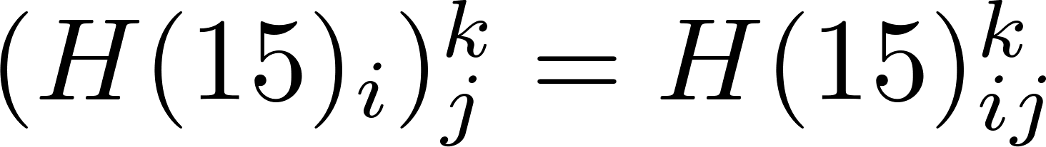
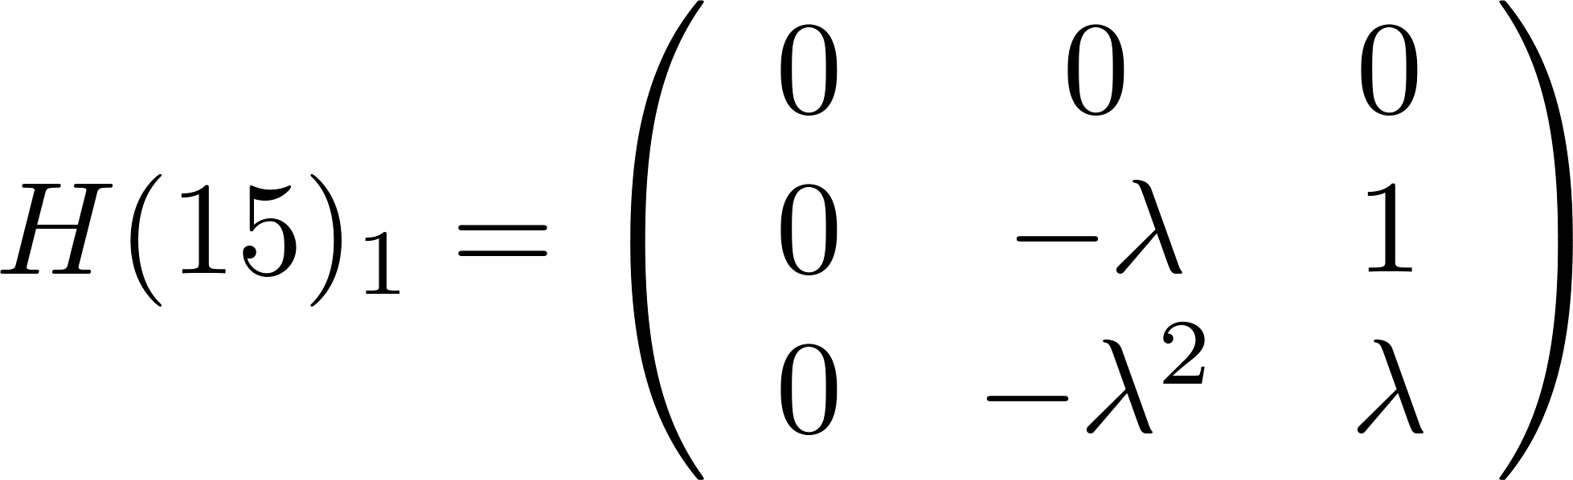
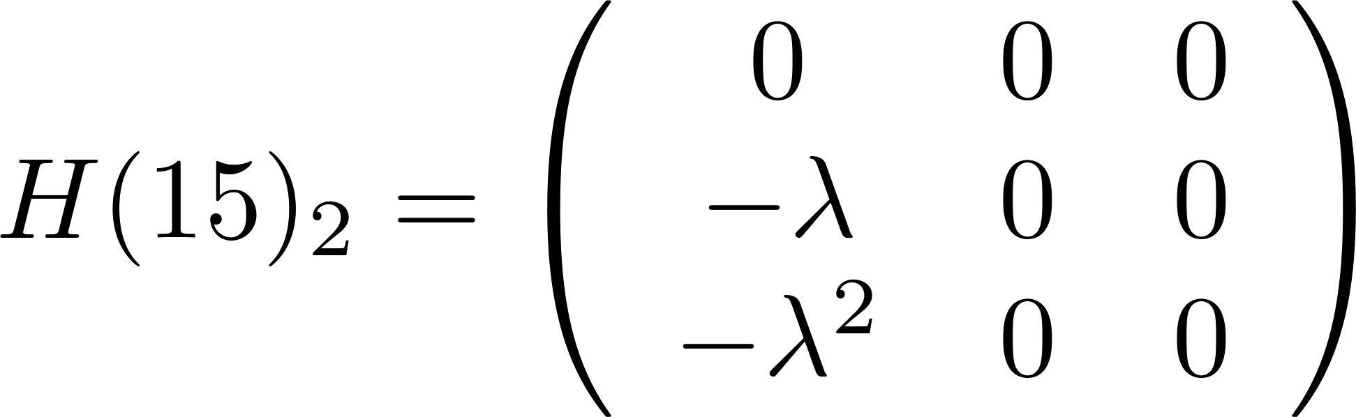
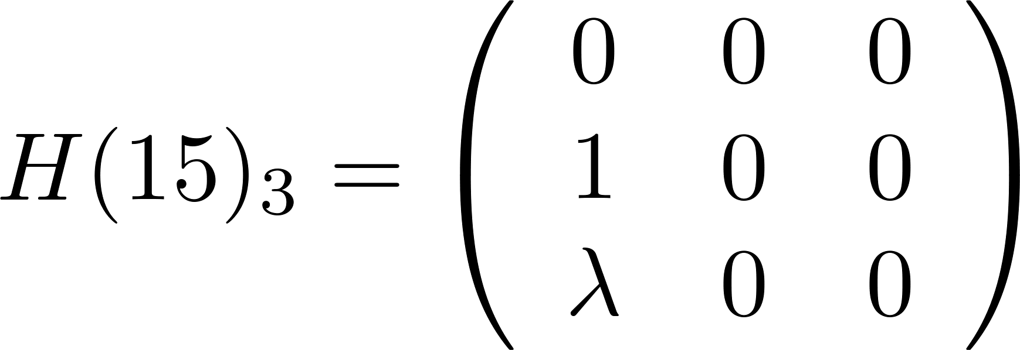
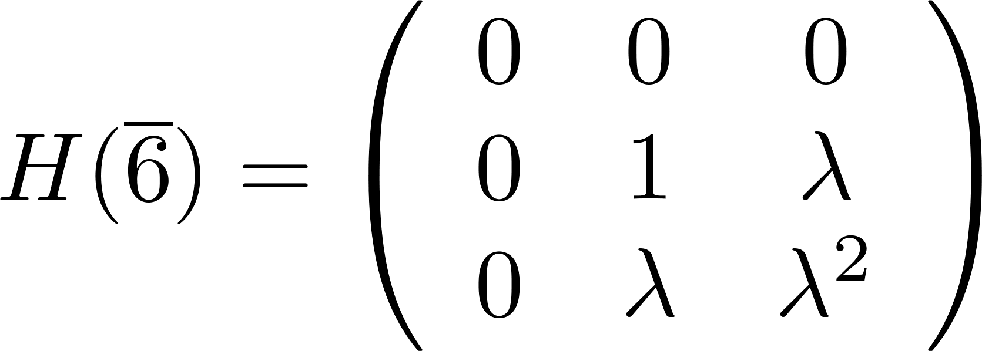
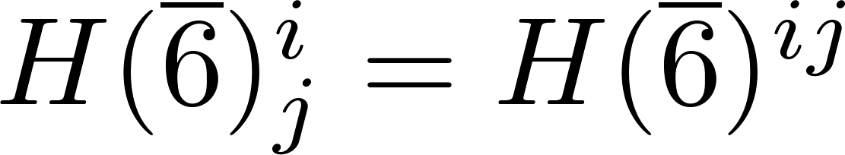
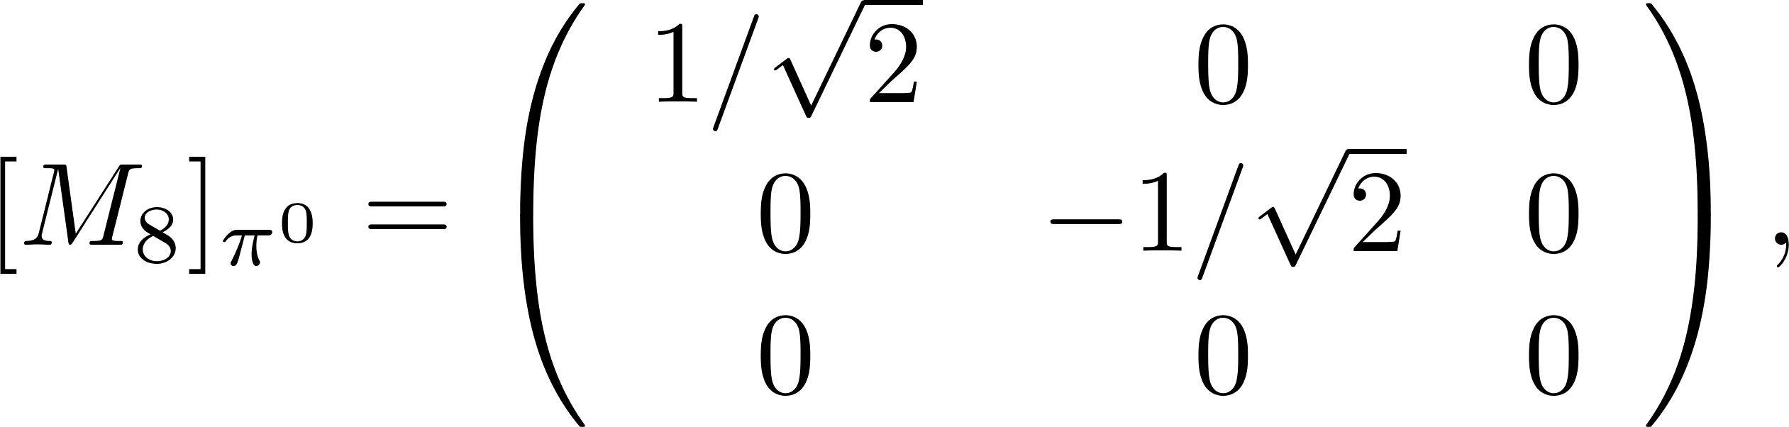
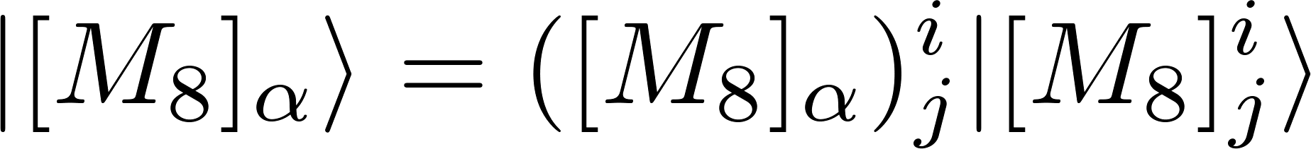
BESIII实验上粲强子、QCD及新物理研讨会
Tensors
Wilson coefficient and Operators
CKM matrix elements
…
5

Slide 6
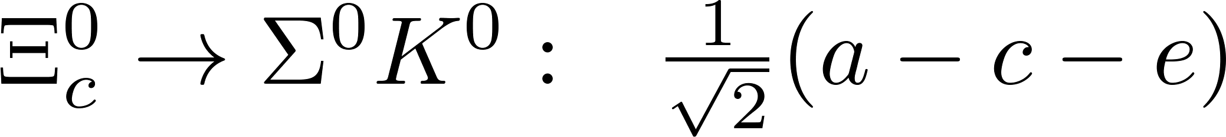
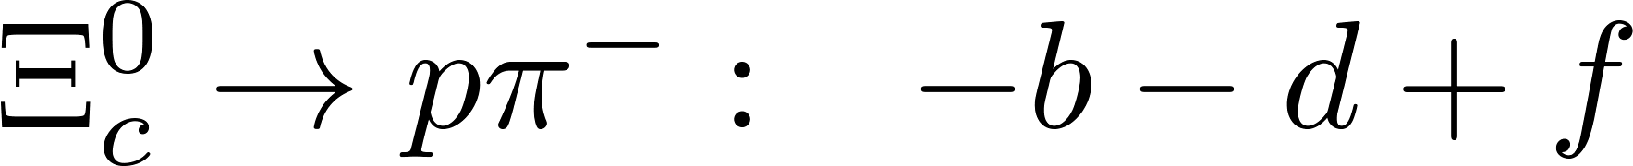
BESIII实验上粲强子、QCD及新物理研讨会
Decay amplitude and SU(3) sum rule
Decomposition
Wigner-Eckart theorem
Other way?
C. P. Jia, D. Wang and F. S. Yu, Nucl. Phys. B 956, 115048 (2020)
6

Slide 7
BESIII实验上粲强子、QCD及新物理研讨会
Contents
1
Motivation
2
Generation of SU(3) sum rule
3
Other decay modes
4
Conclusion

Slide 8
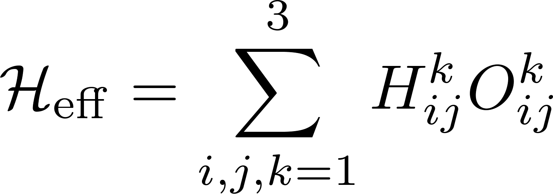
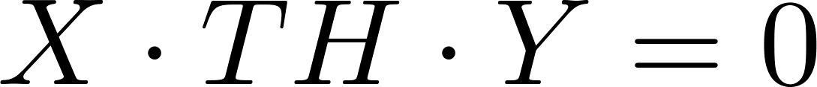
BESIII实验上粲强子、QCD及新物理研讨会
Abstract SU(3) sum rule
If there exists an operator T, under which the Hamiltonian is invariant, T H = 0 . The invariance of Hamiltonian under T is related to the generation of sum rules.
Abstract SU(3) sum rule
Find several operators under which the effective Hamiltonian is invariant.
Apply these operators to the initial/final states and compute coefficients of the obtained matrices expanded by the initial/final states.
8

Slide 9

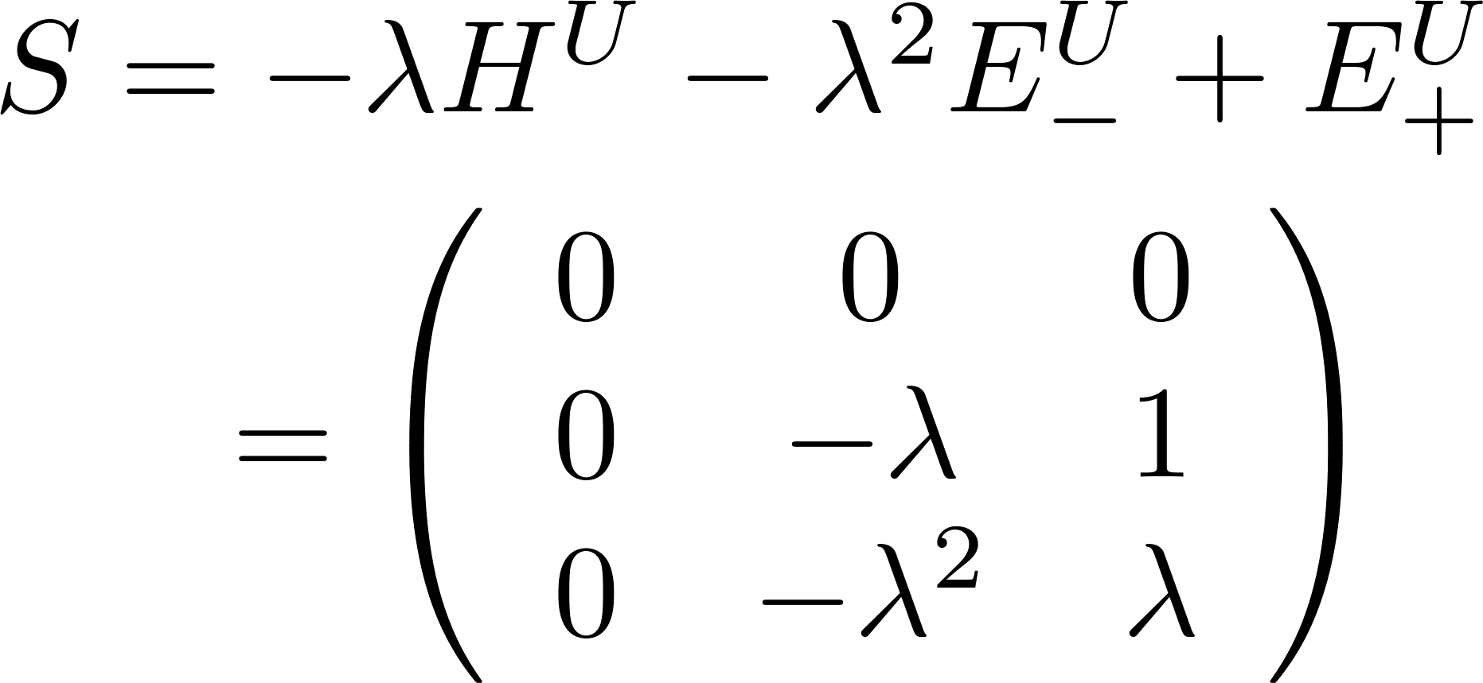
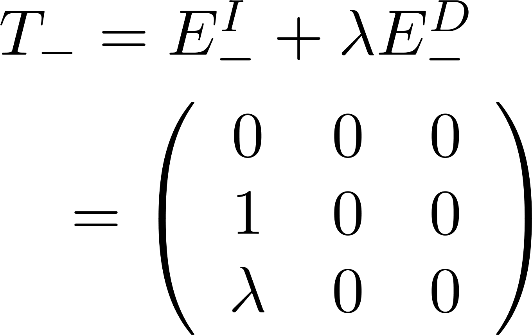

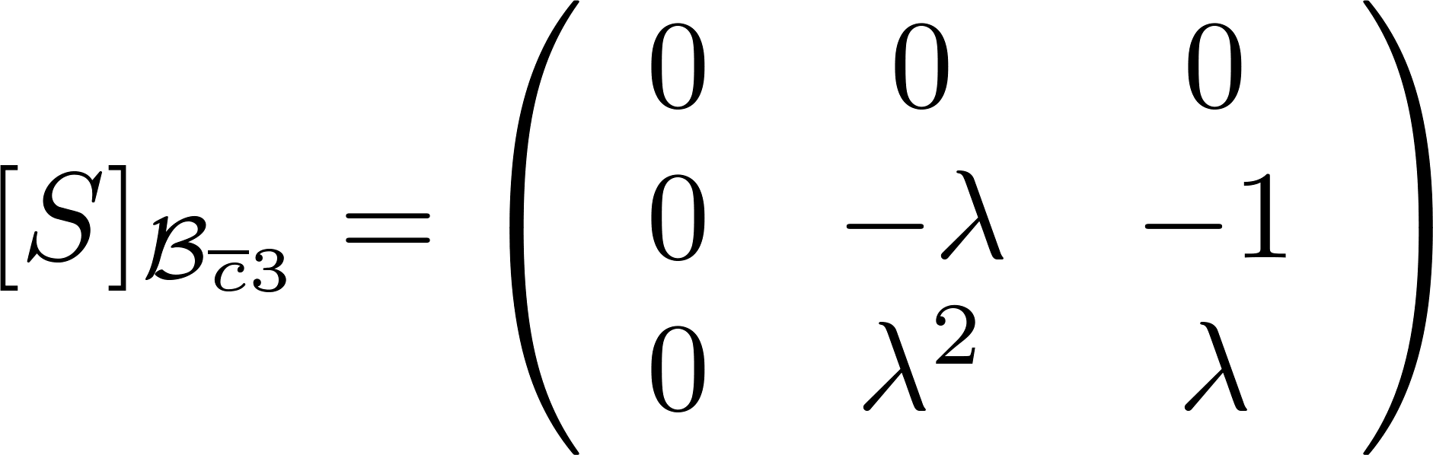
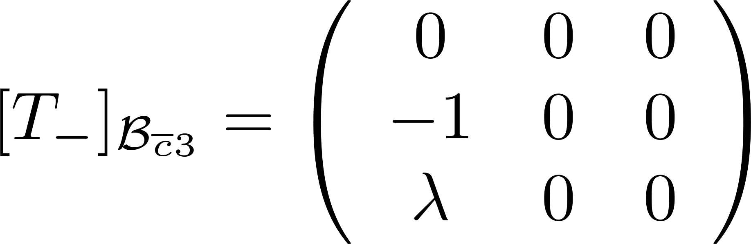
BESIII实验上粲强子、QCD及新物理研讨会
SU(3) sum rule
Y. Grossman and D. J. Robinson, JHEP 04, 067 (2013)
To obtain SU(3) sum rule, we apply operator T to the initial and final states
Basis:
9

Slide 10
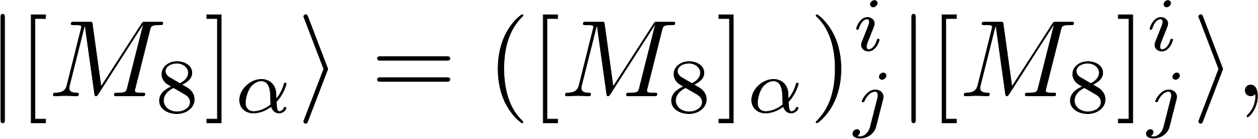
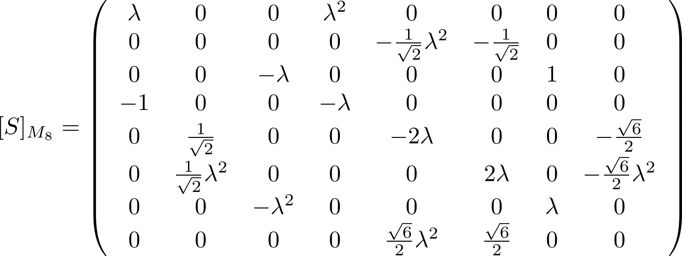
BESIII实验上粲强子、QCD及新物理研讨会
SU(3) sum rule
Adjoint Representation
Basis:
10

Slide 11
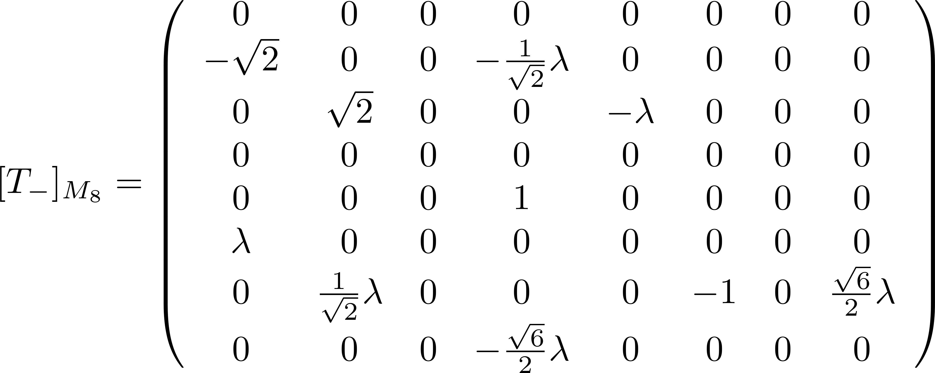
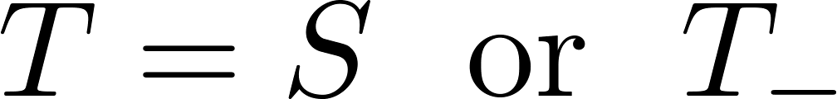
BESIII实验上粲强子、QCD及新物理研讨会
SU(3) sum rule
Master formula:
arXiv:2204.05915 [hep-ph]
11

Slide 12
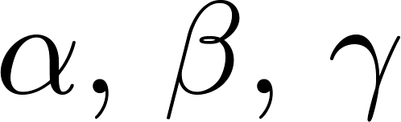

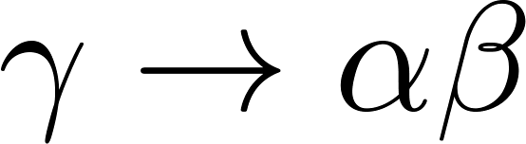
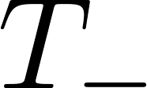
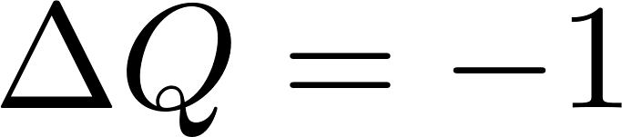
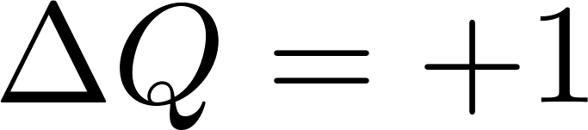
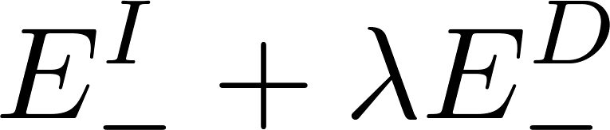

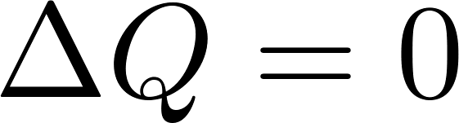
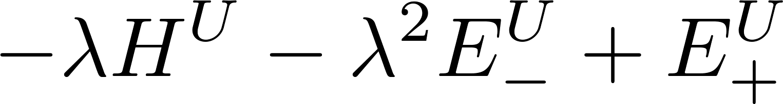
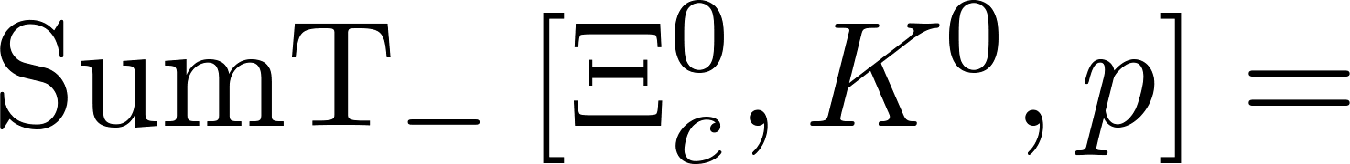
BESIII实验上粲强子、QCD及新物理研讨会
SU(3) sum rule
A SU(3) sum rule is generated if appropriate are selected.
 | Charge |  | Subgroup
arXiv:2204.05915 [hep-ph]
12

Slide 13
BESIII实验上粲强子、QCD及新物理研讨会
Contents
1
Motivation
2
Generation of SU(3) sum rule
3
Other decay modes
4
Conclusion

Slide 14
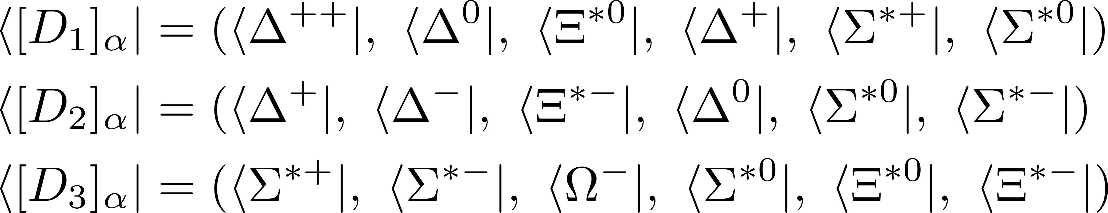
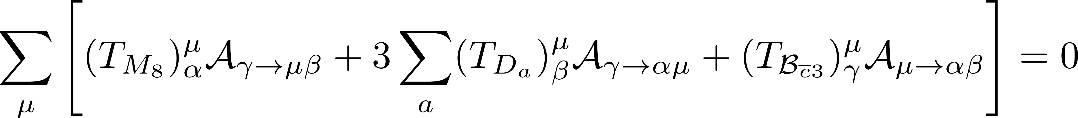
BESIII实验上粲强子、QCD及新物理研讨会
Decay into baryon decuplet
Basis:
Master formula:
arXiv:2204.05915 [hep-ph]
14

Slide 15
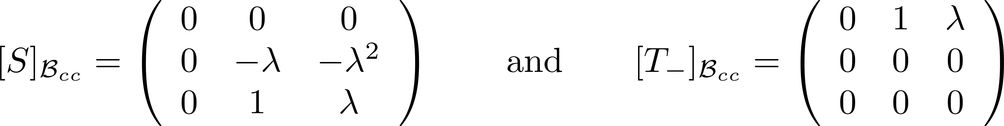
BESIII实验上粲强子、QCD及新物理研讨会
Doubly charmed baryon decays
Master formulas:
arXiv:2204.05915 [hep-ph]
15

Slide 16
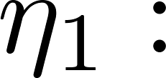
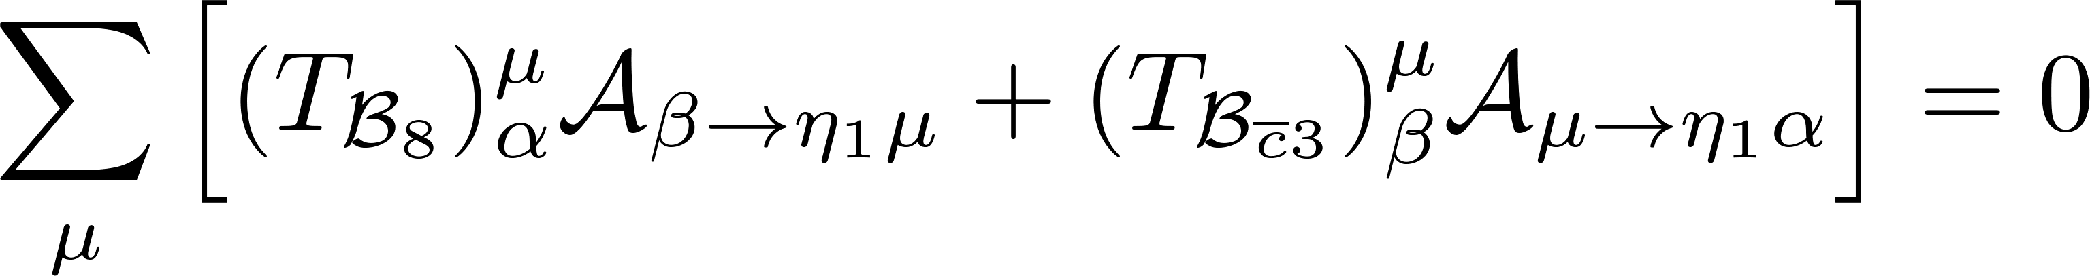
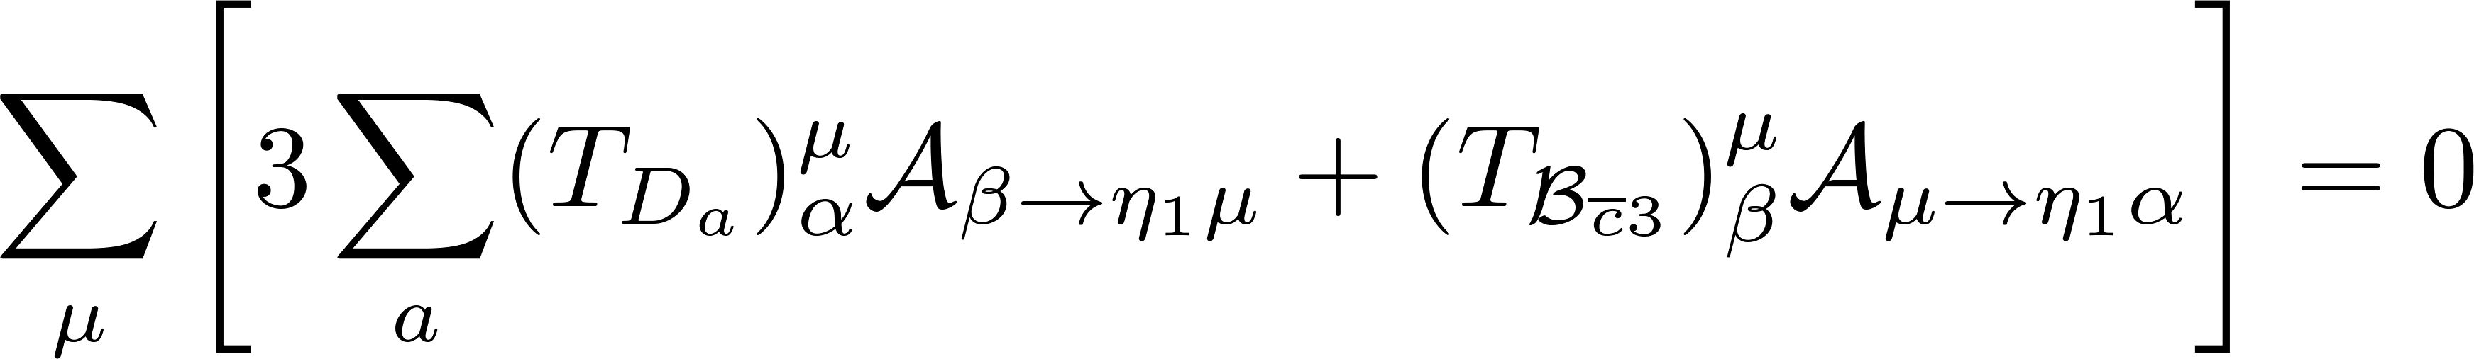
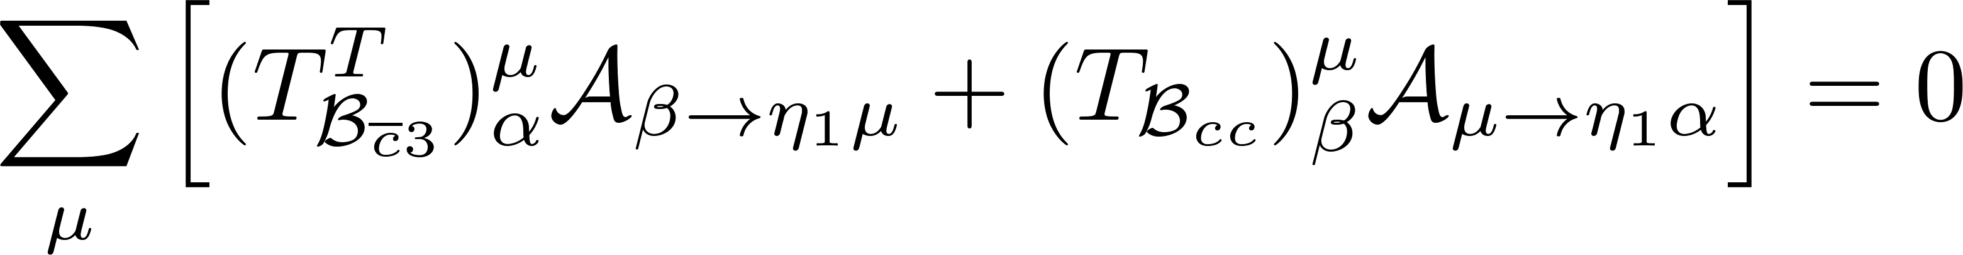
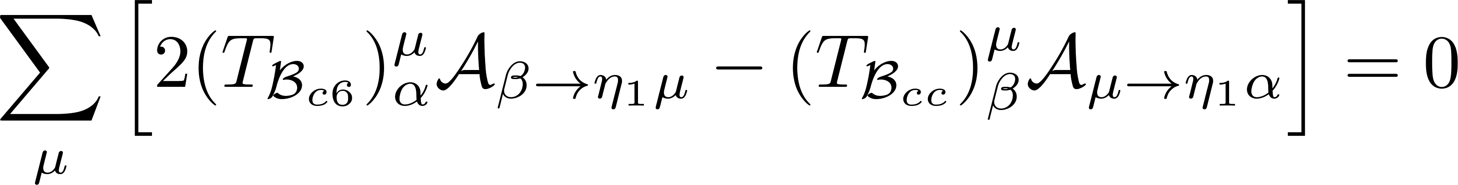
BESIII实验上粲强子、QCD及新物理研讨会
Decay into meson singlet
Identical-representation of SU(3) group
Master formulas:
arXiv:2204.05915 [hep-ph]
16

Slide 17
BESIII实验上粲强子、QCD及新物理研讨会
Contents
1
Motivation
2
Generation of SU(3) sum rule
3
Other decay modes
4
Conclusion

Slide 18
BESIII实验上粲强子、QCD及新物理研讨会
Conclusion
We propose a method to compute amplitude sum rules for the singly and doubly charmed baryon decays in the SU(3) limit without the Wigner-Eckart invariants.
Hundreds of SU(3) sum rules are derived which can be tested by experiments.
Thanks for your attention !
18

