Slide 1
国家重点研发计划
R&D and Verification of Key Technologies for a High Energy Circular Electron-Positron Collider
Zhijun Liang for CEPC MOST2 vertex detector team

Slide 2
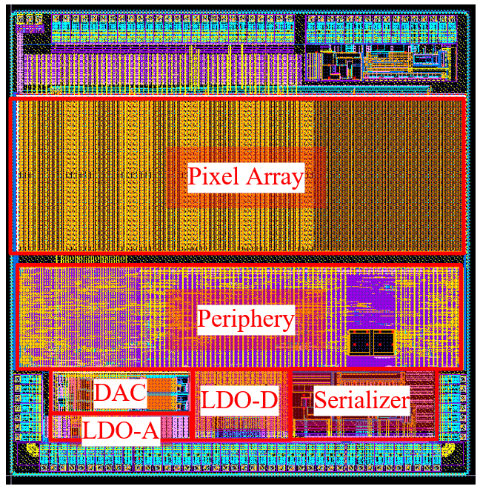
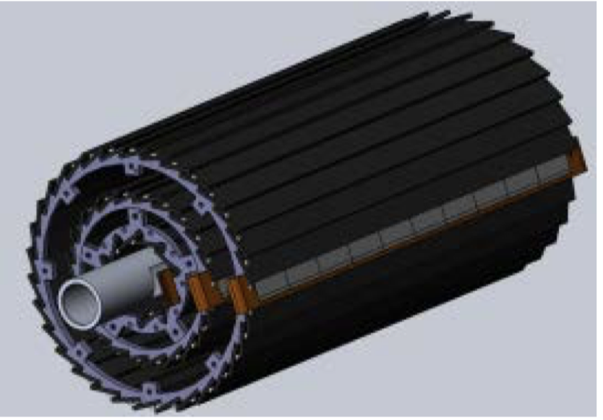
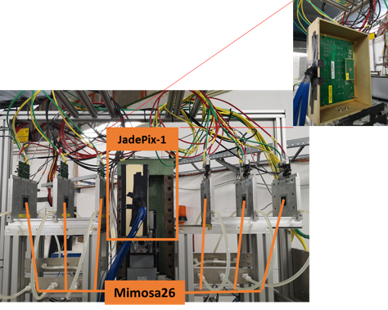
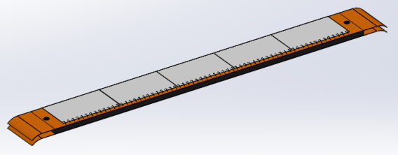
Overview of task2： vertex detector R & D
Can break down into sub-tasks:
CMOS imaging sensor chip R & D
Detector layout optimization, Ladder and vertex detector support structure R & D
Detector assembly
Data acquisition system R & D
CMOS imaging
sensor prototyping
Detector module (ladder)
Prototyping
Full size vertex detector Prototype
Beam test to
verify its spatial resolution
Notes:
Full size vertex detector

Slide 3
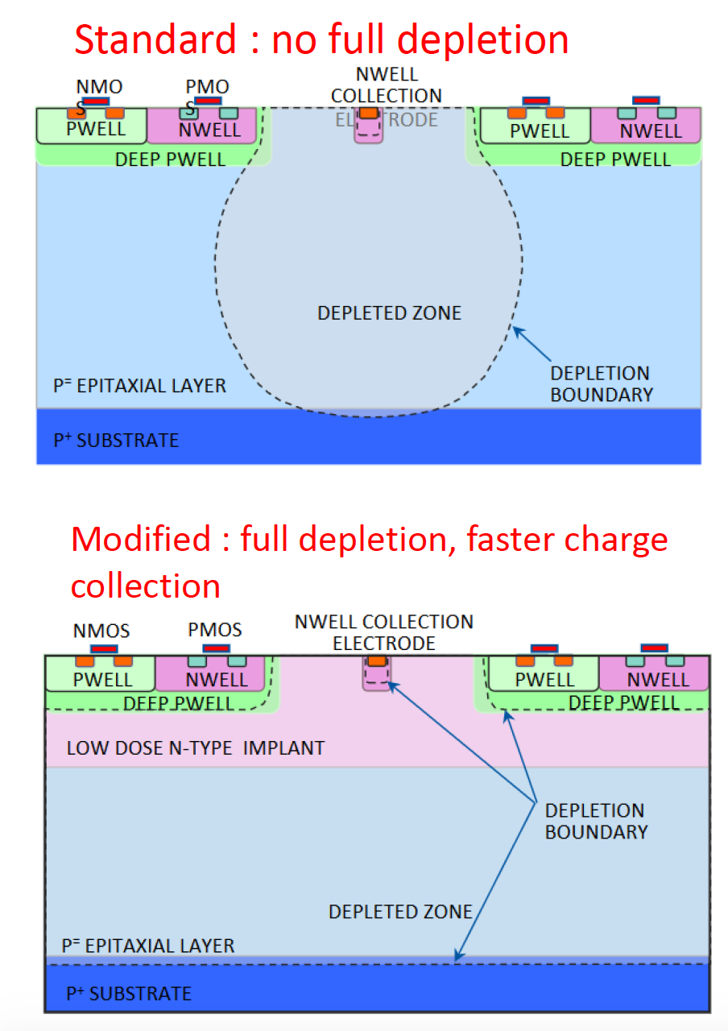
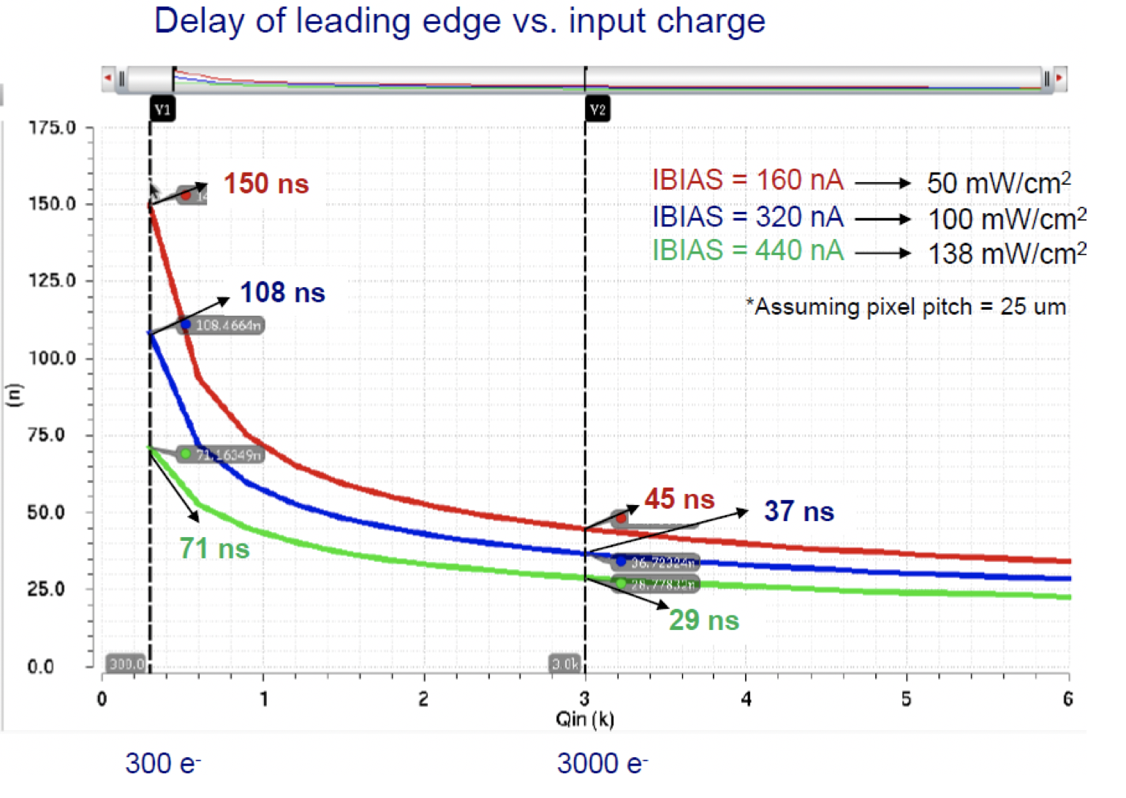
Pixel Analog design
CEPC time stamping precision requirement:
25-100ns, better to time stamping each collision at Z pole
Taichu-1 pixel analog design:
50ns~150ns (based one standard CMOS MAPS tech.)
Consider to use depleted CMOS MAPS

Slide 4
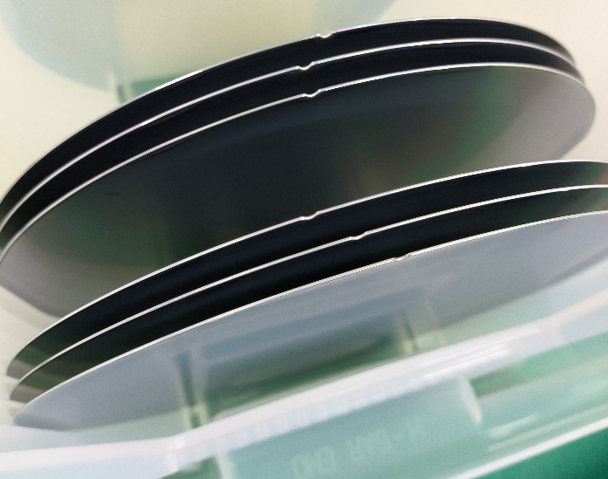
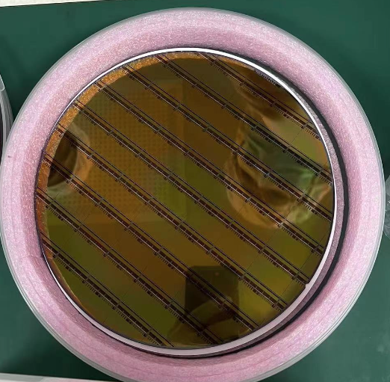
News about Taichupix3 production
6 Taichu3 wafers are ready.
wafer arrival at IHEP in 5th July
3 wafers (standard process) + 3 wafers (modified process)
After irradiation, modified process will give better resolution
Will modified process sensors into the detector assembly
Plan to send 2 wafers for thinning (100um) and dicing
Test single chip performance
Need a quick test of the Taichu3 ASIC
Another 6 wafers waiting for production
If there is issue, can modify the metal layer for next batch

Slide 5
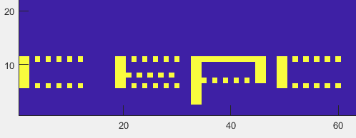
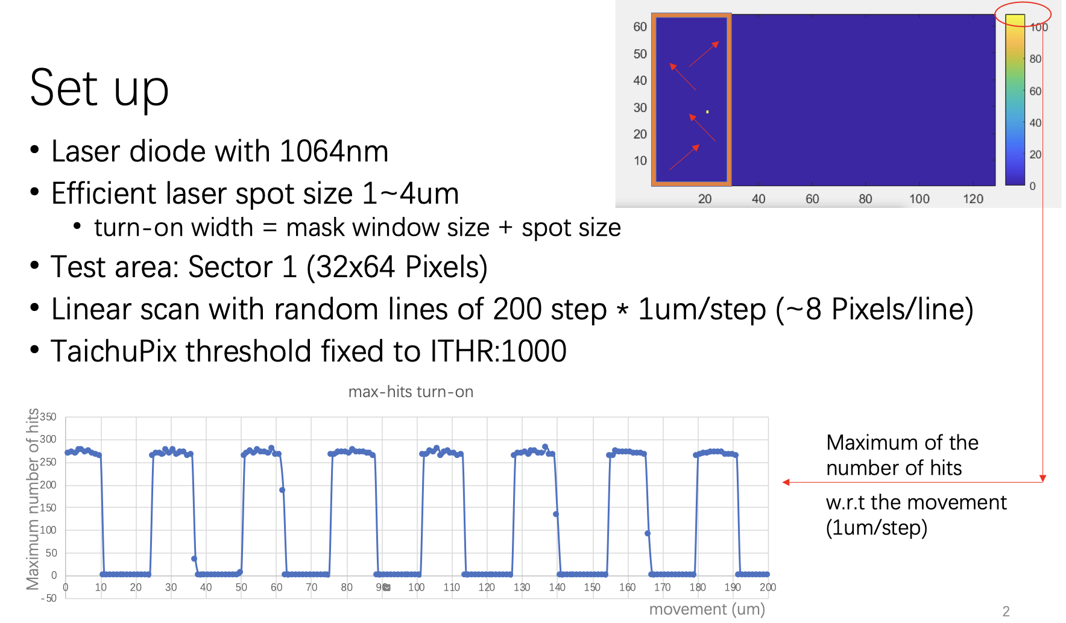
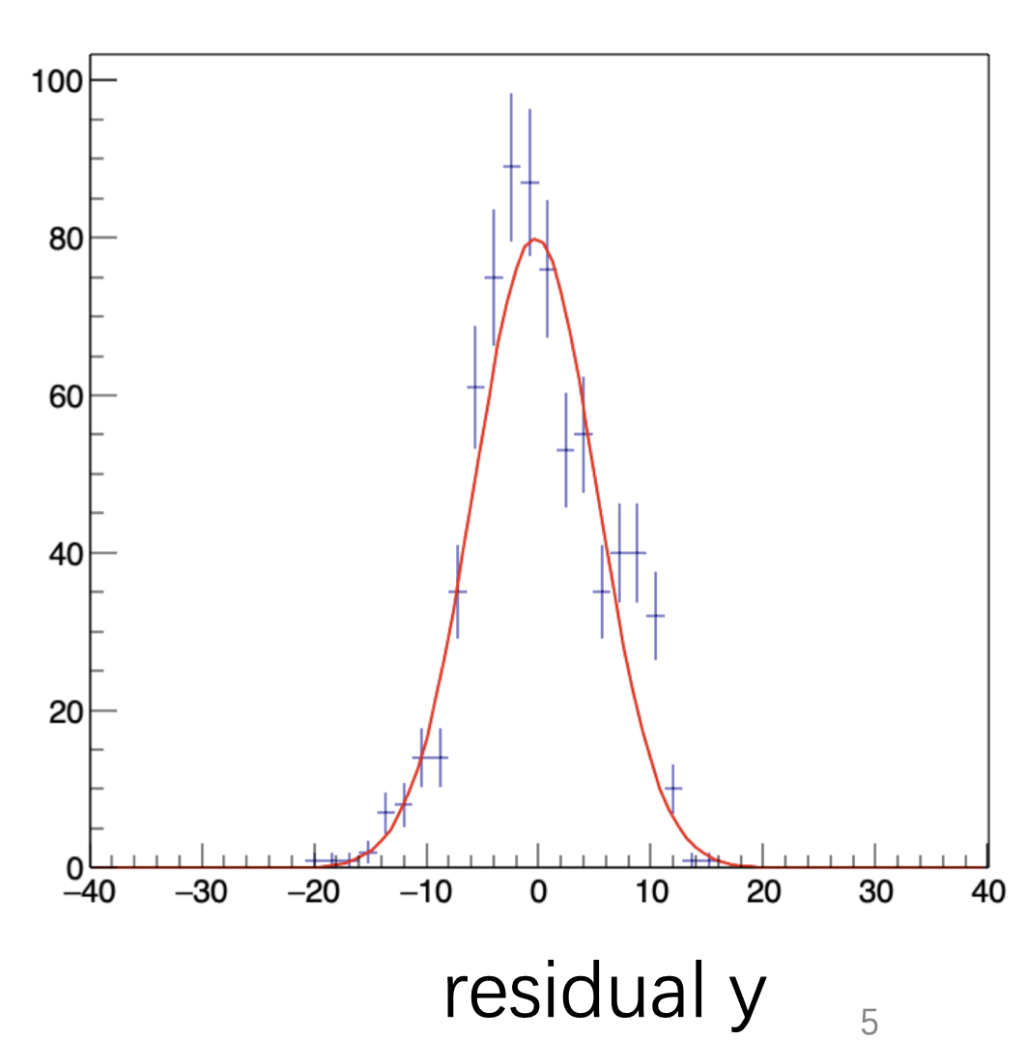
TaichuPix2 laser testing update
Can reach ~5.5μm resolution in laser test
In laser power 70%, cluster size ~2.5
Similar to beta source test cluster size

Slide 6
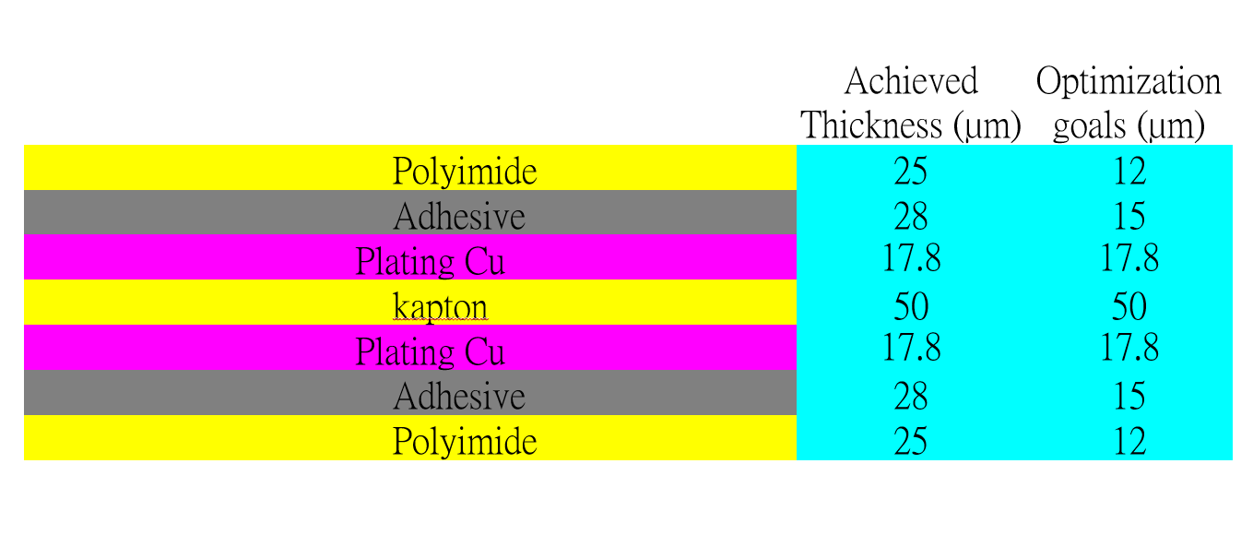
Detector module (ladder) R & D
Completed preliminary version of detector module (ladder) design
Detector module (ladder)= 10 sensors + support structure+ flexible PCB+ control board
Sensors will be glued and wire bonded to the flexible PCB
Flexible PCB will be supported by carbon fiber support structure
Signal, clock, control , power, ground will be handled by control board through flexible PCB
3D model of the ladder
Schematic of ladder electronics
Profile of flexible PCB
Flexible PCB prototype

Slide 7
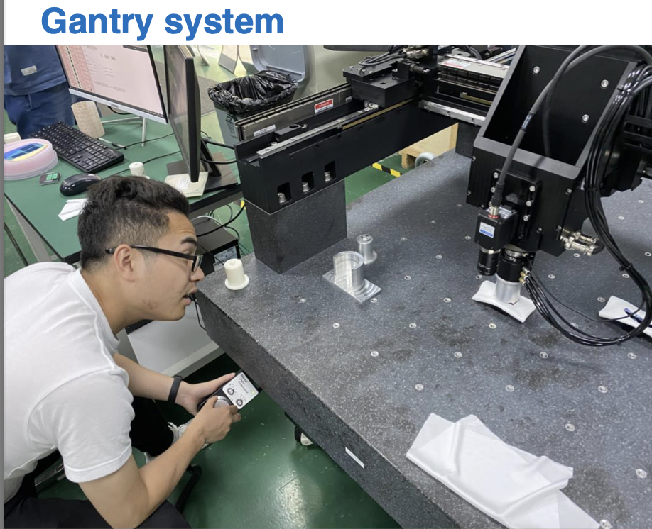
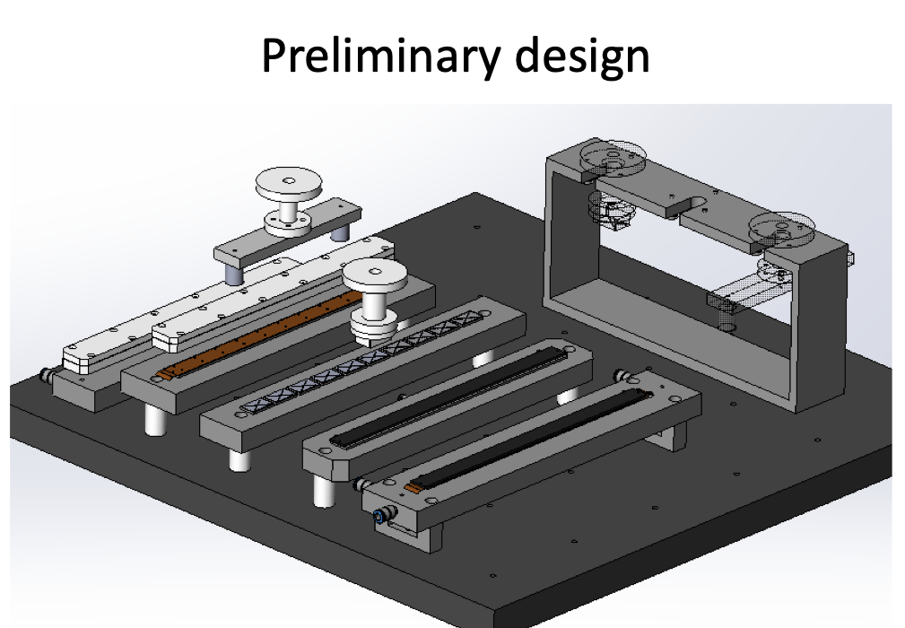
Detector module(ladder) assembly
Use gantry to do module assembly
Progress in assembly procedure and tooling design

Slide 8
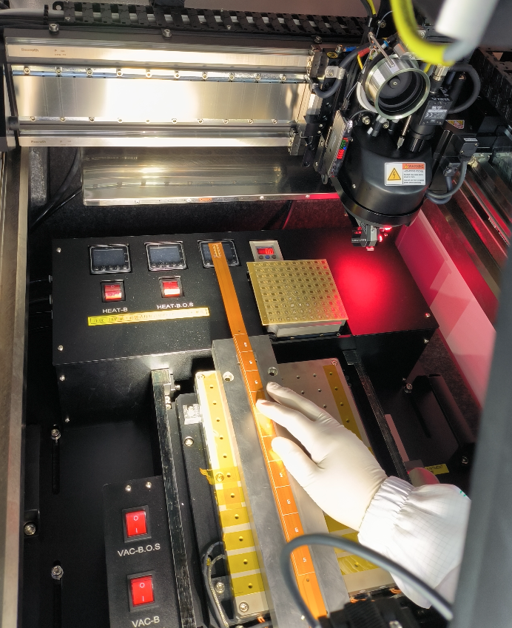
Detector module(ladder) assembly
Setting up wire bonding station
For full-size detector module( ladder)
Progress in assembling dummy sensor
Dummy sensor (glass) on flexible PCB

Slide 9
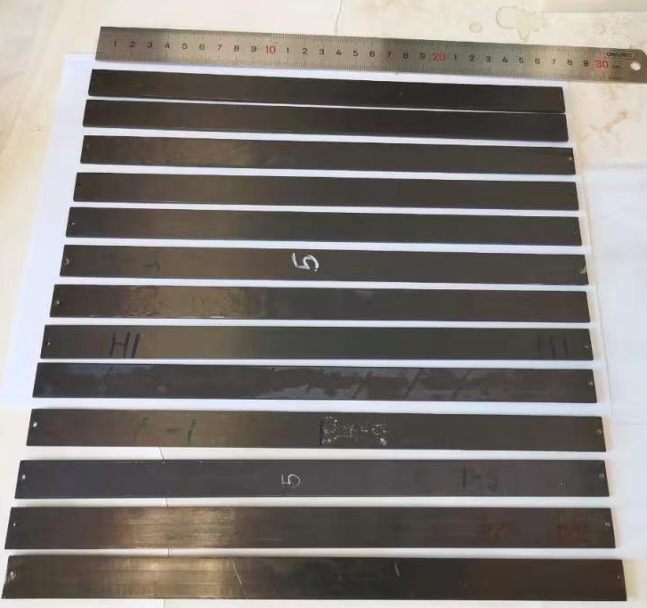
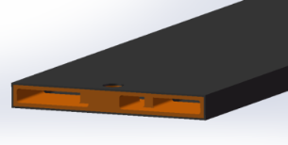
Support structure of the ladder
Production of ladder support with carbon fiber is in good progress
Half of the ladder support has been produced.
Ladder support production
Ladder support
structure 3D model

Slide 10
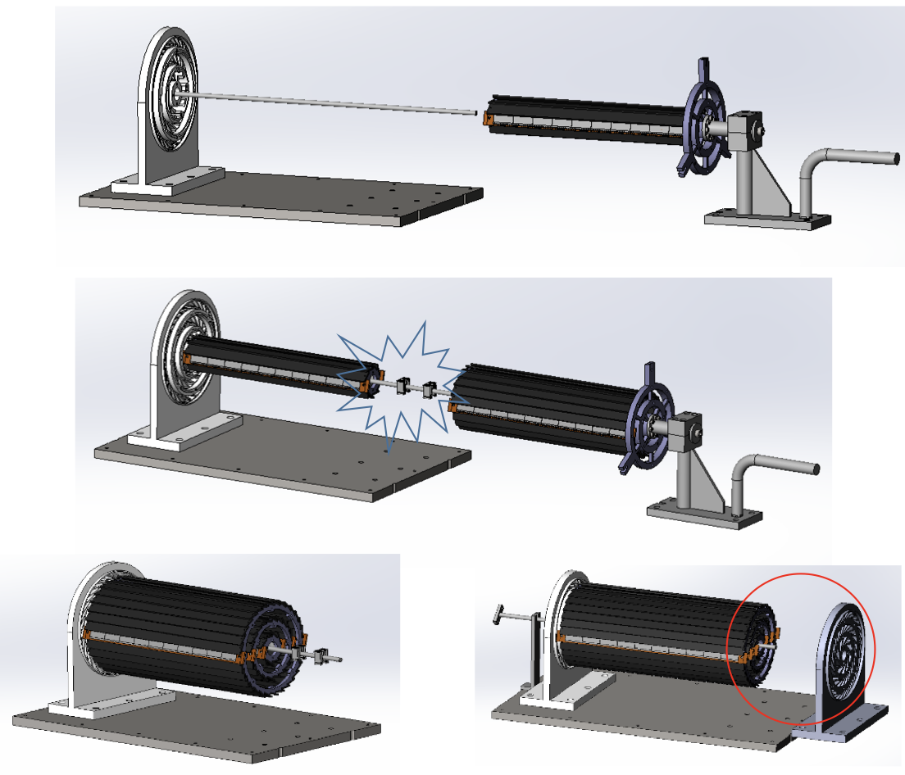
Vertex detector prototype assembly procedure
Ladder installation procedure designed
Mockup with 3D printing in production
Tooling for installation

Slide 11
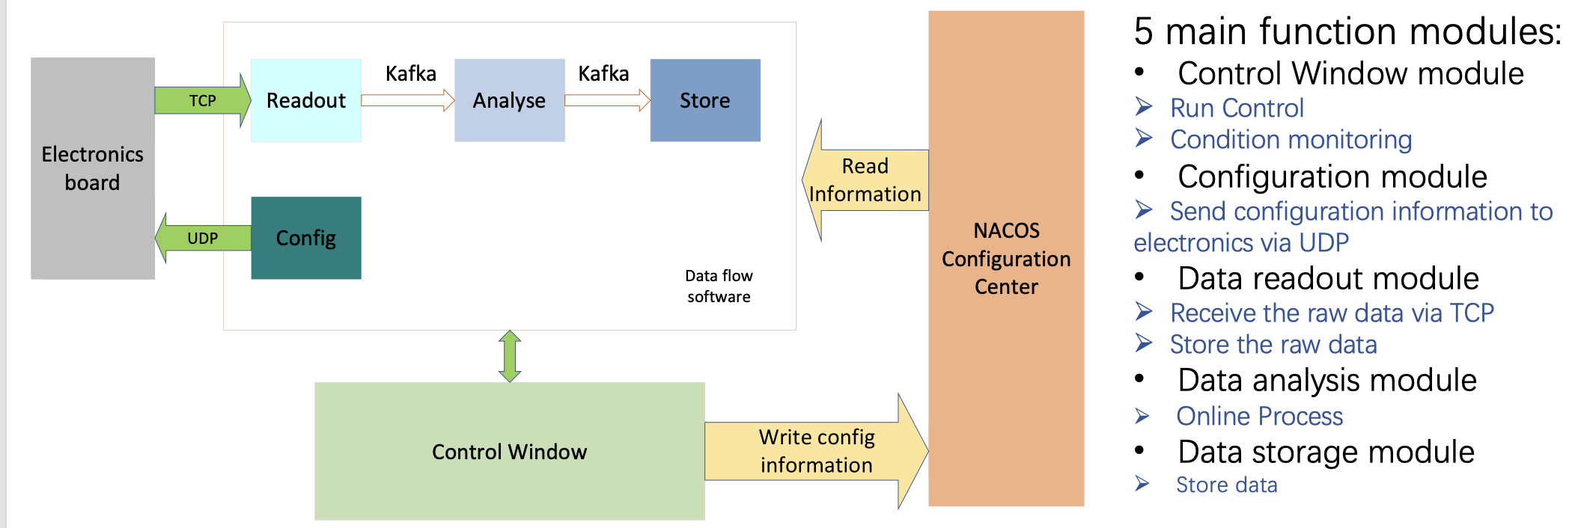
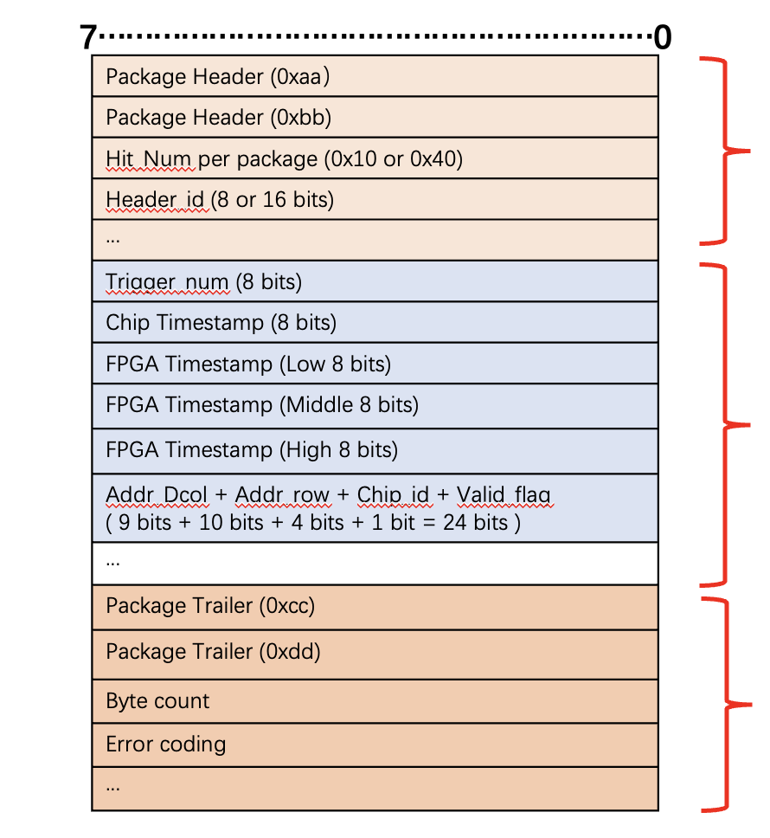
DAQ Architecture development
DAQ Architecture and data structure are defined
DAQ Architecture
data structure

Slide 12
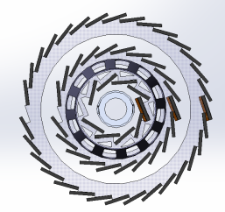
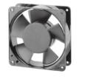
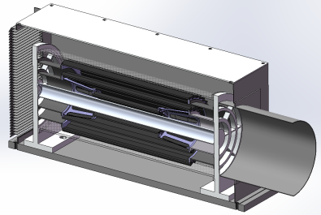
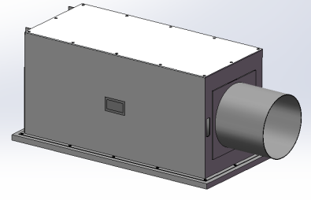
Plan for test beam
Expect to perform beam test in DESY(3 - 7GeV electron beams)
IHEP test beam facility as backup plan (a few hundreds MeV electrons )
Enclosure for detector with air cooling is developed for beam test
Beam is shooting at one sectors of vertex detectors
DESY test beam
Beam
Beam
outlet
Beam
inlet

Slide 13
Timeline
ASIC
ASICs arrive to IHEP (June)
Dicing and Thinning (one wafer dicing before wafer-level tests) (June)
Single ASIC testing
PCB under production ( by Jun 24th )
Wire-bonding on test PCB … (June)
Functional Tests … (June)
Laser, beta source test (July)
Irradiation test (July )
Wafer level testing
Wafer level test of ASICs (End of June)
Dicing , (thinning ?)

Slide 14
Timeline
Ladders Mechanics:
Now: Carbon support samples available
May: Pre-production carbon support ladders available
August: Production of final carbon support ladders (if needed)
Ladders Assembly:
May: Flex cable available
May: Test of wire bonding and gluing on carbon support
Tooling design and production (June)
Dummy sensor (Glass) assembly on flex (JUNE)
Jig tool , Wire bonding tests on flex (July)
Assembly of ladders with chips (August )

Slide 15
DAQ and multi-ASIC testing
Item | Time
TAICHU test board v1.1 | 6.9 - 6.23 (done)
TAICHU standalone test | 6.24 - ？
Bonding and test with flex4 v1.1 | 6.30 – 7.23
Interposer board production | 6.13 - 7.11
Power board (light interposer) production | 6.13 – 6.30 (done)
Flex2 v1.3 production | 6.13 – 7.4
Flex2 v1.3+interposer+fpga test (first prototype) | 7.23 – 8.23
Optimize and batch production | 8.23-？
Final system test
DAQ status report today

Slide 16
Schedule
June: Installation mock-up
Received large part of 3D models from Jinyu today, printing now
July: Barrel support parts fabricated
August: Assembly first Barrel with ladder support only
September: mounting readout ladders
October: finished mounting the ladders, and readout tests
Earlier November: Finish assembly of prototype
November: Cosmic ray testing or BEPC beam test
December 12-22: DESY test beam (test beam time slot reserved for two weeks)

Slide 17
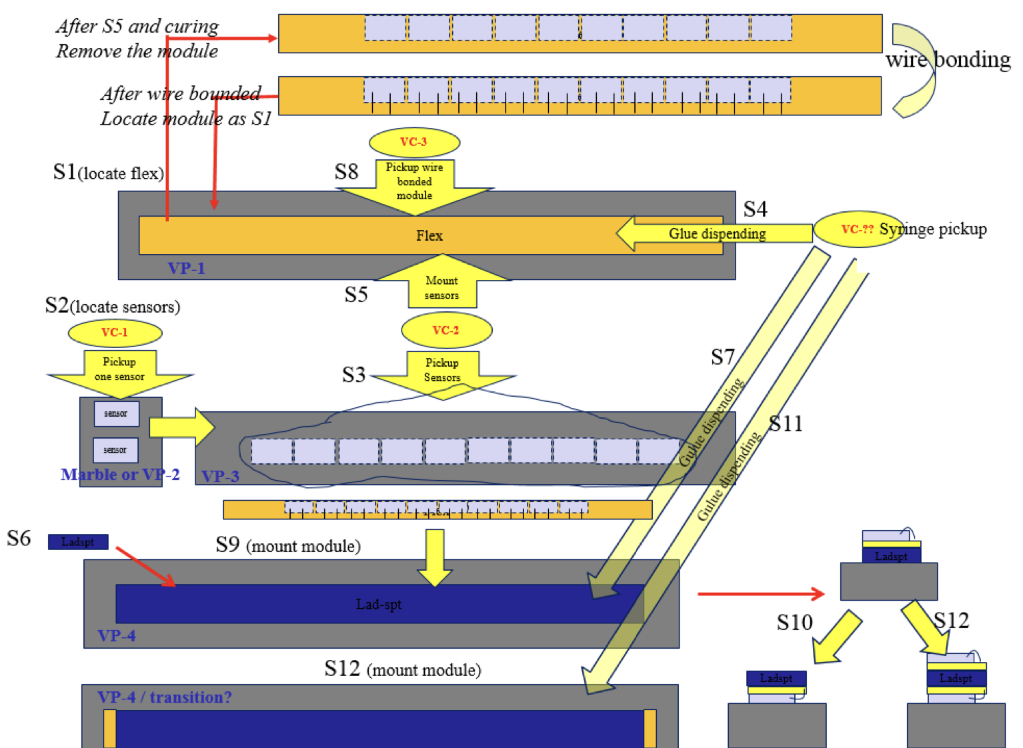
Backup
df

Slide 18
Timeline
ASIC
ASICs arrive to IHEP (June)
Dicing and Thinning (one wafer dicing before wafer-level tests) (June)
Single ASIC testing
PCB under production ( by Jun 24th )
Wire-bonding on test PCB … (June)
Functional Tests … (June)
Laser, beta source test (July)
Irradiation test (July )
Wafer level testing
Wafer level test of ASICs (End of June)
Dicing , (thinning ?)

Slide 19
Timeline
Ladders Mechanics:
Now: Carbon support samples available
May: Pre-production carbon support ladders available
August: Production of final carbon support ladders (if needed)
Ladders Assembly:
May: Flex cable available
May: Test of wire bonding and gluing on carbon support
Tooling design and production (June)
Dummy sensor (Glass) assembly on flex (JUNE)
Jig tool , Wire bonding tests on flex (July)
Assembly of ladders with chips (August )

Slide 20
DAQ and multi-ASIC testing
Item | Time
TAICHU test board v1.1 | 6.9 - 6.23 (done)
TAICHU standalone test | 6.24 - ？
Bonding and test with flex4 v1.1 | 6.30 – 7.23
Interposer board production | 6.13 - 7.11
Power board (light interposer) production | 6.13 – 6.30 (done)
Flex2 v1.3 production | 6.13 – 7.4
Flex2 v1.3+interposer+fpga test (first prototype) | 7.23 – 8.23
Optimize and batch production | 8.23-？
Final system test
DAQ status report today

Slide 21
Time line
Barrel Prototype:
June: Installation mock-up (3D printed)
Received large part of 3D models from Jinyu today, printing now
July: Barrel support parts fabricated
August: Assembly first Barrel with ladder support only
Update from Xinghui today
September: mounting readout ladders
October: finished mounting the ladders, and readout tests
Earlier November: Finish assembly of prototype
November: Cosmic ray testing or BEPC beam test
December: DESY test beam

