Slide 1
Status and R&D plan of the CECP muon detector
Xiaolong Wang
Fudan University
CEPC Physics and Detector Plenary Meeting, 2022.7.13

Slide 2
Scintillator based muon detector
Extruded scintillator
WLS fibre
SiPM
Front-end readout
R&D for readout system
  ASIC
  Chips
  Readout board
  DAQ

Slide 3
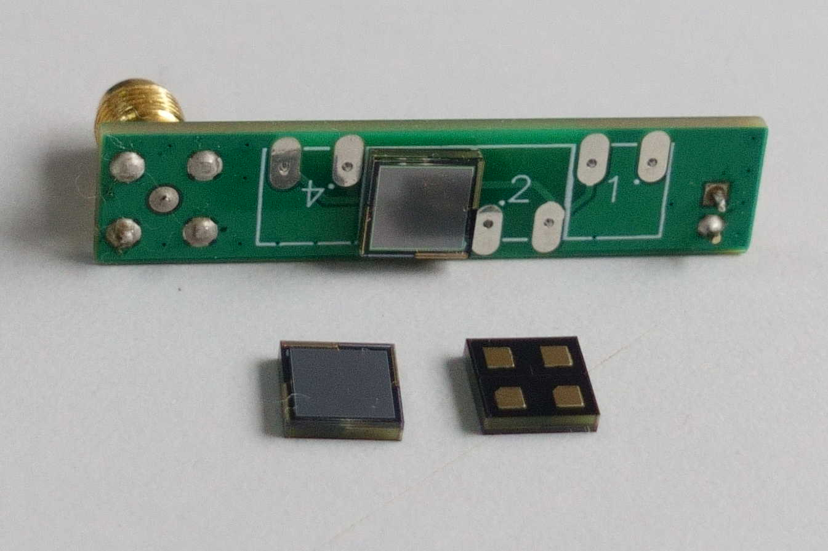
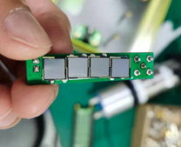

NDL SiPM:
$$1mm×1mm, 3mm×3mm, 6mm×6mm$$
Looks good.

Slide 4
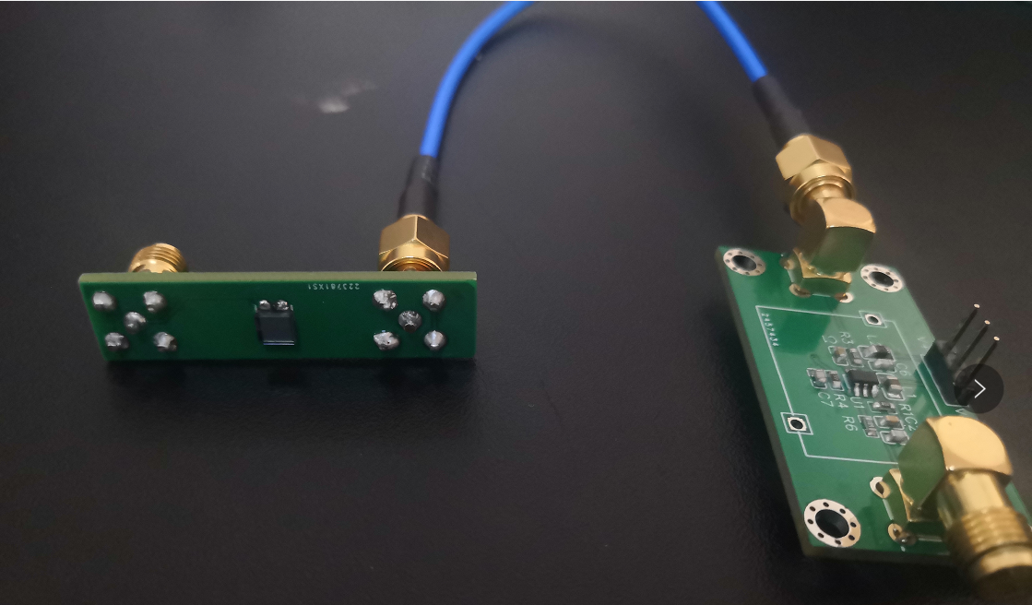
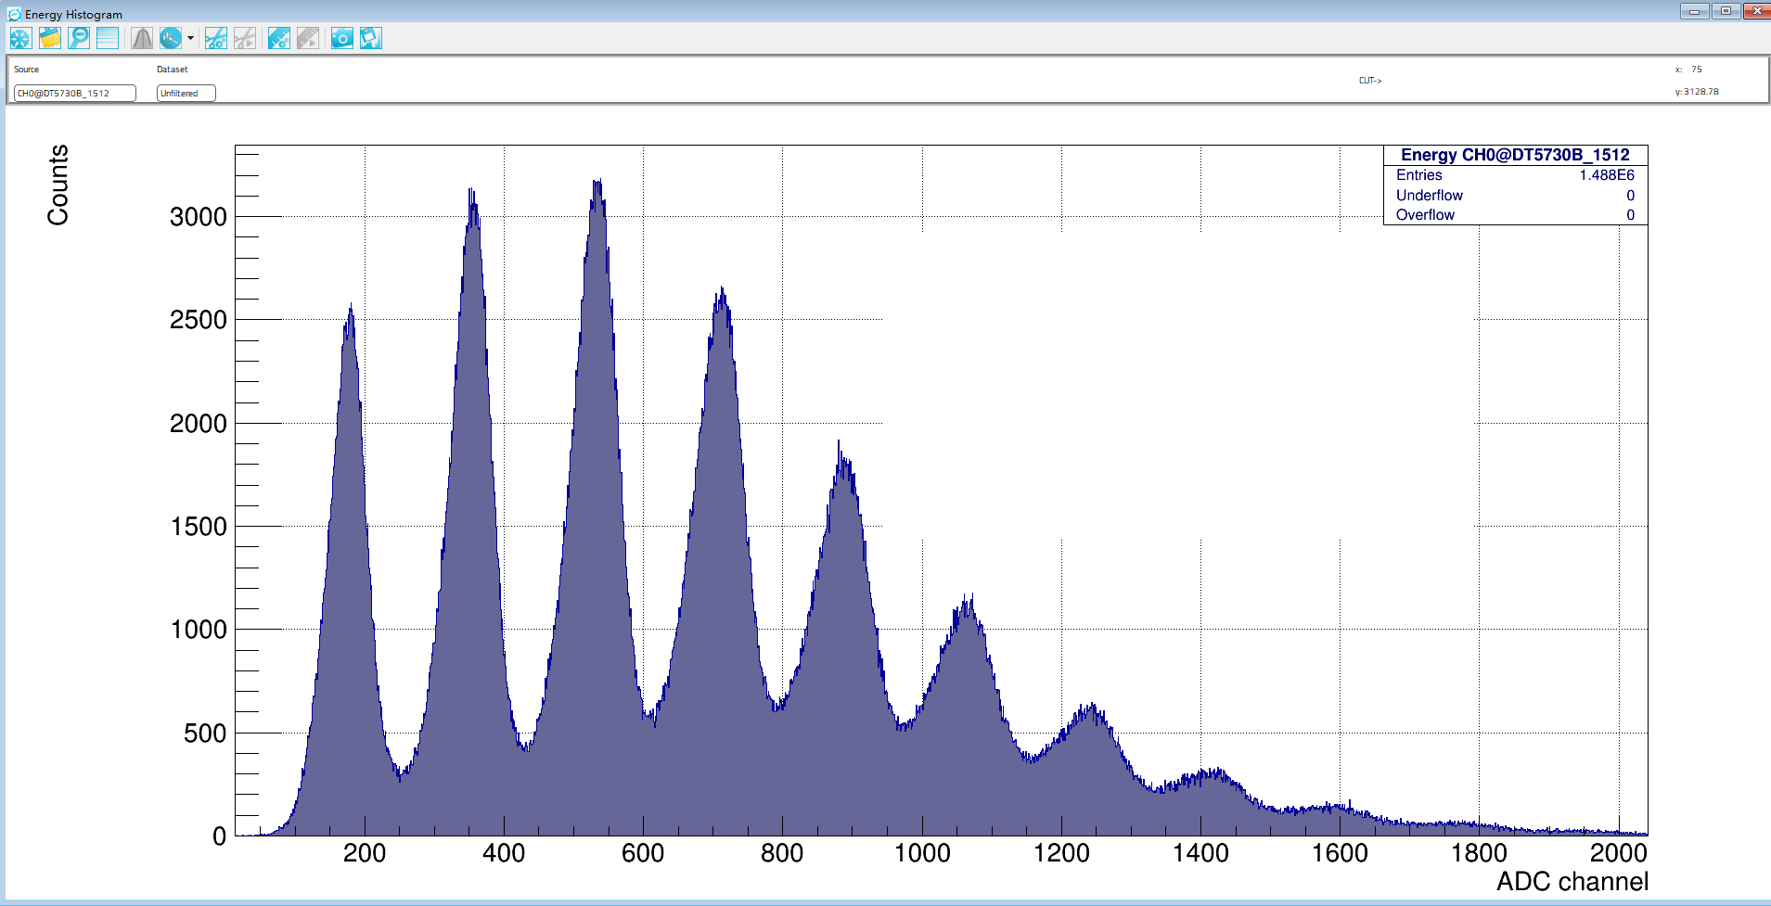
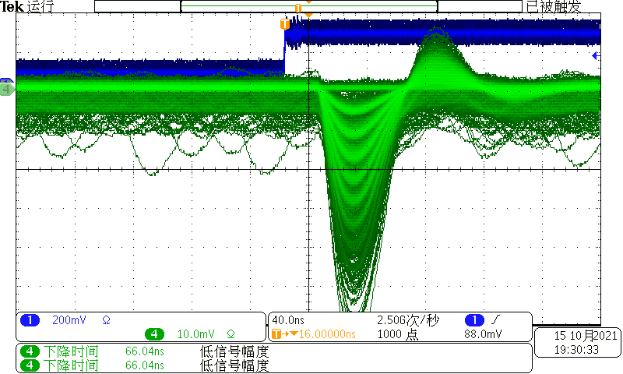
New design on the FE and NDL SiPM
SiPM
Laser source
Very good p.e. peaks!
Laser pulse triggering
The preams are tuned at FDU for different kinds of SiPMs.

Slide 5

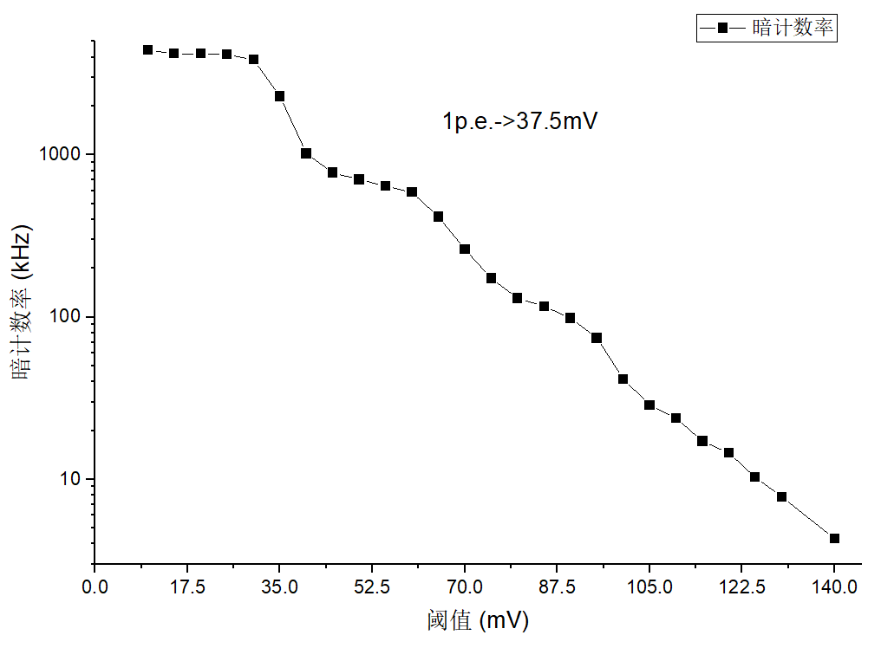
Dark Count Rate
NDL-EQR15
Single p.e.：37.5mV
Threshold>6p.e. DCR<10 Hz
Threshold>7p.e. DCR<1 Hz

Slide 6

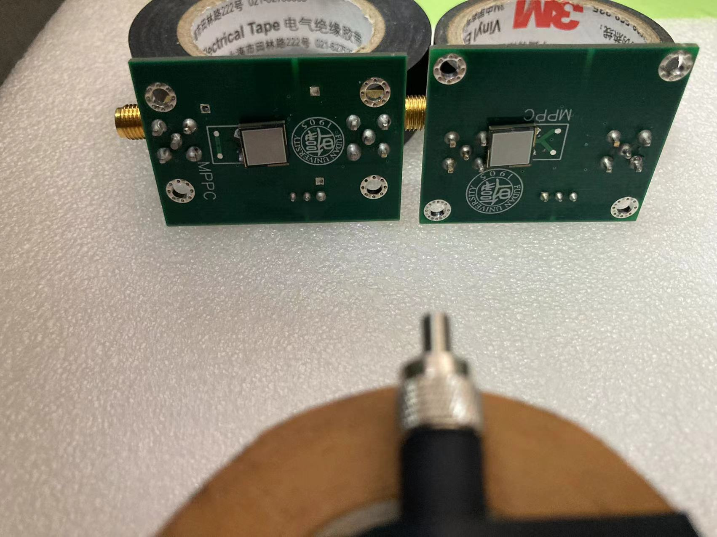
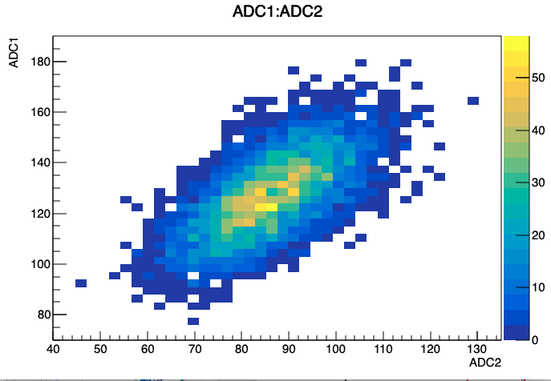
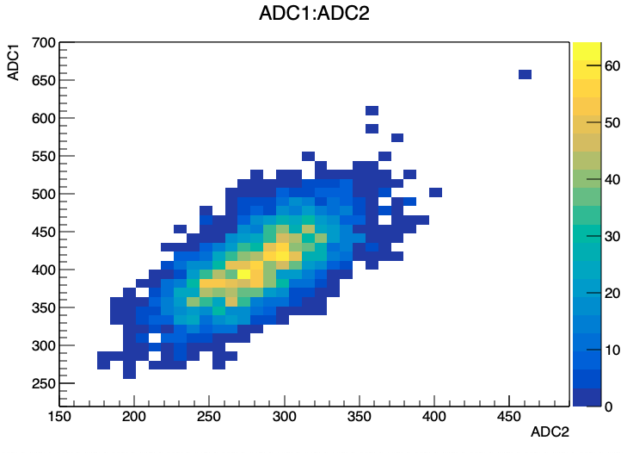

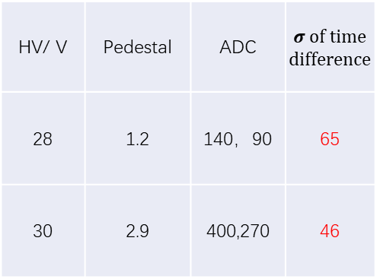
New NDL SiPM with $6mm×6mm$
HV：28 V
HV：30 V
Keep laser constant
HV/ V | Pedestal | ADC | $σ$ of time difference
28 | 1.2 | 140，90 | 65
30 | 2.9 | 400,270 | 46
Time resolution = $σ/\sqrt{2}$

Slide 7
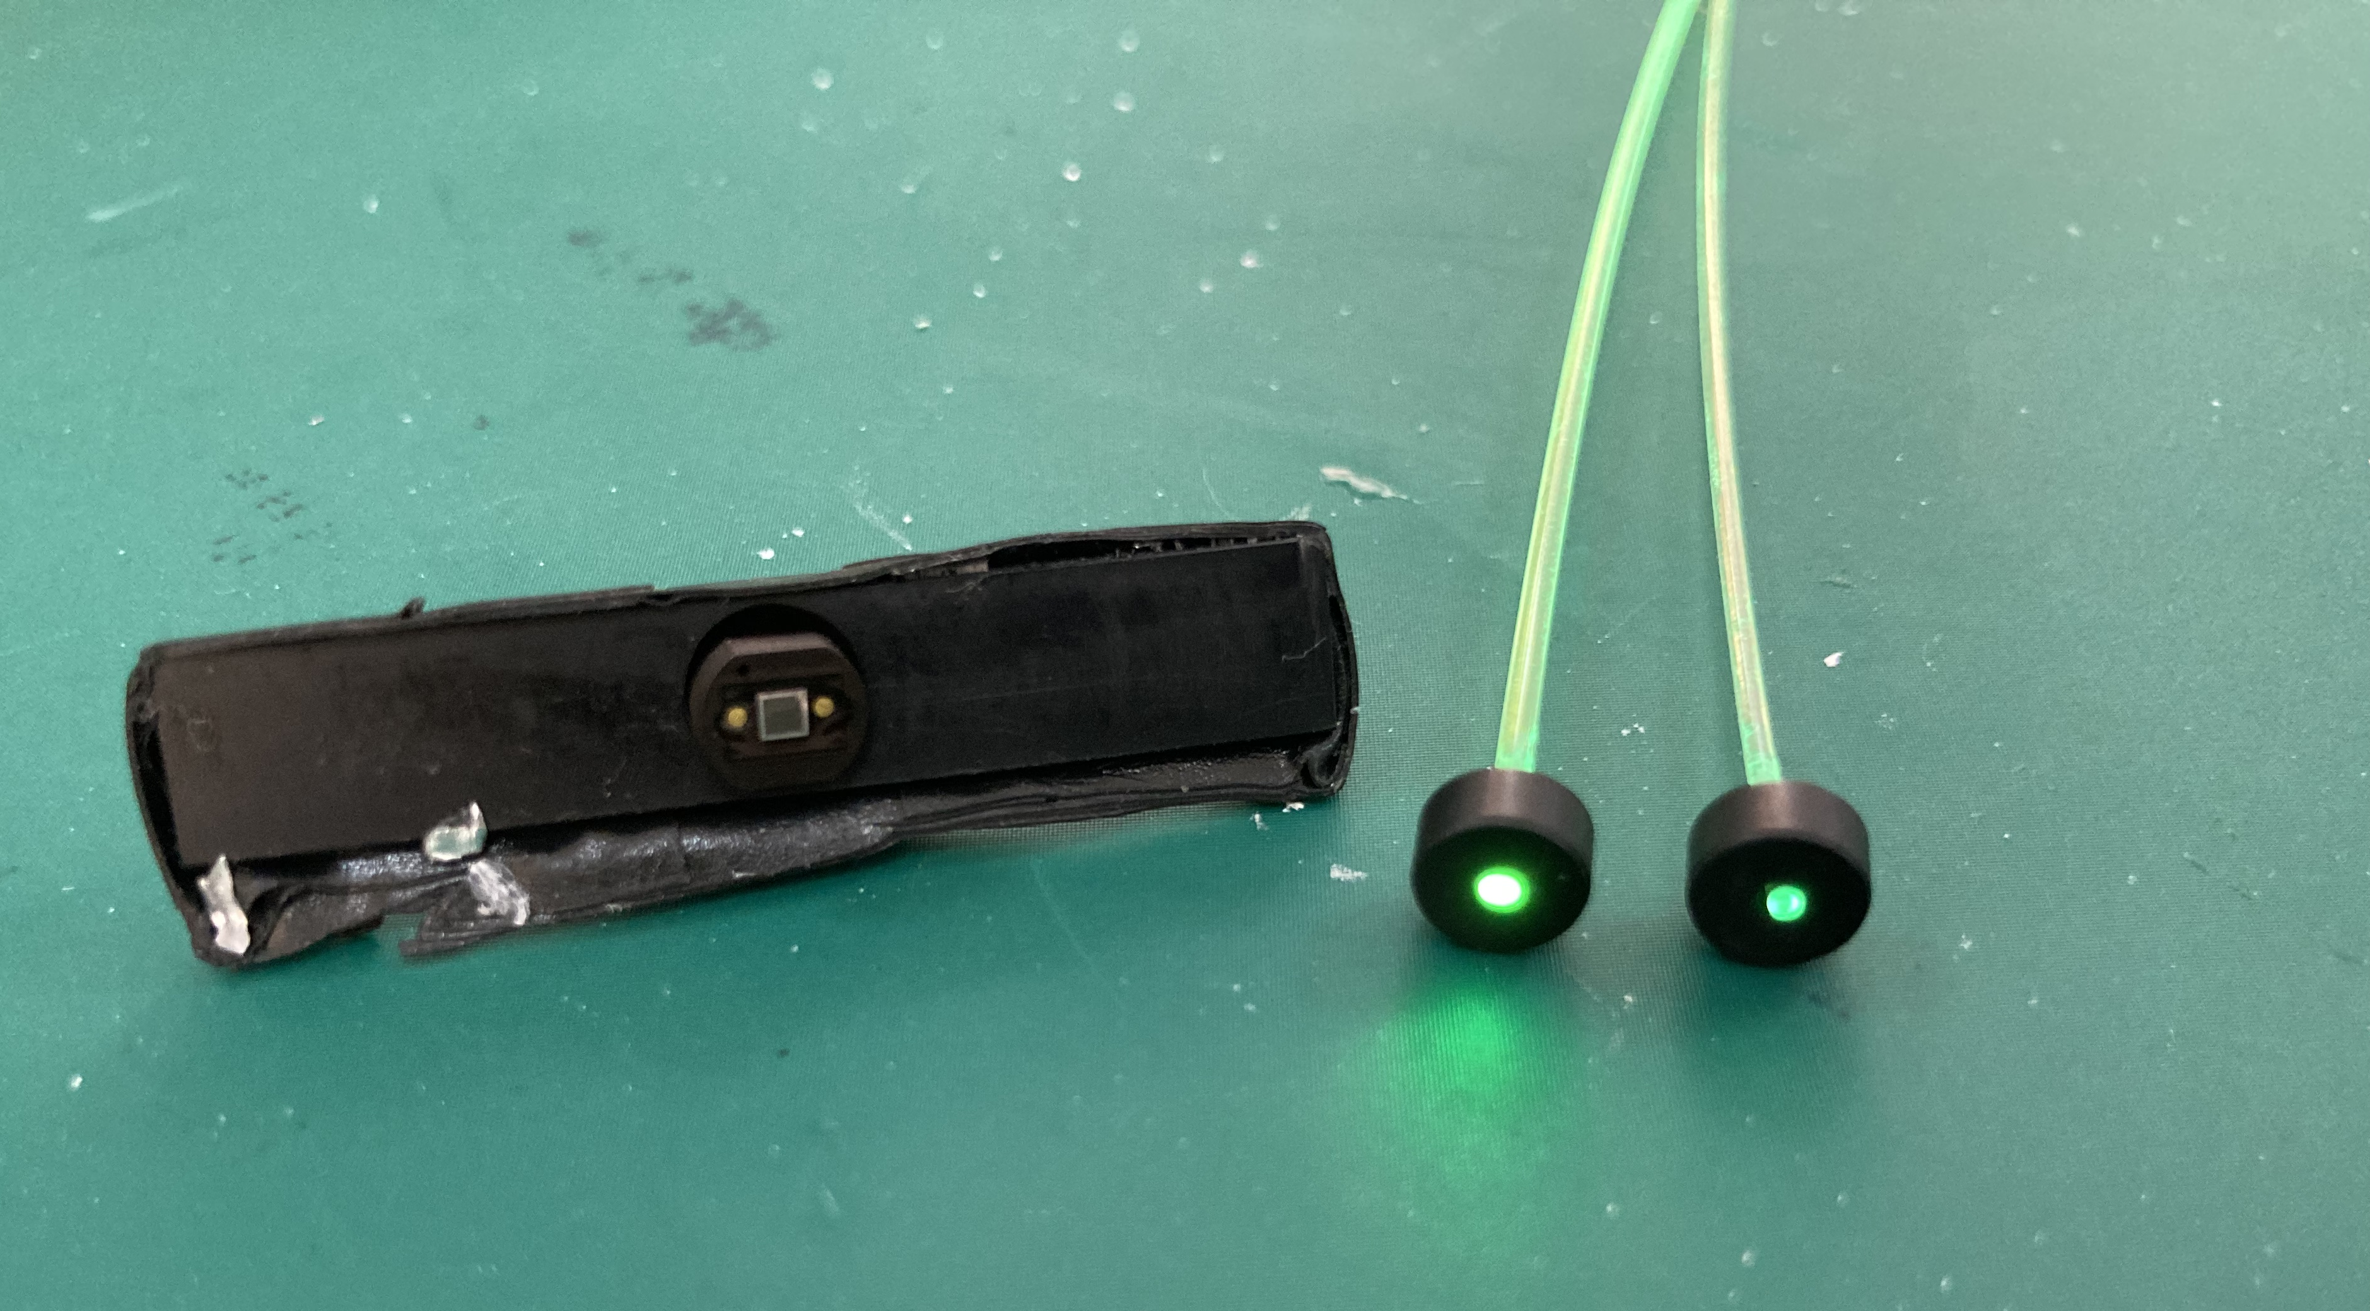
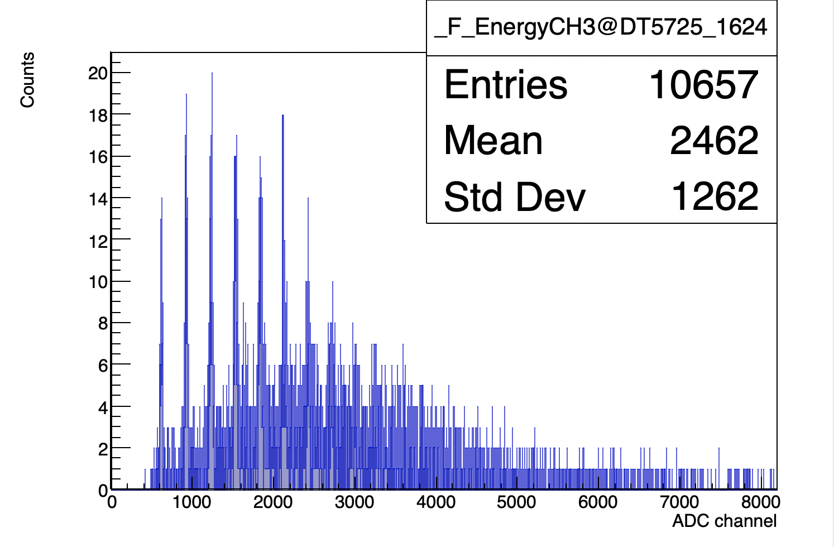
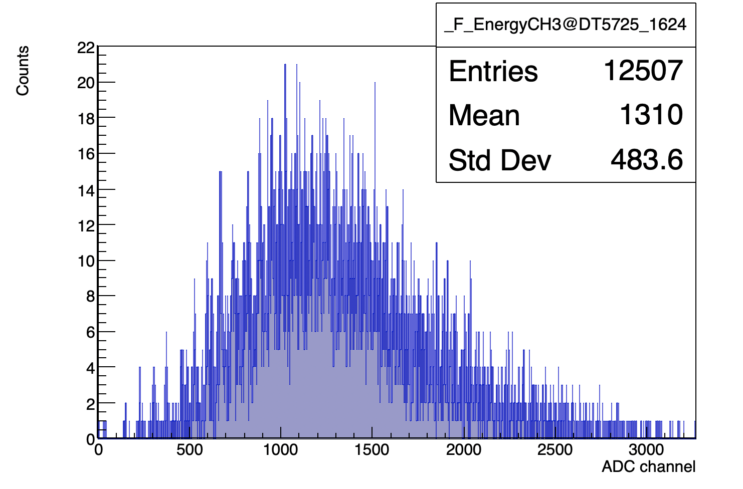
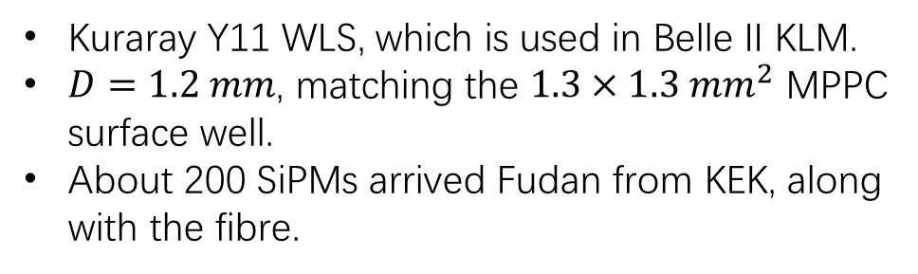

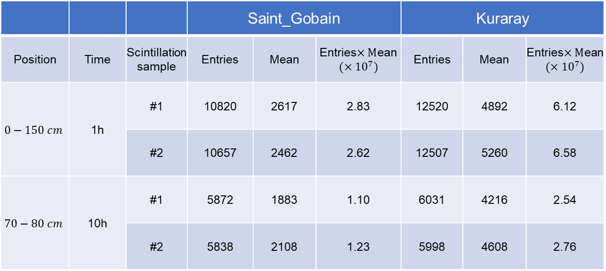
Kuraray WLS fibre
Kuraray Y11 WLS, which is used in Belle II KLM.
$D=1.2 mm$, matching the $1.3×1.3 mm^{2}$ MPPC surface well.
About 200 SiPMs arrived Fudan from KEK, along with the fibre.
Light collection: Kurary:Saint_Goban $≈2 :1$
Kuraray
Saint_Gobain
 |  |  | Saint_Gobain |  |  | Kuraray
Position | Time | Scintillation sample | Entries | Mean | Entries$×M$ean $$(×{10}^{7})$$ | Entries | Mean | Entries$×M$ean $$(×{10}^{7})$$
$$0−150 cm$$ | 1h | #1 | 10820 | 2617 | 2.83 | 12520 | 4892 | 6.12
 |  | #2 | 10657 | 2462 | 2.62 | 12507 | 5260 | 6.58
$$70−80 cm$$ | 10h | #1 | 5872 | 1883 | 1.10 | 6031 | 4216 | 2.54
 |  | #2 | 5838 | 2108 | 1.23 | 5998 | 4608 | 2.76
Saint_Gobain
Kuraray
ADC/4
Talked to domestic company, and they have the interest to do the R&D for WLS fibre.

Slide 8

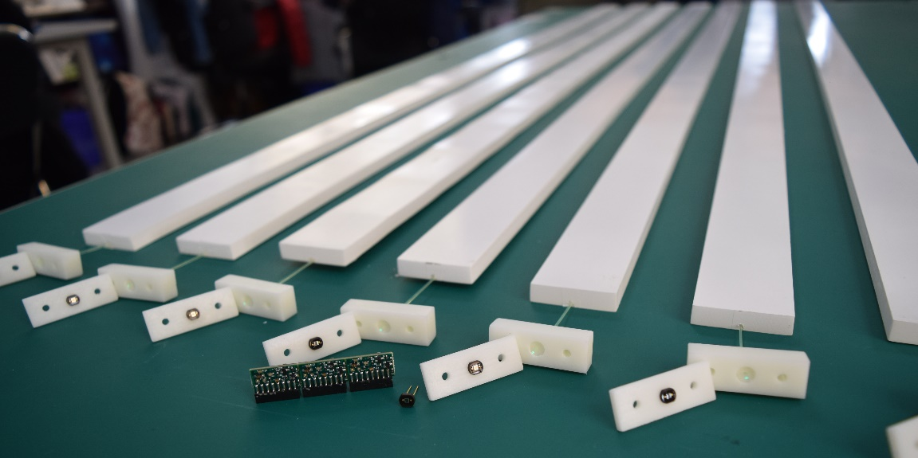
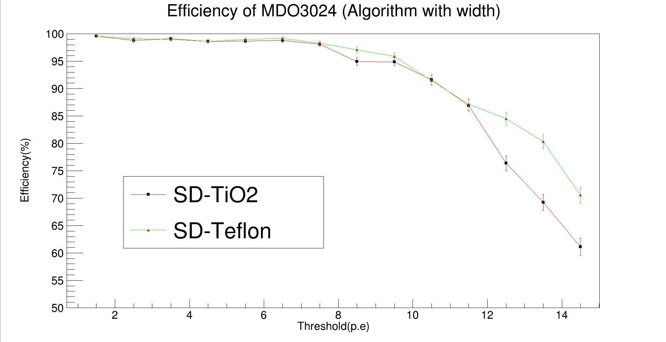
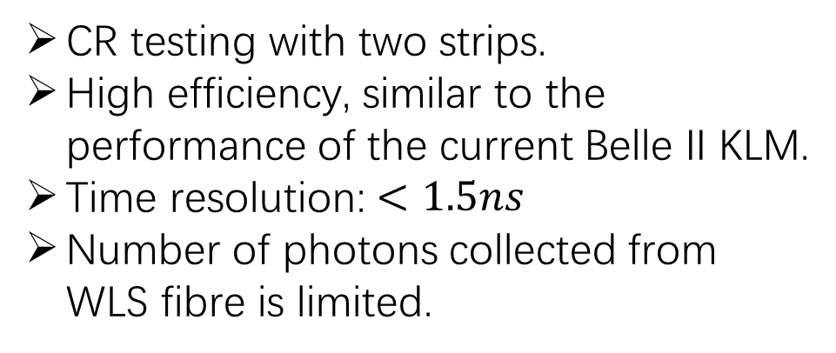
Performance of current design
高能科迪
CR testing with two strips.
High efficiency, similar to the performance of the current Belle II KLM.
Time resolution: $<1.5ns$
Number of photons collected from WLS fibre is limited.

Slide 9
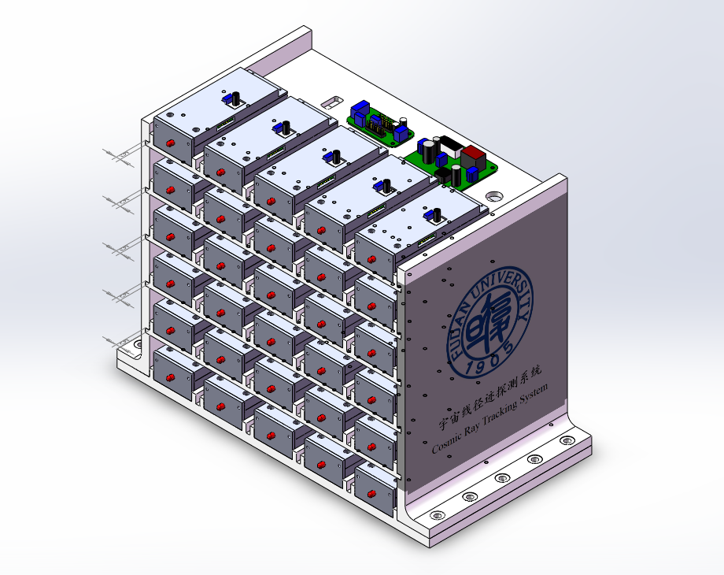
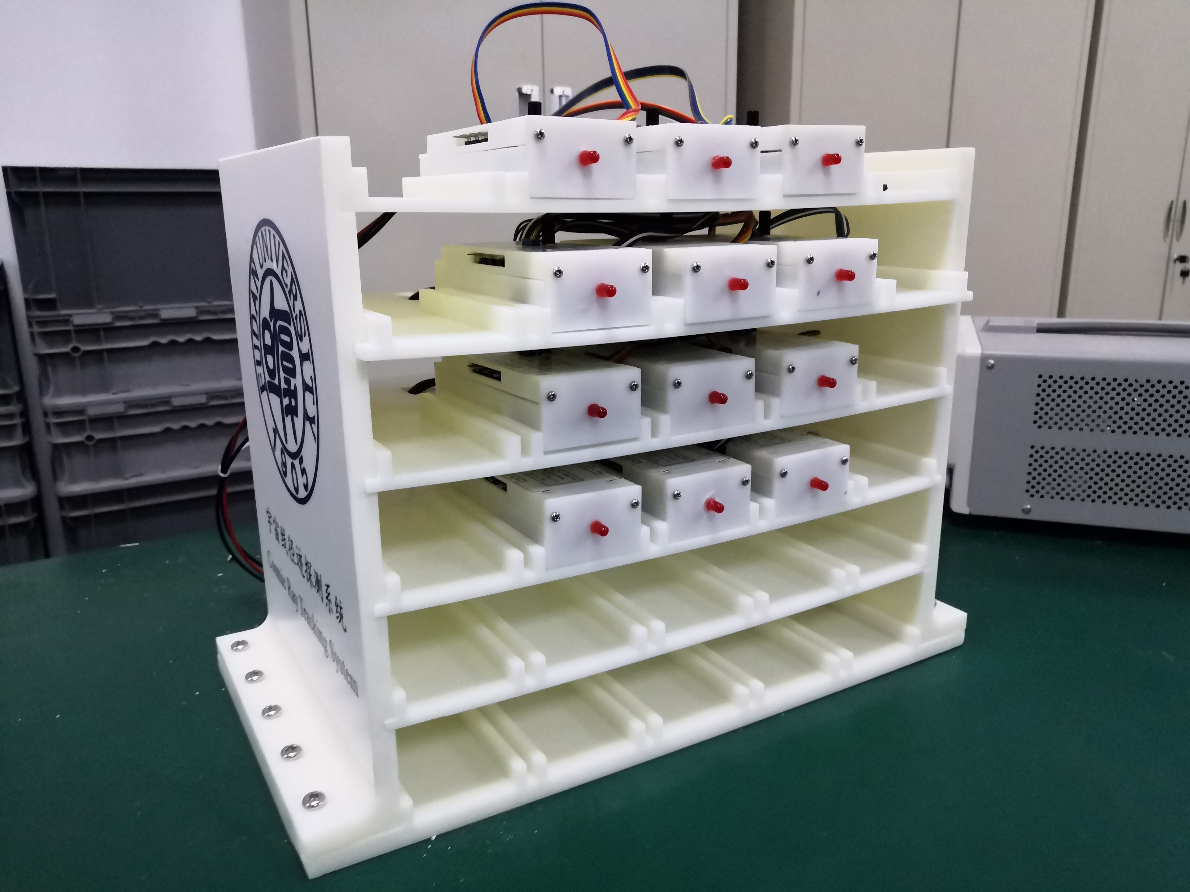
The next step for Scintillator+WLS Fibre+SiPM
Need to make a module as prototype
A small detector for cosmic ray tracker has been made.
We need a large prototype for cosmic ray testing in the near future.

Slide 10
Need to start the R&D for readout/DAQ systems
  arXiv:2203.11349
What we need:
Frond-end readout board
  Integrate preams;
  Maybe integrate HV generator;
  Handle a stations;
Back-end motherboard
  Digitization with new chips, sampling rate;
  Highly integrated ASICs;
  Data transition rate and connection: cable, fibre cable or 5G/6G?
Maybe front-end and back-end should be combined,
  see Belle II upgrade:
How about DAQ? Standalone or common DAQ?

Slide 11
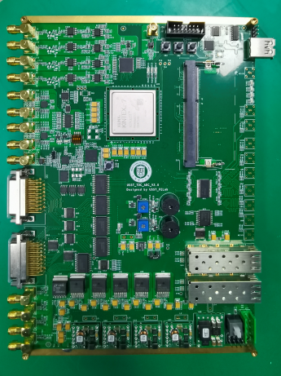
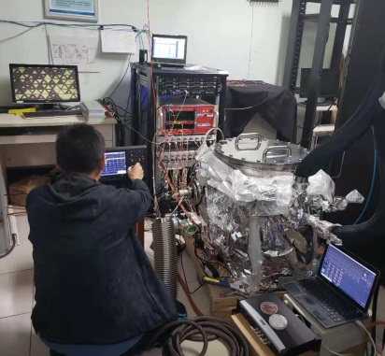
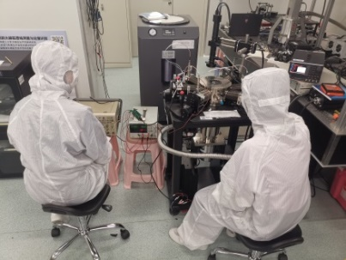
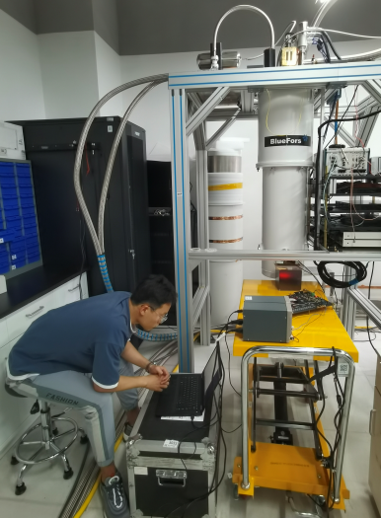
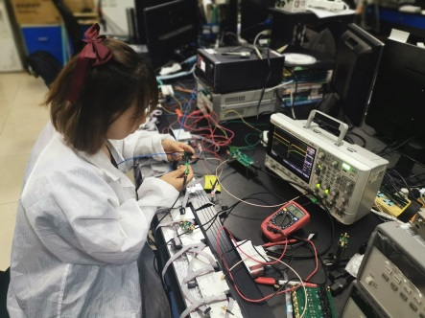
Lab for nuclear electronics at 上海理工
University of Shanghai for Science and Technology
Distance between Fudan and USST: 8km
A large and stable lab, very good equipments
PI: Dr. Qibin zheng (郑其斌), got Ph.D from USTC
Need funding to start the R&D.

Slide 12
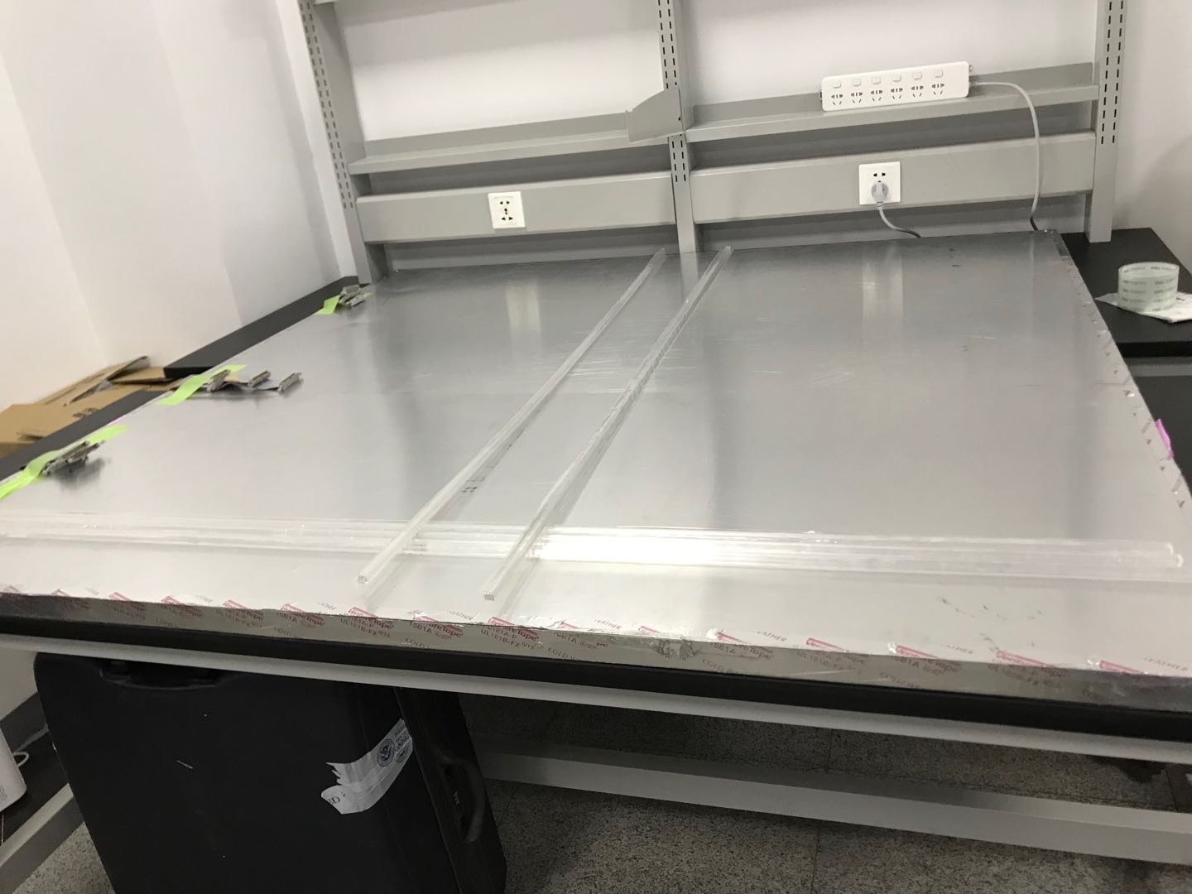
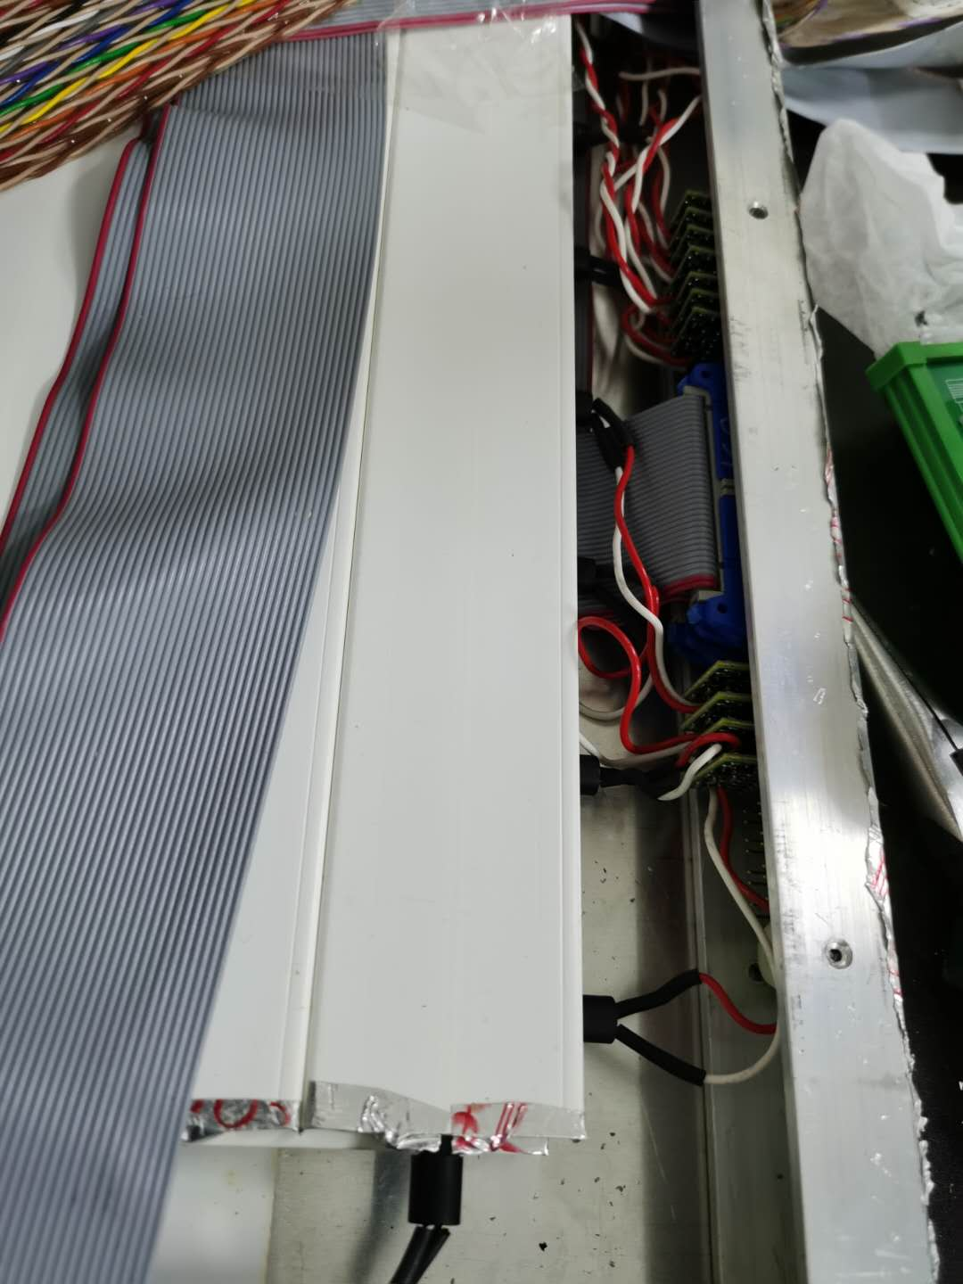
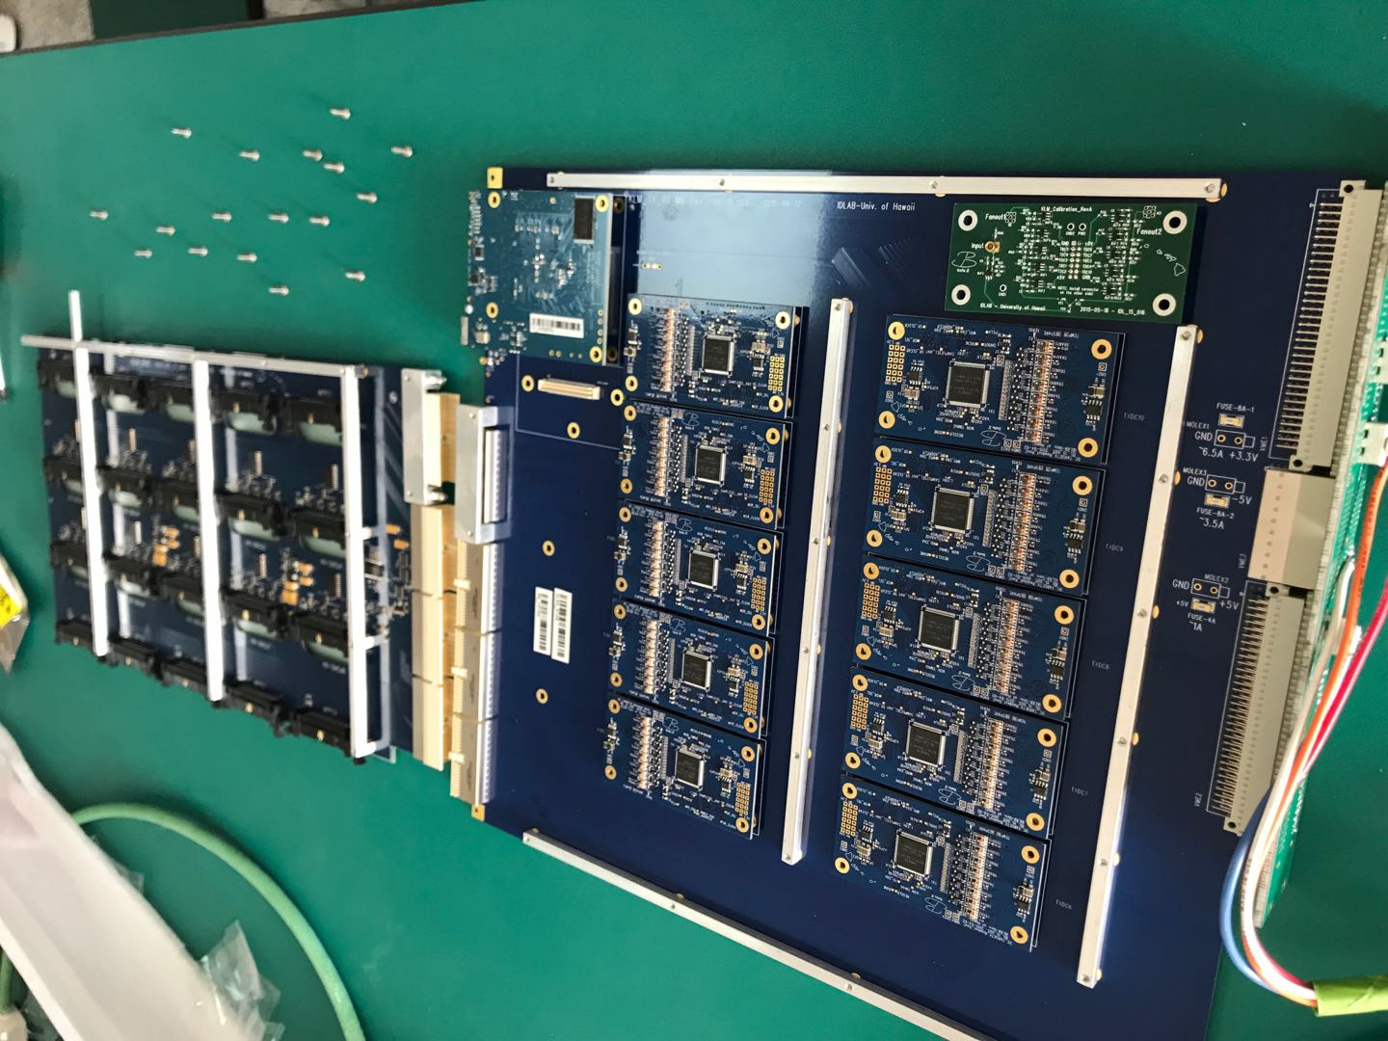
Reference of Belle II KLM

