Slide 1
Taichu3 gluing & wire bonding test
Wei Wang, Tianya Wu

Slide 2
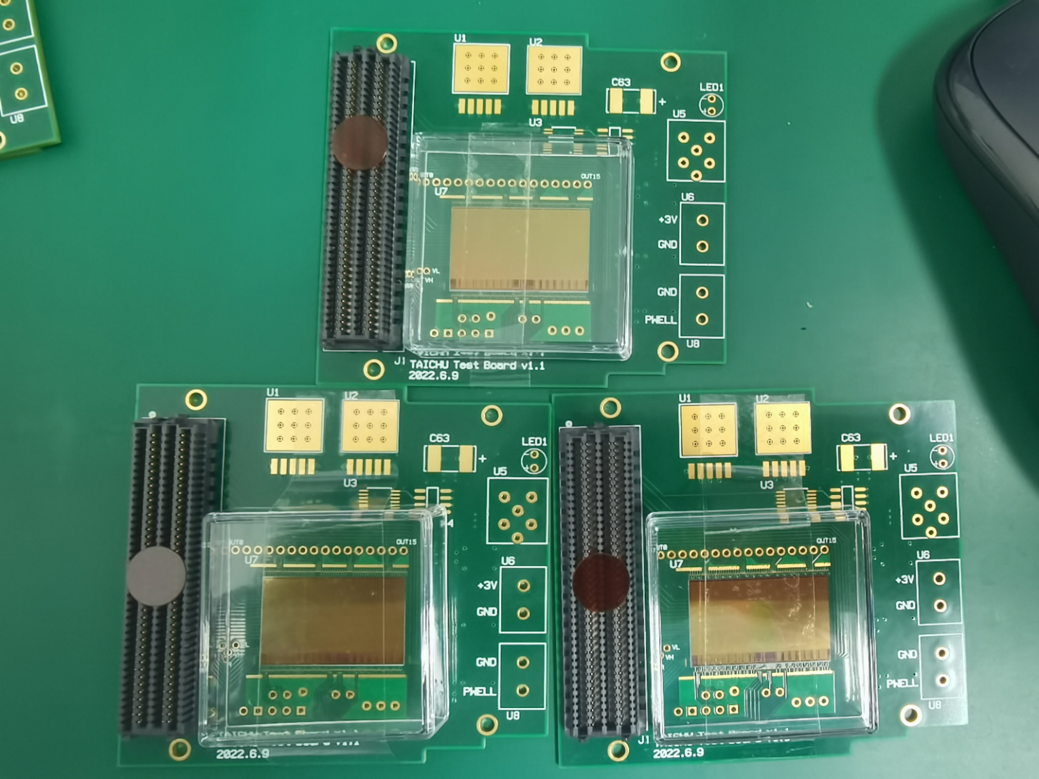
TC3 gluing on PCB
Non-conductive glue
Manual dispensing
Leave for ~8h to dry
Can be fine-tuned within ~1h
After the glue dries, it sticks very firmly and cannot be removed
Three chips glued and sent to company for wire bonding

Slide 3
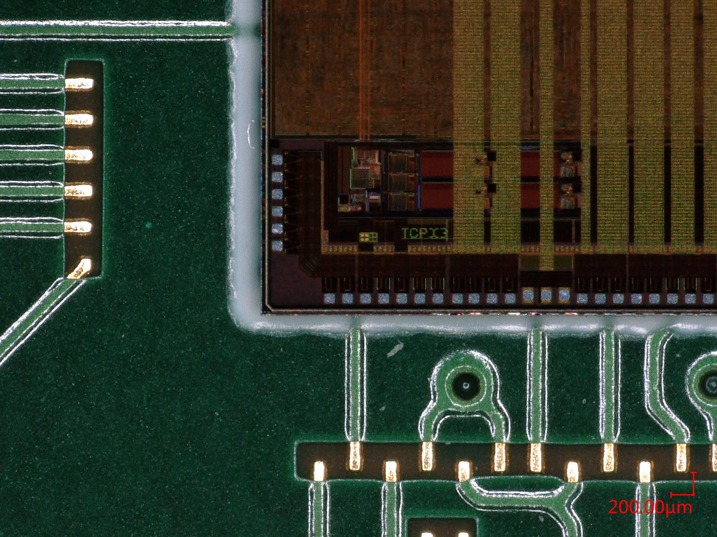
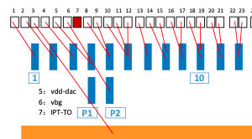
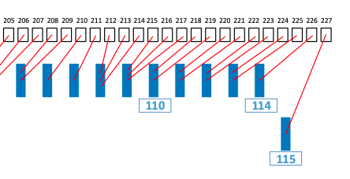

Slide 4
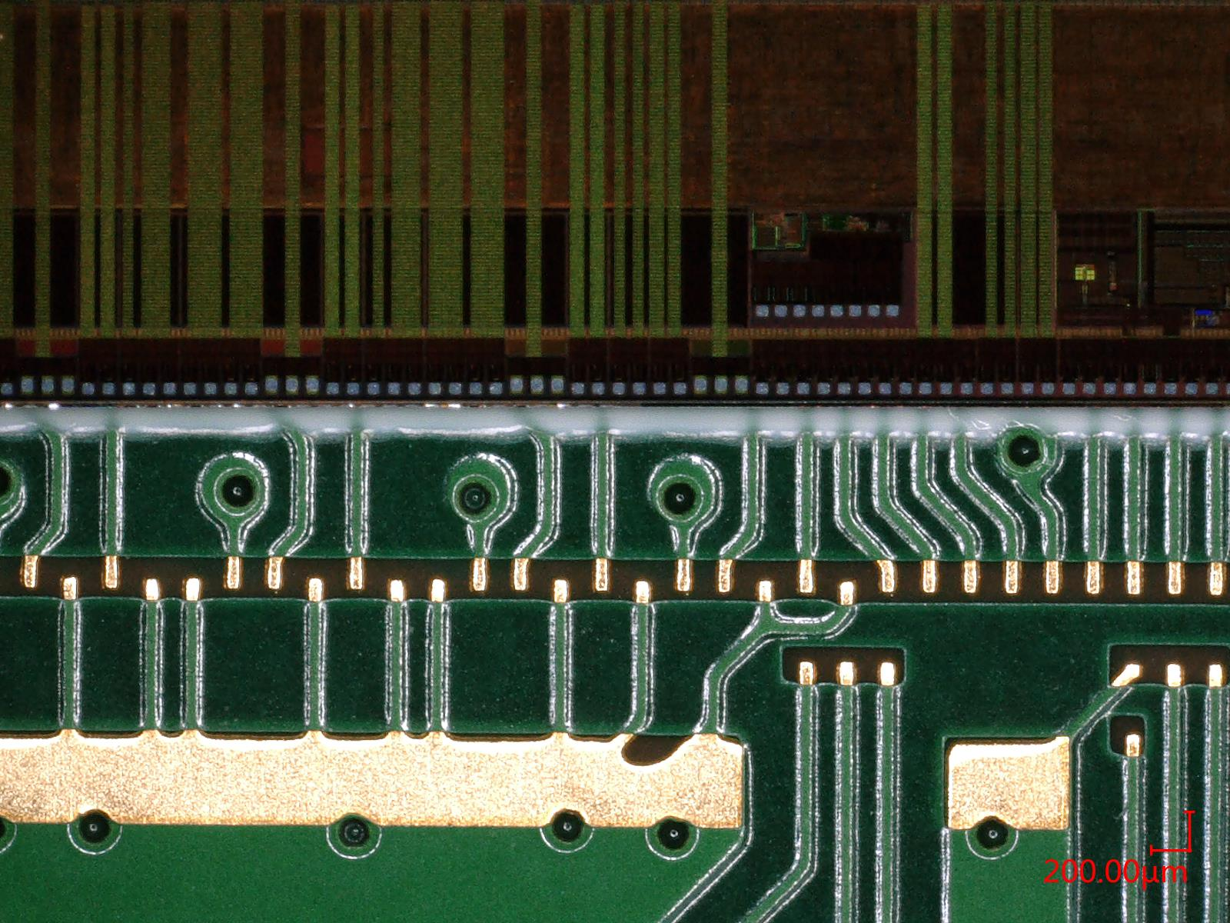

Slide 5
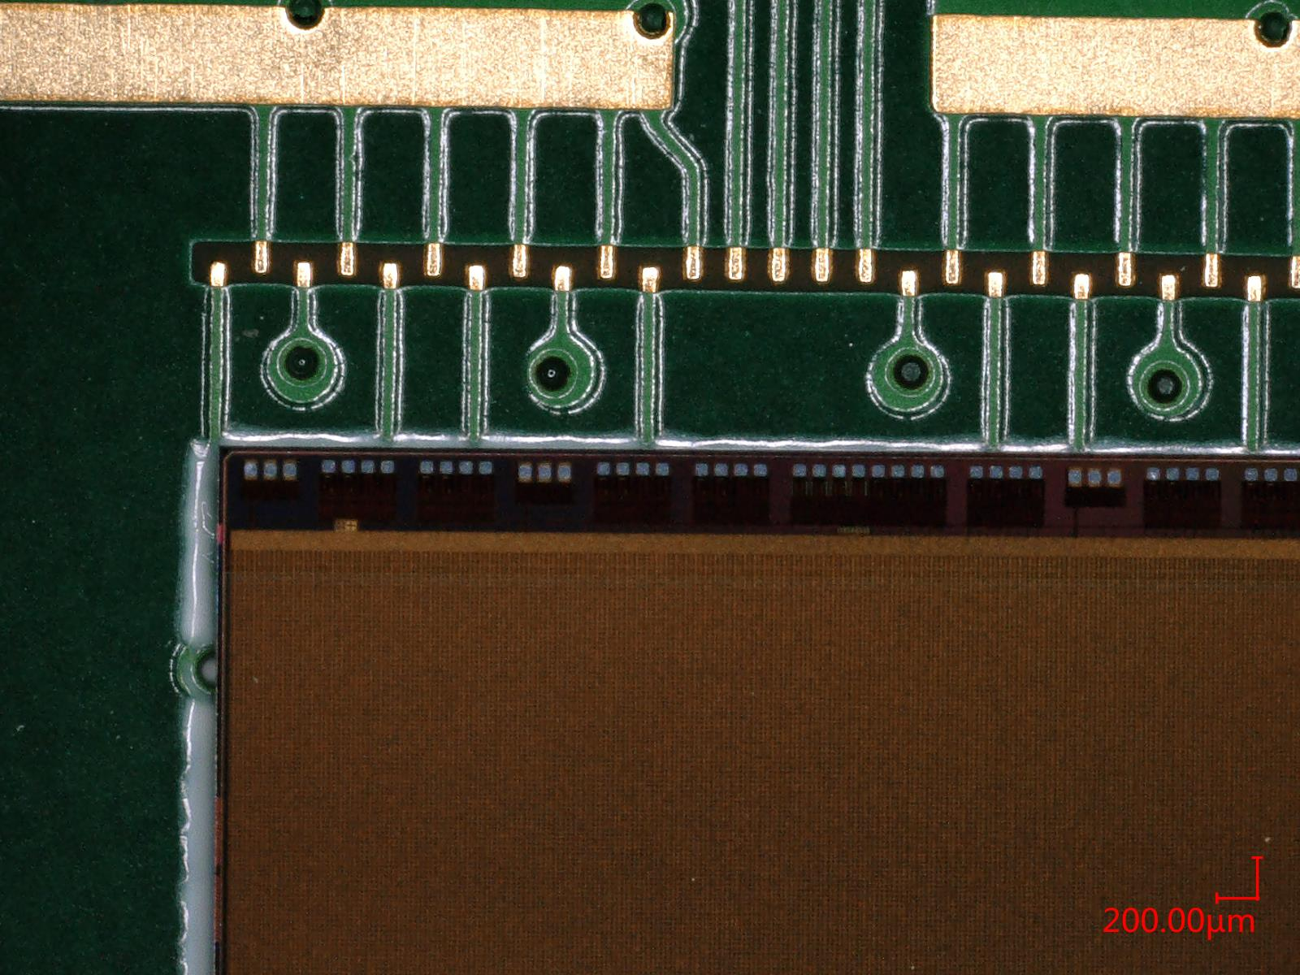
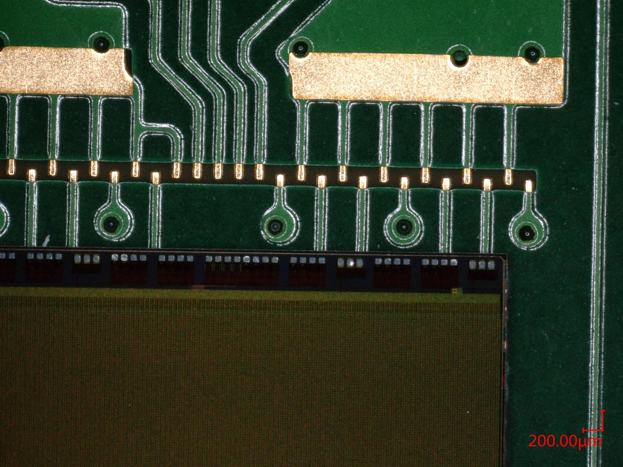

Slide 6
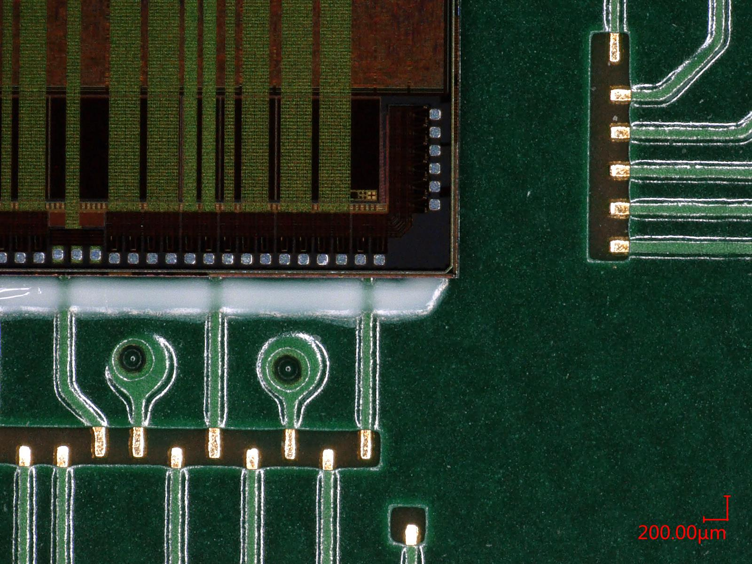
Test wire bonding with Al-wire in 106
Designed 1~3 wires into one pad (some bigger some smaller)
Test the case of 3 wires into one small pad
2 wires already cover the pad
Tough task, might be better with Au-wires(company)?

Slide 7
TC3 gluing to flex
Manual dispensing
TC3 slightly wider than the reserved location (white box on flex)

Slide 8
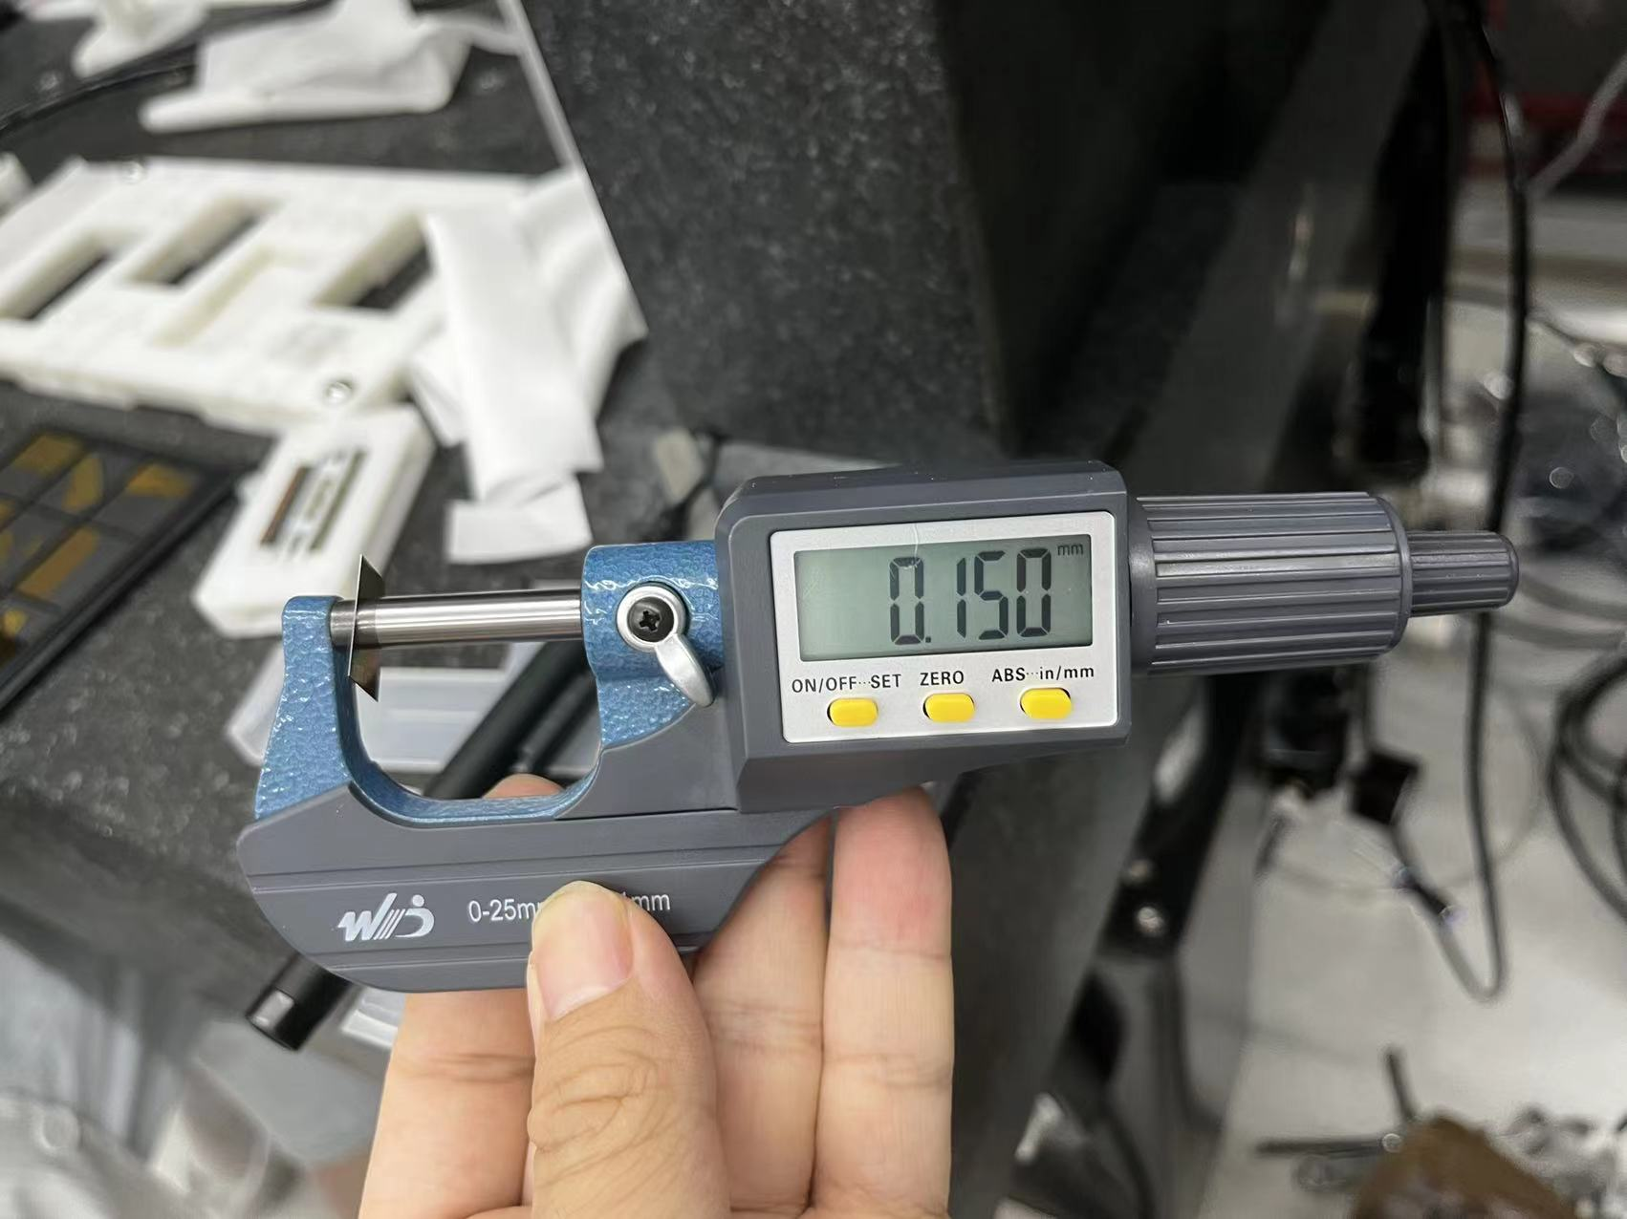
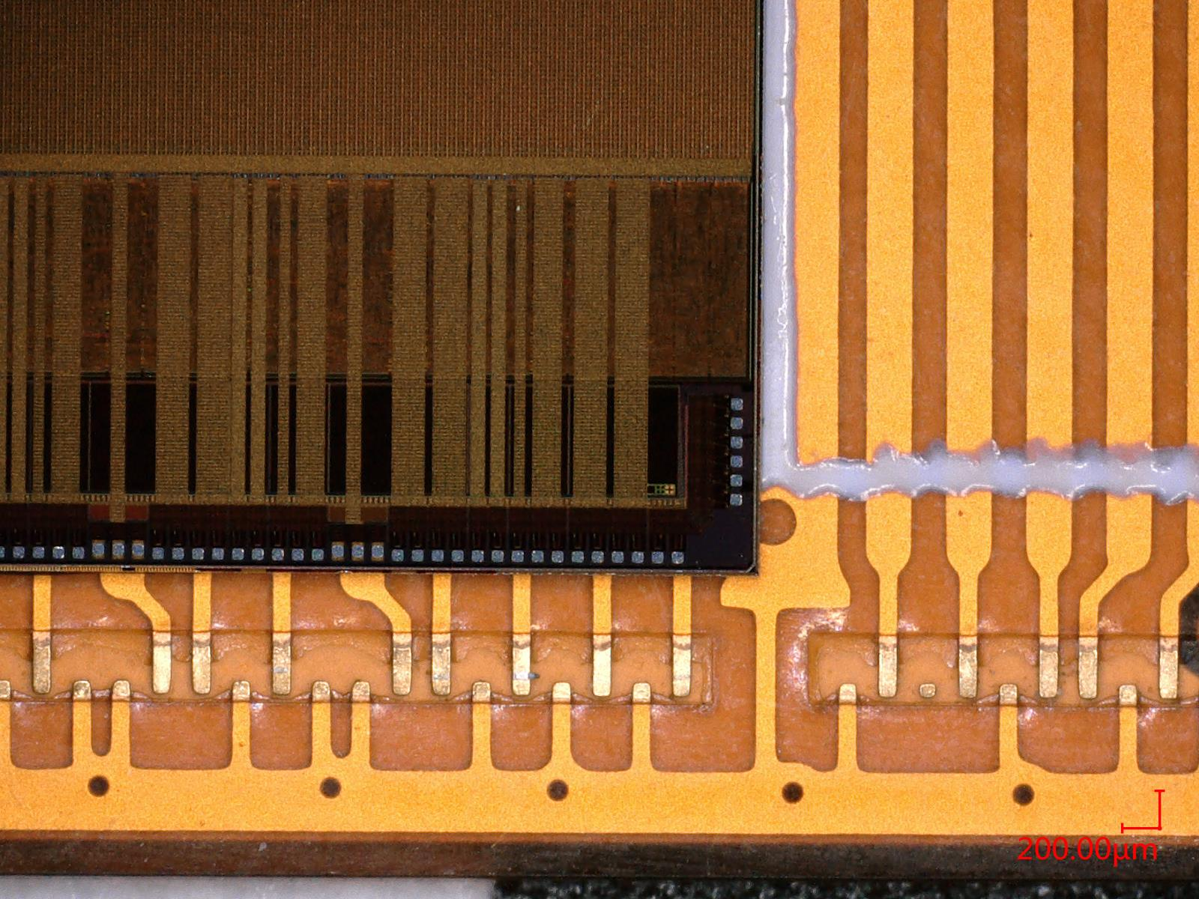
TC3 gluing to flex
Designed 100um gap between 2 chips, hard to adjust manually, should be better with gantry (with some marks)
Chip is very easy to break on the flex, need to fix to ladder before gluing

Slide 9
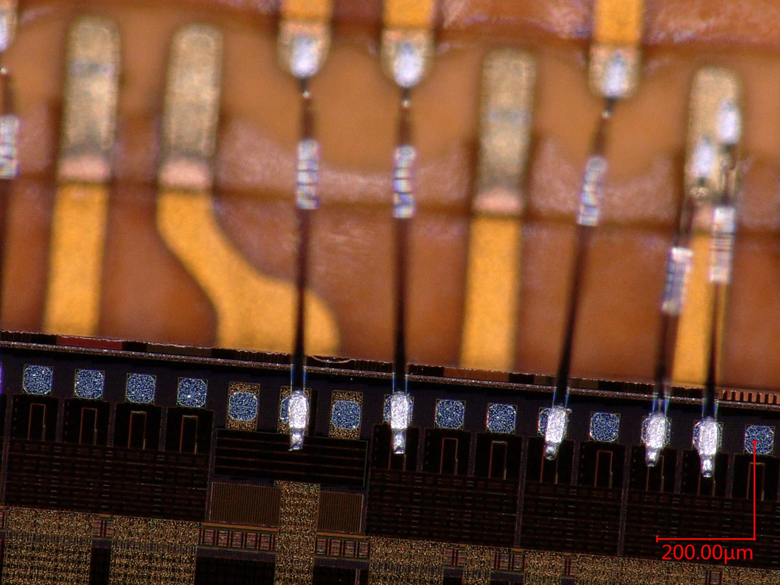
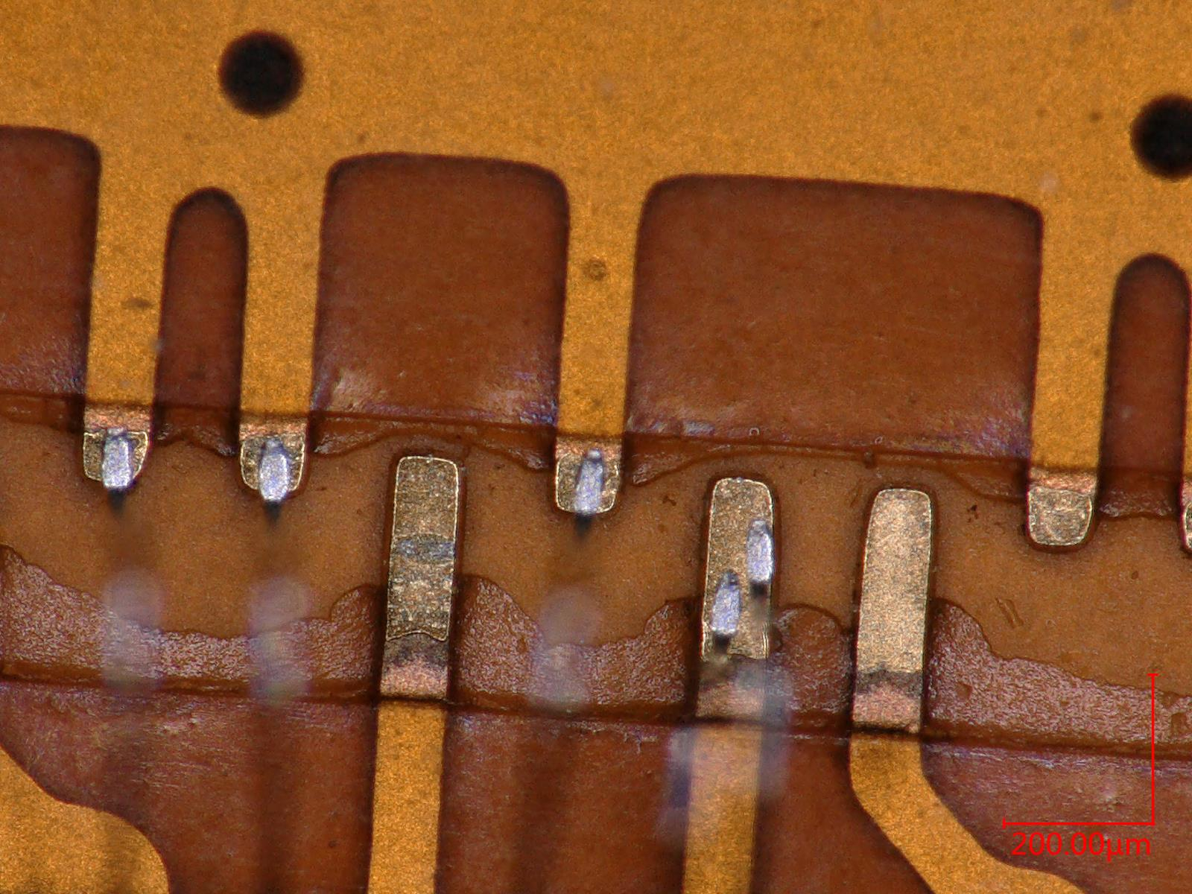
Test wire bonding with flex
Small pad capable for 1 wire
Larger pad capable for 2~3 wires

