Slide 1
工作记录
刘梦瑶

Slide 2
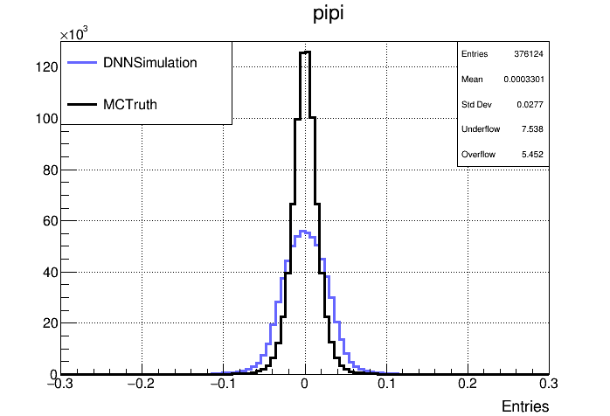
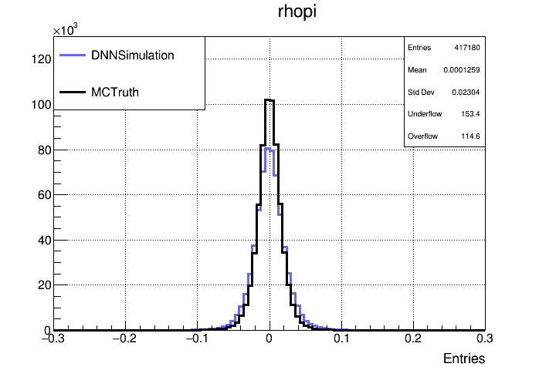
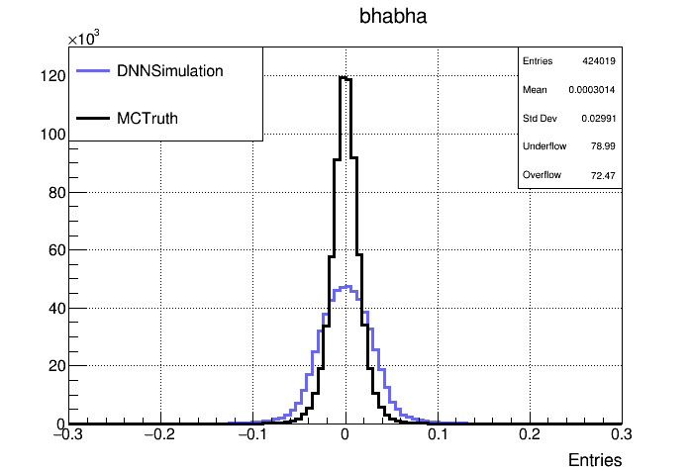
空间分辨：加了weight

Slide 3
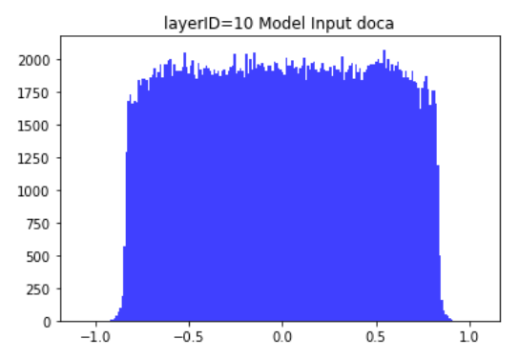
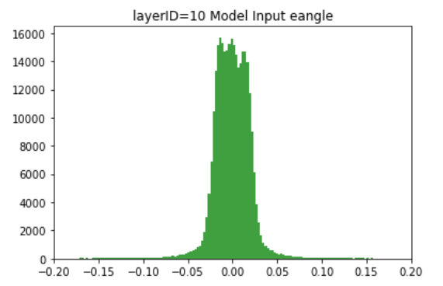
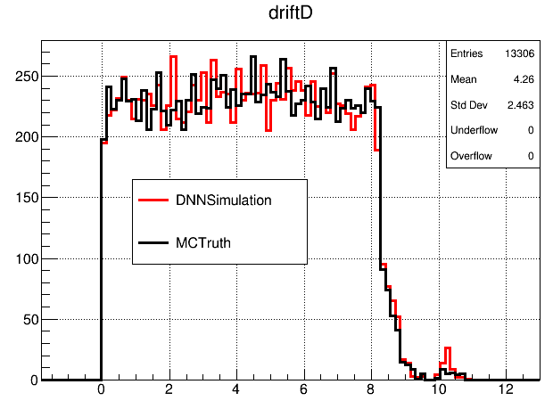
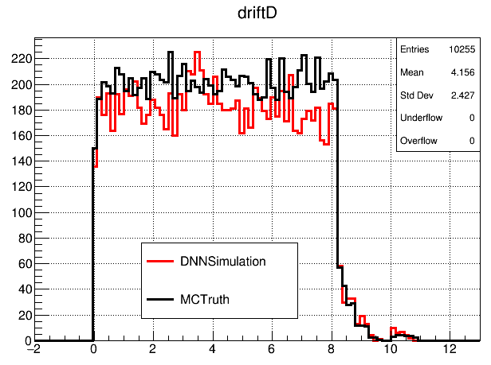
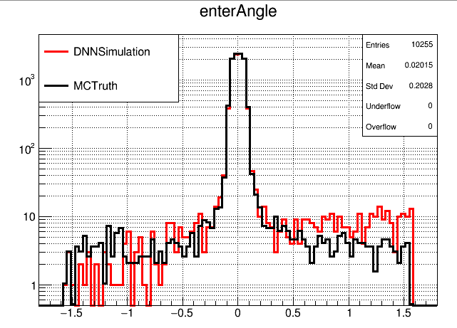
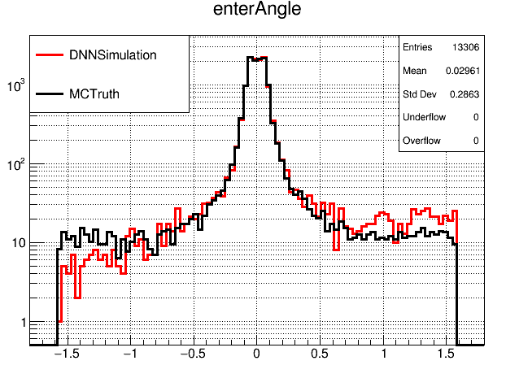
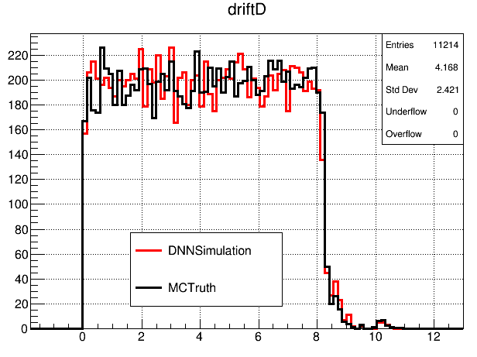
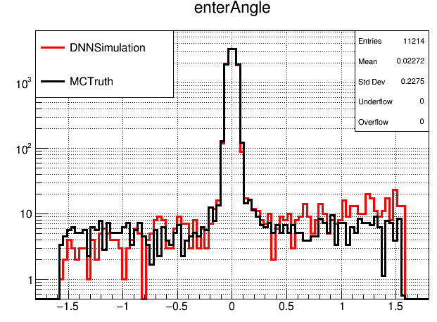
模拟时的输入：layerID=10
rhopi
bhabha
bhabha
pipi
rhopi
pipi

Slide 4
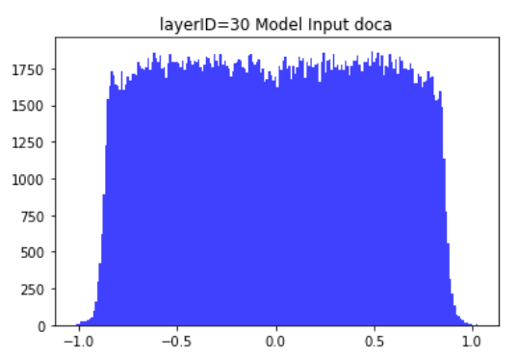
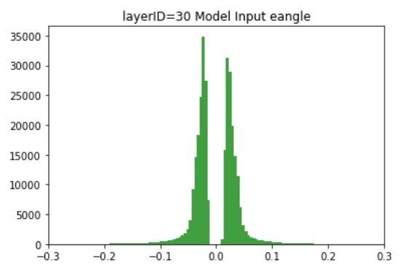
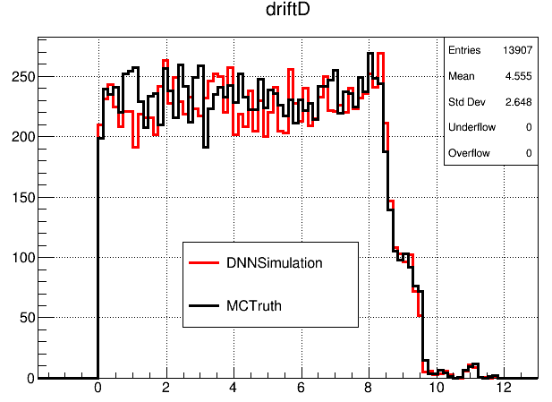
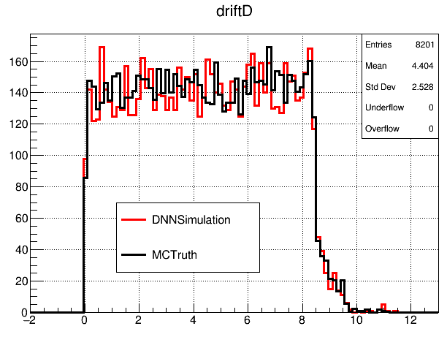
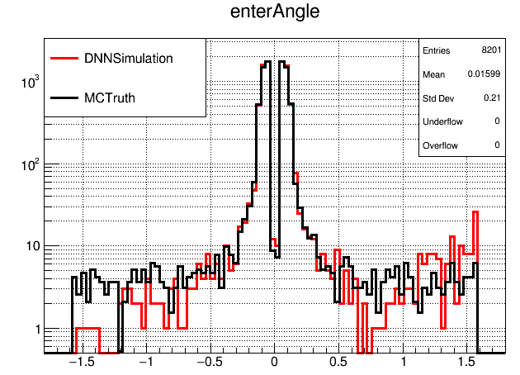
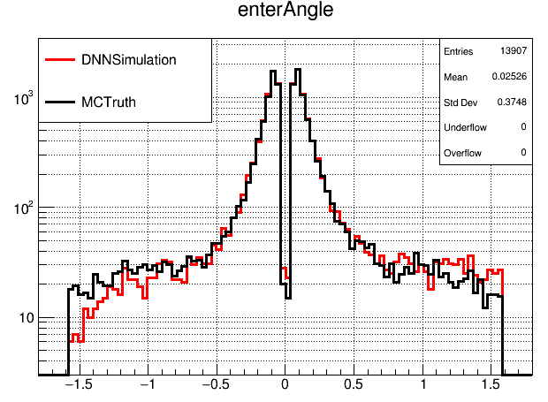
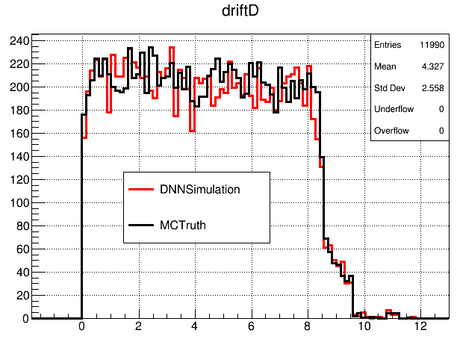
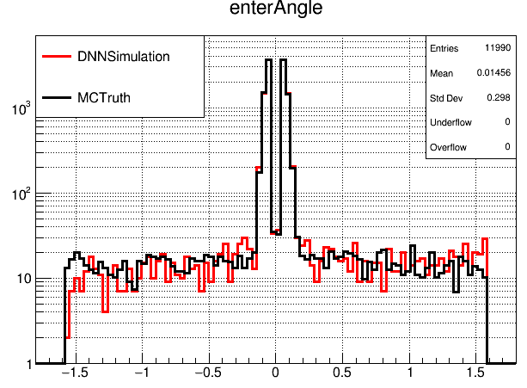
模拟时的输入：layerID=30
rhopi
bhabha
bhabha
pipi
rhopi
pipi

Slide 5
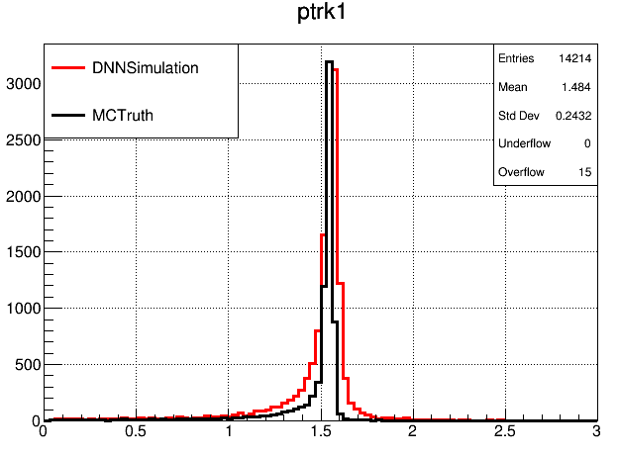
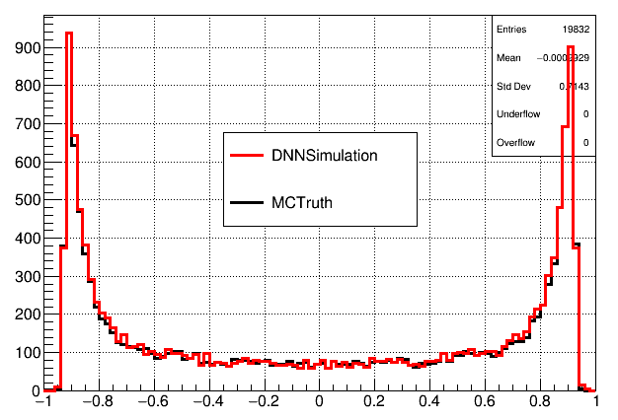
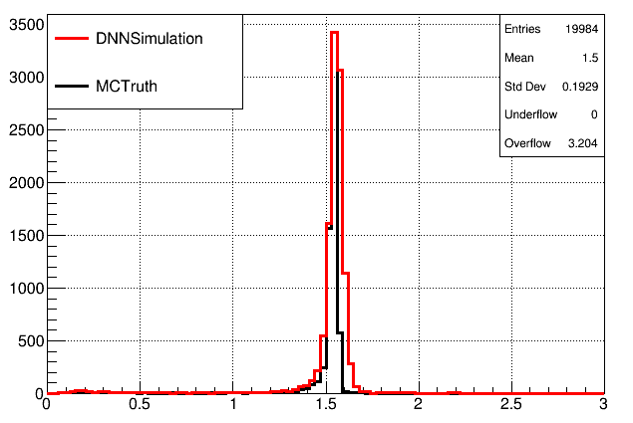
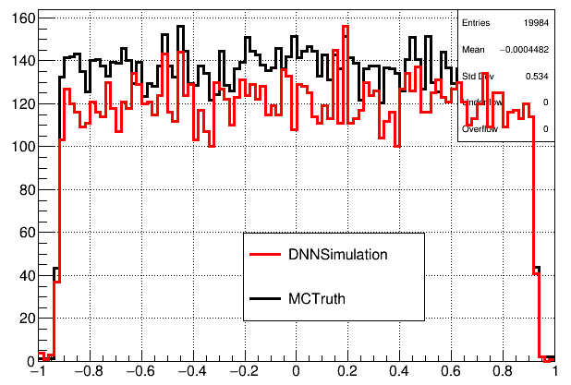
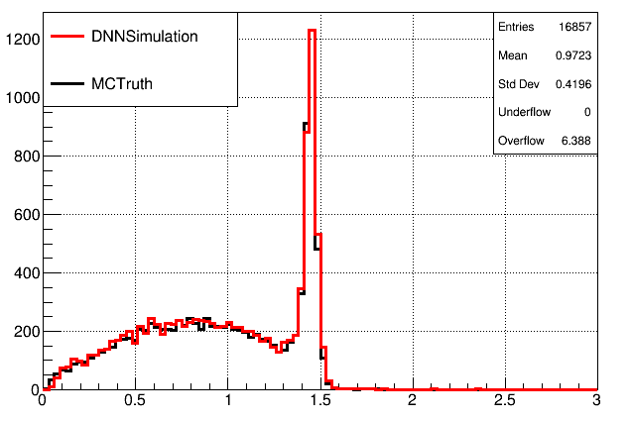
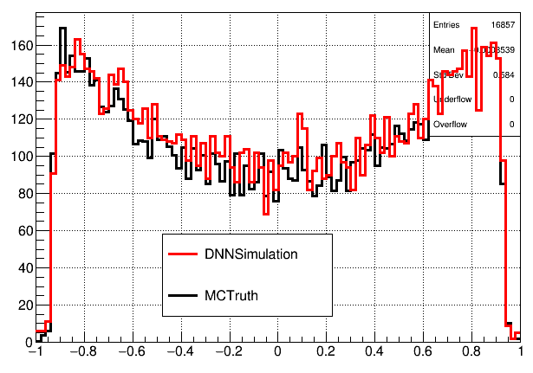
重建后的track的动量和costheta
bhabha
pipi
rhopi

Slide 6
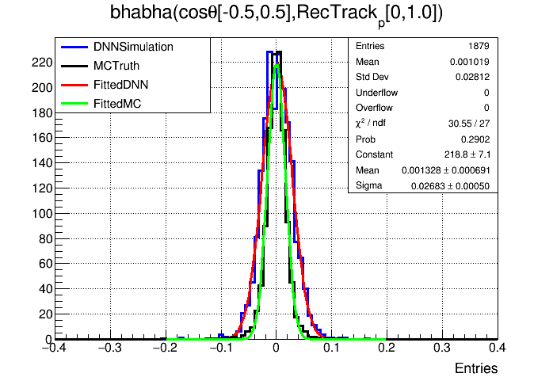
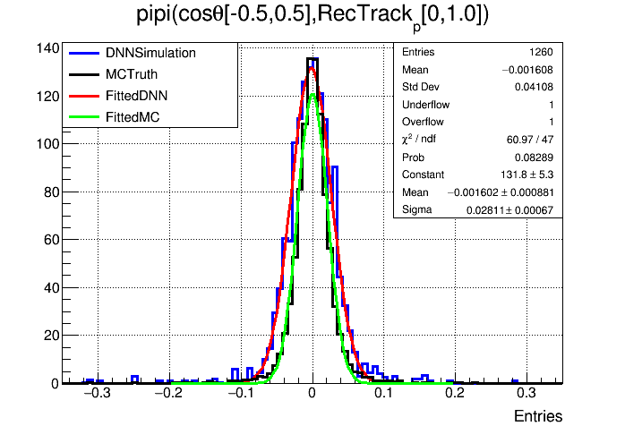
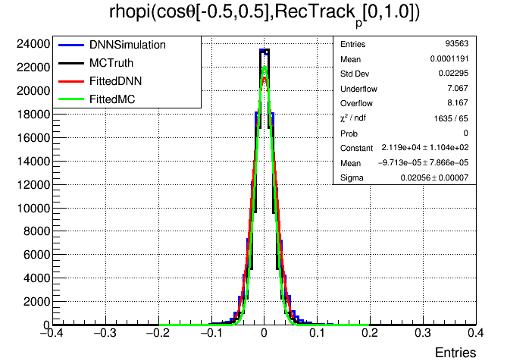
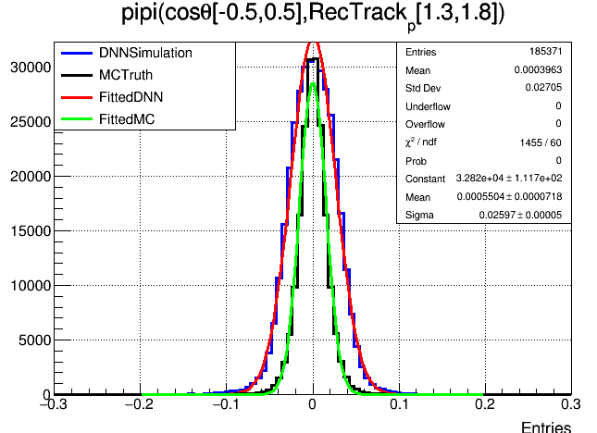
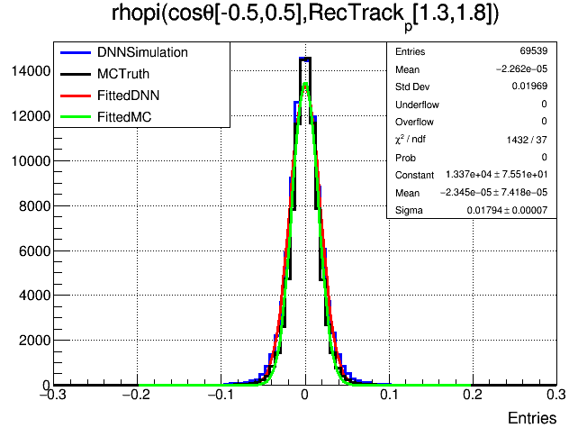
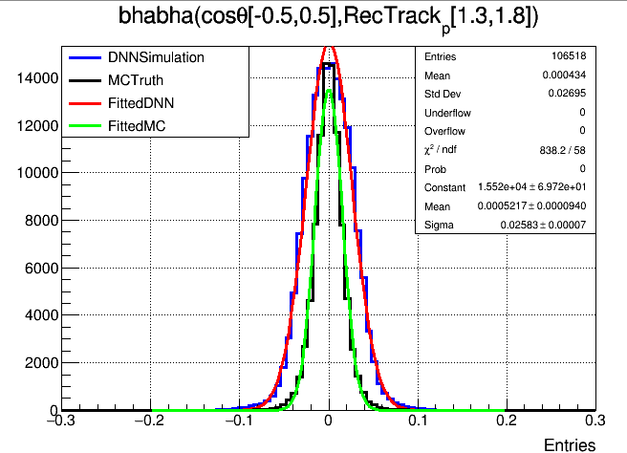
DNN sigma: 268.265um
MC sigma: 162.332um
(268.265-162.332)/162.332 =65.257004%
DNN sigma: 281.080um
MC sigma: 209.262um
(281.080-209.262)/209.262 =34.319657%
DNN sigma: 205.623um
MC sigma: 166.119um
(205.623-166.119)/166.119 =23.780543%
DNN sigma: 258.341um
MC sigma: 153.227um
(258.341-153.227)/153.227 =68.6%
DNN sigma: 259.675um
MC sigma: 153.060um
(259.675-153.060)/153.060 =69.655%
DNN sigma: 179.417um
MC sigma: 154.367um
(179.417-154.367)/154.367 =16.227%

Slide 7
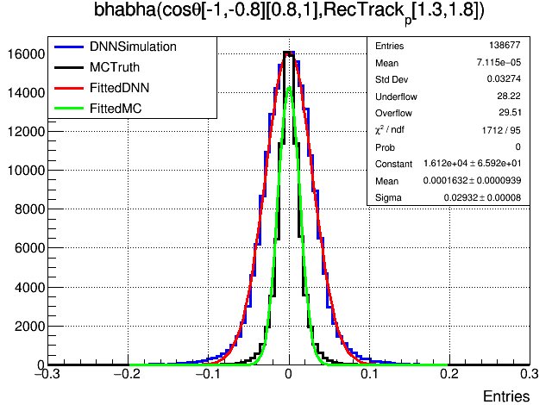
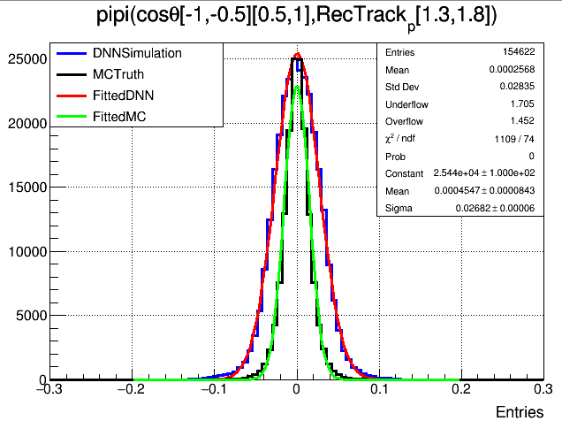
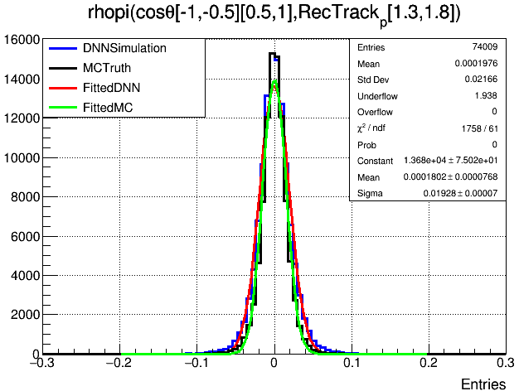
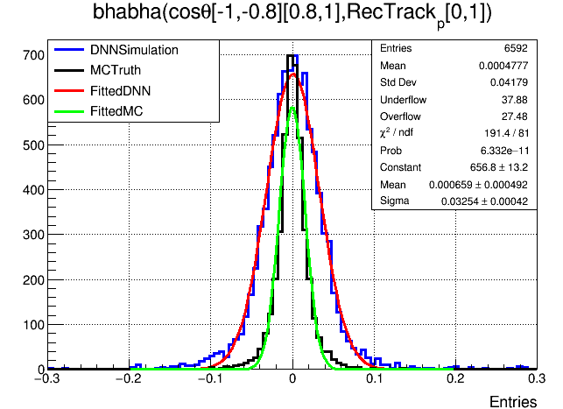
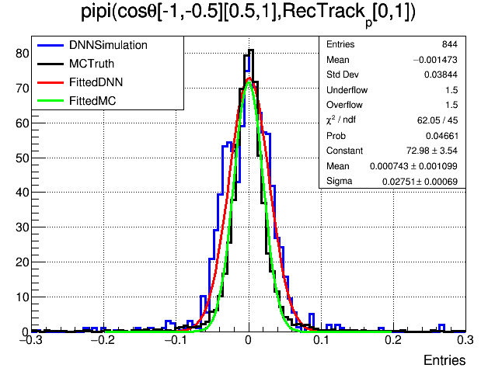
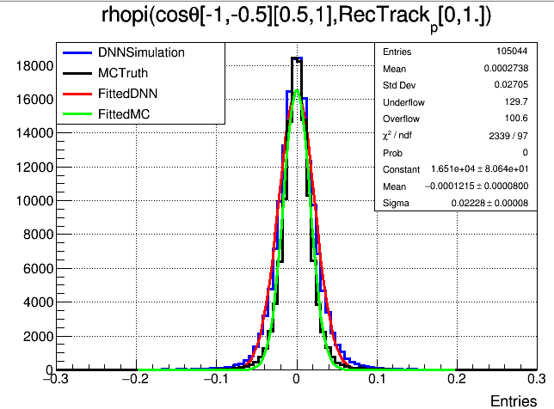
DNN sigma: 293.217um
MC sigma: 133.790um
(293.217-133.790)/133.790 =119.162%
DNN sigma: 268.206um
MC sigma: 151.549um
(268.206-151.549)/151.549=76.9764%
DNN sigma: 192.767um
MC sigma: 152.181um
(192.767-152.181)/152.181=26.6695%
DNN sigma: 325.412um
MC sigma: 157.132um
(325.412-157.132)/157.132=107.0946%
DNN sigma: 275.058um
MC sigma: 201.959um
(275.058-201.959)/201.959=36.195%
DNN sigma: 222.797um
MC sigma: 165.639um
(222.797-165.639)/165.639=34.5075%

Slide 8
