Slide 1
【调研】FCC-ee EPOL meeting
https://indico.cern.ch/event/1162192/
FCC-FS EPOL group meeting 1----10
陈姗红
2022.07.19

Slide 2
Outline
Motivation and requirement
FCC-ee lattice: Placement of RF
The center-of-mass energy measured by the RD method.
use ‘single’ non-colliding bunches
Hardware: wigglers, polarimeters

Slide 3
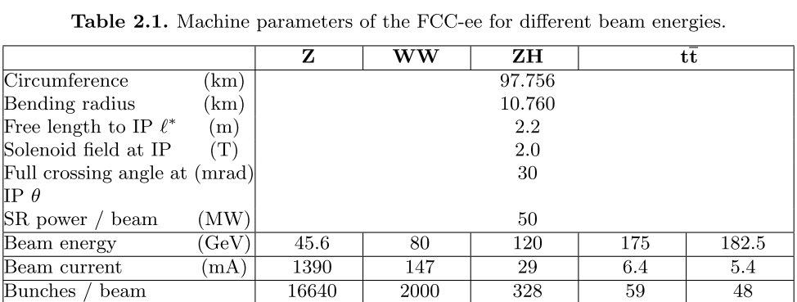
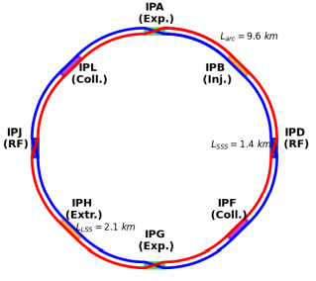
FCC-ee lattice
From FCC-CDR
There should be two interaction points, located in the straight sections at PA and PG.
Two RF sections per ring placed in the straight sections at PD and PJ. The RF cavities will be common to e+ and e− in the case of $t\overline{t}$ .
The intermediate straight sections at PB, PF, PH and PL are placed asymmetrically in the arcs.
FCC-ee: The Lepton Collider Future Circular Collider Conceptual Design Report Volume 2, https://doi.org/10.1140/epjst/e2019-900045-4

Slide 4
FCC-ee with 4 IP/2 IP
[1]K. Oide,Jan. 13, 3rd FCC Physics and Experiments Workshop @ CERN(link: https://indico.cern.ch/event/838435/contributions/3635681/attachments/1967767/3272345/4IP_200113_Oide.pdf)
[2] https://indico.cern.ch/event/1147611/contributions/4832697/attachments/2433424/4167398/20220428_Keintzel_EPOL_newRFsettings.pdf

Slide 5
Placement of RF
In the CDR we requested that the RF be in a single place to make sure that the RF energy gains do not lead to an uncertainty in the center-of-mass energy for the Z and WW threshold.
A Single RF location and two of four experiments they all have the same energy: ${∆E}_{cm}={∆E}_{e^{+}}+{∆E}_{e^{−}}$
It is also essential for the eeH experiment that the center of mass energy is the Higgs mass within a few MeV
i.e. RF in point H (or any single point) would be fine.
However if the e+ RF is in one place and the e-RF in an other, it is important (if the ECM is to be the same in all IPs) that no IP is in between the two.
Conclusion
-- it is clearly preferable to have the whole RF in one single points for the precision measurement era. (Z, WW)
-- for eeH one should take into account that the beam energies might be different leading to a difference in the total beam energy loss by 3.6 MeV/turn. This is probably within tolerance. The scheme of two opposite RF stations where both e+ and e- get accelerated should also be investigated, it will work if the acceleration in the RF stations can be controlled at the 1% level.
with two single RF locations (one for e - one for e+) and four experiments one will have an energy lower (or higher) than the others by the full beam energy loss 36 MeV@Z, 128 MeV @eeH and 350 MeV@WW.
EPOL1: https://indico.cern.ch/event/1080577/contributions/4563511/attachments/2324831/3959694/AB-RF-layout-2021-10-07.pdf

Slide 6
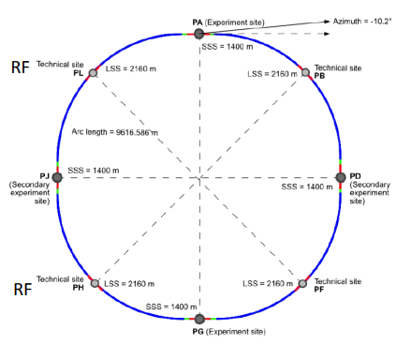
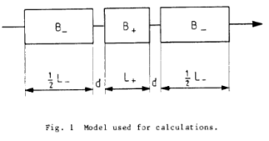
Implementation of polarimeter and wigglers
Wiggler Location
Previously, sections PH and PF have been proposed to host wigglers
Alternative is to install them after IP/Crab sextupole in matching straight
In case of 4IP, 2 wiggler (6 units) per IP
No changes required, 2 sufficiently long drifts present
For 2IP, 4 wigglers (12 units) per IP
Latest IR design take wiggler space requirements into account
Half as many wiggler with 𝐵 = 0.88𝑇 have same effect, but 𝐸𝑐𝑟𝑖𝑡𝑖𝑐𝑎𝑙 = 1.22 MeV
Wiggler design for FCC-ee follows 3 three block LEP design
EPOL1: https://indico.cern.ch/event/1080577/contributions/4545364/attachments/2324366/3958735/MH_FCCee_PolLocation.pdf

Slide 7
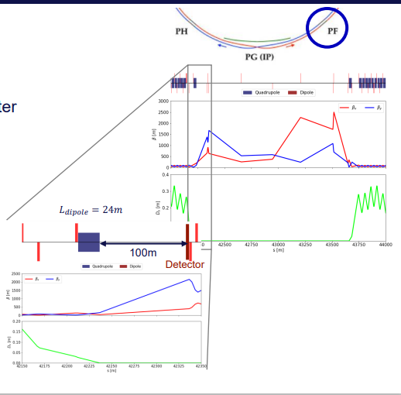
EPOL1: https://indico.cern.ch/event/1080577/contributions/4545364/attachments/2324366/3958735/MH_FCCee_PolLocation.pdf

Slide 8
EPOL1: https://indico.cern.ch/event/1080577/contributions/4545364/attachments/2324366/3958735/MH_FCCee_PolLocation.pdf

Slide 9
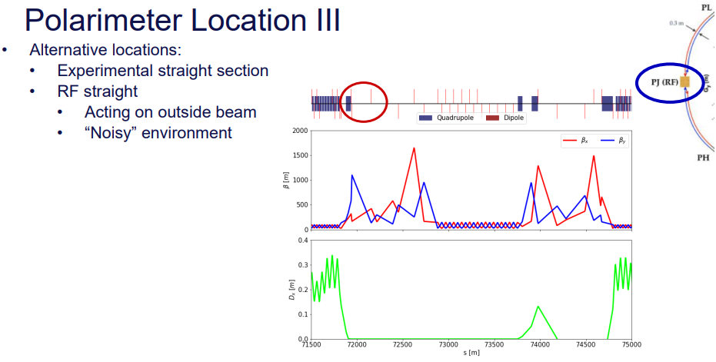
EPOL1: https://indico.cern.ch/event/1080577/contributions/4545364/attachments/2324366/3958735/MH_FCCee_PolLocation.pdf

Slide 10
Conclusion
Wigglers:
Moved from separate insertion to just after the IP
Wiggler specs unchanged and appear fine, radiation load to be looked into
Polarimeter:
Currently located left of insertion F for clockwise beam
Study relocation to upstream of IP
RF-magnet:
Not looked into, but less constraints for location
EPOL1: https://indico.cern.ch/event/1080577/contributions/4545364/attachments/2324366/3958735/MH_FCCee_PolLocation.pdf

Slide 11
EPOL2: https://indico.cern.ch/event/1096821/contributions/4614227/attachments/2349005/4006271/EPOL-report-PEDphysco-AB-2021-11-18.pdf
Placement of RF

Slide 12
Placement of RF
EPOL2: https://indico.cern.ch/event/1096821/contributions/4614227/attachments/2349005/4006271/EPOL-report-PEDphysco-AB-2021-11-18.pdf

Slide 13
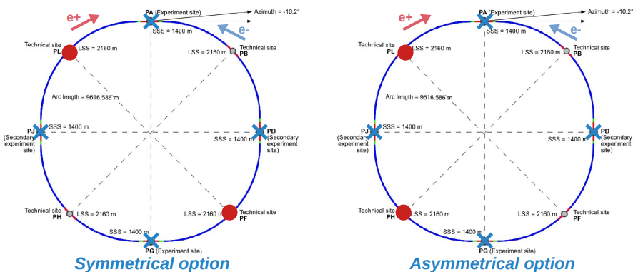
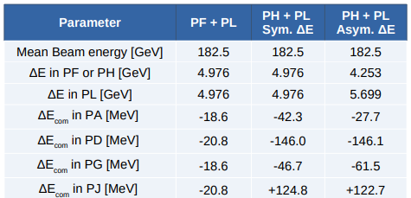
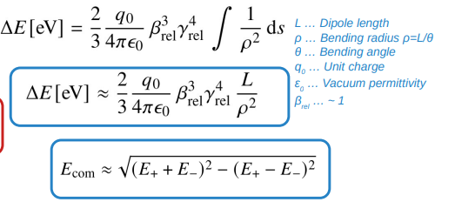
Placement of RF
How does $E_{com}$(Center of mass energy) depend on RF location?
8 points & 91 km circumference & Optics with 4 IPs
Beam energy and $E_{com}$ sensitive to placement of the RFs
Symmetrical: best for delivering almost same $E_{com}$
Asymmetrical: leads to more difference in $E_{com}$ (O(100 MeV))
Seen effects probably reflect strong $E^{4}$dependence
EPOL2: https://indico.cern.ch/event/1096821/contributions/4614226/attachments/2348851/4006455/20211118_Keintzel_EPOL_FCCee.pdf

Slide 14
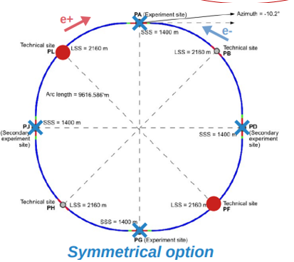
Placement of RF
EPOL3: https://indico.cern.ch/event/1099047/contributions/4624531/attachments/2362116/4032609/20211209_Keintzel_EPOL_FCCee_MADXComp.pdf

Slide 15
EPOL4: https://indico.cern.ch/event/1108961/contributions/4664943/attachments/2371223/4052477/Polarimeter-Location.Jan21.pdf

Slide 16
EPOL4: https://indico.cern.ch/event/1108961/contributions/4664943/attachments/2371223/4052477/Polarimeter-Location.Jan21.pdf

Slide 17
EPOL4: https://indico.cern.ch/event/1108961/contributions/4664943/attachments/2371223/4052477/Polarimeter-Location.Jan21.pdf

Slide 18
EPOL4: https://indico.cern.ch/event/1108961/contributions/4664943/attachments/2371223/4052477/Polarimeter-Location.Jan21.pdf

Slide 19
EPOL4: https://indico.cern.ch/event/1108961/contributions/4664943/attachments/2371223/4052477/Polarimeter-Location.Jan21.pdf

Slide 20
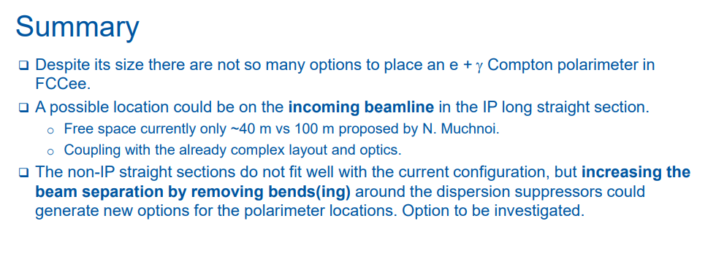
EPOL4: https://indico.cern.ch/event/1108961/contributions/4664943/attachments/2371223/4052477/Polarimeter-Location.Jan21.pdf

Slide 21
FCC-ee
Beam separation : 30 cm
探测器的摆放考虑正负电子束流之间的间隔

Slide 22
https://indico.cern.ch/event/1119730/contributions/4701833/attachments/2380213/4066758/EPOL.pdf

Slide 23
对撞区的上游？
Compton IP(Electron-laser IP)
1个 Compton system
EPOL10: https://indico.cern.ch/event/1162192/contributions/4882082/attachments/2446301/4193936/MH_FCCee_PolLocation.pdf

Slide 24
对撞区的上游？
约1km
2个 Compton system
EPOL10: https://indico.cern.ch/event/1162192/contributions/4882082/attachments/2446301/4193936/MH_FCCee_PolLocation.pdf

Slide 25
EPOL10: https://indico.cern.ch/event/1162192/contributions/4882082/attachments/2446301/4193936/MH_FCCee_PolLocation.pdf

Slide 26
EPOL10: https://indico.cern.ch/event/1162192/contributions/4882082/attachments/2446301/4193936/MH_FCCee_PolLocation.pdf

Slide 28
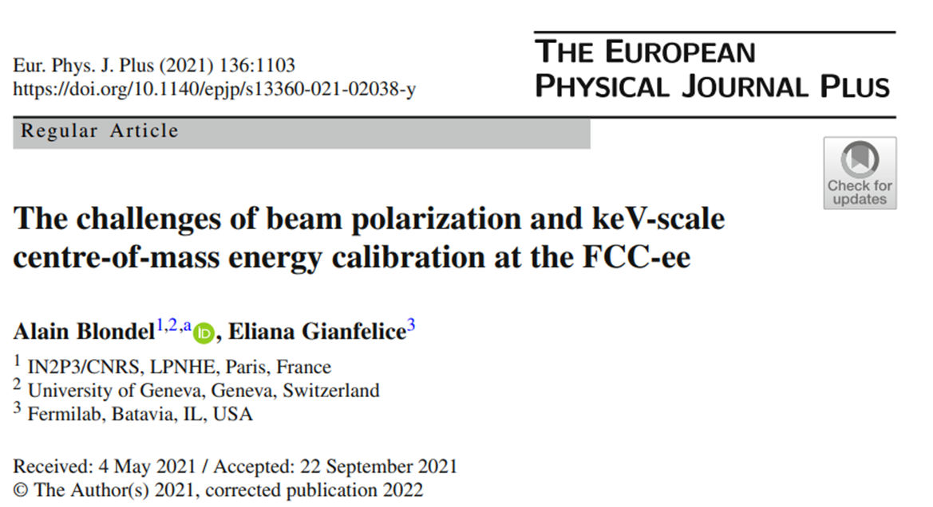
https://doi.org/10.1140/epjp/s13360-021-02038-y

Slide 29
https://doi.org/10.1140/epjp/s13360-021-02038-y
ppm measurement of the W and Z masses and widths, as well as lepton forward-backward asymmetries around the Z pole
s-channel $e^{+}e^{−}→H$ cross section is also under study.
A list of main challenges, required studies and associated tools, R&D and tests need to be performed.
Transverse polarization can be obtained around both the Z pole and up to W pair threshold.
motivation
Beam polarization and keV-scale centre-of-mass energy at the FCC-ee
RD provide an instantaneous precision on beam energy 1ppm at Z pole and serves as basis for on a running mode 5 times an hour on pilot bunch for both electrons/positrons.
$$ECM=2\sqrt{{E_{b}^{−}E}_{b}^{+}}cos\frac{α}{2}$$
Asymmetric wigglers to speed up the long polarization time for polarize 5%~10% polarization(1 hour at the begging of the physical fills).
$$e^{+}e^{−}→μ^{+}μ^{−}$$
Can provide great precision α is the beam crossing angle and beam spread and the difference of the $e^{+}e^{−}$beam energies
Require corrections for beam energy variations, RF accelerations and energy losses due to SR and beamstrahlung.

Slide 30
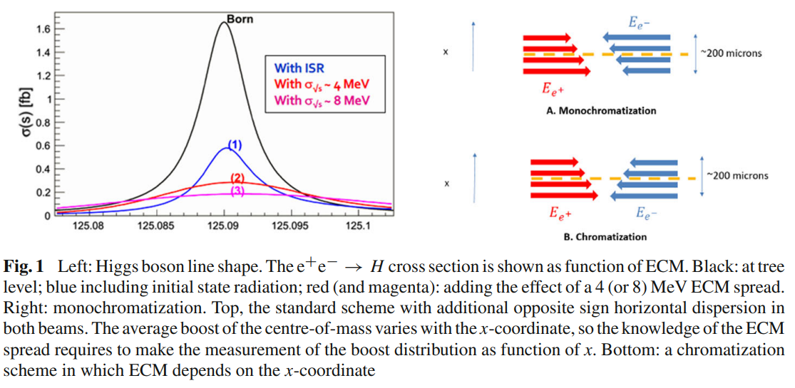
A first look at beam energy monitoring issues for the Higgs resonance $e^{+}e^{−}→H$ run
The ECM setting must be exactly the Higgs boson mass within a fraction of the Higgs width, and cannot be chosen to avoid spin resonances.
Fluctuations due to ground motion $±90MeV$ per beam at the Z resonance
ECM spread should determined by experimental input.
Using the muon pairs
Need a good energy model
Shift beam energy by $±220MeV$
Close a half integer

Slide 31
Challenges ahead
Z pole, polarization time is 256 h.
For reach 5%~10%, the time is 14~29 h;
8 wigglers B+~0.57 T by factor 10 time reduced.
W pair threshold, Skolov-Ternov time is 14 h.
10% polarization time is 1.6 h.
Not need wiggles.
Beam polarization build up by Skolov-Ternov effect.
The choice of wiggler location, parameters and number results from the need of decreasing polarization time keeping the beam horizontal emittance, energy spread and additional energy loss within limits.
Although it will be impossible to operate them with a full machine because of the excessive synchrotron radiation
a detailed design of the wigglers, especially concerning the management of the 900 KeV critical energy photons, is needed. However, we do not expect this to be a critical issue

Slide 32
Challenges ahead
Non-colliding bunches will be used for energy calibration
Colliding bunches lifetime being about 1 h (Bhabha scattering limited)
Non-colliding bunches miss the extra focusing lens seen by the colliding bunches (beam–beam incoherent tune shift is expected to be about 0.1 per IP), their tunes will be different and they may land on a spin–orbit resonance or even on the integer resonance.
We can imagine that some compromises have to be done to insure the survival of the non-colliding bunches and their polarization.
Hundreds of Non-colliding bunches with a reduced population is 1e10
their lifetime being limited by Touschek effect, will be first injected with wigglers switched on until polarization reaches between 5% and 10% when wigglers will be switched off and the remaining bunches injected
Monitoring the energy by targeting one different bunch each 10 min

Slide 33
Challenges ahead
Sources of ECM biases
RD is the average beam energy over the accelerator. The average beam energy will be therefore different from the beam energy at the IP.
Effects related to possible beam energy drifts during the physics run (main dipole field, horizontal orbit and corrector settings, machine circumference, RF phasing), call for a frequent energy monitoring (≈ each 10 min) and the development of models for interpolation as done at LEP.
From the machine model, the relative systematic error introduced by this effect is about 2.5e−6 for both Z pole and W pair threshold.
The beam energy is azimuth-dependent due to synchrotron radiation, RF stations and wake fields.
Other effects which introduce systematic errors such as energy-dependent particle densities at the IP, counter-rotating bunch fields and longitudinal space charge have negligible effects.

Slide 34
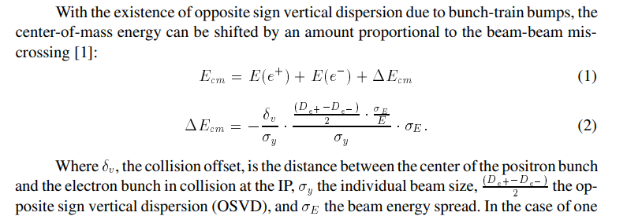
Challenges ahead
LEP Center-of-mass energies in presence of opposite sign vertical dispersion in bunch-train operation
An offset between colliding beams affects the CM energy if the dispersion of the two rings has opposite sign. For parasitic effects, the CM energy error is
this is one of the most challenging aspect of the ECM determination at FCC-ee.
Colliding-beam offsets result in measurable beam–beam deflection at the beam collision frequency, which can be picked up with the beam position monitors.
Another possibility is to measure high-energy photons from radiative Bhabha scattering or beamstrahlung at the collision point

Slide 35
Challenges ahead
Depolarization, kicker and operation mode
One of the issues that was raised in the study is the fact that the resonant frequency corresponding to beam energy is not the only possible one, its synchrotron side bands can also cause depolarization, leading to a possible mistake in the true measurement by, e.g. one or several synchrotron tune.
The effect is particularly visible at the WW threshold energy (80 GeV per beam) where the larger energy spread excites the synchrotron resonances.
In conclusion, the resonant depolarization process and its sensitivity to the energy spread and synchrotron tune should be further studied to optimize the procedures and the machine settings. The precision obtainable at the W threshold energy should be clarified and, if possible, improved.

Slide 36
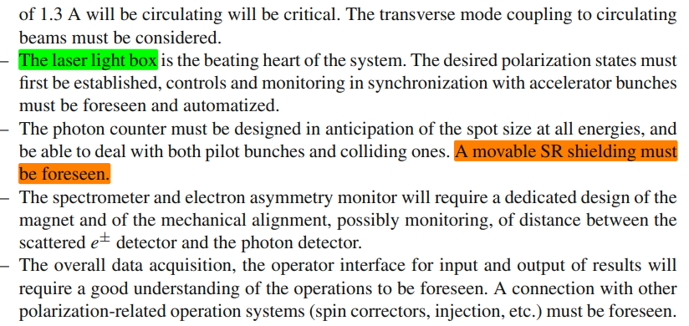
Challenges ahead
Polarimeter implementation and spectrometer operation
The measurement of the polarization need not be very precise in absolute scale, but it must be fast and sensitive. Its main function is to measure the polarization and depolarization of the pilot bunches. However, it will be important for two other functions

Slide 37
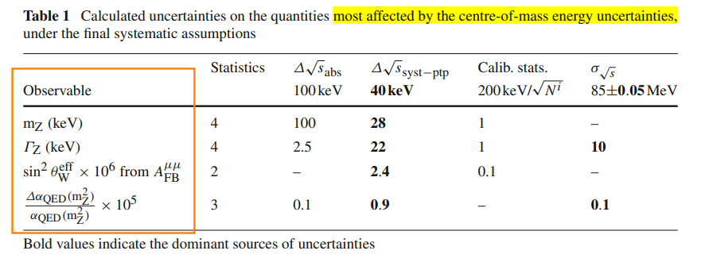
Challenges ahead
Point-to-point ECM systematics
The polarimeter in its spectrometer function, and the direct measurement of the centre-of-mass energy using the invariant mass distribution of muon pairs.

Slide 38
https://doi.org/10.1140/epjp/s13360-021-02038-y

