Slide 1
国家重点研发计划
R&D and Verification of Key Technologies for a High Energy Circular Electron-Positron Collider
Zhijun Liang for CEPC MOST2 vertex detector team

Slide 2
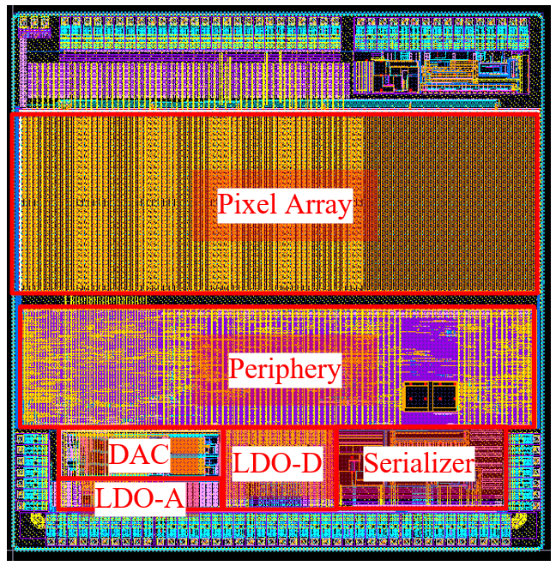
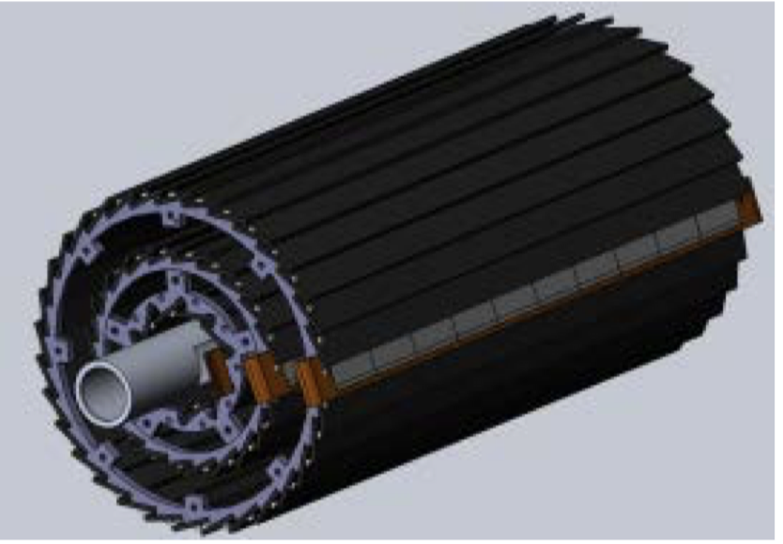
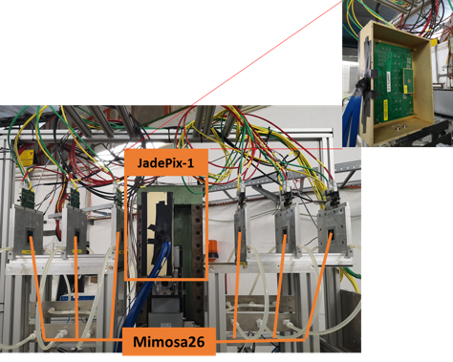
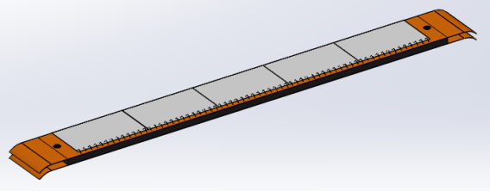
Overview of task2： vertex detector R & D
Can break down into sub-tasks:
CMOS imaging sensor chip R & D
Detector layout optimization, Ladder and vertex detector support structure R & D
Detector assembly
Data acquisition system R & D
CMOS imaging
sensor prototyping
Detector module (ladder)
Prototyping
Full size vertex detector Prototype
Beam test to
verify its spatial resolution
Notes:
Full size vertex detector

Slide 3
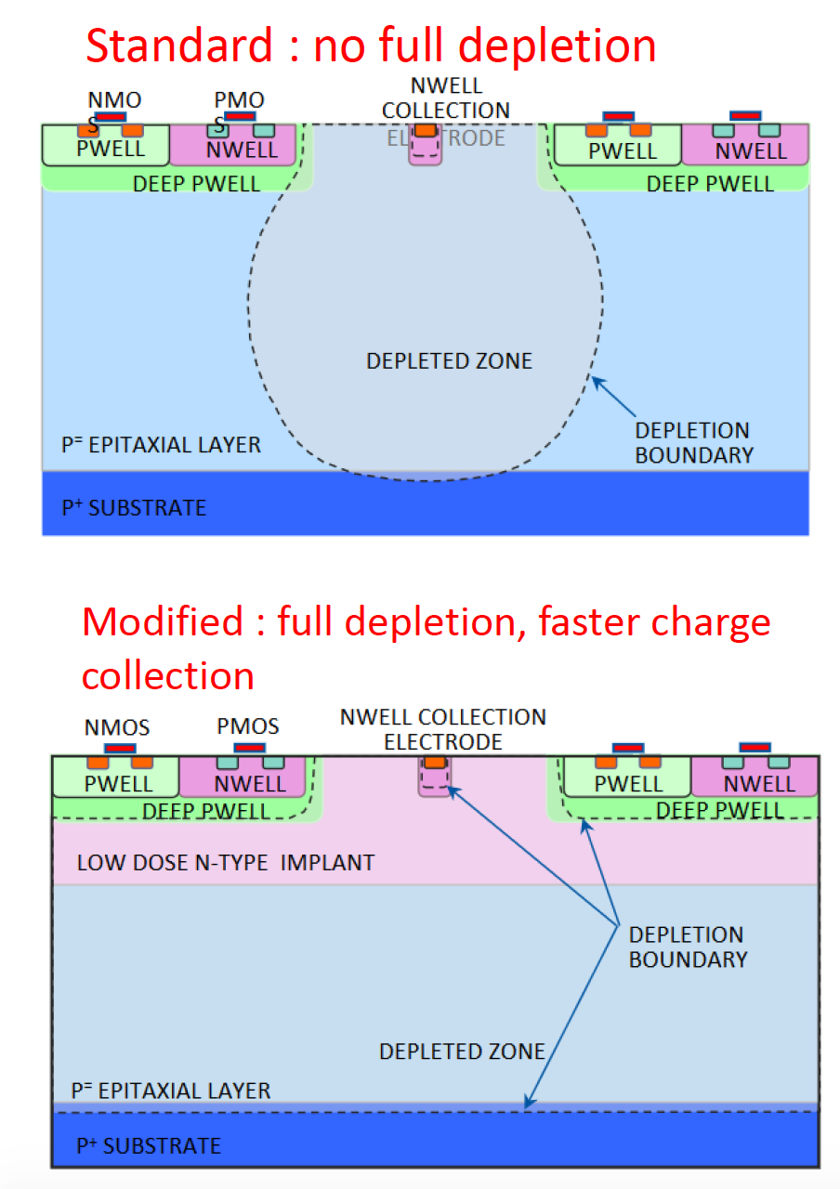
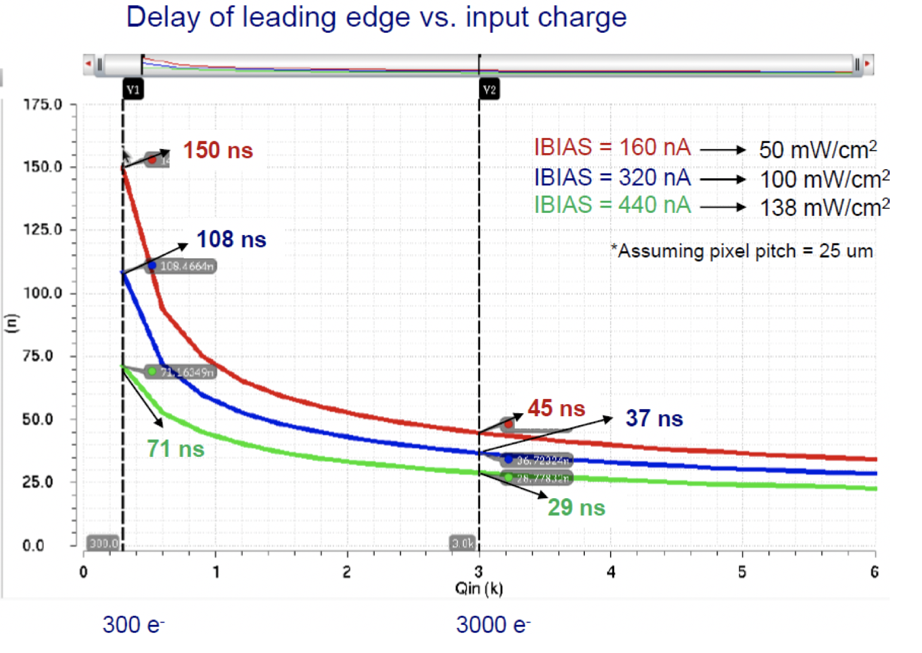
Pixel Analog design
CEPC time stamping precision requirement:
25-100ns, better to time stamping each collision at Z pole
Taichu-1 pixel analog design:
50ns~150ns (based one standard CMOS MAPS tech.)
Consider to use depleted CMOS MAPS

Slide 4
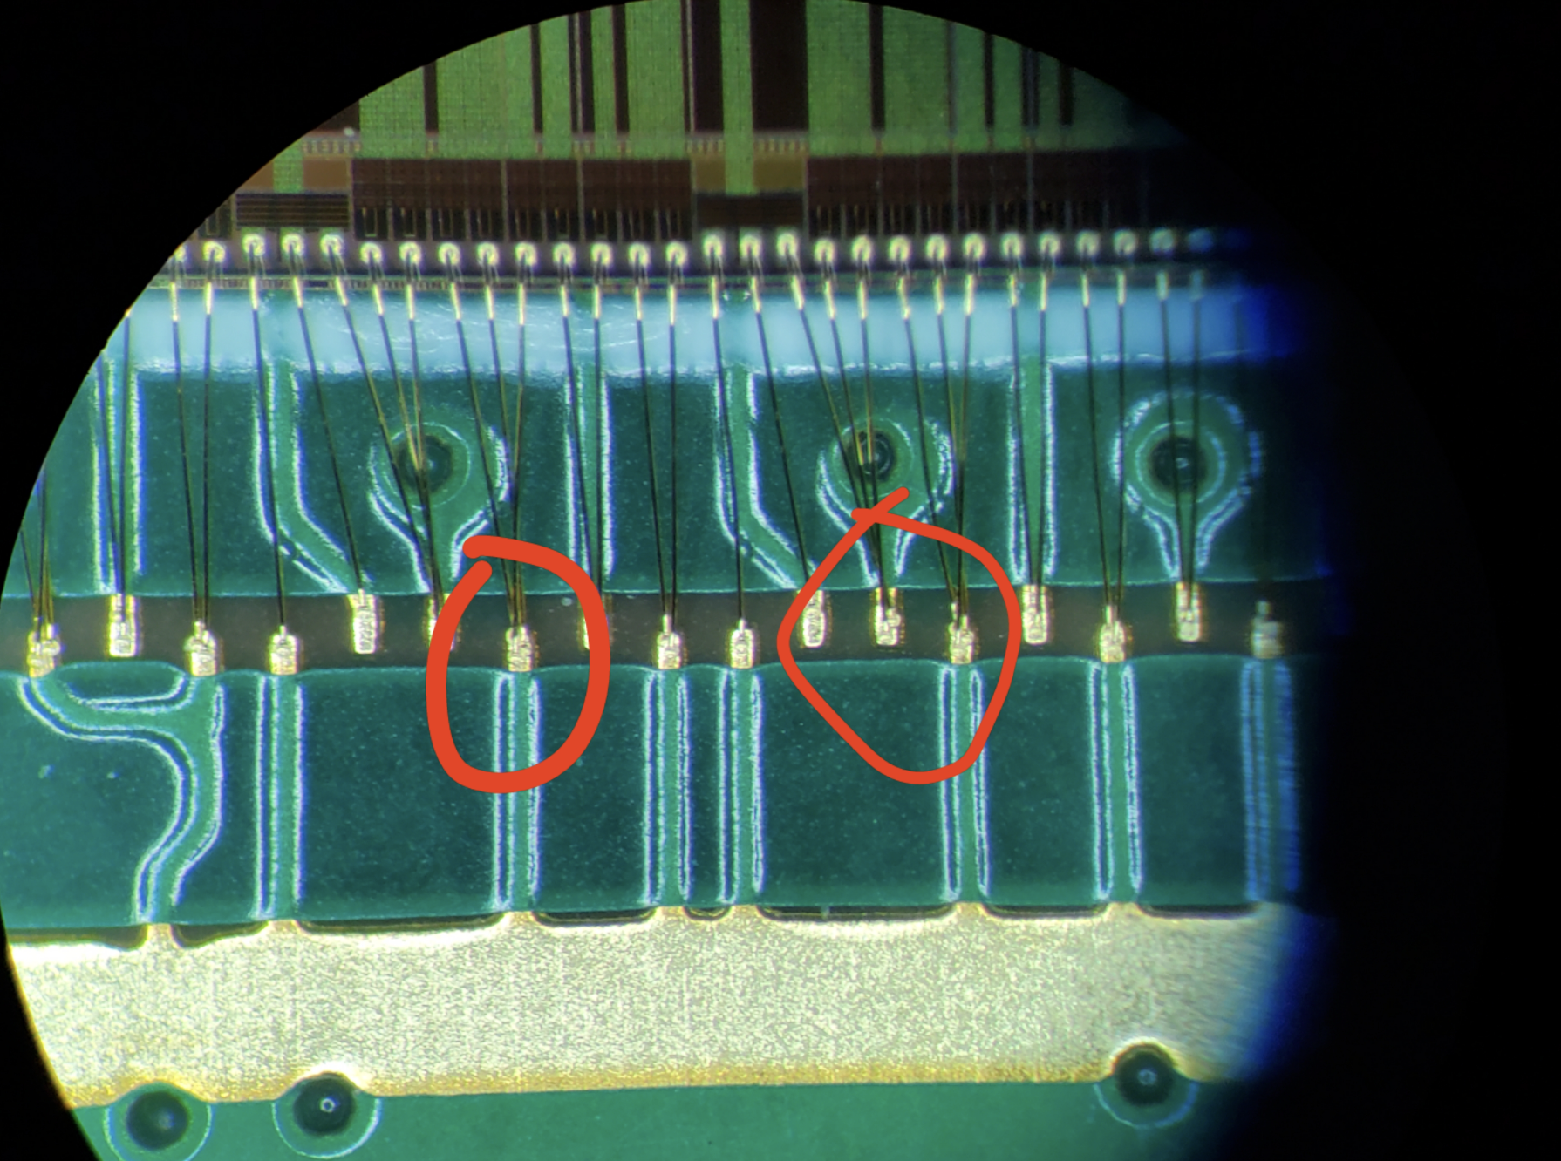
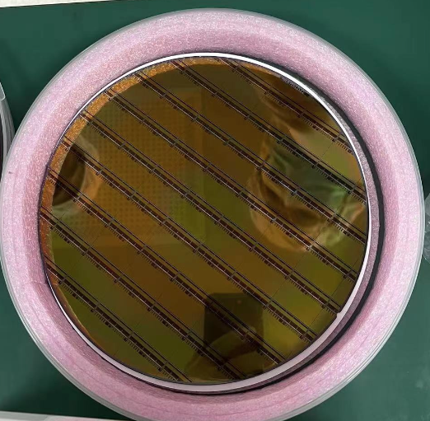
News about Taichupix3 production
6 Taichu3 wafers are ready.
wafer arrival at IHEP in 5th July
3 wafers (standard process) + 3 wafers (modified process)
After irradiation, modified process will give better resolution
Will modified process sensors into the detector assembly
Send 1 wafers for thinning (150um) and dicing
Test single chip performance
Send 5 chips with PCB boards to company for wired bonding
5 board bonded.
Wire bonding one PCB board at IHEP
Try to wire bonding one chip on flex at IHEP next week
Send 3 wafers to NCAP for wafer testing , thinning and dicing

Slide 5
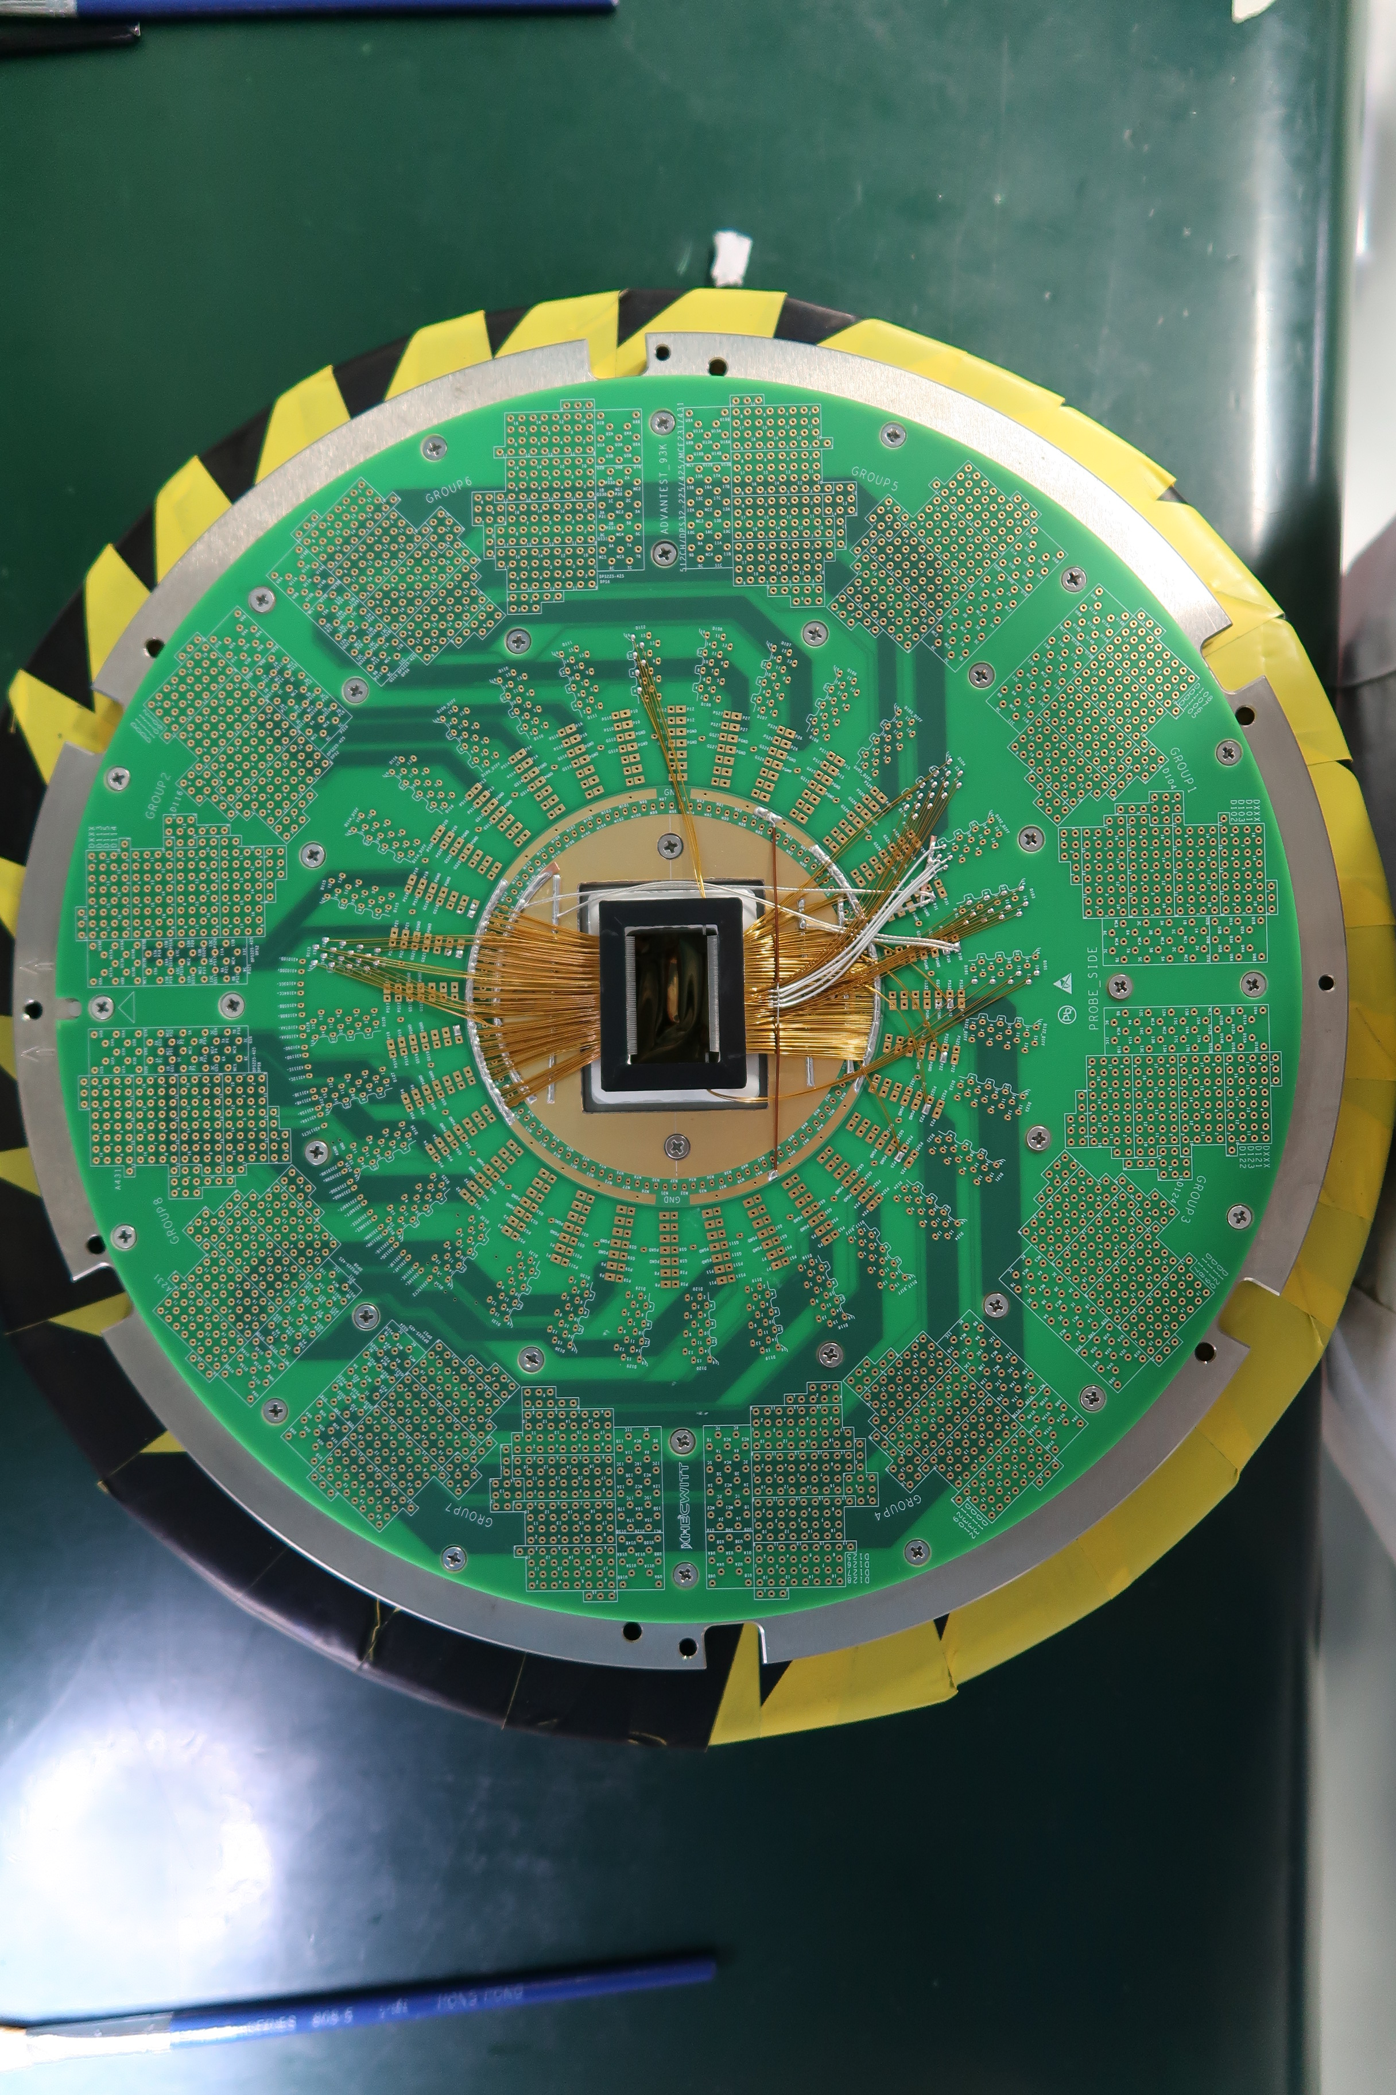
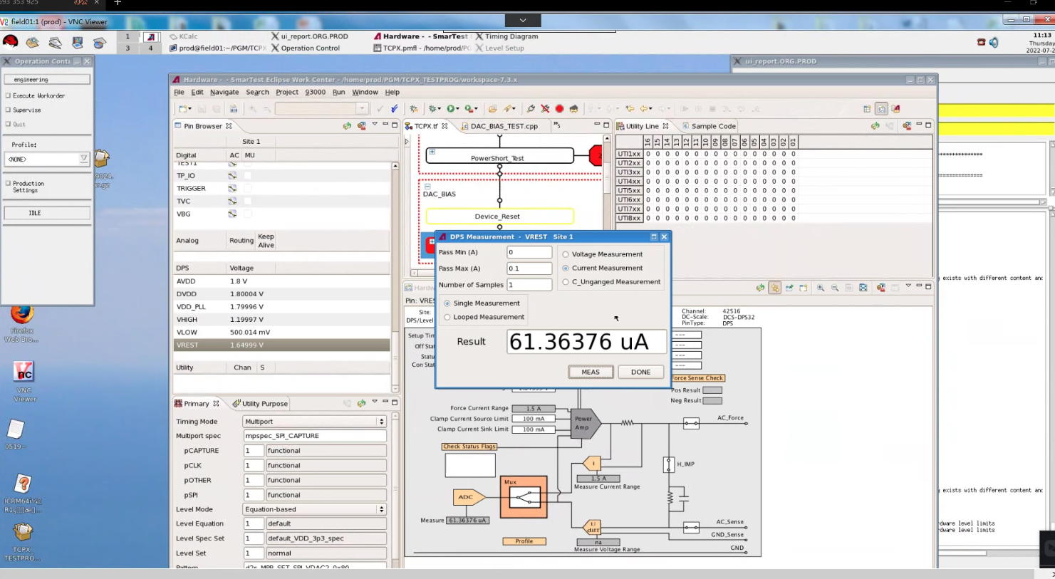
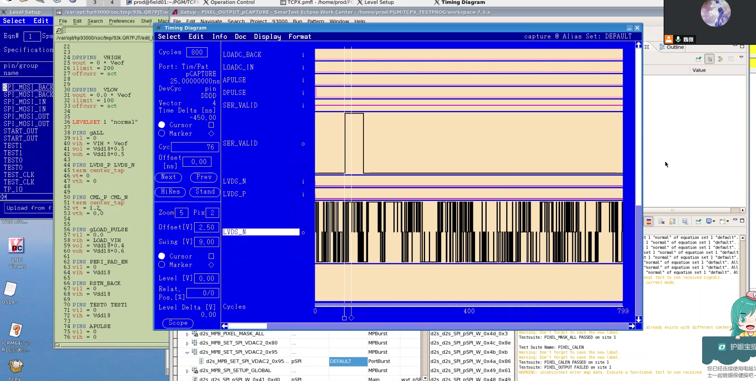
Taichupix3 testing
Wafer level test
Probe card
Single chip test board testing on-going
Wafer level testing in NCAP (on-going )
Remote connection from IHEP to NCAP
Remote commissioning of testing program

Slide 6
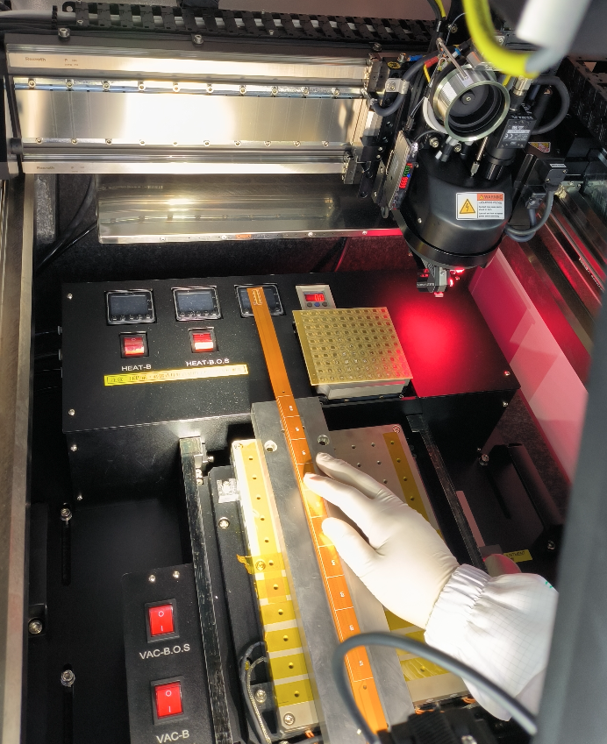
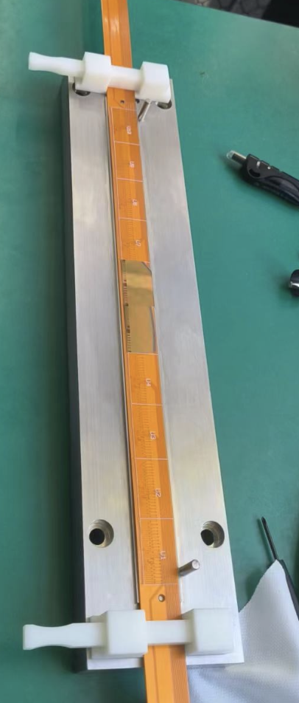
Detector module(ladder) assembly
Setting up wire bonding station
For full-size detector module( ladder)
Progress in assembly in ladder
Dummy sensor (glass) on flexible PCB

Slide 7
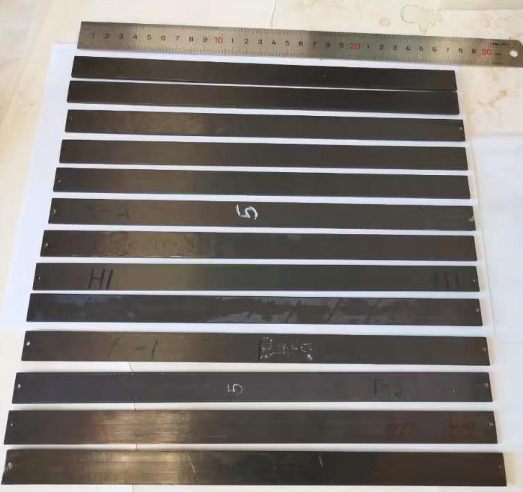
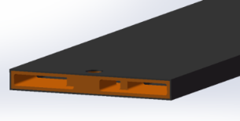
Support structure of the ladder
Ladder support production
Production of ladder support with carbon fiber is in good progress
Half of the ladder support has been produced.
The yield of first batch of production is a bit low (~30%)
New batch of production has high yield
Ladder support
structure 3D model

Slide 8
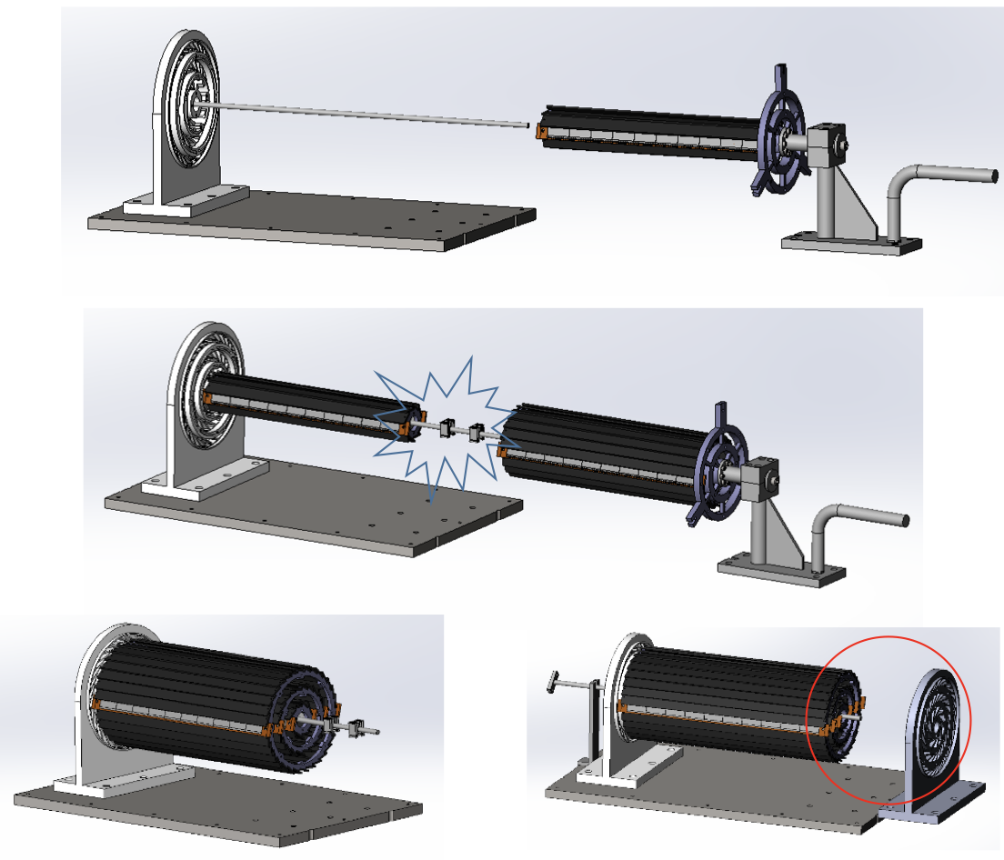
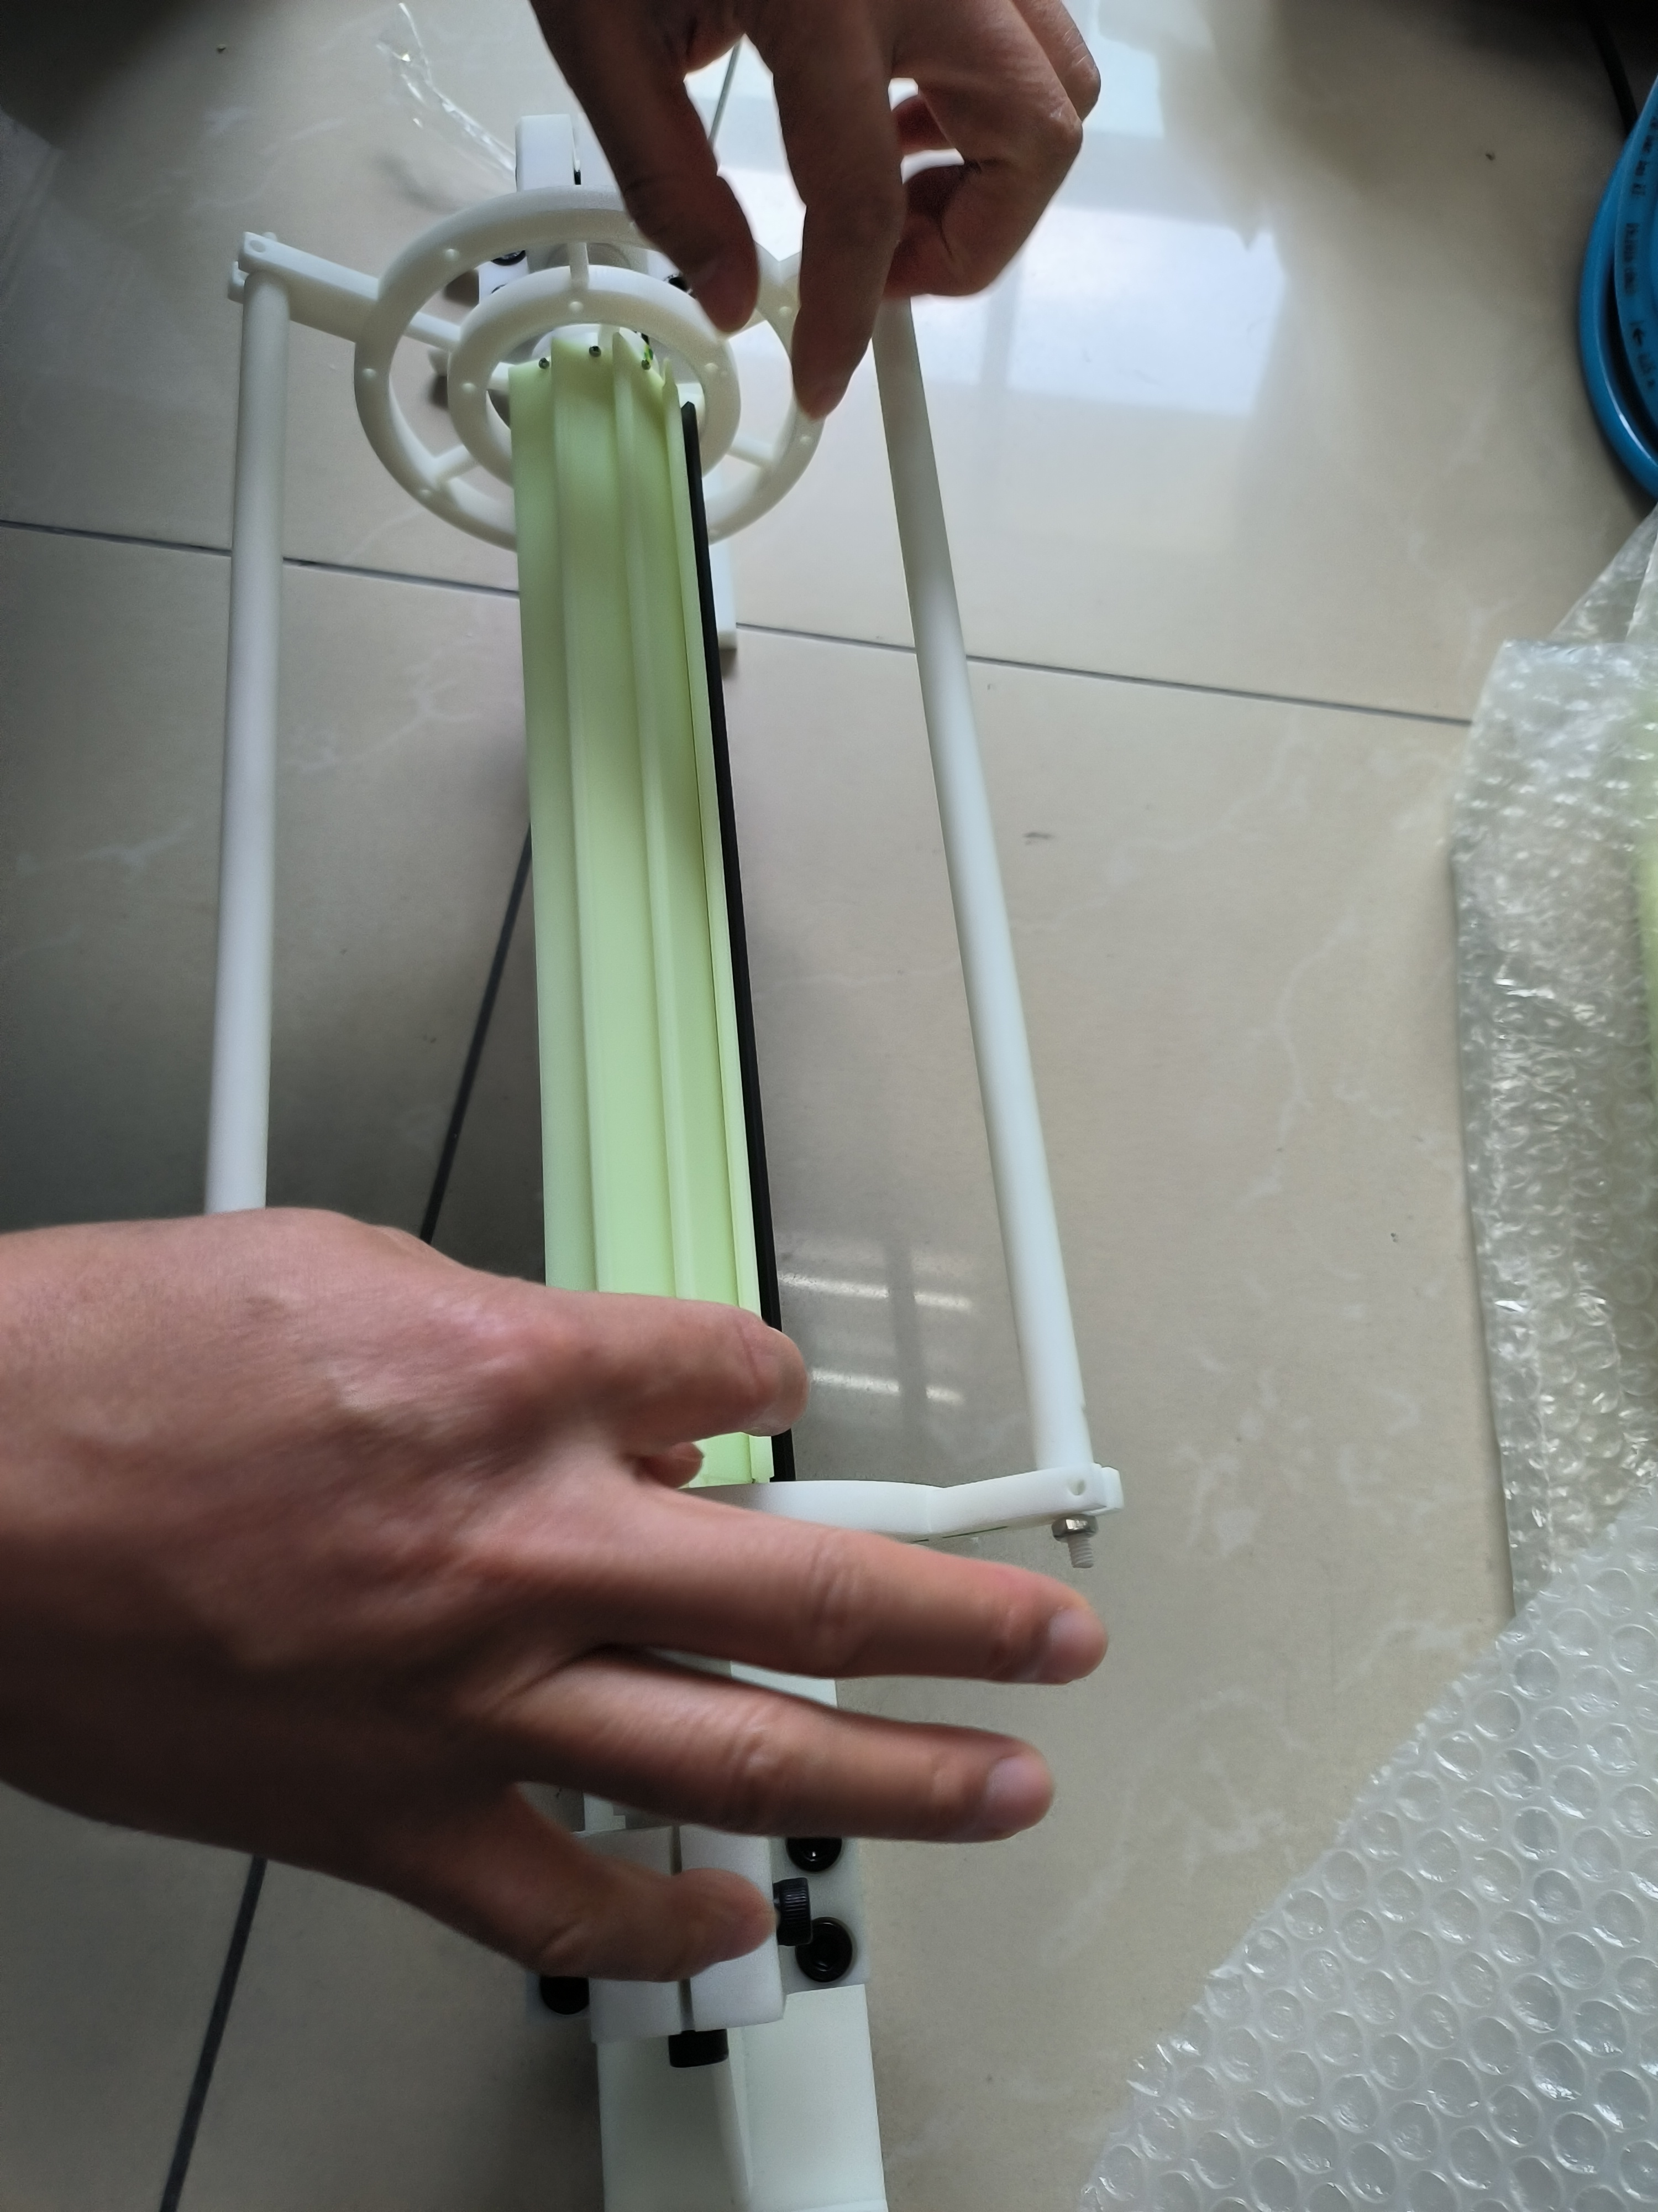
Vertex detector prototype assembly procedure
Ladder installation procedure designed
Mockup with 3D printing production done
Talks will be scheduled next week
Mockup with 3D printing

Slide 9
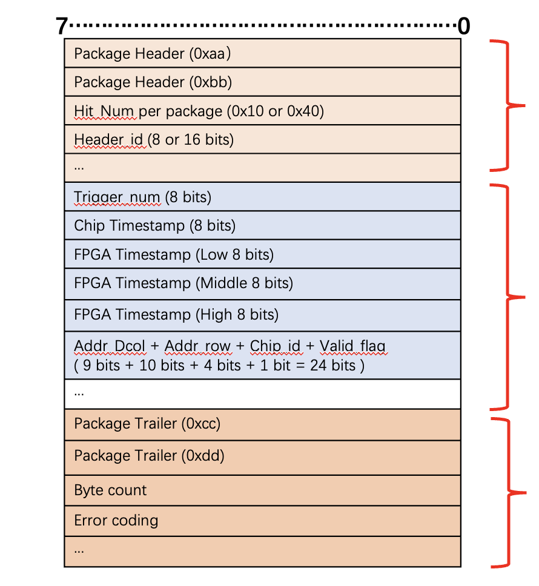
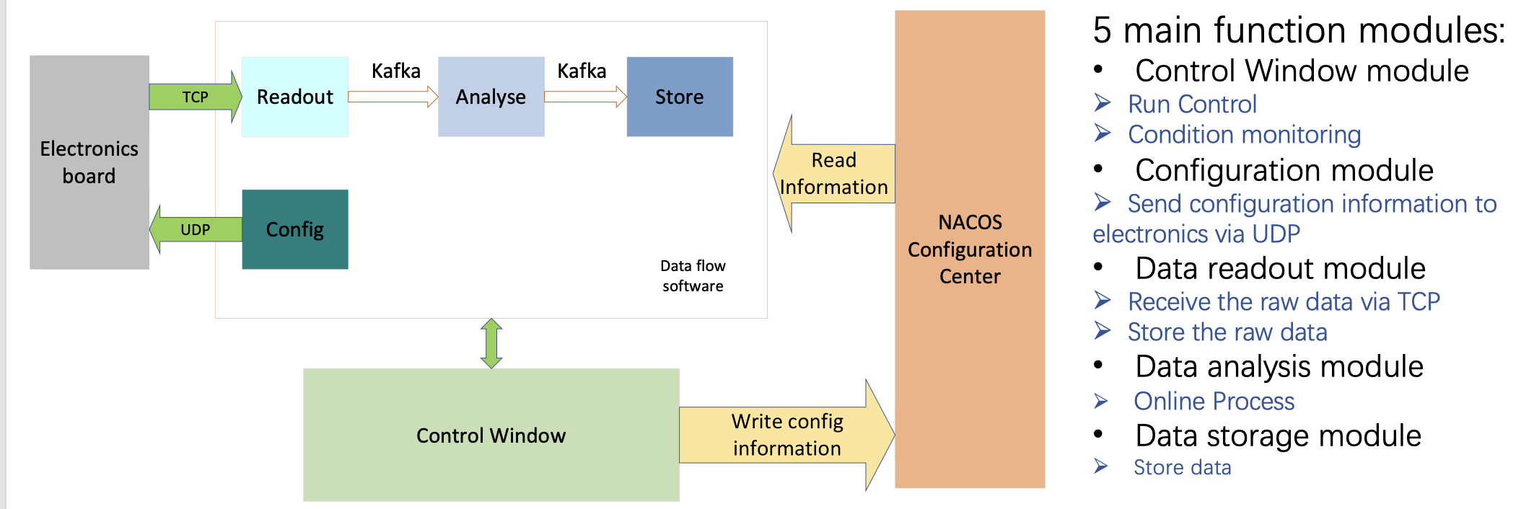
DAQ Architecture development
DAQ Architecture and data structure are defined
Discussion of DAQ data structure last week
data structure
DAQ Architecture

Slide 10
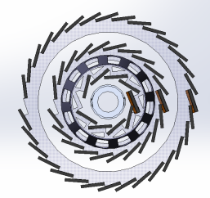
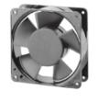
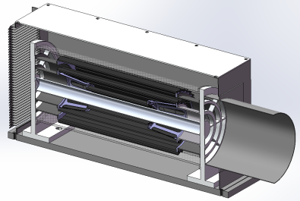
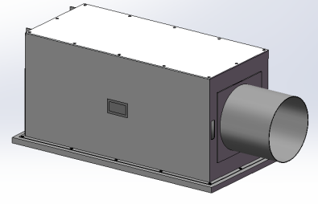
Plan for test beam
Expect to perform beam test in DESY(3 - 7GeV electron beams)
IHEP test beam facility as backup plan (a few hundreds MeV electrons )
Enclosure for detector with air cooling is developed for beam test
Beam is shooting at one sectors of vertex detectors
List of people
Request for Invitation letter
List of equipment
DESY test beam
Beam
Beam
outlet
Beam
inlet

Slide 11
Plan for test beam
Person power, expertise
Ming Qi (NJU, overall)
Zhijun Liang (IHEP, overall)
Tianya Wu(IHEP, ASIC)
Xiaomin Wei(NWPU, ASIC )
Jia Zhou (DAQ)
Ziyue Yan (firmware)
Needs more DAQ software, firmware and offline expertise

Slide 12
Instrumentations
1. vertex detector prototype
2. FPGA boards (15 boards including JTAG adapter)
3. Test PC (2 personal computers. one for test one for backup)
3 PC for DAQ, electronics , offline ?
2T haredisk , 交换机switcher (24 channels, 8 channels …),
temp monitoring slow control (PC needed)
Power adaptors …, 4-5 DC power supply
4. Several DC power supply (borrow it from DESY?)
5. Several network cables and other cables.
6. Borrow one oscilloscope for debug

Slide 13
Timeline
ASIC
ASICs arrive to IHEP (June)
Dicing and Thinning (one wafer dicing before wafer-level tests) (June)
Single ASIC testing
PCB under production ( Done)
Wire-bonding on test PCB … (Done)
Functional Tests … (on-going)
Laser, beta source test (Aug)
Irradiation test (Oct )
Wafer level testing
Wafer level test of ASICs (on-going)
Dicing , (thinning ?)

Slide 14
Timeline
Ladders Mechanics:
Now: Carbon support samples available
Pre-production carbon support ladders available
September: Production of final carbon support ladders (if needed)
Ladders Assembly:
May: Flex cable available
May: Test of wire bonding and gluing on carbon support
Tooling design and production (June)
Dummy sensor (Glass) assembly on flex (JUNE)
Jig tool , Wire bonding tests on flex (done)
Assembly of ladders with chips (August )

Slide 15
DAQ and multi-ASIC testing
Item | Time
TAICHU test board v1.1 | 6.9 - 6.23 (done)
TAICHU standalone test | 6.24 - ？
Bonding and test with flex4 v1.1 | 6.30 – 7.23
Interposer board production | 6.13 - 7.11
Power board (light interposer) production | 6.13 – 6.30 (done)
Flex2 v1.3 production | 6.13 – 7.4
Flex2 v1.3+interposer+fpga test (first prototype) | 7.23 – 8.23
Optimize and batch production | 8.23-？
Final system test

Slide 16
Schedule
August: Assembly first Barrel with ladder support only
September: mounting readout ladders
October: finished mounting the ladders, and readout tests
Earlier November: Finish assembly of prototype
November: Cosmic ray testing or BEPC beam test
December 12-22: DESY test beam (test beam time slot reserved for two weeks)

Slide 17
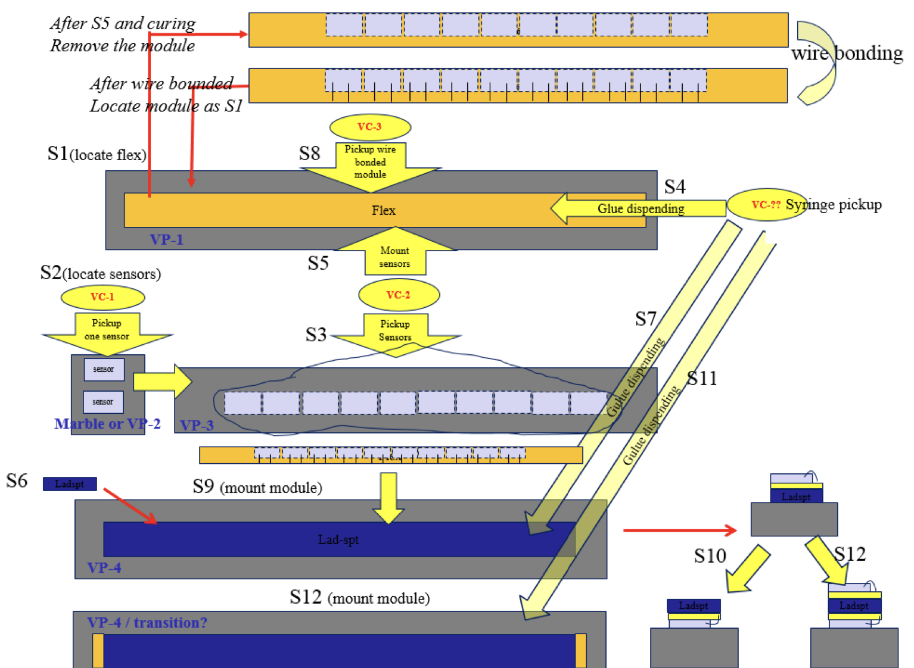
Backup
df

Slide 18
Timeline
ASIC
ASICs arrive to IHEP (June)
Dicing and Thinning (one wafer dicing before wafer-level tests) (June)
Single ASIC testing
PCB under production ( by Jun 24th )
Wire-bonding on test PCB … (June)
Functional Tests … (June)
Laser, beta source test (July)
Irradiation test (July )
Wafer level testing
Wafer level test of ASICs (End of June)
Dicing , (thinning ?)

Slide 19
Timeline
Ladders Mechanics:
Now: Carbon support samples available
May: Pre-production carbon support ladders available
August: Production of final carbon support ladders (if needed)
Ladders Assembly:
May: Flex cable available
May: Test of wire bonding and gluing on carbon support
Tooling design and production (June)
Dummy sensor (Glass) assembly on flex (JUNE)
Jig tool , Wire bonding tests on flex (July)
Assembly of ladders with chips (August )

Slide 20
DAQ and multi-ASIC testing
Item | Time
TAICHU test board v1.1 | 6.9 - 6.23 (done)
TAICHU standalone test | 6.24 - ？
Bonding and test with flex4 v1.1 | 6.30 – 7.23
Interposer board production | 6.13 - 7.11
Power board (light interposer) production | 6.13 – 6.30 (done)
Flex2 v1.3 production | 6.13 – 7.4
Flex2 v1.3+interposer+fpga test (first prototype) | 7.23 – 8.23
Optimize and batch production | 8.23-？
Final system test
DAQ status report today

Slide 21
Time line
Barrel Prototype:
June: Installation mock-up (3D printed)
Received large part of 3D models from Jinyu today, printing now
July: Barrel support parts fabricated
August: Assembly first Barrel with ladder support only
Update from Xinghui today
September: mounting readout ladders
October: finished mounting the ladders, and readout tests
Earlier November: Finish assembly of prototype
November: Cosmic ray testing or BEPC beam test
December: DESY test beam

