Slide 1
CEPC Vertex Detector R&D DAQ

Slide 2
Chip layout
Each chip : 1024 * 512
ladder
Which?
or


Slide 3
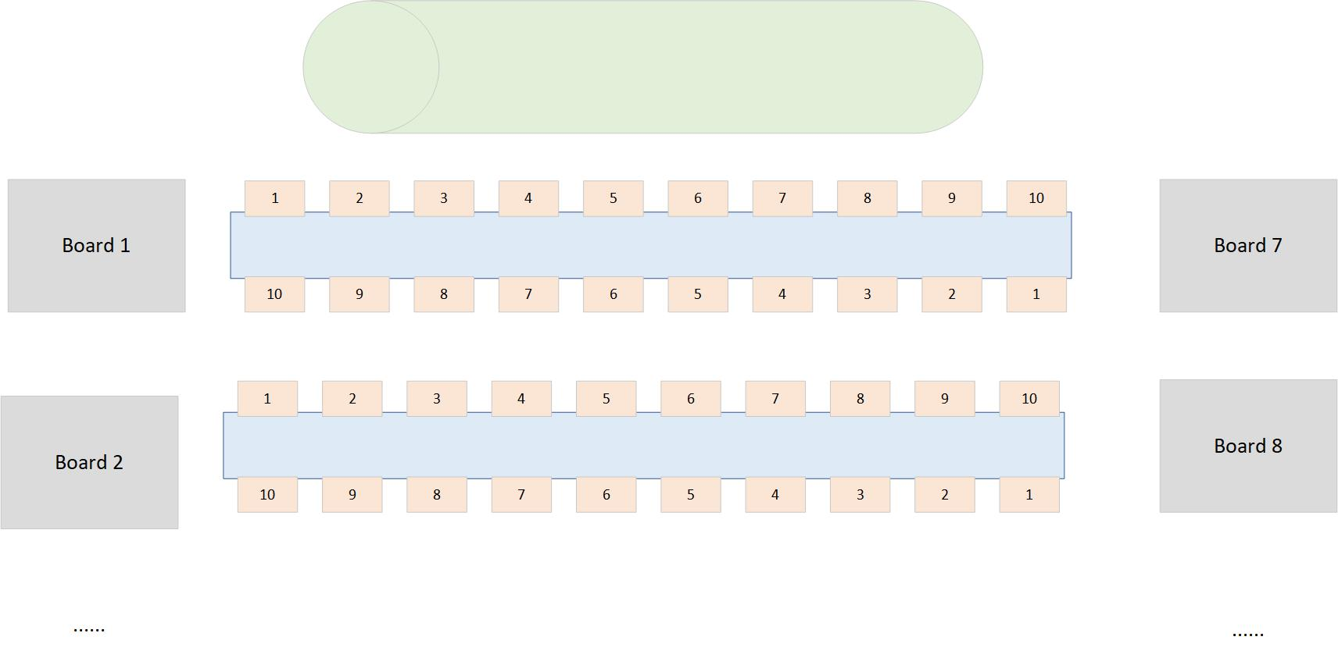
Chip id

Slide 4
Configuration process
The configuration information is sent to the electronics board through UDP
After completing the configuration, electronics sends the "configuration completion" message to DAQ?
Polling flag bit （Empty function module，complete later)
Wait long enough (several minutes ?)
3.DAQ sends “start” command to Run Control board
4.When it is necessary to end data retrieval, DAQ sends the “stop” command to Run Control board

