Slide 1
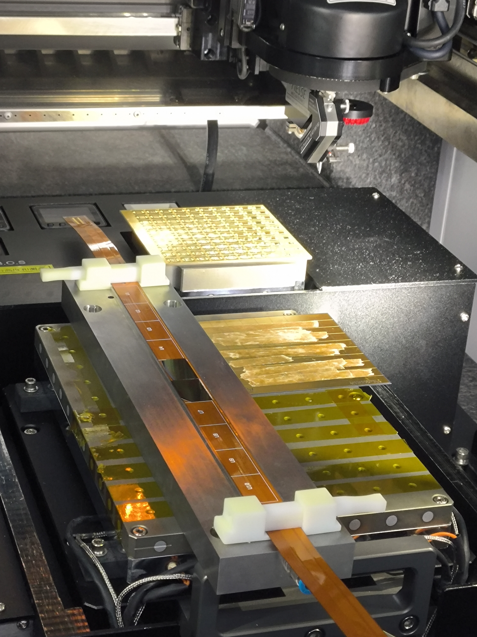
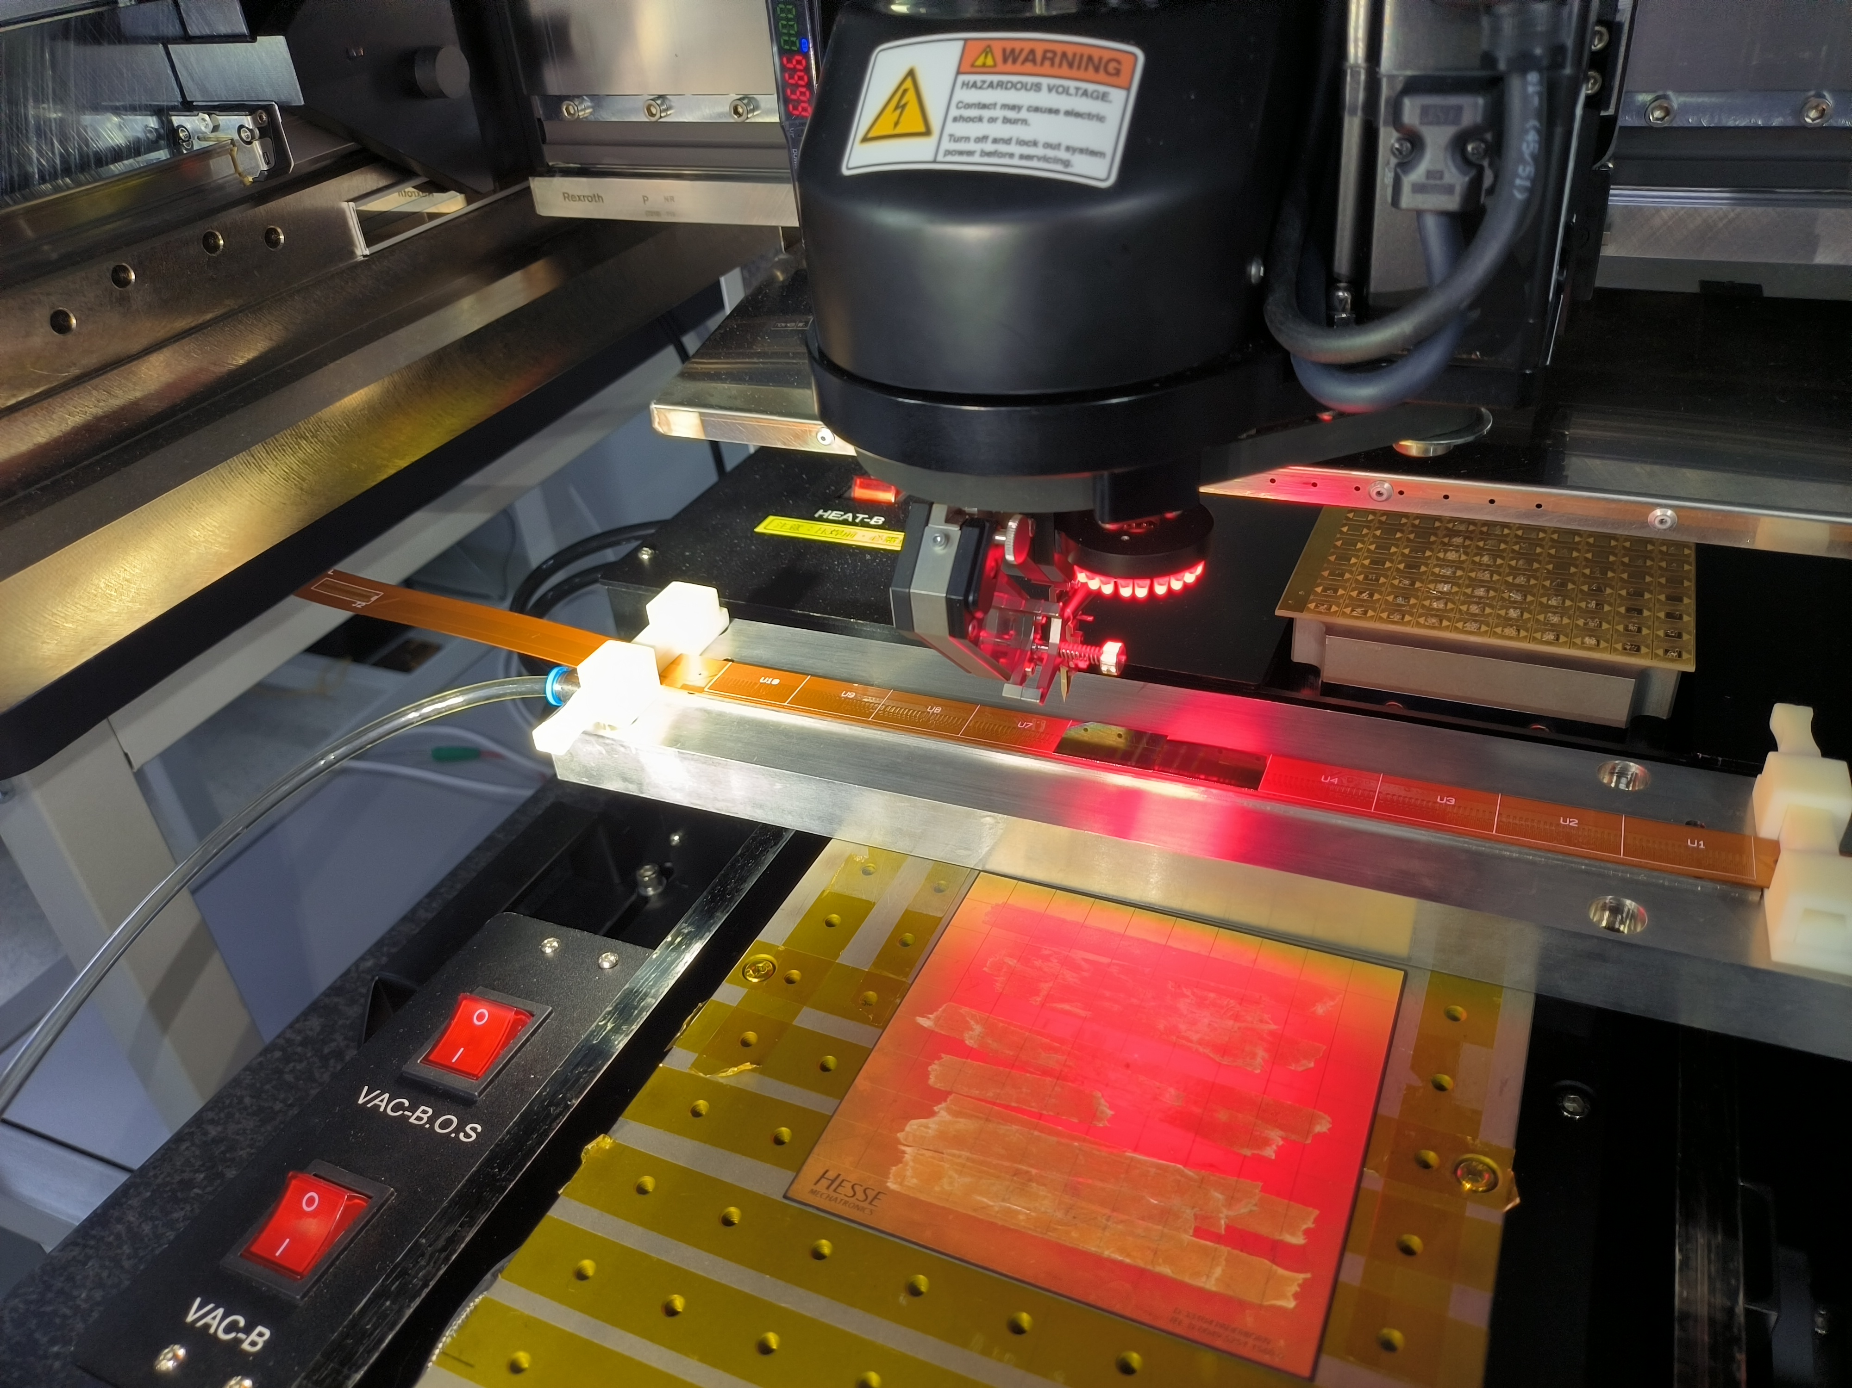
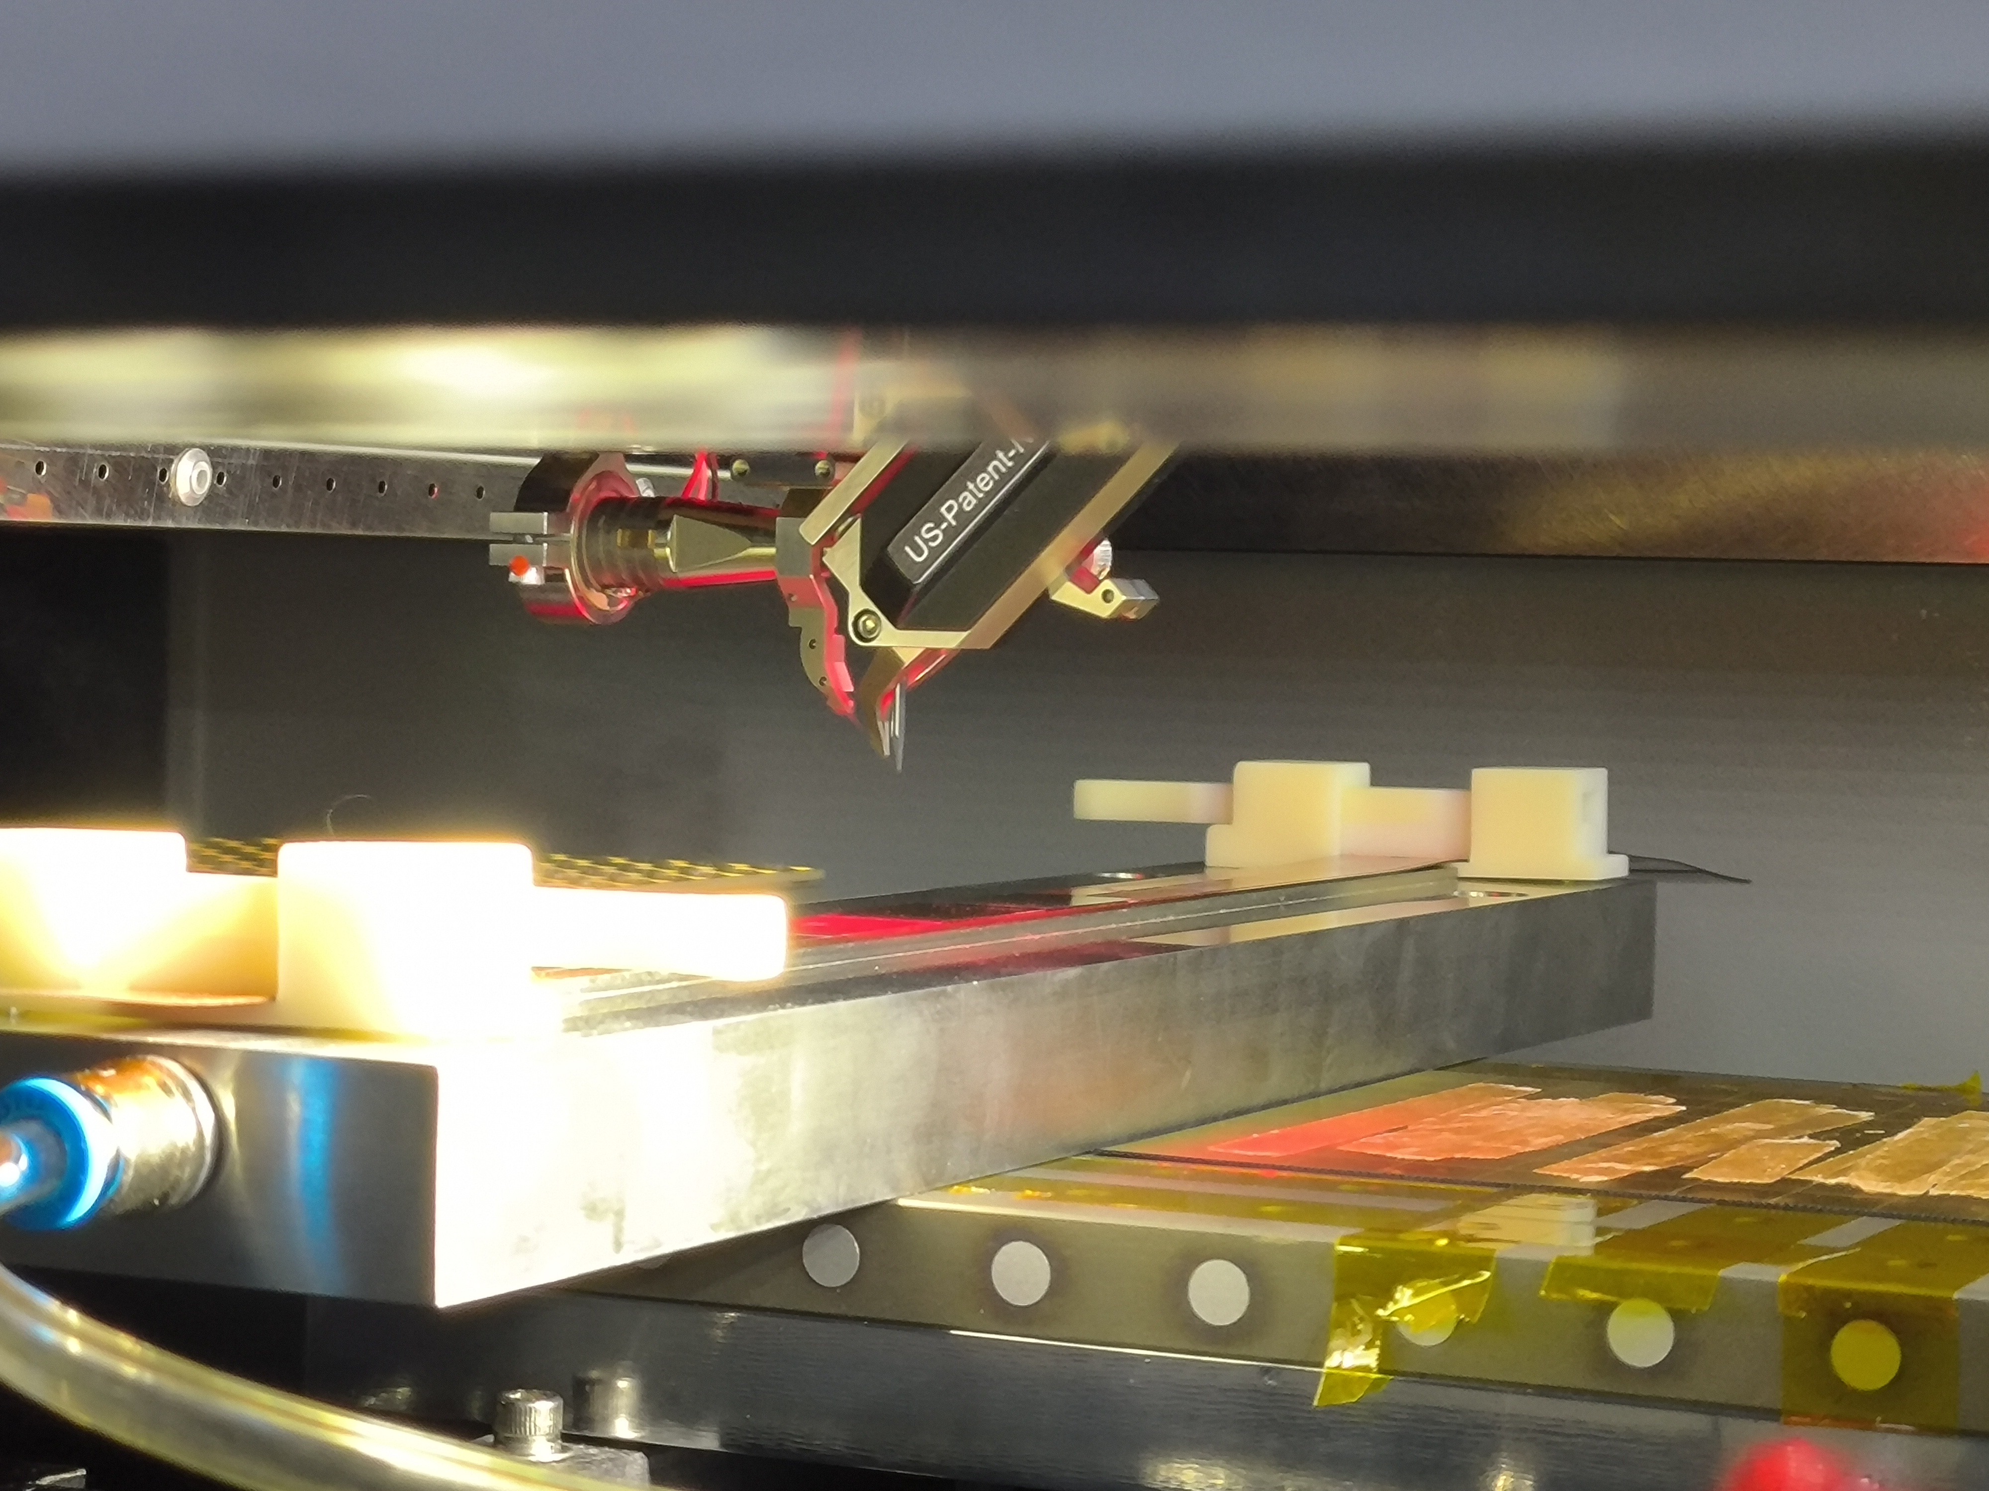
Status of flex board
A flex wire bonding support was designed, a small optimization will be done to match the wire bonding machine.
The TaichuPix3 at the edge is difficult to reach while wire bonding
The flex support height should be halved to match the wire machine.

Slide 2
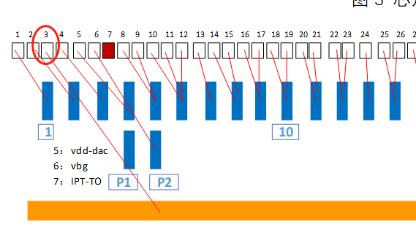
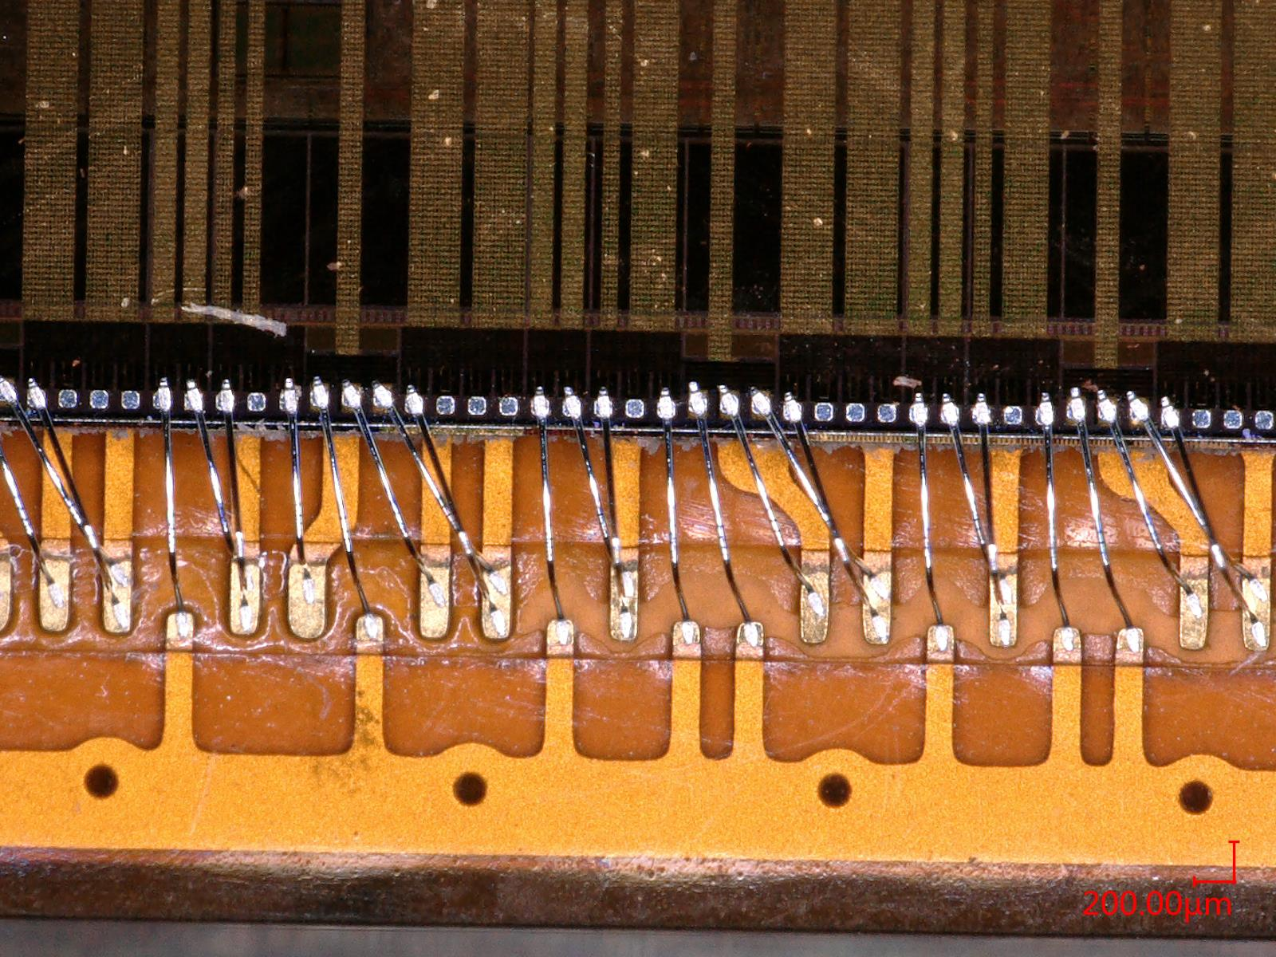
Status of flex board
Preliminary Flex boards were produced, some optimizations can be done to improve the wire bonding yield at IHEP.
Challenges:
227 pads on TCX3 connect to 114 pins on PCB, the rule is complicated to check wires one by one.
The GND bus on flex was faded, no wire contacts.
For some pins on PCB maps to 3 wires, the dimension of pins is limited.

Slide 3
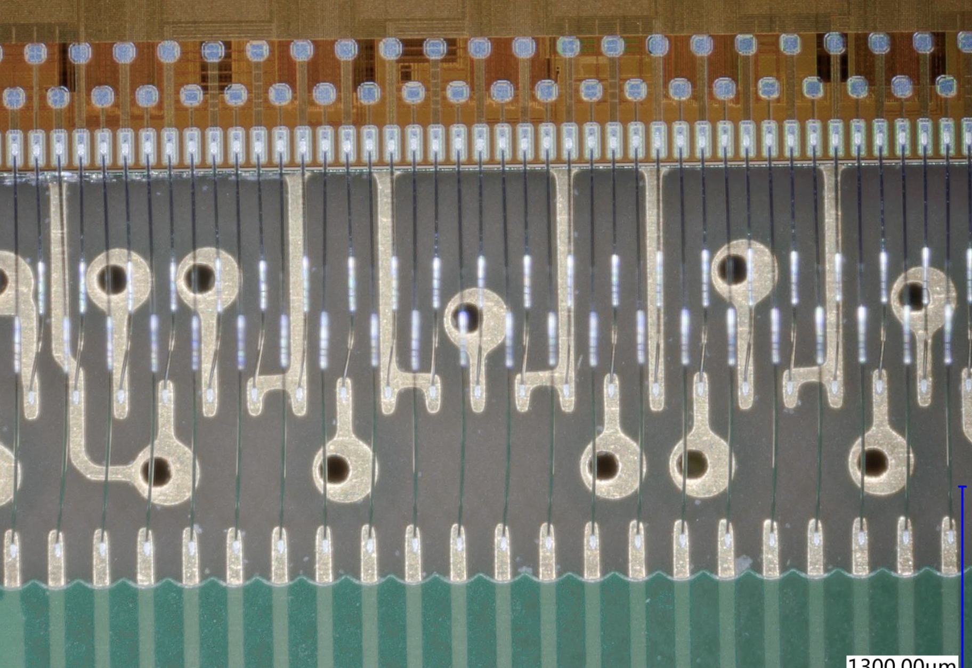
Suggestions on Flex board
For wire bonding at IHEP
→Expecting a map that pads on TCX3 match pins on flex(one by one), keep the same design but increasing the pins density on flex board.
An example of two rows pins
In this way, it is easier for engineer to verify the position of each pin.

Slide 4
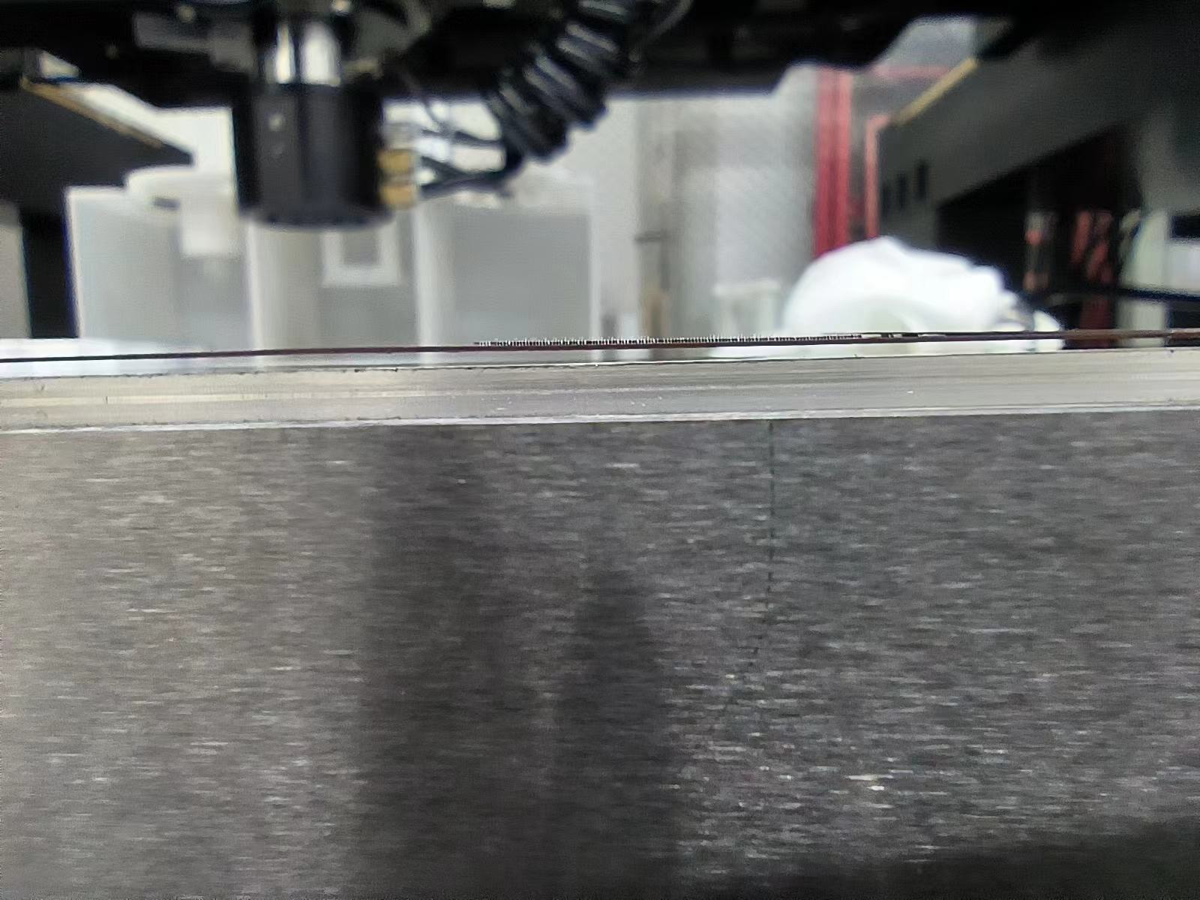
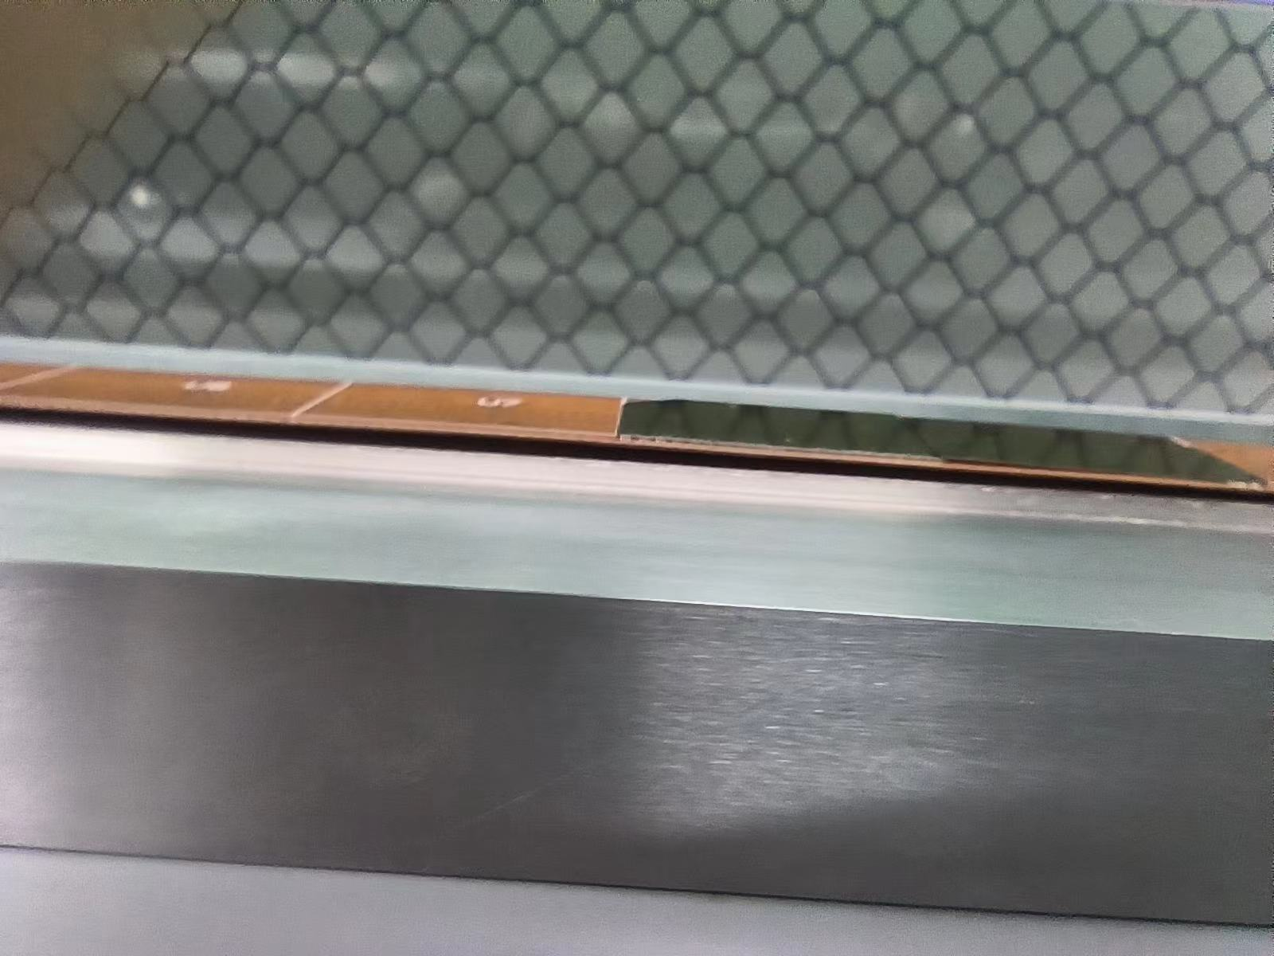
Some potential issues
How to assemble the ladder from flex support?
Flex can be fixed on the support tightly after vacuuming
when the vacuum is finished, the flex will arch up in the middle region.
The wires still connect on the board, more experiments need to be done to ensure the wire bonding.

