Slide 1
EW Amplitudes without Gauge Cancellation
Junmou Chen (Jinan University(Guangdong))
For SYSU-PKU Collider Physics forum For Young Scientists
Based mainly on 2203.10440
In collaboration with Kaoru Hagiwara, Junichi Kanzaki, Kentarou Mawatari
See also 1611.00788, 1902.06738

Slide 2
1. MotivationL: problems of Feynman Diagram
2. Solution: “new Feynman Diagram”
3. Numerical Implmentation
3.1 Implementation at HELAS
3.2 Numerical Results

Slide 3
1. Motivation: subtle gauge cancellation

Slide 4
1 Motivation: subtle gauge cancellation
Longitudinal Vector boson: $ε_{L}^{μ}\sim k^{μ}/m$ ~ $E/$m
Amplitude: $A\left(V_{L}^{1},..,V_{L}^{n}\right)$~ ${(E/\text{m}\text{)}}^{n},$ by naïve power counting
Physical meanings:
Unphysical energy increase for single (Feynman) diagrams
Large cancellation between diagrams to restore unitarity (Higgs boson plays an essential role )

Slide 5
1 Motivation: subtle gauge cancellation
Example: WW>WW
Final Amplitude:
No inconsistency with Higgs boson

Slide 6
1. Motivation: subtle gauge cancellation
Theoretical Problems
Power counting does not work
Single diagrams don’t have physical interpretations when poles on-shell
SMEFT with Higgs couplings
Collinear splitting functions; soft functions and etc.
Others

Slide 7
Goldstone equivalence theorem(GET)
See, e.g. Nucl. Phys. B 261, 379 (1985)
M. S. Chanowitz and M. K. Gaillard
GET is not enough.

Slide 8

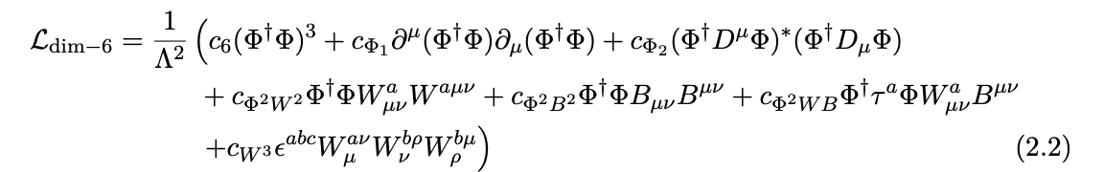
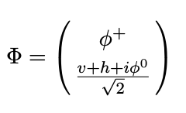
1. Motivation: subtle gauge cancellation
Theoretical Problems
Ex.1: SMEFT and Higgs Couplings Measurement
Measuring Higgs couplings
through Higgs (mainstream)
b) through
See e.g. Hennings et.al, Phys. Rev. Lett. 123, 18180

Slide 9
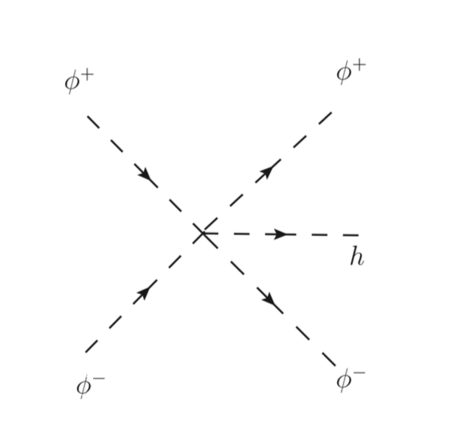
1. Motivation: subtle gauge cancellation
Theoretical Problems
Ex1: SMEFT and Higgs Couplings Measurement
Measuring Higgs self-couplings through
(Mainstream: double Higgs production)
Importance is of the same level as hh production in muon colliders
Junmou Chen, Chih-Ting Ting, Yongcheng Wu, Tong Li
Chang-Yuan Yao
PhysRevD.105.053009
JHEP10(2021)099

Slide 10
1. Motivation: subtle gauge cancellation
Theoretical Problems
Ex1: SMEFT and Higgs Couplings Measurement
At what exactly range is on this picture(GET) valid? Corrections?
Even simpler amplitude WW>WW？
We need a method that manifests GET, but computes amplitudes exactly.

Slide 11
1Motivation: subtle gauge cancellation
Theoretical Problems
Ex.2: EW collinear splitting function
Splitting function important to collider physics
ISR, parton distribution & (DGLAP) evolution:
FSR, parton showers:
splitting function

Slide 12
1 Motivation: subtle gauge cancellation
Theoretical Problems
Ex.2: EW collinear splitting function
Calculation:
as
by power counting
Something is wrong! The same origin of WW scattering!

Slide 13

1. Motivation: subtle gauge cancellation
Theoretical Problems
Ex.2: EW collinear splitting function
Calculation:
Taking GET gives the wrong answer
(for light quarks)
Effective W approximation

Slide 14
1. Motivation: subtle gauge cancellation
Theoretical Problems
Ex.2: EW collinear splitting function
A series of new splitting functions: cannot be captured by GET,
We need systematic vev corrections
Full list published first time in
1611.00788 (JHEP 11 (2017) 093)
Junmou Chen, Tao Han, Brock Tweedie

Slide 15
1. Motivation: subtle gauge cancellation
Numerical Problem
Cancellation between large numbers(diagrams) easily leads to errors
Total cross section of WW > ZZ
when t/u channel propagators are
given physical decay width
(Madgraph before v3_** versions)

Slide 16
1. Motivation: subtle gauge cancellation
Numerical Problem: Cancellation between large numbers(diagrams)
Computing efficiency
Madgraph v3_2_0
pp > jj w+{0}w-{0}h:
Event no: 147/10000
pp > jj w+{T}w-{T}h:

Slide 17
2. Solution: “New Feynman Rule(Diagram)”

Slide 18
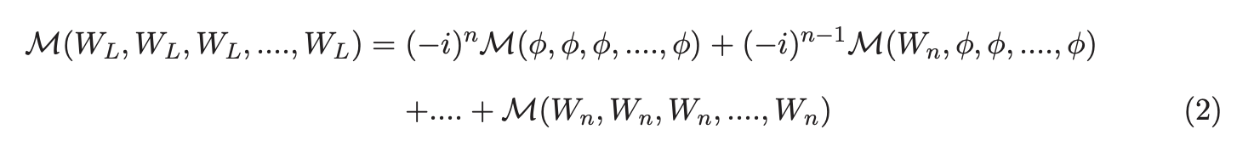
2. Solution: “New Feynman Diagram”
Goldstone equivalence theorem(GET)
Can be extended to full equality(On-shell gauge symmetry )
(From gauge symmetry)
:
GET
N-point amplitudes:
The terms (diagrams) on the RH are $2^{N}$ times of LH (Naïve est.)

Slide 19

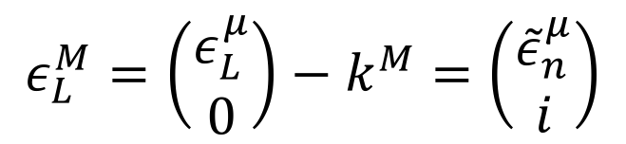
2. Solution: “New Feynman Diagram”
5-component formalism
$$g_{MN}=diag(1,−1,−1,−1,−1)$$
$$k^{M}=\left(\begin{matrix}k^{μ} \\ im_{V}\end{matrix}\right)$$
GET
;
Polarization vector
$$ε_{L}^{M}=\left(\begin{matrix}ε_{L}^{μ} \\ 0\end{matrix}\right)−k^{M}=\left(\begin{matrix}{\tilde{ε}}_{n}^{μ} \\ i\end{matrix}\right)$$
Well behaved in high energy and a single object
Gauge and Goldstone components combined together
N-point amplitudes(pol.vec., propagators, vertices)

Slide 20
2. Solution: “New Feynman Diagram”
Gauge Choice and Propagator: 5-components formalism
Simplest solution: Feynman Gauge

Slide 21
2. Solution: “New Feynman Diagram”
Gauge Choice and Propagator: 5-components formalism
Gauge cancellation exists also on the propagator
Unitary Gauge
energy increase
Energy increase too!
Feynman Gauge
Even Feynman gauge gives unphysical energy increase!

Slide 22
2. Solution: “New Feynman Diagram”
Gauge Choice and Propagator: 5-components formalism
Gauge cancellation exists also on the propagator (Rxi gauge)
Degrees of freedom in Feynman gauge
energy increase
Physical degrees of freedom
Even Feynman gauge gives unphysical energy increase!

Slide 23

2. Solution: “New Feynman Diagram”
Gauge Choice and Propagators: 5-components formalism
Goldstone equivalence gauge(GEG)
proposed in JHEP11(2017)093
Junmou Chen, Tao Han & Brock Tweedie
Gauge condition:
or
Transverse:
Longitudinal:
satisfies
does not satisfy
with
So where is $k^{μ}$ term?
“Scalarized” into Goldstone mode!

Slide 24
2. Solution: “New Feynman Diagram”
Gauge Choice and Propagators: 5-components formalism
Goldstone equivalence gauge(GEG)
When on-shell,
Gauge-Goldstone mixing terms
Pol. Vec. :

Slide 25
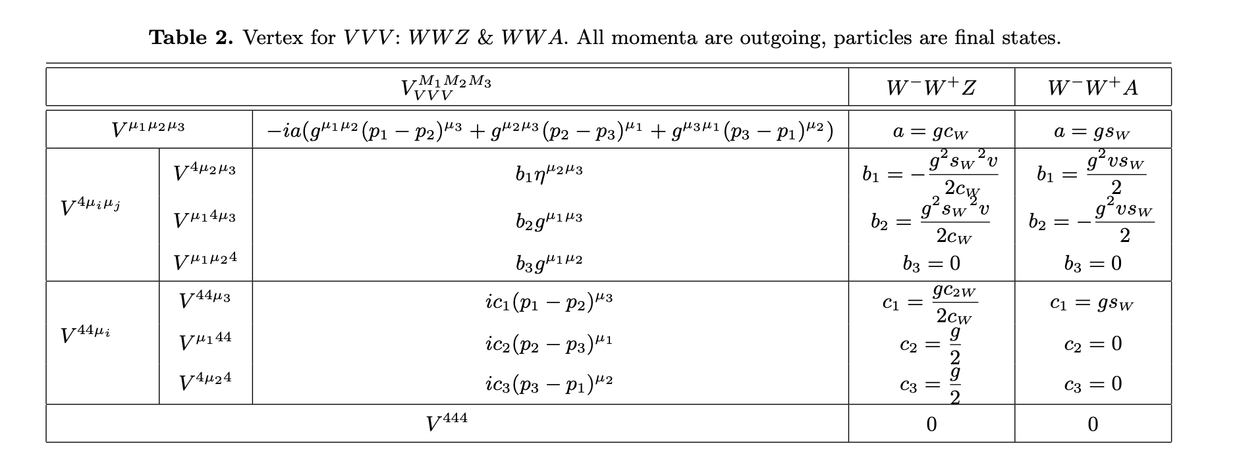
2. Solution: “New Feynman Diagram”
Vertices(SM)

Slide 26
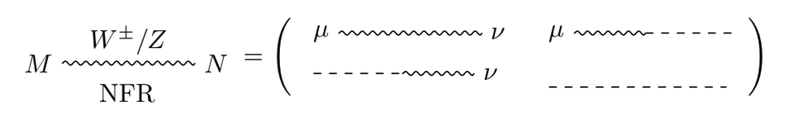
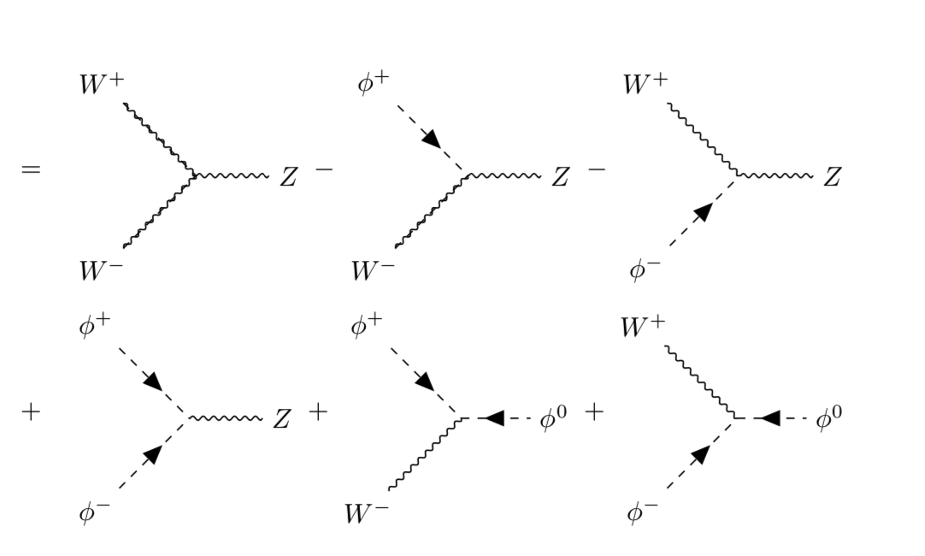
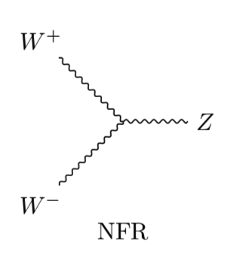

2. Solution: “New Feynman Diagram”
New Feynman Rule(SM)
Propagator:
WWZ:
NFR=New Feynman Rule
“wave function” of $φ$: $i$ for initial, $−i$ for final

Slide 27
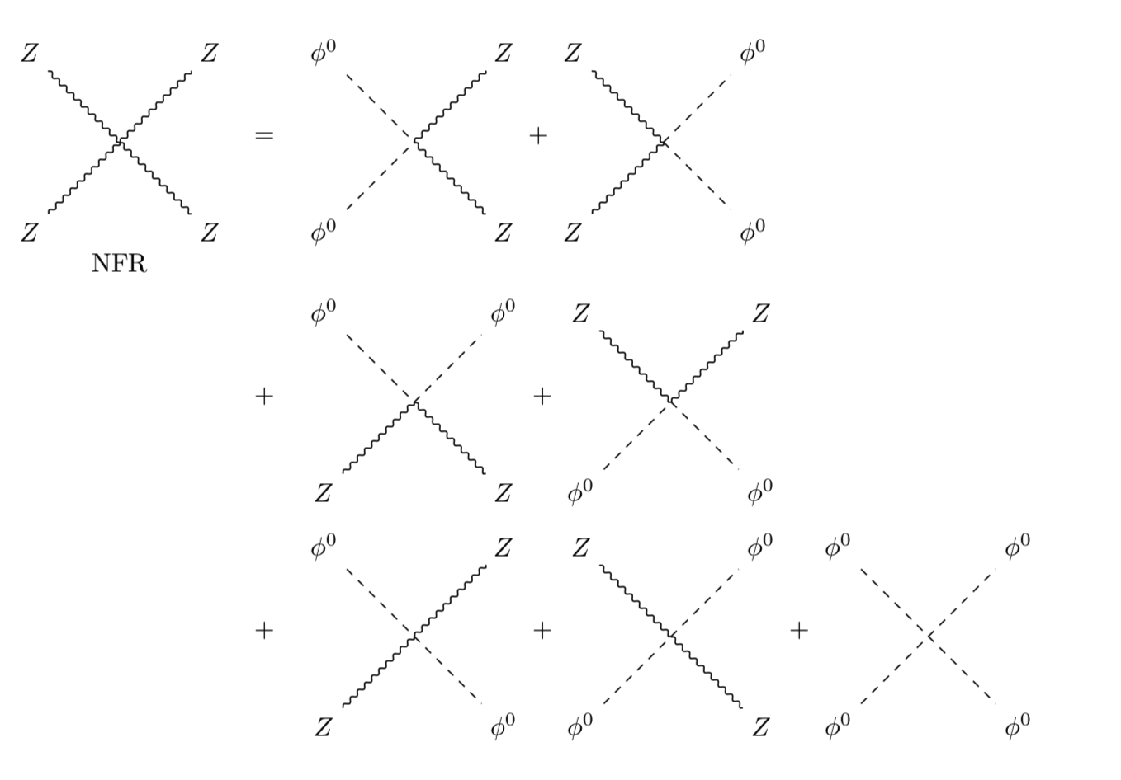
2. Solution: “New Feynman Diagram”
New Feynman Rule(SM)
Vertices doesn’t exist in “Old” Feynman Diagrams
ZZZZ:
NFR=New Feynman Rule

Slide 28
2. Solution: “New Feynman Diagram”
New Feynman Rule(SM)
Ex1: WW>WW
Notes: Intepretation of NFR are
wildly different from OFR
(Old Feynman Rules)
NFR=New Feynman Rule

Slide 29
2. Solution: “New Feynman Diagram”
New Feynman Rule(SM)
Ex2: ZZ>ZZ
Doesn’t exist in
“Old” Feynman Rules
NFR=New Feynman Rule

Slide 30
2. Solution: “New Feynman Diagram”
New Feynman Rule(SM)
Ex3: WW>Zh
Doesn’t exist in
“Old” Feynman Rules
NFR=New Feynman Rule

Slide 31
3.1 Numerical Implementation

Slide 32
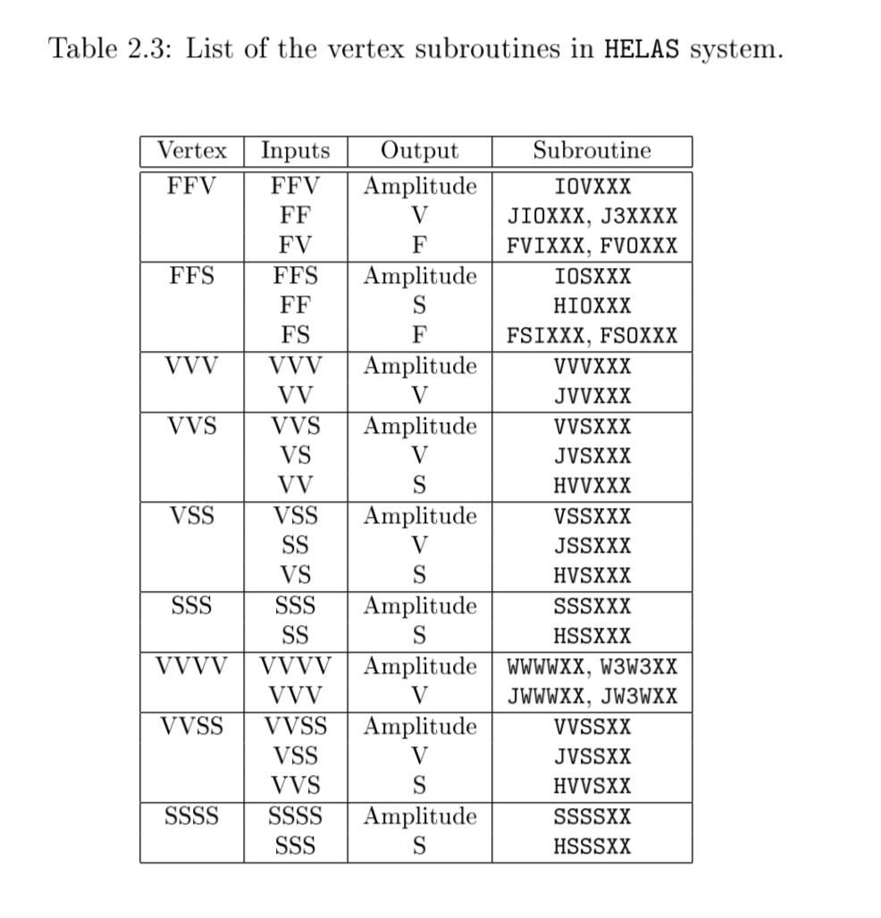
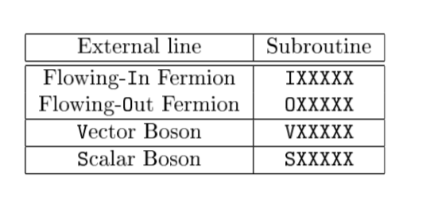
3.1 Numerical Implementation
(Old) HELAS(HELicity Amplitudes Subroutines) Introduction
HELAS compute amplitudes for Madgraph
See e.g. 1106.0522
HELAS Basic setup: subroutines
Vertices
External Lines

Slide 33
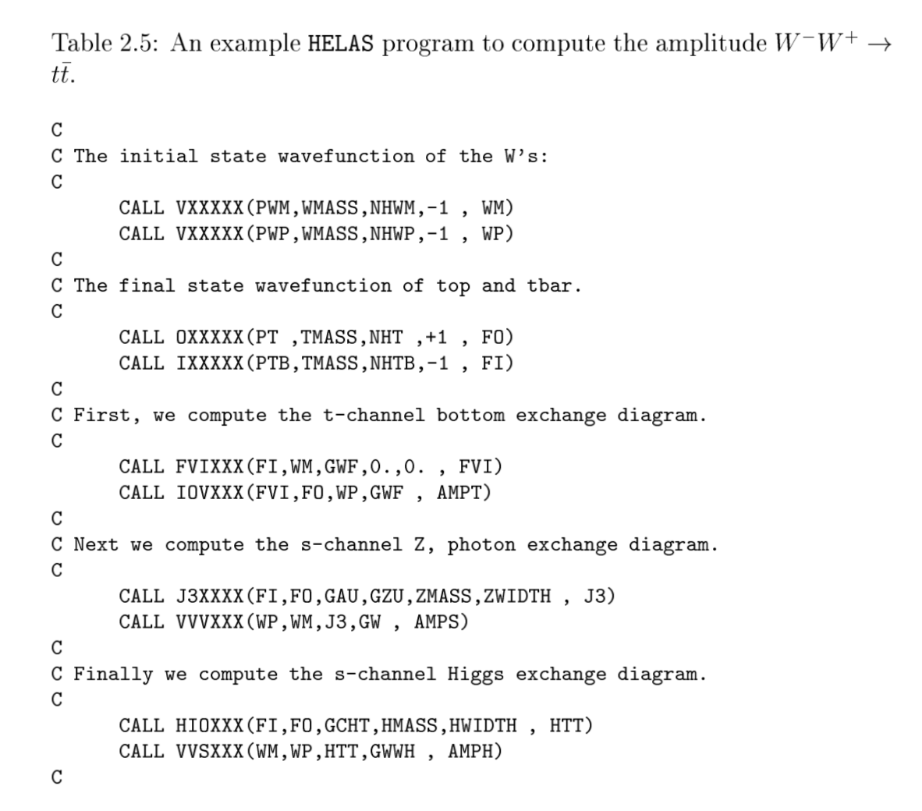
3. Numerical Implementation
(Old) HELAS(HELicity Amplitudes Subroutines) Introduction
Computing Amplitudes (Example)

Slide 34
3. Numerical Implementation
New HELAS (implementing “New Feynman Diagrams”)
1. Replace polarization vectors of W/Z to 5-component form
2. Replace propagators of W/Z to GEG in 5-component form
3. Extend vertices involving W/Z to incorporate Goldstone components
(4). Replace propagators of photon and gluons to parton shower gauge (counter part of GEG for massless case.)
5. Add vertices not existing in Old Feynman Rules(ZZZZ, WWZh,WWAh)
Codes can be found in https://madgraph.ipmu.jp/IPMU/Softwares/HELAS/index.html(HELAS V42)

Slide 35
3.2 Numerical Implementation

Slide 36
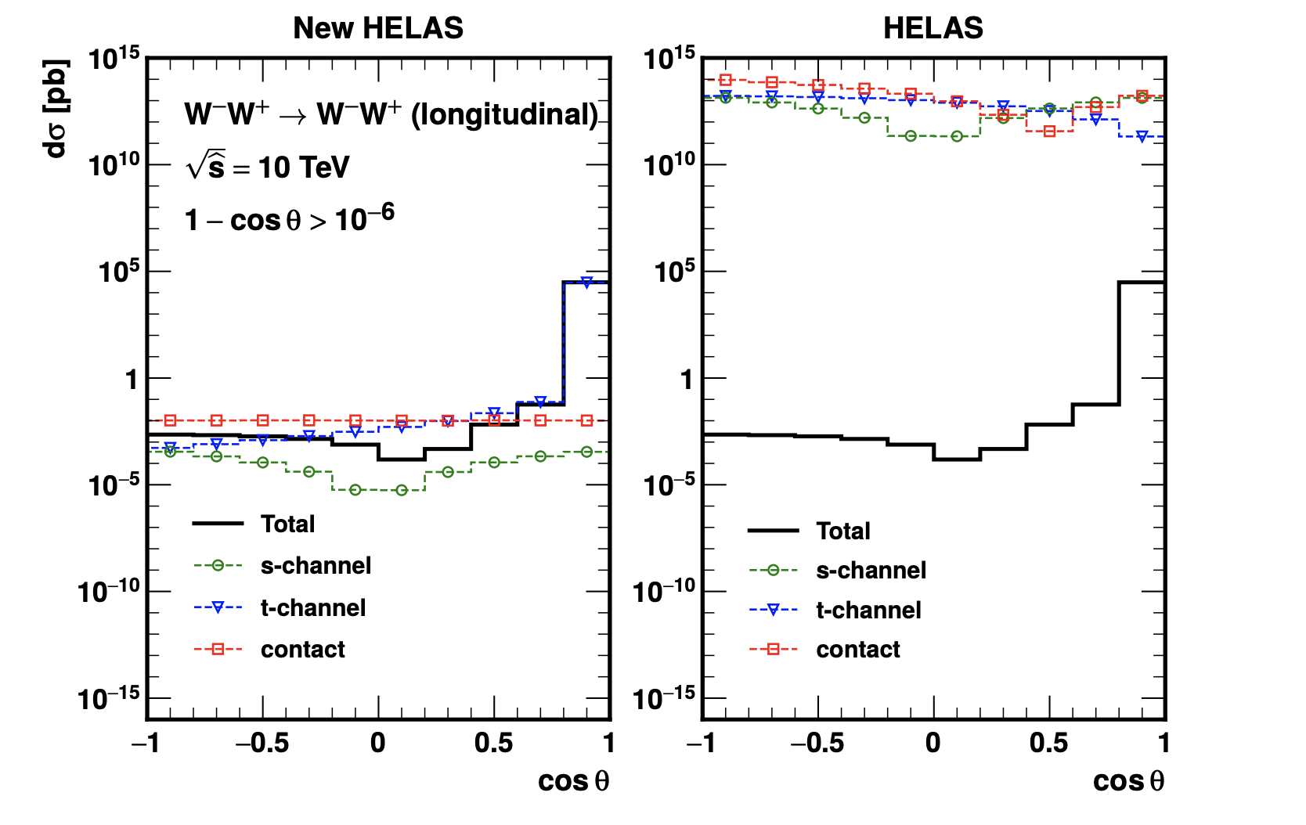
3.2 Numerical Results
New HELAS Results: 2→2 VBS
WW>WW

Slide 37
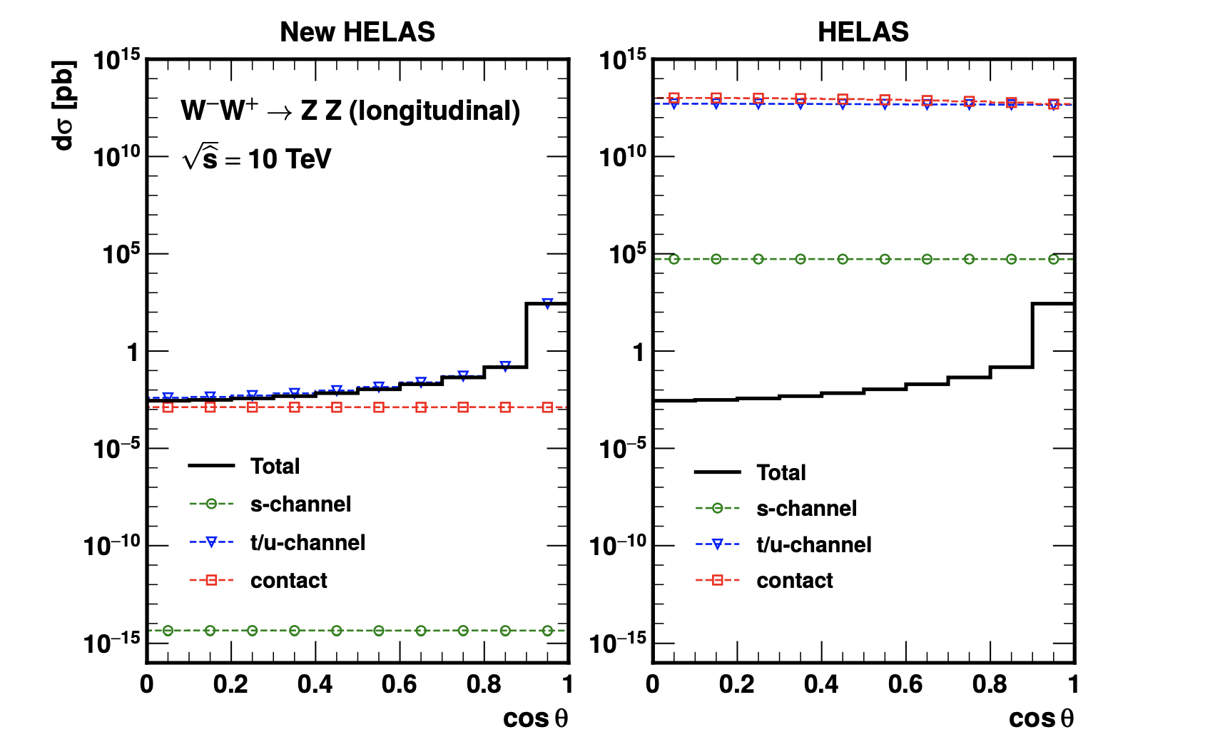
3.2 Numerical Results
New HELAS Results: 2→2 VBS
WW>ZZ

Slide 38
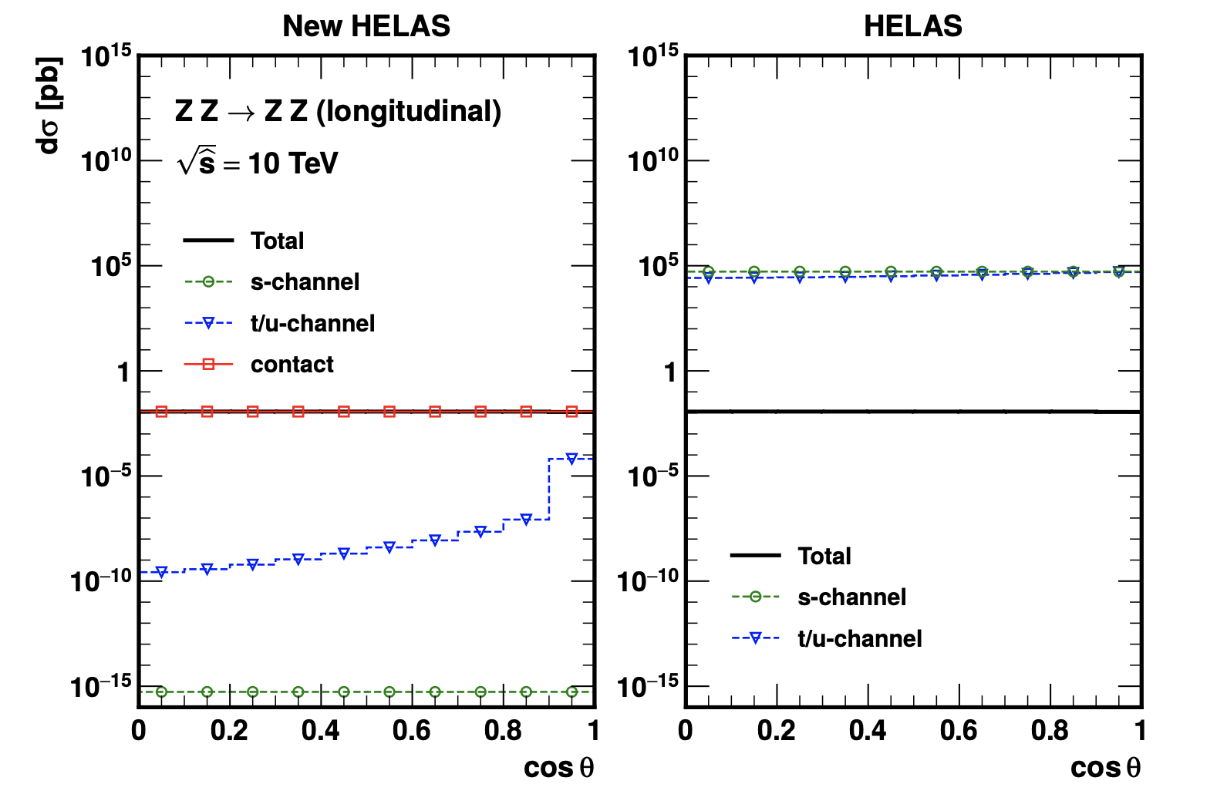
3.2 Numerical Results
New HELAS Results: 2→2 VBS
ZZ>ZZ

Slide 39
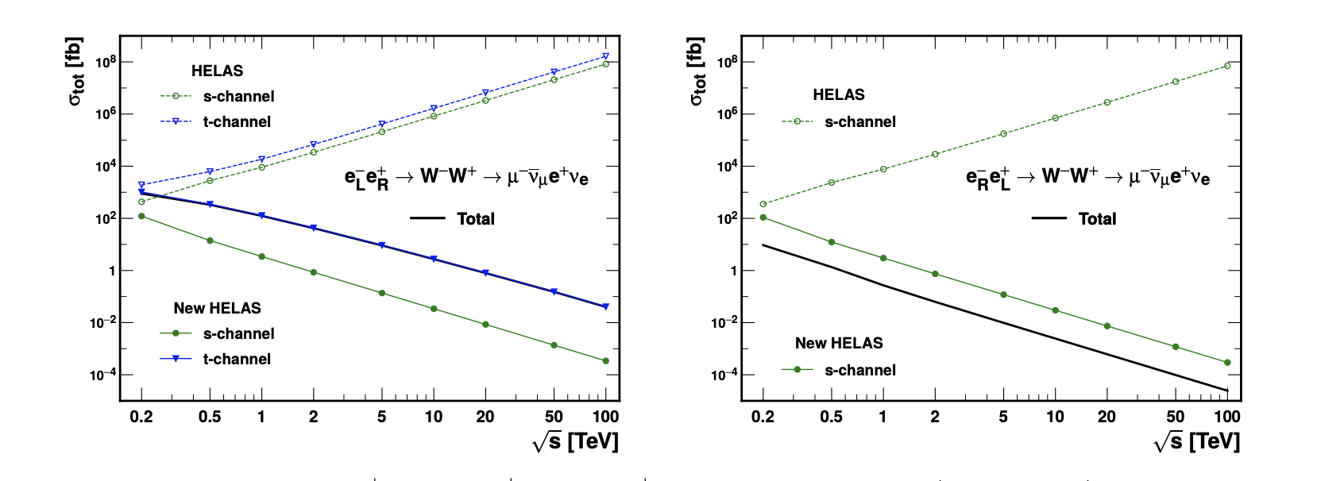
3.2 Numerical Results
New HELAS Results: VBS(WW production) at lepton colliders
: total cross section

Slide 40
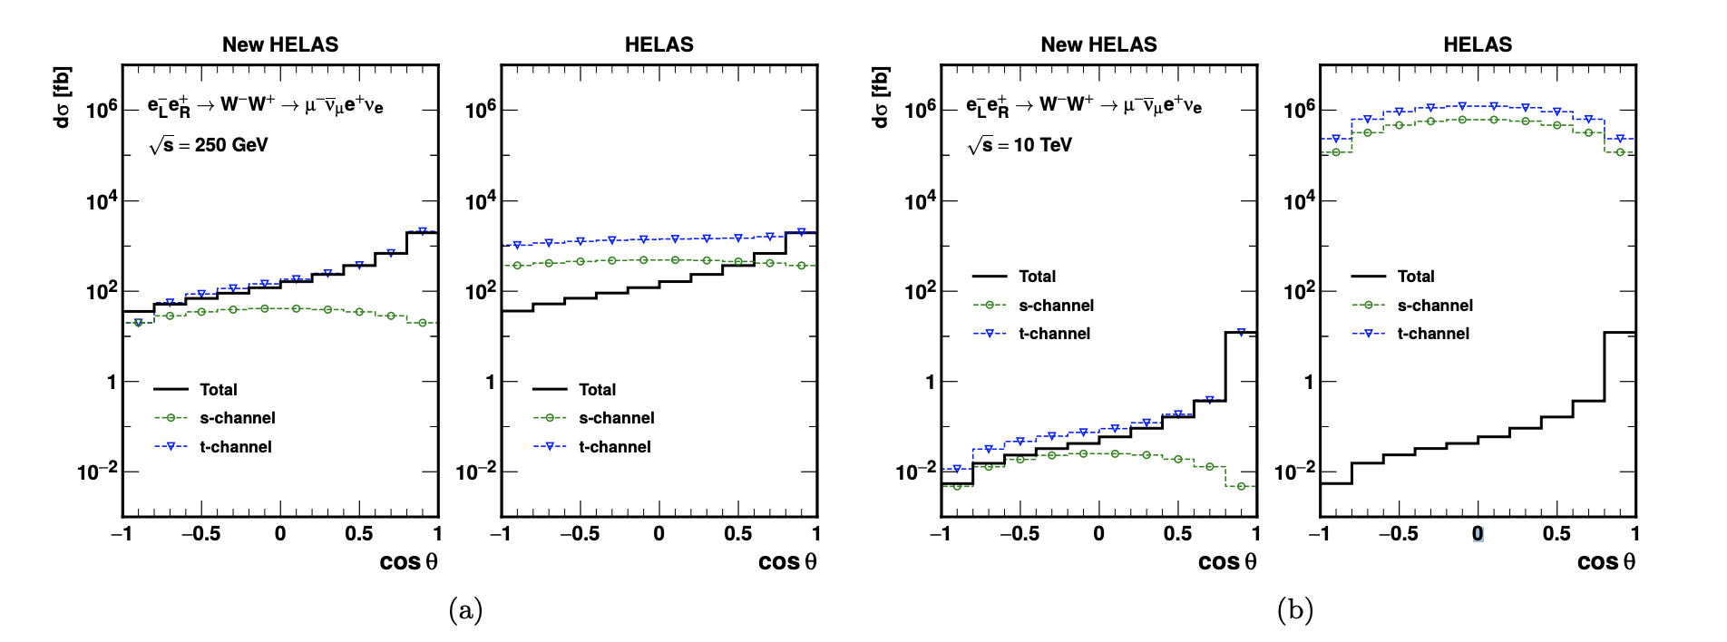
3.2 Numerical Results
New HELAS Results: WW production at lepton colliders
: angular distribution

Slide 41
Conclusion
We propose a formalism (New Feynman Diagram) to solve gauge cancellation of weak scattering amplitudes, including:
5-component pol. vec., propagators (in GEG), vertices
2. We implement NFD to HELAS(SM), and demonstrate some numerical
results
3. Future: Needs deeper understanding, to be integrated into Madgraph(? ) and with other models(?)

Slide 42
1 Motivation: subtle gauge cancellation
Theoretical Problems
Ex.2: EW collinear splitting function
When B//C (LH), i.e. collinear, A approaches on-shell
Factorization:
Calculation:

Slide 43
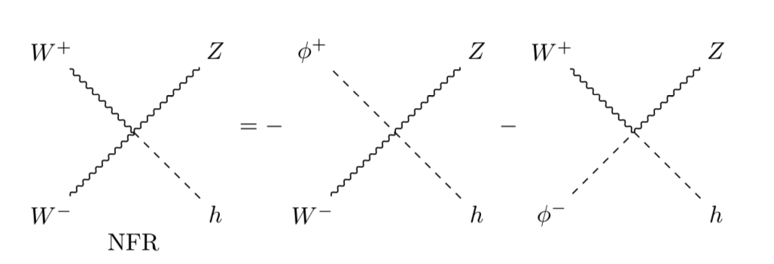
2. Solution: “New Feynman Diagram”
New Feynman Rule(SM)
Vertices doesn’t exist in “Old” Feynman Diagrams
WWZh/WWAh
NFR=New Feynman Rule

Slide 44
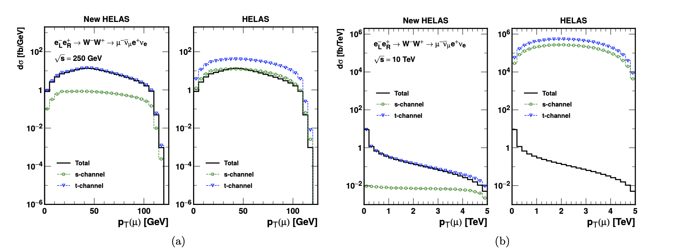
3.2 Numerical Results
New HELAS Results: WW production at lepton colliders
: pT(mu) distribution

Slide 45
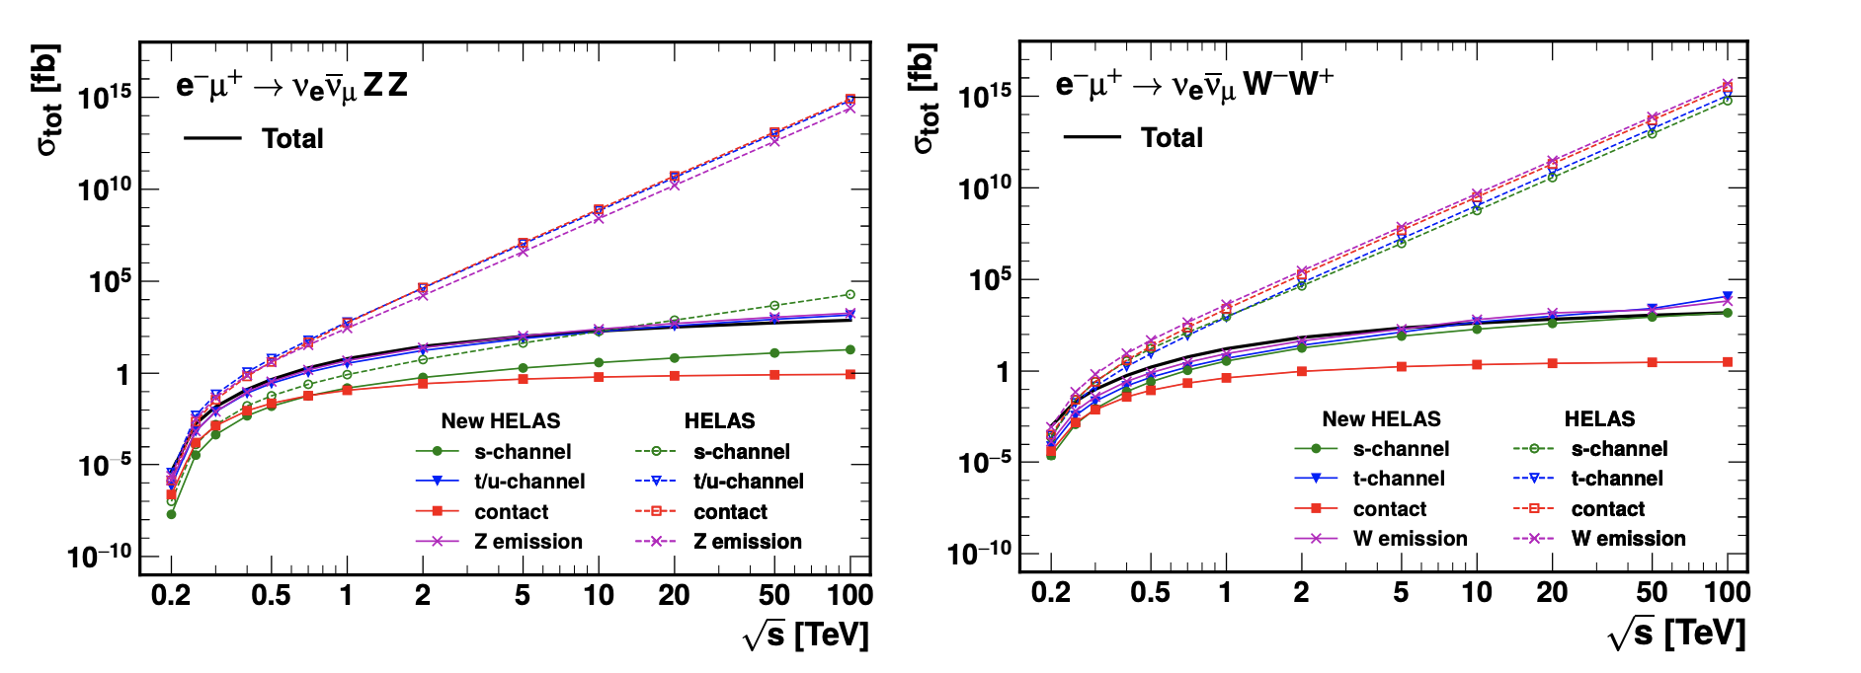
3.2 Numerical Results
New HELAS Results: VBS at lepton colliders
: total cross section

Slide 46
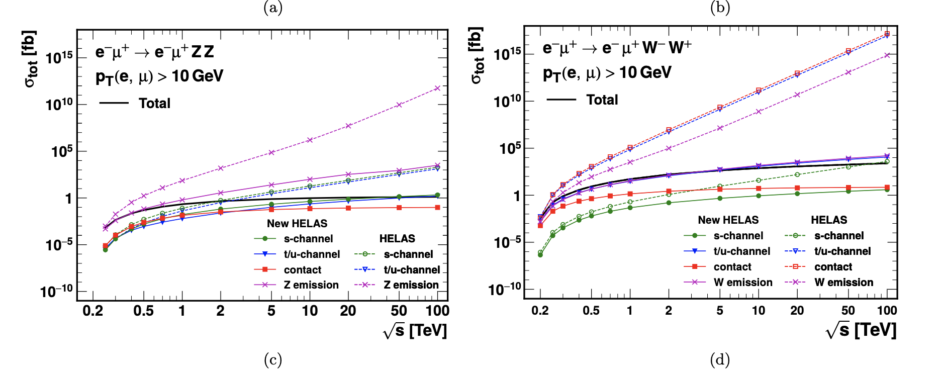
3.2 Numerical Results
New HELAS Results: VBS at lepton colliders
: total cross section

Slide 47
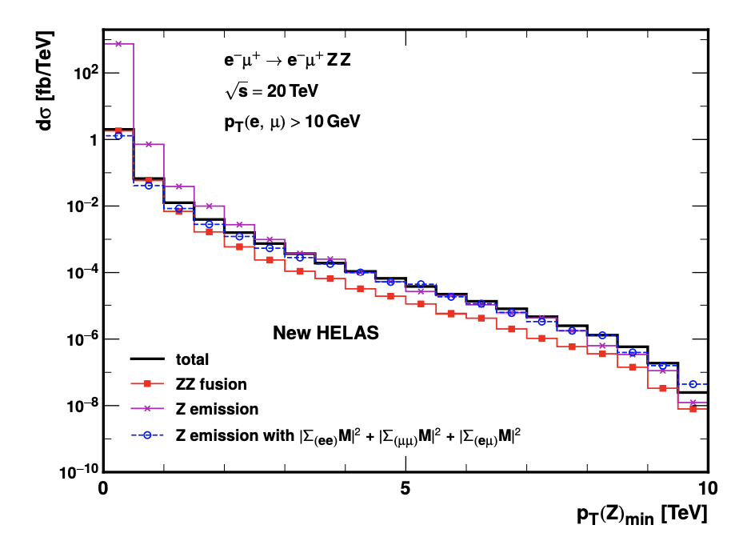
3.2 Numerical Results
New HELAS Results: VBS at lepton colliders
: gauge cancellation at small pT

