Slide 1
Probing the subatomic world using photon and electron scatterings
Xiaqing Li （李夏卿）
Hadronic Physics Group, Laboratory for Nuclear Science
Massachusetts Institute of Technology
August 17, 2022
Seminar at University of Chinese Academy of Sciences

Slide 2
Outline
Introduction
Compton scattering and nucleon polarizabilities
Electron scattering and nucleon 3D spin structures
  Fixed-target experiments at JLab and electron-ion collider at BNL
  Development on novel polarized ³He target and ion source
Summary

Slide 3
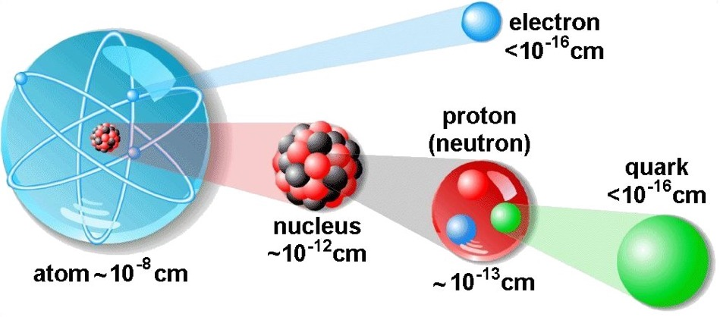
Nuclear physics studies the structure of matter
Most of the visible matter in the universe is made of atomic nuclei
Nucleons are the building blocks of the atomic nuclei
Nucleons are strongly interacting bound states of quarks and gluons
Theory of strong interaction ➔ Quantum Chromodynamics (QCD)

Slide 4
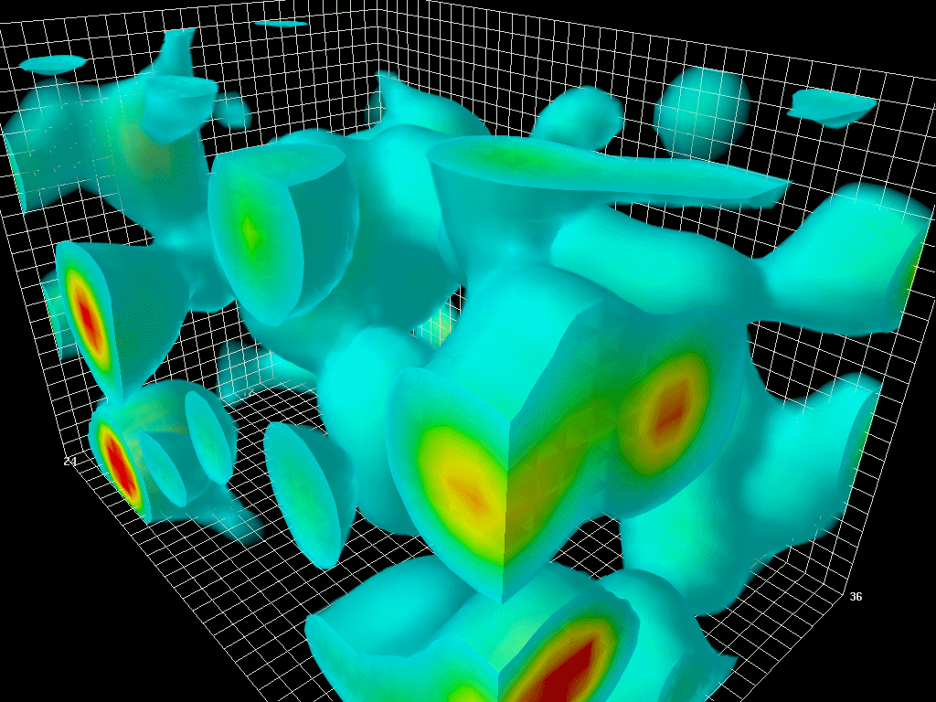
QCD and nucleon structure
Quantum Chromodynamics (QCD)
  Asymptotic freedom
  Well established in high energy region (perturbative QCD)
  Non-perturbative QCD (non-pQCD) remains challenging
Theoretical frameworks in non-pQCD region
  Lattice QCD
  Chiral Effective Field Theory (χEFT)
  Models
Nucleon is a rich lab for non-pQCD studies
QCD-vacuum structure from lattice QCD
Derek Leinweber, U. of Adelaide
Featured in Frank Wilczek’s 2004 physics Nobel Prize Lecture

Slide 5
Nucleon structure
Nucleon is rich in non-pQCD regime
  Charge distribution
  Spin distribution
  Quark momentum distribution
  3D structure
  Polarizabilities (electromagnetic/spin)
  ……
Milestones of understanding of nucleon structure:
  1933: Proton’s magnetic moment Otto Stern, Nobel Prize 1943
  1960: Elastic e-p scattering Robert Hofstadter, Nobel Prize 1961
  1968: Deep inelastic e-p scattering
  Jerome I. Friedman, Henry W. Kendall, Richard E. Taylor, Nobel Prize 1990
  1973: QCD asymptotic freedom
  David J. Gross, H. David Politzer, Frank Wilczek, Nobel Prize 2004

Slide 6
Nucleon electromagnetic polarizabilities
Electric polarizability (α_{E})
Magnetic polarizability (β_{M})
“Stretchability”
“Alignability”
(Graphs credited to P. P. Martel)
Both are fundamental structure constants of nucleons

Slide 7
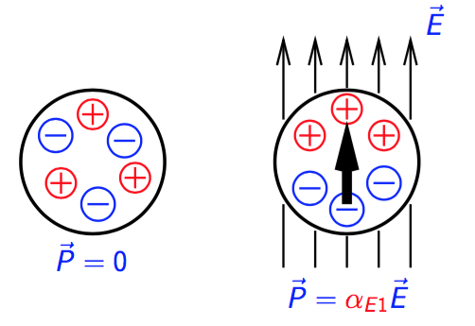
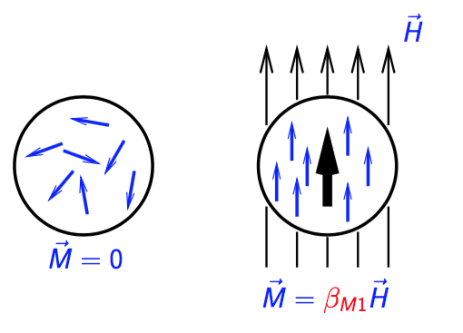
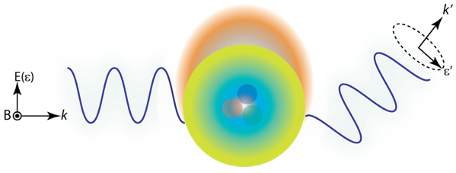
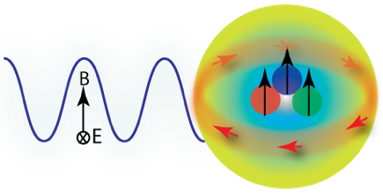
Nucleon electromagnetic polarizabilities
Electric polarizability (α_{E})
Magnetic polarizability (β_{M})
Both are fundamental structure constants of nucleons
In nuclear Compton scattering, the incident real photon acts as an external EM field applied to the nucleon

Slide 8
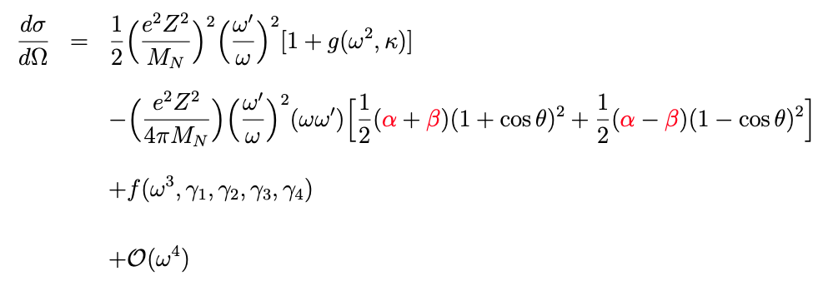
Differential cross section of Compton scattering N (γ, γ’) N’
Born term
(nucleons are assumed as point-like particles)
dominant in
forward-angle cross section
dominant in
backward-angle cross section
To extract α and β of the proton:
Measure the forward and backward Compton scattering cross sections
eZ : nucleon charge
M_{N} : nucleon mass
κ: anomalous magnetic moment
ω : incident photon energy
ω' : scattered photon energy

Slide 9
Differential cross section of Compton scattering N (γ, γ’) N’
Born term
(nucleons are assumed as point-like particles)
dominant in
forward-angle cross section
dominant in
backward-angle cross section
More difficult!
To extract α and β of the neutron:
No stable free neutron target
Neutron cross sections are small
Effective neutron target: ²H, ³He, ⁴He, …
eZ : nucleon charge
M_{N} : nucleon mass
κ: anomalous magnetic moment
ω : incident photon energy
ω' : scattered photon energy

Slide 10
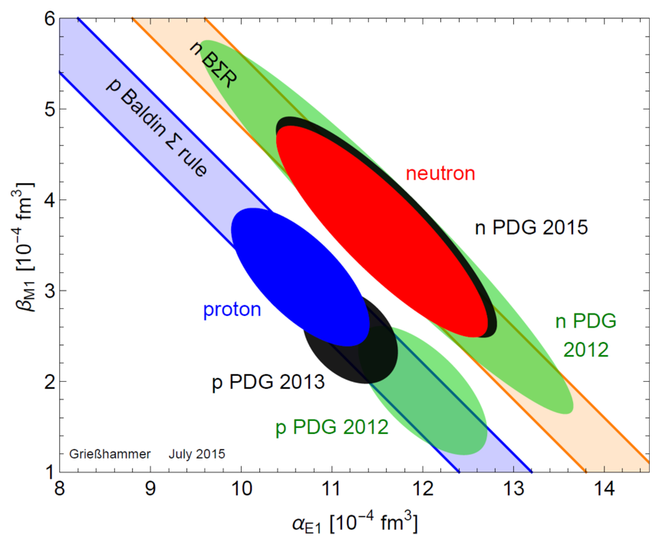
Status of α_{N} and β_{N} from χEFT global extraction
Baldin sum rule (BSR):
L. S. Myers et al., Phys. Rev. Lett. 113, 262506 (2014)
H. W. Grießhammer, J. A. McGovern, D. R. Phillips, and G. Feldman, Prog. Part. Nucl. Phys. 67, 841 (2012)
J. A. McGovern, D. R. Phillips, and H. W. Grießhammer, Eur. Phys. J. A 49, 12 (2013)
H. W. Grießhammer, J. A. McGovern, and D. R. Phillips, Eur. Phys. J. A 52, 139 (2016)

Slide 11
The High Intensity γ-Ray Source (HIγS) facility at Duke University
Photon beam energy: 1 - 120 MeV
Nearly 100% circular/linear photon beam polarization
Total flux: ～10¹⁰ γ/s (E_{γ}<20 MeV) and～10⁸ γ/s (E_{γ}>60 MeV)
Ideal photon beams to study nucleon polarizabilities!
Operated by Triangle Universities
Nuclear Laboratory (TUNL)
Free-electron laser (FEL)
Compton backscattering
Quasi-monoenergetic
intense γ-ray beams

Slide 12
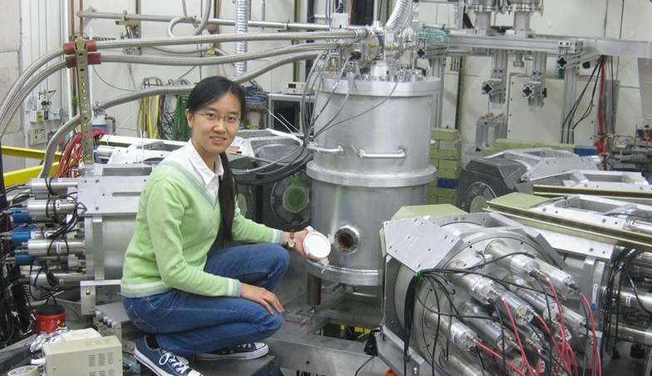
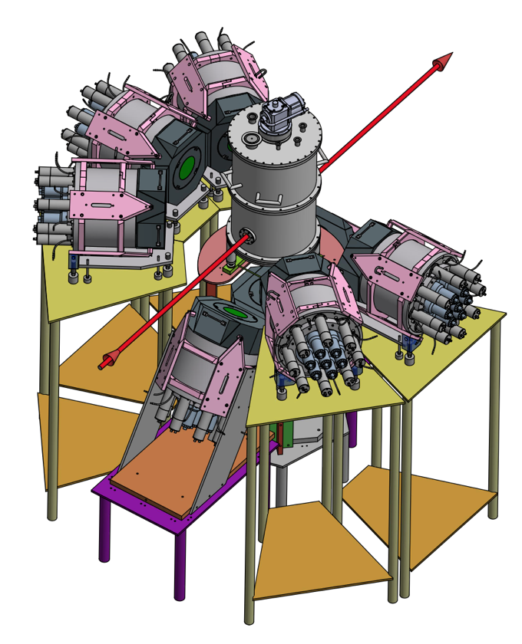
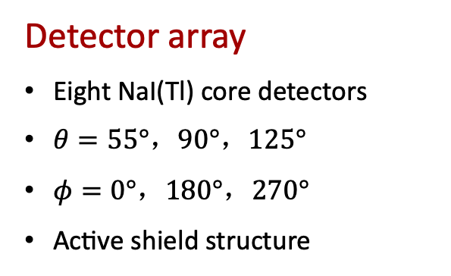
Experimental apparatus for Compton @ HIγS
γ-ray beam
Detector array
Eight NaI(Tl) core detectors
$θ=55°，90°，125°$
$φ=0°，180°，270°$
Active shield structure
Cryogenic target
liquid ⁴He (LHe)
Liquid hydrogen (LH₂)
Liquid deuterium (LD₂)

Slide 13
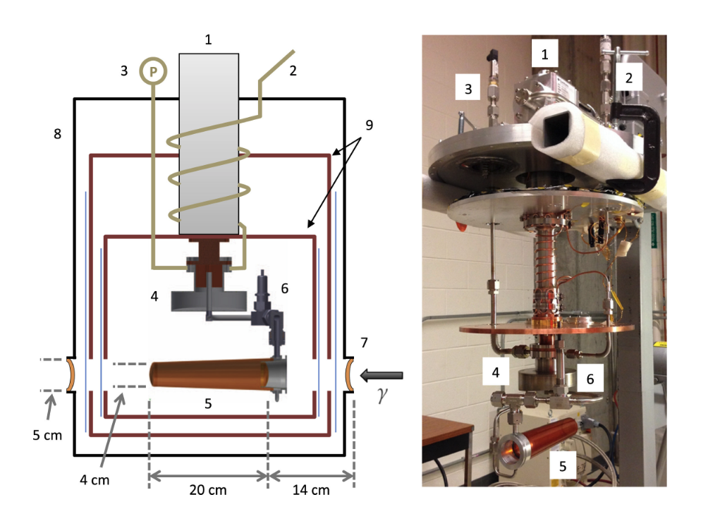
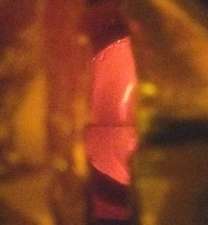
Cryogenic target
1. Cryocooler
2. Room-temperature gas inlet
3. Vent line with pressure gauge
4. Condenser
5. Target cell
6. Outlet valve
7. Kapton window
8. Aluminum can
9. Thermal shield
56 cm
Liquid
level
D. P. Kendellen et al., Nucl. Instrum. and Meth. A 840, 174–180 (2016)
Target cell
Notes:
Temparature

Slide 14
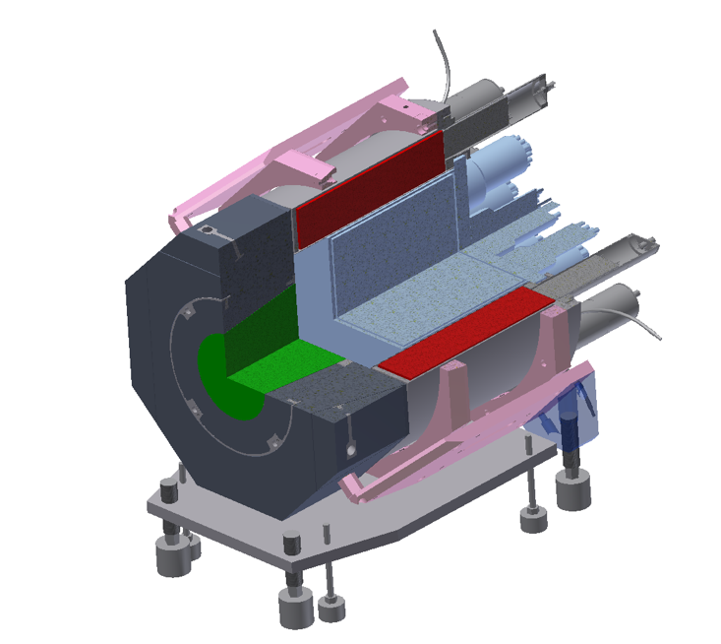
HIγS NaI Detector Array (HINDA)
10”×10” Nal(Tl) core detector
Cosmic-ray muon background rejection
using HINDA anti-coincident shield
Paraffin shield
Cosmic-ray muons
Shield cut
Pb collimator
Nal(Tl) shield annular segments
Beam induced photon events

Slide 15
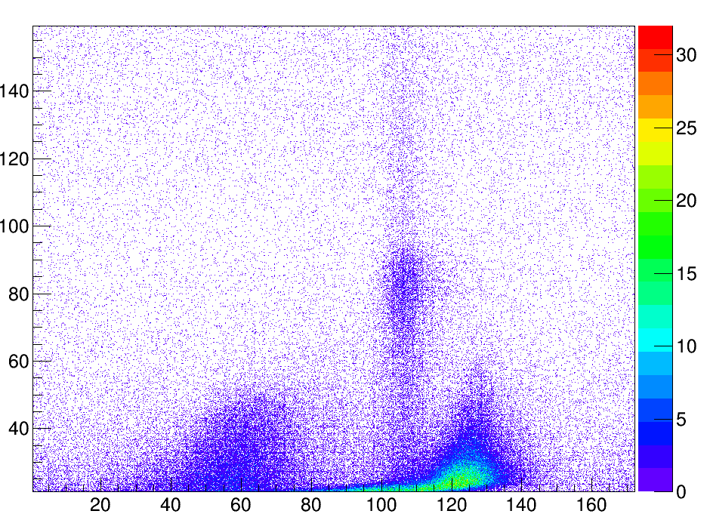
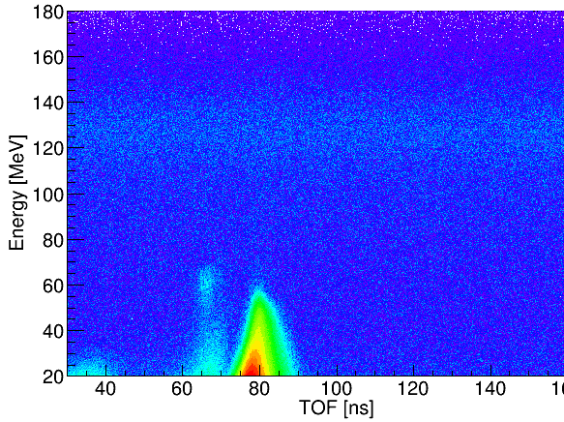
Data analysis – Compton event selection
Use anti-coincident shield (shield cut) and beam timing structure (TOF cut) to suppress cosmic-ray muon background
  Remove >99% cosmic events (3000 counts/hr -> 6 counts/hr) in the region of interest
Random events
Prompt events
No cut
Shield cut only
TOF cut only
Shield+TOF cuts

Slide 16
Data analysis – Compton event selection
Use anti-coincident shield (shield cut) and beam timing structure (TOF cut) to suppress cosmic-ray muon background
Subtract random (time-uncorrelated) background from the prompt peak
Before random subtraction
After random subtraction

Slide 17
Data analysis – Compton event selection
Use anti-coincident shield (shield cut) and beam timing structure (TOF cut) to suppress cosmic-ray muon background
Subtract random (time-uncorrelated) background from the prompt peak
Subtract empty target background from full target data
Empty
Full
Empty
Full

Slide 18
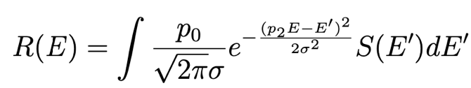
Data analysis – fit for photon yield
Fit to the net energy spectrum of each detector
Total fit = detector response function + background
Detector response function
  Convolution of the simulated detector response S(E) with a Gaussian smearing function
Background
  Exponential low-energy background at forward scattering angles
  Bremsstrahlung flat background at all angles
Photon yield is summed over the region of interest

Slide 19
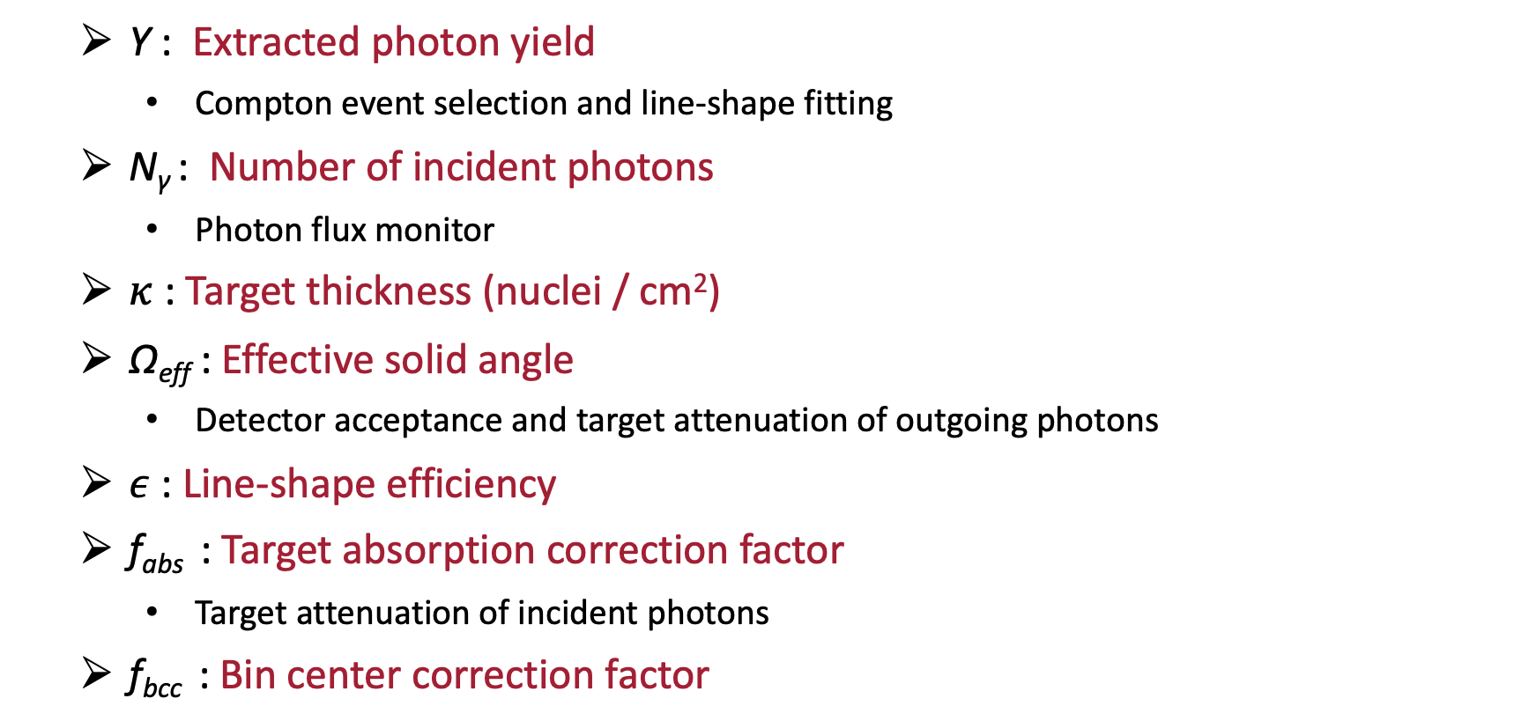
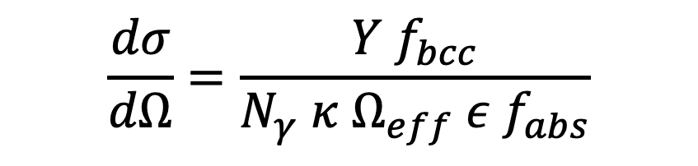
Differential cross section extraction
  Y : Extracted photon yield
    Compton event selection and line-shape fitting
  N_{γ} : Number of incident photons
    Photon flux monitor
  $κ$ : Target thickness (nuclei / cm²)
  Ω_{eff} : Effective solid angle
    Detector acceptance and target attenuation of outgoing photons
  $ε$ : Line-shape efficiency
  f_{abs} : Target absorption correction factor
    Target attenuation of incident photons
  f_{bcc} : Bin center correction factor
$$\frac{dσ}{dΩ}=\frac{Y f_{bcc}}{N_{γ} κ Ω_{eff} ε{ f}_{abs}}$$

Slide 20
Results of elastic Compton scattering from ⁴He at 81 MeV at HIγS
X. Li et al., Phys. Rev. C 101, 034618 (2020)
Circularly polarized beam
Unpolarized differential cross sections extracted with unprecedented precision
Fore-aft asymmetry indicates a strong sensitivity to sub-nuclear effects
Strongly motivates new χEFT calculation of Compton scattering from ⁴He
α_{n} and β_{n} then can be extract from the ⁴He data combined with the relatively well-known proton values
K. Fuhrberg et al., Nucl. Phys. A 591, 1 (1995)
M. H. Sikora et al., Phys. Rev. C 96, 055209 (2017)

Slide 21
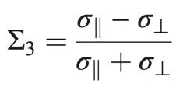

Results of Compton scattering from the proton at 81 and 83 MeV at HIγS
X. Li et al, Phys. Rev. Lett. 128, 132502 (2022)
Circularly (81 MeV) and linearly (83 MeV) polarized beams
Polarized differential cross sections measured for the first time below the pion-production threshold
Provided a novel experimental approach to extract α_{p} and β_{p}
Motivates new high-precision proton measurements at HIγS
Beam asymmetry Σ₃ calculated from the measured cross sections at HIγS
V. Olmos de León et al., Eur. Phys. J. A 10, 207 (2001)
B. E. MacGibbon et al., Phys. Rev. C 52, 2097 (1995)
V. Sokhoyan et al. (A2 Collaboration), Eur. Phys. J. A 53, 14 (2017)

Slide 22
Systematic uncertainties
Type | Source | Value
Normalization | Number of incident photons | 2%
 | Target thickness | 1%
Point-to-point | Boundary of region of interest | ⁴He: 1% - 3% Proton: 1% - 12%
 | Shield-energy cuts
 | Time-of-flight cuts
 | Fitting window
 | Effective solid angles | Negligible*
* Systematic uncertainties on effective solid angles were assigned to two out-of-plane detectors due to insufficient determinations of the the positions of that two detectors
σ_{syst} are comparable to σ_{stat} in both the ⁴He and proton results
σ_{syst} of the ⁴He results are dominated by normalization contributions
σ_{syst} of the proton results are dominated by point-to-point contributions

Slide 23
Compton @ HΙγS program outlook
High resolution measurements for deuteron
  To reduce inelastic contaminations and extract the differential cross sections of elastic Compton scattering from the deuteron
  Two larger volume NaI(Tl) detectors with higher energy resolution in use
Compton scattering from ³He
  Liquid ³He target is being prepared
  Improved α_{n} and β_{n} extraction
Compton scattering from the proton
  Improvement in statistics of proton data
  Unprecedented precision in α_{p} and β_{p} extraction

Slide 24
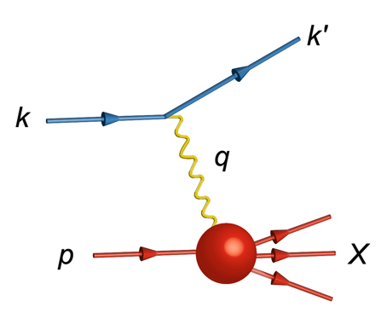
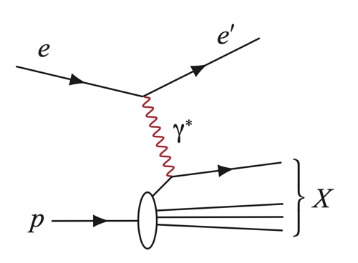

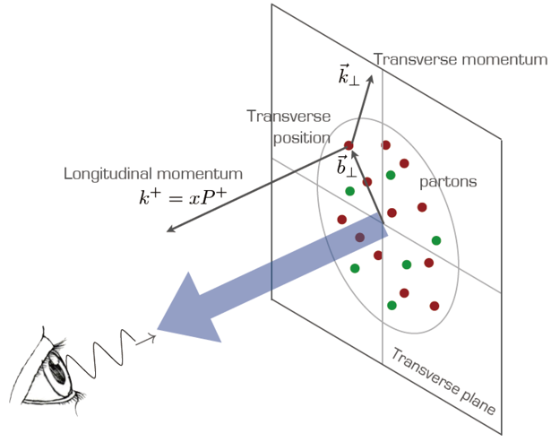
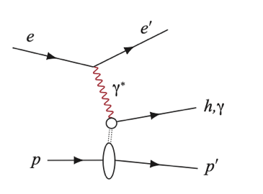
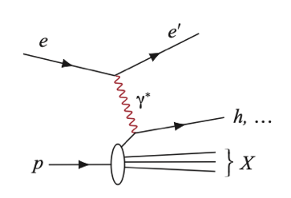
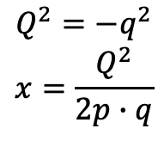

Probe nucleon structure with an electron microscope
Elastic electron scattering from the proton
  electromagnetic structure of the proton
  Two form factors G_{E}(Q²) and G_{M}(Q²)
Deep inelastic scattering (DIS) at higher energies
  partonic structure of the proton
  Parton distribution functions (PDF)
From 1D to 3D structures
  Exclusive DIS: generalized parton distributions (GPD)
  Semi-inclusive DIS: transverse momentum dependent PDFs (TMD)
1961
$$Q^{2}=−q^{2}$$
$$x=\frac{Q^{2}}{2p∙q}$$
$$q$$
1990

Slide 25
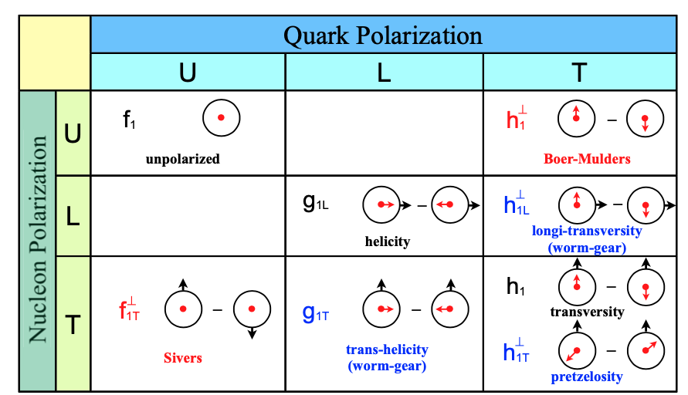
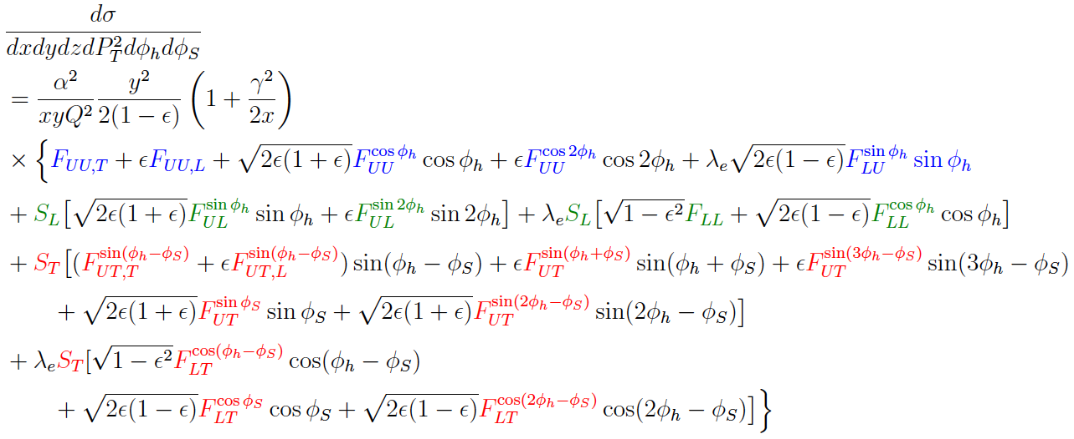
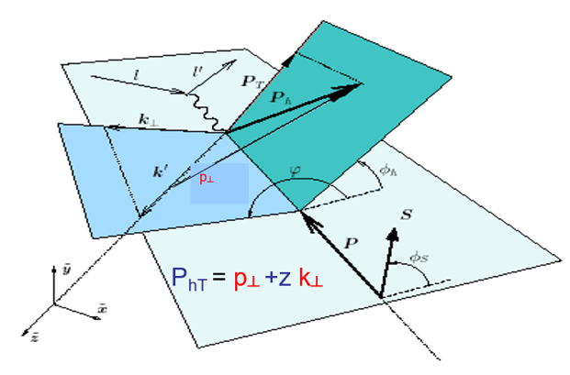
Semi-inclusive deep inelastic scattering (SIDIS)
Golden channel to study TMD

Slide 26
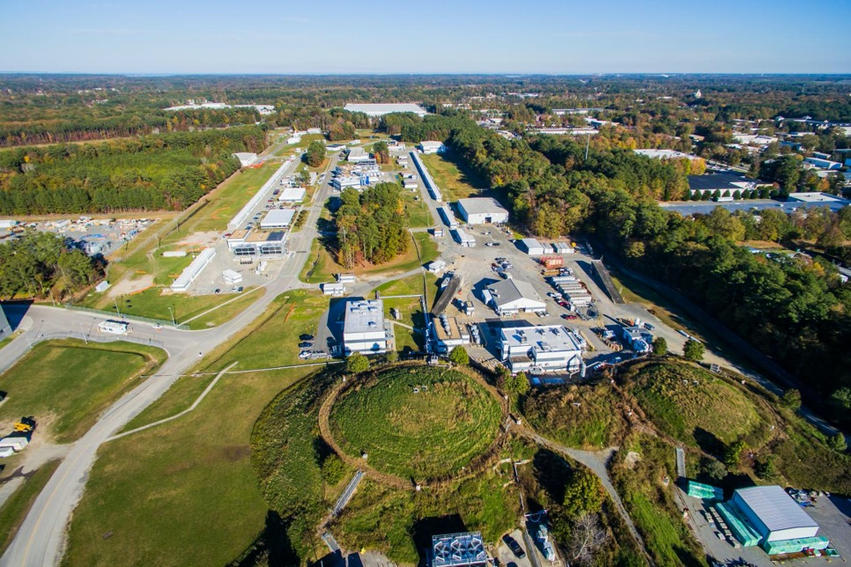
Jefferson Lab
Thomas Jefferson National Accelerator Facility (JLab), Newport News, VA
Completed 6 GeV to 12 GeV upgrade for the electron beam in 2015
4 experimental Halls

Slide 27
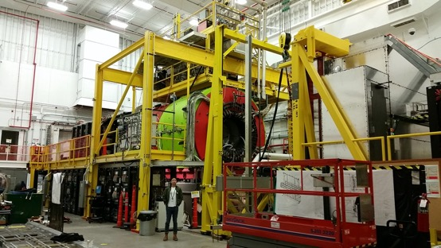
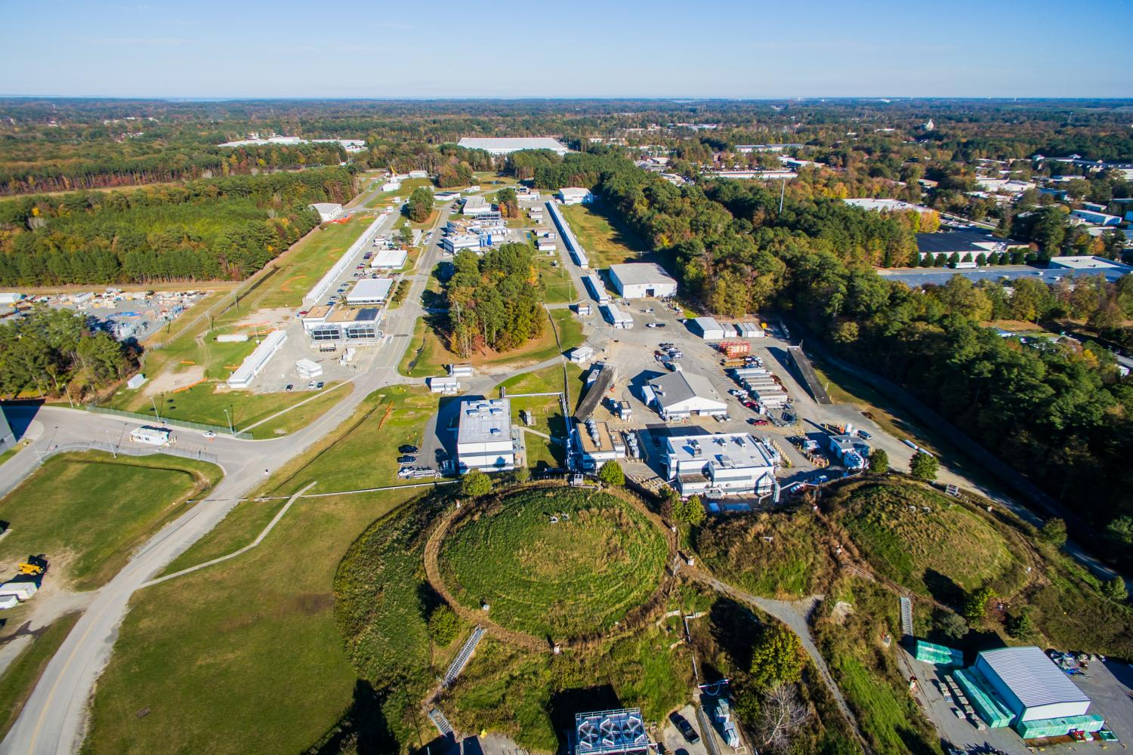
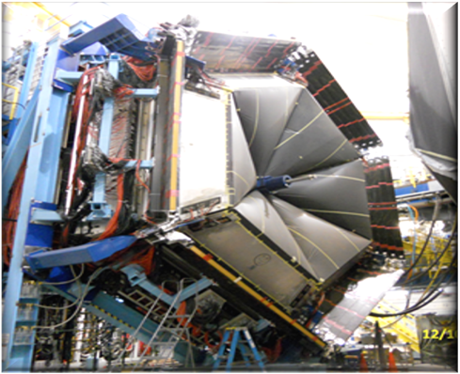
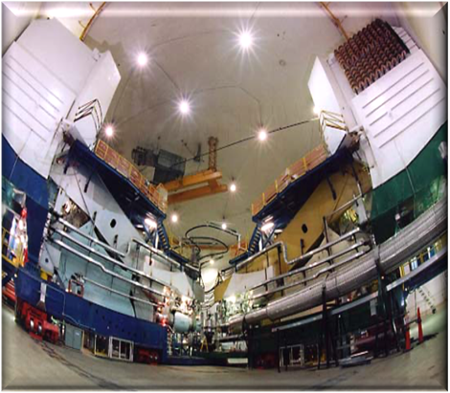
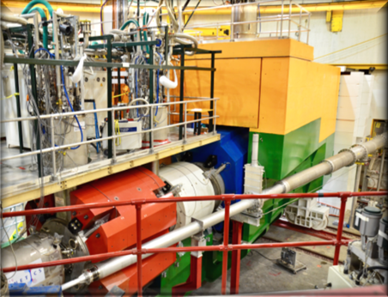
Jefferson Lab
Hall D GlueX
Hall B CLAS12
Hall A
Hall C

Slide 28
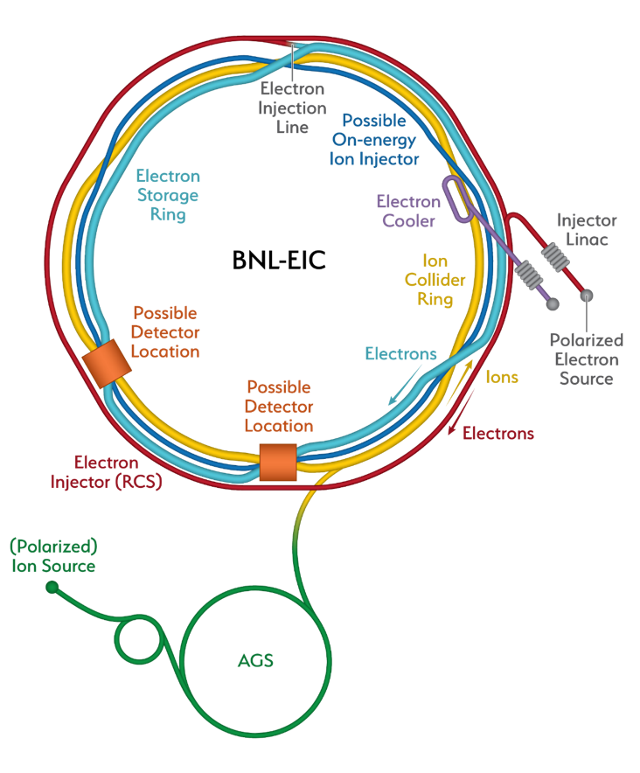
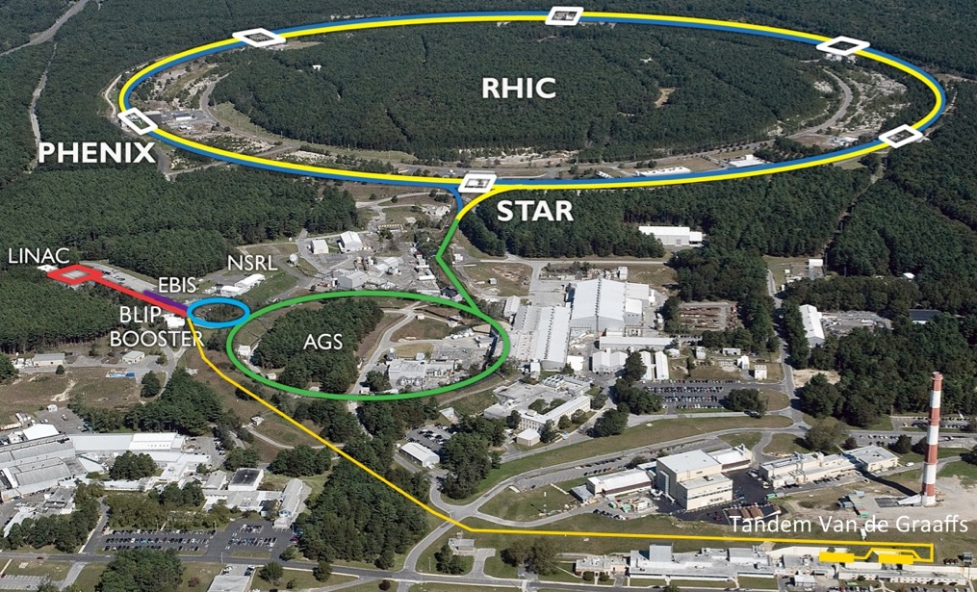
Electron-Ion Collider
Add counter-circulating electron storage ring in existing Relativistic Heavy Ion Collider (RHIC) at Brookhaven National Lab (BNL), Long Island, NY
Project officially launched by US DOE in January 2020
275 GeV/nucleon max. on 18 GeV e-beam, 2 detectors
Graph from EIC Yellow Report

Slide 29
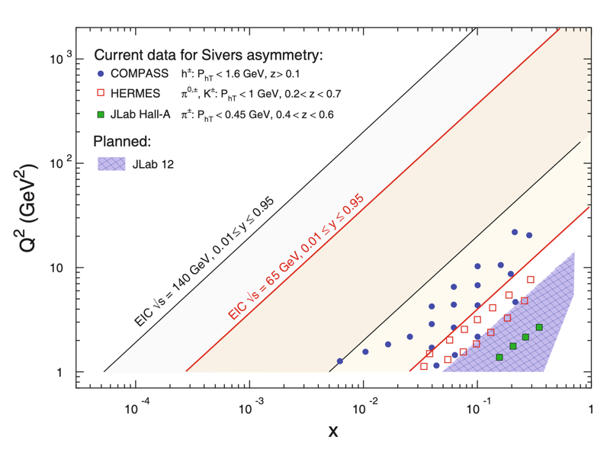
Complementary kinematic coverages provide more comprehensive 3D partonic picture of nucleon
EIC white paper
JLab 12 GeV: valence quarks
EIC: sea quarks and gluons (exploring gluon dynamics for the first time)
Richard G. Milner and Rolf Ent, Visualizing the Proton (2022)

Slide 30
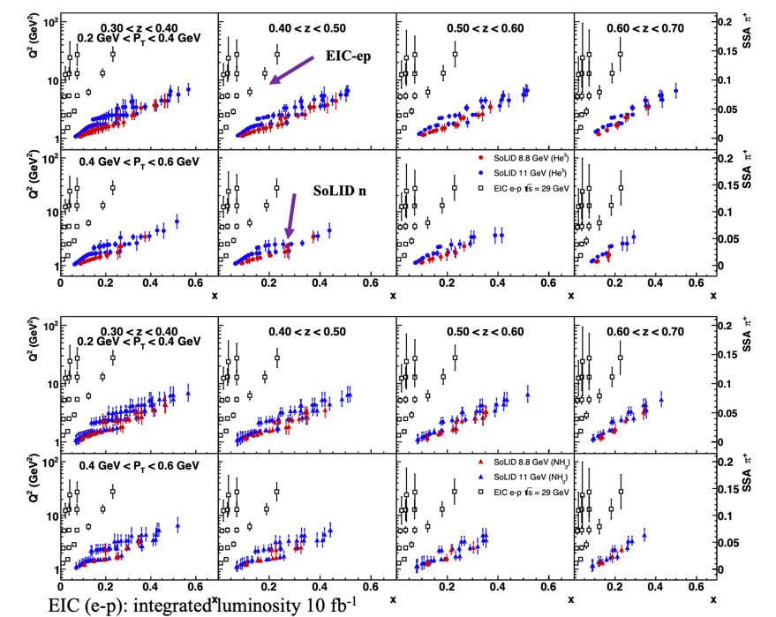
SIDIS projections at JLab 12 GeV and EIC
Statistical projections on single spin asymmetry
at the proposed SoLID spectrometer at Hall A JLab
Statistical projections on single spin asymmetry at the EIC

Slide 31
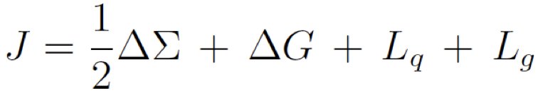
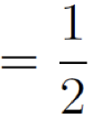
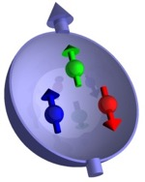
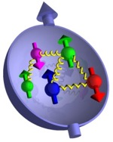


Nucleon spin structure
Spin puzzle
proton
Quark spin
(best known)
Gluon spin
(start to know)
Orbital angular
momentum
(little known)

Slide 32
Nuclear spin-polarized ³He
Spin-polarized ³He nucleus is an effective spin-polarized neutron target
Polarized ³He targets at Jefferson Lab
  SEOP, 60% in-beam polarization in 10-bar gases
  7 experiments approved for 12 GeV upgrade
Polarized ³He ion source at RHIC for the future EIC
  MEOP, concept developed by BNL-MIT collaboration
  High magnetic field (5 T) at BNL’s Electron Beam Ionization Source

Slide 33
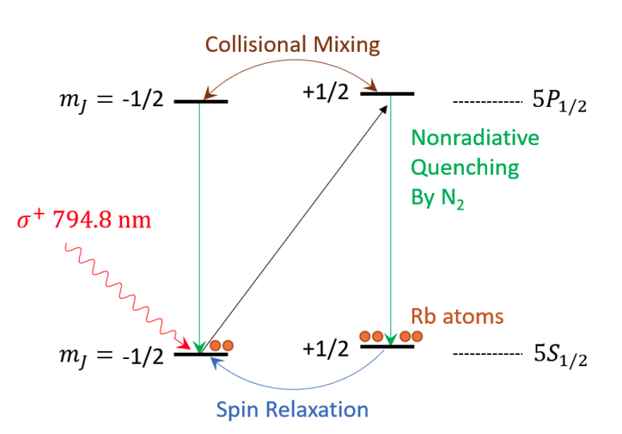
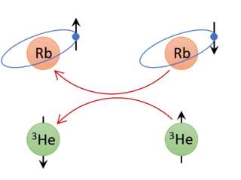
Optical pumping techniques for polarized ³He
Spin-exchange optical pumping (SEOP)
Optically pump alkali-metal atoms in mixture
Spin exchange between alkali electrons and ³He nuclei
Large pressure range (1 to 13 bar)
Low pumping rate
Metastability-exchange optical pumping (MEOP)
Optically pump metastable-state ³He
Spin transfer via metastability exchange collision
Limited pressure range (~1 mbar)
High pumping rate
C. Peng, Ph.D. dissertation (2018)
F.D. Colegrove, L.D. Schearer, G.K. Walters Phys. Rev. Lett. 132, 2561 (1963)

Slide 34
Path to polarized ³He in high magnetic field
SEOP: untenable in high field due to increasing wall relaxation
MEOP: weak hyperfine coupling
High-field MEOP development
  Motivated by NMR medical imaging demand (Kastler Brossel Lab, Paris)
  Found MEOP effective at higher pressures
  Successfully produced nearly 60% polarization at 100 mbar and 4.7 T
A. Nikiel-Osuchowska et al., Eur. Phys. J. D 67, 200 (2013)
Open symbols: low field (1 – 3 mT)
Filled symbols: high field (1.5 – 4.7 T)
T.R. Gentile et al., Rev. Modern Phys. 89, 045004 (2017)

Slide 35
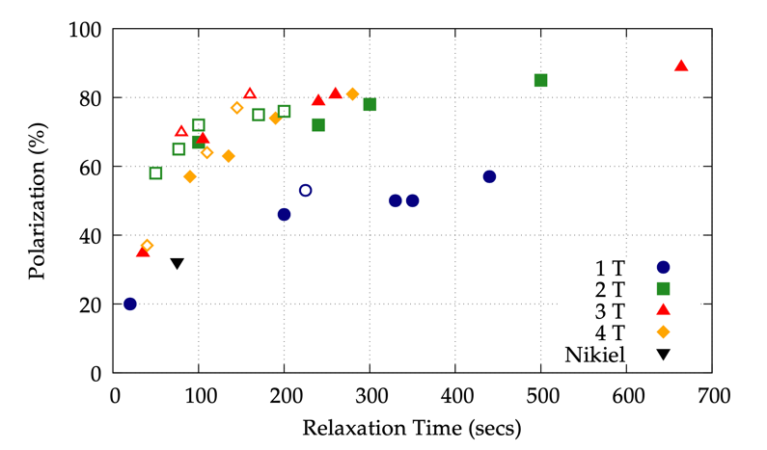
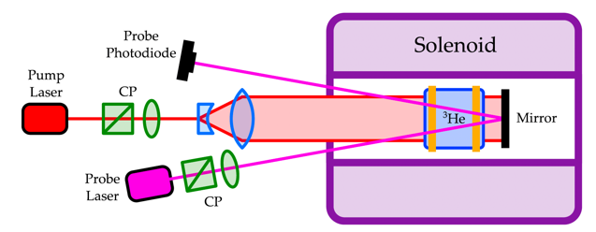
BNL-MIT development of high magnetic field MEOP
Polarized ³He ion source for the EIC at RHIC at Brookhaven National Lab
Electron Beam Ion Source operates at 5 T
MEOP within 5 T field, transfer into EBIS for ionization and extraction
J.D. Maxwell et al., Nucl. Instr. and Meth. A 959, 161892 (2020)

Slide 36
Proposed experiment using polarized ³He at CLAS12 at JLab
5-T solenoid in interaction region
CLAS12: CEBAF Large Acceptance Spectrometer for operation at 12 GeV
  High luminosity electron scattering
  Multi-particle final-state response
C12-20-002: A program of spin-dependent electron scattering using a polarized ³He target at CLAS12
Scientific opportunities
  SIDIS and nucleon spin structures
  Nuclear corrections to SIDIS
  Tagged DIS (deuteron tagging)
  Quasi-elastic scattering
  Deeply virtual exclusive processes
30 days of running at 10.6 GeV

Slide 37
Proposed experiment using polarized ³He at CLAS12 at JLab
5-T solenoid in interaction region
CLAS12: CEBAF Large Acceptance Spectrometer for operation at 12 GeV
  High luminosity electron scattering
  Multi-particle final-state response
C12-20-002: A program of spin-dependent electron scattering using a polarized ³He target at CLAS12
  Spokespeople: H. Avakian, J. Maxwell, R. Milner, and D. Nguyen.
  Approved with A- rating conditionally on the high-field MEOP target development
Novel target design to accommodate to the standard CLAS12 configuration

Slide 38
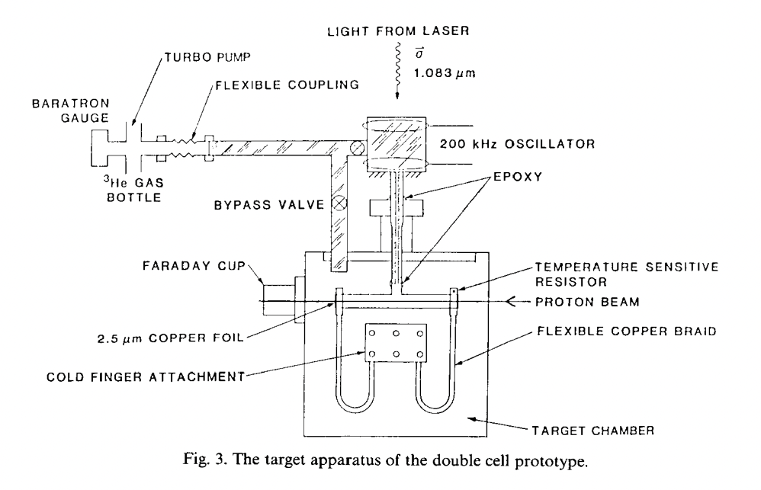

Novel polarized ³He target for CLAS12
New target design combining two key features
High-field MEOP technique
  accommodate to the 5-T CLAS12 solenoid
  ³He gas pressure increase 100$×$
Double-cell target design
  MIT-Bates 88-02 double-cell MEOP system
  polarize at room temperature
  transfer to cold target chamber
  target density increase 60$×$
R.G. Milner, R.D. McKeown and C.E. Woodward, Nucl. Instr. and Meth. A 274, 56 (1989)
Notes:
The new design of the target combines two key features. The first is the high-field MEOP which is required by the 5-T. Secondly it adopts the double-cell target design which has been employed by the MIT-Bates

Slide 39
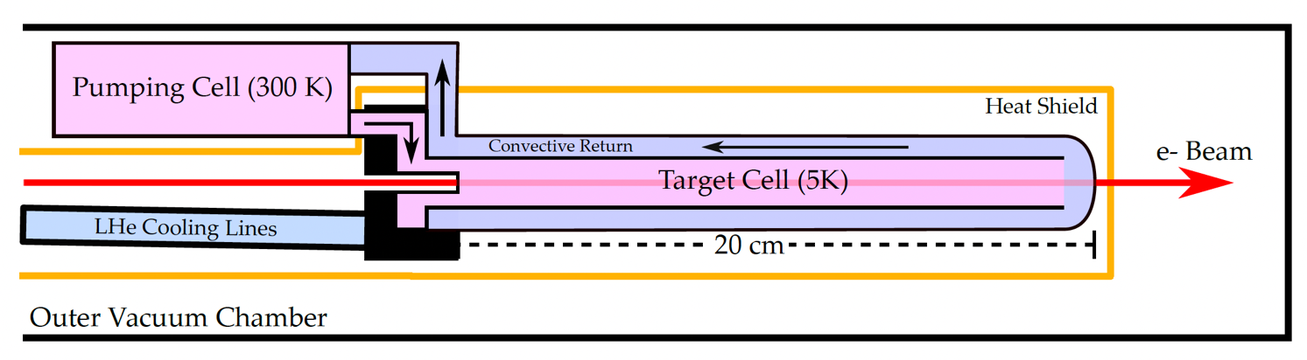

Polarized ³He target conceptual design
J.D. Maxwell and R.G. Milner, Nucl. Instr. and Meth. A 1012, 165590 (2021)
Pumping cell (293 K)
Borosilicate glass cell
MEOP to 60% polarization
Annular cylindrical volume
Target cell (5 K)
100 cm³, 20-cm aluminum cell coated with cryogenic layer
Cooled by LHe heat exchanger
Luminosity: 2.7$×$10³⁴ nucleons/cm²/s at 0.5-μA beam current
Notes:
This is the sketch of what the proposed design looks like. The 3he is supposed to be polarized in the room temperature pumping cell made of borosilicate glass hopefully to obtain 60% polarization using MEOP, and then transferred convectively to a target cell in the electron beamline. The target cell is 20 cm long and made of aluminum. The polarized 3He can pass through and return to the pumping cell to be repolarized, This will be cooled by liquid helium heat exchanger. In this scheme, we could achieve a luminosity of 2.7 time 10 to 34 nucleons per cm^2 per second at a beam current of 0.5 uA.

Slide 40
³He depolarization mechanisms
Wall relaxation: borosilicate glass and coating for aluminum
Transverse B-field gradient
  10⁴ seconds relaxation time around the pumping region
Ionizing radiation
  ³He₂⁺ ions from the beam
  suppressed with higher field
  to be validated by in beam tests
J.D. Maxwell and R.G. Milner, Nucl. Instr. and Meth. A 1012, 165590 (2021)
K. Bonin et al., Phys. Rev. A 37, 3270 (1988)
Notes:
Thinking about how much polarization we could achieve, we need to consider a few mèchanisms of depolarization.
So first of all the wall relaxation effects can be suppressed by the borosilicate glass and the cryogenic coating for the aluminum wall.
Next is the depolarization due to the transverse magnetic field gradient. This is a field map of the 3He relaxation time in different locations within the CLAS12 solenoid. The Y-axis is the radial distance away from the center and X-axis is the distance along the axial direction. We will put the target cell around the center at this box and the here is the spot for the pumping cell. You can see the relaxation time is still quite long in this blue box region. You can also see as you get further away from the solenoid, the relaxation time is getting much worse, which means it can be difficult to transfer polarized gas from outside the CLAS12 solenoid.

Slide 41


Target development progress – low field test
30-Gauss magnetic field
1-mbar sealed ³He cell
70% nuclear polarization
~180 seconds relaxation with discharge on
Work by James Maxwell, Dien Nguyen, Xiaqing Li
Polarized ³He test system in Nov. 2022
J.D. Maxwell, C.S. Epstein and R.G. Milner, Nucl. Instr. and Meth. A 764, 215 (2014)

Slide 42


Target development progress – high field test
5-T warm-bore solenoid (tests were done up to 4 T)
1-mbar sealed ³He cell
1083-nm probe laser
45% polarization with limited laser power
  New laser has been ordered to accommodate to 5-T field
Work by James Maxwell, Dien Nguyen, Xiaqing Li
Polarized ³He test system in March 2022
Relaxation time: 100 sec
J.D. Maxwell et al., Nucl. Instr. and Meth. A 959, 161892 (2020)

Slide 43
Projected schedule for CLAS12 polarized ³He target development
High-field polarization at varied pressures by January 2023
Double cryogenic cell prototype constructed by fall 2023
Double cryogenic cell prototype ready for beam tests by January 2024
Target system in CLAS12 by January 2025
Possibility for transverse target once longitudinal polarization proven

Slide 44
Summary
Nucleons (proton and neutron) are the building blocks of the visible universe
The structures of nucleon are described by QCD in terms of quarks and gluons
Understanding of the nucleon structure is still incomplete
Photons and electrons are powerful probes to image the nucleon structure at various length scales
Compton scattering program at the HIγS facility is promising in the state-of-the-art studies on nucleon polarizabilities
JLab 12 GeV programs are actively underway for the next 10-15 years with the focus on valence quarks
The future EIC at BNL represents the frontier of the next generation of QCD community in understanding the structure of the nucleon and nuclei in the region of sea quarks and gluons

Slide 45

Acknowledgement
The Compton @ HIγS collaboration
Research generously supported in part by the U.S. Department of Energy Office of and National Science Foundation
Notes:
This is collaborative work between Jlab and MIT and here is the core crew of the taskforce. We’d like to thank the Jlab target group for the engineering support. This program is supported by the DOE through Jlab and MIT. With all this, I would like to say thank you and take questions.

Slide 46
Acknowledgement
JLab-MIT collaboration for CLAS12 polarized ³He:
  MIT: Prof. Richard Milner, Dr. Xiaqing Li
  JLab: Dr. James Maxwell, Dr. Dien Nguyen, Dr. Harut Avakian
Research generously supported by the U.S. Department of Energy Office of Nuclear Physics through Jefferson Lab and MIT
Thanks for your attention!
Notes:
This is collaborative work between Jlab and MIT and here is the core crew of the taskforce. We’d like to thank the Jlab target group for the engineering support. This program is supported by the DOE through Jlab and MIT. With all this, I would like to say thank you and take questions.

Slide 47
Backup slides

Slide 48



χEFT extraction of α_{p} and β_{p} from HIγS data
Baldin sum rule (BSR):
With BSR constraint
BSR free

Slide 49

Photon flux monitor
Consists of five plastic scintillator paddles and an aluminum radiator
Detect the e⁻ e⁺ generated from the radiator from photoelectric effects, Compton scattering, and pair production
Calibration factors determined from calibration runs using an in-beam NaI photon detector

Slide 50







Beam asymmetry of Compton scattering
Linearly polarized beam and unpolarized target
Beam asymmetry, $Σ_{3}$
$$Σ_{3}=\frac{\frac{dσ_{∥}}{dΩ}−\frac{dσ_{⊥}}{dΩ}}{\frac{dσ_{∥}}{dΩ}+\frac{dσ_{⊥}}{dΩ}}$$
$$\frac{dσ_{∥}}{dΩ}+\frac{dσ_{⊥}}{dΩ}=\frac{dσ}{dΩ}(unpol)$$

Slide 51








Deeply virtual exclusive processes and GPD
$$t={(p−p^{′})}^{2}$$
$$ξ≈\frac{x}{2−x}$$
Deeply virtual Compton scattering (DVCS)
Deeply virtual meson production (DVMP)
DVCS
  (π, Κ, ρ, φ …)
Bethe-Heitler
DVMP

