Slide 1
Impedance and collective effects of HEPS storage ring
Presenter: Na Wang
Contributors: Na Wang, Haisheng Xu, Saike Tian, Sen Yue, Zhe Duan, Xiaoyu Li, Xiaoyu Liu
2022.8.19

Slide 2
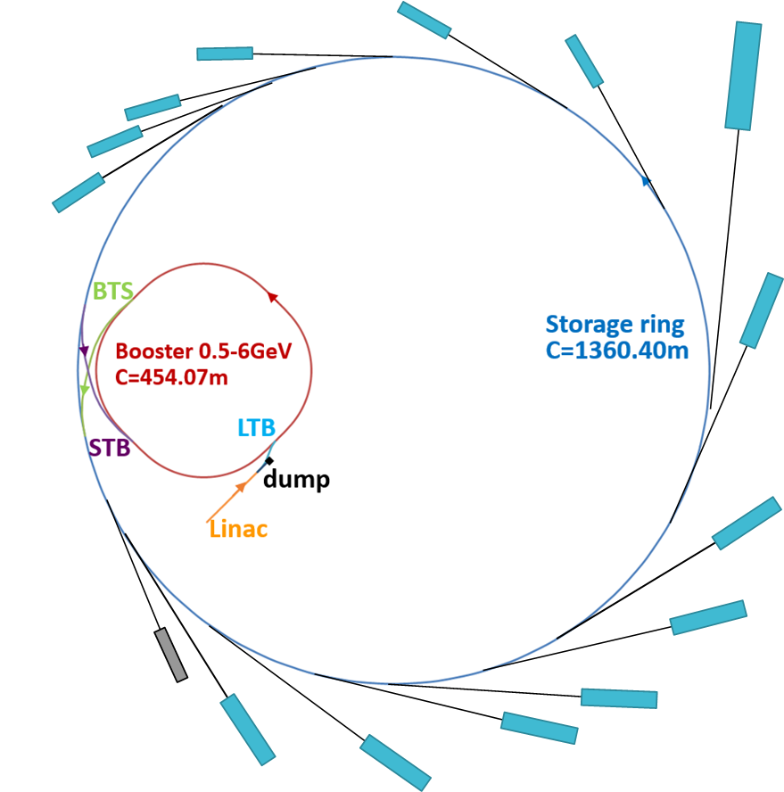
Main parameters and schematic layout
Ring: 48 hybrid 7BAs,
ε₀~ 34.8 pm @ 6GeV
Main parameters | Value
Beam energy [GeV] | 6
Circumference [m] | 1360.4
Emittance [pm.rad] | < 60
Brightness [phs/s/mm²/mrad²/0.1%BW] | >10²²
Beam current [mA] | 200
σ_{z} at zero current W/O HRF [mm] | 4.6
σ_{z} at zero current W/ HRF [mm] | 28
Radiation damping time (x/y/z) [ms] | 9/14/10
Booster: FODO lattice,
ε₀~ 16 nm @ 6GeV
Linac: 500MeV,
Mature technology
Two operation scenarios
  High-brightness mode: n_{b} = 680 (1.3 nC/bunch, 0.3mA/bunch)
  High-bunch-charge mode: n_{b} = 63 (14.4 nC/bunch, 3.2 mA/bunch)
J. Synchrotron Rad. 25, 1611-1618 (2018)
On axis swap out +
High energy accumulation (in booster)

Slide 3
Main challenges on collective effects
To reach high machine performance
  High beam current
  Low emittance
  Large number of small gap IDs
Small momentum compaction
Strong focusing magnet
Strong sextupoles
Small beam pipe aperture
NEG coating
Increased beam coupling impedance, small obstacles become more of concern
The beam is more easily to be disturbed by the perturbations
The impedance and collective effects need to be carefully studied

Slide 4
Impedance modeling
Resistive wall：
12 types of beam pipes with different materials and dimensions
Insertion devices：
CPMU&IVU
IAU&Wiggler
Wiggler+Mango
Drift sections for upgrade
RF cavities：
166.6MHz RF cavities
500MHz HRF cavities
RF dampers
Drift sections for upgrade
Injection & Extraction：
Injection, extraction kickers
Horizontal dump kicker
Vertical dump kicker
Pre-extraction kicker
Injection, extraction LSMs
Vacuum system：
Bellows
Flanges
Gate valve
Vacuum pump
Absorbers
Transitions
More than 60 individual elements are modeled
Diagnostics：
BPMs
TBPMs
Vertical feedback kicker
Horizontal feedback kicker
Longitudinal feedback kicker
Tune kicker
DCCT
Mechanical system：
MASKs
Collimators
Longitudinal and transverse impedances are calculated with test Gaussian beam of σ_{z}=3mm
Analytical formulae, ABCI, CST, …
Used for study of collective effects and full current beam parameters
Effective impedances are evaluated at σ_{z}=4.6mm W/O HRF

Slide 5
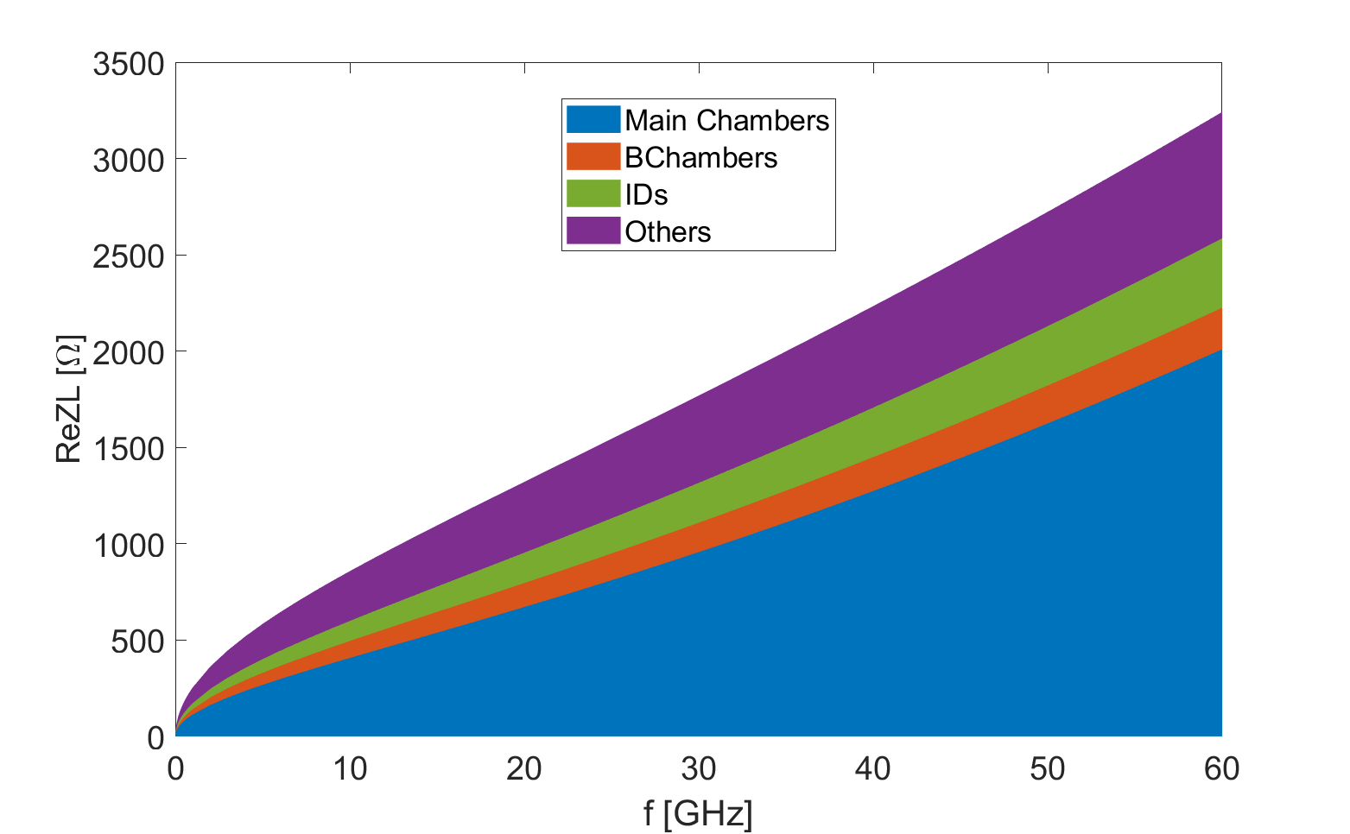
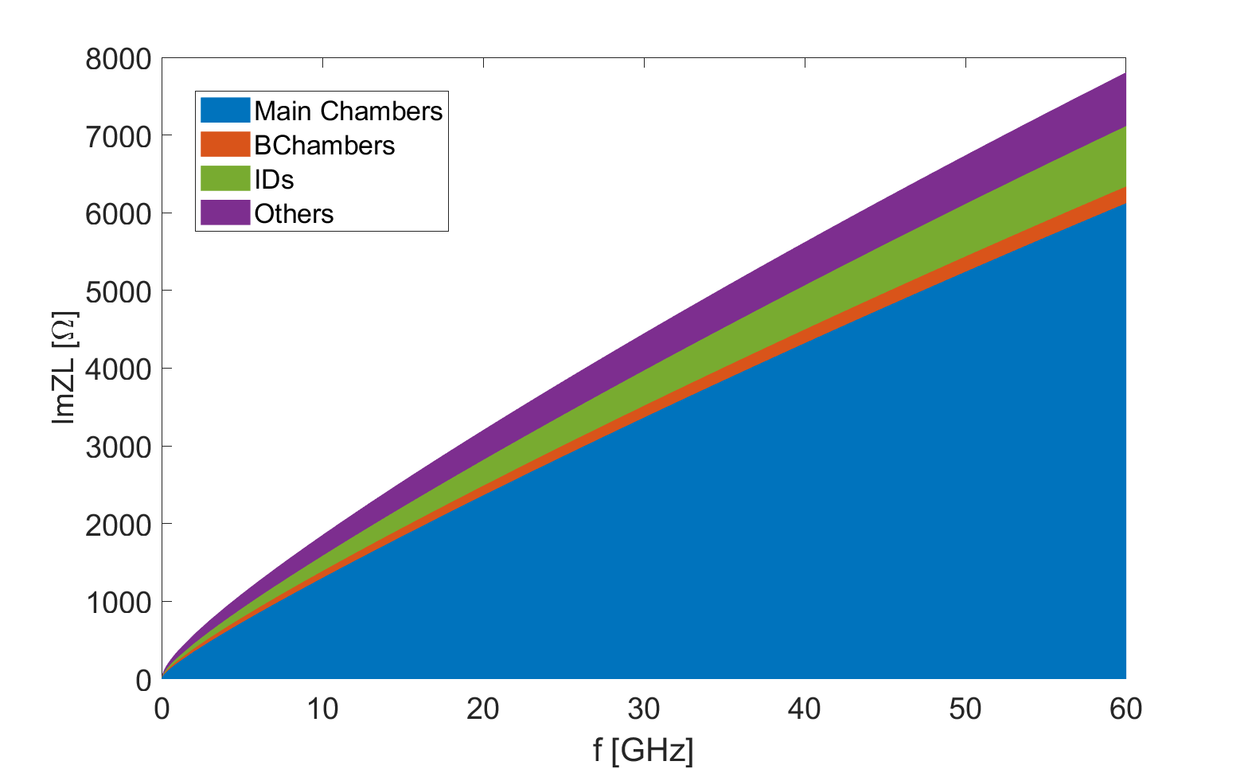
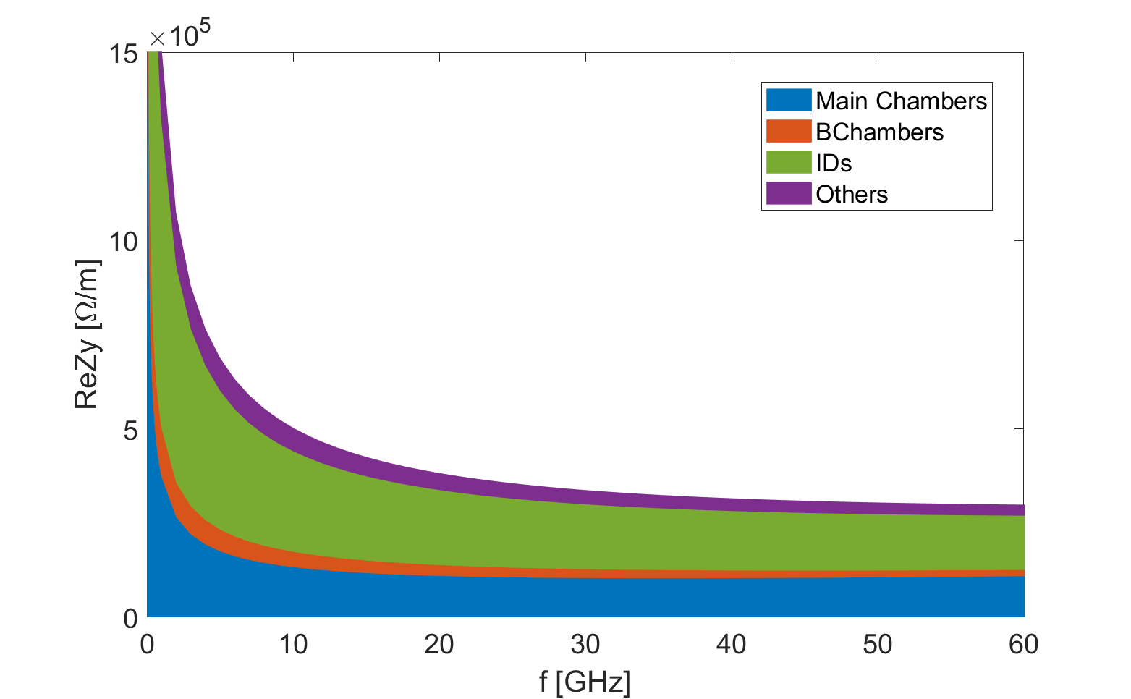
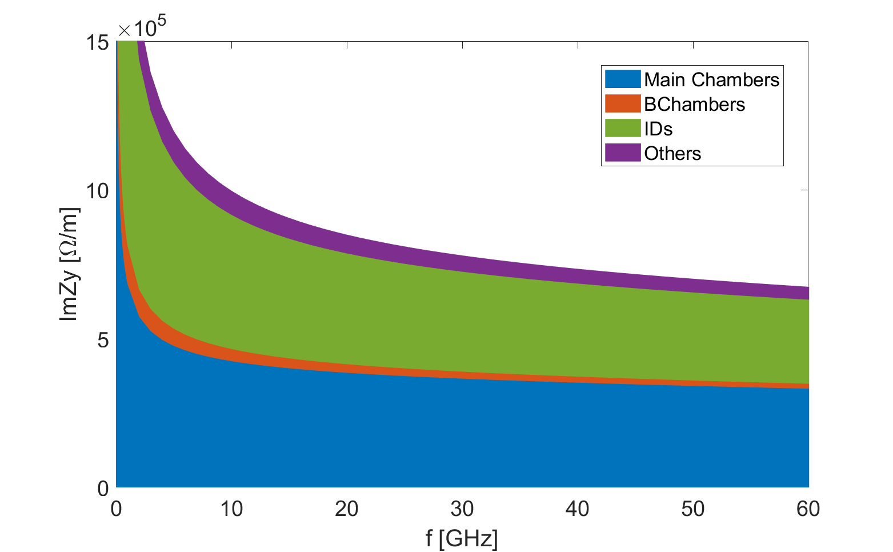
1. Resistive wall
Beam pipes with different materials and dimensions are calculated with analytical formula of multi-layer cylindrical impedance model.
Main part of the vacuum chamber is made of copper with NEG coating, which dominates the longitudinal resistive wall impedance.
The main vacuum chamber (NEG coated) and the small gap IDs dominate the vertical resistive wall impedance.
ReZL
ImZL
Phys. Rev. ST-AB 10, 111003
ReZy
ImZy

Slide 6
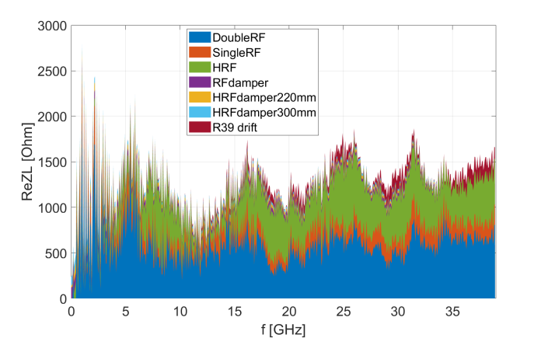
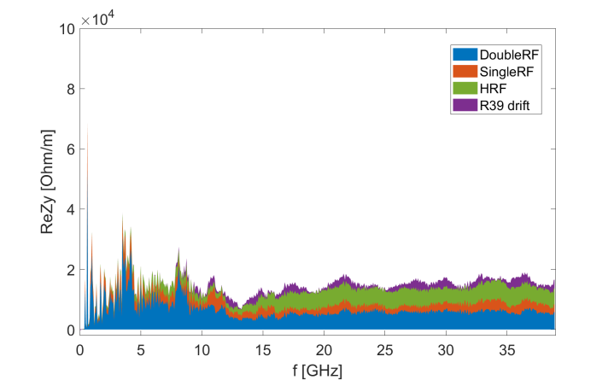
2. RF cavities
The RF system consists of 5 fundamental RF cavities at 166.6 MHz, and two harmonic RF cavities at 499.8 MHz for bunch lengthening.
RF cavities show small contribution to the broadband impedances, but give dominant contribution to the loss factor.
The high order modes are damped below the threshold of synchrotron radiation damping, by introducing large aperture beam pipe and HOM dampers.
ReZL
ReZy
 | k_{l}, V/pC | Z||/n, mΩ | k_{y}, kV/pC/m
RF cavities | 22.0 | 0.3 | 0.6
Total | 83.7 | 226.3 | 86.4

Slide 7
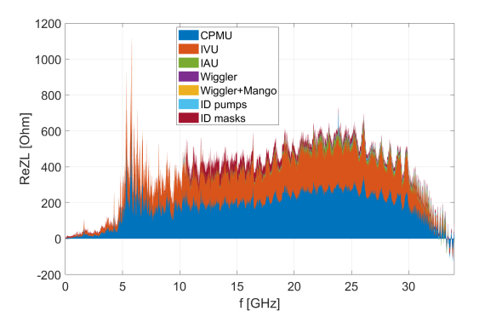
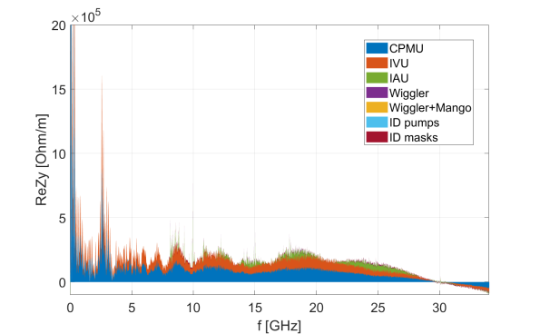
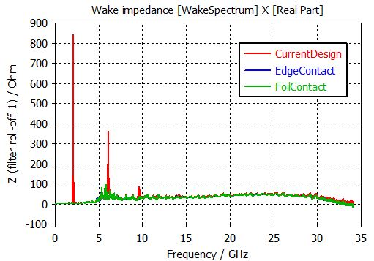
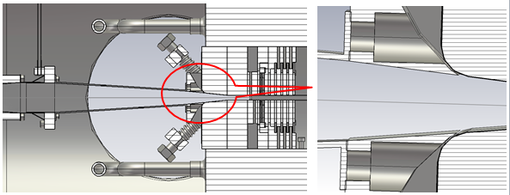
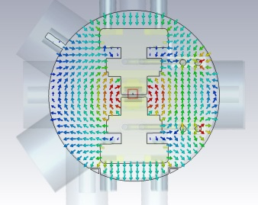
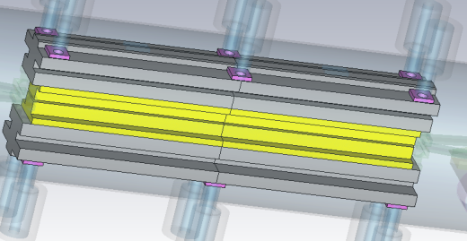
3. Insertion devices
Broadband+narrowband.
The geometrical impedance contribute approximately 10% of the total transverse kick factor, and ~5% in the longitudinal plane.
Total of 19 IDs (11 in vacuum, 8 in air)
ReZy
ReZL
 | k_{l}, V/pC | Z||/n, mΩ | k_{y}, kV/pC/m
IDs | 4.1 | 8.9 | 8.1
Total | 83.7 | 226.3 | 86.4
Longitudinal resonance at 2.1GHz due to the poor contact at both end of the shielding foil ⇒ mitigated with improved electrical contact.
Strong vertical resonances at around 100 MHz inside the vacuum tank with magnetic poles ⇒Mode damping with ferrite blocks, as proposed in SPEAR3, is considered.

Slide 8
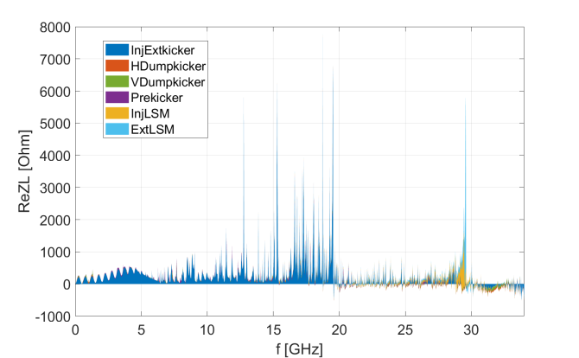
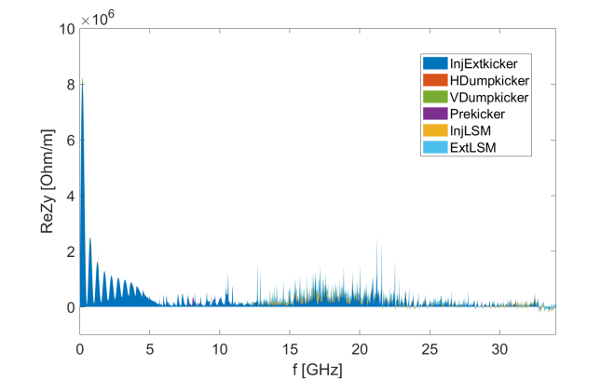
4. Injection & Extraction
Both inj. and ext. system consists of one Lambertson and five 300 mm long stripline kickers.
  Five-cell stripline kicker is proposed for saving longitudinal space, reducing kicker strength, easing the vacuum pumping and reducing the beam coupling impedance.
H/V dump kickers are used to reduce the beam density on the collimators when dump the beam.
Pre-kicker for reducing the beam density before extraction to avoid damage to the Lambertson.
ReZL
 | k_{l}, V/pC | Z||/n, mΩ | k_{y}, kV/pC/m
Inj.&Ext. | 5.3 | 2.5 | 9.9
Total | 83.7 | 226.3 | 86.4
ReZy
The Inj. and Ext. kickers show the dominant impedances, which contribute approximately 10% of the ring total transverse kick factor. Their contributions to the loss factor and Z||/n are ~6% and ~1%, respectively.

Slide 9
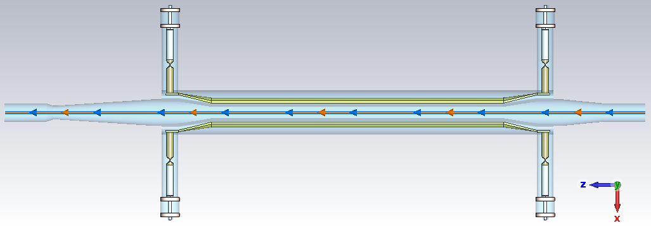
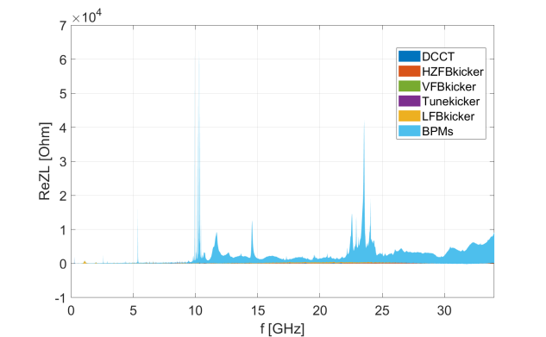
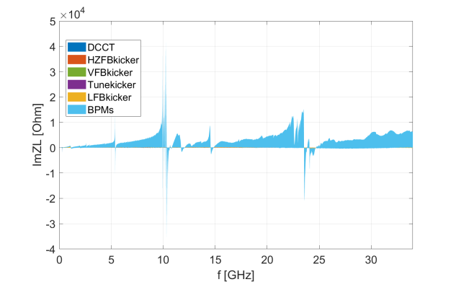
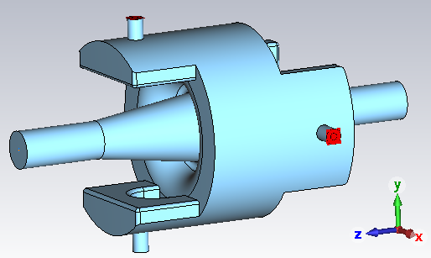
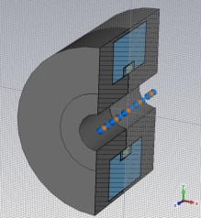
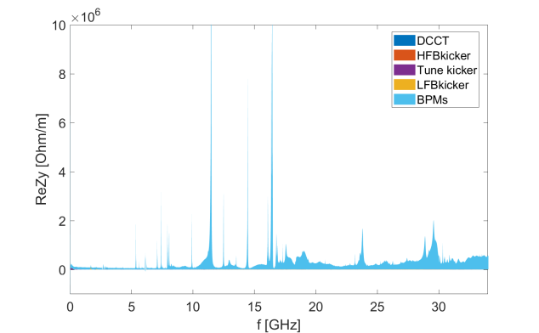
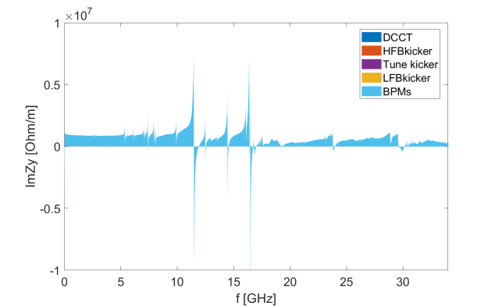
5. Diagnostics
Different types of bellows and BPM assemblies are modeled ⇒one of the dominate contributor to the broadband impedances (~20%), Resonances exist in both longitudinal and transverse planes.
The broadband impedance contributed by the DCCT and feedback kickers are small.
ReZL
f_{r} ~10GHz
ImZL
ReZy
ImZy
 | k_{l}, V/pC | Z||/n, mΩ | k_{y}, kV/pC/m
Bellows&BPM | 13.9 | 57.5 | 16.0
DCCT&FBkickers | 4.1 | 1.7 | 0.5
Total | 83.7 | 226.3 | 86.4
f_{r} ~11.5GHz
f_{r} ~16.5GHz

Slide 10
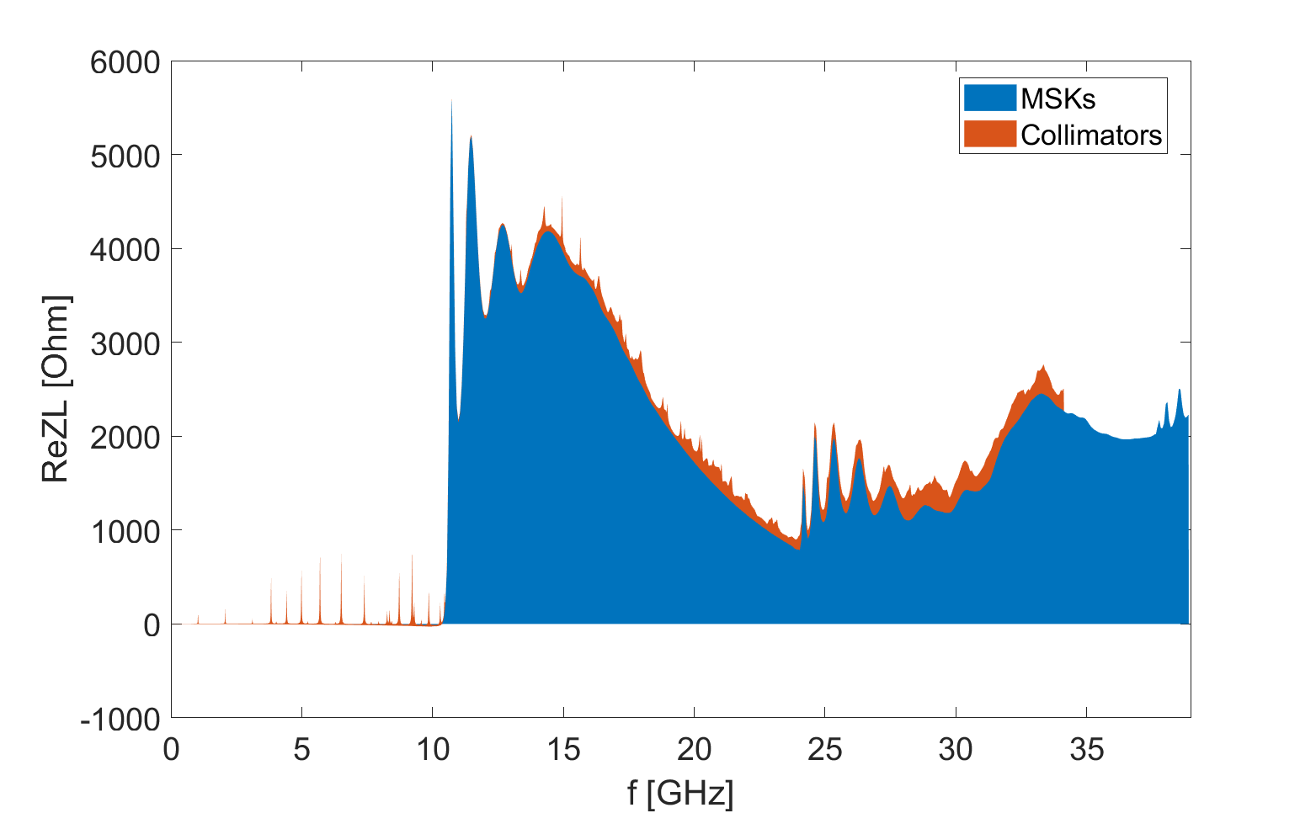
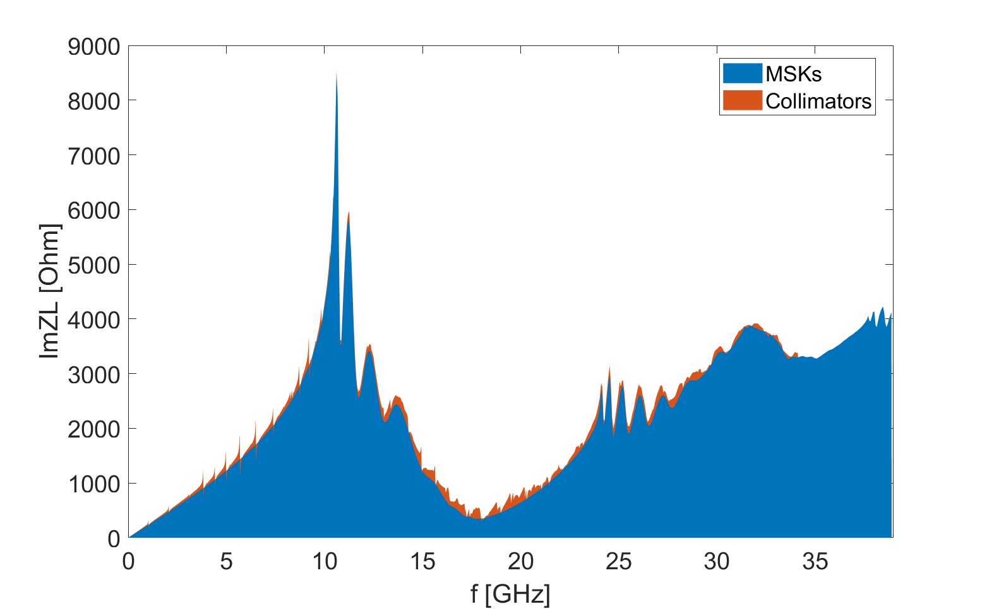
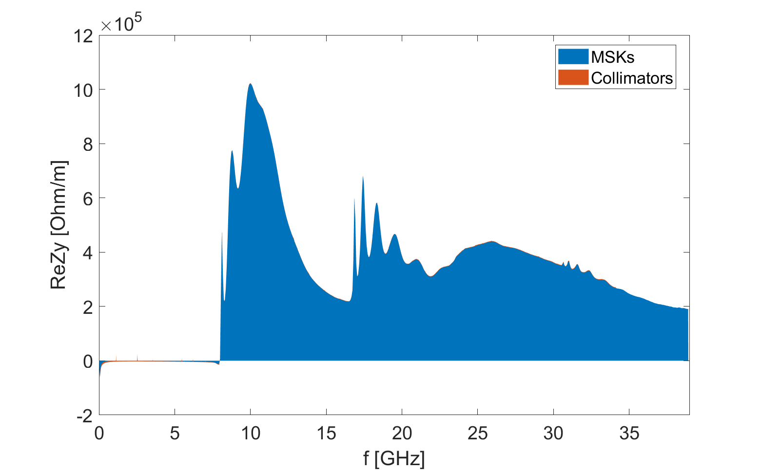
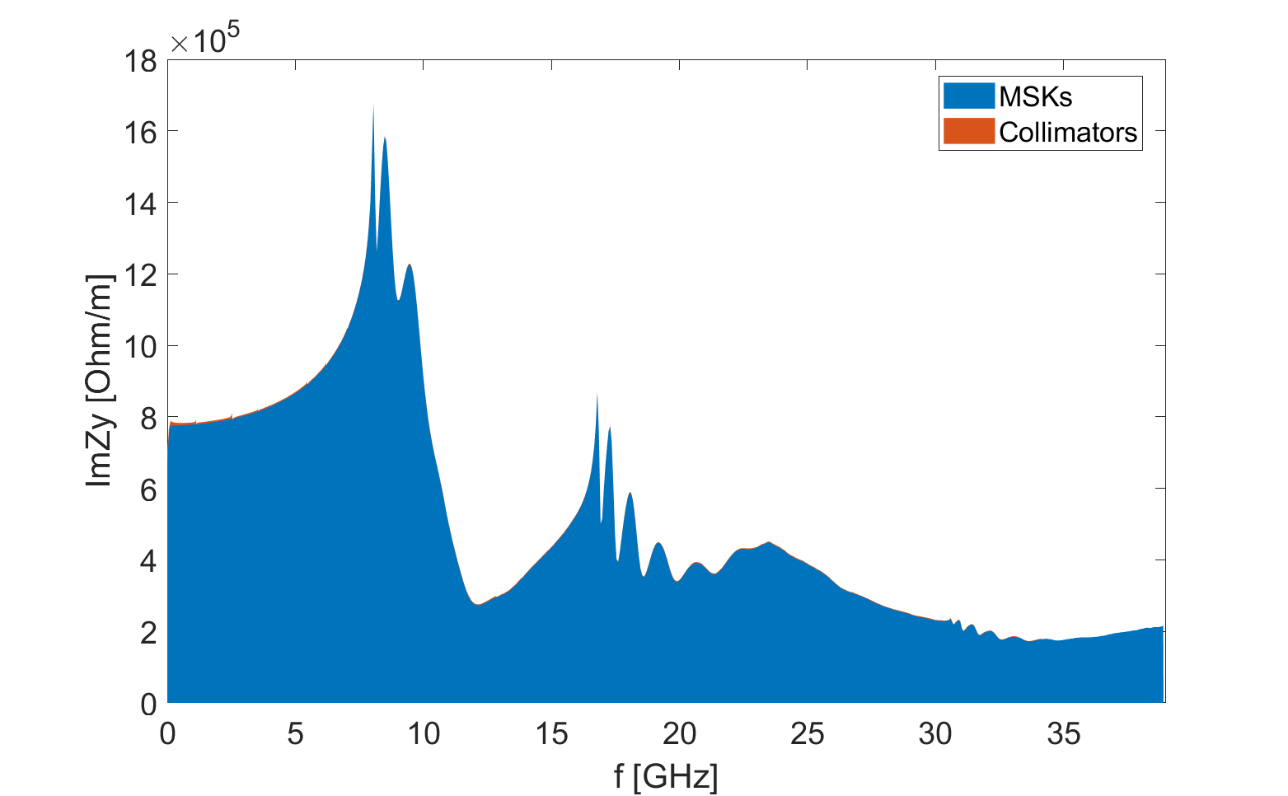
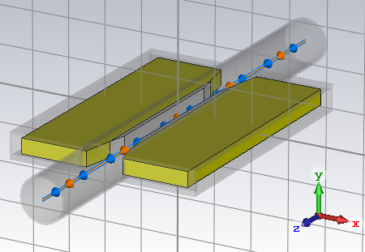
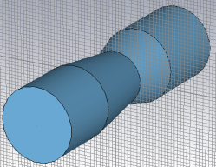
6. Collimators and masks
The masks have typical intrusion height of 3 mm ⇒one of the dominate contributor to the broadband impedances (~20%).
Horizontal collimators (with minimum gap of 7mm) are used to control the beam losses ⇒ less contribution to broadband impedances (<1%), but with horizontal resonances.
ReZL
ImZL
ReZy
ImZy
 | k_{l}, V/pC | Z||/n, mΩ | k_{y}, kV/pC/m
Masks&Coll | 10.3 | 53.1 | 15.1
Total | 83.7 | 226.3 | 86.4

Slide 11
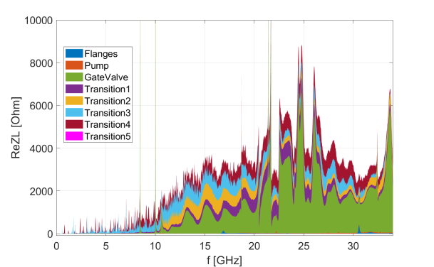
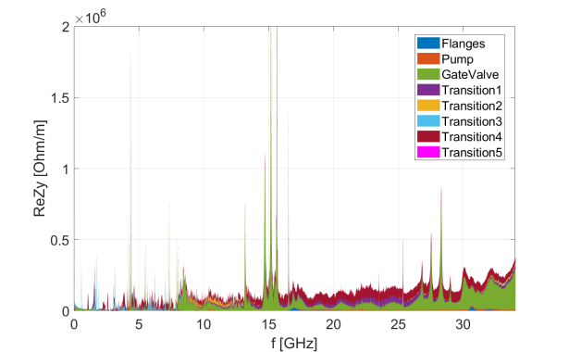
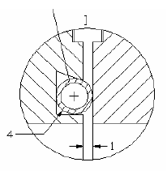
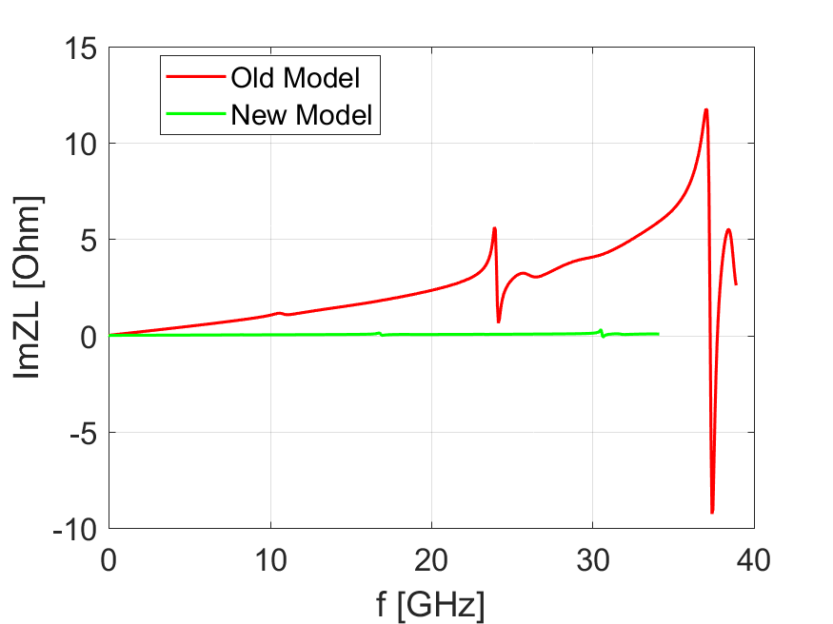
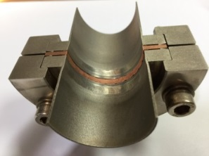
7. Vacuum components
ReZL
 | k_{l}, V/pC | Z||/n, mΩ | k_{y}, kV/pC/m
Vacuum transitions | 8.9 | 35.9 | 4.6
Gate Valves | 4.1 | 24.4 | 4.0
Flanges &pumping ports | 0.1 | 1.2 | 0.4
Total | 83.7 | 226.3 | 86.4
ReZy
RF shielding of the flanges is optimized considering its large contribution to the impedance
The vacuum transitions and gate valves show large contributions to the broadband impedances (15% in loss factor, 27% in Z||/n, 10% in k_{y}).
Narrowband resonances exist in both longitudinal (@8.5GHz, 10GHz) and transverse(@4.4GHz, 15.2GHz, 15.6GHz) planes by the gate valves.
The impedance contribution from the flanges and pumping ports are small.
SSRF or BEPCII design
One cylindrical gap:
width = 1mm
depth = 1mm
Impedance is mainly contributed by the construction or mounting errors (which specifies the tolerance limit of ~0.1mm)

Slide 12
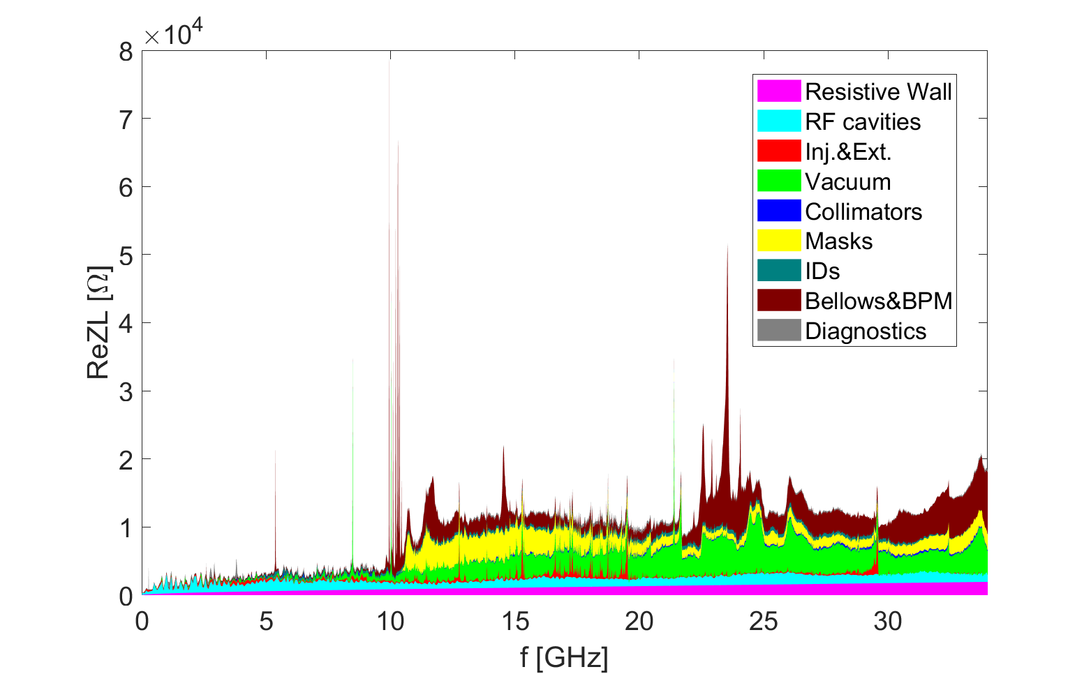
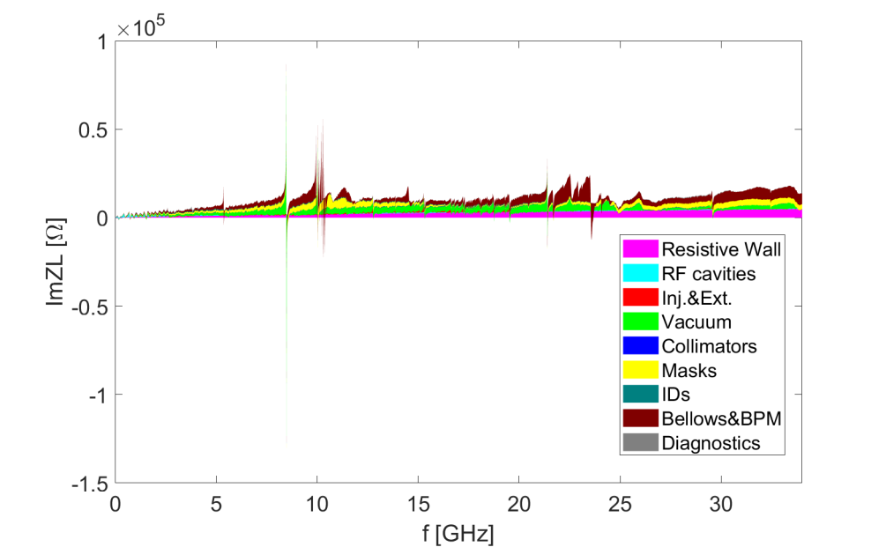
Longitudinal impedance
Broadband impedances mainly contributed by: resistive wall, transitions, masks, bellows&BPM
Narrowband impedances mainly contributed by: Gate valve, bellows
Gate valve
Bellows
Bellows
Gate valve
Bellows
Bellows
ReZL
ImZL

Slide 13
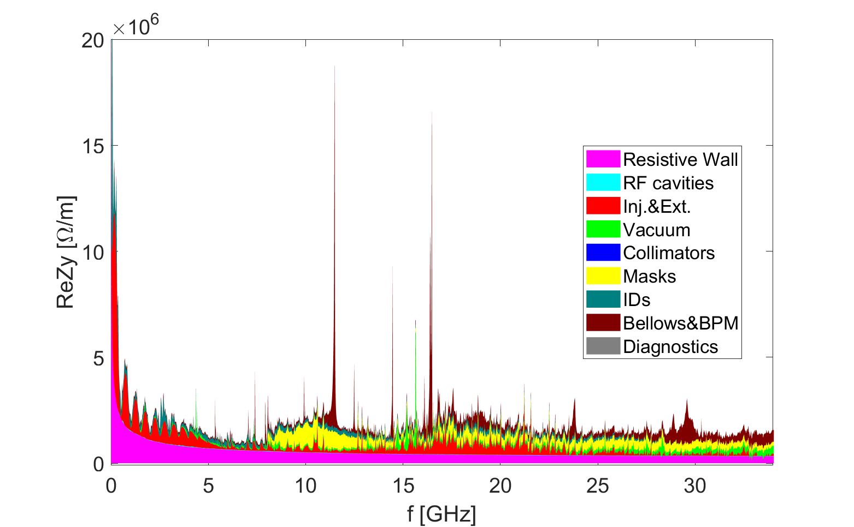
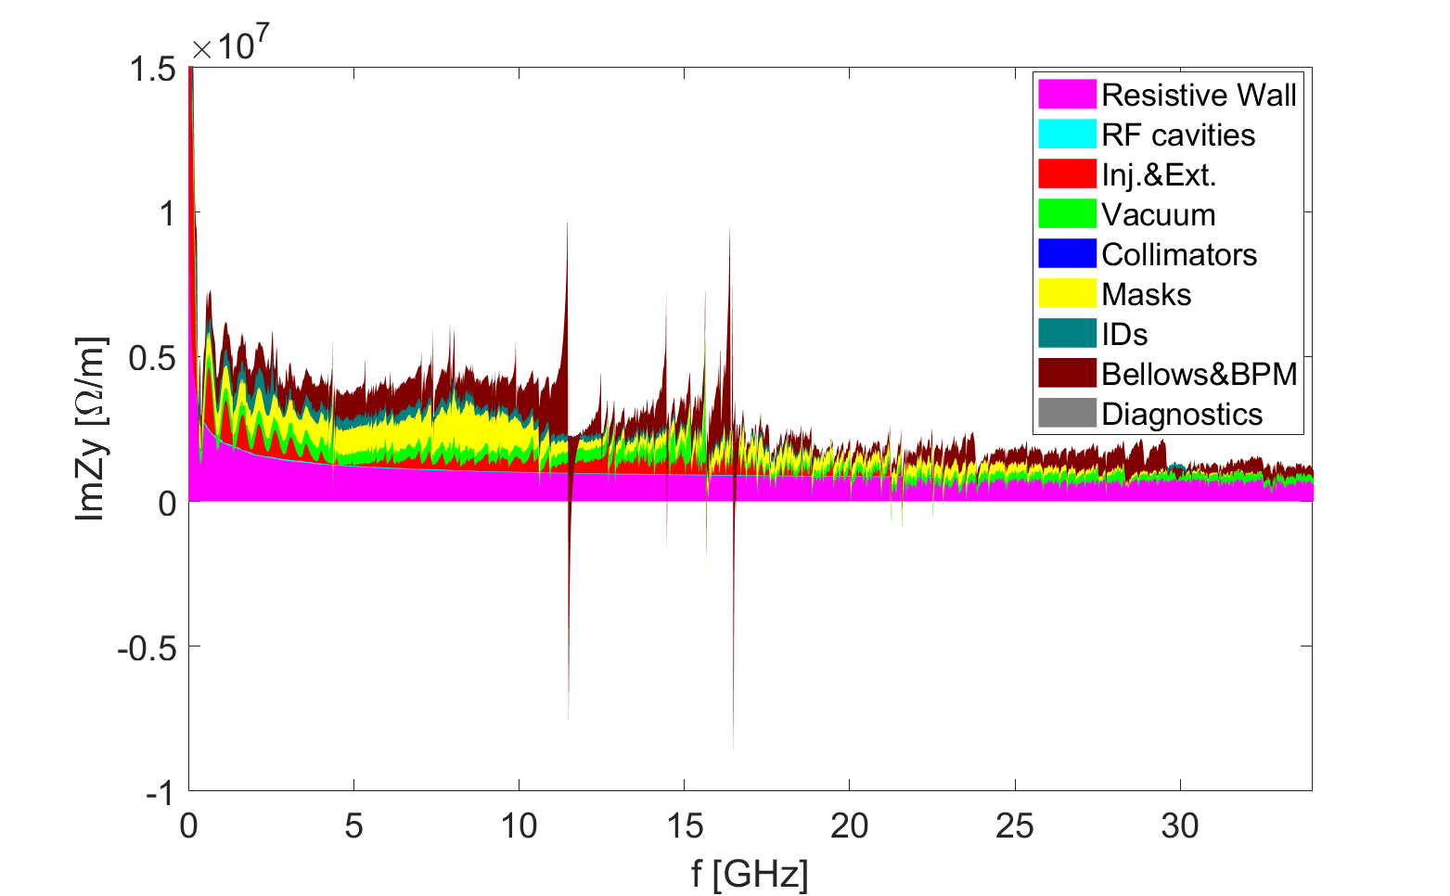
Vertical impedance
Vertical impedances are normalized by local beta functions.
Broadband impedances mainly contributed by: resistive wall, inj.&Ext. kickers, masks, bellows&BPM
Narrowband impedances mainly contributed by: In-vacuum IDs, inj.&Ext. kickers, BPM
In-vacuum IDs
BPMs
In-vacuum IDs
BPMs
Inj.&Ext. kickers
Inj.&Ext. kickers
ReZy
ImZy

Slide 14
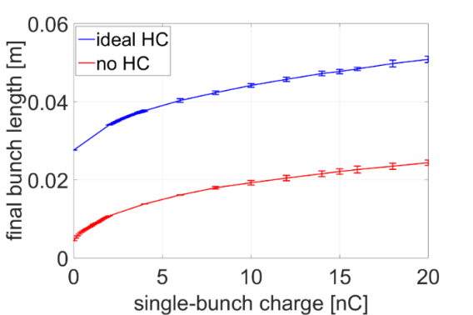
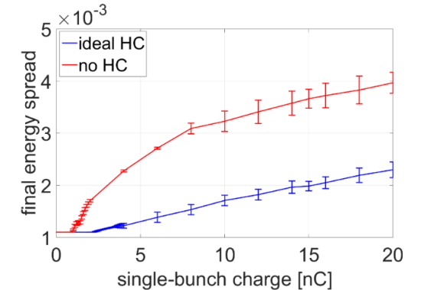
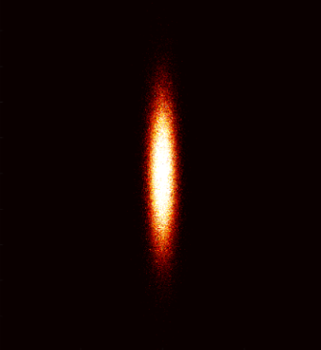
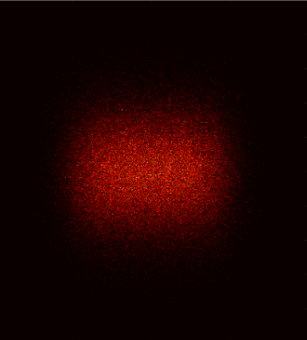
Simulations on single bunch instabilities
Microwave instability
  Harmonic cavities are used to lengthen the bunches, so as to increase beam lifetime and especially to mitigate IBS effect and collective beam instabilities.
  The beam energy spread increase above the instability threshold is mitigated by introducing the H.C.
  No beam loss at the max. target single bunch charge (14.4 nC/bunch, 63 bunches & 200 mA), but with obvious bunch lengthening and beam energy spread increase
w/o H.C.
w/ H.C.
Zero current
Bunch Length
Energy Spread

Slide 15
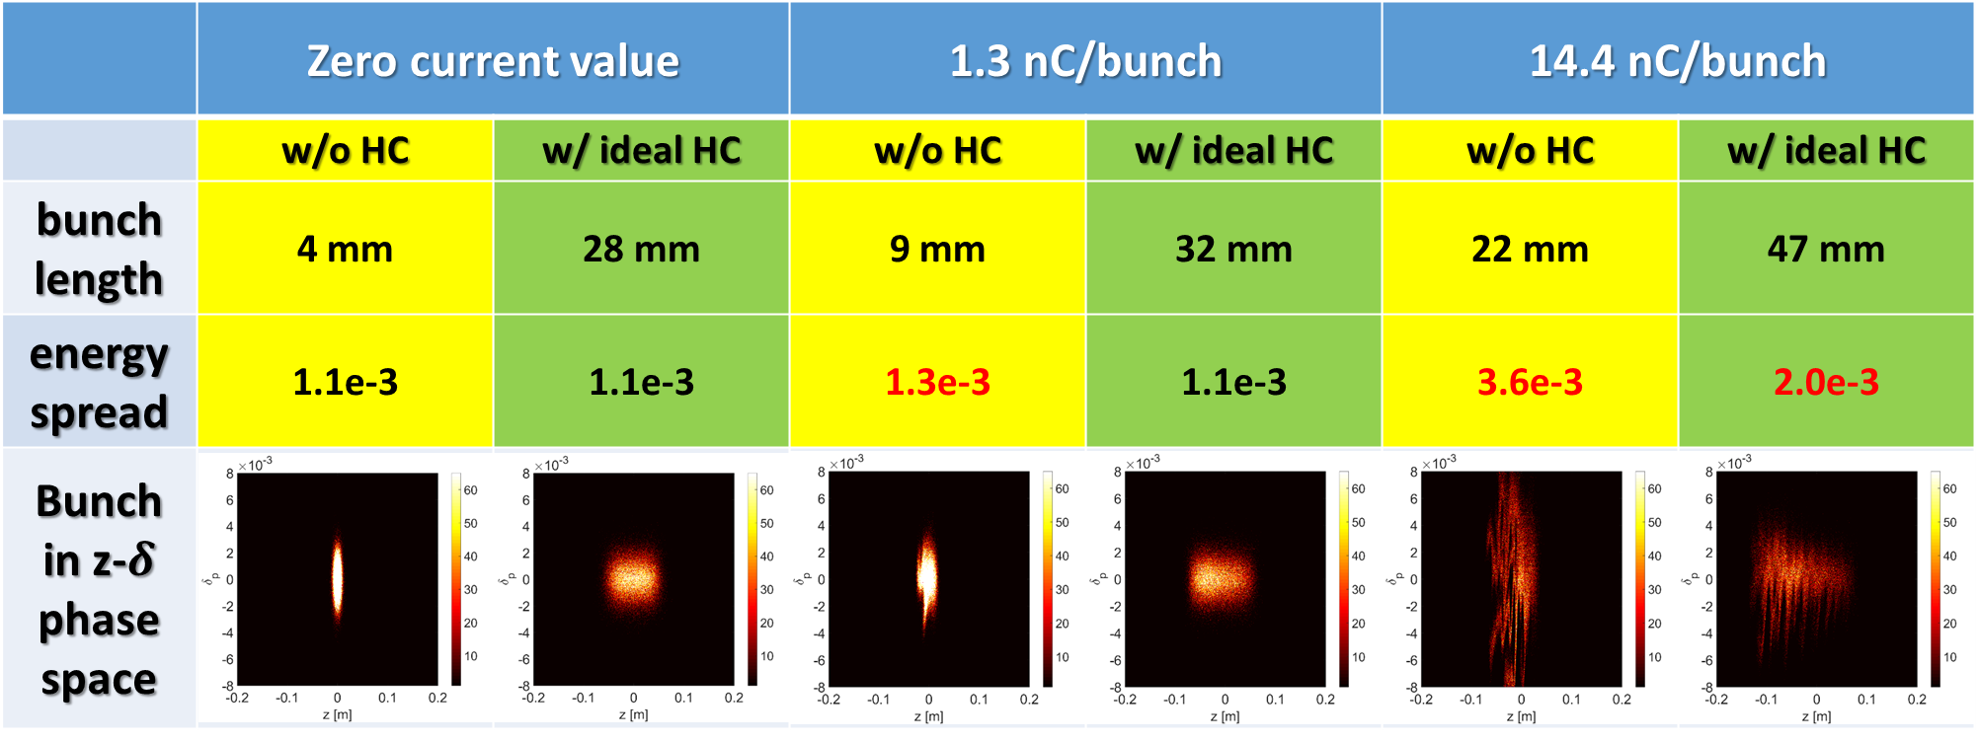
Influence on longitudinal beam parameters
Longitudinal beam disturbance observed at both target bunch charge for the two operation modes.
Harmonic cavity is essential to mitigate the disturbance, as well as beam energy spread increase.
However, brightness reduction (10~20%) is still expected for the high bunch charge mode.

Slide 16
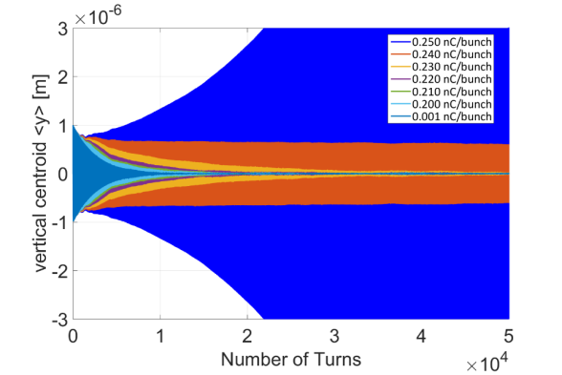
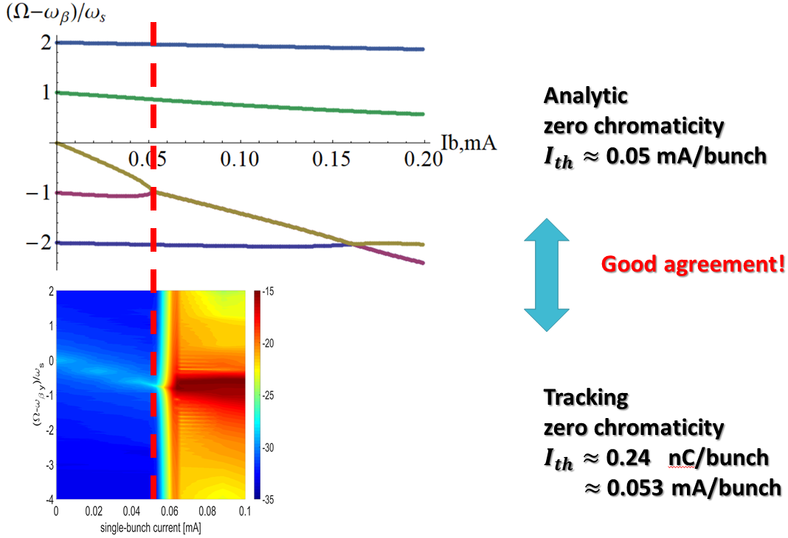
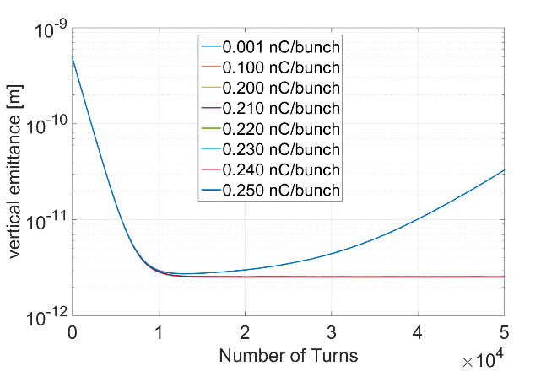

Transverse mode coupling instability
Strong instability with beam size blowup and beam losses.
For the case without HC and zero chromaticity the instability threshold is ~0.24nC
zero chromaticity
$I_{th}≈$0.24 nC/bunch
0.25 nC/bunch
All the others

Slide 17
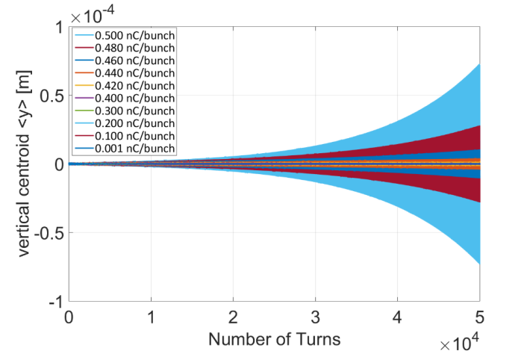
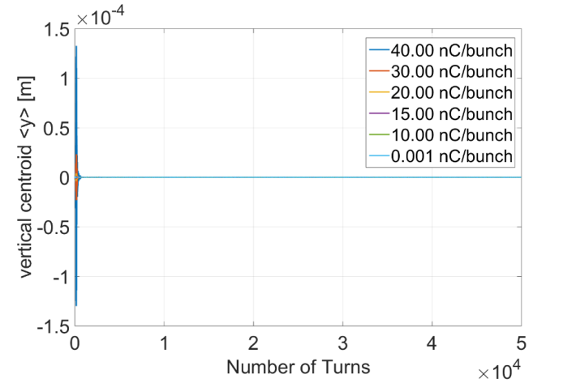
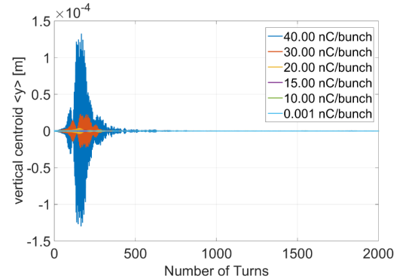
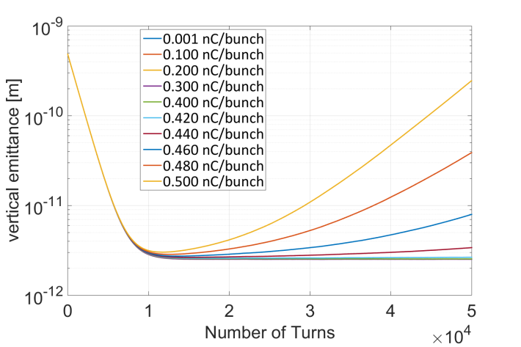
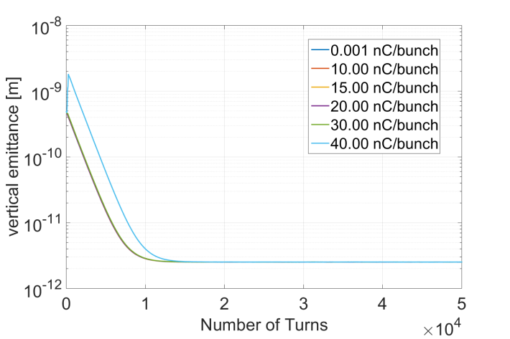



Transverse mode coupling instability w/ HC
zero chromaticity
$I_{th}≈$0.42 nC/bunch
+5 chromaticity
$I_{th}$> 30 nC/bunch
High-charge effects in the transient process after injection needs carefully study
Zoom in

Slide 18

Transverse resistive wall instability
-1.71f₀
-0.71f₀
0.29f₀
1.29f₀
Coupled bunch instability can be driven by the resonance of the transverse resistive wall impedance around zero frequency.
The instability growth time for the most dangerous mode (at −0.71f₀~ −156 kHz) is approximately 0.6 ms in vertical ⇒bunch-by-bunch feedback damping is needed.
The resistive wall impedance generated by the IDs contributes more than half of the growth rate.
The growth time in the horizontal plane is approximately 1.4ms.

Slide 19



Coupled bunch instability from HOMs
CPMU&IVU
  6 CPMU (2.64m) + 5 IVU (4.64m)
  HOM frequency depends on the length and gap (nominal: 5mm) of the IDs
Is this estimation too strict?
  Resonance overlap with beam spectrum line
  Measurements are weaker than simulations (3~4MΩ/m vs. 60~150MΩ/m)
  Damping from chromaticity?
RF cavities
  HOM absorber with large beam pipe
  HOMs below cutoff frequency has been damped below the SR threshold
Wakefield simulations show that the HOMs from other components are bellow the threshold given by SR or BbyB feedback, more detailed eigenmode analysis are underway.
Single ID:
HOM absorber

Slide 20
Beam ion effects
The beam ion effects are calculated by particle tracking simulations with Elegant
  The beam gets more unstable at low beam current, and no apparent beam quality degradations observed at design beam current and vacuum conditions. The results are confirmed by our self developed code (Phys. Rev. Acc. Beams 23, 074401).
Beam oscillation amplitude for different vacuum conditions (@680 bunches & 200mA)
Beam oscillation amplitude for different beam current (@680 bunches & 1nTorr)

Slide 21
Summary
An detailed impedance model has been built for the instability analysis and particle tracking simulations.
  Dominant contributors to the broadband impedance include: resistive wall, masks, bellows&BPM, vacuum transitions and gate valves
  Dominant contributors to the narrowband impedance include: in-vacuum IDs, inj.&ext. kickers, bellows&BPM, gate valves
  Impedances are optimized based on iteration with hardware designs
No beam loss at the max. target single bunch charge (14.4 nC/bunch, 63 bunches & 200 mA), however, brightness reduction (10~20%) is unavoidable.
With the aid of feedback system and positive chromaticity, it is feasible to control the multi-bunch instabilities for 200 mA operation.
Beam ion effect would not be a critical issue at the design beam current and vacuum condition.

Slide 22

Thank you for your attention!

Slide 23







Vacuum components
Hard transition between beam pipe with different cross sections (Absorbers included)
Transition1
Transition2
Transition3
Transition4
Transition5
RF shielding of the flanges is optimized considering its large contribution to the impedance
Gate valves and vacuum pumping ports are designed with RF shielding
SSRF or BEPCII design
One cylindrical gap:
width = 1mm
depth = 1mm
Impedance is mainly contributed by the construction or mounting errors (which specifies the tolerance limit of ~0.1mm)

Slide 24




Impedance bench measurements
Coaxial wire measurement of the injection strip-line kicker
  Good agreement has been reached between measurements and simulations.
NEG coating
The conductivity of NEG coating is measured with resonant cavity considering different coating thickness.

Slide 25





Bunch-by-bunch feedback
Provide the needed physical parameters for the design of BBB feedback system
Check the effectiveness of the designed FB system by tracking simulations
w/o limit on kicker power
$P_{peak}$ ~ 4.34 kW
w/ limit on kicker power
$P_{peak}$ < 1 kW
FB off
FB off
Vertical centroid vs. turns
FB on
FB on
Vertical centroid vs. turns
Vertical centroid vs. turns
CBI modes vs. turns

Slide 26






Total impedance budget
σz, mm | kloss, V/pC | ZL/n, mΩ | ky, kV/pC/m
4.6 | 83.7 | 226.3 | 86.4
22.9 | 6.6 | 338.0 | 26.6
With longer test bunch length, the loss factor and transverse kick factor decrease, while the longitudinal impedance increases.
The contribution from different elements varies with bunch length.
σ_{z}=4.6mm
σ_{z}=22.9mm
Loss factor
Z||/n
k_{y}

Slide 27

HEPS储存环阻抗演化
电阻壁、Masks、Transitions
更多真空和束测元件
电阻壁、真空元件、bellows

