Slide 1
第十六届TeV物理工作组学术研讨会
暨邝宇平院士学术思想研讨会
祝邝宇平老师九十华诞
生日快乐
Xiao-Gang He
Beijing, November 10, 2022

Slide 2
The TeV Physics Workshop
国际高能物理学术界最近一二十年和未来几十年最为关注的课题是超出粒子物理标准模型的新物理。目前实验上能够达到的探索新物理的能量尺度就是TeV能量区域，因此寻找新物理最主要是在TeV能量区域发现新的物理现象。
早在2005年，由清华物理系的邝宇平老师牵头，成立了清华牵头的全国TeV物理工作组，每年举办一次全国性 “TeV物理工作组研讨会”。
我们非常感激邝老师的远见和其他工作组人员长期不懈的努力，使我们有良好机会聚会并讨论相关物理，协助成从小到大的各种研究团队，理论和实验，的成长！

Slide 3
TeV Physics
- a frontier of partricle and particle astrophysics
Congratualtions to the organizers of this workshop!
Even at the pademic altert, the workshop is successfully help having total 48 talks presented!
Topics covring from energy, intensity, and cosmo-asptophysics frontiers in both theory and experiment.

Slide 4
Exciting progresses have been reported coverying a wide range
Recent highlights from ATLAS Shu Li
Recent highlights of the CMS experiment Chen Zhou
`
LHCb实验上新物理的间接寻找 Jibo He
`
Future e+e- Higgs Factories - Status, Progress and Development Xinchou Lou
`
Looking forward to New Physics and neutrinos with FASER at the LHC T. Inada
`
微扰场论研究进展 Yanqing Ma
·
Search for resonances decaying to three W bosons in proton-proton collisions Qiang Li
`
Search for resonances decaying to three W bosons in proton-proton collisions Bin Yan
`
Pulsar Polarization Arrays Jing Ren
Direct detection of dark photon dark matter using radio telescopes Shuailiang Ge
`
中微子天文学最新进展 Donglian Xu
`
中微子理论进展汇报 Shun Zhou
`
鸿蒙：探索宇宙的起源与黑暗时代 Xuelei Chen
`
暗物质直接探测 Ning Zhou
`
早期宇宙中的物质库分布及其天体物理后果 . Yuqing Lou
`
新物理引力波信号研究进展 Fapeng Huang
`
通向新物理的有效途径：SMEFT和HEFT . Jianghao Yu
`
Detecting ultra-light particles from astro-physical obervations Jing Shu

Slide 5
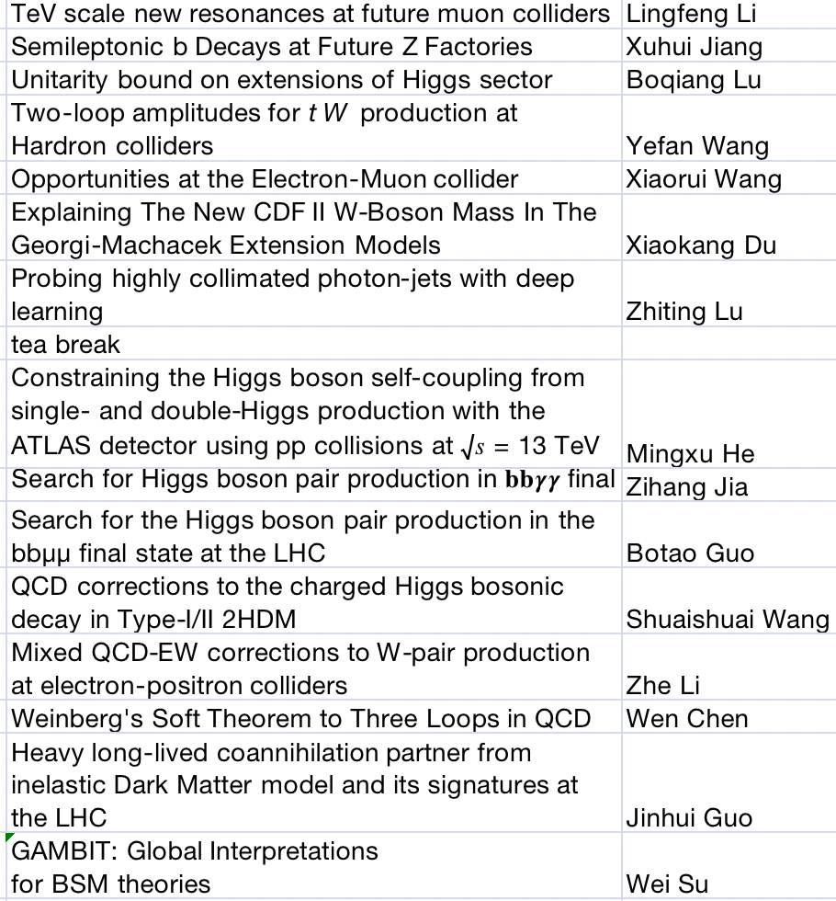
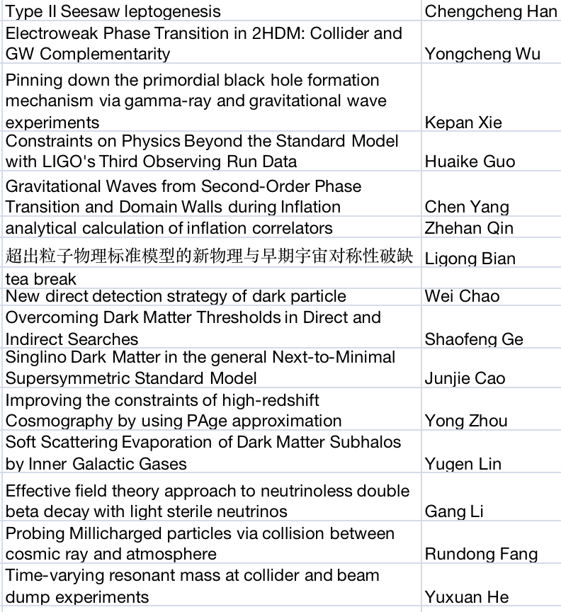

Slide 6
TeV physcis
TeV physics: contributions from all directions！
The energy frontier: from lower energies colliders at SLAC, CERN, Fermilab in the early days to now the LHC, and future higher energy colliders, CEPC, FCC and ...
Now we are colliding proton beams at TeV energies, discover heavy particle, like W, Z, Top and Higgs. A alot of discoveries!
The intensity frontier: Neutrino-，K-, Tau-charm-, B-, Higgs- ... factries, and other high luminosity beam experiments...
Fermi beta decay theory predicted high energy gauge boson...
g-2 of muon, B anomalies and edm of fundamental particle, imlies new physics at TeV scale...A lot of discoveries!
The cosmo-astrophysics frontier: Comsmic rays (gamma, proton, elctron, muon, neutrino..), CMB, power spectrum, black holes ,...
Universe is the biggest collider! highest energy particle beams, WIMP dark mater of TeV scale,... A lot of discoveries!
All are intemately related! We need to work together to go forward!
More New discoveries to come? Where?

Slide 7
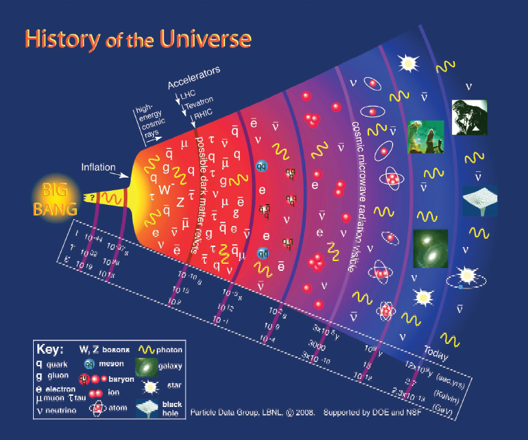
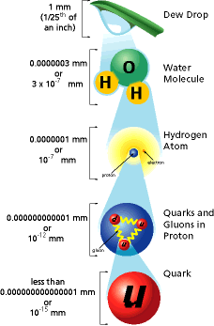
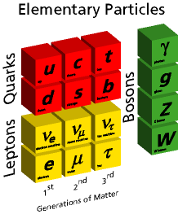
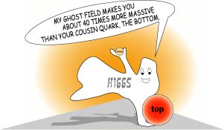
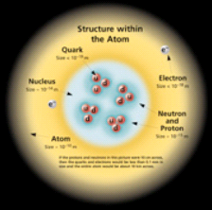
The standard model of strong and electroweak interactions
The Standard models
SU(3) x SU(2) x U(1) gauge theory for strong and electroweak interactions
Inward Bound

Slide 8
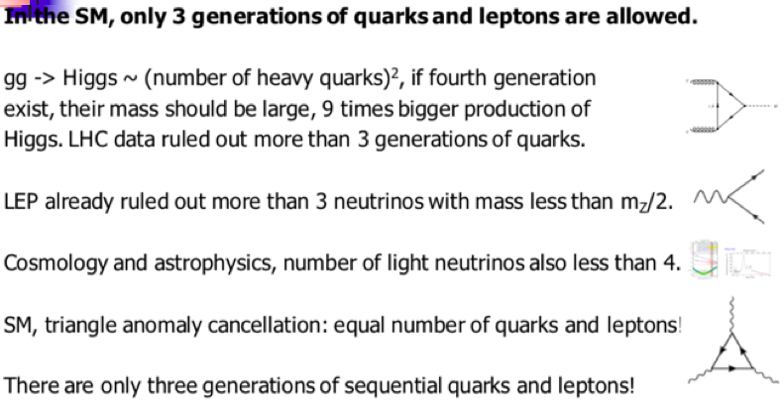
SM works well. But there are some anomalies at some high statistic level, among them, the muon g-2 anomaly is an serious one with 4.2 s from SM prediction!

Slide 9
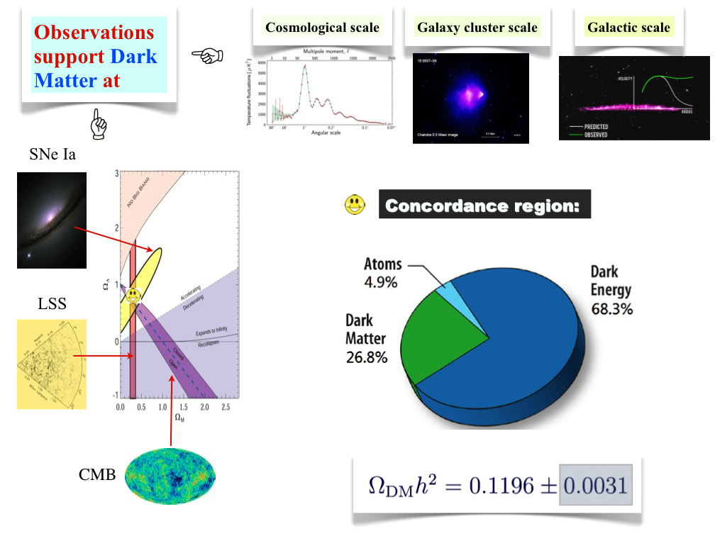
The Standard Model of Cosmology
Big-Bang + Cosmological constant: ΛCDM Big Bang Theory

Slide 10
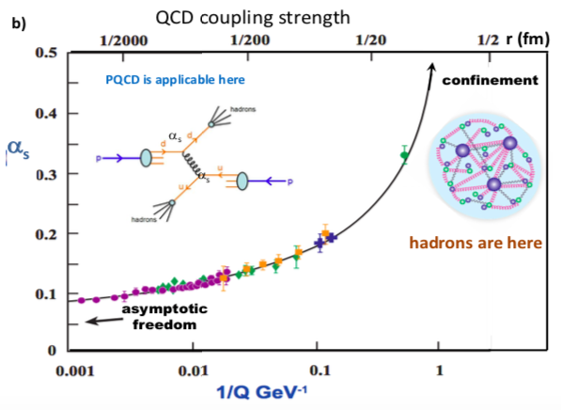
Test the SM
QCD sector
Successes: Asymptotic freedom, quark and gluon jets discovery…
But there are still mathematic problems awaiting to be solve. Most calculations are perturbatively treated, NNN..LO calculations…. Strong interaction at low energy has large non-perturbative effects. New tools are needed: lattice gauge theory is one of the ways ….
From PDG QCD review:
The Yang–Mills existence and mass gap problem is an unsolved problem in mathematical physics and mathematics, and one of the seven Millennium Prize Problems defined by the Clay Mathematics Institute, which has offered a prize of US$1,000,000 for its solution.
Where is glueball?
4sigma anomaly for strong coupoling? Bin Yan at this workshop

Slide 11
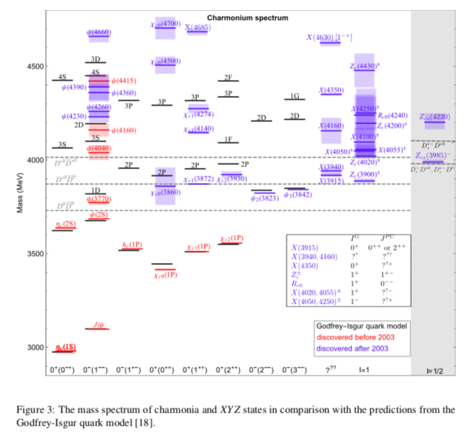
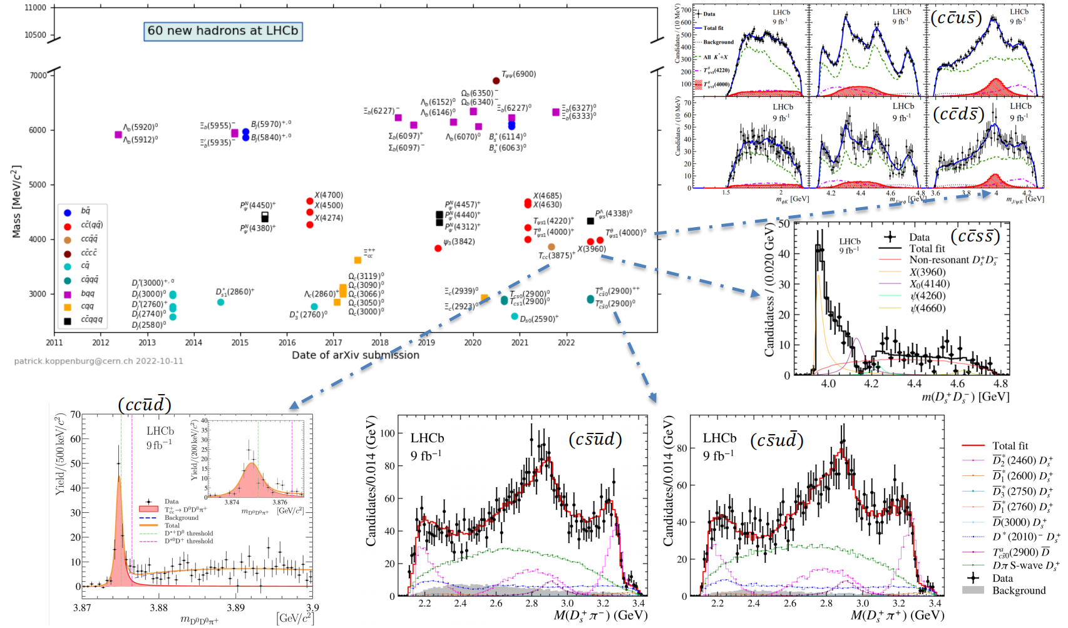
QCD sector
Many new exotic hadron states discovered in recent years
How the exotic states, XYZ, and also pentaquarks form?
Hadron spectroscopy not understood! More data needed!
Flavor physics at BES, BESIII, BELLE-II, LHCb, STCF… can do a lot!
Jibo He for LHb
Shu Li for Atlas at this whorkshop

Slide 12
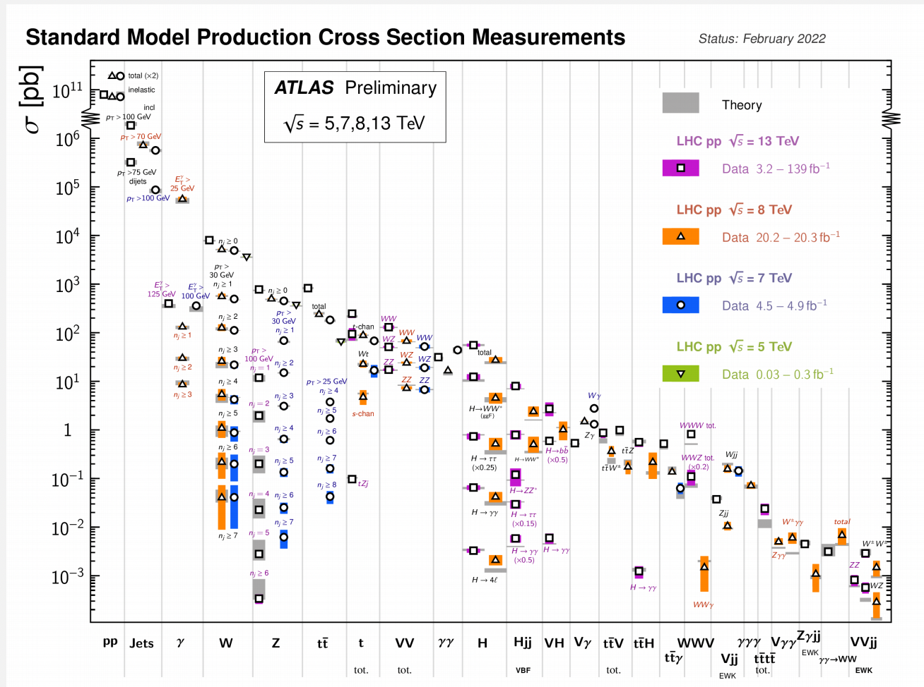
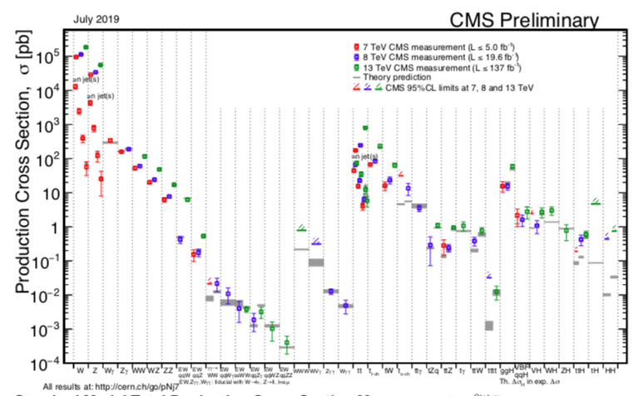
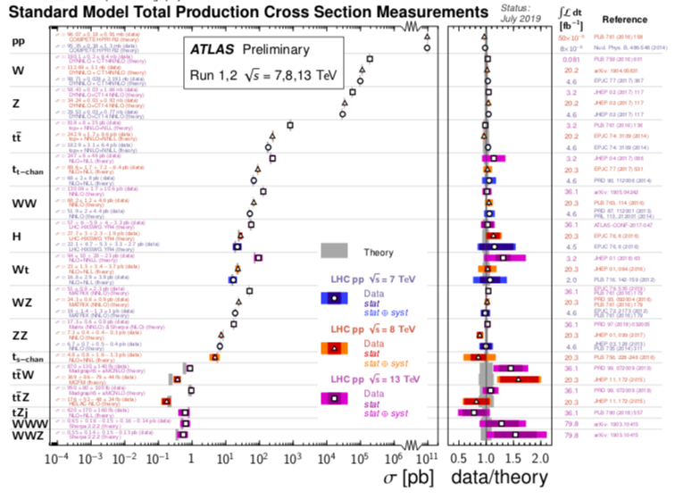
QCD and Electroweak sectors
W, Z, t and Higgs… discovered in the expected region with the right cross sections
Miltu-boson physics
Qiang Li, Z Li, YF Wang at this workshop
New progresses on puterbative field theory
Yanqing Ma, W. Chen at this workshop
Parton distribution are fitted by data
Good prediction for cross sections, but need first principle calculations of PDF!

Slide 13
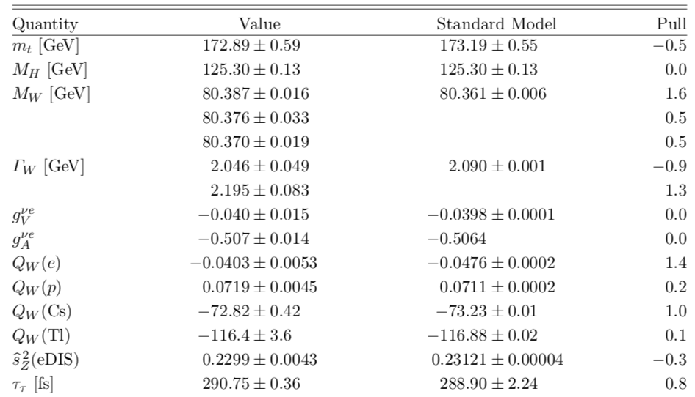
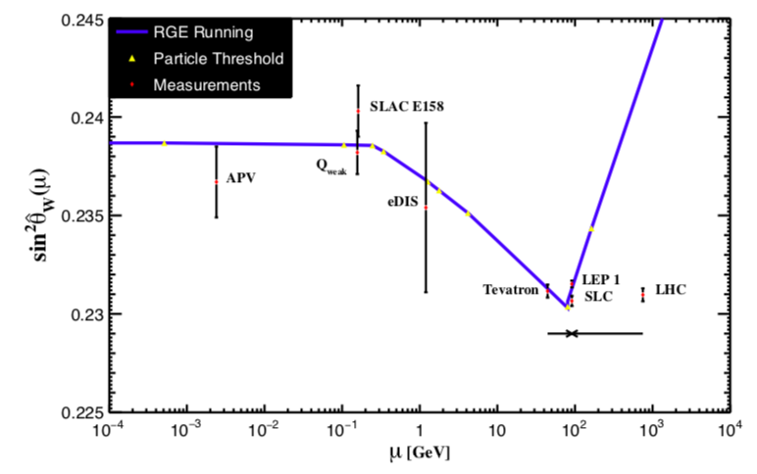
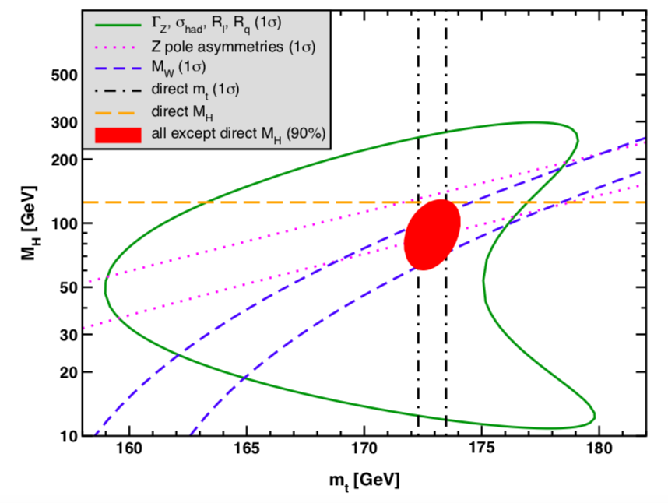
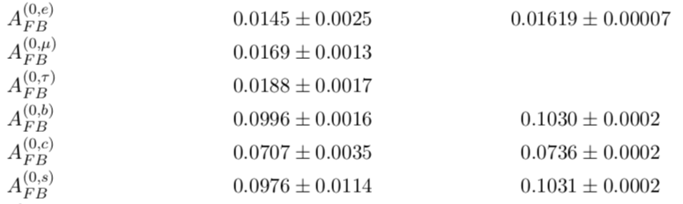
Electroweak Gauge-Fermion sector
SM in good agreement with data
There are a few quantities off by 3σ
ILC, FCCee, CEPC… can do a lot!

Slide 14
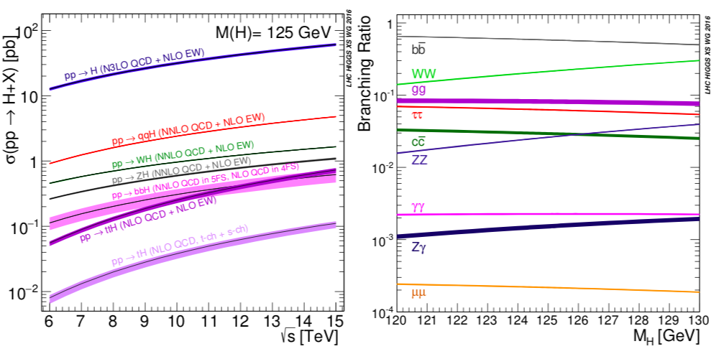
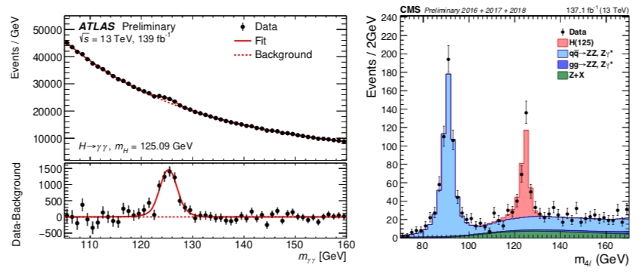
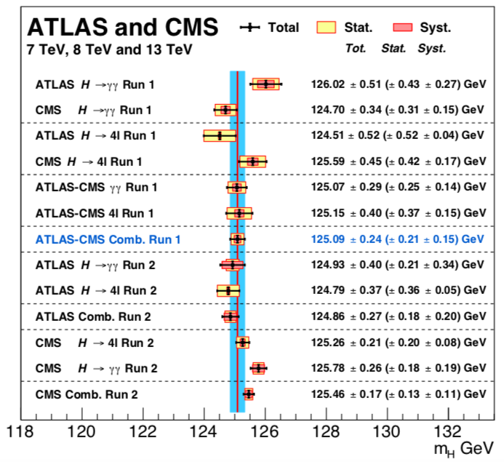
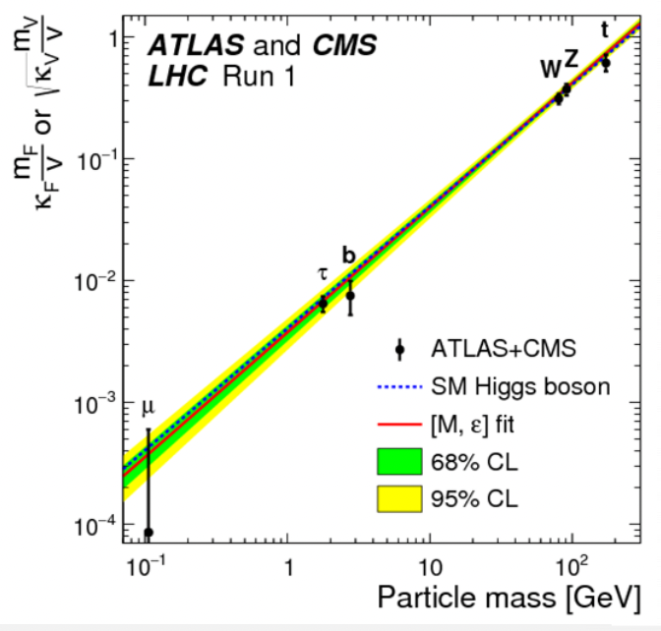
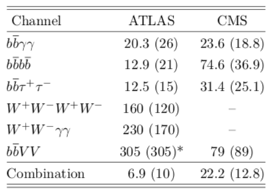
Higgs sector
SM agree data well. There are rooms for new physics beyond SM within error bars
pp -> HH
A lot to do for LHC, HHLC
ILC,
FCCee
CEPC
No more new physics? No!
There are a lot of reasons there are much more ahead of us!
Shu Li and Chen Zhou at this workshop

Slide 15
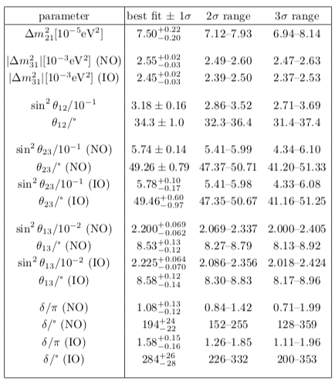
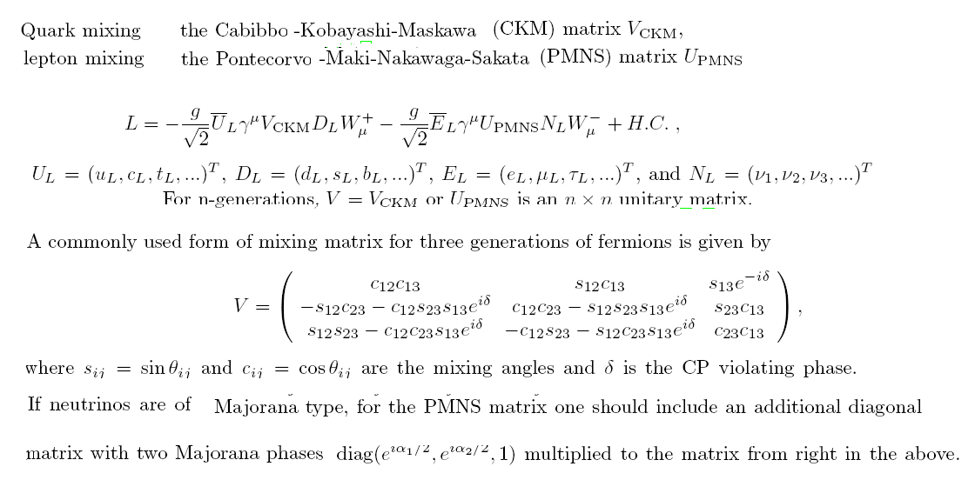
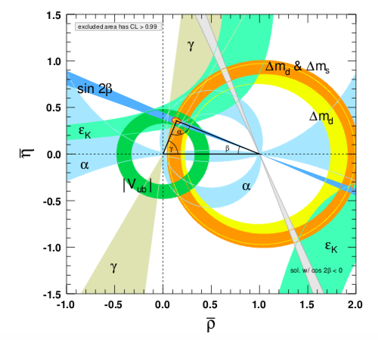
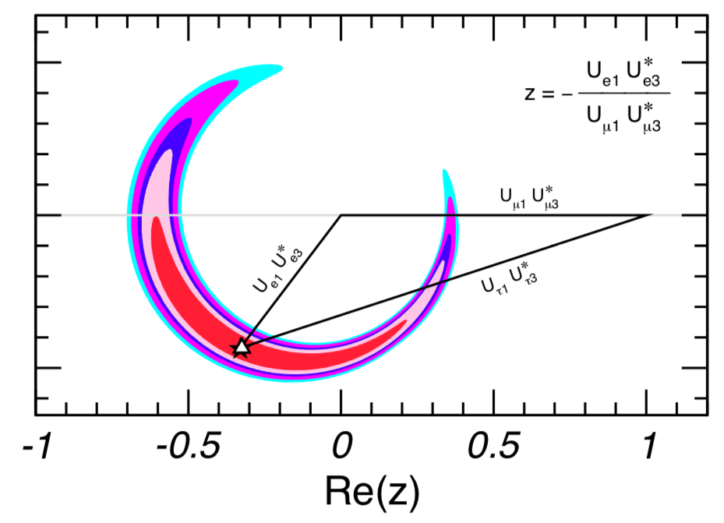

Yukawa and Flavor Sector
S Zhou, review at this workshop
Neutrino Sector →
<-- Quark Sector

Slide 16
The Standard Model of Cosmology
Big-Bang Inflation + Cosmological constant: ΛCDM Big Bang Theory

Slide 17
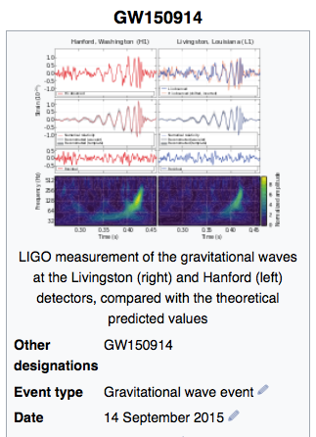
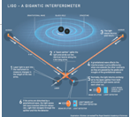
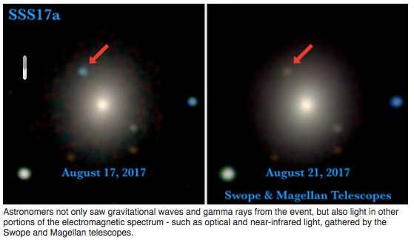
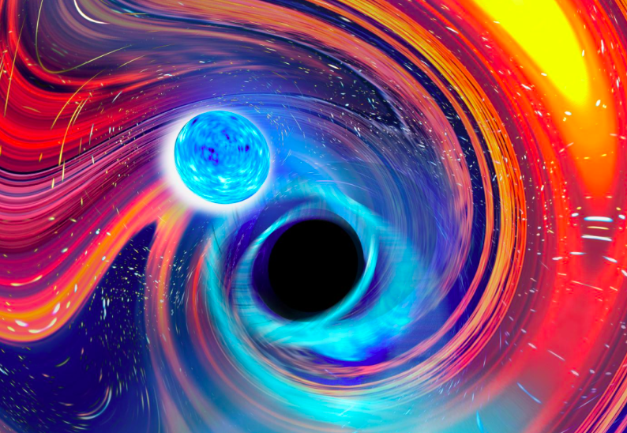
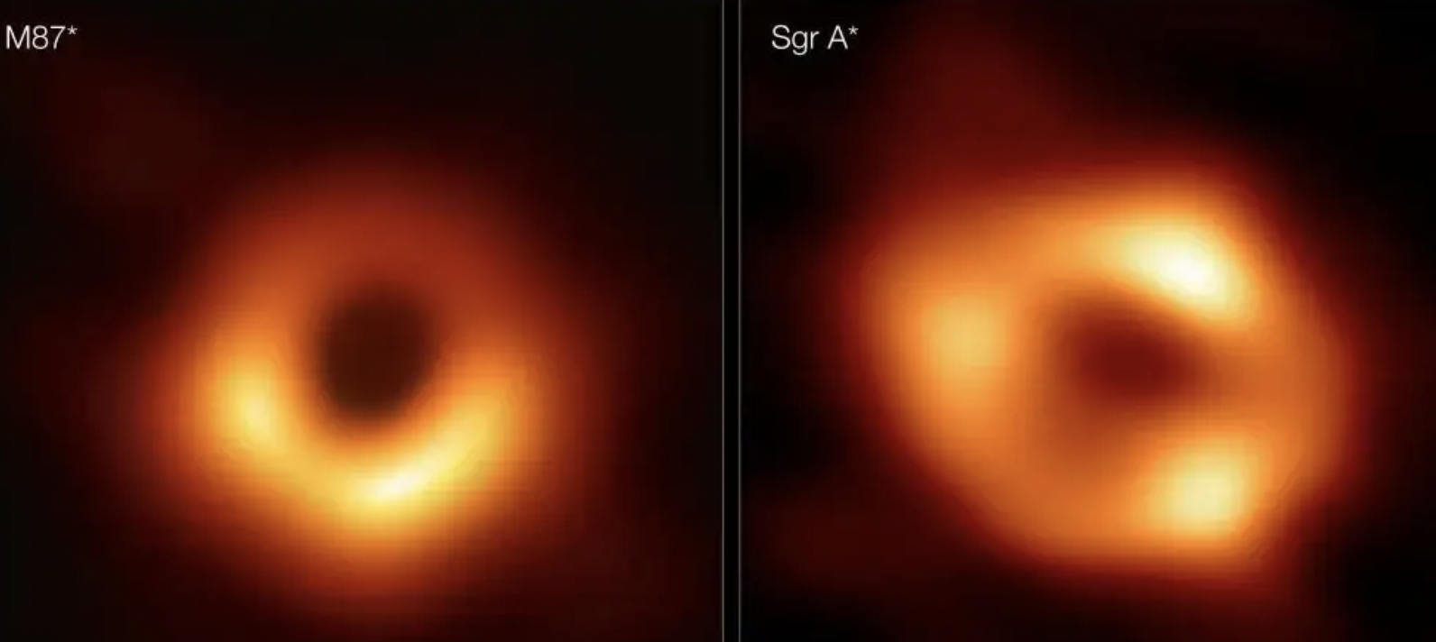
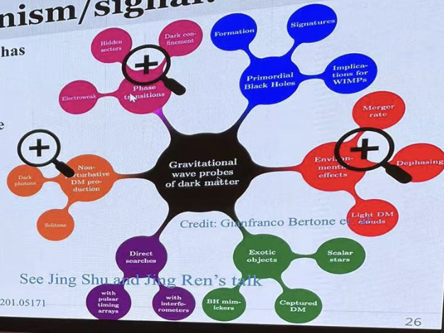
16/10/2017 detected gravitational wave from merge of two neutron stars.
GW200105, GW200115 detected gravitational wave from merge of one neutron star and a black hole.
Preditions hyper massive
black holes in our Universe
Yuqing Lou at this workshop
鸿蒙， Xuelei Chen
11/2/2016Ligo announced the discovery of gravitational wave due to merge of two black holes.
Gravitational wave,
Fapeng Huang
at this workshop

Slide 18
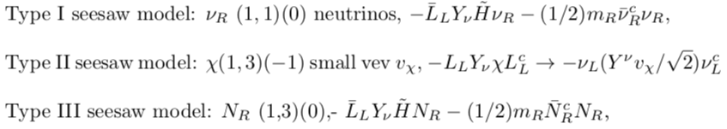

The need of going beyond SM
The SM is a beautiful and successful models to describe what we know. But how good is it and is there indications that is may not be the complete theory addressing all problems facing particle physics and cosmology?
Yes, there are many hints. Some of the prominent phenomenological ones are:
The neutrino mass problem. Need to introduces ν_{R} in the model. Then one has
And models of generating neutrino masses at loop levels.
Shun Zhou review at this workshop
Cosmological evidences: Dark matter, Dark energy
and matter-antimatter asymmetry

Slide 19
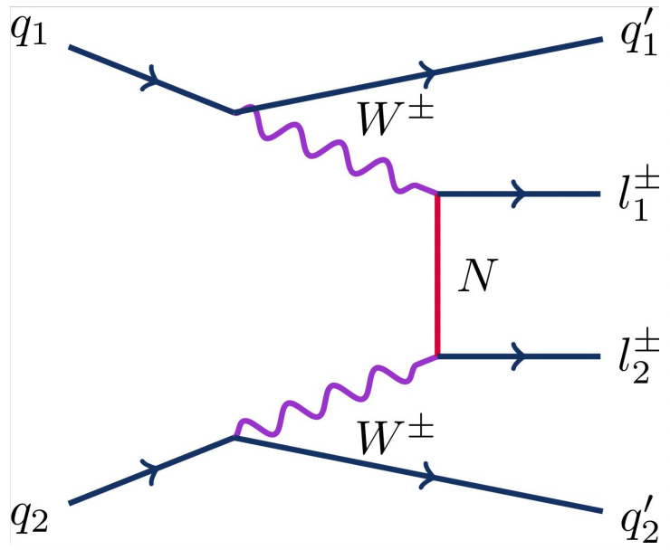
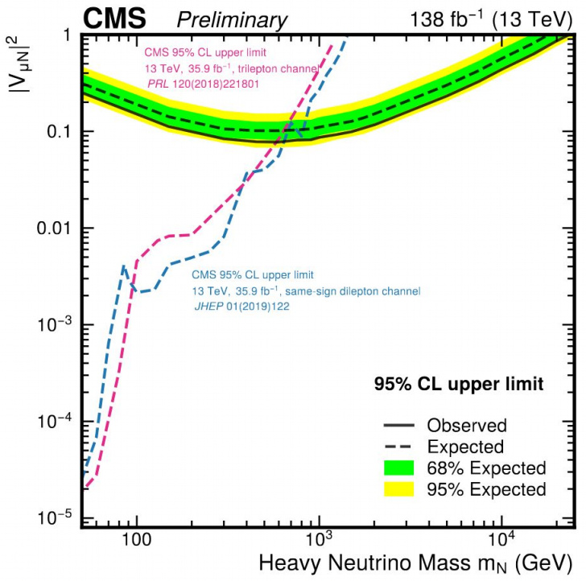
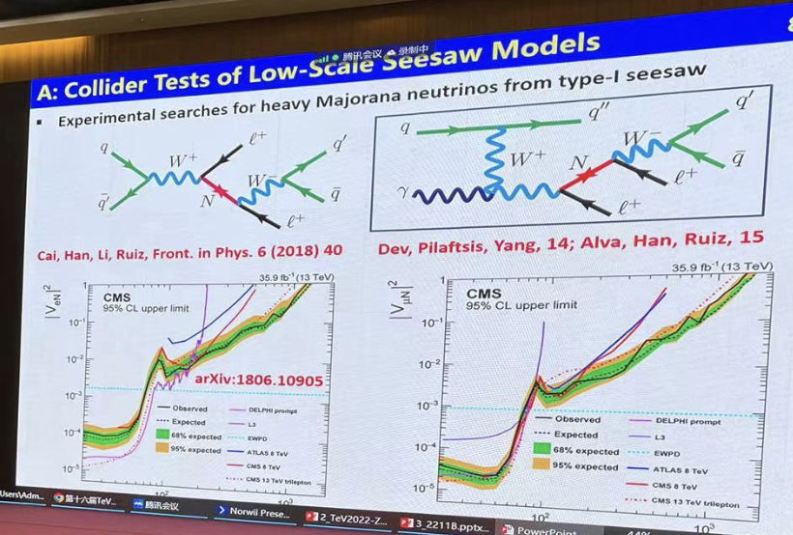
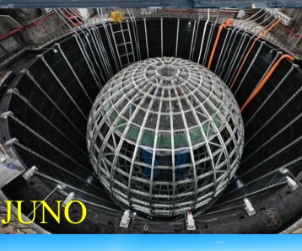
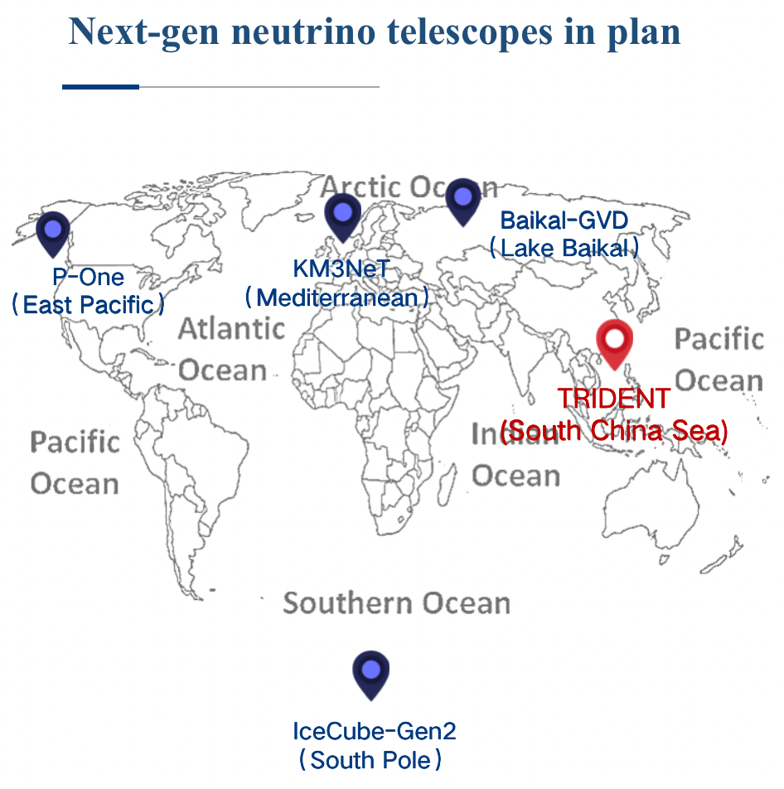
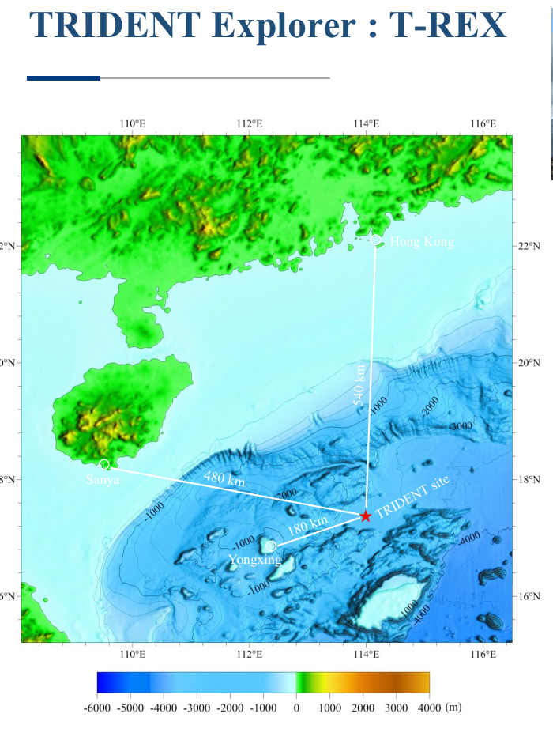
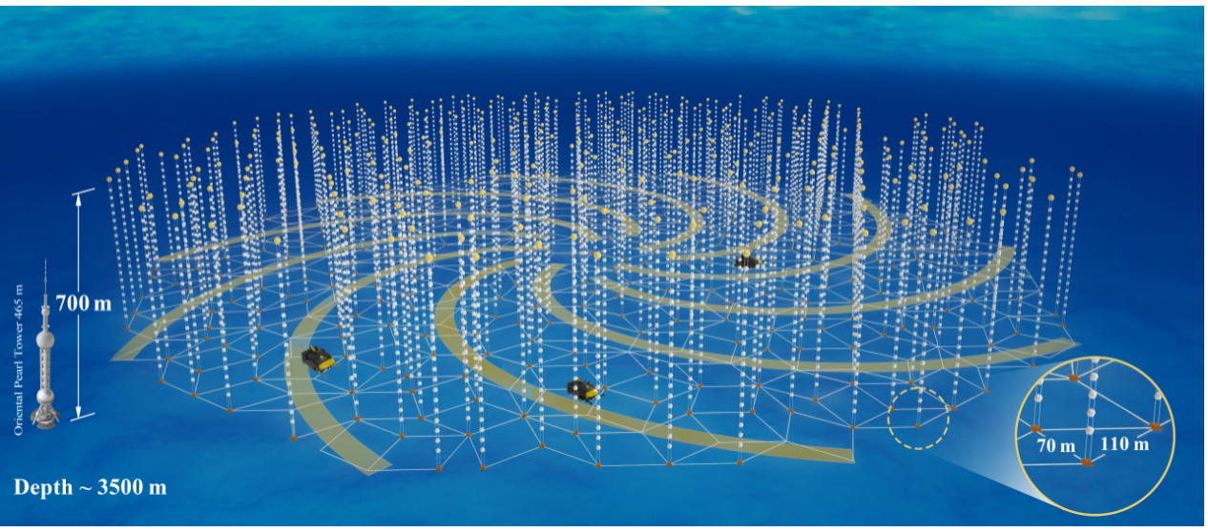
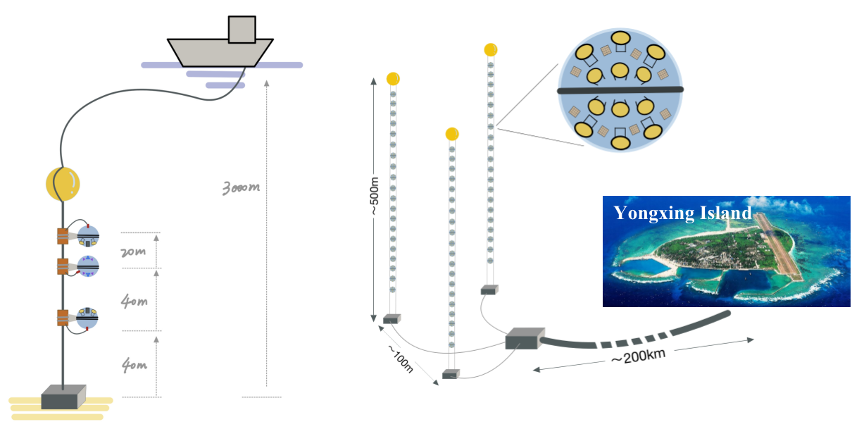
Neutrino Physics
In good shape internationally and domestically, Shun Zhou, Donglian Xu reviews, Gang Li at this workshop
Daybay neutrino experiment started the “leading”
era for China in neutrio experimental physics
JUNO will lead the effort to neutrino
mass and other related such as muti-messengers,
High energy neutrino cosmic ray detections
It is time for China to play an important role!
Trident Neutrino telescop
Also prposal from IHEP, Baical neutrino telescop

Slide 20
More theoretical ones
The hierarchy problem: Why electroweak scale ~ v~ 300 GeV is so much lower than the Planck scale ~ m_{Planck} ~ 10¹⁹ GeV.
Cosmological constant problem, very small but none zero.
Strong CP problem, why θ <10⁻¹⁰ is so small?
Unification of all forces:
a) Grand unification of strong and electroweak interaction
b) Theory of Everything, unification of strong, electroweak and gravity
Too many free parameters in the theory? Possible to reduce them?
Why there are just 3 generations? Neutrion, Dirac or Majorana particle?
…

Slide 21
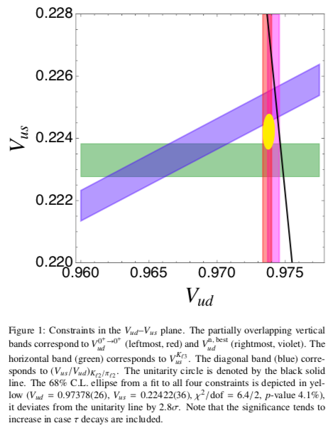
Anomalies
There are also a few anomalies in flavor physics which show some deviations from SM predictions at some level, but not up to 5σ yet.
But they have generated a lot of concerns and people are trying to provide solutions to them. Here I discuss a few related to flavor physics.
The unitarity of CKM matrix; The g-2 muon anomaly;
B -> μμ K^{(*)}, D^{(*)} τ ν…
CKM unitarity:
|V_{ub}|² ~ 10⁻⁵ negligible, so usually study
Δ= |V_{ud}|²+|V_{us}|²-1
Zoom in superallowed 0+ -> 0+ nuclei transition and
K -> π l ν show about 3σ level deviation
aeXiv:2208.11707

Slide 22
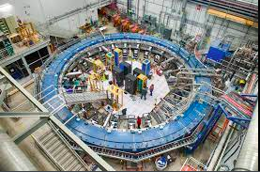
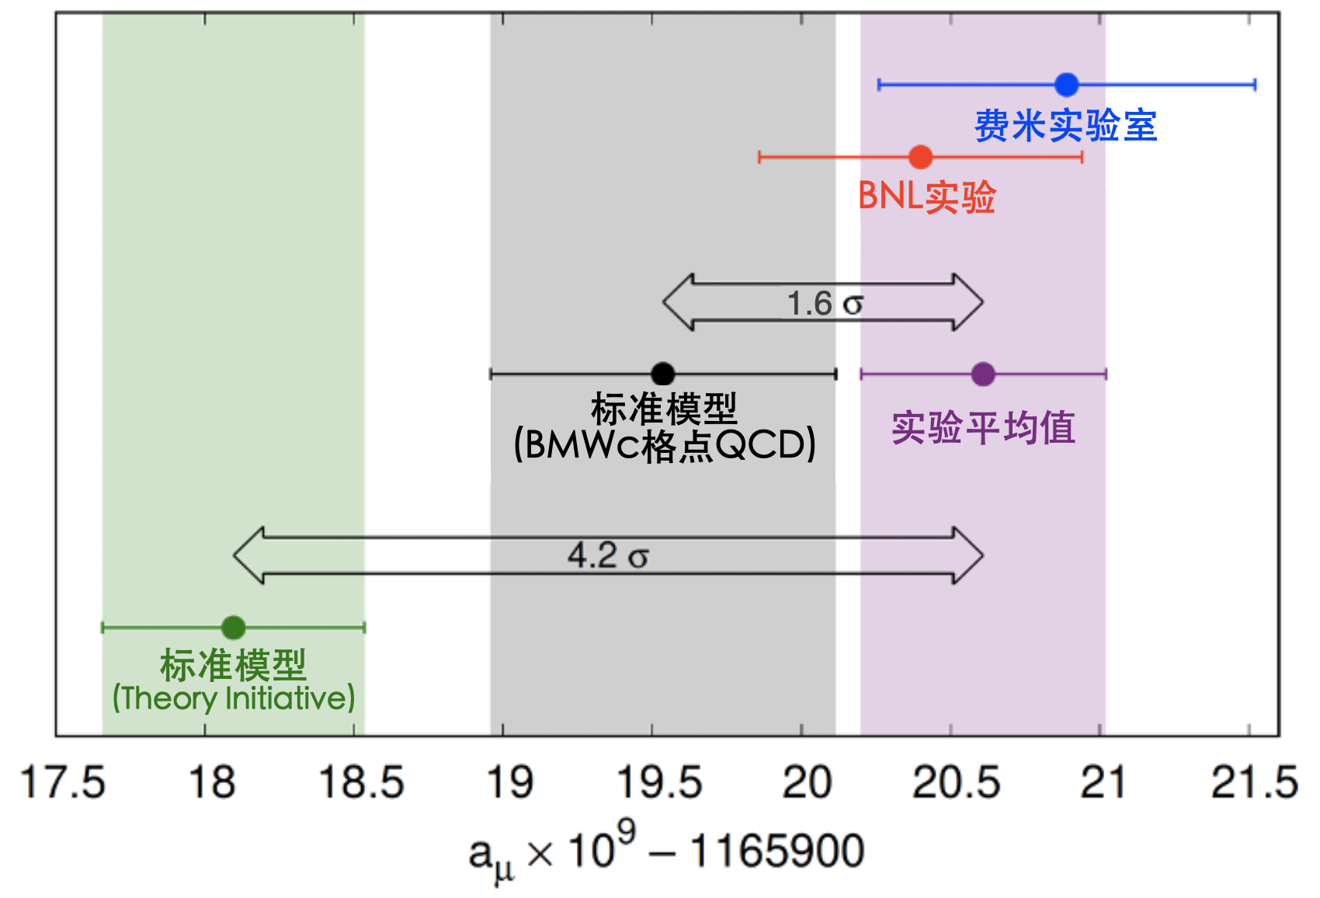
Moun g-2
Muon a_{μ} has also been measured to high precision.
BNL experiment (1997 – 2001) final result
for Δa_{μ} = a_{μ}(exp) – a_{μ}(SM) at 2.7σ larger than zero.
FNL experiment first result announce in April, 2021, confirm BNL result but with a high confidence level at 3.3σ.
Combining BNL and FNL results, Δa_{μ} =251(59)x10⁻¹¹ .
The deviation away from SM is at 4.2σ level!
Recent Lattice calculation indicate the deviation is only
at one σ level. More accurate theory calculations and
Experimental measurement needed to confirm this anomaly.
Even the anomaly itself still needs to be confirmed, but a lot of efforts have been made to explore the anomaly through beyond SM physics to match data.
Z’, leptoquark, higgs….

Slide 23
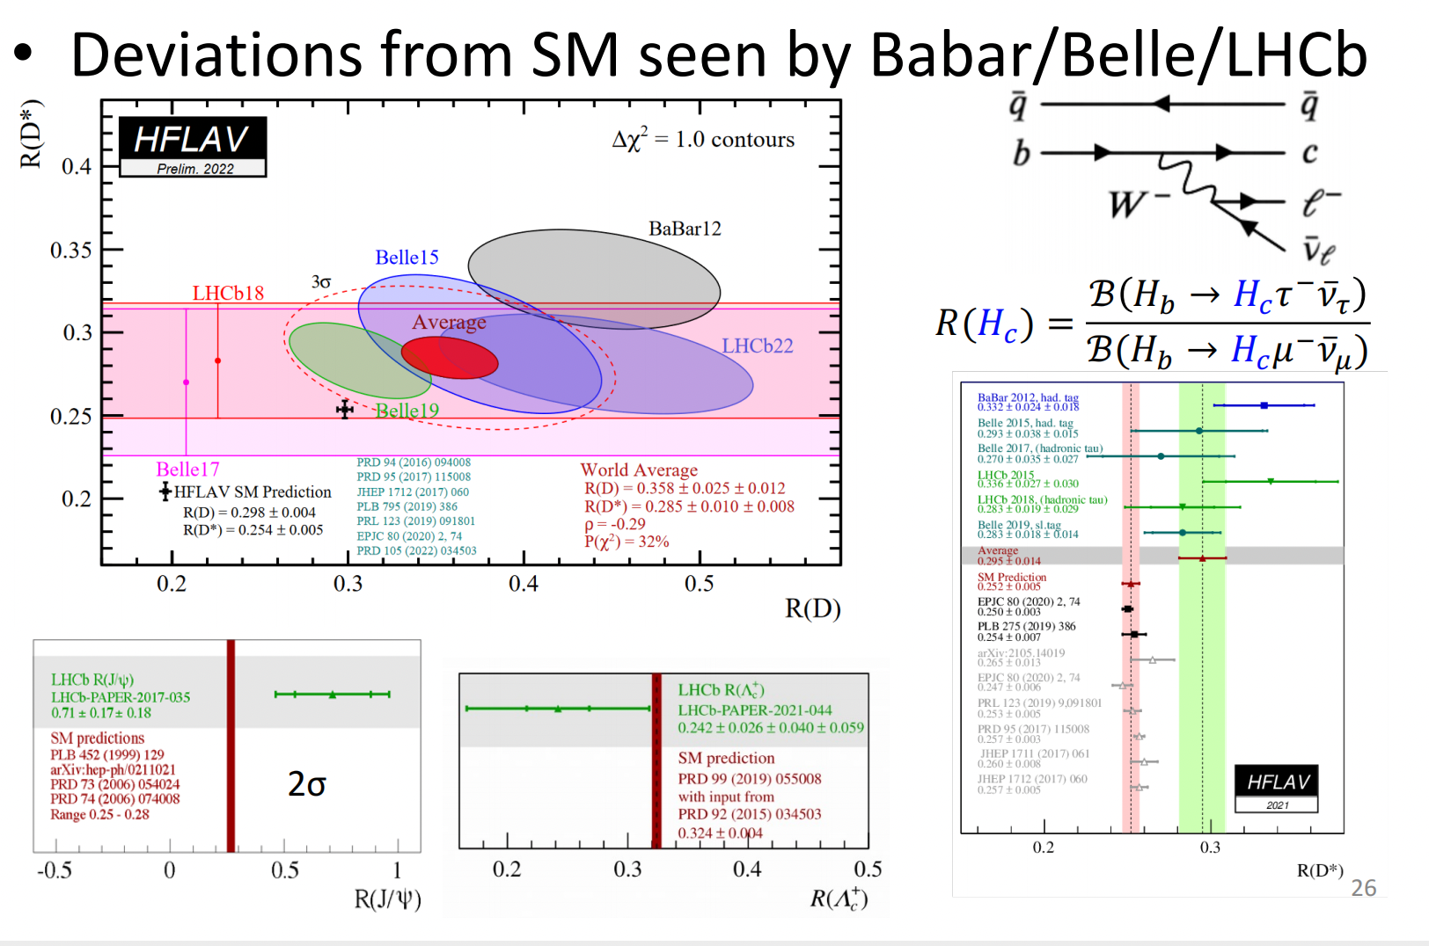
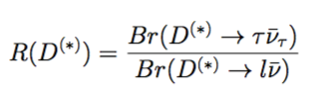
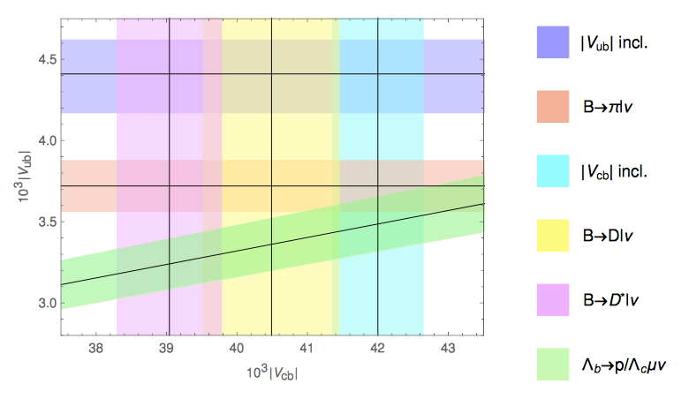
R_{D(*)} anomalies in B -> D^{(*)} τν
4σ effects!
Jibo He at this workshop

Slide 24
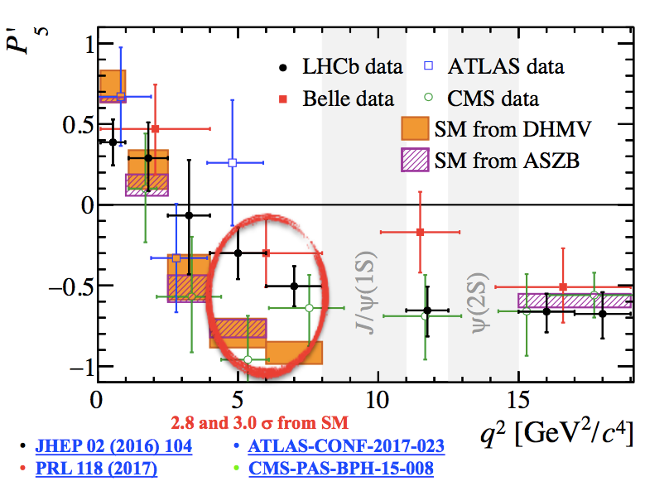







B ->μμ K^{(*)} anomalies
Before 2019
New data on B_{s} -> μ⁺μ⁻ from LHCb, lowered the differences
LHCb arXiv:1705.03274
All these processes are induced by b -> s ll interaction.
Consistently lower than SM predictions. Combined effects are now about 4σ !

Slide 25



Status since 2019
LHCb data still show a 3.1 σ deviation from SM prediction
New physics?
All the anomalies need further experimental confirmation! But one can explore possible directions new physics may come in.

Slide 26

The W Mass Anomaly
Recent CDF II analysis show that the W mass is more than SM value
(Science 376 (2022) 170)
m_{W} = 80,375 (6) MeV
The CDF II values is 7σ above SM value!
An anomaly!
Needs further more accurate experimental measurements.
Improved SM calculations. A hint for new physics beyond SM?
Explanations of the amomolies pointing to new physics in the TeV scale!
JB He, Xiaokang Du at this workshop

Slide 27



Anomalies in cosmology
A Review of the Particle Physics, Astrophysics, and Cosmology Associated with the Cosmological Tensions and Anomalies arXiv:2203.06142[astro-ph.CO]
A few examples: H₀, S8 and Cold dark matter tensions
Requires modify the SM of cosmology?
H₀ tension

Slide 28

What Anomalies tell us?
– Cambridge Dictionary
B decays and muon g-2 that are different from SM predictions and therefore not satisfactory.
These anomalies might be some hints of something more that just SM.
Will these anomalies stand with time??? More Data!!!
Nothing much since 3*250 from LHC! searched for susy, new higgs, new heavy particles null results! but at intensity fromtier, new hadrons discoveried...

Slide 29



New particle searches
Shu Li, Chen Zhou, MX He, ZH Jia, BT Guo, JH Guo, RD Fang, YX He at this workshop
Unfortunately, no big news of anomalous events since 3*250 =750 GeV.
Energy frontier:
Real production of new particles, HLHC, FCC, SPPC -> 100 TeV future colliders
Intensity frontier
Even at low energies, with high intensity, can probe virtual heavy particle effects and new interactions from rare decays. BESIII, LHCB, BELLEII,...STCF…

Slide 30







Search for Dark Photon
Shu Li for Atlas, Inada Tomohiro for Faser, Bin Yan, SL Ge, XL Chen at this workshop
Besides collider related search, like BES, Faser, LHC...
Our fast, 鸿蒙 too
A new program in China

Slide 31










Dark matter detection all have null results
Great progresses have been made in the Cosmo-astrophyscal frontier, inlcluding Lhaaso detection of the highest cosmic gamma ray, the detection of dark matter still have null results. New form of dark matter?
Chen Zhou for CMS, Ning Zhou for PandaX, JJ Cao, Wei Cao, Kepan Xie, YG Lin, Shuailing Ge, Shafeng Ge at this workshop

Slide 32

Search goes on
Heavy new particles: SUSY, Extra Higgs, fermion and gauge bosons, Extra dimension, Dark photon, Dark matter...
Light new particles: Axion, other goldstone particles or alike, Dark photon, Dark matter, other exotics...
New interactions: Modify SM models of particle and cosmological, fifth force...
Need a comprehensive program both theoretical and experimental efforts!
Theory: New ideas and identify possible
new processes to test SM and new physics
New type of dark matter, New methods, tools...
JH Yu, S Zhou, CC Han, J. Ren, ZT Lu, G Li, Y Zhou, KP Xie, Wei Su, YC Wu, Y Chen, ZH Qin, LG Bian, BQ Lu, HK Guo...
Experiments: Continue existing efforts (LHC, BELL, BES, PandaX, CEDEX, XeononNT, Icecube and cosmic ray, neutrino factories...). New proposed colliders (CEPC, FCC, IHC, STCF, ...), Underground facilities ( HyperK, PaandaXnT, CEDEX upgrade, Darkside, neutrino factories, Axion, dark phton experiment (darkshine..)...)....
A lot to do, but confusing stage, where will be land, landscape or swampland?

Slide 33
Exciting progresses have been reported coverying a wide range
Recent highlights from ATLAS Shu Li
Recent highlights of the CMS experiment Chen Zhou
`
LHCb实验上新物理的间接寻找 Jibo He
`
Future e+e- Higgs Factories - Status, Progress and Development Xinchou Lou
`
Looking forward to New Physics and neutrinos with FASER at the LHC T. Inada
`
微扰场论研究进展 Yanqing Ma
·
Search for resonances decaying to three W bosons in proton-proton collisions Qiang Li
`
Search for resonances decaying to three W bosons in proton-proton collisions Bin Yan
`
Pulsar Polarization Arrays Jing Ren
Direct detection of dark photon dark matter using radio telescopes Shuailiang Ge
`
中微子天文学最新进展 Donglian Xu
`
中微子理论进展汇报 Shun Zhou
`
鸿蒙：探索宇宙的起源与黑暗时代 Xuelei Chen
`
暗物质直接探测 Ning Zhou
`
早期宇宙中的物质库分布及其天体物理后果 . Yuqing Lou
`
新物理引力波信号研究进展 Fapeng Huang
`
通向新物理的有效途径：SMEFT和HEFT . Jianghao Yu
`
Detecting ultra-light particles from astro-physical obervations Jing Shu

Slide 35


Need more experiments guide
The China based particle and efforts reported at this workshop: CEPC (Xinchou Lou), PandaX(Nign Zhou), 鸿蒙(Xuelei Chen), Pusar Polrization Array (Jing Ren), light dark mater and Axion (jing Shu)...
Faser for new physics, I. Tomohiro
Electro-Ion Collider Also a good facility for
new physics Bin Yan at this workshop
e-mu collider Xiaorui Wang at this workshop
muon collider Lingfeng Li at this workshop
Z factories XH Jiang
Other experimental proposal efforts in China: STCF (USTC), CDEX (N0DBD-Jingping Tsinghua), JUNO (N0DBD, IHEP), High energy Neutrino Telescop （Lake Baikal, IHEP), South China Sea Trident Neutrino Telescope (SJTU), DarkShine (Shanghai, SJTU) ...
Support them all? Sure! At least get some of them built!

Slide 36



Great efforts have been make for CEPC support our colleagues!
This is part of the great Chinese renaissance dream!

Slide 37



Great efforts have been make for STCF.
Support our colleagues!
Carry on the great successful tradition of BES! We continue to lead in the area!

Slide 38
Some history guide
lepton vs hadron fixed target and head one collisions
1. Precision measurement of early collider discovered Pairy violation and CP
violation
2. precision measurements of neutral current (i.e. polarized e+d) predicted m_{W}, m_{Z}
3. UA1/UA2 discovered W/Z particles
4. LEP/SLC nailed the gauge sector: precision measurements of W and Z (i.e. LEP
+ Tevatron) predicted m_{t} and m_{H}
5. Tevatron discovered top, LHC discovered a Higgs particle
6. Higgs factory nails the Higgs & top sector and some new “stuff”?
7. What other precision tests will bring us???
The “darkness” before the dawn? Ahead of us is brightness? Let us work for that!

Slide 39
We thank the organizers
Hai-Peng An, Xianyu Zhong Zhi, Qiang Wang and all staffs
for organizing such a wondrful whorshop in a difficult time.
Thank you for your attentions!

