Slide 1
Leakage in Time: An Analysis Relevant to Off-Time Pile-Up @ CEPC
Muchen He, Yuzhii Che, Fanjie Meng, Manqi Ruan
Institute of High Energy Physics, Chinese Academy of Sciences
Aug 2022

Slide 2
Content
Introduction
Basic Configuration
Basic Z Pole Analysis
Event Time Spacing Simulation
Z->qq Residual Energy Simulation
Single Particle Residual Energy Simulation
Conclusion

Slide 3
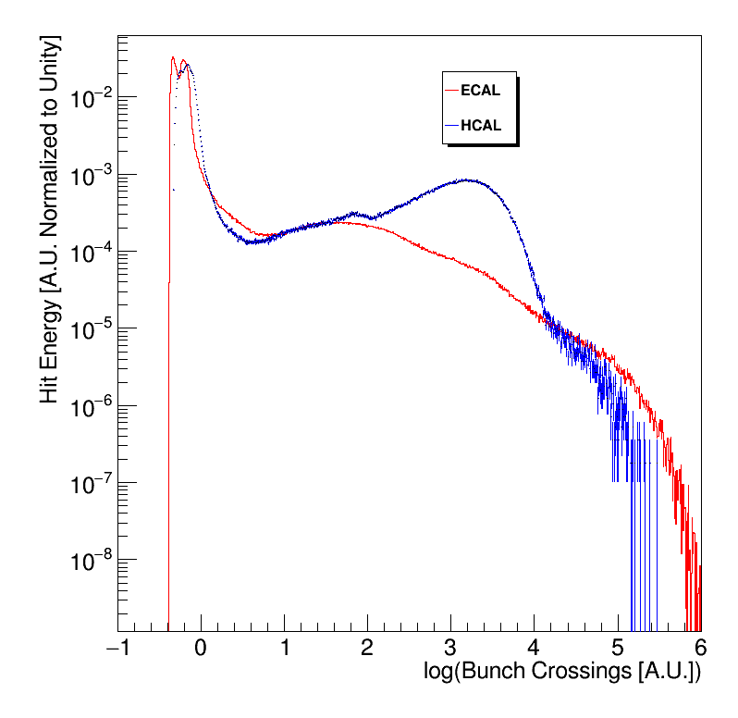
Introduction
We propose the concept “leakage in time”to describe when energy is deposited at large time in ECAL/HACL, say at ${10}^{3}$ ns. The ECAL/HCAL may have stopped taking in data at this point.
When events are spaced closer than the “tail” of the energy distribution, we have off-time pileup.
Off-time pileup: the residual energy/hits that are mixed from a previous event to the next event due to time overlap
Tail at ${10}^{2}\sim {10}^{6}$ Bunch Crossings

Slide 4
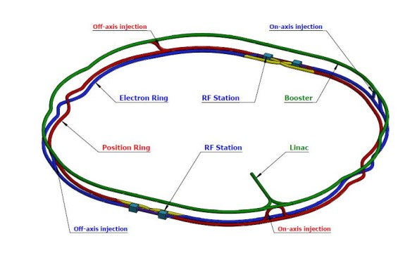
2. Basic Configuration – Beam @ CEPC
In Z pole mode:
2 Years, 6000h per year, 12000 hours total
2 interaction points (IP)
$3×{10}^{12}$ events
Bunch Spacing = 15 ns
=> On average, Event Spacing is 1920 Bunch Crossing (15 ns = 1 Bunch Crossing)
CEPC Accelerator Study Group, Snowmass2021 White Paper AF3-CEPC, ArXiv Preprint Arxiv: 2203.09451, (2022).
The CEPC Study Group, CEPC Conceptual Design Report: Volume 2-Physics & Detector, ArXiv Preprint ArXiv:1811.10545 2, (2018).
The CEPC Study Group, CEPC Conceptual Design Report: Volume 1 – Accelerator, ArXiv Preprint: Arxiv: 1809.00285, (2018).

Slide 5
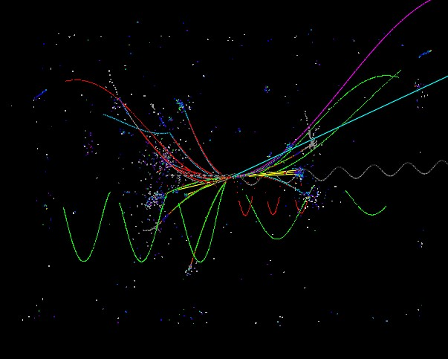
2. Basic Configuration - Simulation
CEPC Baseline ECAL and HCAL
Samples:
Z->qq:
Physics List: QGEP_BERT_HP
Statistics: 20000
Single Particle (Photon/Mu-/Pi+):
Physics List: QGSP_BERT_HP and QGSP_BERT
3 – 80 GeV
Statistics: 5000
Notes:
Add: Druid Diagram

Slide 6
3. Basic Z Pole Analysis
Z->qq Event at the Average Time Separation

Slide 7
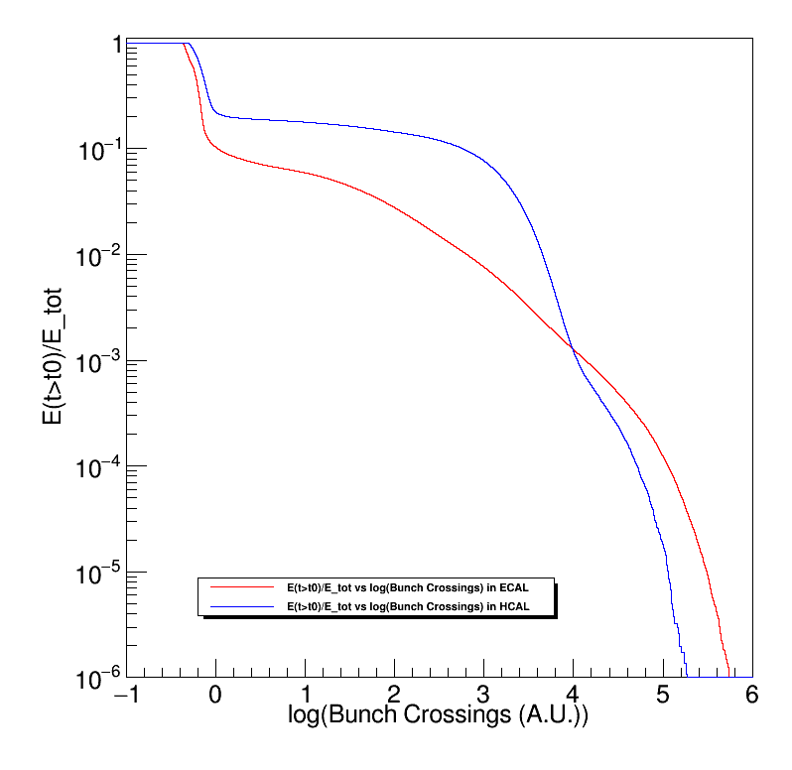
Some Diagrams we will see
Probablity Density Function (PDF): f(t) (diagram above)
Cumulative Density Function (CDF):
$$\int_{0}^{x}{f\left(t\right)dt}$$
1 – Cumulative Density Function (Diagram Above)
Residual Energy (Pileup Energy) vs Time

Slide 8
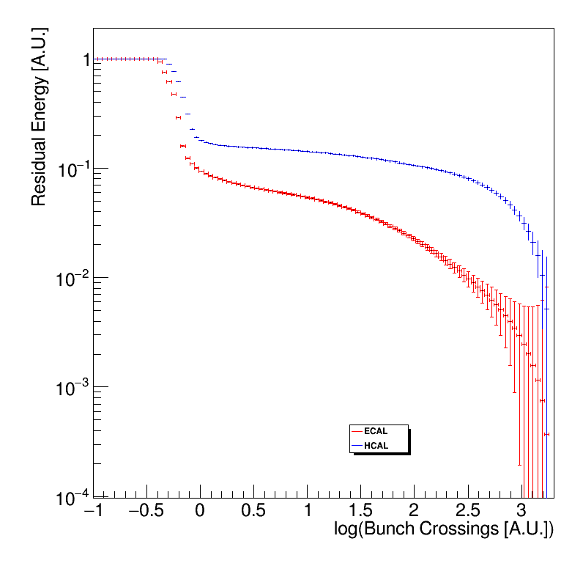
ECAL Total Energy Deposited = 56.4386 GeV
HCAL Total Energy Deposited = 33.7725 GeV
ECAL + HCAL Total Energy ∽ 90 GeV
Statistics= 20000
ECAL : $\frac{σ_{E}}{E}=\frac{0.16}{\sqrt{20000\frac{E}{GeV}}}$
HCAL: : $\frac{σ_{E}}{E}=\frac{0.6}{\sqrt{20000\frac{E}{GeV}}}$
The average spacing between Z->qq events is 1920 Bunch Crossings. At this value, the expected residual energy is:
ECAL : 0.269684 GeV (0.477836%)
HCAL : 1.46803 GeV (4.34656%)
Residual Energy vs log(Bunch Crossings (A.U.)) of the Z->qq Sample in ECAL and HCAL Using QGSP_BERT_HP
Notes:
(1-y)/sqrt(N)
y/sqrt(N)
Ask: Error Bar?

Slide 9
4. Event Time Spacing Simulation
An more percise representation of event time spacing

Slide 10
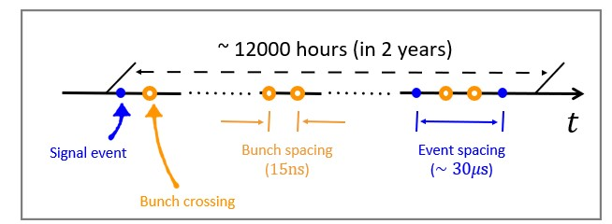
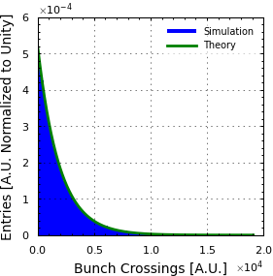
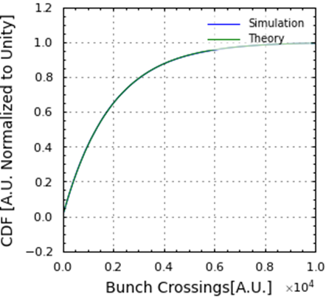
4.1 Model with continuum approximation
Z Boson yield: $N=3×{10}^{12}$
Average (expectation) time spacing between events: 1920 Bunch Crossings (15 ns per bunch crossing)
Toy Model
Assume:
event time = uniform random
0 ≤ event time ≤ 1920 * N
$PDF\left(t\right)=\frac{N}{T_{run}}{\left(1−\frac{t}{T_{run}}\right)}^{N−1}$
$$\int_{0}^{x}{PDF\left(t\right)dt}$$

Slide 11
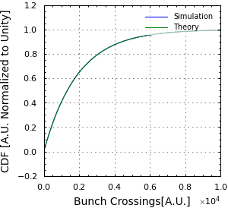
4.2 Toy MC and Reference Points
Select Reference point that contain 1%, 10% and 25% of Events (i.e. 1%/10%/25% of events have time separation less than the given value).
Percent of Events | Reference Point (Bunch Crossings)
1% | 19.16773322 Bunch Crossings
10% | 202.35696001 Bunch Crossings
25% | 552.32577016 Bunch Crossings
Integral of PDF
Y-axis contains the fraction of Events with Time Separation < x value

Slide 12
6. Full Simulation of single

Slide 13
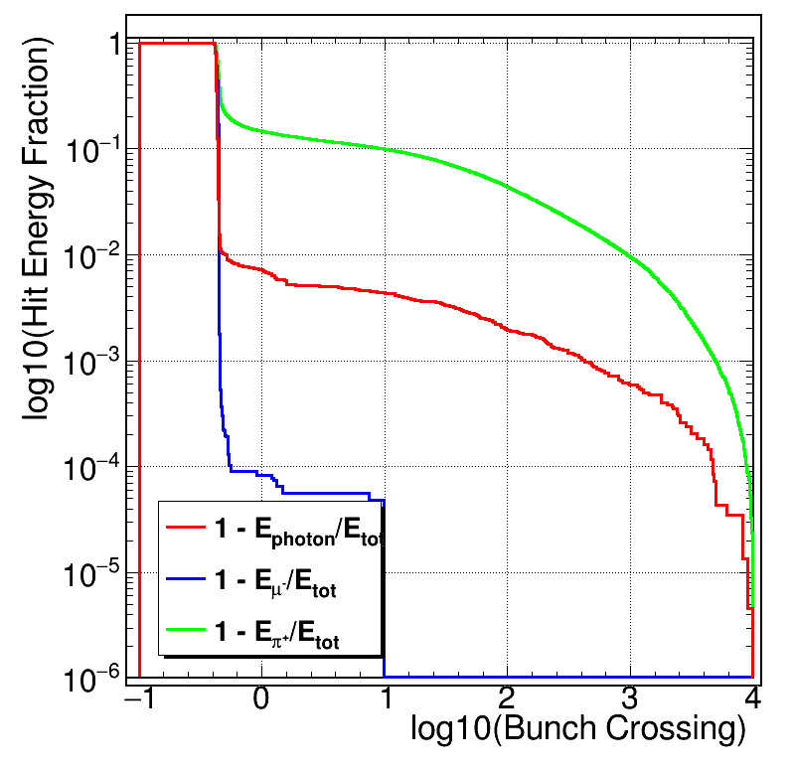
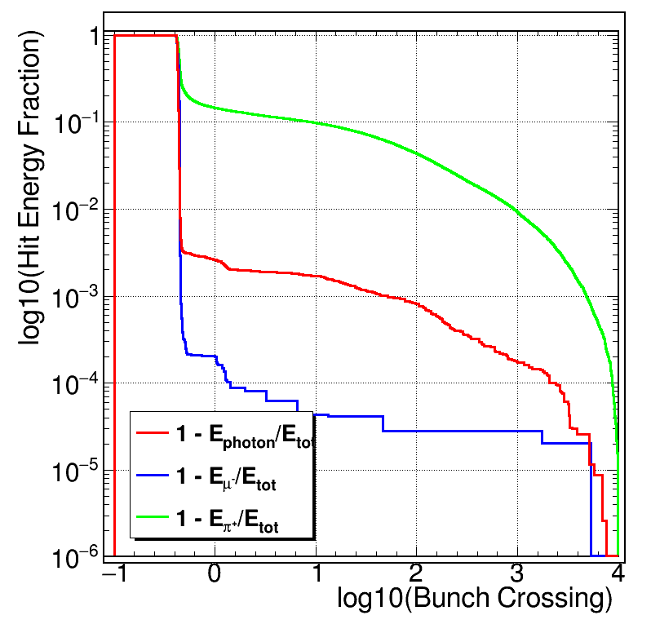
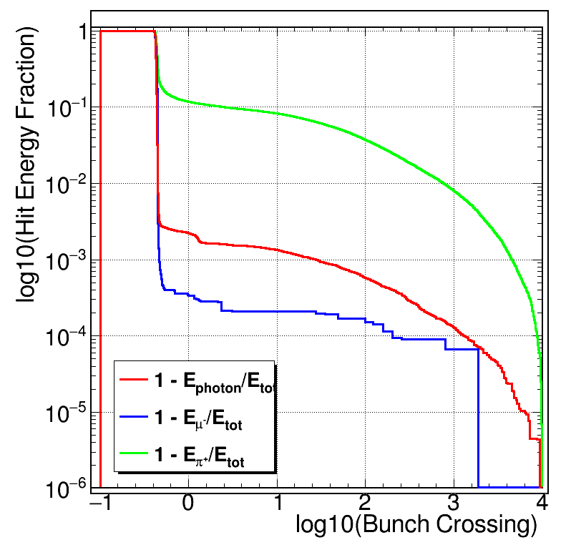
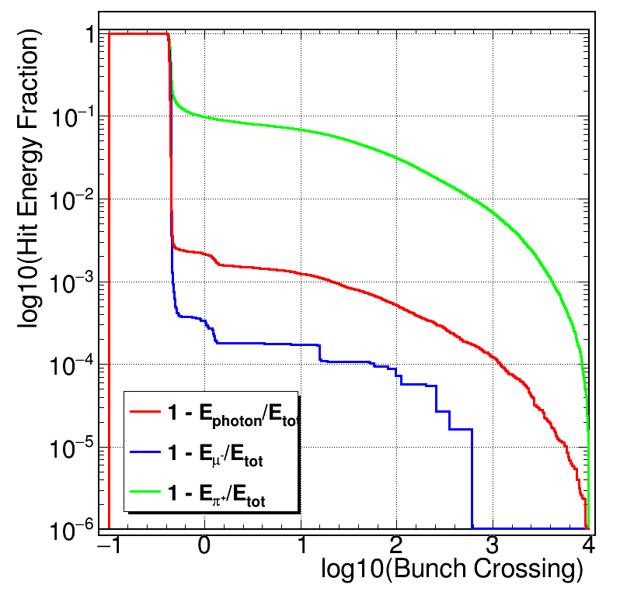
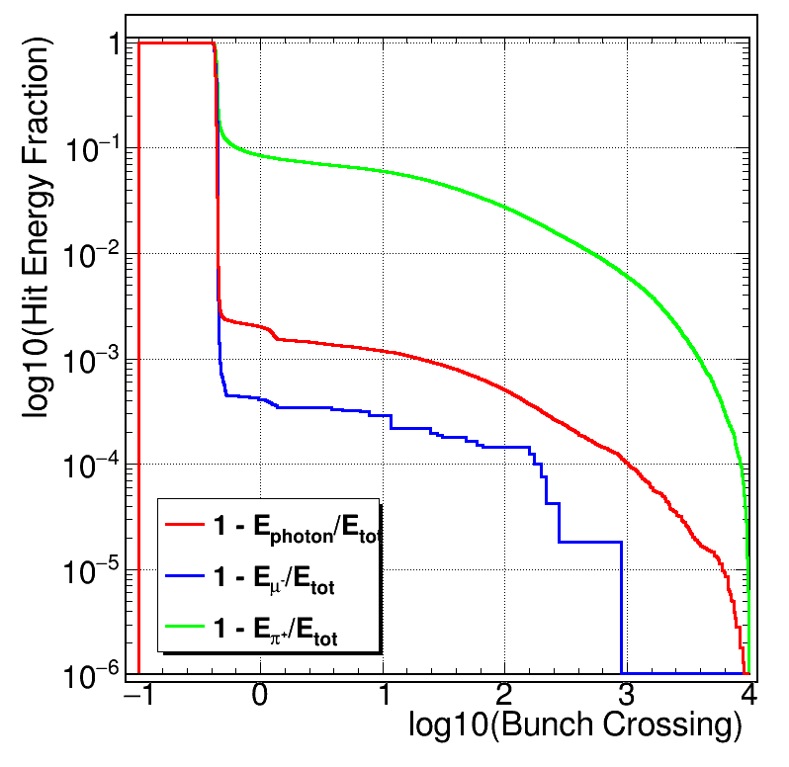
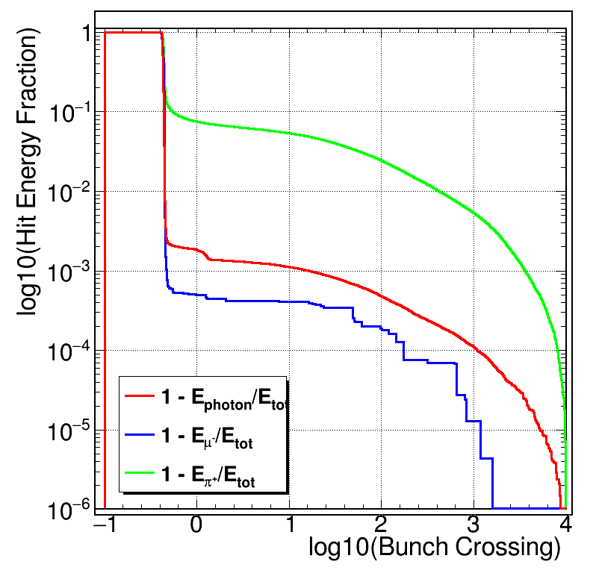
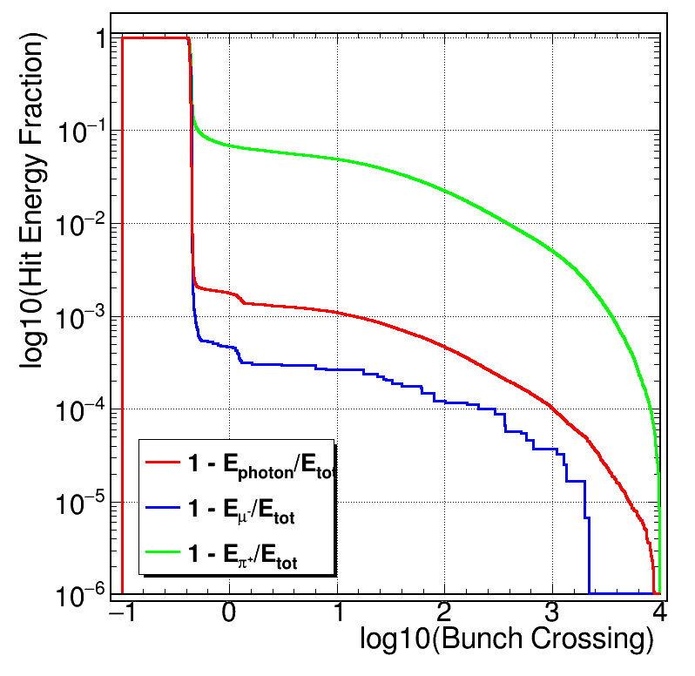
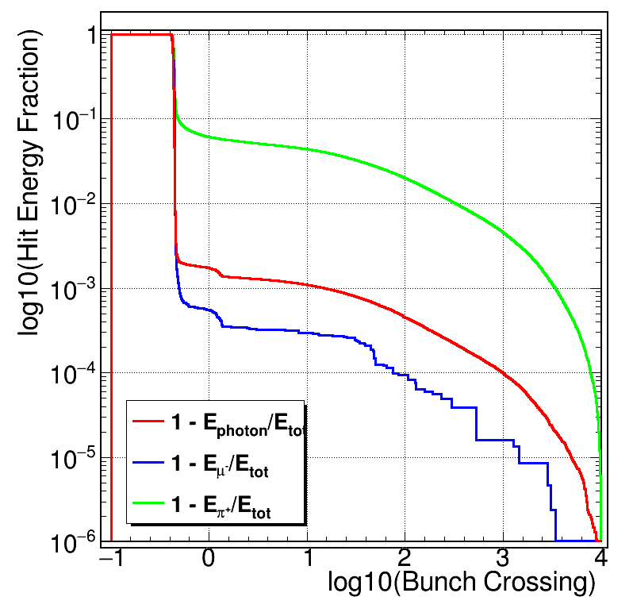
Energy decay curve at different incident energy (ECAL_HP)
3 GeV
5 GeV
10 GeV
15 GeV
20 GeV
30 GeV
50 GeV
80 GeV

Slide 14
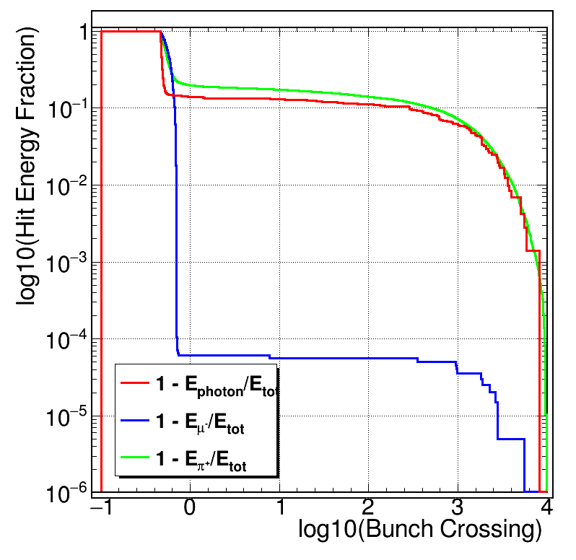
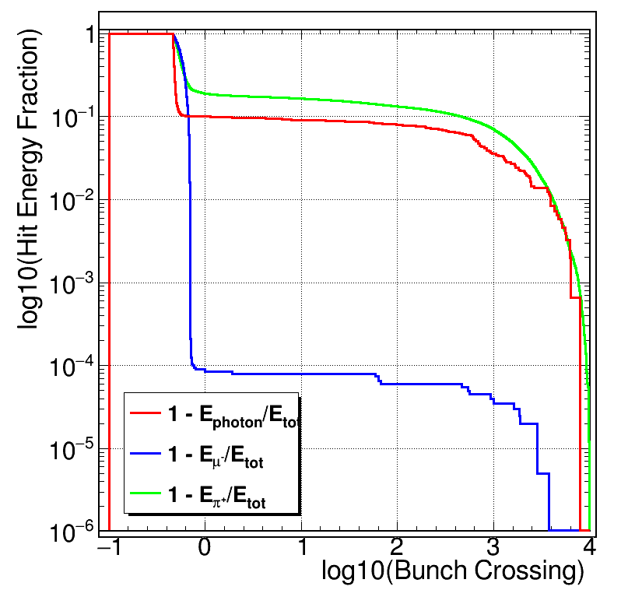
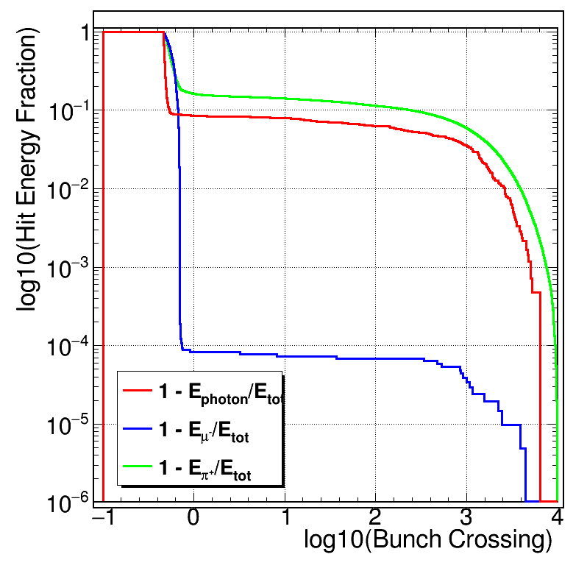
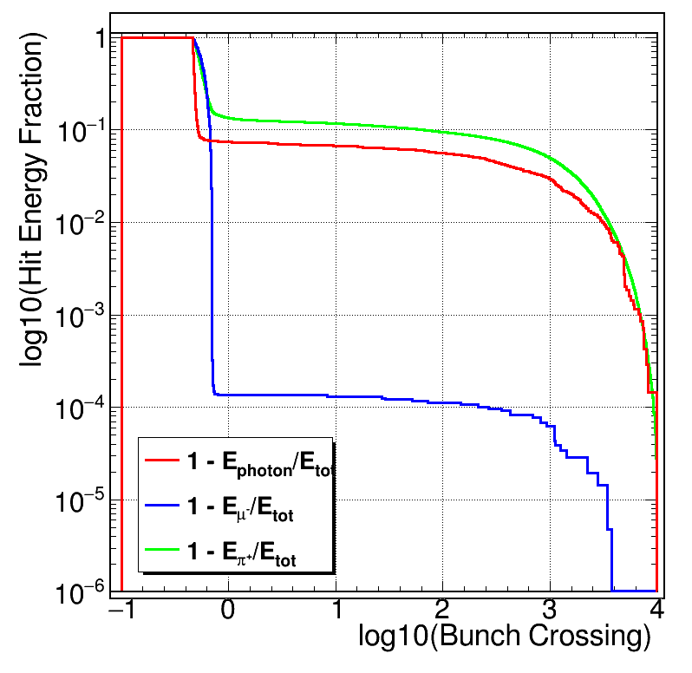
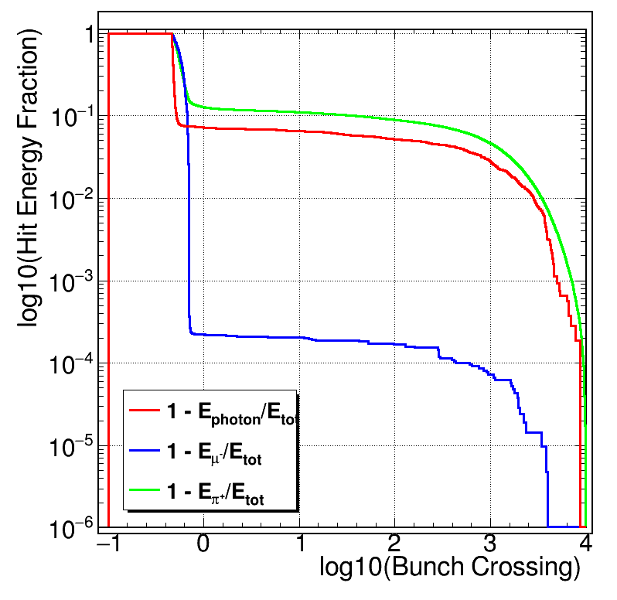
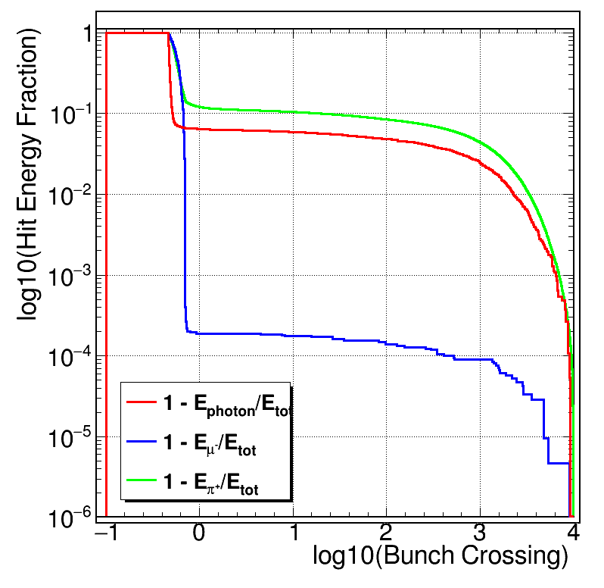
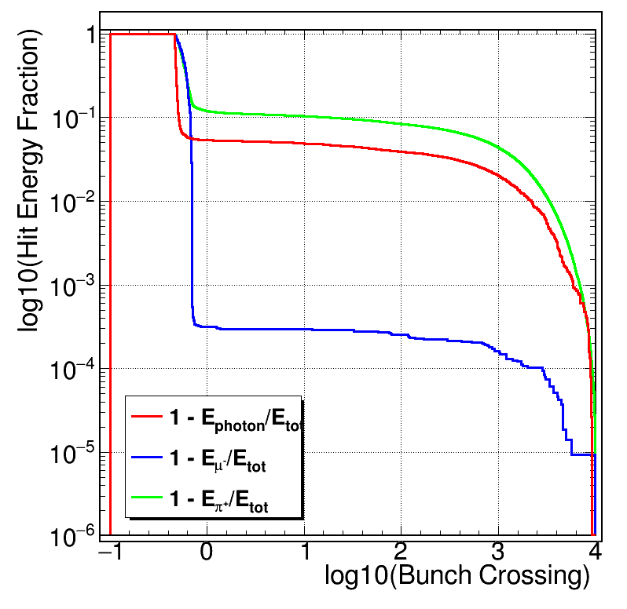
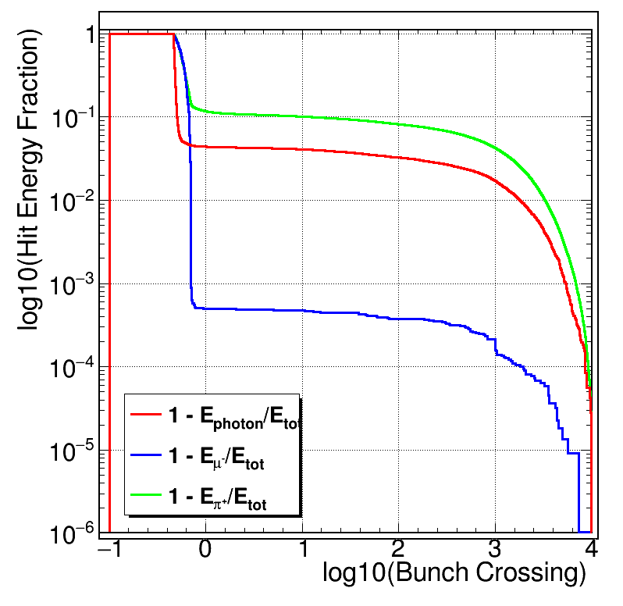
Energy decay curve at different incident energy (HCAL_HP)
3 GeV
5 GeV
10 GeV
15 GeV
20 GeV
30 GeV
50 GeV
80 GeV

Slide 15
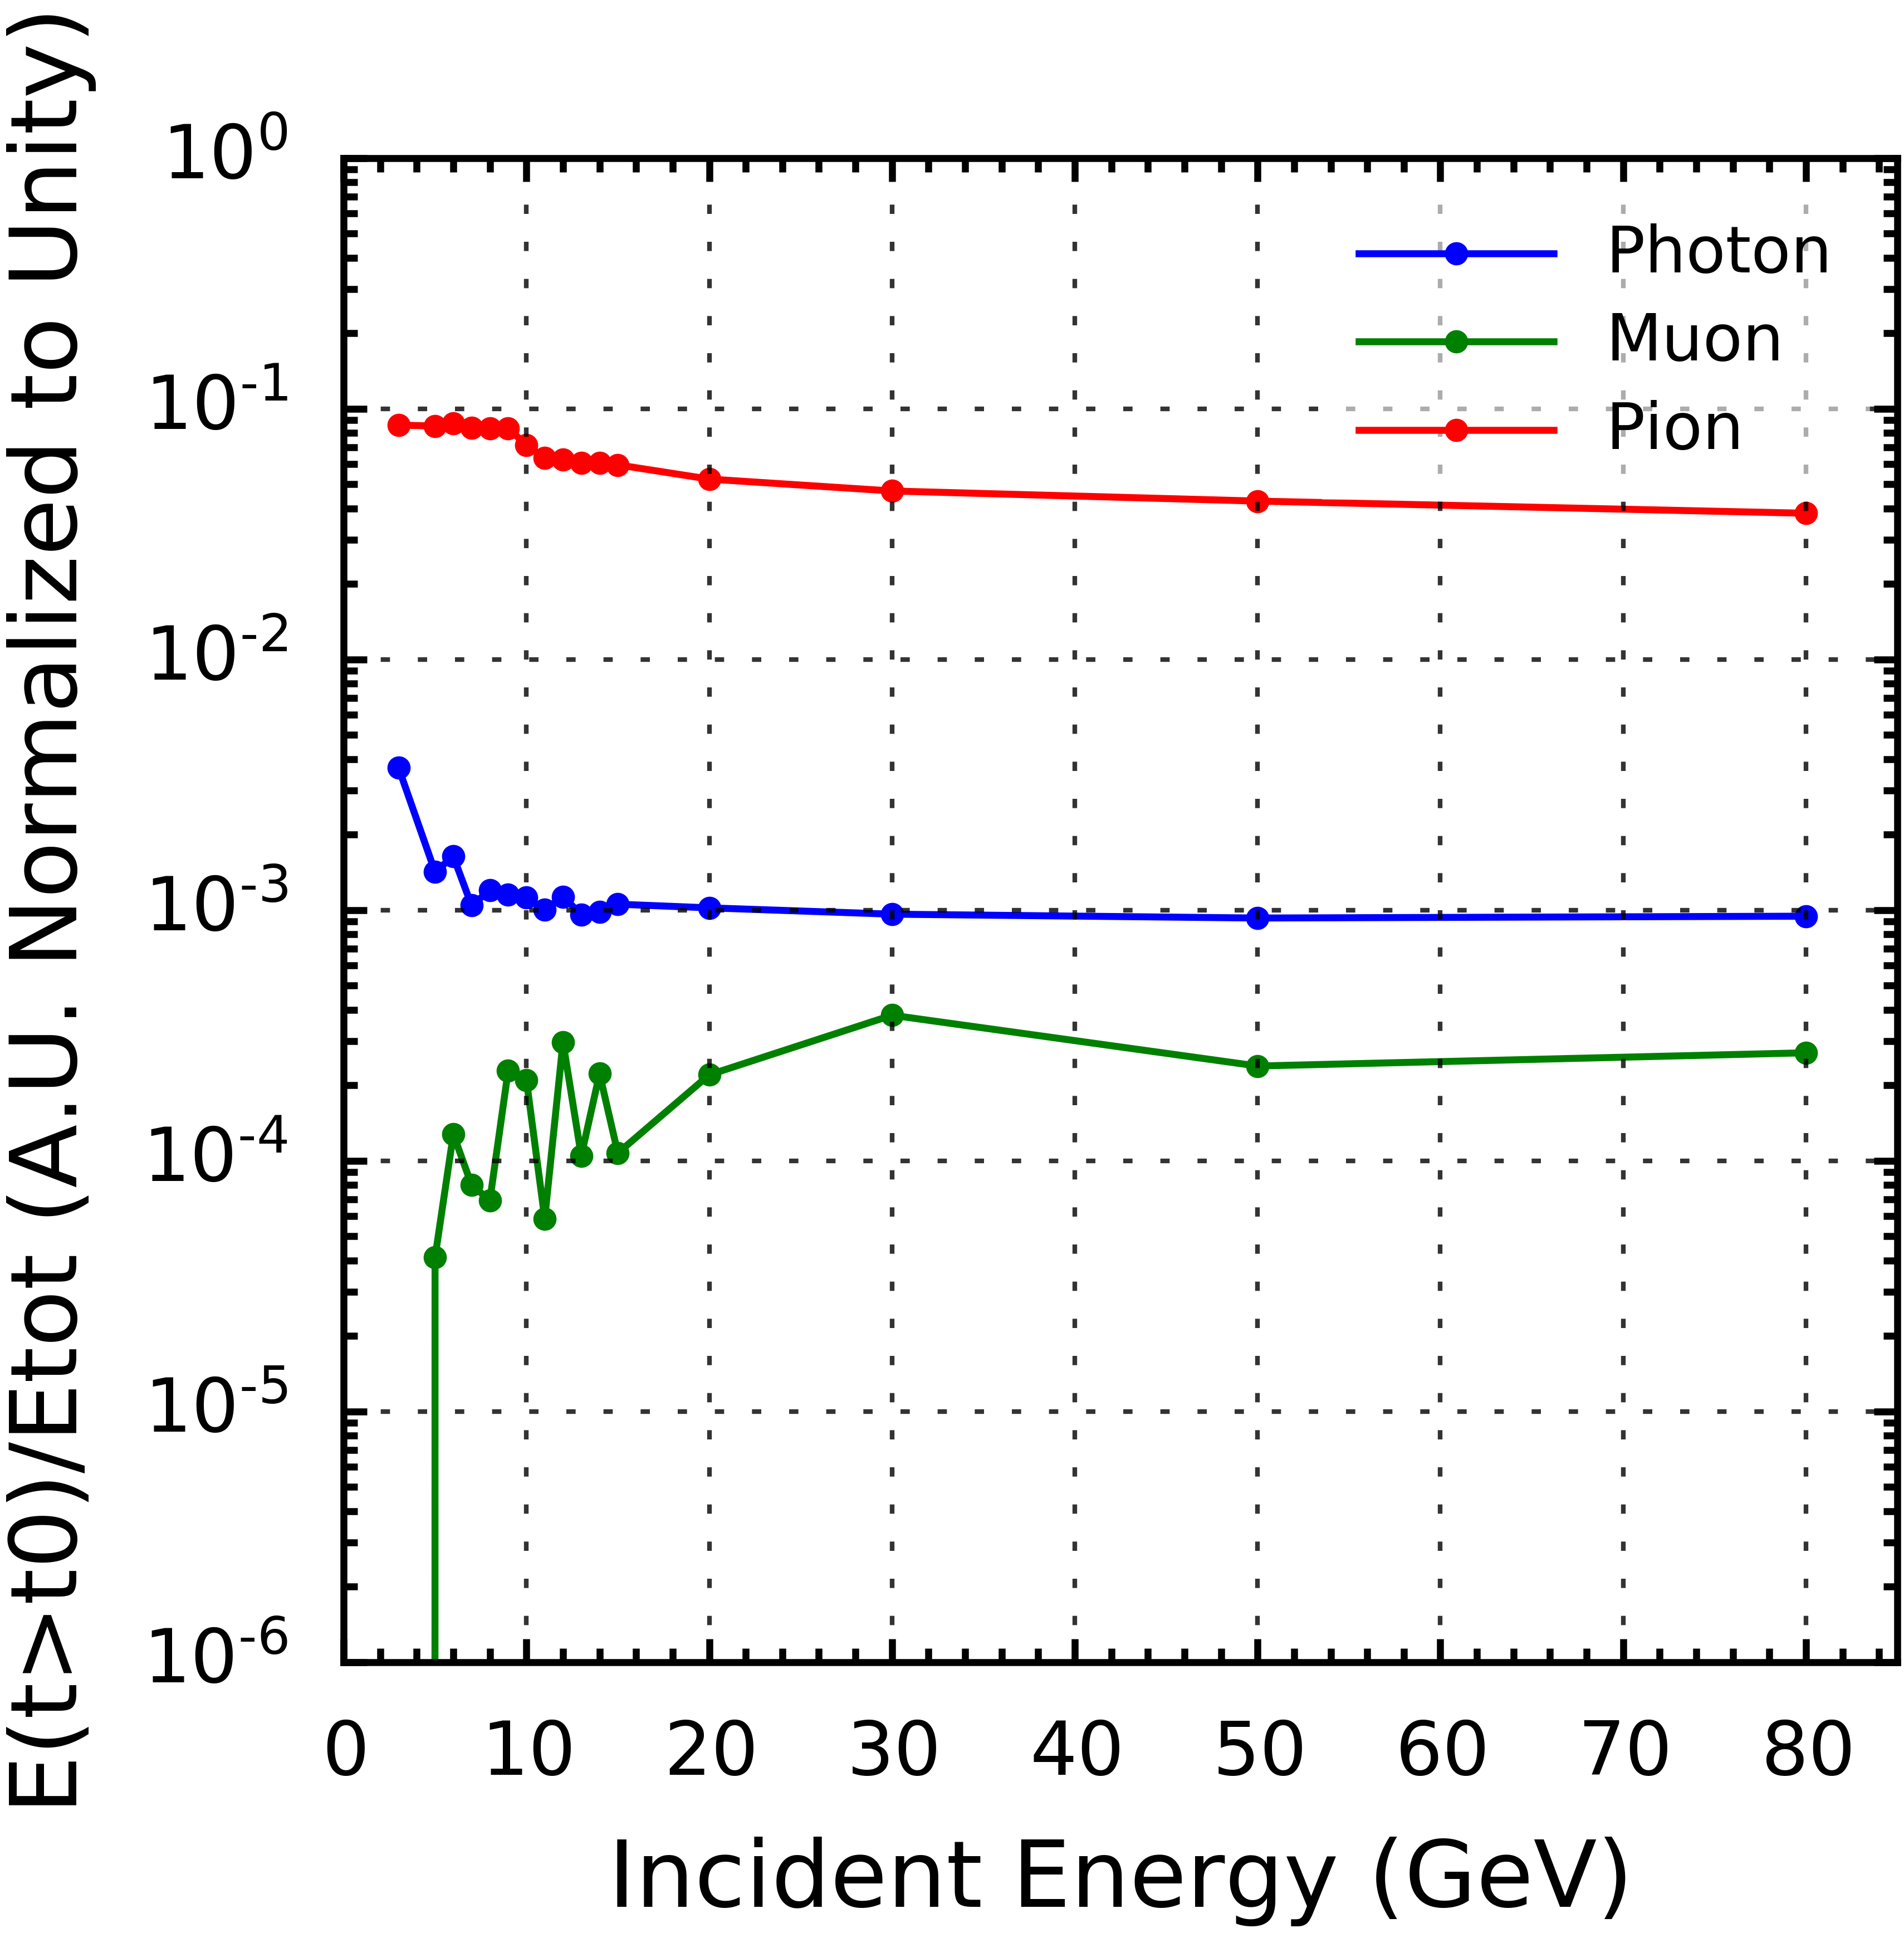
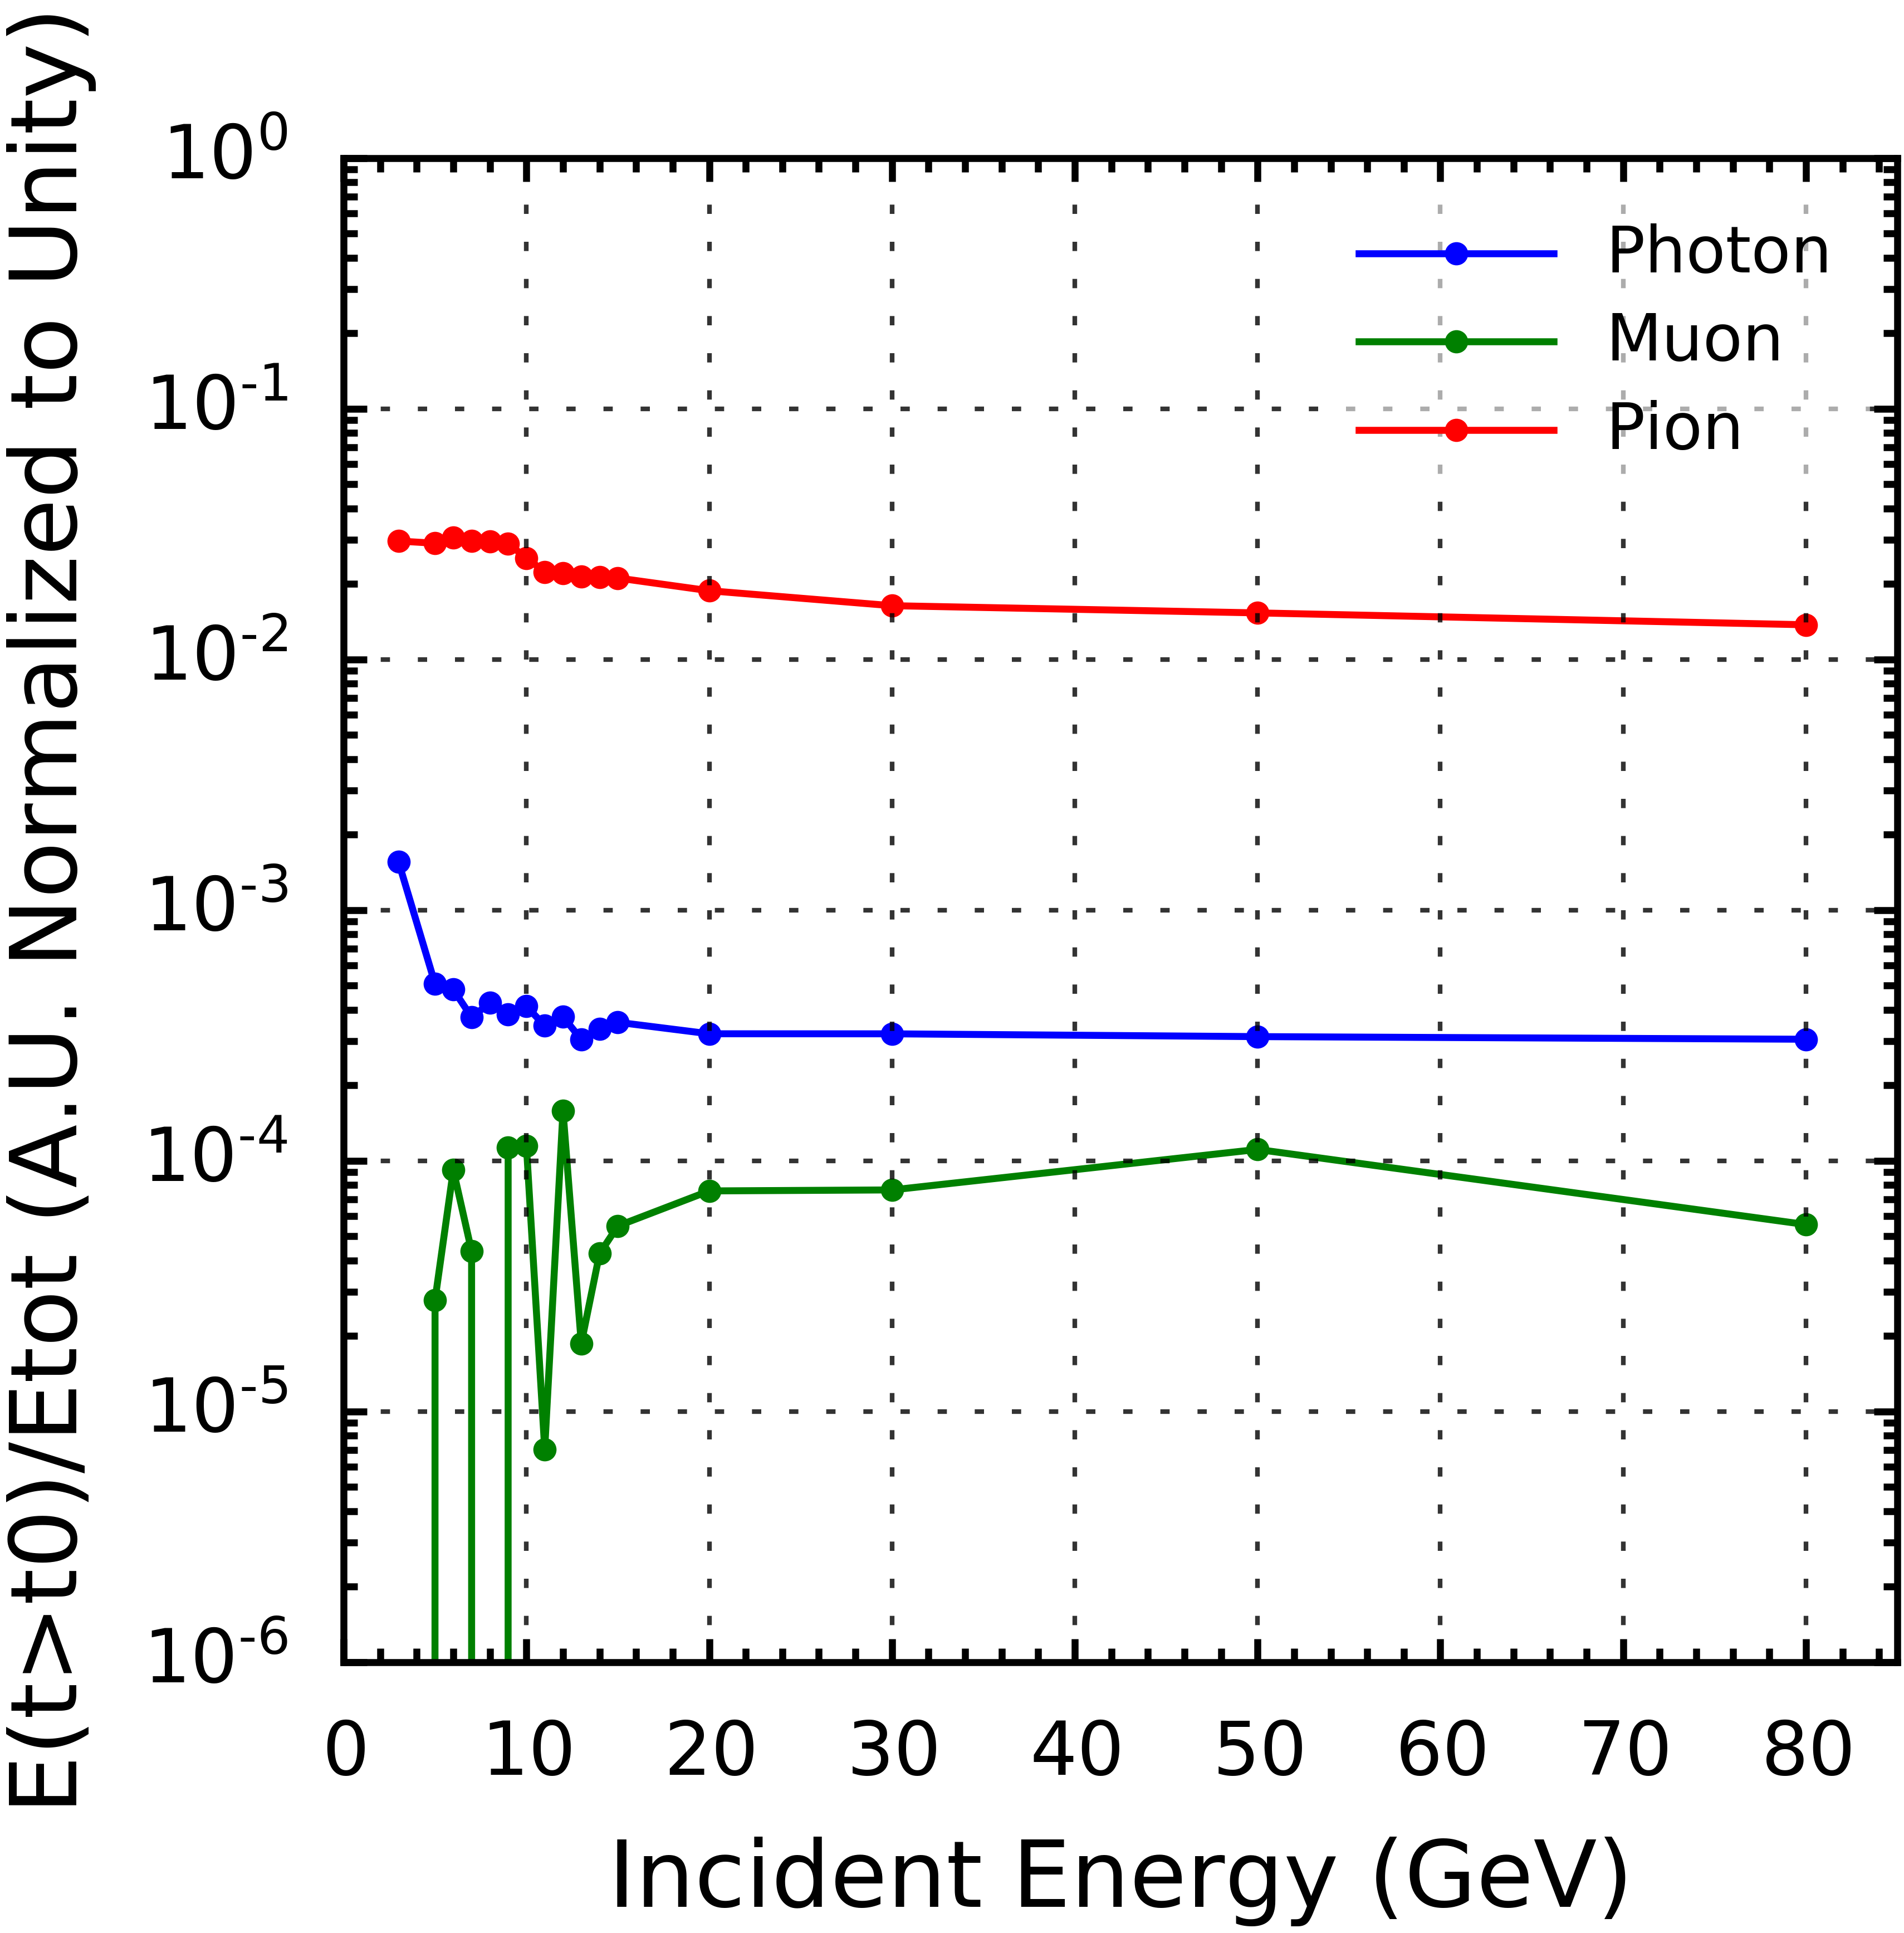
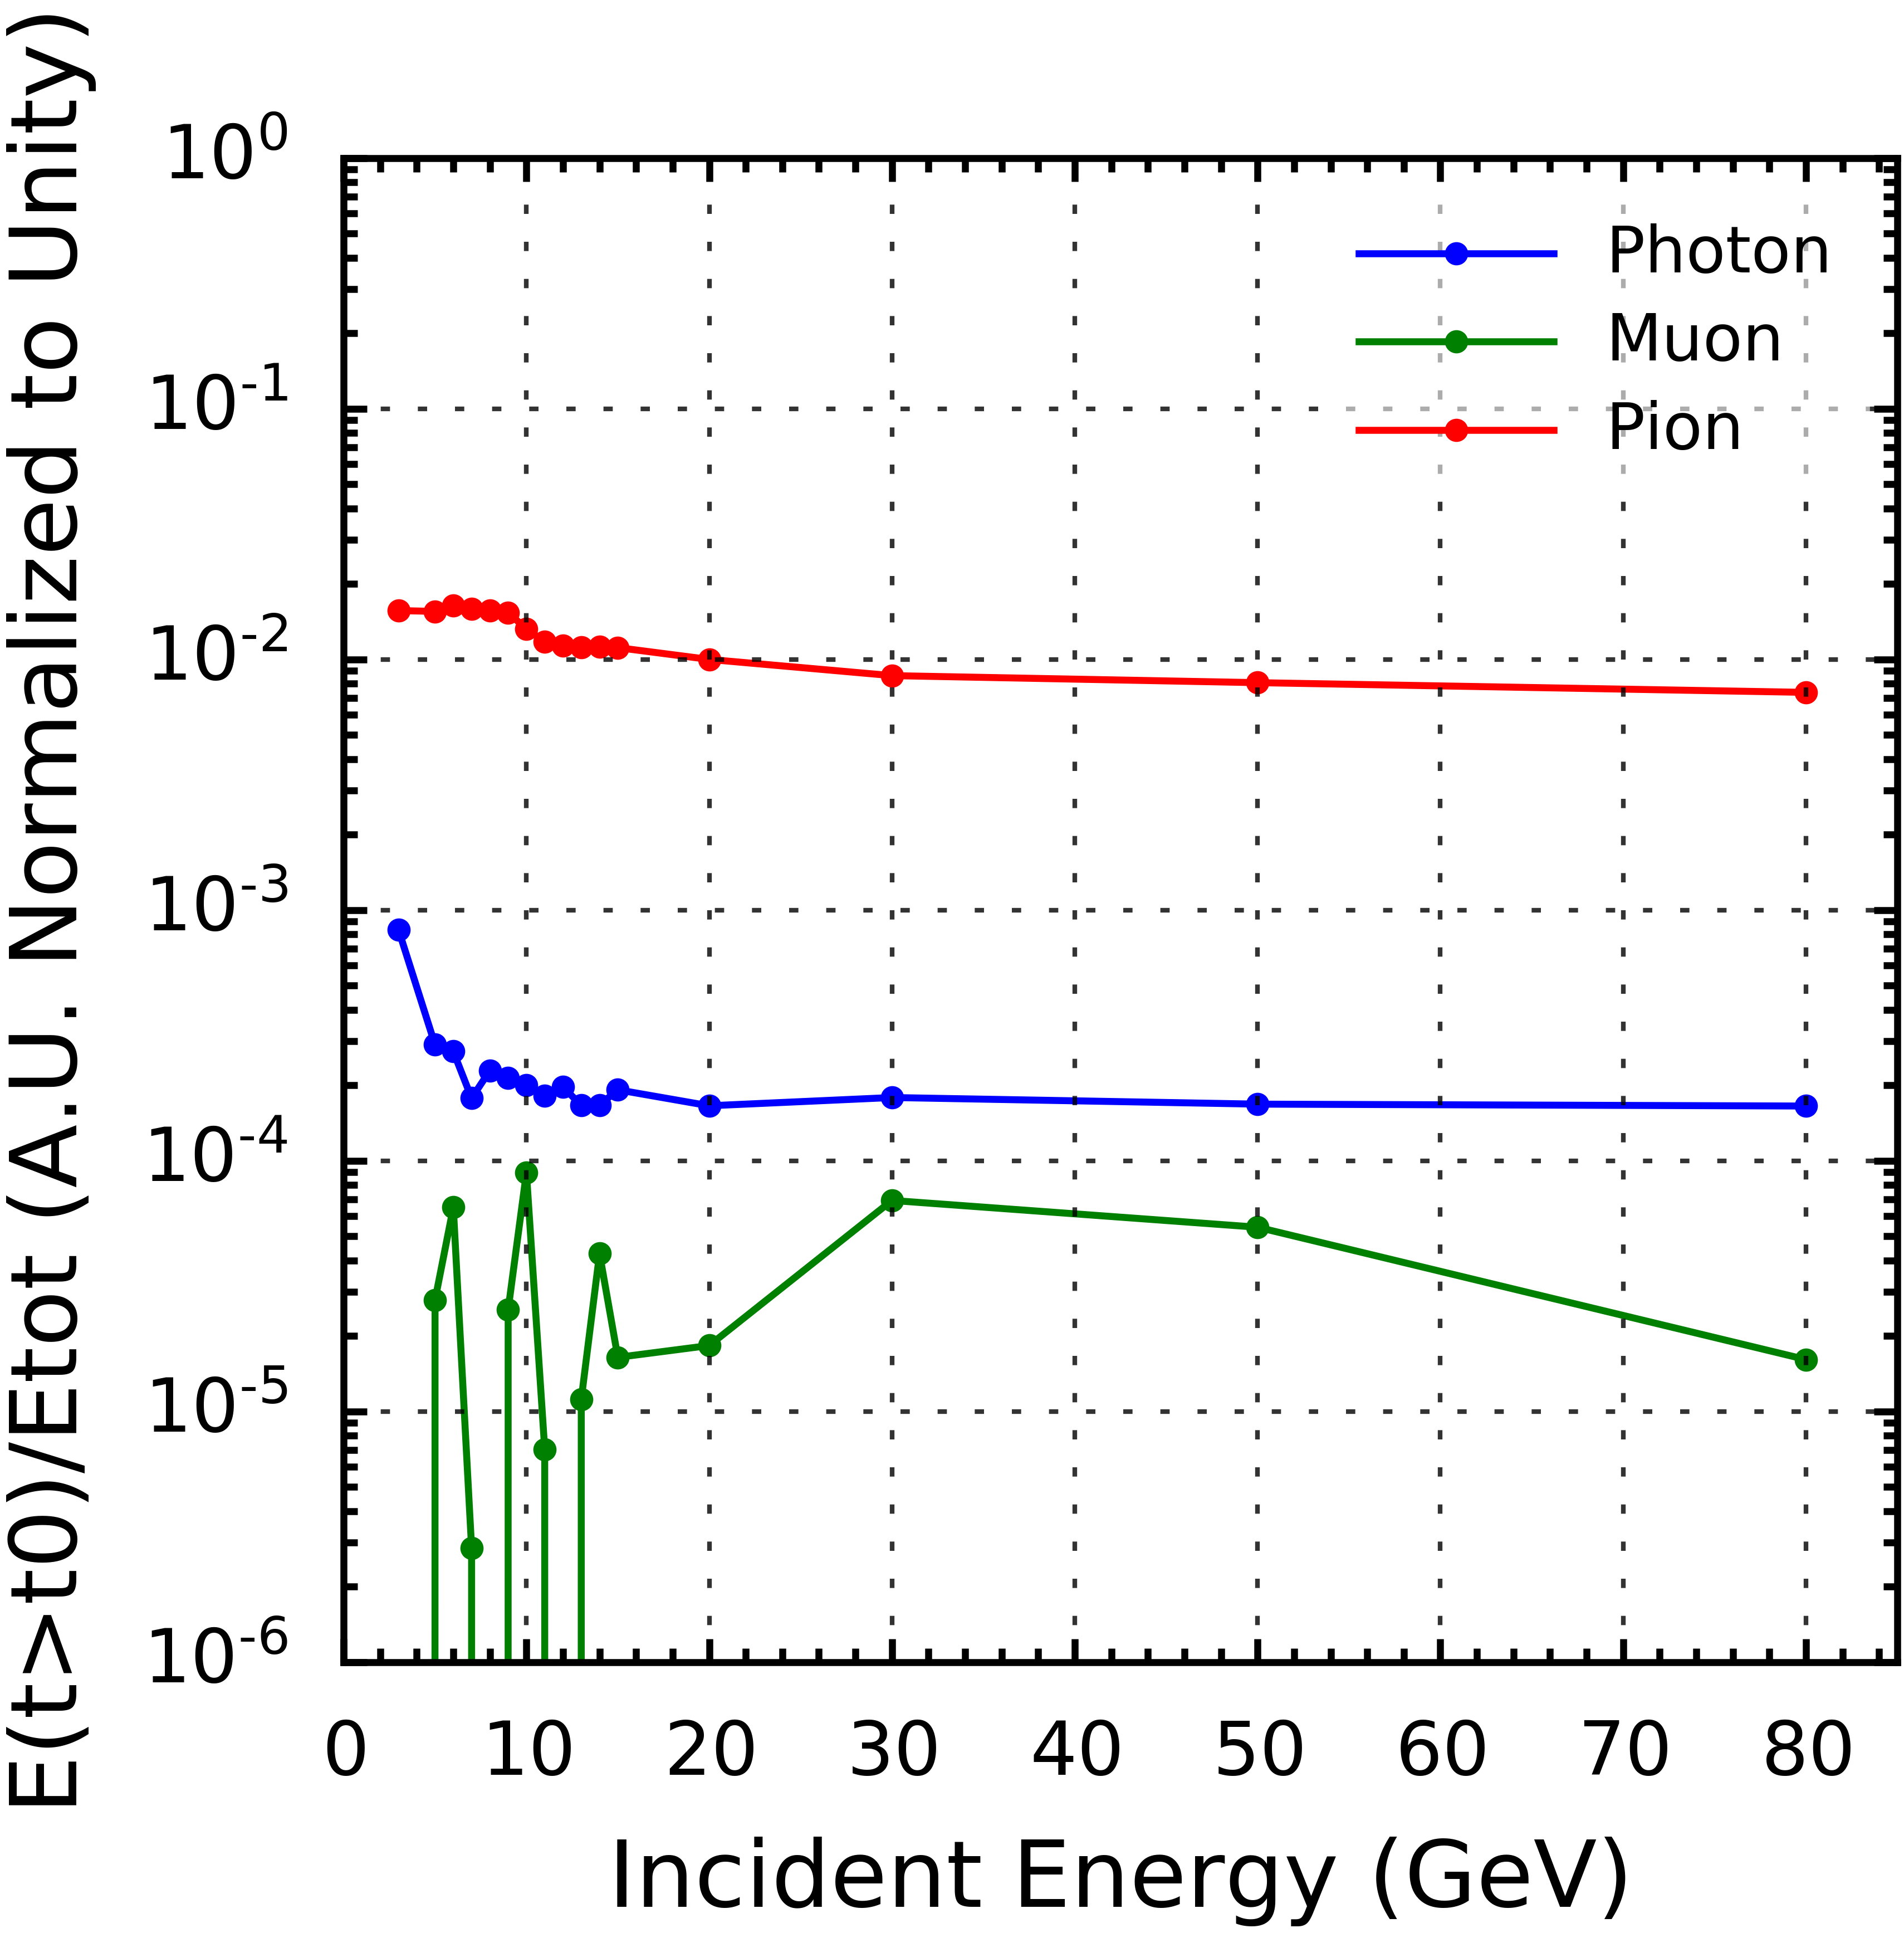
Residual Energy vs Incident Energy in ECAL at Different Reference Points
1%
10%
25%
Graph of Residual Energy vs Incident Energy (Beam Energy) of Muon, Photon and Pion Samples in ECAL at 1%, 10% and 25% Reference Points
Y-Axis: residual energy at reference points 1% (≈19 Bunch Crossings), 10% (≈202 Bunch Crossings) 25% (≈552 Bunch Crossings), defined as
$$\int_{\text{Ref} \text{Point}}^{∞}{E\left(t\right)dt}$$

Slide 16
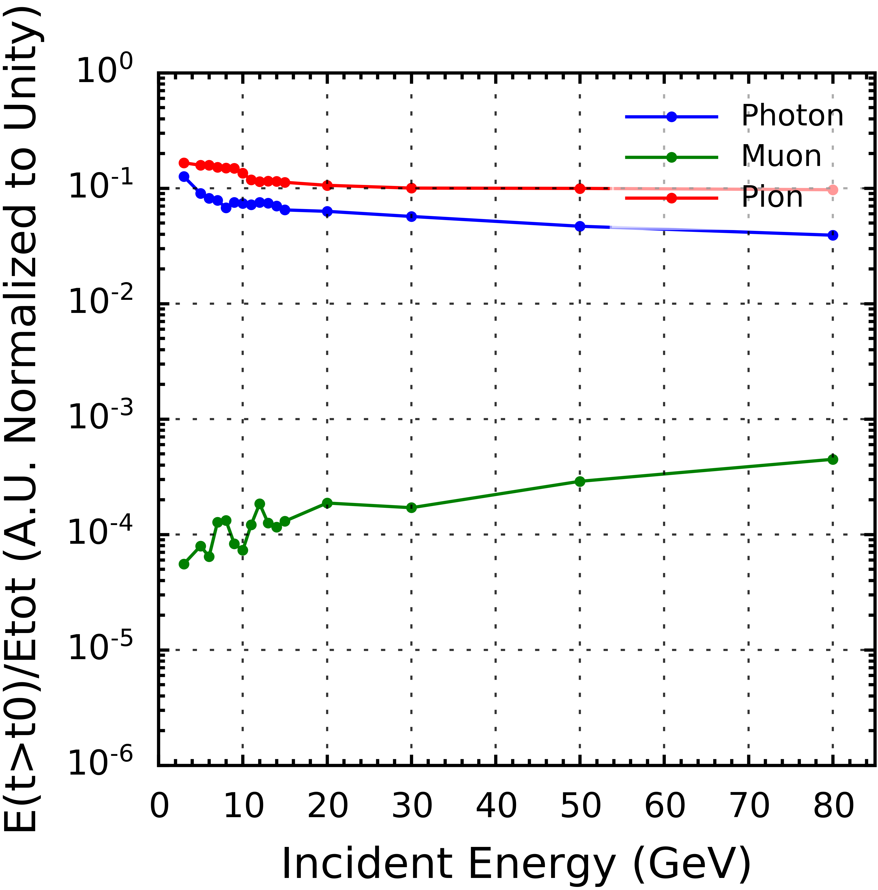
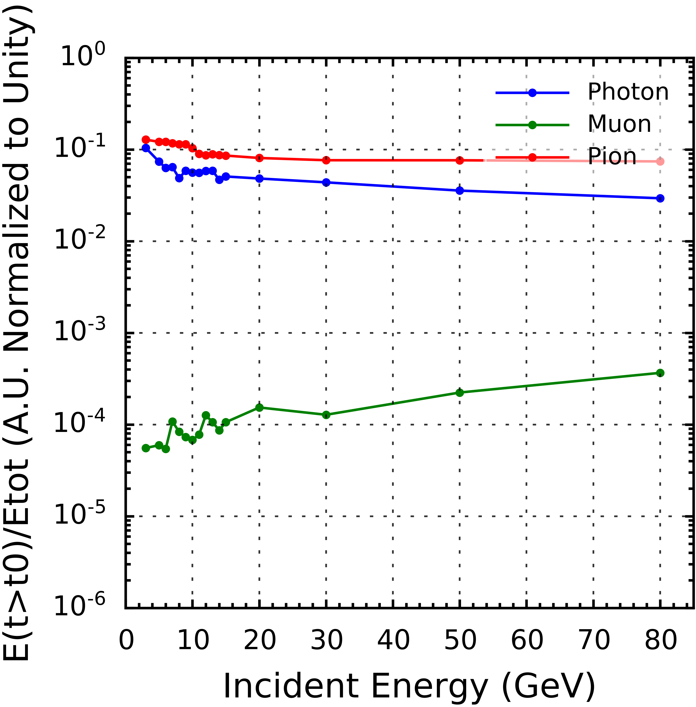
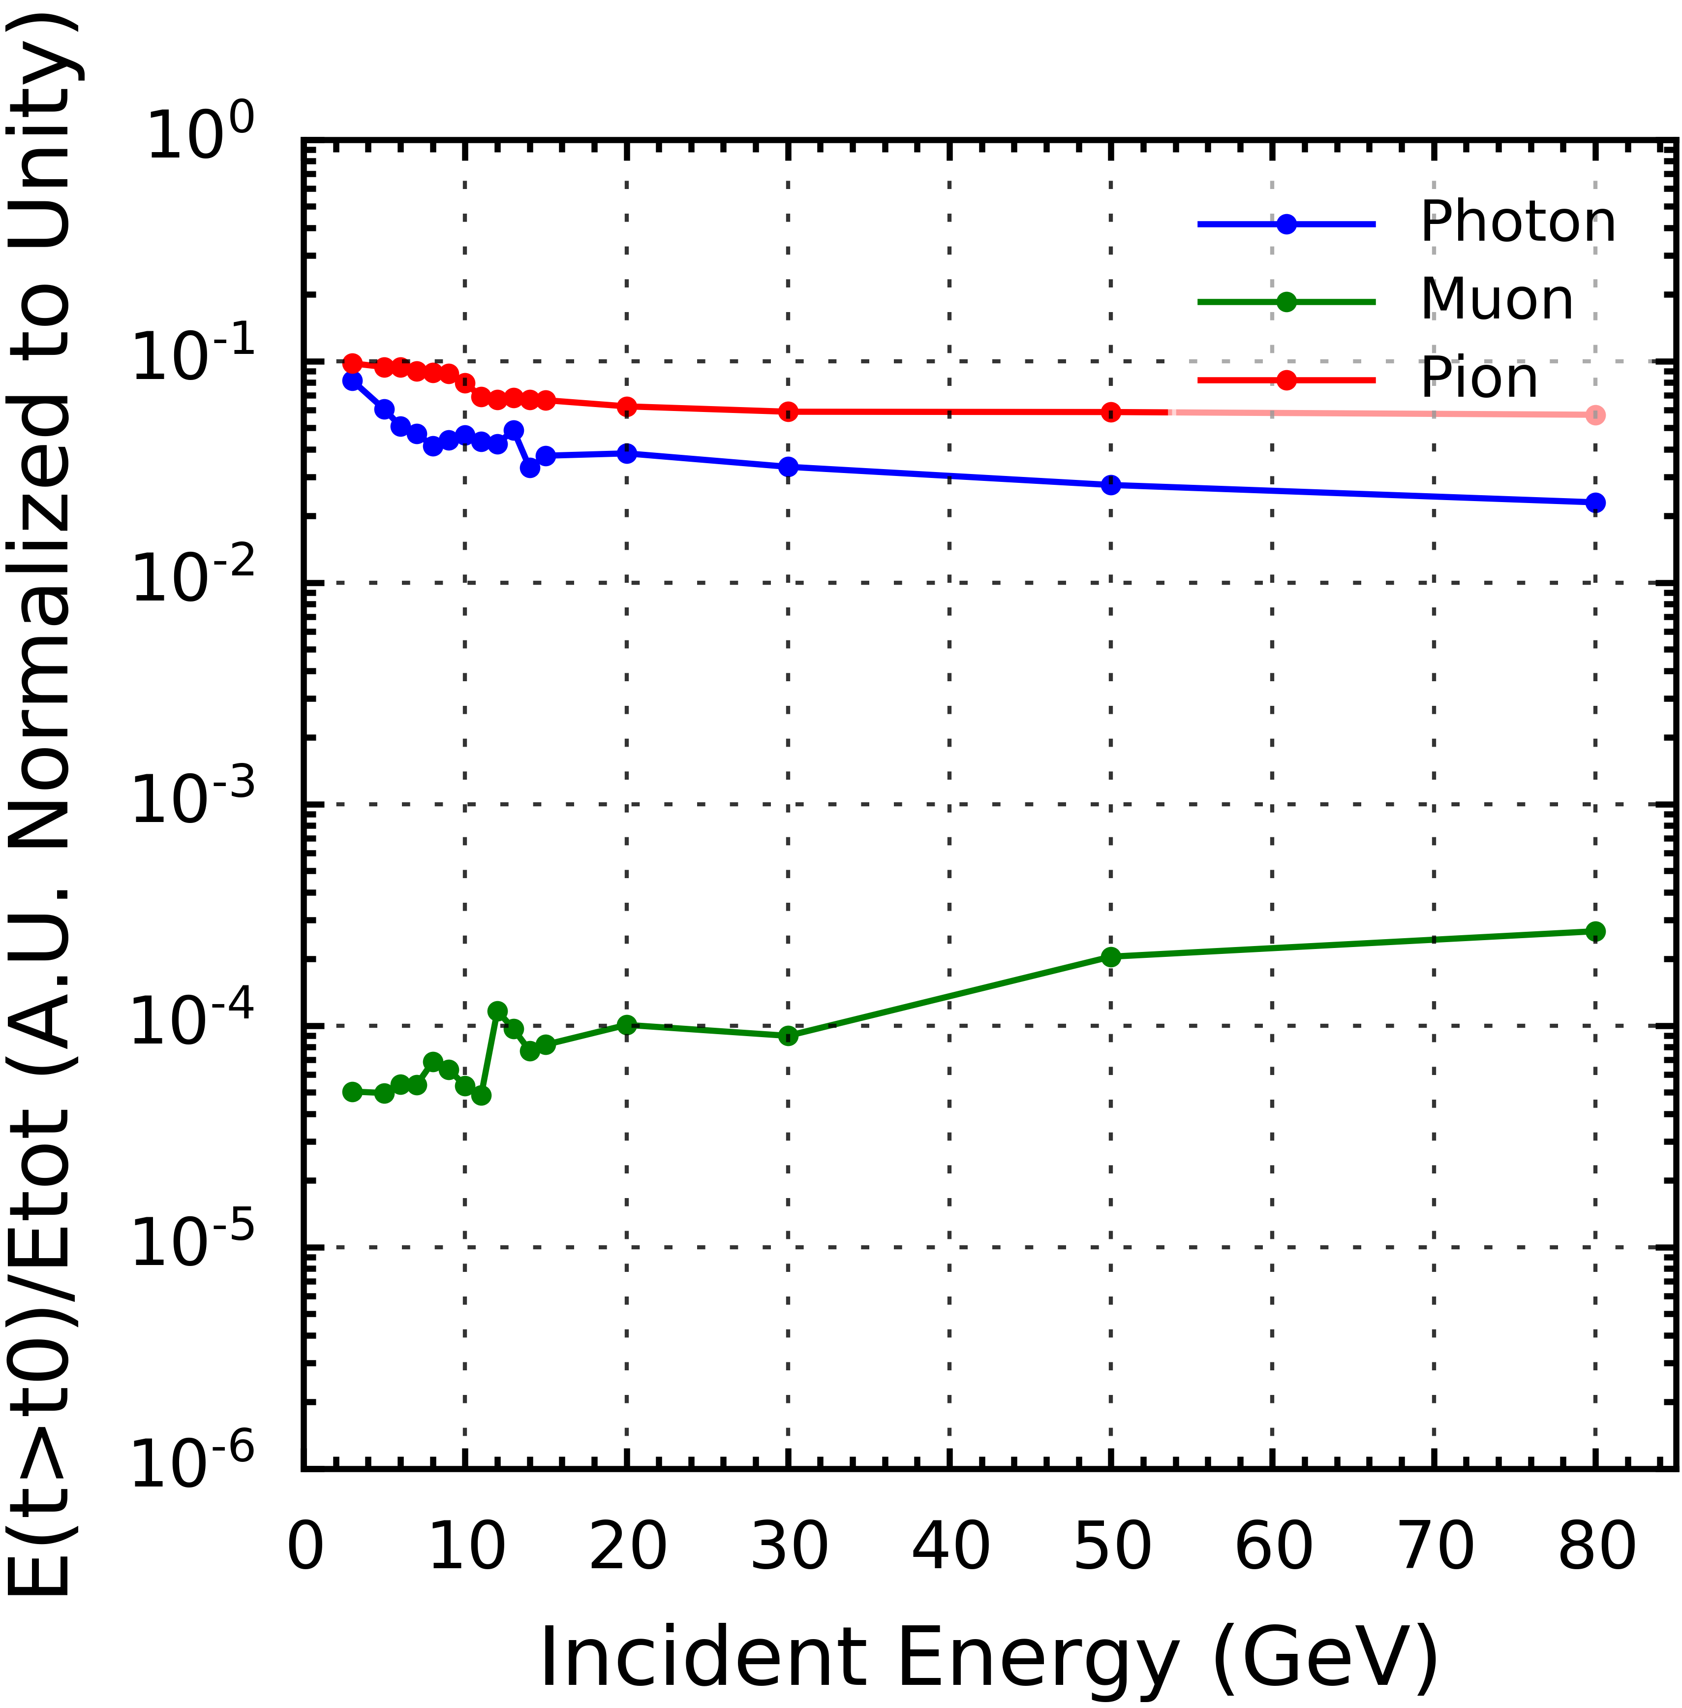
Residual Energy vs Incident Energy in HCAL at Different Reference Points
1%
10%
25%
Graph of Residual Energy vs Incident Energy (Beam Energy) of Muon, Photon and Pion Samples in HCAL at 1%, 10% and 25% Reference Points
Y-Axis: residual energy at reference points 1% (≈19 Bunch Crossings), 10% (≈202 Bunch Crossings) 25% (≈552 Bunch Crossings), defined as
$$\int_{\text{Ref} \text{Point}}^{∞}{E\left(t\right)dt}$$

Slide 17
5. Full Simulation Sample of Z to qq
Shower energy decay curve in a real physics process.

Slide 18
ECAL (Total Energy 56.4386 GeV)
1% Reference Point：2.88587GeV(5.11329%)
10% Reference Point：1.07655GeV(1.90747%)
25% Reference Point：0.612964GeV (1.08607%)
HCAL (Total Energy 33.7725 GeV)
1% Reference Point：5.74483GeV(17.0094%)
10% Reference Point：4.40209GeV(13.0338%)
25% Reference Point：3.43148GeV(10.16%)
ECAL + HCAL: total energy ~ 90 GeV
Total Event # : 20000 Events
ECAL : $\frac{σ_{E}}{E}=\frac{0.16}{\sqrt{20000\frac{E}{GeV}}}$
HCAL: : $\frac{σ_{E}}{E}=\frac{0.6}{\sqrt{20000\frac{E}{GeV}}}$
Residual Energy vs log(Bunch Crossings (A.U.) of the Z->qq Sample in ECAL and HCAL Using QGSP_BERT_HP
Notes:
(1-y)/sqrt(N)
y/sqrt(N)
Ask: Error Bar?

Slide 19
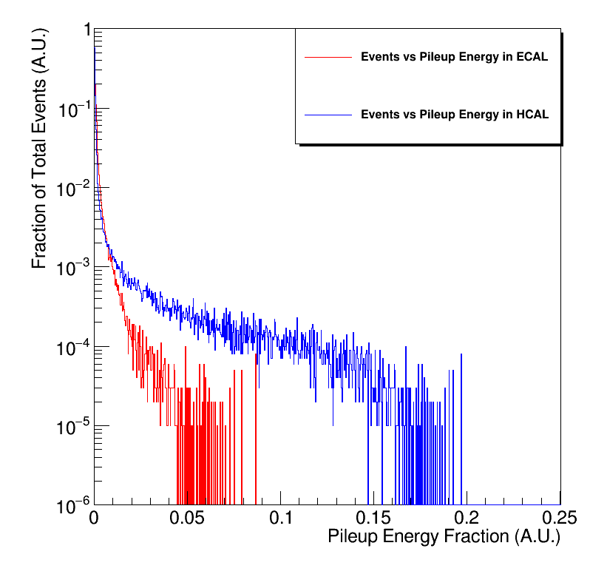
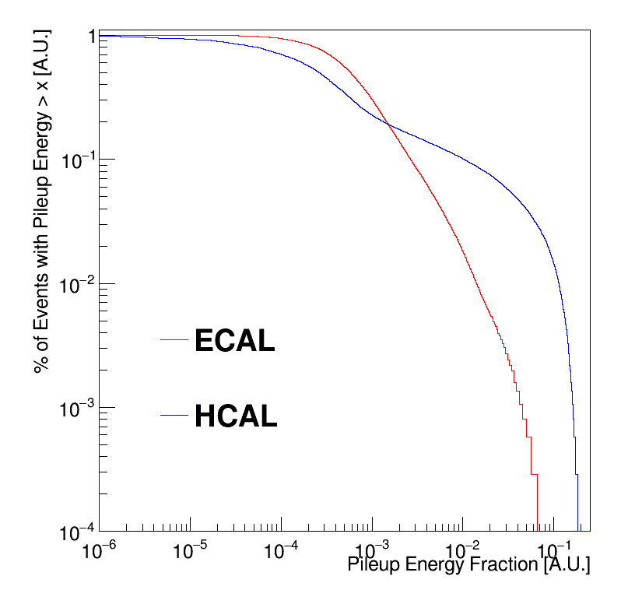
Events vs Fraction of Pileup Energy in ECAL and HCAL (PDF)
Pileup Energy is defined as E_(t>t_0)/E_(tot) where t0 is the time separation between events obtained from Toy Model.
Residual (Pileup) Energy is extrapolated from the previous curve residual energy vs log(Bunch Crossing) curve.

Slide 20
7. Conclusion
During the Z-pole mode of operation at CEPC, there will inevitably be off-time pileup happening. Here we must use the word off-time pileup carefully. We have not investigated how the left-over energy from the previous event affect the next event; instead, we have quantified how much energy is “leaked” from an event given a certain data taking window (and how much energy that will be mixed into the next event).
In the particles investigated, $π^{+}$ particle has the largest effect on off time pileup, followed by $μ^{−}$ then $γ$.
At the reference point of 202 bunch crossings (10% of events) the residual energy in HCAL can be as high as 4.4GeV (13% of total energy deposited in HCAL).
Leakage is significant! Causes not only lost of relevant hit energy, but also contamination from previous event(s): depending on the timing separation of events As well as integration time.
Lot of things to be followed up…

Slide 21
Conclusion
=> Even in the best-case scenario of events being spaced by 1920 Bunch Crossings, there is still 1.47 GeV of Residual Energy within the HCAL. This may lead to some difficulties with reconstructing the total momentum & energy of an event, which we call for attention. <=
Reference Point | ECAL Residual Energy | HCAL Residual Energy
19 Bunch Crossing (1%) | 2.89 GeV (5.1%) | 5.74 GeV (17%)
202 Bunch Crossing (10%) | 1.08 GeV (1.9%) | 4.4 GeV (13%)
552 Bunch Crossing (25%) | 1.61 GeV (1.1%) | 3.43 GeV (10.2%)
1920 Bunch Crossing (Average) | 0.27 GeV (0.5%) | 1.47 GeV (4.3%)

Slide 22
Backup

Slide 23
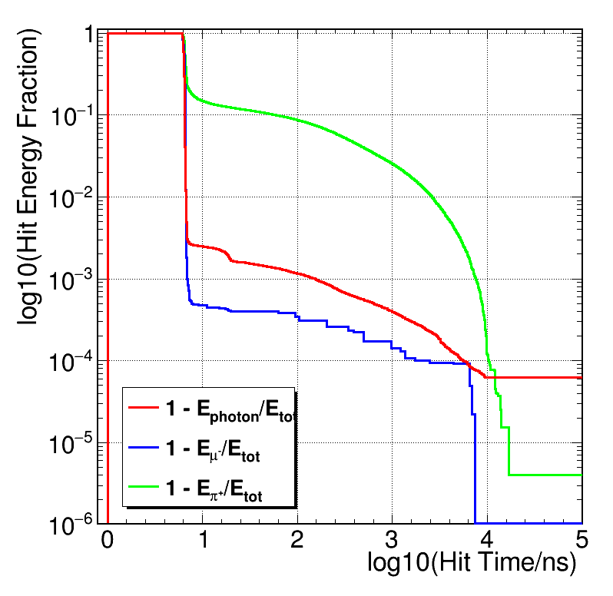
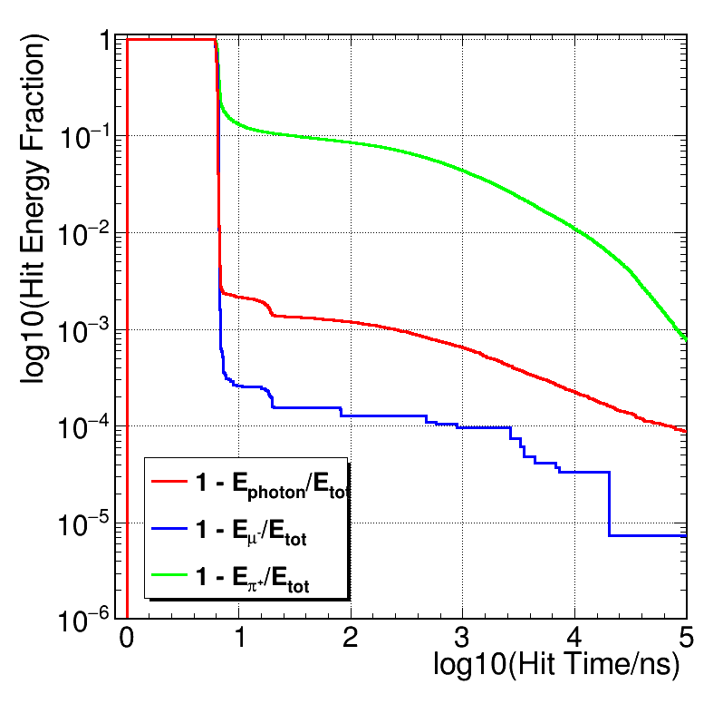
Physics Model:
QGSP_BERT vs. QGSP_BERT_HP
10 GeV particles with QGSP_BERT
10 GeV particles with QGSP_BERT_HP
Energy Deposited Much Later

Slide 24
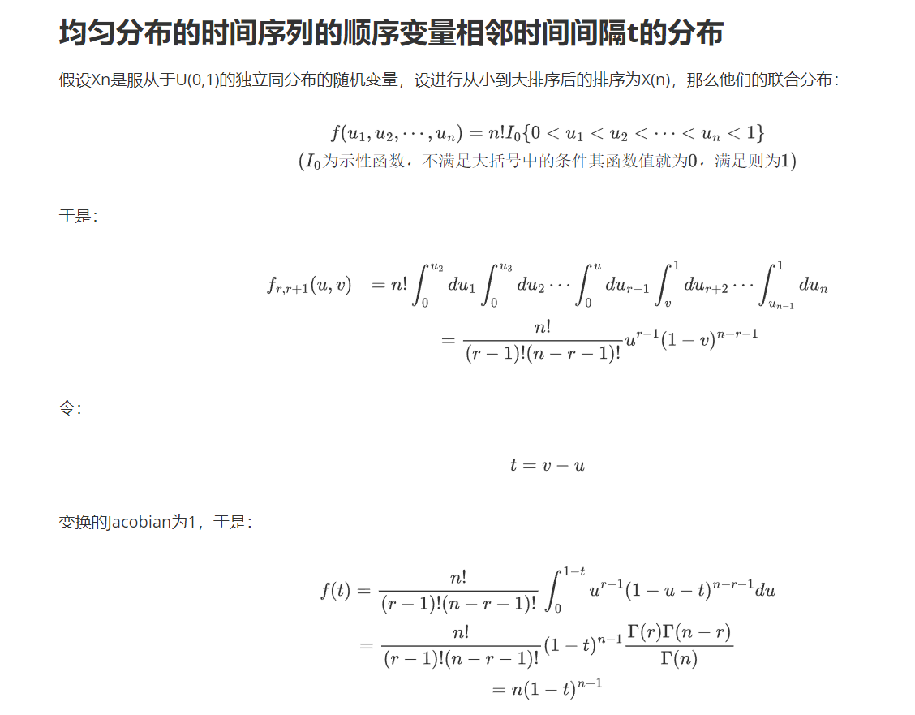
Model with continuum approximation
bunch time spacing:
dt -> 0

Slide 25
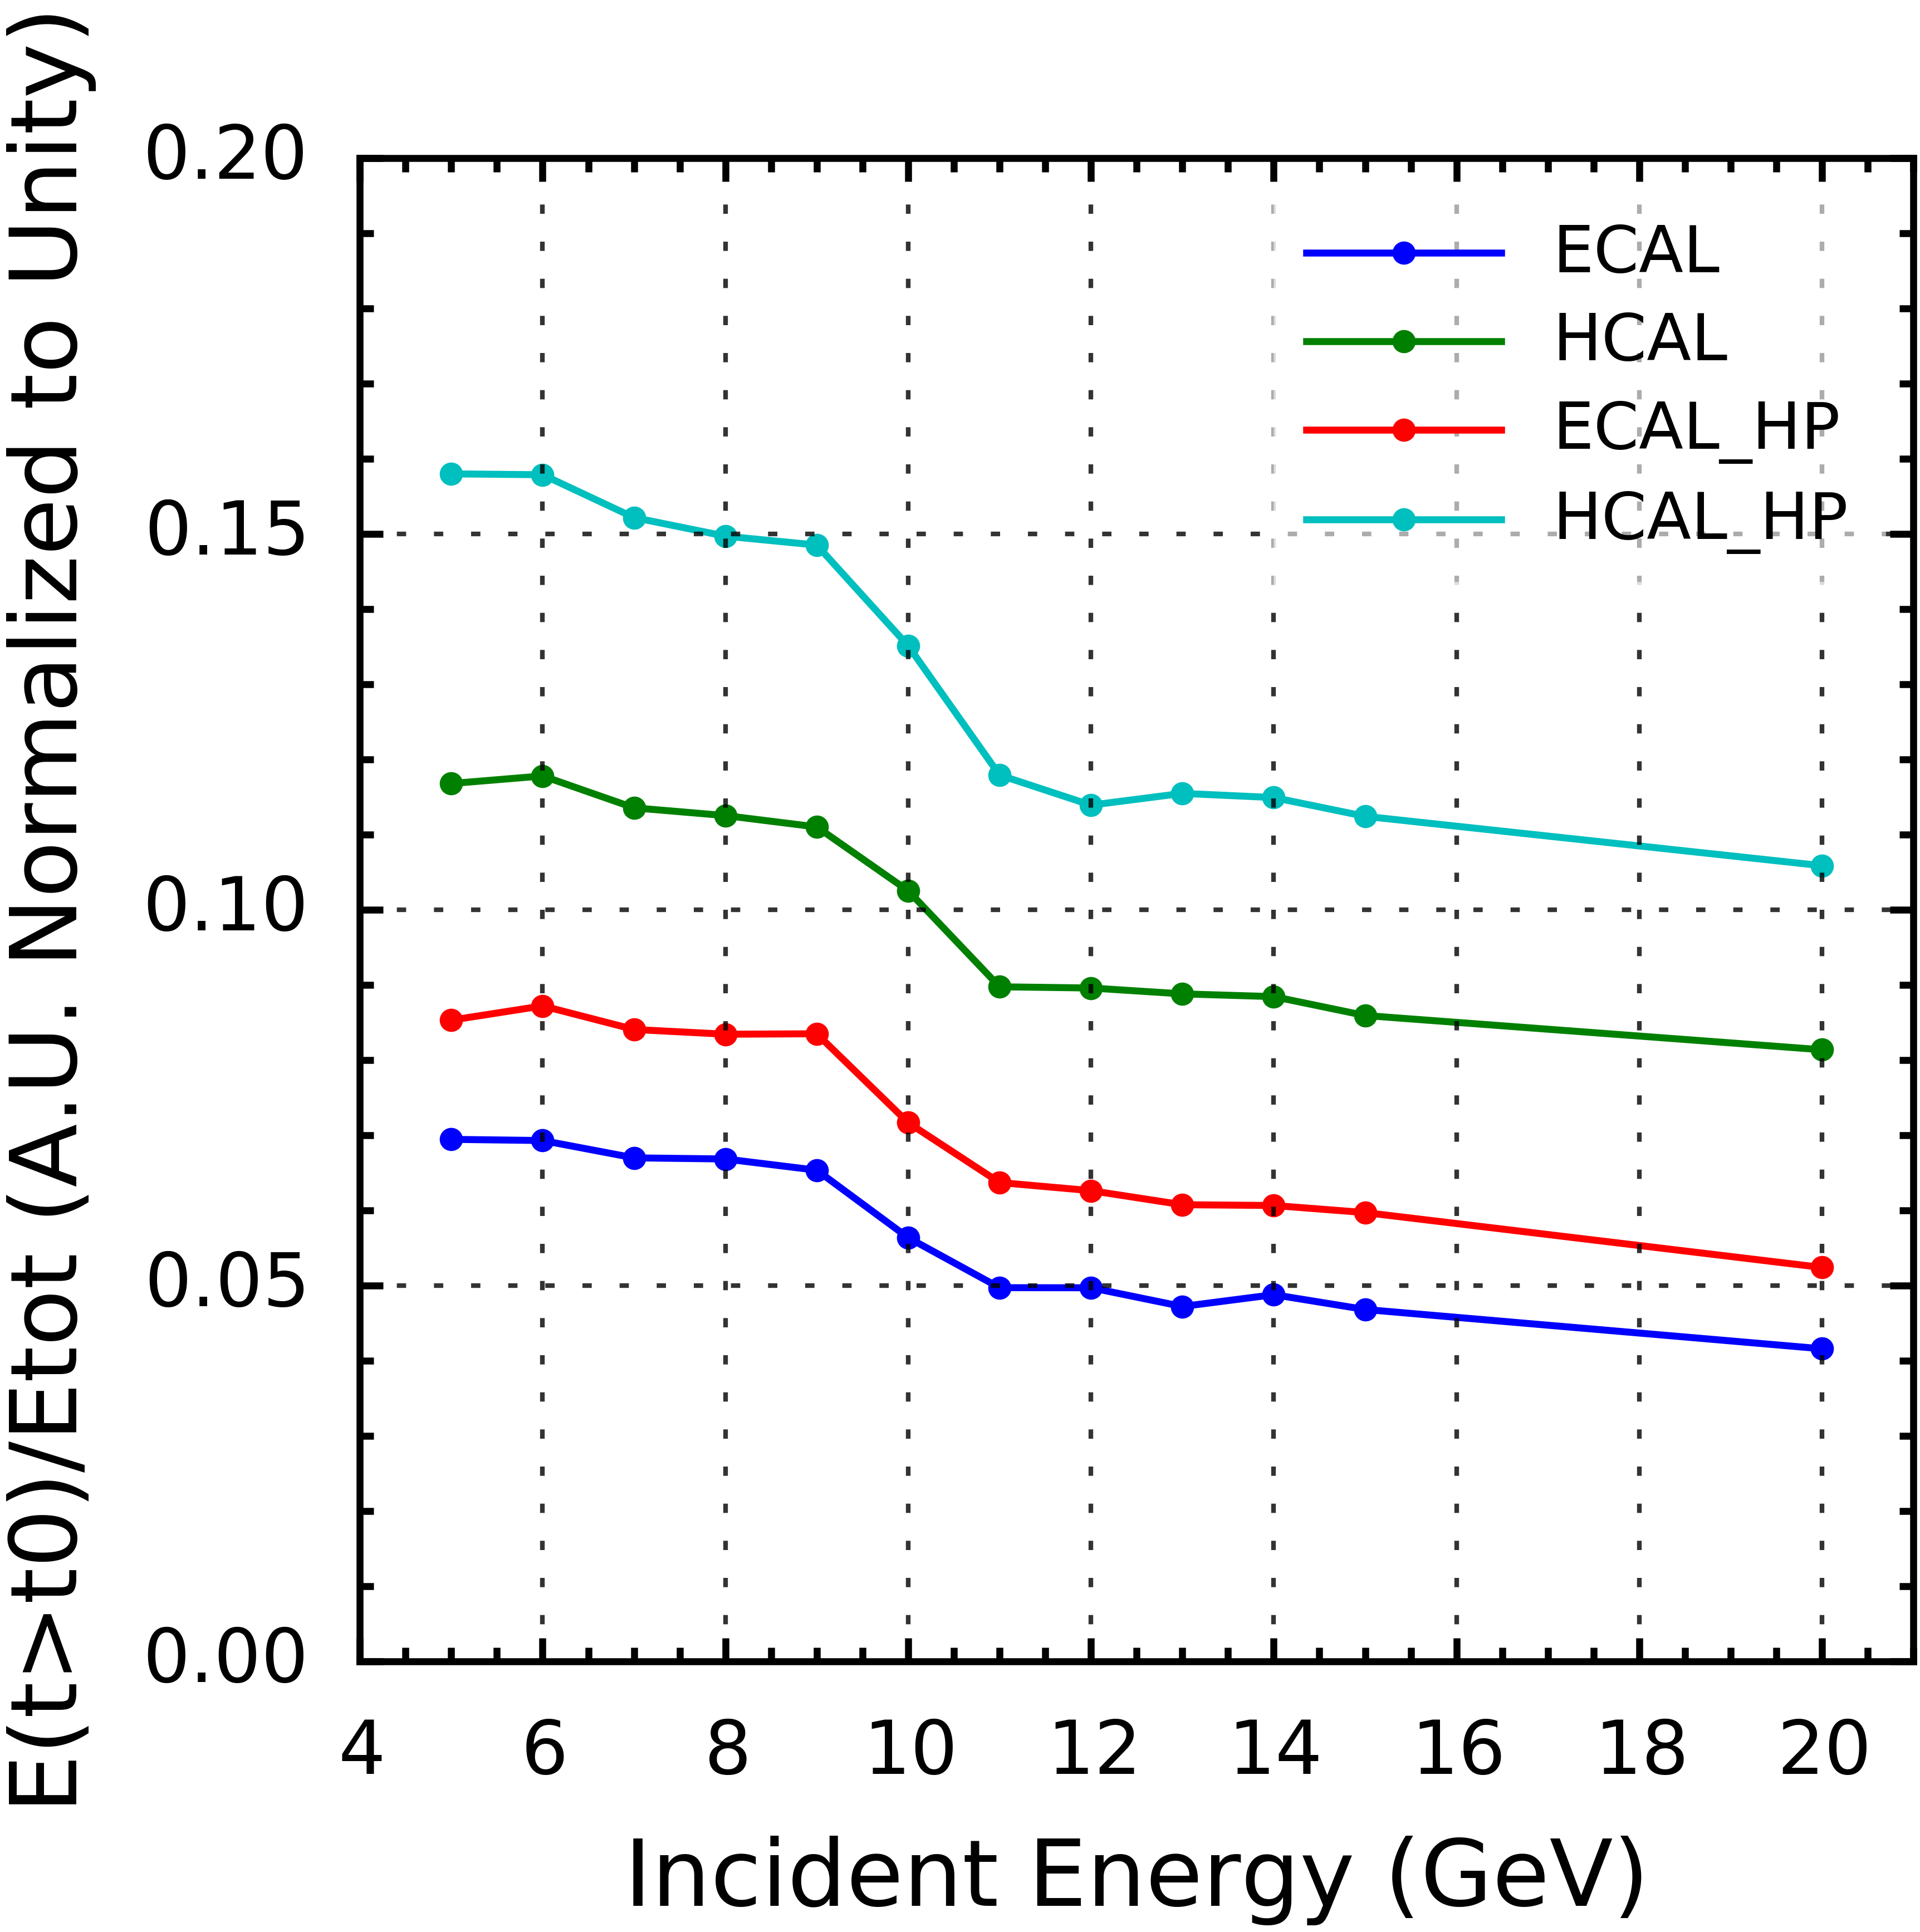
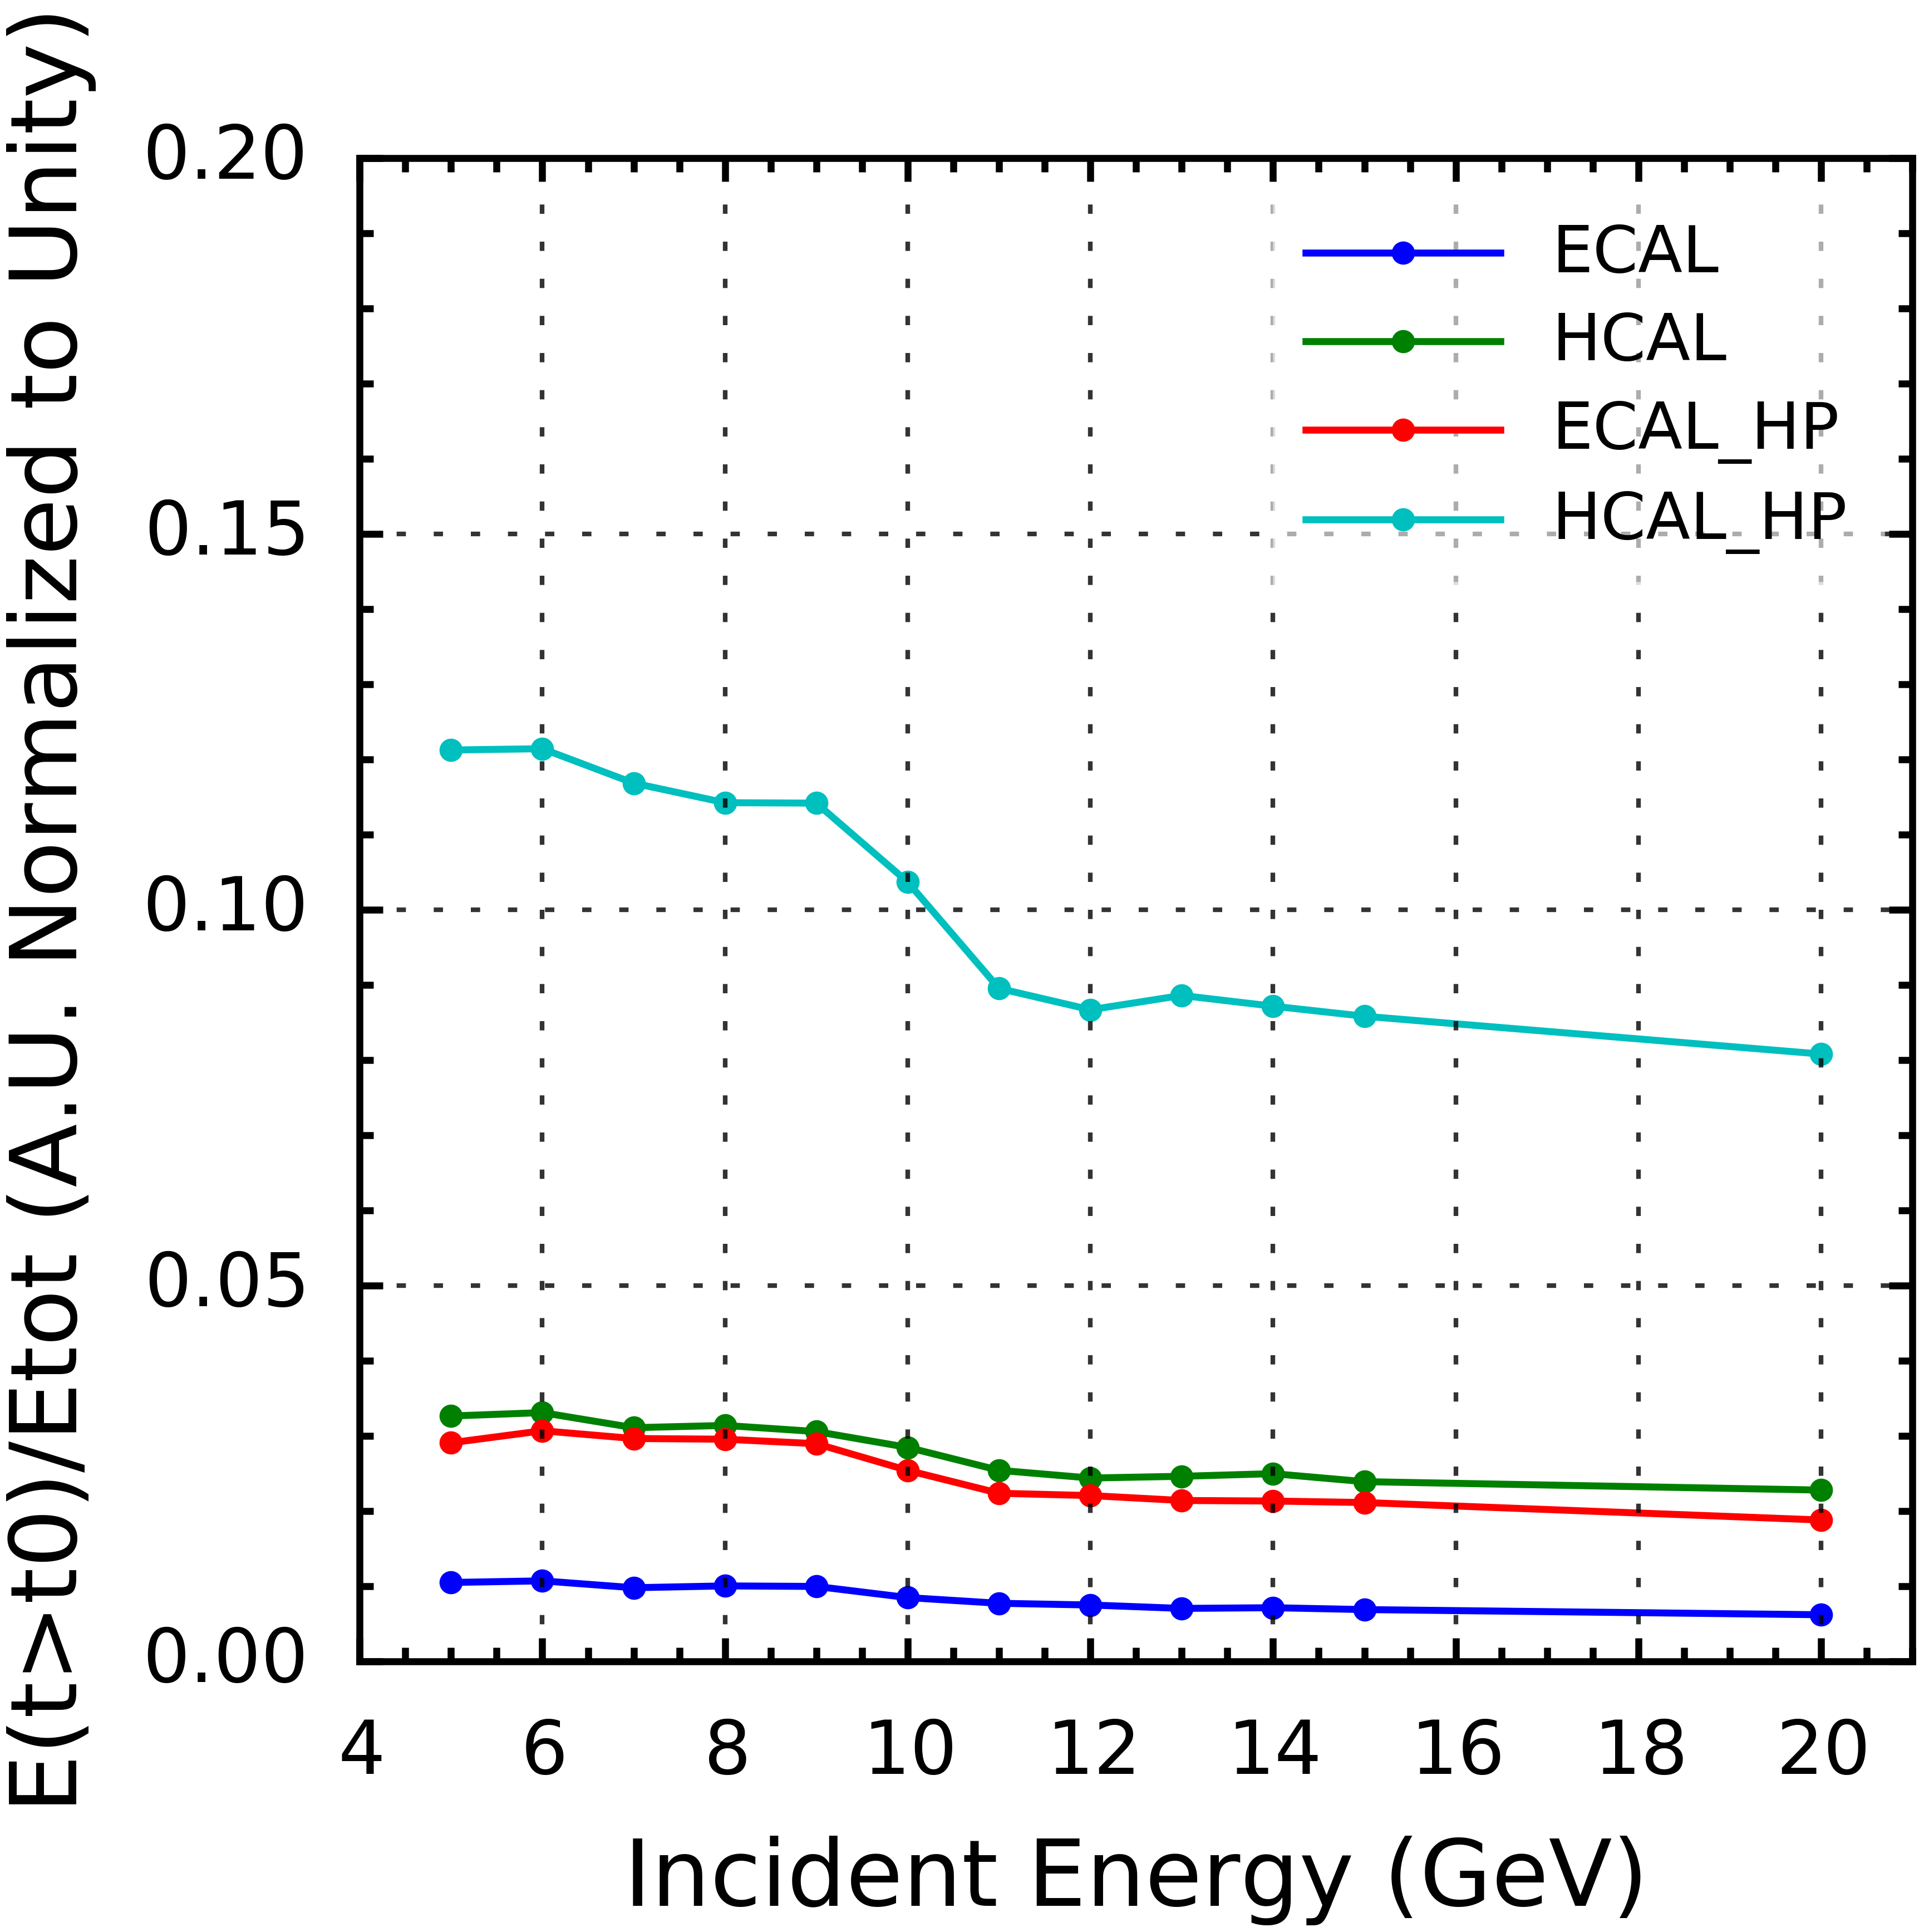
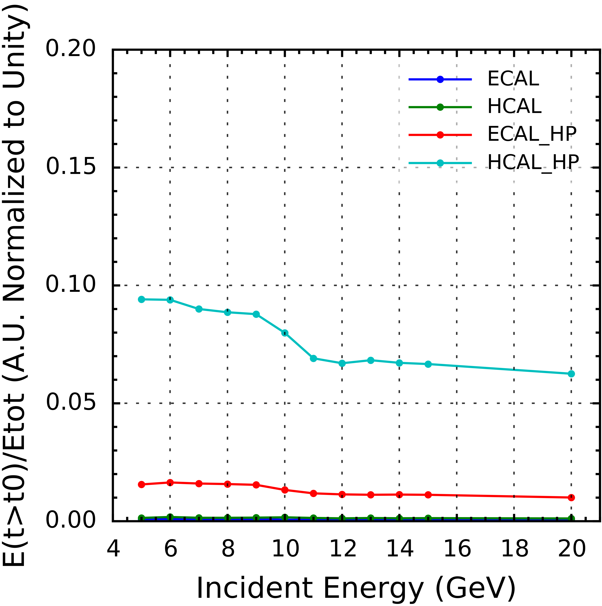
Residual Energy vs Insident Energy of Pion at Different Reference Points
10%
25%
1%
Residual Energy vs Incident Energy of Pion in ECAL and HCAL Using Both QGSP_BERT and QGSP_BERT_HP
Notice the sudden drop of the curves around 10 GeV consistent across all the graphs.

Slide 26
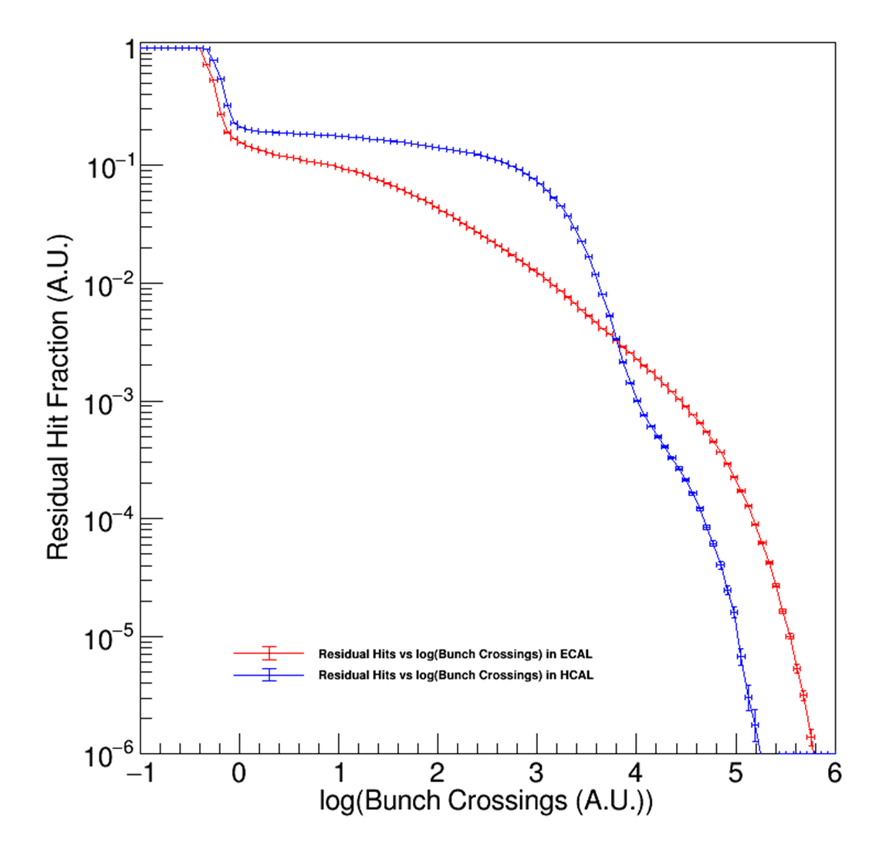
Why Z->qq
In Z pole mode, the expectation value of the event time spacing is very small ~1920 Bunch Crossings (1 Bunch Crossing = 15 ns).
Z pole has mostly 2 types of events: Z->qq and invisible decay
Good enough to consider only 1 type of process: Z->qq
Residual Hit Fraction vs log(Bunch Crossings (A.U.) of the Z->qq Sample in ECAL and HCAL (20000 Events)

Slide 27
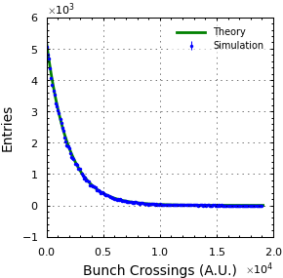
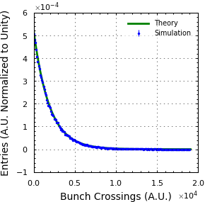
# of Events with Separation less Than Threshold (100000 Total Data Points for Simulation) With Error Bars
# of Events(Normalized) with Separation less Than Threshold (100000 Total Data Points for Simulation) With Error Bars
Notes:
Error estimated as 1/sqrt(N) N = Bin Content

Slide 28
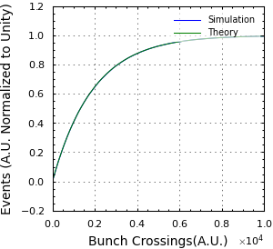
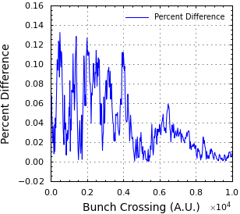
Fraction of Events with Separation Less than Bunch Crossing Threshold
Percent Difference Between Theory and Simulation

Slide 29
Action Item
We believe that the material of detector may have effects on the energy spectrum of the detectors. Thus, we will proceed to investigate the change of materials.
We did not consider the effective time of data taking, and we will incorporate that in the future.
We will investigate how sensitive are critical performance (e.g. BMR) to the leakage effect.
The “real” off-time pileup: contamination of individual events by previous event(s).

