Slide 1
国家重点研发计划
R&D and Verification of Key Technologies for a High Energy Circular Electron-Positron Collider
Zhijun Liang for CEPC MOST2 vertex detector team

Slide 2
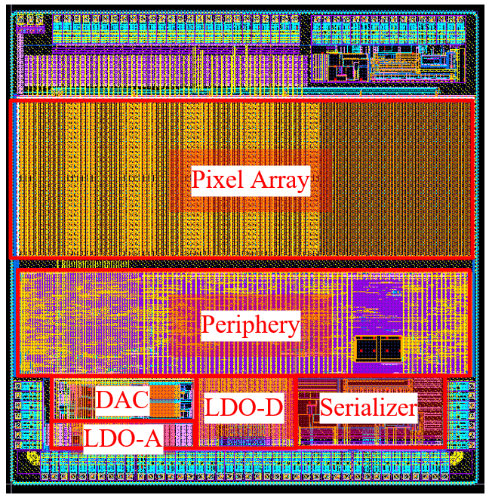
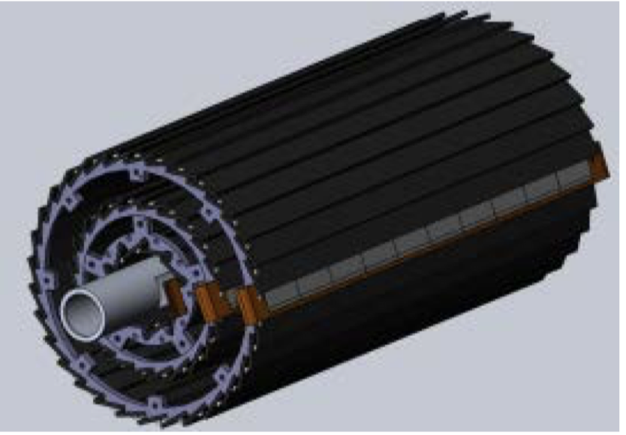
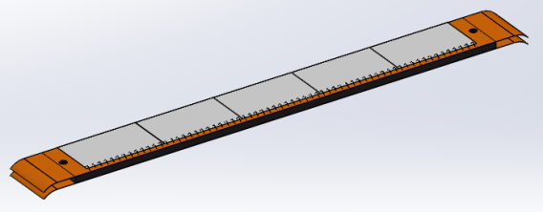
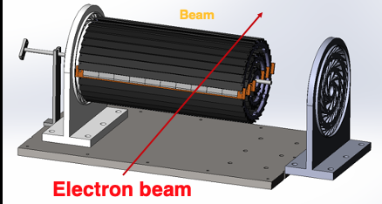
Overview of task2： vertex detector R & D
Can break down into sub-tasks:
CMOS imaging sensor chip R & D
Detector layout optimization, Ladder and vertex detector support structure R & D
Detector assembly
Data acquisition system R & D
CMOS imaging
sensor prototyping
Detector module (ladder)
Prototyping
Full size vertex detector Prototype
Beam test to
verify its spatial resolution
Notes:
Full size vertex detector

Slide 3
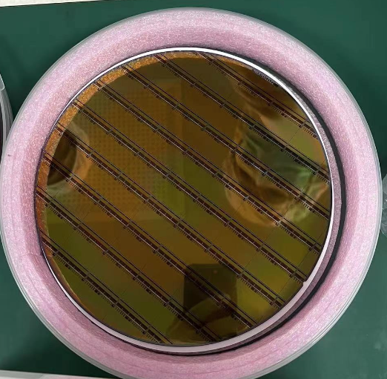
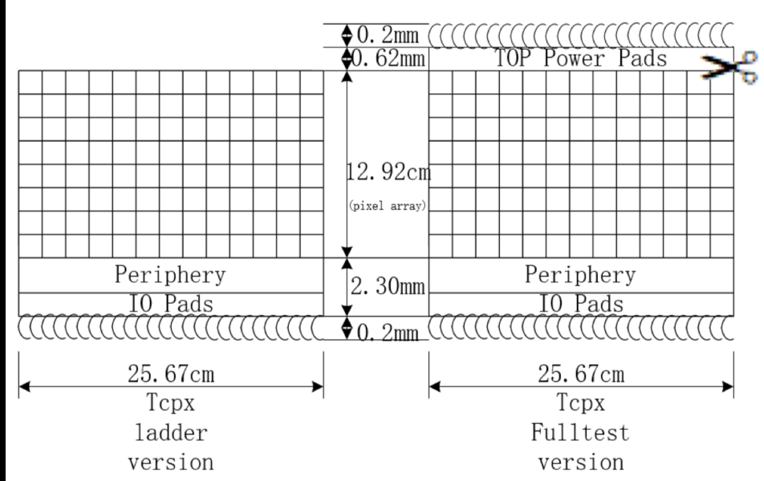
News about Taichupix3 production
6 Taichu3 wafers are ready.
Wafer arrival at IHEP in 5th July 2022
3 wafers (standard process) + 3 wafers (modified process)
After irradiation, modified process will give better resolution
Will modified process sensors into the detector assembly
Send 4 wafers to NCAP for wafer testing , thinning and dicing
Send 1 wafers for thinning (150um) and dicing
Test single chip performance
1st round: Send 5 chips for wired bonding
2 boards working
2nd round (this week): Send 5 more chip
3 chips with normal dicing (top and bottom pads available)
2 chips dicing without top pads
IR drop tests in next step

Slide 4
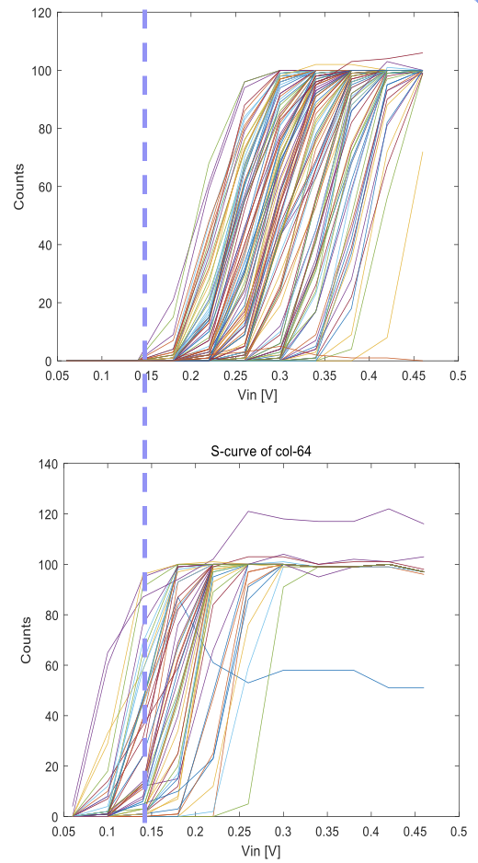
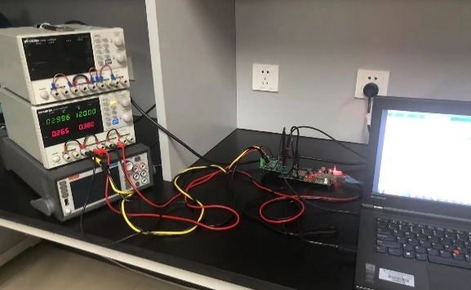
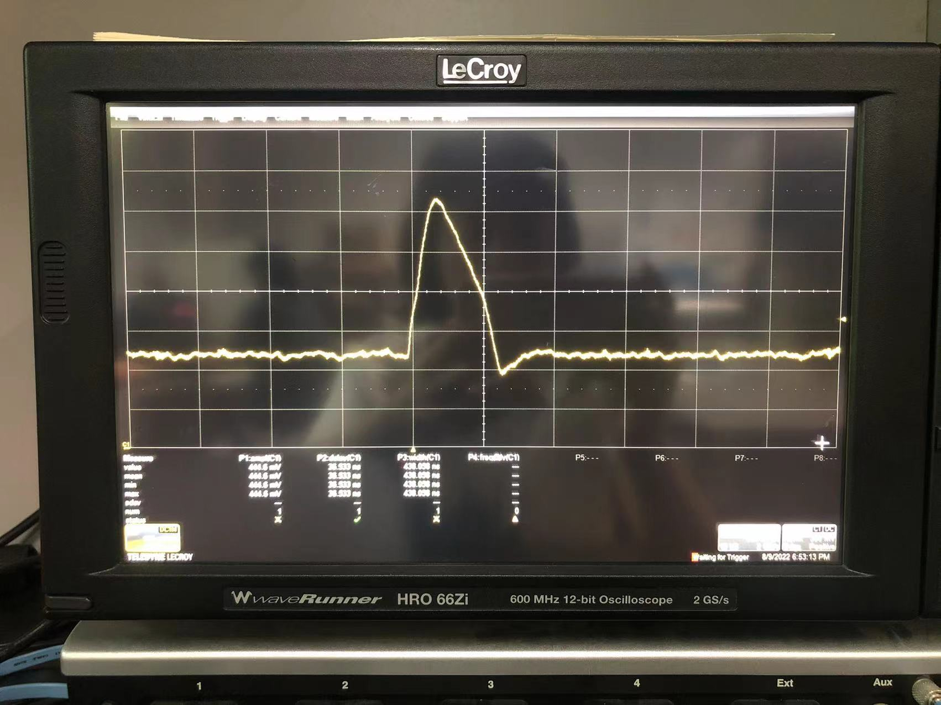
Preliminary TaichuPix-3 test
TaichuPix2
Single chip test system built
Taichipix3 can reach ~100 e- lower threshold than Taichu2
Improvement of DAC design in TC3 verified
Taichu2 mean threshold | Taichu3 mean threshold
267 e- | ~169 e-
TaichuPix3

Slide 5
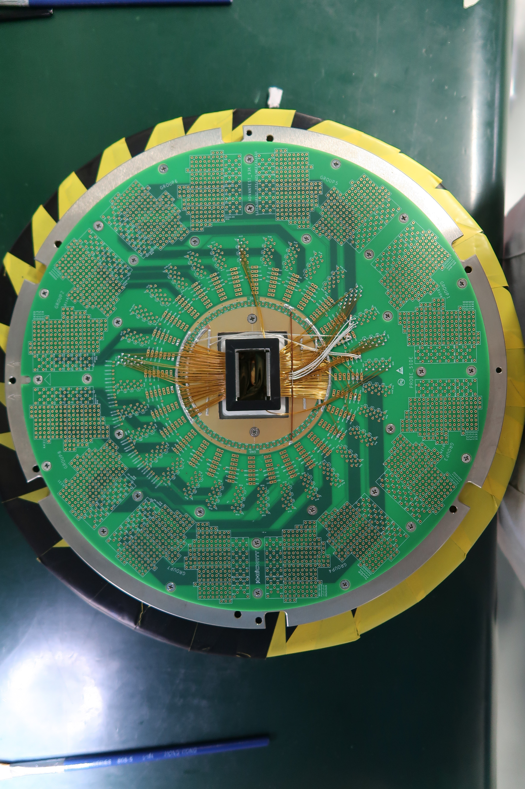
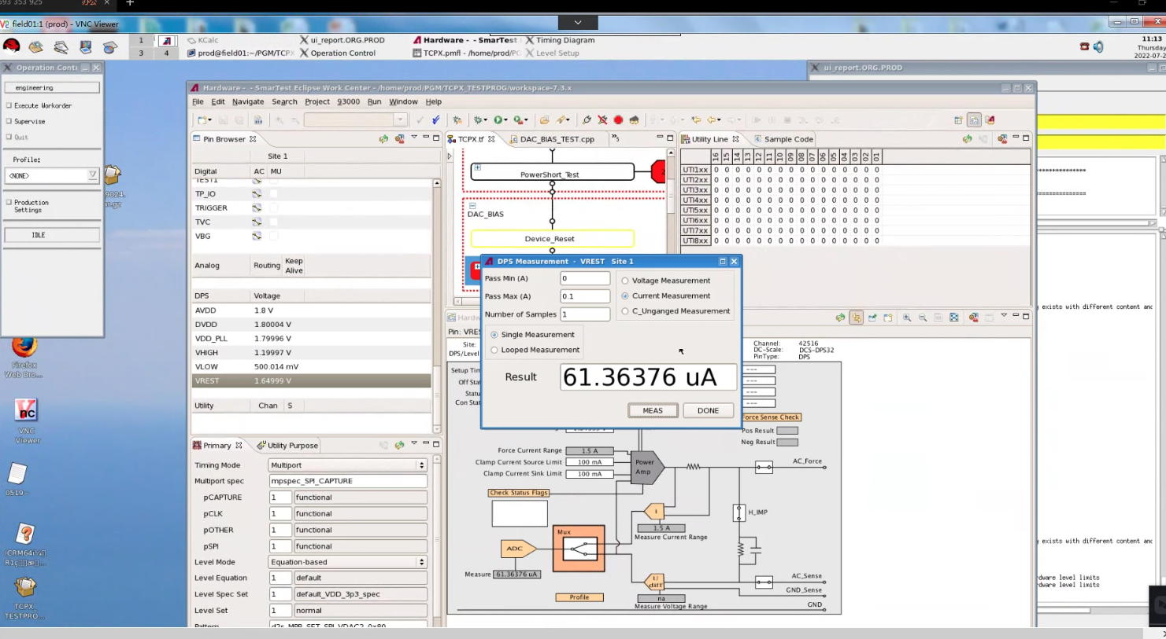
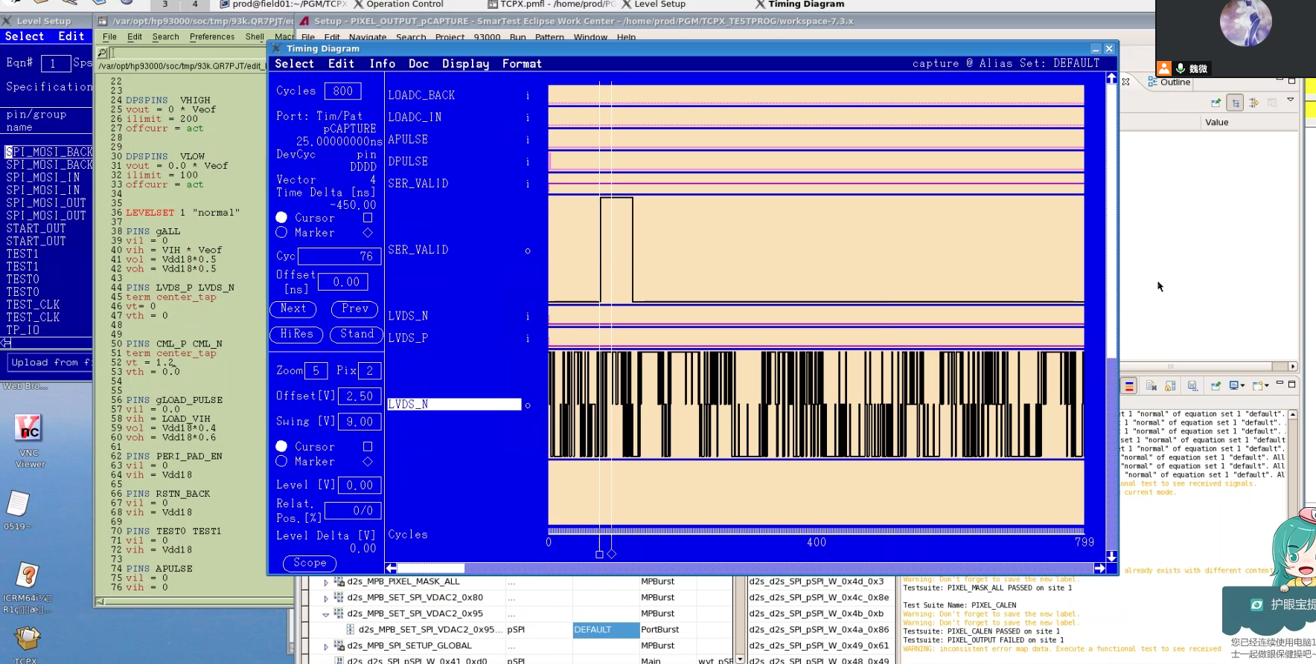
Taichupix3 wafer-level testing
Wafer level test
Probe card
Single chip test board testing on-going
Wafer level testing in NCAP (on-going )
Remote connection from IHEP to NCAP
Remote commissioning of testing program
probe cards repaired, updating test procedure
More testing results this week ? Yield ?

Slide 6
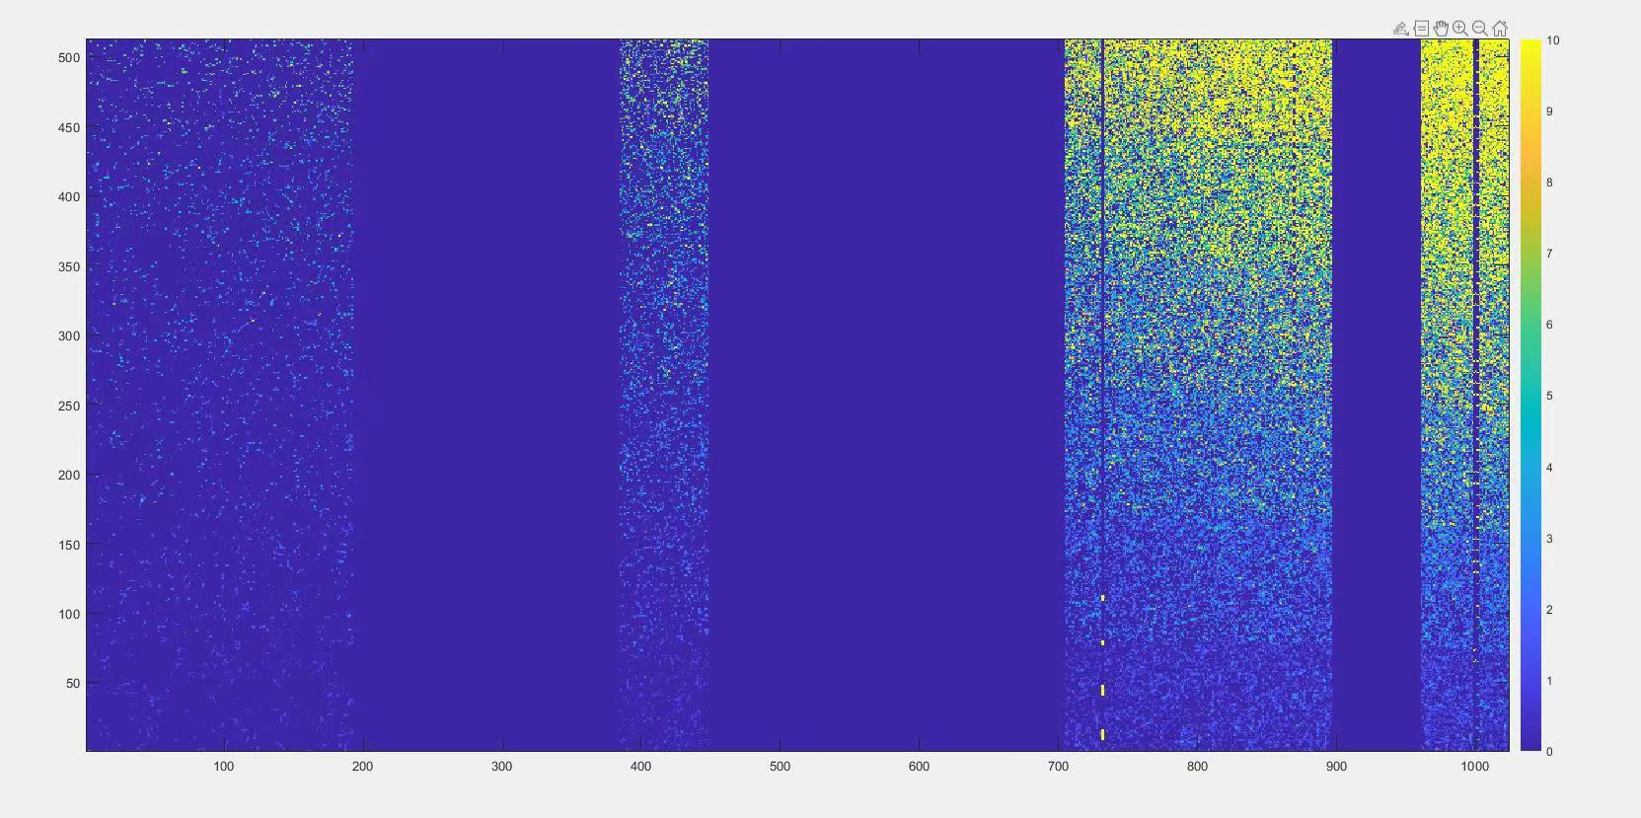
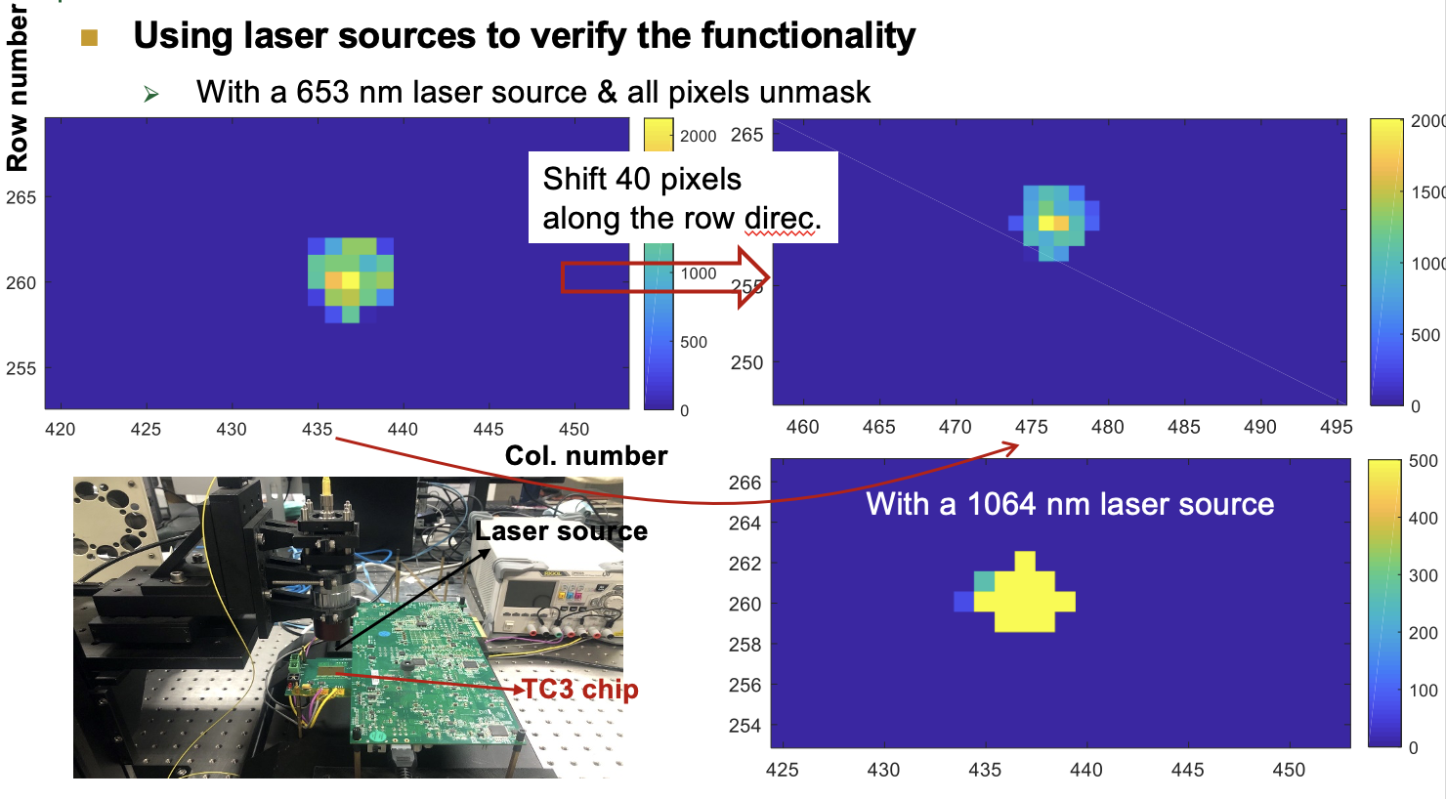
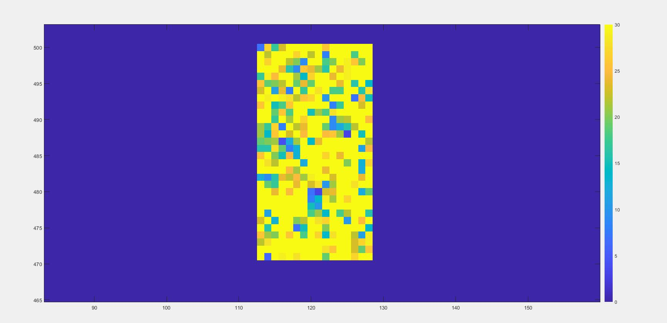
TaichuPix3 tests
Functionality of the full signal chain proved with laser tests
Threshold scan in Beta source tests
Irradiation tests
Oct, two days in BSRF
X ray machine will repair in September.
Beta source tests
laser tests
Beta source tests

Slide 7
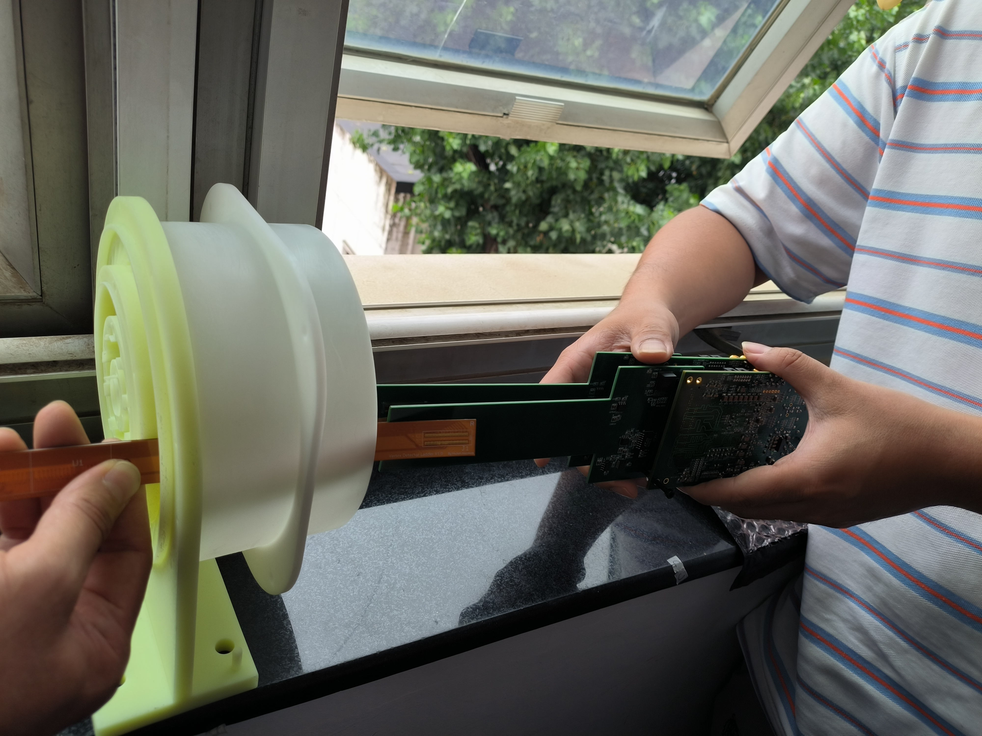
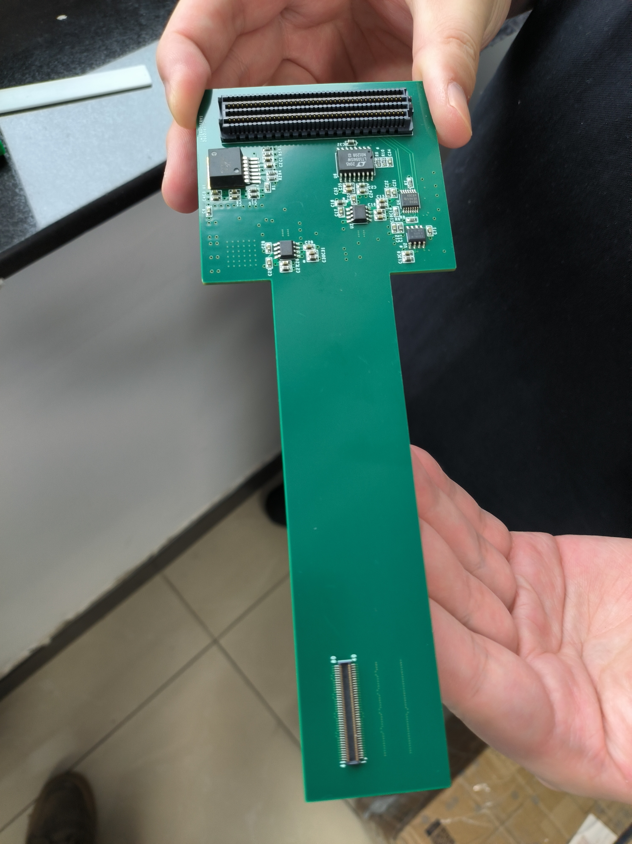
Flex and interface board
Interface board was planned to have soft+hard PCB design
Interface board is to connected the flex and FPGA board
Due to low yield, switched to hard PCB design, no flexible components
Expect no much impact to support structure
Time scale for 2nd version of interface board ?
Interface board+FPGA +flex
Interface board

Slide 8
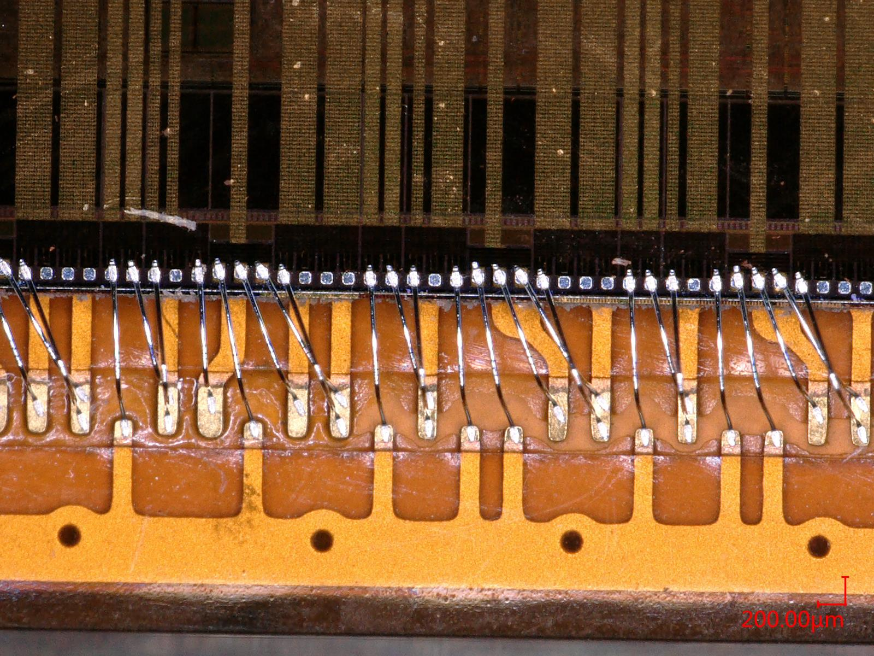
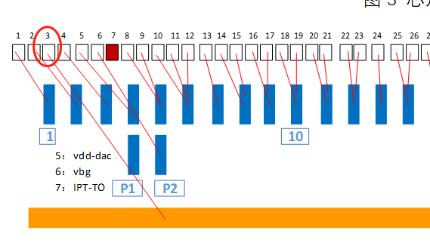
Flex and interface board
2nd version of the flex submitted ? Will return in 2-3 weeks ? Middle September?
Double metal layer and 4th layer metal design
Enlarge opening of the pad on flex (100um * 400um)
Add bus for ground for wire bonding
Modified the position of the hole
Change the position of the connector (on the other side of the sensor)
Testing with single chip 1st version flex with wire bonding
Large leakage current ?

Slide 9
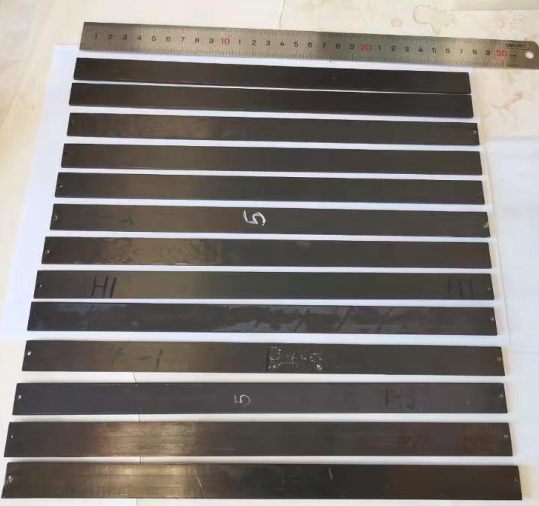
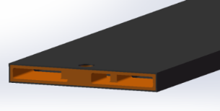
Support structure of the ladder
Ladder support production
Production of ladder support with carbon fiber is in good progress
Half of the ladder support has been produced. （IHEP designed)
The yield of first batch of production is a bit low (~30%)
New batch of production has high yield, when ?
Expected 120 good ladder support in this production
Ladder support
structure 3D model

Slide 10
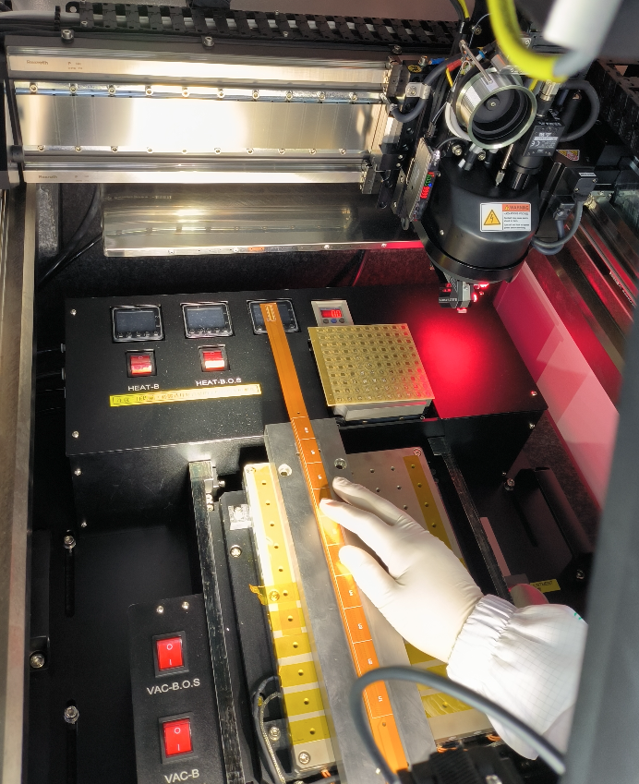
Detector module(ladder) assembly
Setting up wire bonding station
For full-size detector module( ladder)
Progress in assembly in ladder
Dummy
2 flex with 10 glass dummy ASIC assembly
Automatic glue dispensing using gantry
Real chip
Wire bonded one Taichu3 on flexible PCB
Jun and Ziyue are testing it with interface board

Slide 11
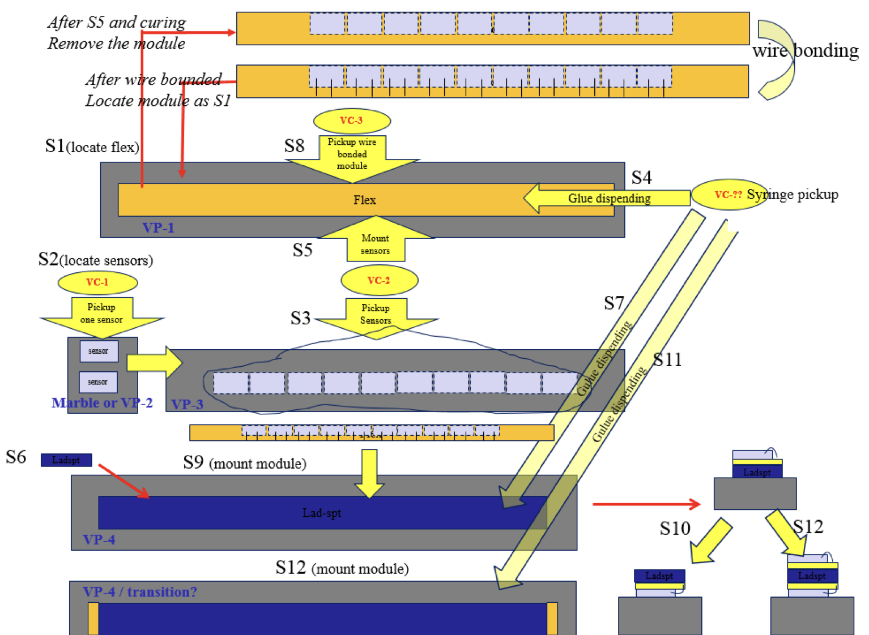
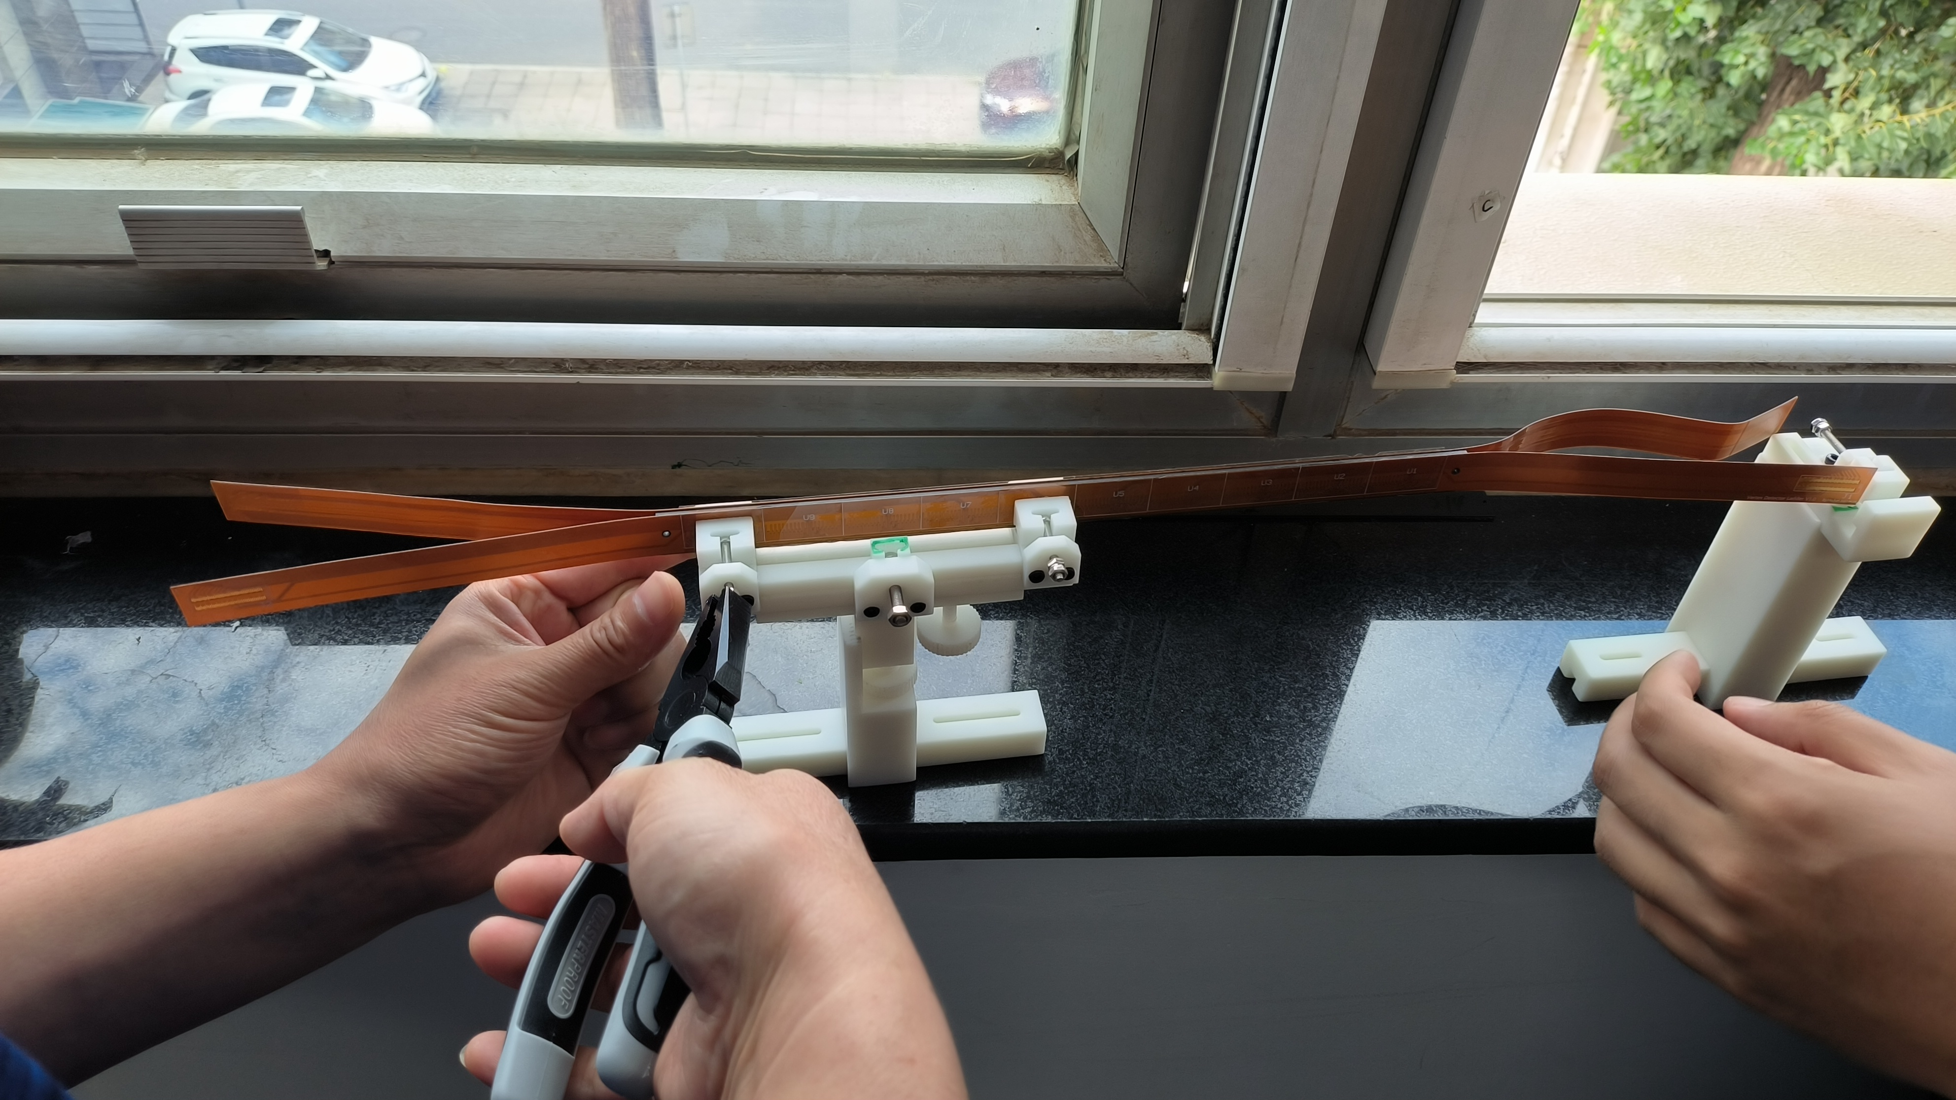
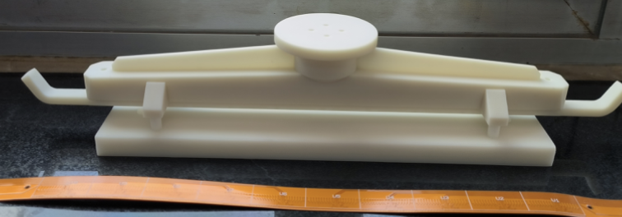
Ladder assembly
Ladder (double side)= 20 ASIC chips + two flexible PCB + carbon fiber support
Ladder assembly procedure verified with dummy ASIC (glass)

Slide 12
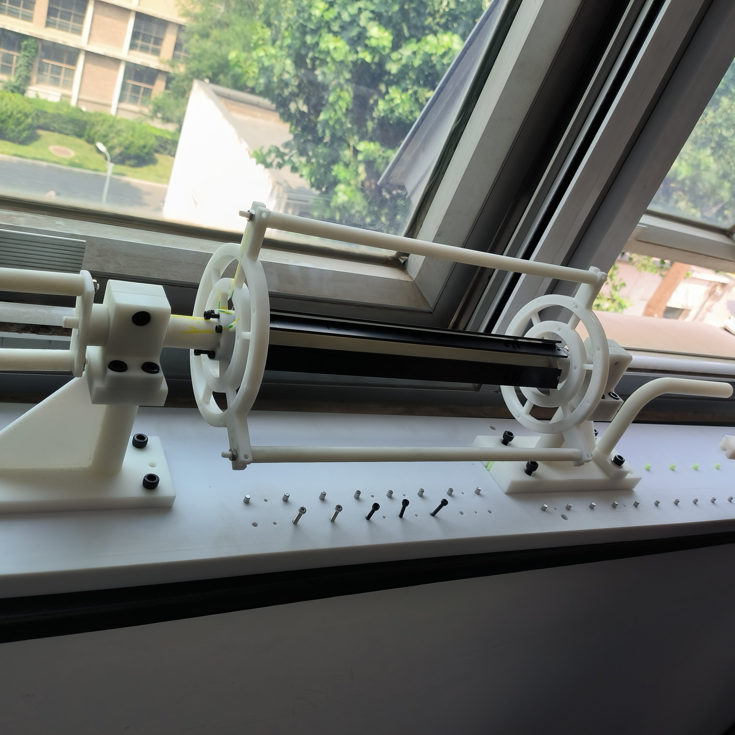
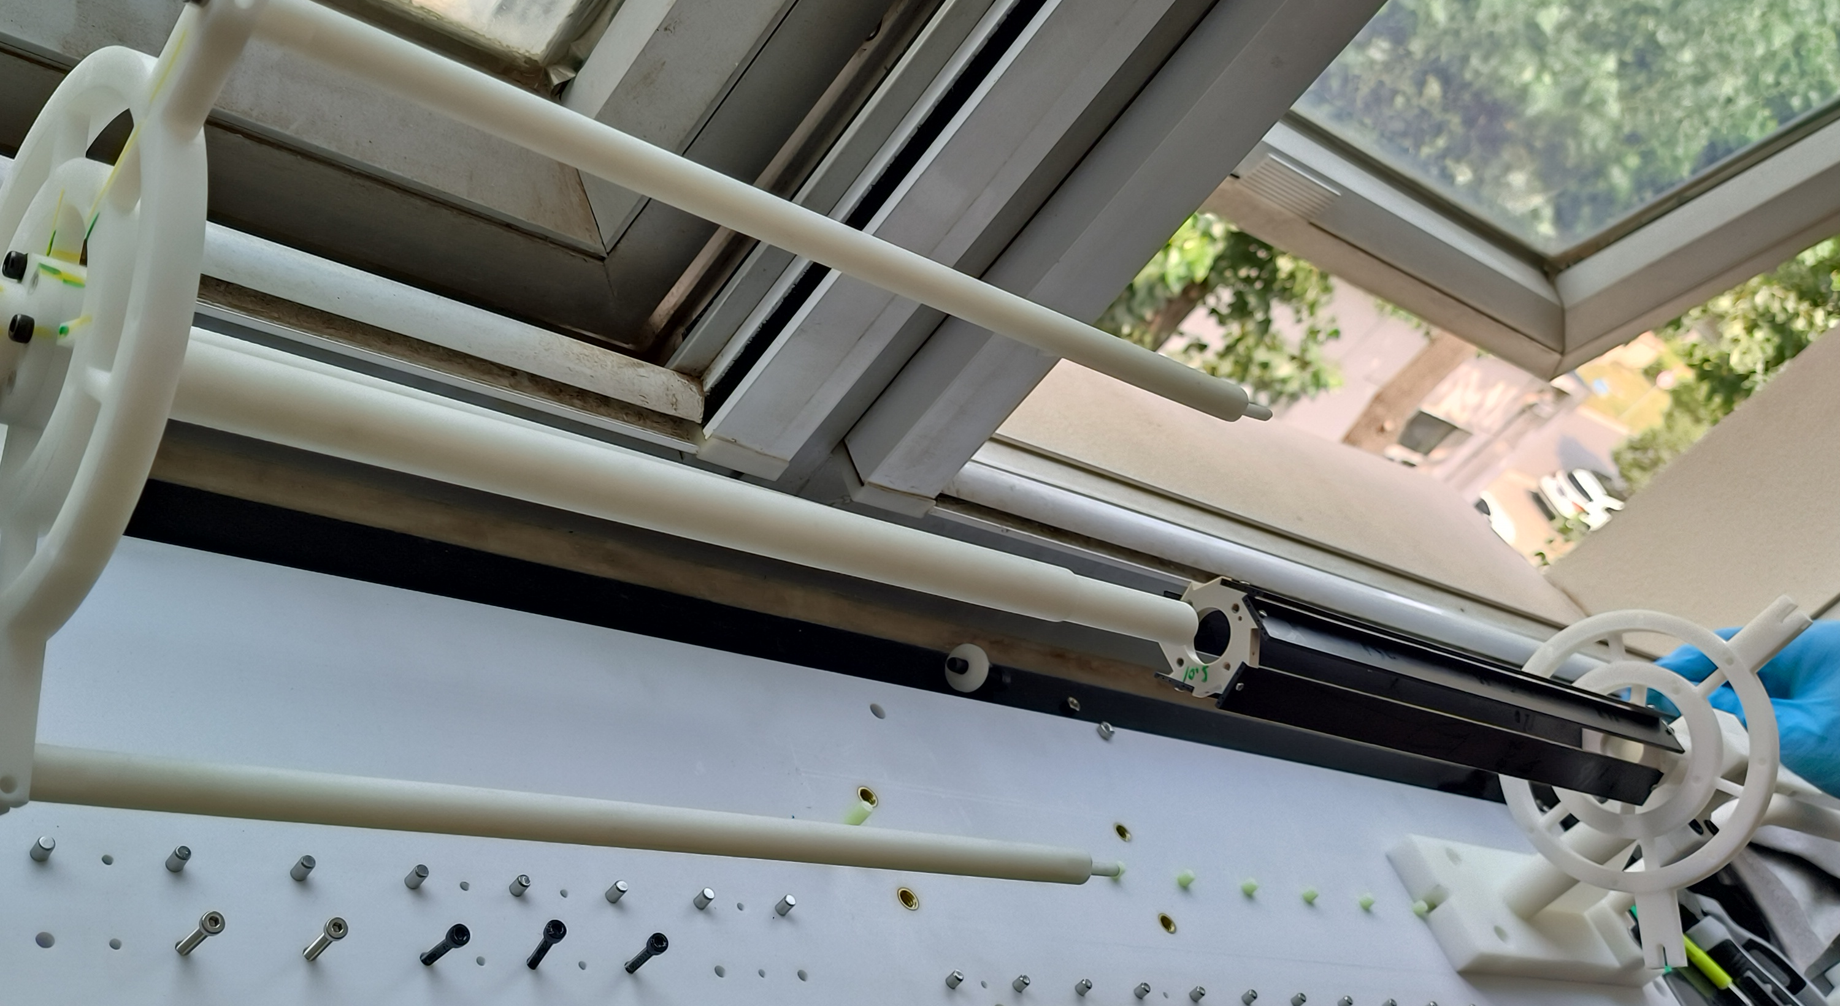
Vertex detector prototype assembly procedure
Ladder installation procedure designed
Mockup with 3D printing production done
Assembly with 3D mockup model
Production with aluminum machining started
Expected finished at middle of September

Slide 13
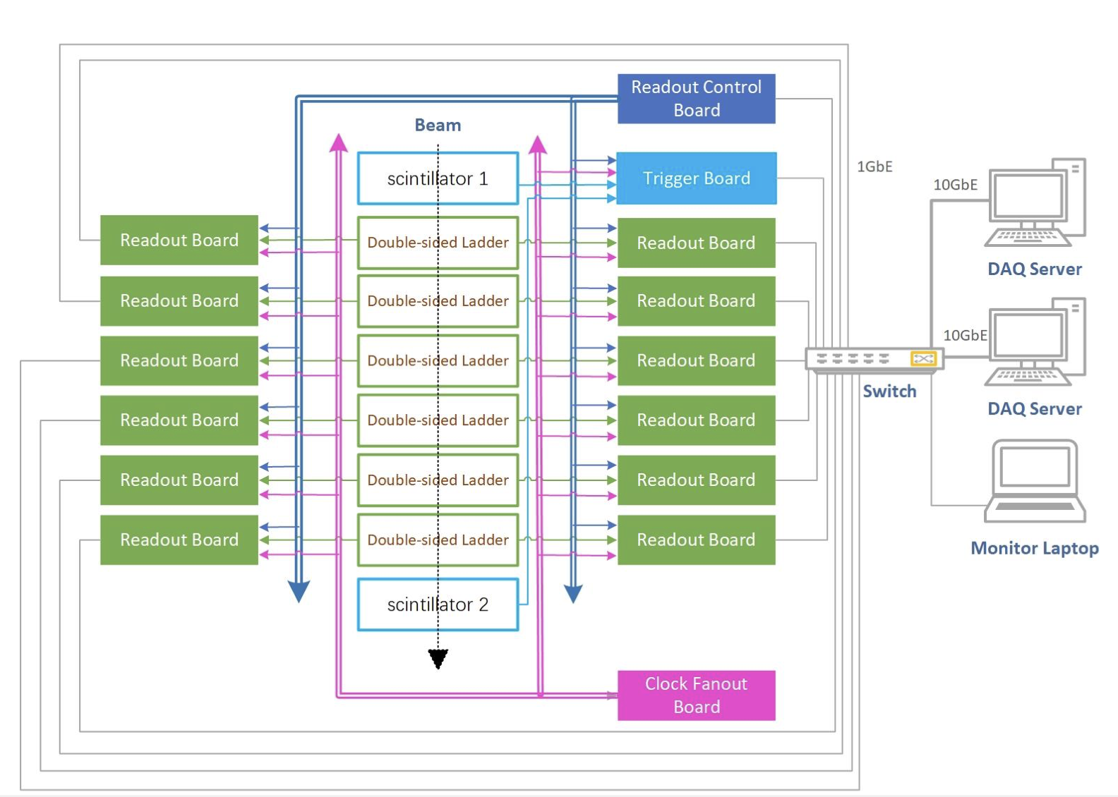
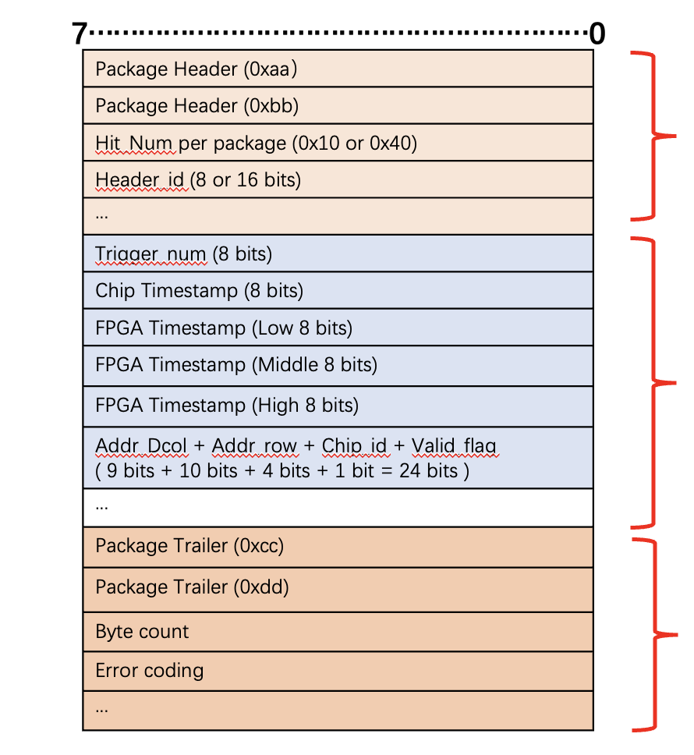
DAQ Architecture development
Try to config single chip test board and data handling with DAQ software (next step)
Purchase 3 DAQ PC for data taking (next step)
Parallel processing for each FPGA board
Hit maps on-line monitoring
DAQ
data structure

Slide 14
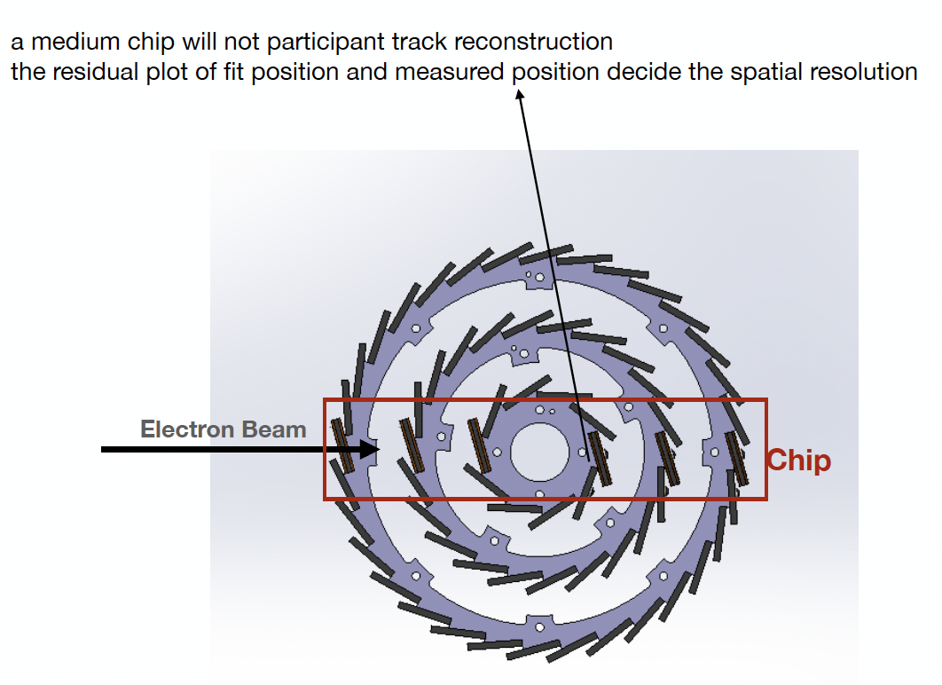
offline reconstruction
Dedicated discussion with Linhui Wu, Gang Li, Shuqi, Hao Zeng
Alignment strategy will be presented today

Slide 15
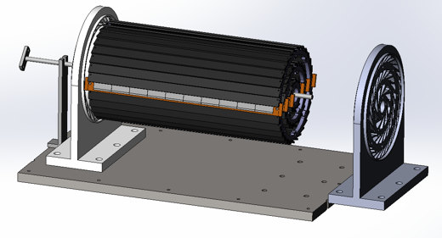
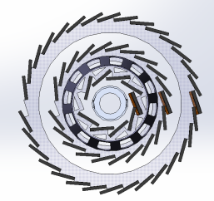
Plan for test beam
Expect to perform beam test in DESY(3 - 7GeV electron beams)
IHEP test beam facility as backup plan (1-2 GeV electrons )
Enclosure for detector with air cooling is developed for beam test
Beam is shooting at one sectors of vertex detectors
List of people
Request for Invitation letter
List of equipment
DESY test beam
Beam
Beam
Electron beam

Slide 16
Plan for test beam
Person power, expertise
Ming Qi (NJU, overall)
Joao (IHEP, overall)
Zhijun Liang (IHEP, overall)
Tianya Wu(IHEP, ASIC)
Xiaomin Wei(NWPU, ASIC )
Jia Zhou (IHEP ,DAQ)
Ziyue Yan (IHEP ,firmware)
Xinhui Huang (IHEP, mechanism)
Shuqi Li (IHEP, offline)
Requesting Invitation letters (almost ready)
Application Passports

Slide 17
Equipment for Test beam
Instrumentations
1. vertex detector prototype
2. FPGA boards (15 boards including JTAG adapter)
3. Test PC (2 personal computers. one for test one for backup)
3 PC for DAQ, electronics , offline ?
2T harddisk , 交换机switcher (24 channels, 8 channels …),
temp monitoring slow control (PC needed)
Power adaptors …, 4-5 DC power supply ?
4. Several DC power supply (borrow it from DESY?)
5. Several network cables and other cables.
6. Borrow one oscilloscope for debug

Slide 18
Timeline
ASIC
ASICs arrive to IHEP (June)
Dicing and Thinning (one wafer dicing before wafer-level tests) (June)
Single ASIC testing
PCB under production ( Done)
Wire-bonding on test PCB … (Done)
Laser tests, Functional Tests … (on-going)
Beta source test (on-going)
Irradiation test (Oct, two days )
Wafer level testing
Wafer level test of ASICs (on-going)
Dicing , (thinning ?)

Slide 19
Timeline
Ladders Mechanics:
Now: Carbon support samples available
Pre-production carbon support ladders available
September: Production of final carbon support ladders (if needed)
Ladders Assembly:
May: Flex cable available
May: Test of wire bonding and gluing on carbon support
Tooling design and production (June)
Dummy sensor (Glass) assembly on flex (JUNE)
Jig tool , Wire bonding tests on flex (done)
Assembly of ladders with chips (Sep )

Slide 20
Time line
Barrel Prototype:
June: Installation mock-up (3D printed)
Received large part of 3D models from Jinyu today, printing now
July: Barrel support parts fabricated
August: Assembly first Barrel with ladder support only
September: mounting readout ladders
October: finished mounting the ladders, and readout tests
Earlier November: Finish assembly of prototype
November: Cosmic ray testing or BEPC beam test
December: DESY test beam

Slide 21
Global Schedule
August: Assembly first Barrel with ladder support only
September: mounting readout ladders
October: finished mounting the ladders, and readout tests
Earlier November: Finish assembly of prototype
November: Cosmic ray testing or BEPC beam test
December 12-22: DESY test beam (test beam time slot reserved for two weeks)

Slide 23
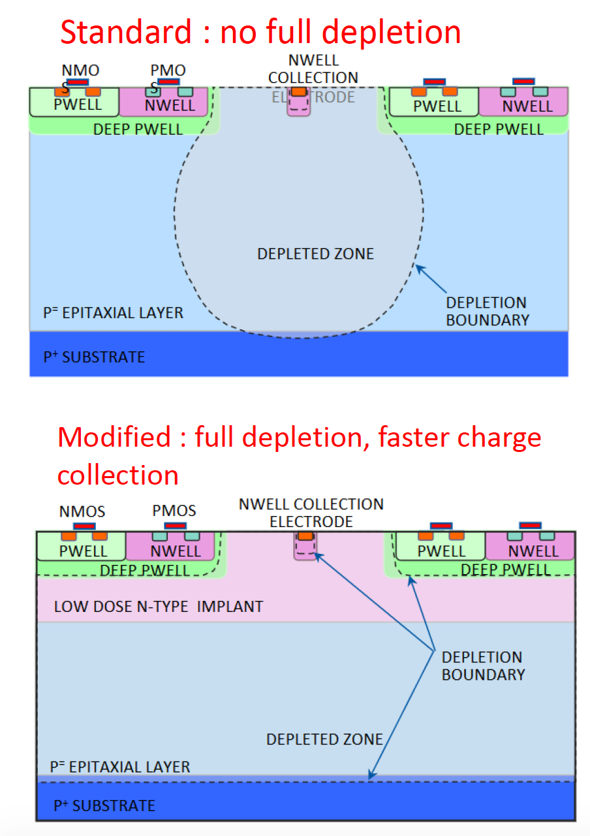
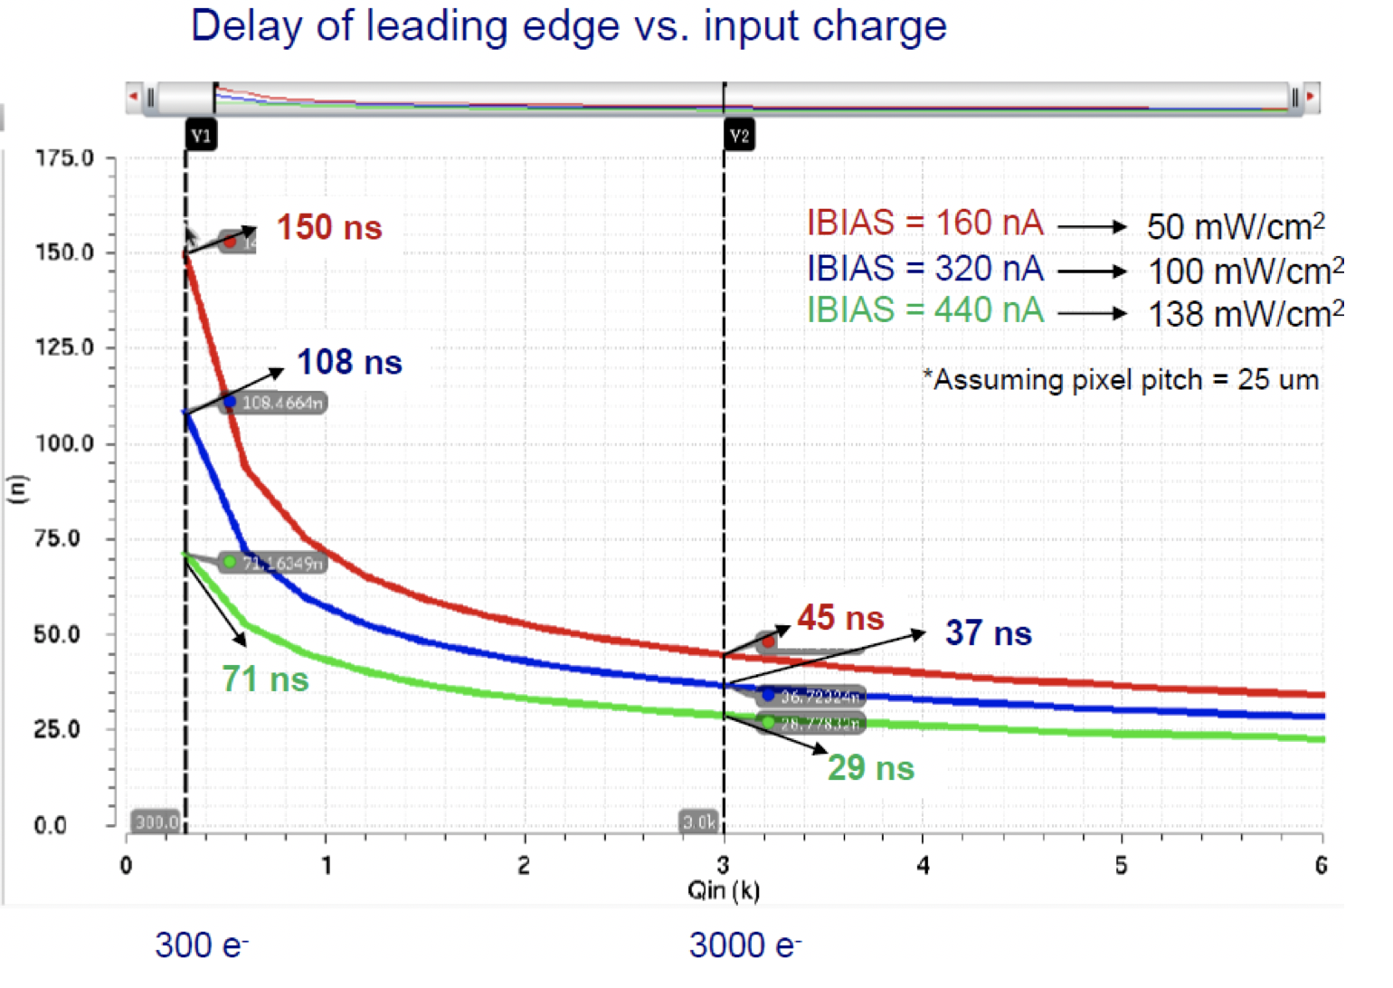
Pixel Analog design
CEPC time stamping precision requirement:
25-100ns, better to time stamping each collision at Z pole
Taichu-1 pixel analog design:
50ns~150ns (based one standard CMOS MAPS tech.)
Consider to use depleted CMOS MAPS

Slide 24
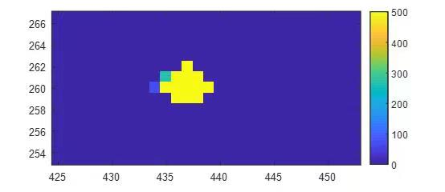
News about Taichupix3 testing
First Laser tests
Single chip test news
Charge injection done
S curve scan in next step
Need to mask off noise pixel
Laser tests
Source tests (next step)
Threshold tuning
IR drop tests? (next step)
Top pad need ? → dicing
Irradiation tests
BSRF beam time in Oct 2022
X ray machine ?

