Slide 1
CEPC Vertex Detector R&D DAQ Progress
Hongyu Zhang, Jia Zhou
2022.09.01

Slide 2
Current progress
The electronic board has been obtained for data retrieval.
Only one board
Write a simple software for data retrieval test.
The configuration process is being supplemented and improved
Data has been successfully obtained from electronics

Slide 3
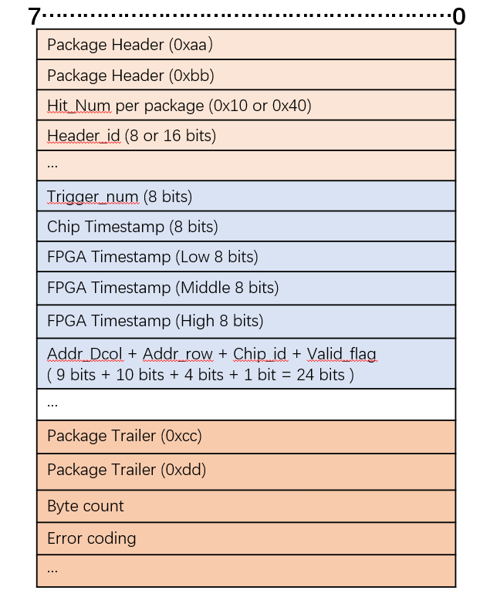
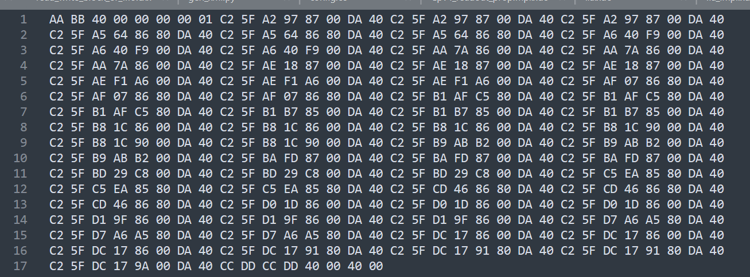
Data Format
（722，257）
(722,1)
One packet
Each effective data is repeated three times

Slide 4
Problem
Duplicate data
Large amount of data （GB）
Continuous data flow

Slide 5
Equipment
mobile workstation *2 (linux)
— Survey completed
PC *1 (windows)
switch
several mobile hard disks (data backup)
USB drive (program backup)

Slide 6
THANKS

