Slide 1
IHEP GPU Status
Jingyan Shi
IHEP-CC

Slide 2
Application Supported
Slurm GPU cluster at IHEP support:
LQCD
BES GPU PWA
JUNO GPU
HIGGS GPU
HEPS Design
Machine Learning
Other

Slide 3
GPU Resource
3 main GPU resource partitions
Partitions | Group | Nodes | GPU card | CPU core | Share/dedicated
Lgpu | Lqcd | 1 | 8 | 36 | Dedicated
Gpu | Lqcd, gpupwa,junogpu,mlgpu, higgsgpu,bldesign etc. | 24 | 183 | 892 | share
Other | Pqcd,neuph etc. | 4 | 18 | 119 | Dedicated (will be changed)

Slide 4
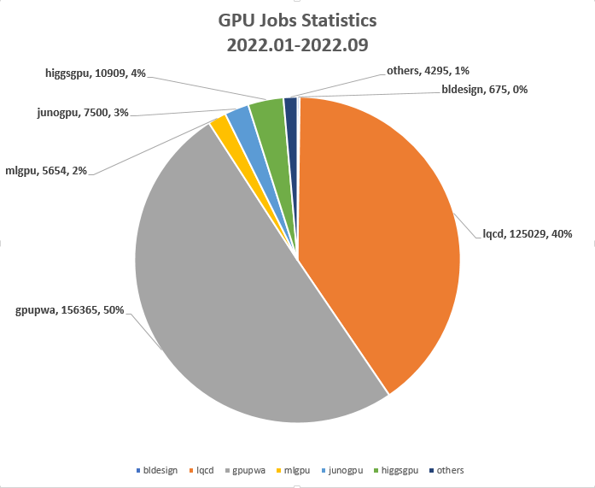
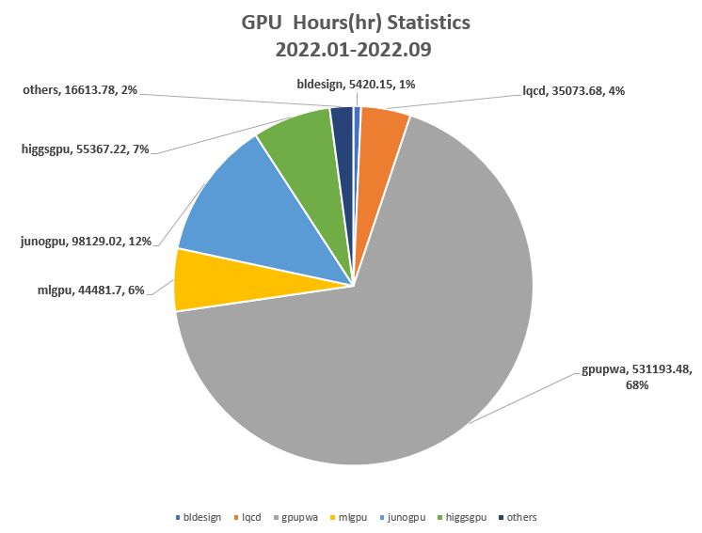
Job Statistics
2022.01.01- 2022.09.07

Slide 5
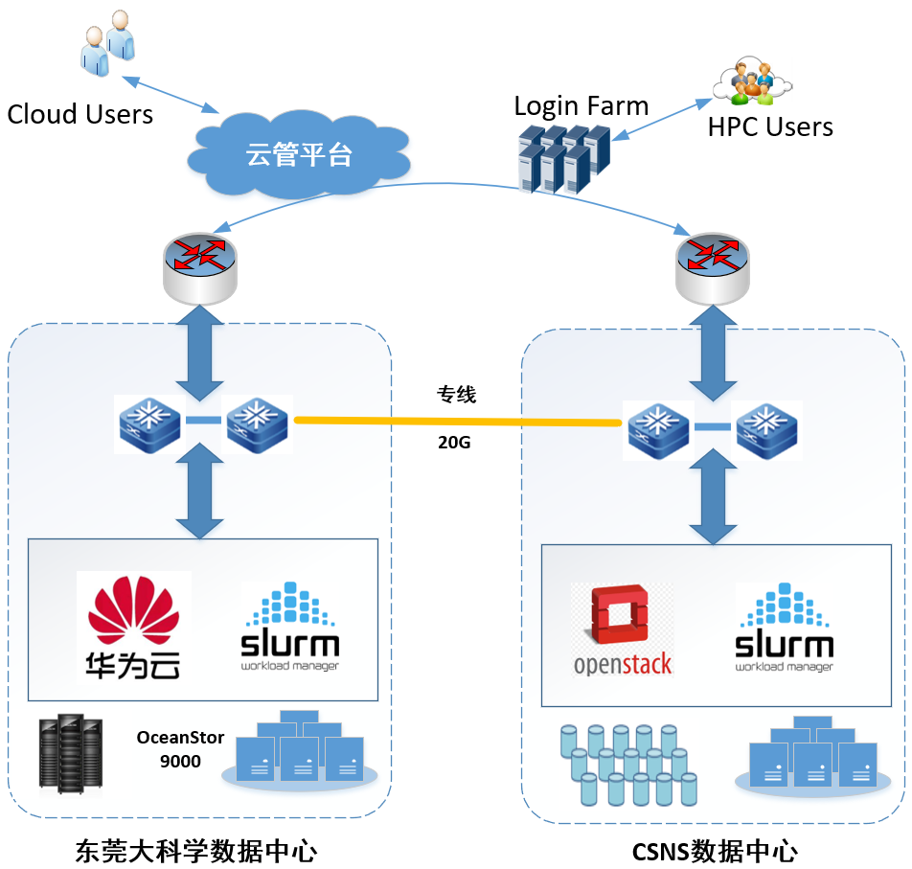
Dongguan Big Science Data Center
Invested by Dongguan
20Gbps dedicated network connection to CSNS
10Gbps dedicated network connection from CSNS to IHEP
Hetergeneous architecture(x86+ARM+GPU)
30000 cpu cores
6PB storage（OceanStor 9000）
Support
Material science simulation
VASP、LAMMPS、GroMacs、QUANTUMESPRESSO
Neutron and HEP Science simulation
Geant4、Fluka、LQCD
CSNS exp. Data storage
云计算：4600核
X86-HPC：15000核 ARM-HPC：9600核
GPU：80 Tesla V100
存储：6PB
云计算：840核
X86-HPC：5000核 GPU：10 Tesla P100
存储：1PB

Slide 6
Our Plan
Basic idea
Provide limit GPU resources for all IHEP exp.
Code and Debug,
Shared short queue
Big GPU requirement
Need to be discussed case by case
Run at Dongguan? gpu cards from current application?
Discussion

