Slide 1


Introduction of Dark SHINE experiment
SYSU-PKU Collider Physics forum For Young Scientists
Jing Chen
2022.10.12

Slide 2
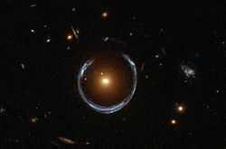
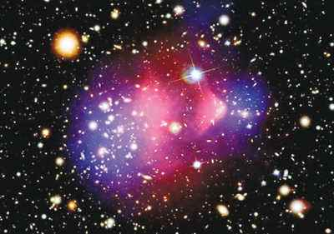
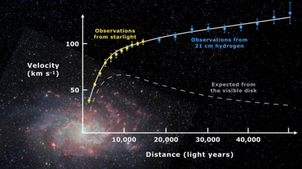
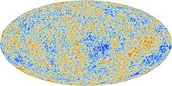
Evidence of dark matter
Gravitational Lensing
The Bullet Cluster
Rotation Curve
Cosmic Microwave Background

Slide 3
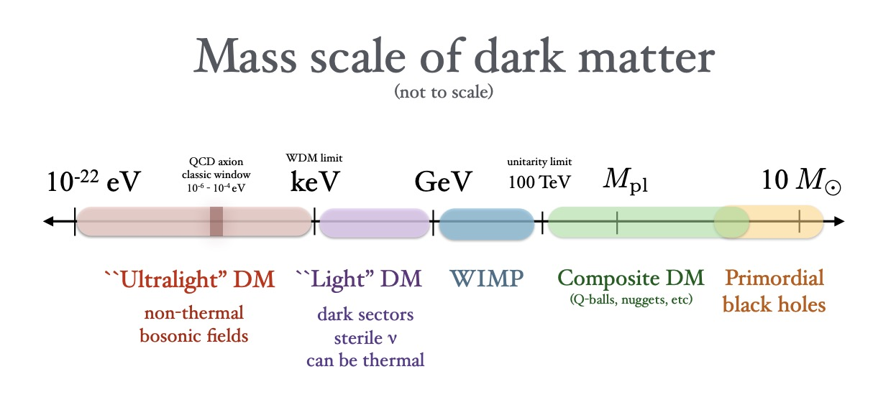
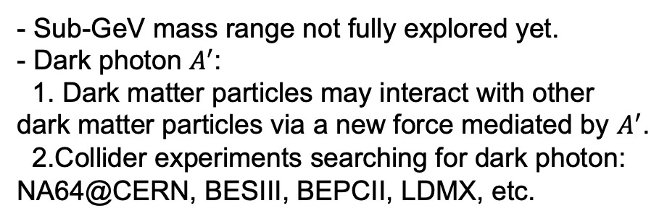
Dark matter candidates
Dark matter is the mysterious substance that makes up roughly a quarter of the Universe.
arXiv:1904.07915
Dark Matter can exist in wide mass range, from Ultralight DM to Primordial Black Holes.
Searching for light DM:
experimental search:
- Sub-GeV mass range not fully explored yet.
- Dark photon $A^{′}$:
1. Dark matter particles may interact with other dark matter particles via a new force mediated by $A^{′}$.
2.Collider experiments searching for dark photon: NA64@CERN, BESIII, BEPCII, LDMX, etc.
- Space experiments:
DAMPE, AMS etc.
- Collider experiments:
LHC, BELLE-II , BESIII etc.
- Underground experiments:
CDEX，PandaX, LUX, Xenon etc.

Slide 4
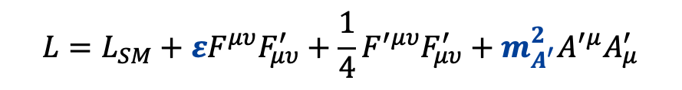

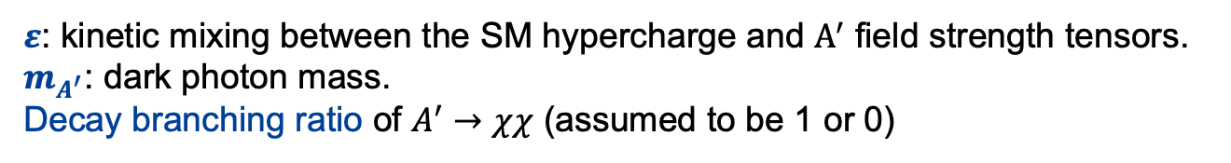
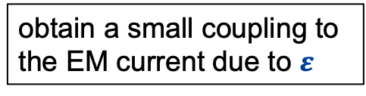
Search for dark photon
Dark photon is an important portal between the standard model (SM) particles and the dark matter.
obtain a small coupling to the EM current due to $ε$
not couple directly to SM particles
SM
$$A^{′}$$
DM
$$L=L_{SM}+εF^{μυ}F_{μυ}^{′}+\frac{1}{4}F^{′μυ}F_{μυ}^{′}+m_{A^{′}}^{2}A^{′μ}A_{μ}^{′}$$
Kinetic mixing term
Field strength tensor
Dark photon field
The minimal dark-photon model with 3 unknown parameters:
$ε$: kinetic mixing between the SM hypercharge and $A^{′}$ field strength tensors.
$m_{A^{′}}$: dark photon mass.
Decay branching ratio of $A^{′}→χχ$ (assumed to be 1 or 0)
arXiv:2104.10280

Slide 5


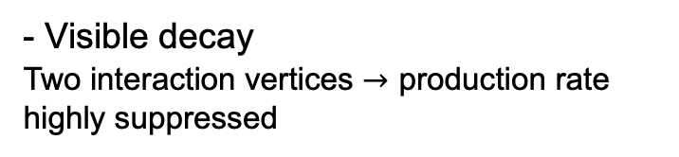


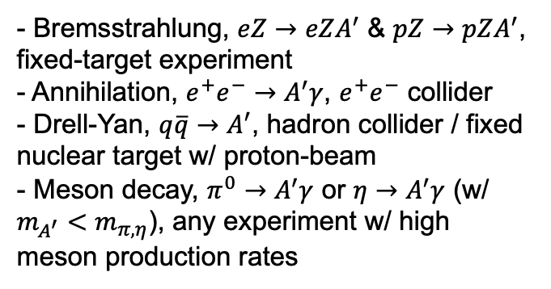
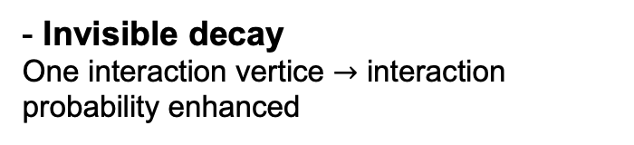




Search for dark photon
$A^{′}$ production:
$A^{′}$ decay:
$$ε$$
$$ε$$
$$ε$$
$$ε$$
$$\sqrt{α_{D}}=g_{χ}$$
$$ε$$
- Bremsstrahlung, $eZ→eZA^{′}$ & $pZ→pZA^{′}$, fixed-target experiment
- Annihilation, $e^{+}e^{−}→A^{′}γ$, $e^{+}e^{−}$ collider
- Drell-Yan, $q\overline{q}→A^{′}$, hadron collider / fixed nuclear target w/ proton-beam
- Meson decay, $π^{0}→A^{′}γ$ or $η→A^{′}γ$ (w/ $m_{A^{′}}<m_{π,η}$), any experiment w/ high meson production rates
- Visible decay
Two interaction vertices $→$ production rate highly suppressed
- Invisible decay
One interaction vertice $→$ interaction probability enhanced
Better sensitivity!

Slide 6
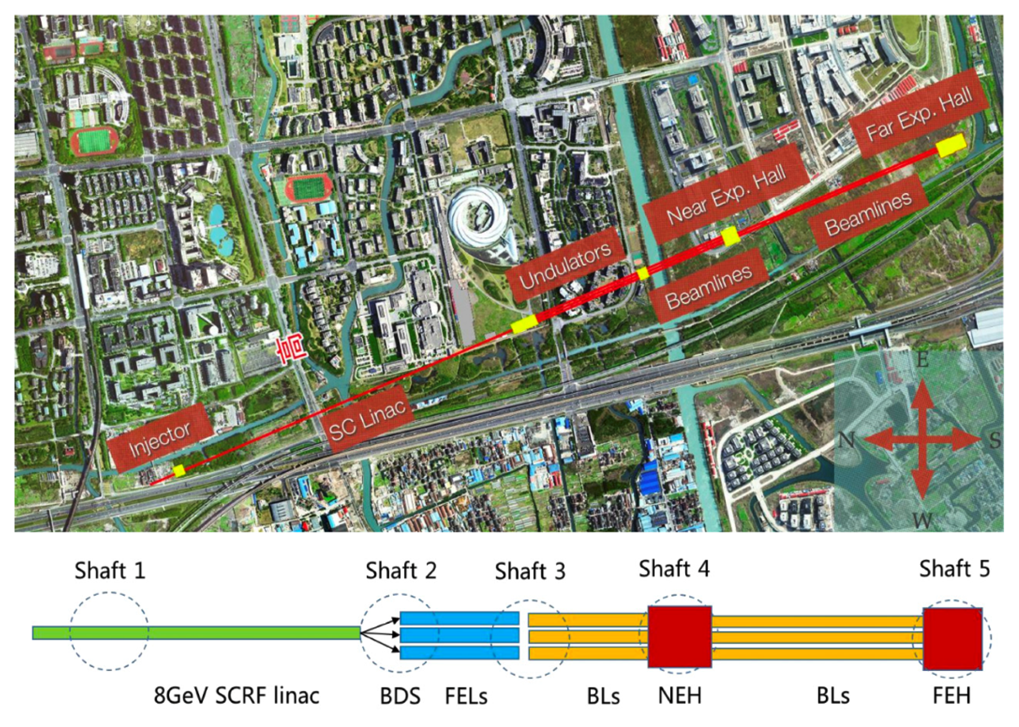
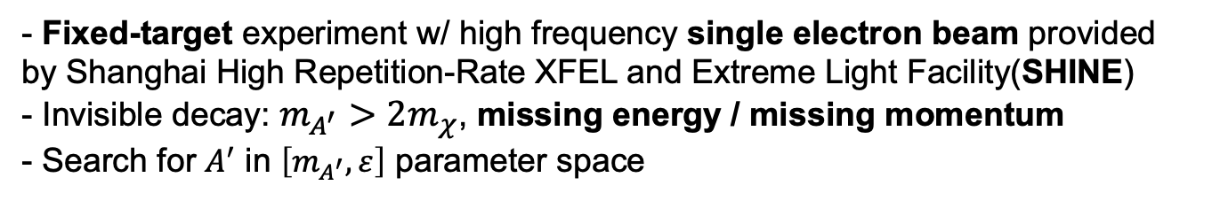
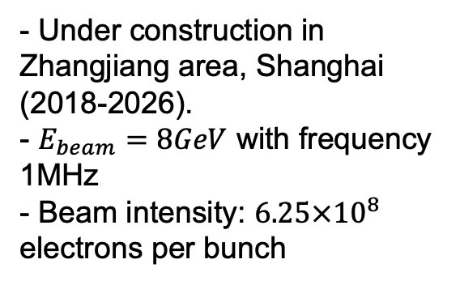
The SHINE facility
Dark SHINE:
- Fixed-target experiment w/ high frequency single electron beam provided by Shanghai High Repetition-Rate XFEL and Extreme Light Facility(SHINE)
- Invisible decay: $m_{A^{′}}>2m_{χ}$, missing energy / missing momentum
- Search for $A^{′}$ in $\left[m_{A^{′}},ε\right]$ parameter space
The SHINE:
- Under construction in Zhangjiang area, Shanghai (2018-2026).
- $E_{beam}=8GeV$ with frequency 1MHz
- Beam intensity: $6.25×{10}^{8}$ electrons per bunch
Science Bulletin 61, 117(2016), 720-727

Slide 7
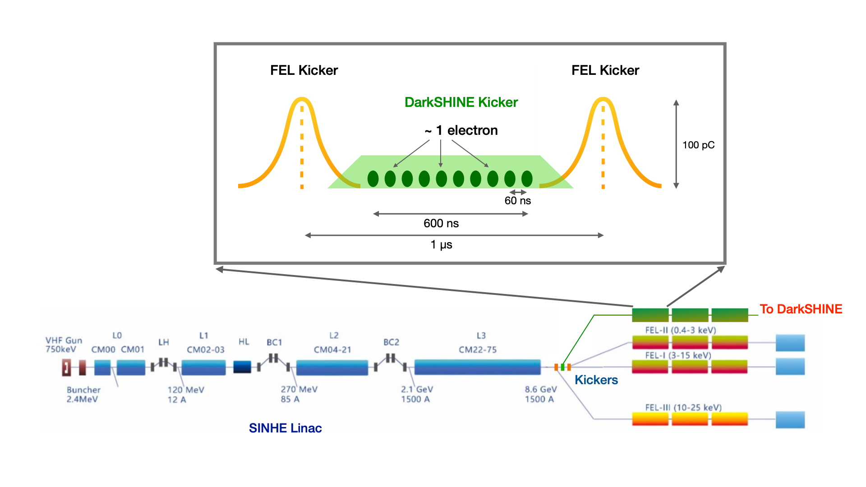
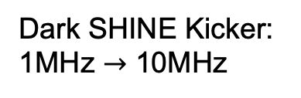
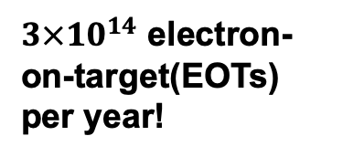

The SHINE facility
Single electron beam is needed for Dark SHINE.
Dark SHINE Kicker: 1MHz $→$ 10MHz
$3×{10}^{14}$ electron-on-target(EOTs) per year!
FEL kicker
Dark SHINE Kicker
1300 buckets provided by 1.3GHz microwave
100pC in one bucket
electron beam w/ one electron per bunch
$6.25×{10}^{8}$ electrons per bunch

Slide 8
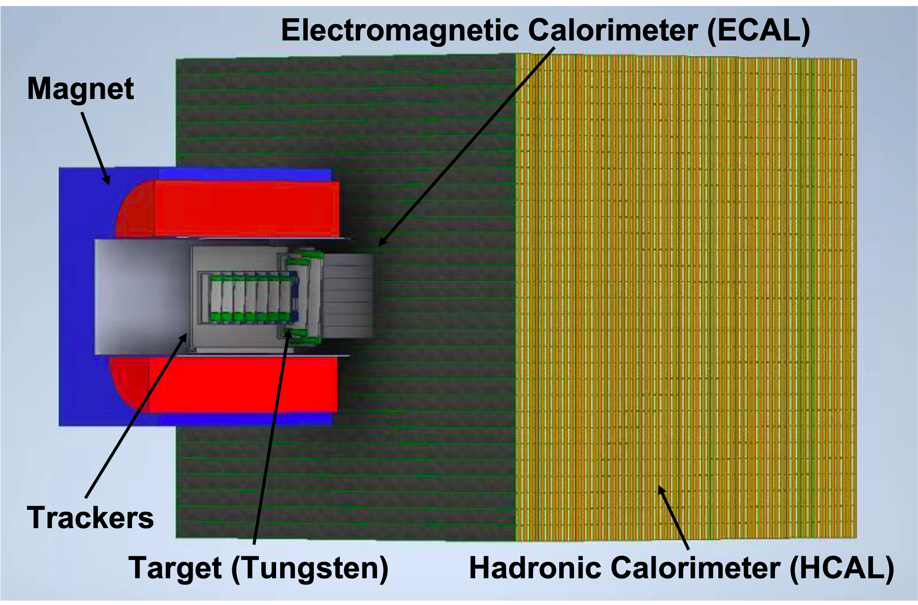
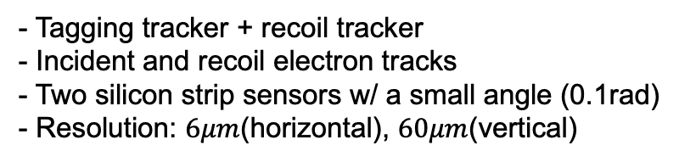
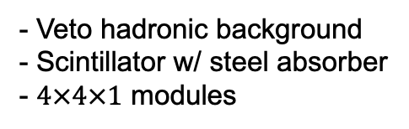


Dark SHINE detector
ECAL:
- Electron & photon
- Scintillator: LYSO(Ce)
high light yield, fast decay time, low electronic noise
- $20×20×11$ crystals
$$2.5×2.5×4{cm}^{3}$$
- Energy resolution of LYSO: 10%
HCAL:
- Veto hadronic background
- Scintillator w/ steel absorber
- $4×4×1$ modules
Tracker:
- Tagging tracker + recoil tracker
- Incident and recoil electron tracks
- Two silicon strip sensors w/ a small angle (0.1rad)
- Resolution: $6μm$(horizontal), $60μm$(vertical)
Magnet:
- 1.5T magnetic field

Slide 9
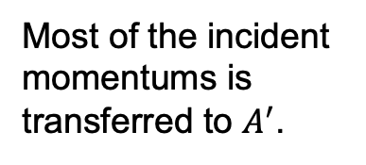
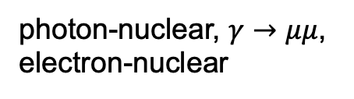
Signal & background
Signal signature:
Signal
Background
Most of the incident momentums is transferred to $A^{′}$.
Major background processes:
Veto handles
Leading background:
photon bremsstrahlung
Rare processes:
photon-nuclear, $γ→μμ$, electron-nuclear
one track
missing momentum
ECAL energy
HCAL energy

Slide 10
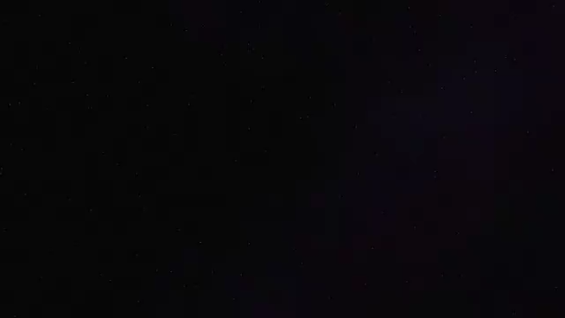
Event display

Slide 11
Simulation
Signal
Background
- Low momentum of recoil electron
- Recoil electron carry most of the incident momentum
- Recoil electron angle has on average value
- Recoil electron angle small

Slide 12
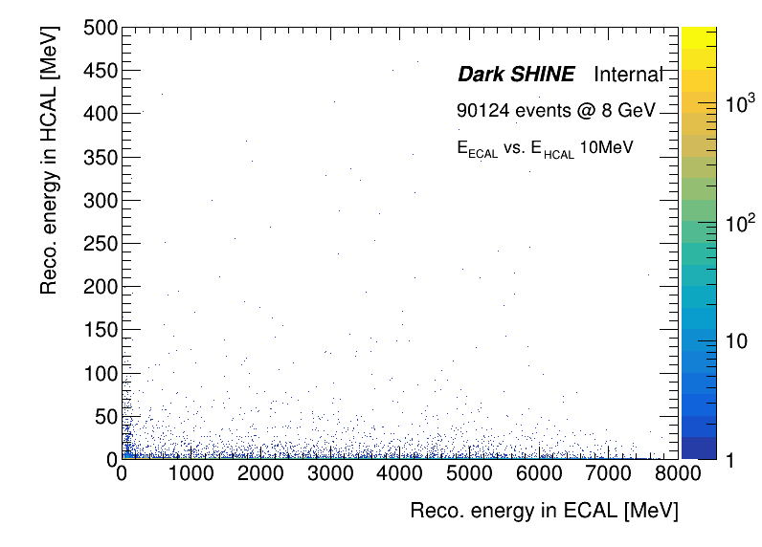
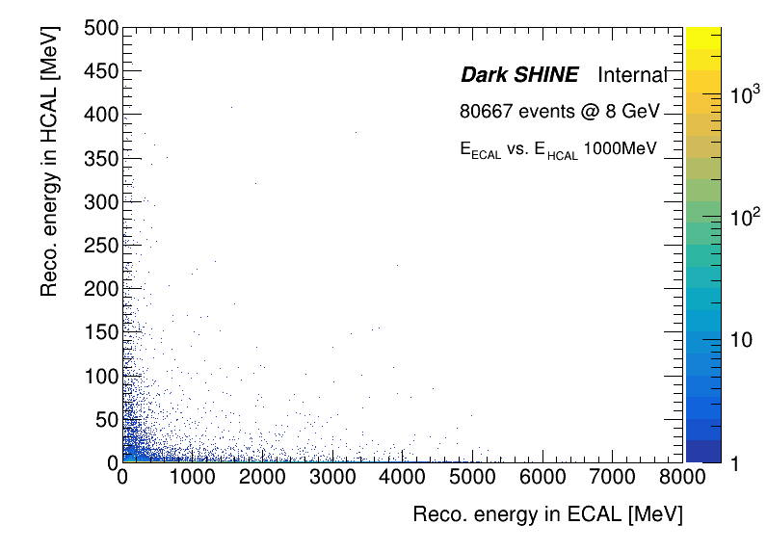


ECAL energy vs. HCAL energy
Signal: $m_{A^{′}}=10MeV$
SR
SR
Inclusive bkg.
Signal: $m_{A^{′}}=1GeV$
SR
SR

Slide 13
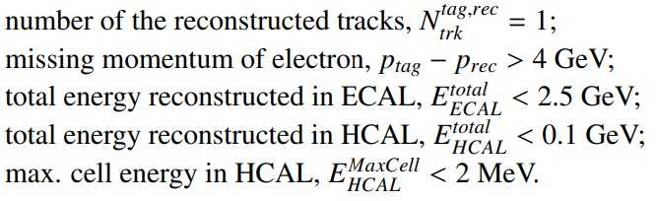
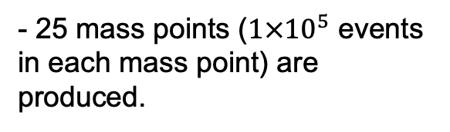
Signal region
Signal region definition:
- 25 mass points ($1×{10}^{5}$ events in each mass point) are produced.
- Around 60% signal events survive the cut-flow.
Signal efficiency:
- Efficiency drops in:
Low-mass region of a few MeV: tight energy cuts.
High-mass region above 1 GeV: particles with large incident/recoil angle go into the HCAL directly.

Slide 14
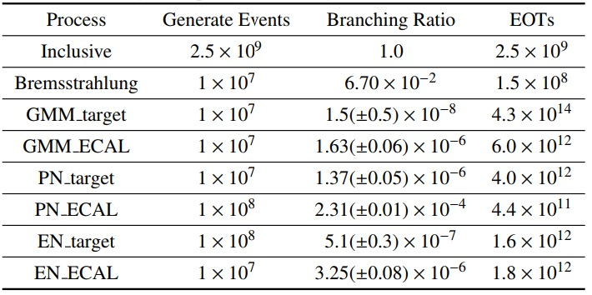
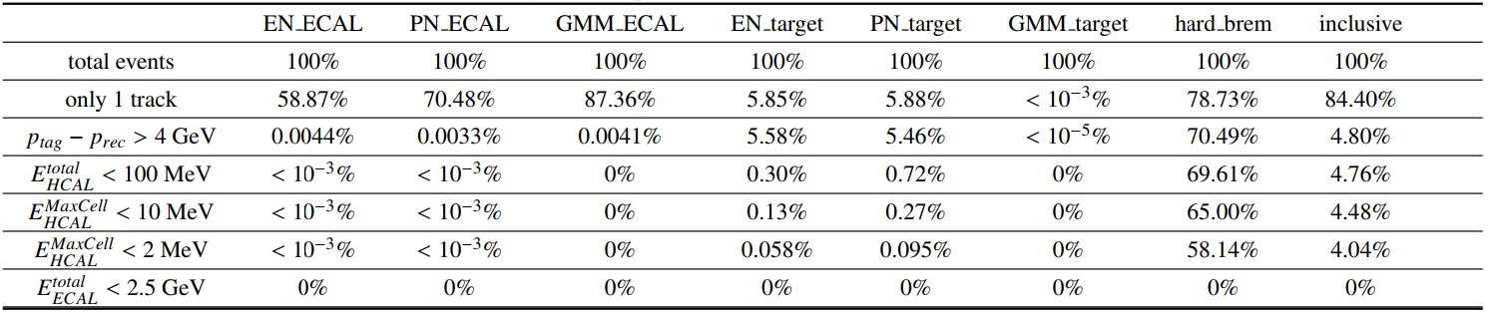
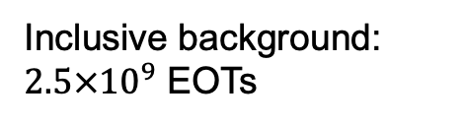

Background estimation
Background samples:
Inclusive background: $2.5×{10}^{9}$ EOTs
$>3×{10}^{14}$EOTs
Lack of statistics!
Extrapolate from fit results
Cut-flow:
No background events left after SR selection.

Slide 15
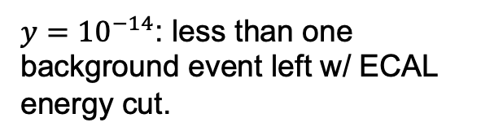


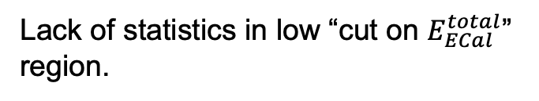
Background estimation
Fit the fraction of events below energy cutoff as a function of cut values on ECAL energy.
Extrapolate from inclusive background simulation.
Validation from inclusive background simulation.
Extrapolate from rare processes simulation.
${y=10}^{−14}$: less than one background event left w/ ECAL energy cut.
Extrapolate from the fit results.
Lack of statistics in low “cut on $E_{ECal}^{total}$” region.
Event yield (${3×10}^{14}$EOTs):
$$2.53×{10}^{−3}$$
2.5GeV

Slide 16
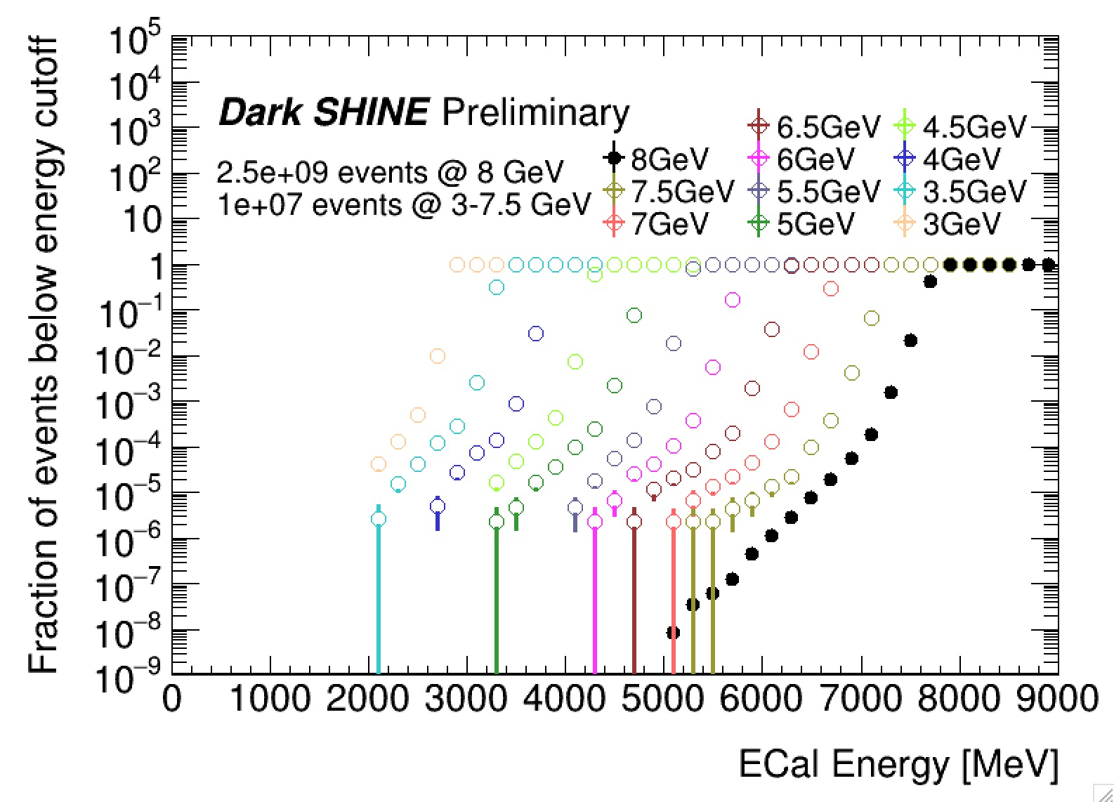

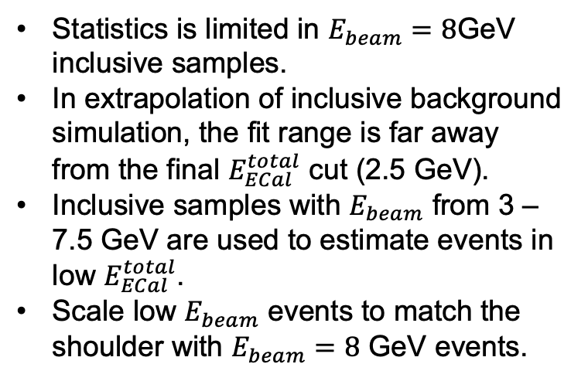
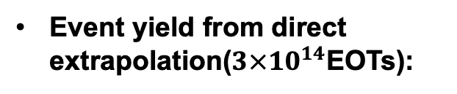
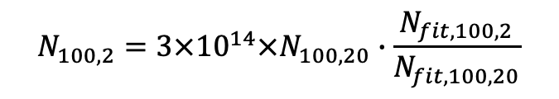
Background estimation
Validation from inclusive background simulation.
Statistics is limited in $E_{beam}=8$GeV inclusive samples.
In extrapolation of inclusive background simulation, the fit range is far away from the final $E_{ECal}^{total}$ cut (2.5 GeV).
Inclusive samples with $E_{beam}$ from 3 – 7.5 GeV are used to estimate events in low $E_{ECal}^{total}$.
Scale low $E_{beam}$ events to match the shoulder with $E_{beam}=8$ GeV events.
Event yield from direct extrapolation(${3×10}^{14}$EOTs):
$$N_{100,2}={{3×10}^{14}×N}_{100,20}∙\frac{N_{fit,100,2}}{N_{fit,100,20}}$$
$$=9.23×{10}^{−3}$$

Slide 17
Background estimation
Extrapolate from rare processes simulation.
Rare processes background samples are produced with larger statistics.
Fit the fraction of events below energy cutoff in other rare processes (EN_ECAL, EN_target, PN_ECAL, PN_target).
2.5GeV
rare processes scaled according to the corresponding branching ratio.

Slide 18
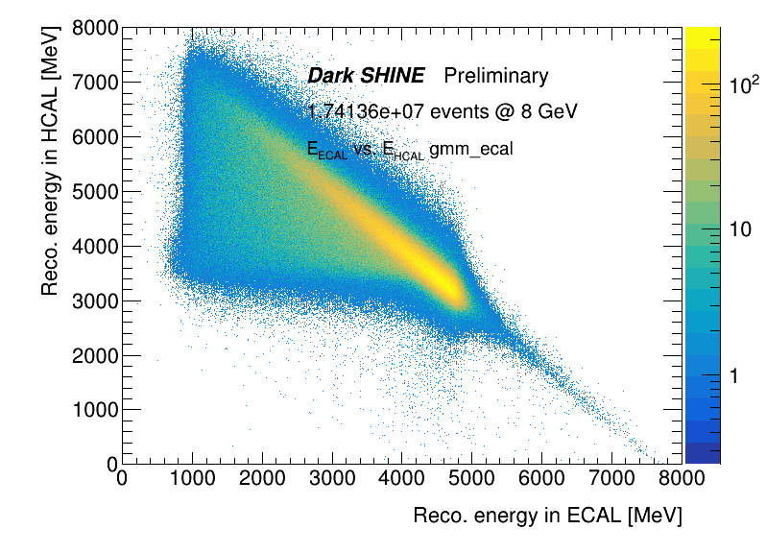
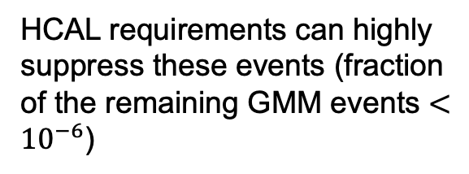


Background estimation
Extrapolate from rare processes simulation.
Estimate the number of background events corresponds to $3×{10}^{14}$ EOTs.
Don’t need to further extrapolation on:
GMM_target
$4.3×{10}^{14}$EOTs $>3×{10}^{14}$EOTs
GMM_ECAL:
$6.0×{10}^{12}$EOTs
Energy carried by the muon pair
HCAL requirements can highly suppress these events (fraction of the remaining GMM events $<{10}^{−6}$)

Slide 19



Background estimation
Extrapolation from rare processes simulation
${3×10}^{14}$EOTs
0.0016
0.013
Bkg. Events:
0.015
Most conservative number
$$5.93×{10}^{−5}$$
$$2.53×{10}^{−7}$$

Slide 20
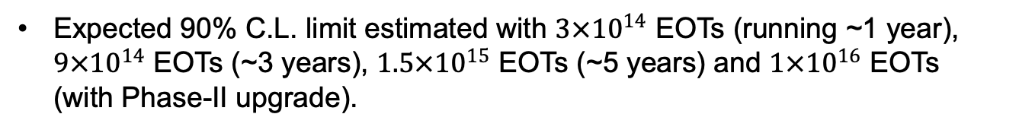
Sensitivity study
Expected 90% C.L. limit estimated with $3×{10}^{14}$ EOTs (running ~1 year), $9×{10}^{14}$ EOTs (~3 years), $1.5×{10}^{15}$ EOTs (~5 years) and $1×{10}^{16}$ EOTs (with Phase-II upgrade).
Comparing with other experiments, Dark SHINE can provide competitive sensitivity.

Slide 21
Summary
Dark SHINE: a fixed-target experiment to search for light dark matter.
Detector R&D ongoing.
First round of preliminary study has been finished:
- Good signal efficiency, background well suppressed (~0.015 bkg. event expected for 1 year operation).
- Expecting competitive sensitivity.
- Accepted by Science China.
The project is officially sponsored by NSFC Original Exploration Project 2021 and Shanghai pilot program for basic research.

Slide 22
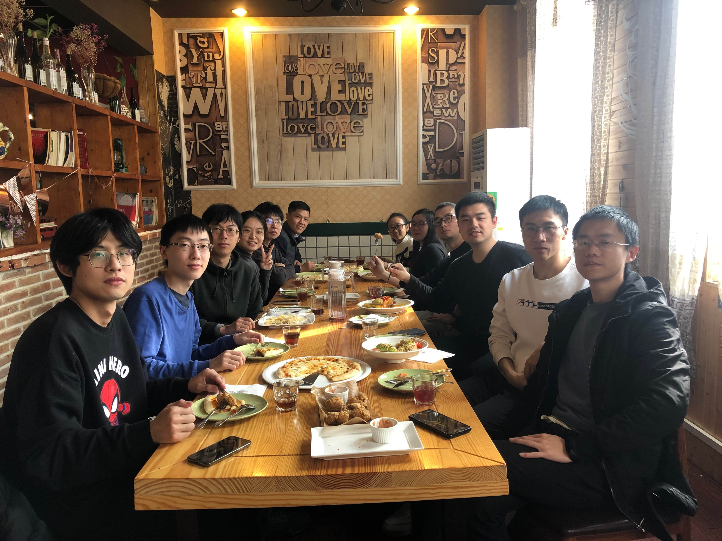

Slide 23
Backup

Slide 24
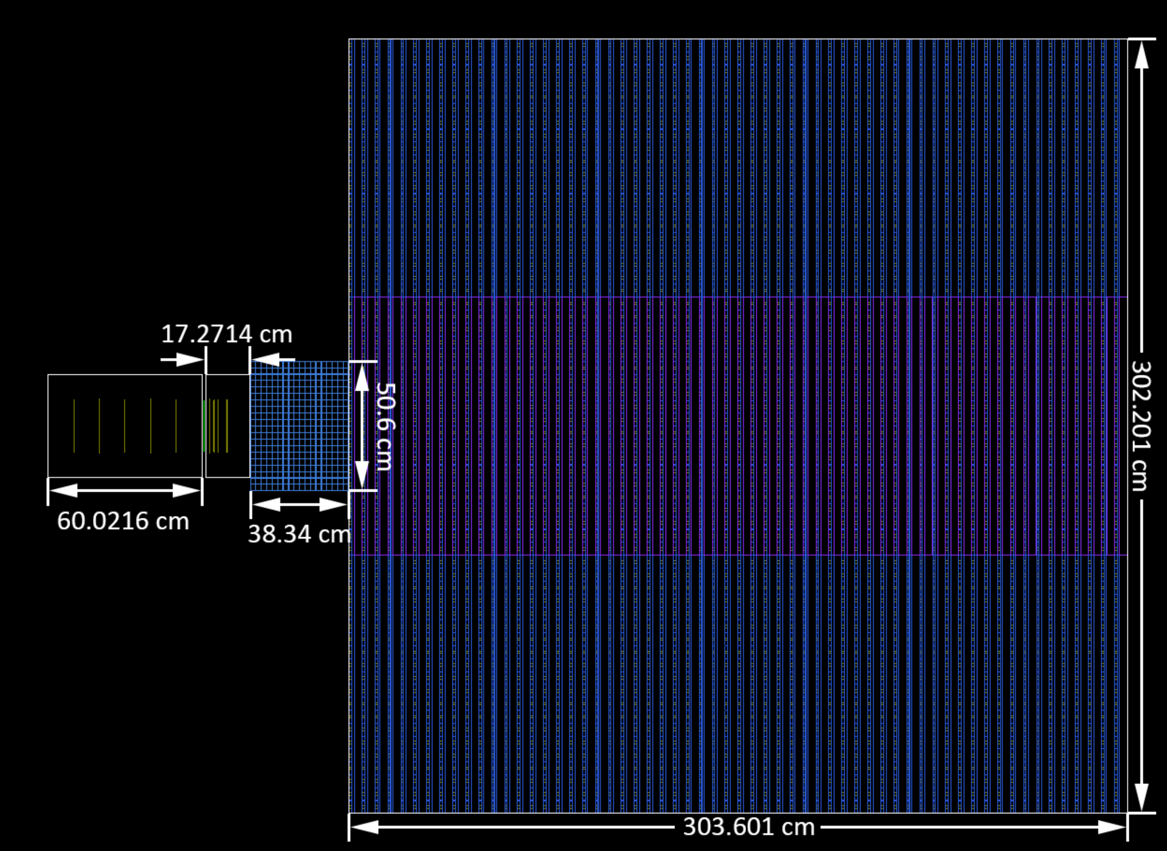
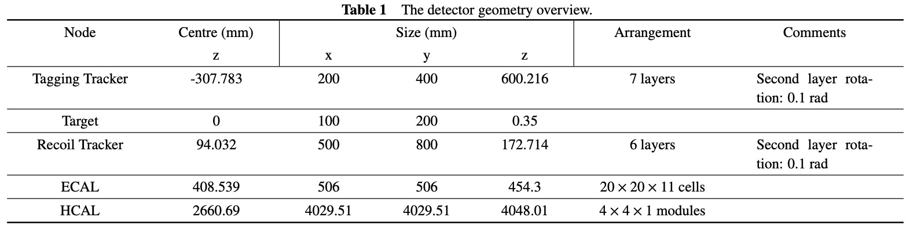
Dark SHINE detector

Slide 25
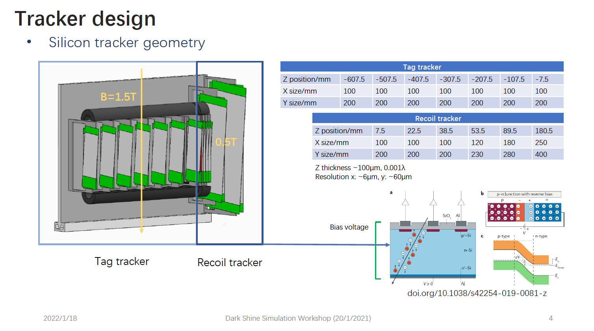
Tracker design

Slide 26
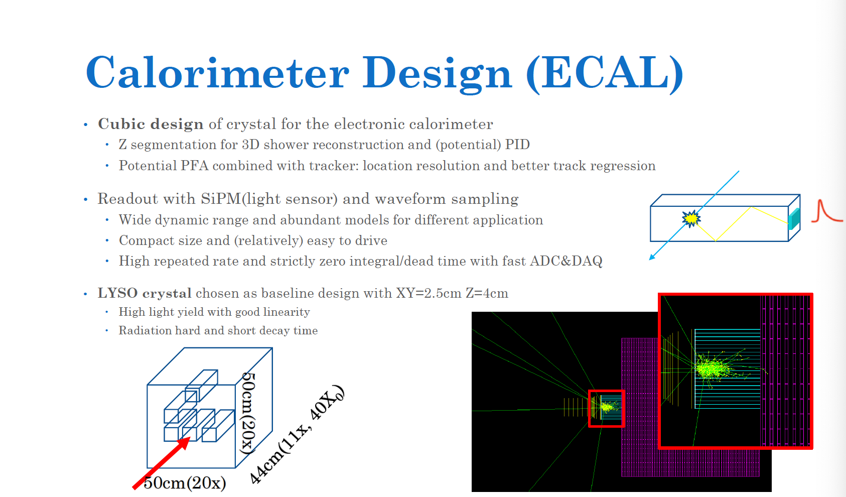
ECAL design

Slide 27
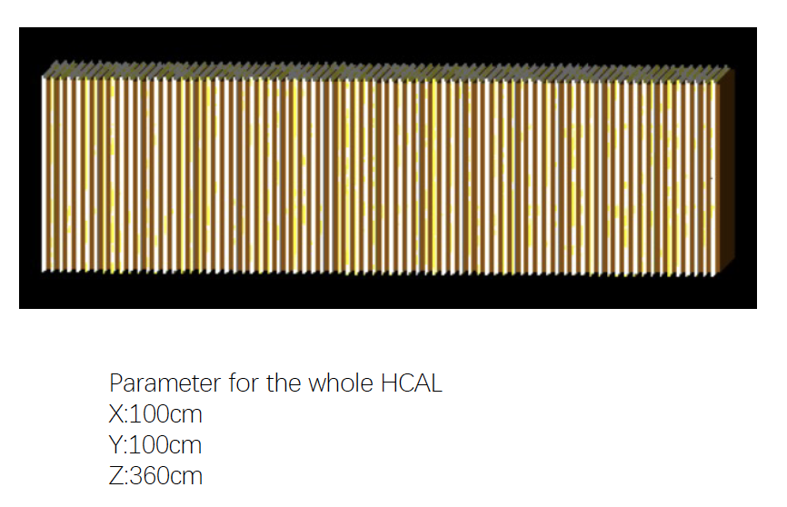
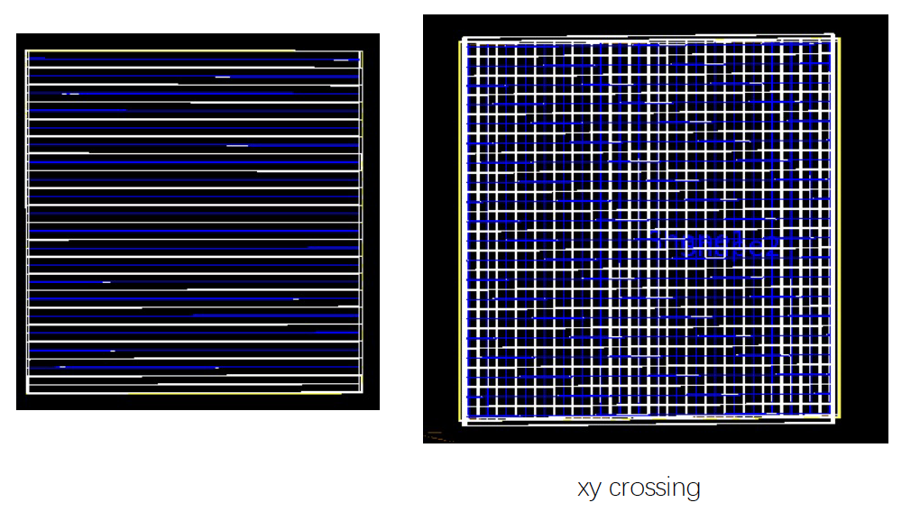
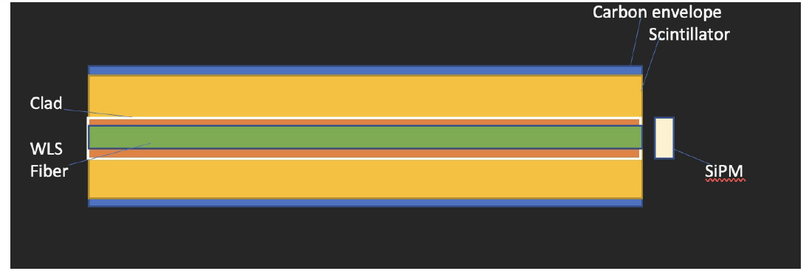
HCAL design

Slide 28
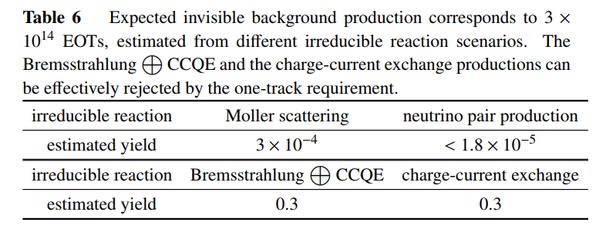
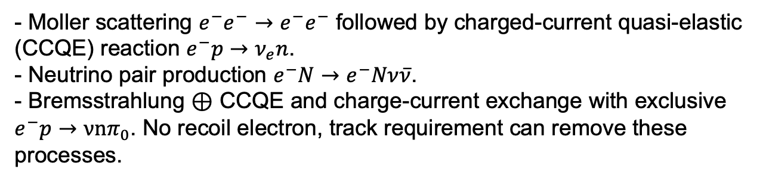
Invisible background
Neutrino productions:
- Moller scattering $e^{−}e^{−}→e^{−}e^{−}$ followed by charged-current quasi-elastic
(CCQE) reaction $e^{−}p→ν_{e}n$.
- Neutrino pair production $e^{−}N→e^{−}Nν\overline{ν}$.
- Bremsstrahlung $⊕$ CCQE and charge-current exchange with exclusive $e^{−}p→νnπ_{0}$. No recoil electron, track requirement can remove these processes.

Slide 29

Inclusive cross-section
Inclusive cross-section of dark photon bremsstrahlung from electron interacting with W target, assuming $ε=1$.

Slide 30

Dark photon search experimental results
arXiv: 1707.04591
NA64, PRL123, 121801 (2019)

Slide 31
Plan
2022: Finish 1st simulation studies of Dark SHINE detector system, publish the work at SCI journal publication, establish Dark SHINE collaboration formally with SHINE facility to start also the R&D work on the beamline.
2023: R&D of the ECAL/HCAL calorimeter systems, Silicon Tracker system, magnet and mechanical supporting layout, publish 1-2 technical papers on the sub systems, determine 1st conceptual design of Dark SHINE beamline.
2024: In-lab technical Demonstration of detector prototypes, wrap-up the overall conceptual design report of Dark SHINE detector system and the preliminary beamline conceptual design report.
2025: Finish up the sub-detector prototyping and carry on to cosmic tests and beam tests.
2026: start the construction of the Dark SHINE beamline and detector systems.
2028: first commissioning of the overal Dark SHINE experiment at the accomplished SHINE facility and dedicated Dark SHINE specific beamline.

Slide 32

Plan
https://indico-tdli.sjtu.edu.cn/event/412/contributions/1720/attachments/1030/1662/DarkSHINE_TDLISummerSchool_2021.pdf

