Slide 1
Configuration time
Problem :
The former program would take a long time up to 30 minutes to complete the configuration via MATLAB, including an extra delay about 7 minutes.
Meanwhile, data wrote to those addresses used for SPI transmitting could not be read back.
Solotions:
‘Active’ signal bond with UDP package sending for SPI transmitting was not normally enabled, now fixed.
The clock assigned to SPI was slow, now speeded up from 1.25Mhz to 12.5Mhz .
Use python to send data and add a readback for every single package.
The whole configuration now could be finished in quite a few seconds.

Slide 2
Remote update
The remote update method send update image via UDP to the flash on board while a initial firmware already loaded on FPGA.
A 5MB update image takes about 16 minutes to complete the whole process.
The address remained for the update is now limited to 24bits which meets our current needs.

Slide 3
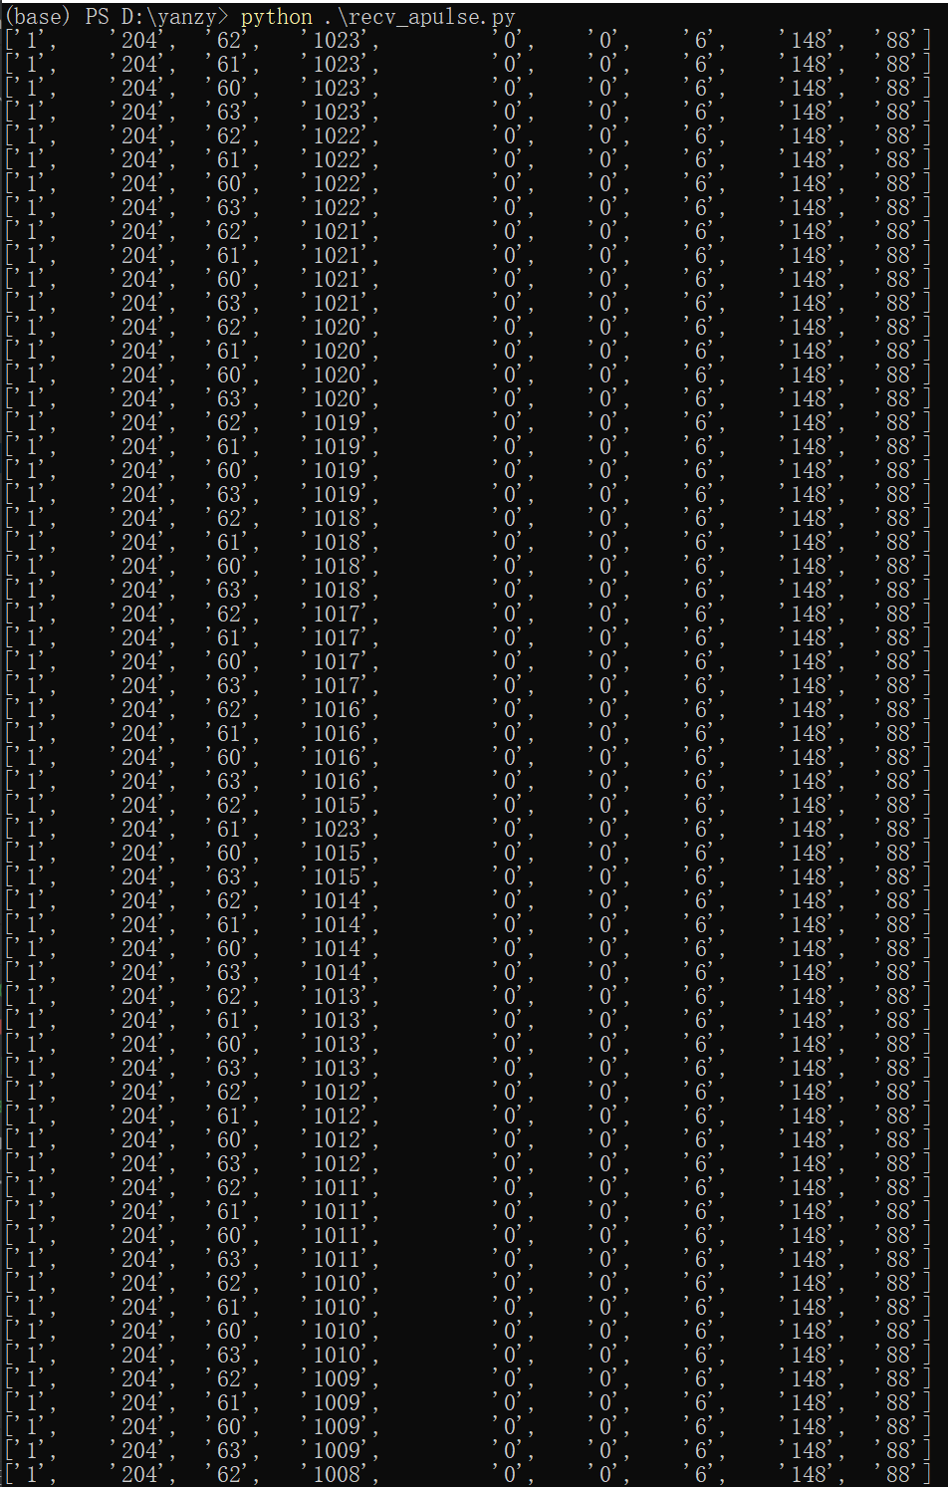
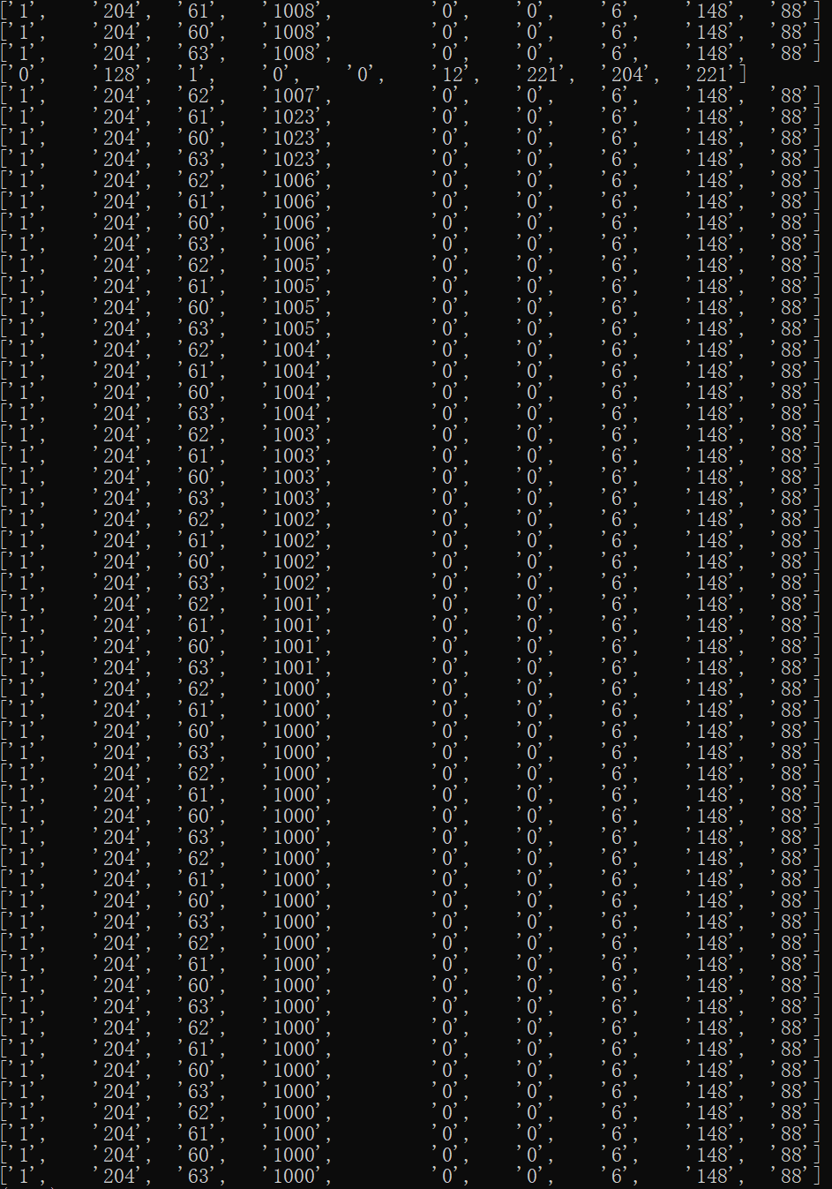
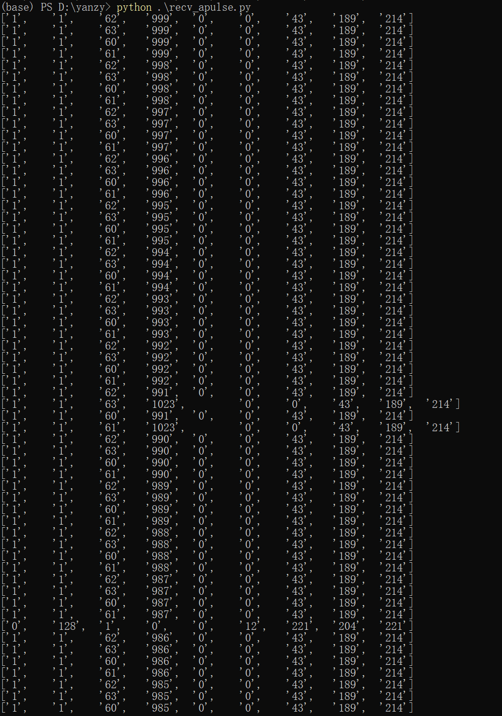
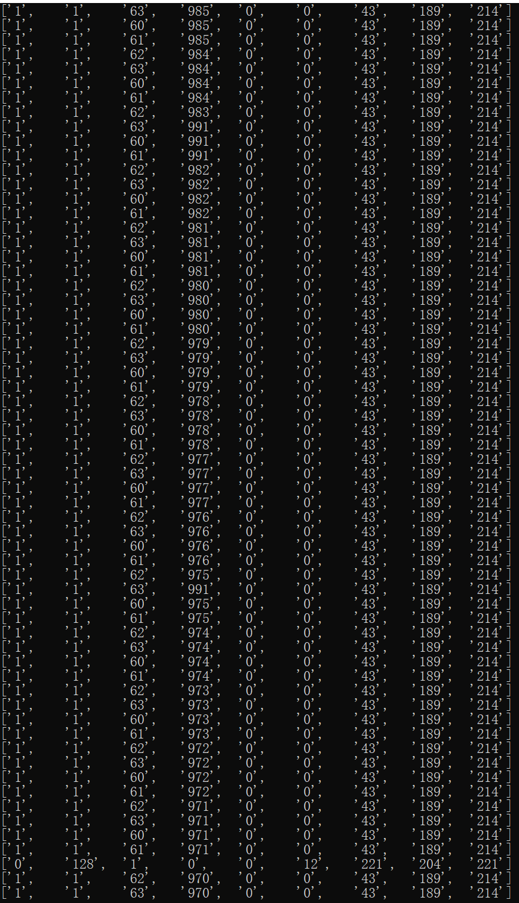
Disturbance Pixel
In a-pulse read tests , pixel-row 1023 could make disturbance overwriting other pixels output.
row 1000-1023, col 60-63
row 970-999, col 60-63

Slide 4
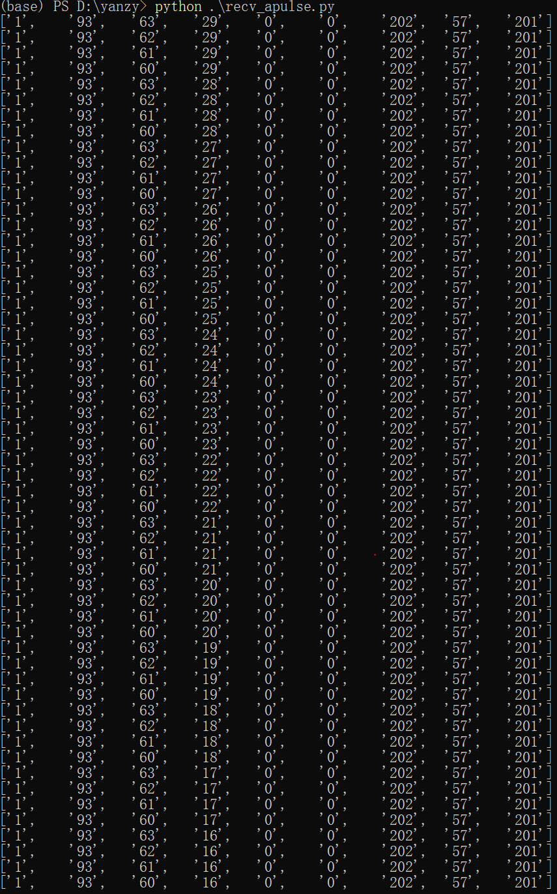
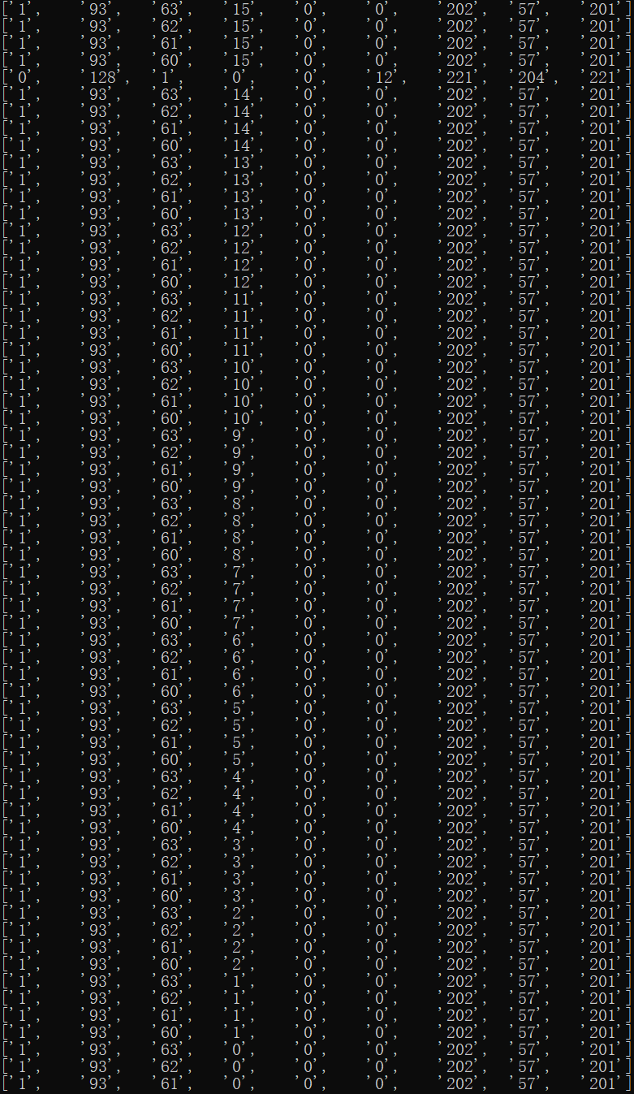
Disturbance Pixel
The disturbance would be reduced or avoided as the row picked for the read window declines.
row 0-29, col 60-63

