Slide 1
Peak finding using ML with partial-label dataset
Guang Zhao, Shuiting Xin
zhaog@ihep.ac.cn

Slide 2
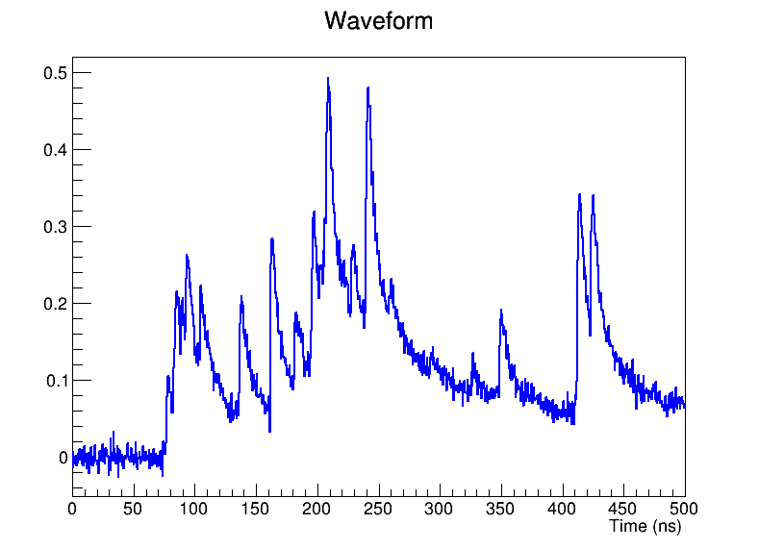
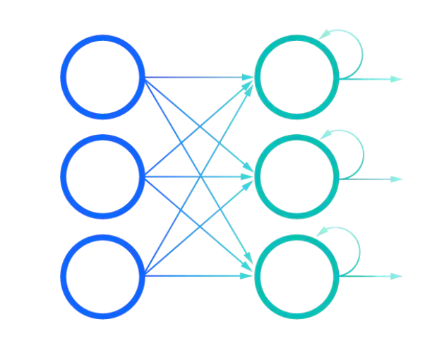
Peak finding with ML
Advantage of ML:
Can learn internal signal/background characteristics automatically, and make full use of the information
Peak finding with ML:
Supervised binary classification with slicing window samples
Architecture: RNN based network
RNN
Signal
Noise
“Memory” structure for sequence data

Slide 3
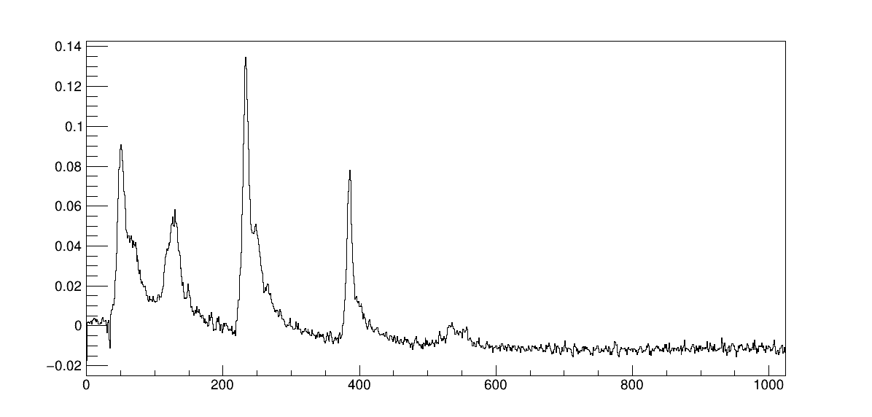
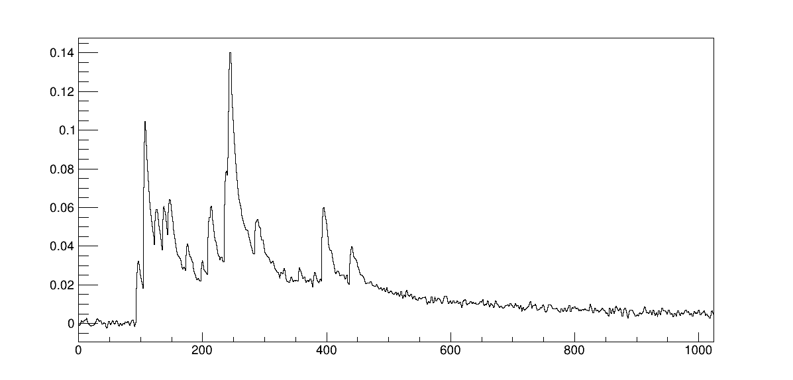
Dataset: Full labelled MC
Labelled MC samples
~20 primary ionizations per waveform
Tuned based-on beam test waveforms: noise model, amplitude, peak rising-time
Beam-test data
MC

Slide 4
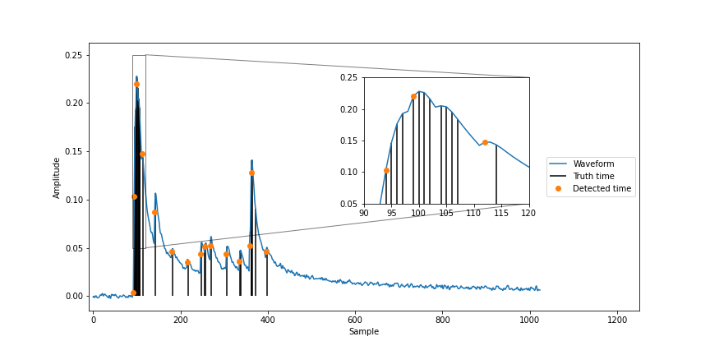
Peak finding with ML/derivative
Neural Network
Derivative
The NN can find the peaks more effective!

Slide 5
ROC comparison
RNN is a better binary classifier than the derivative method
Note: ROC curve is a standard tool for evaluation binary classifiers. ROC curve with larger area-under-curve (AUC) is better

Slide 6
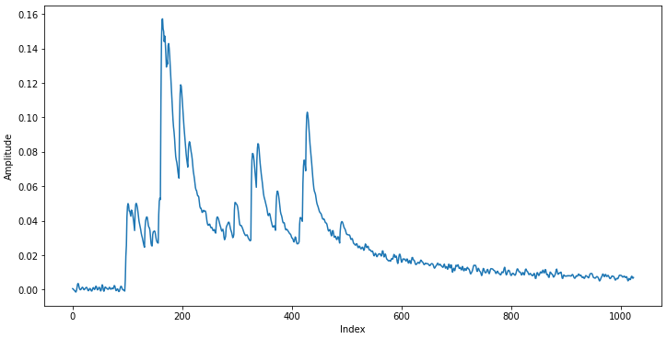
Challenge for data
Supervised learning requires labels in good quality
There is no “truth” information for labelling in data
(MC waveform for demonstration)

Slide 7
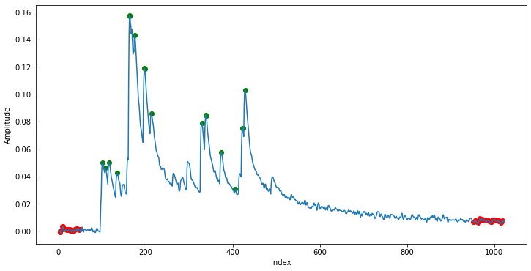
Adding partial labels
Some labels can still be added with human knowledge
Signal with large confidence:
Big “local maxima“
Background with large confidence:
“Marginal” bins
(MC waveform for demonstration)

Slide 8
Strategy for data
Train
Apply
Partial labelled train dataset
Supervised model
Test dataset
Due to the discrepancy between data/MC, try to train the model with data.
In the development stage:
Using MC sample for the whole process (assuming partial label)
Easy for performance evaluation

Slide 9
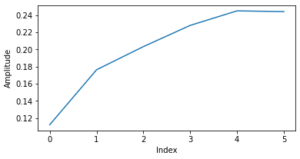
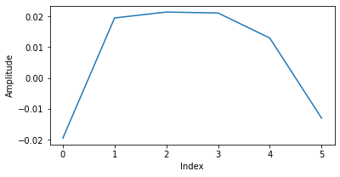
Preprocessing
Intuitive idea:
Remove possible biases for the partial labelled samples
Preprocessing procedures
Slicing window size: 15 -> 6
To reduce the contamination from the overlapping (due to partial labeling, overlapping cannot be effectively learned)
Baseline subtraction
Simple linear baseline subtraction for each slicing sample (improve noise detection for noise superposing on the signal)
Height shifting
Shift the absolute height to around 0 (removing the possible bias introduced by the training sample, because noises are always with low height in the partial labelled samples)

Slide 10
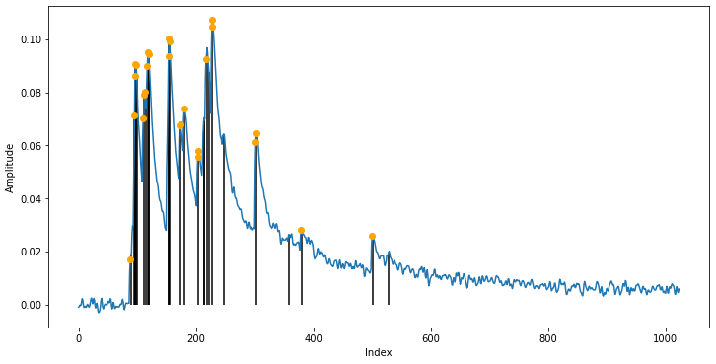
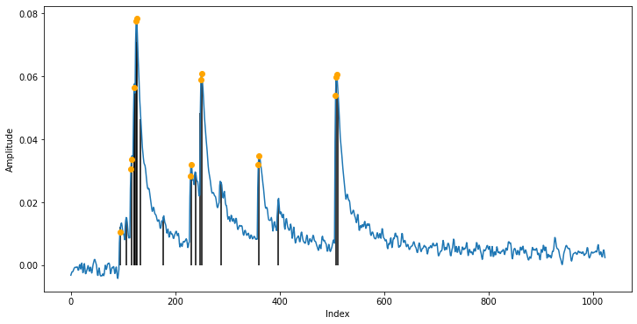
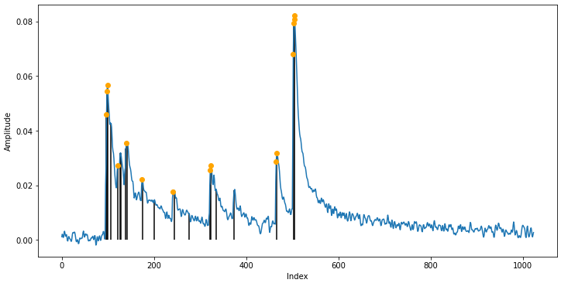
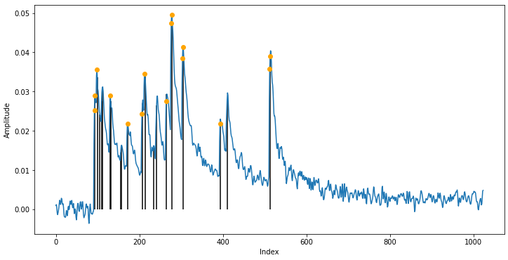
Peak finding results (partial labels)
TPR = 0.452
FPR = 0.019

Slide 11
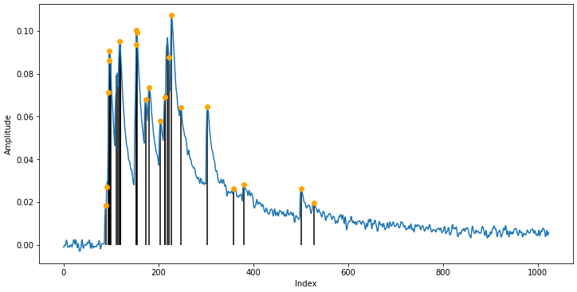
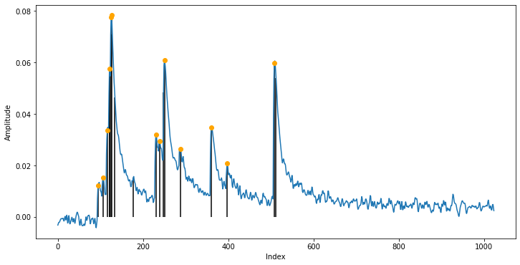
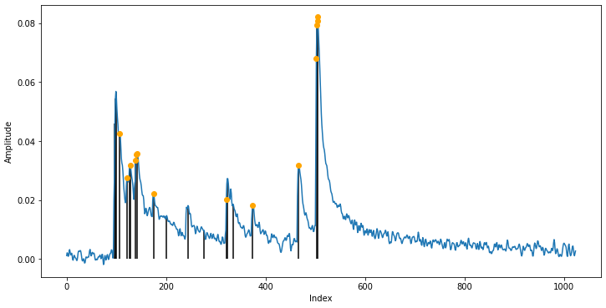
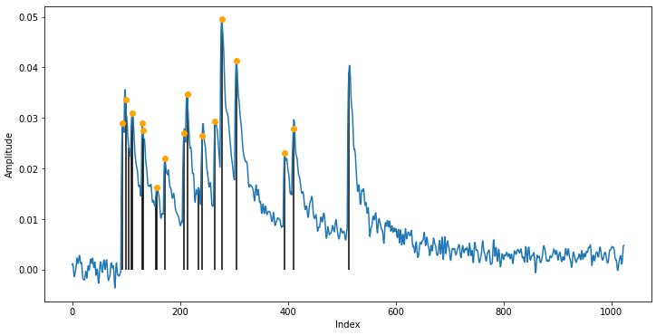
Peak finding results (full labels)
TPR = 0.616
FPR = 0.004

Slide 12
Conclusion
Have tried to train the peak finding classifier with partial-label datasets
The peak finding performance with MC sample looks okay
To perform further optimize the model and to apply the method with beam test data

