Slide 1
DAQ progress
2022.09.15

Slide 2
Current progress
Offline data parsing
Online data parsing
Offline drawing function
Compared with written calculation results

Slide 3
Current progress
Get the number and
completethe offline
drawing, but the
result is not quite correct

Slide 4
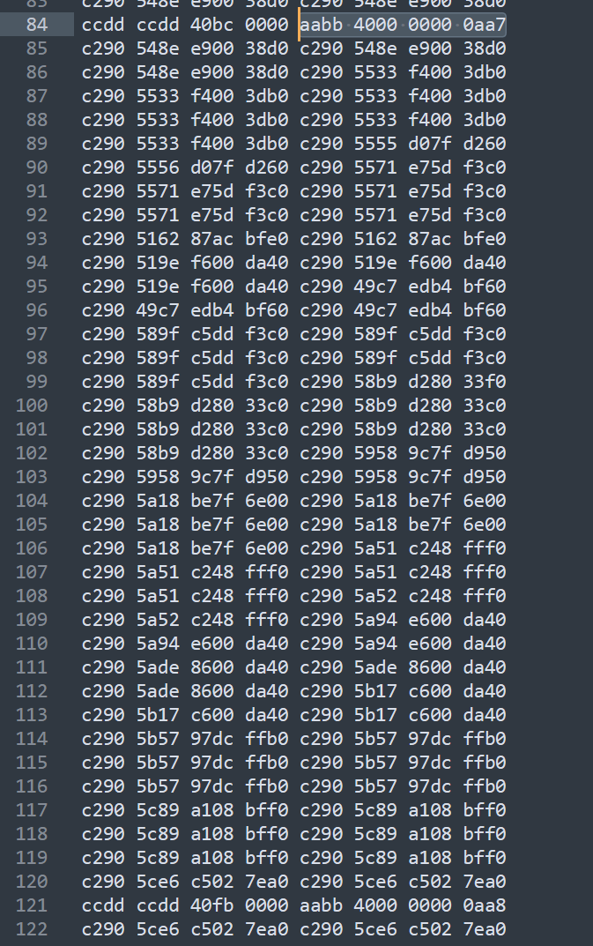
To be improved
The number between 2 consecutive
packet headers is not 64

Slide 5
To be improved
Data exception
Data duplication
Header id repetition
Abnormal number of data

Slide 6
Next plan
Find the cause of data exception
config or readout?
Improve the official software

Slide 7
THANKS

