Slide 1
Dummy Wafer

Slide 2
Timeline
20220901 : Dummy wafer submission
20220905: Engineer Contacted me
20220913: Start to do thinning
20220916: Misoperating the original Dummy and compensated for two new.
20220921：Finished all the process and ship a box to IHEP
20220922: Wafer received.

Slide 3
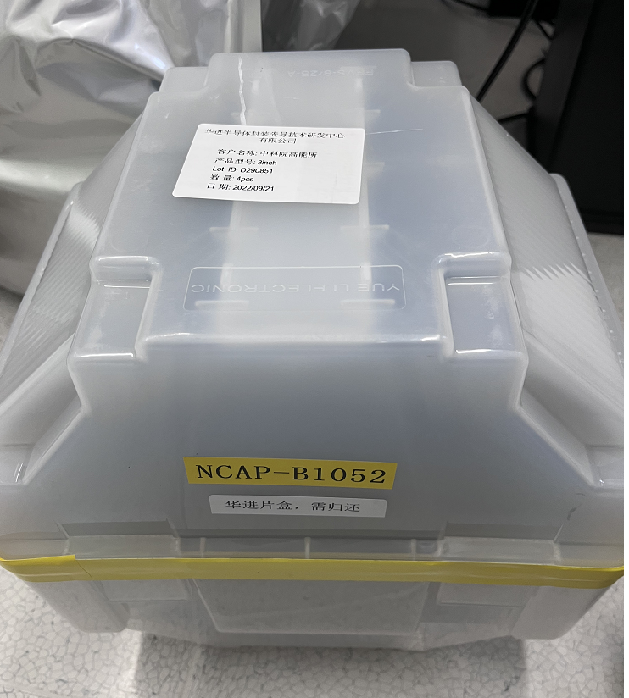

Slide 4
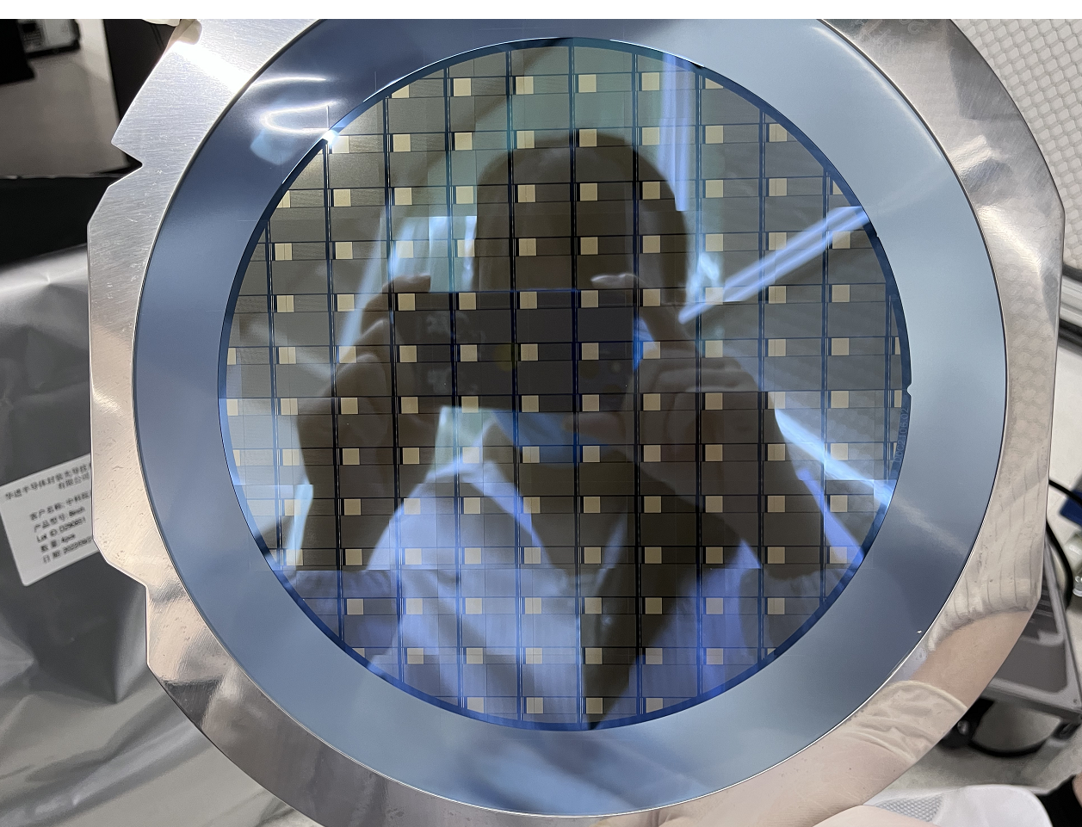

Slide 5
