Slide 1
DAQ progress
2022.09.22

Slide 2
Current progress
DAQ
Updated the online decoding function of the software
The software is already able to properly configure, take numbers, and parse data
Workstations have arrived
Electronics
Electronics has updated the initialization of package header id and timestamp each fetch
Electronic devices have arrived

Slide 3
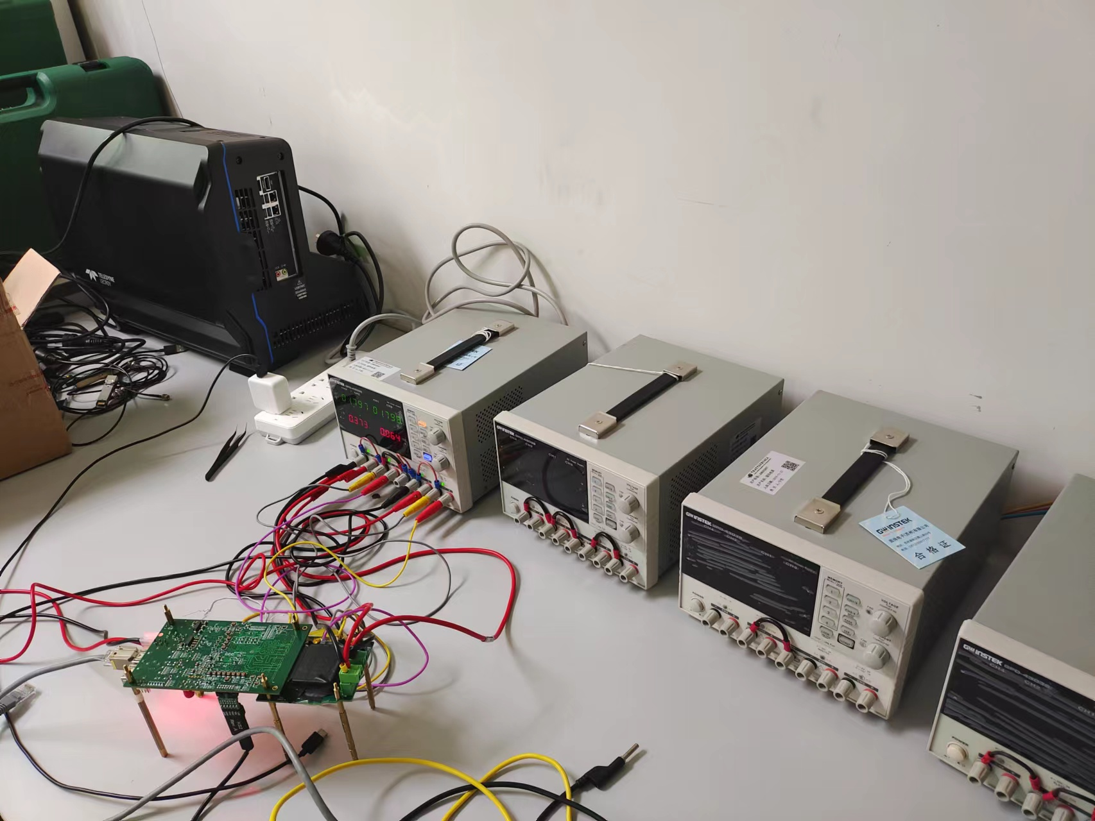
Device

Slide 4
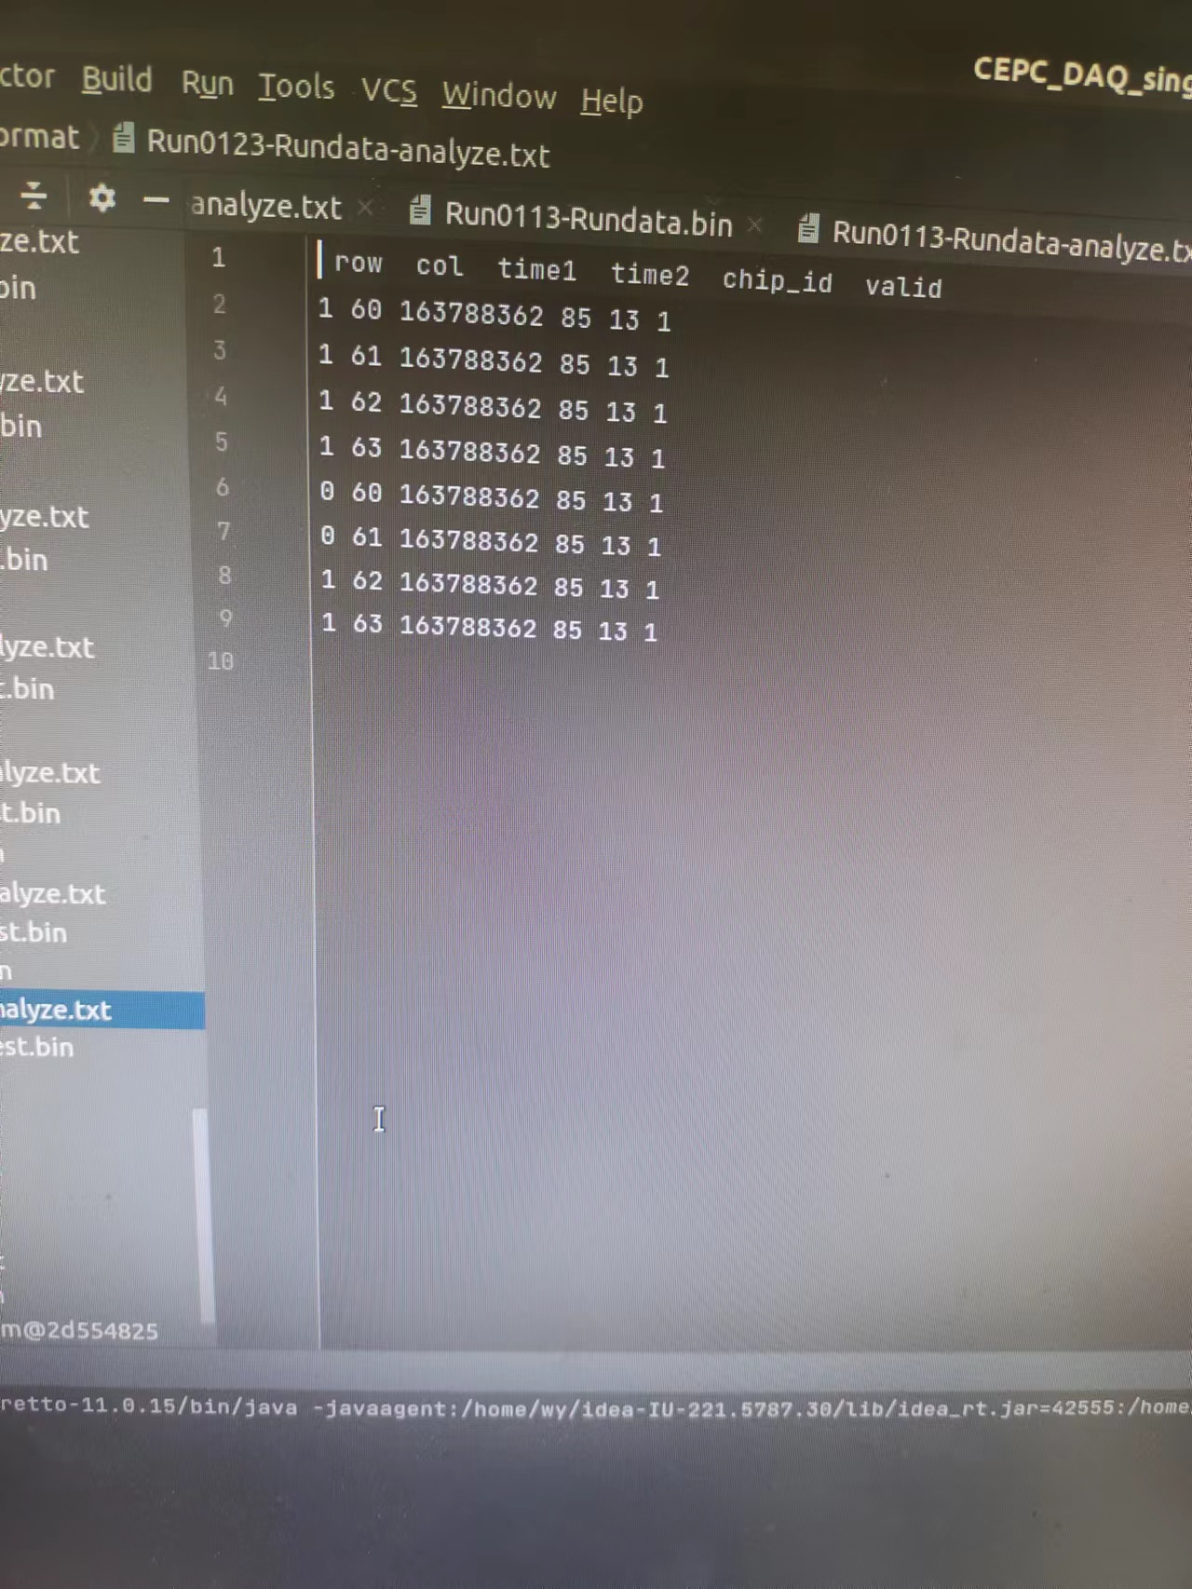
To be discussed
Row 0 data sometimes doesn't come out
These should be 0, but out is 1

Slide 5
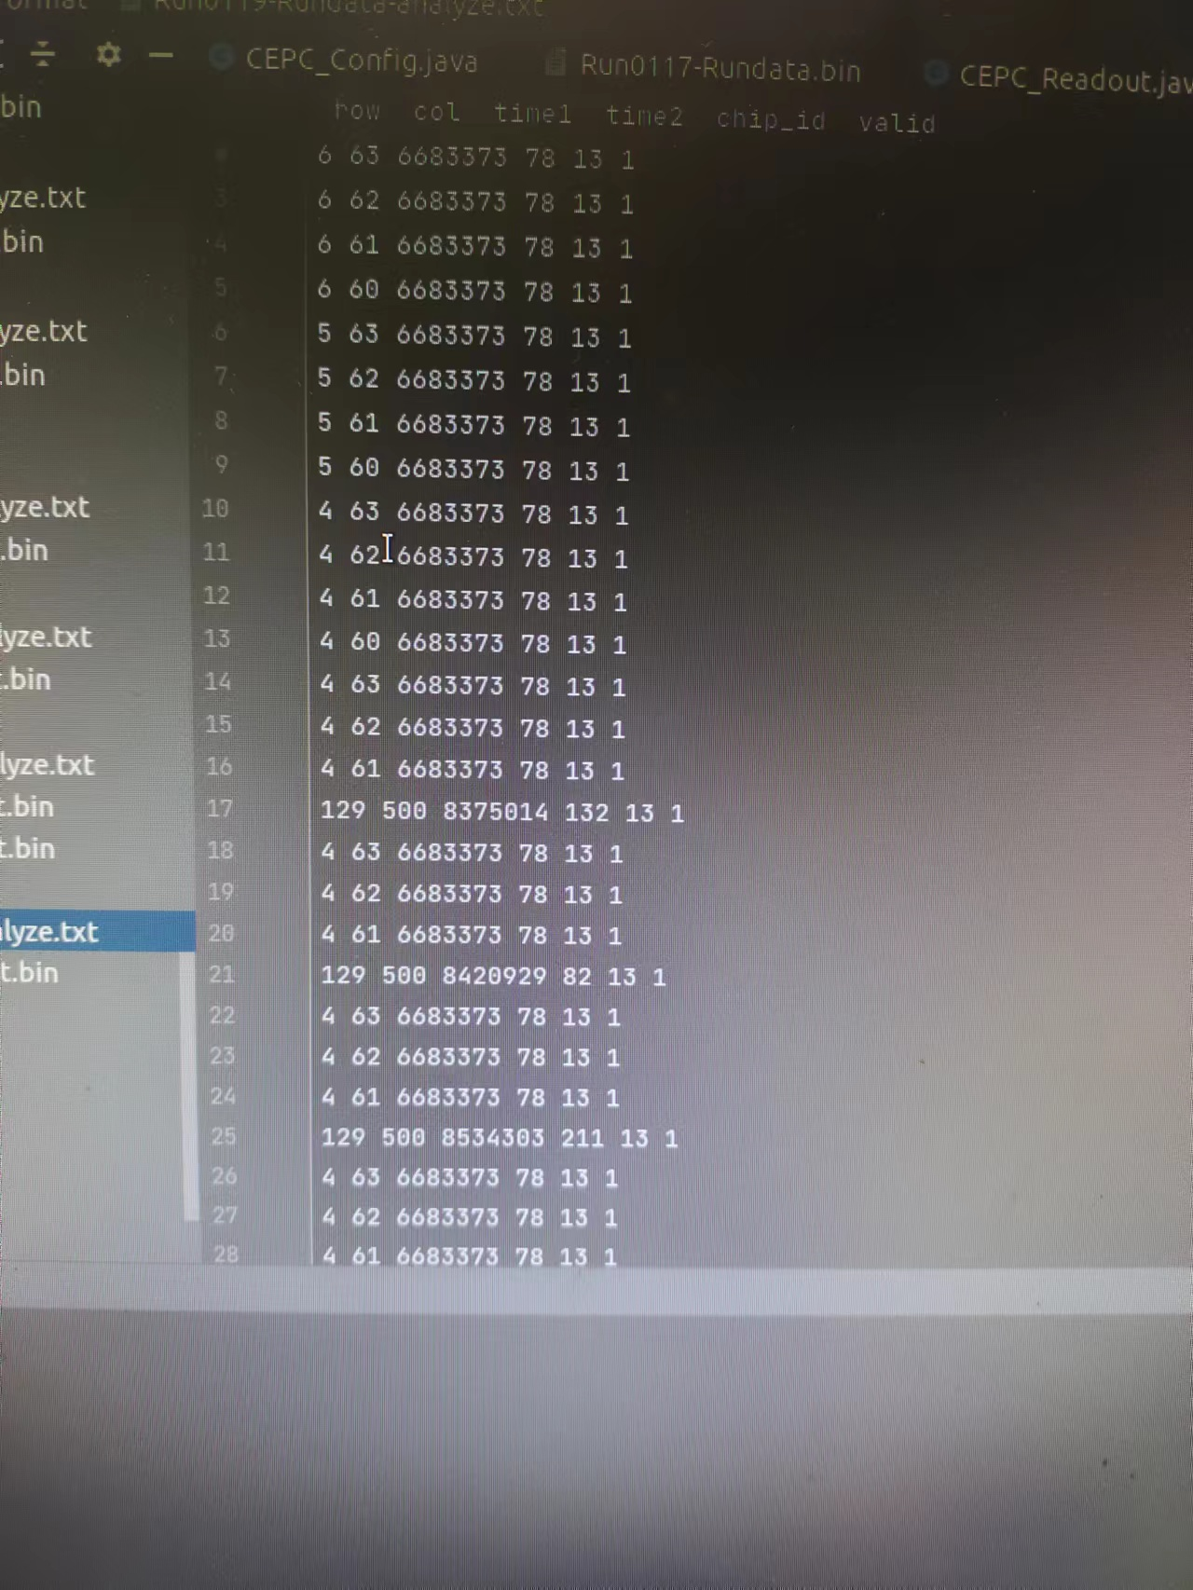
To be discussed
Exception address output
After configuring the corresponding address output, there will be some fixed pixel address output
Common exception addresses are:
(129,500)、(128,500)······
Not sure if it's the cause of the apulse pattern

Slide 6
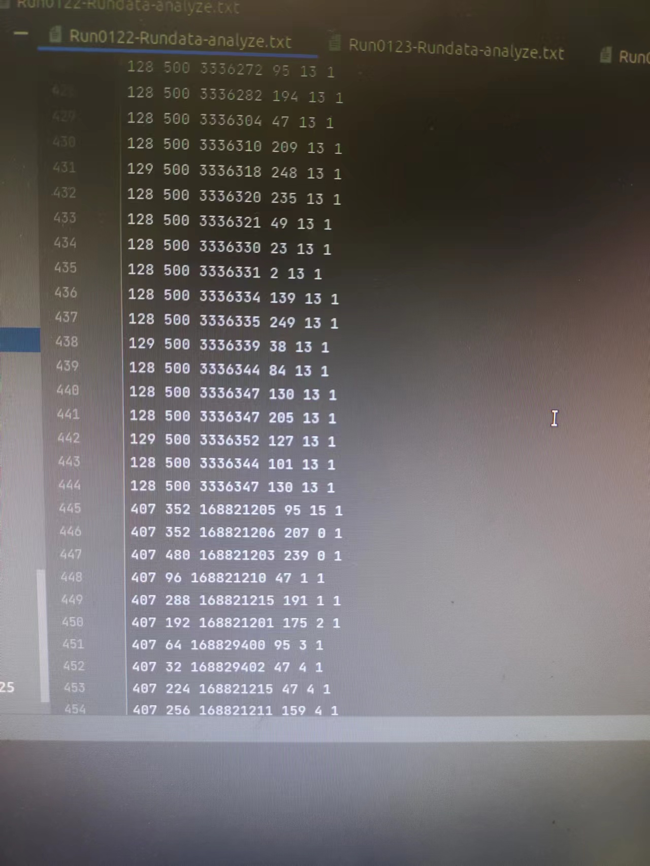
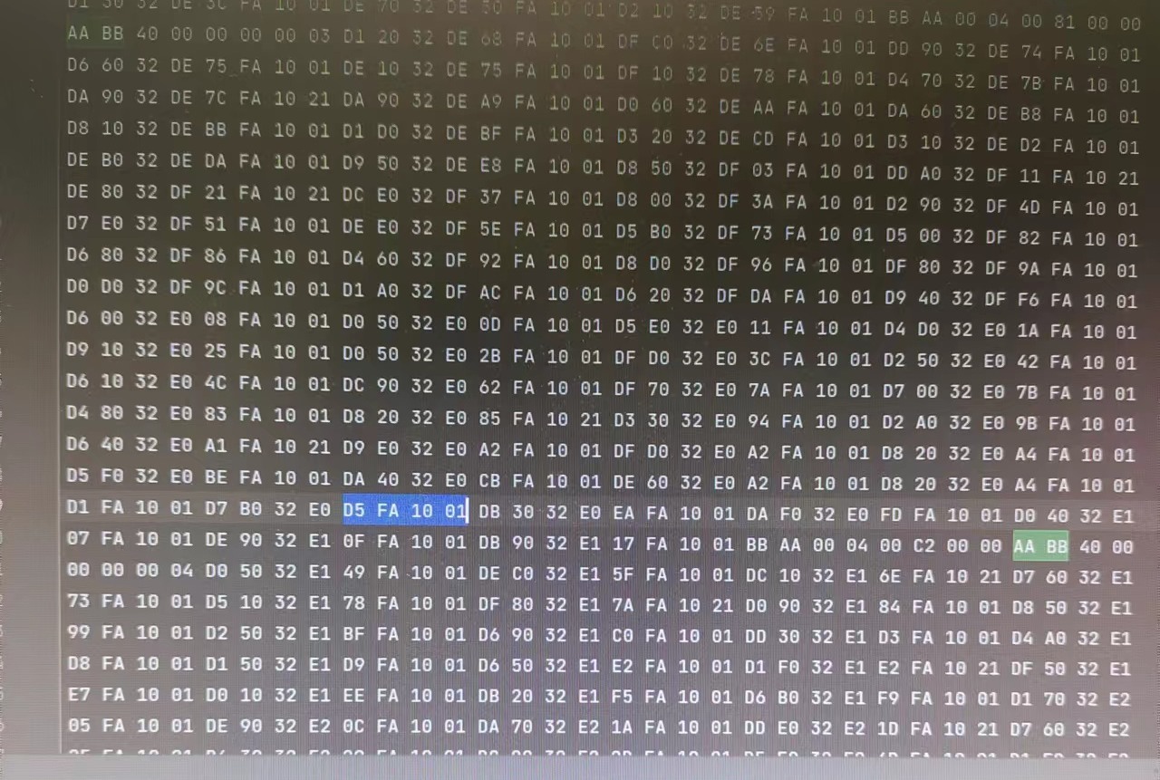
To be discussed
Byte misalignment
Package 3 has a 4-byte data loss
chip_id should be 13, but other values appear in the parsing

Slide 7
Next plan
Install the environment for the new computer and transfer the program to the new workstation (Online applications have not been approved)
Further improve the functionality of the software

Slide 8
THANKS

