Slide 1
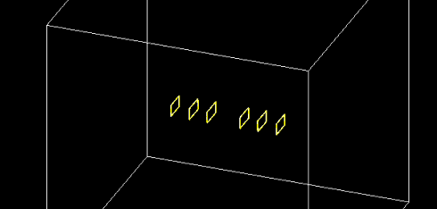
探测器几何
将flex，chip还有fiber组合为一个module，以便后续几何模型摆放
选取了6个module按实际位置角度摆放
旋转矩阵为：
G4ThreeVector RX = G4ThreeVector(1, 0, 0);
G4ThreeVector RY = G4ThreeVector(0, 0.999907, -0.013645);
G4ThreeVector RZ = G4ThreeVector(0, 0.013645, 0.999907);

Slide 2
chip厚度对物质量影响
thickness(um) | X/X0
50 | 0.00353067
100 | 0.00459764
150 | 0.00566481

Slide 3
chip厚度对物质量影响
k:1.00009
X0(ladder radiation length):190.237mm
chip_thickness:50um
total_thickness:671.6um
Material_budget = k*total_len/X0 = 0.00353067
50um

Slide 4
100
k:1.00009
X0(ladder radiation length):167.841mm
chip_thickness:100um
total_thickness:771.6um
Material_budget = k*total_len/X0 = 0.00459764

Slide 5
150
k:1.00009
X0(ladder radiation length):153.877mm
chip_thickness:150um
total_thickness:871.6um
Material_budget = k*total_len/X0 = 0.00566481

Slide 6
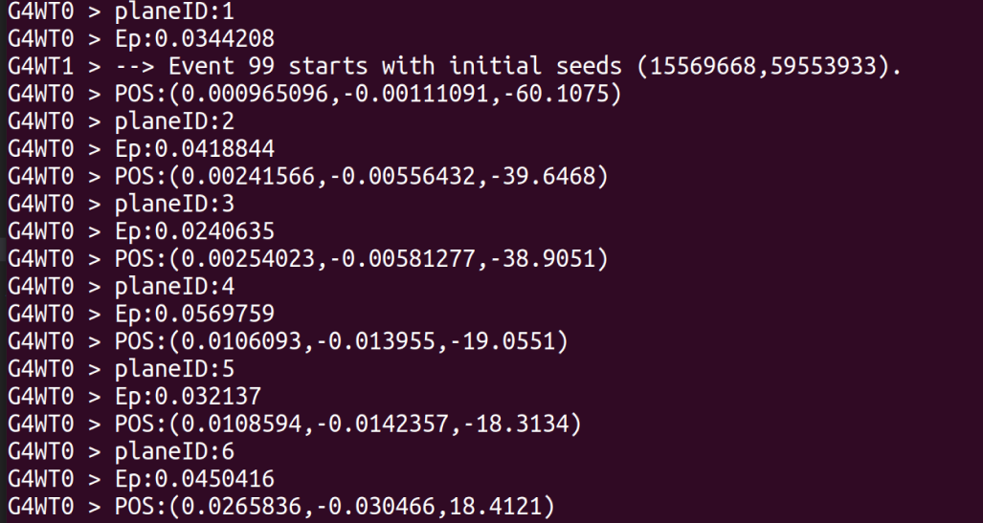
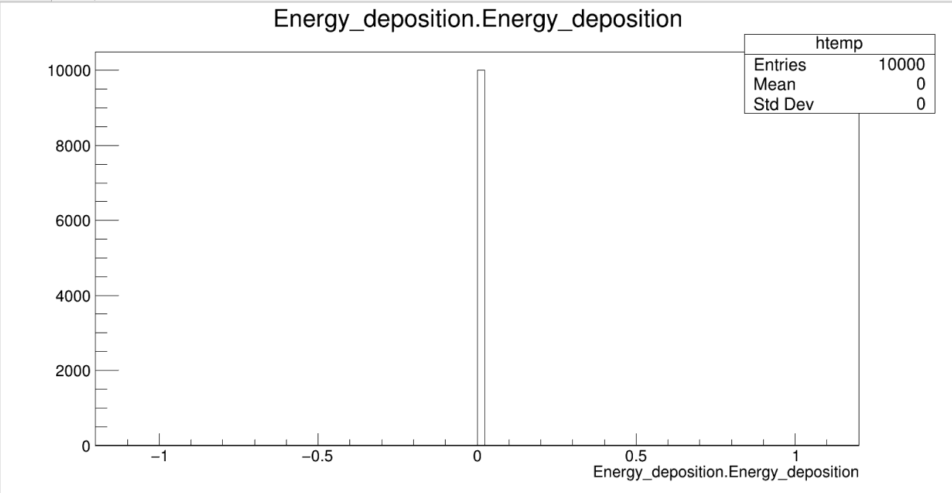
问题
存储数据问题：
按Event存储数据，HitID,HitPos均为vector格式
目前在存储读到数据的时候出现问题：
1.在从探测器读信号时没有问题：
2.在写入root文件时出现了问题：

