Slide 1
Summry of polarization maintenace in CEPC Booster
ChenTao
22-9-27

Slide 2
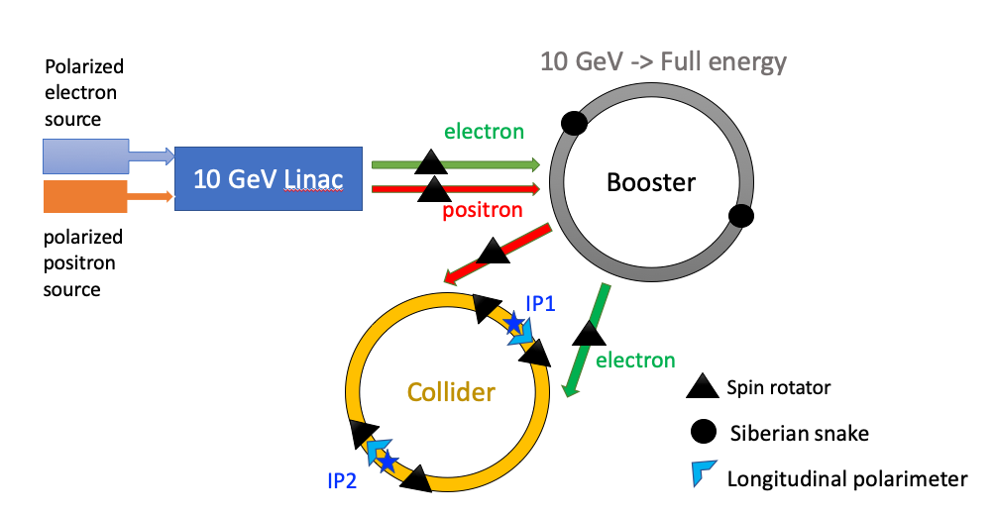
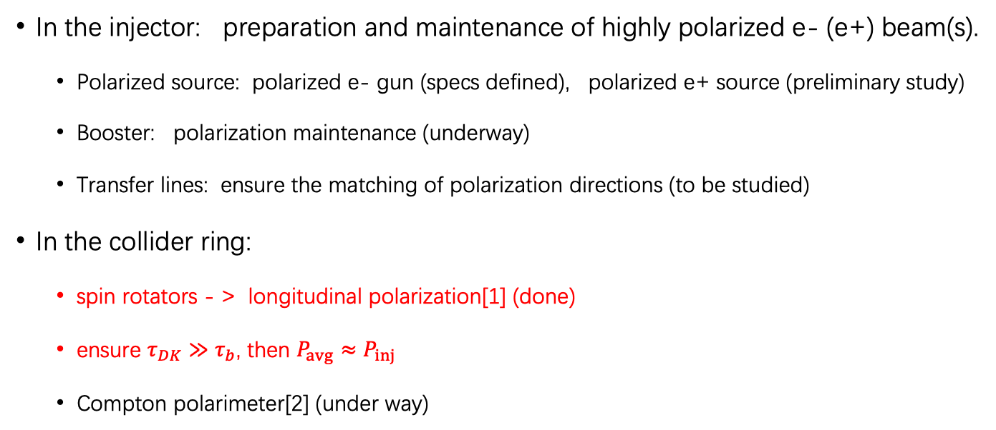
Longitudinal polarization @ CEPC
  In the injector: preparation and maintenance of highly polarized e- (e+) beam(s).
    Polarized source: polarized e- gun (specs defined), polarized e+ source (preliminary study)
    Booster: polarization maintenance (underway)
    Transfer lines: ensure the matching of polarization directions (to be studied)
  In the collider ring:
    spin rotators - > longitudinal polarization[1] (done)
    ensure $τ_{DK}≫τ_{b}$, then $P_{avg}≈P_{inj}$
    Compton polarimeter[2] (under way)
[1] W. H. Xia et al., RDTM (2022) doi: 10.1007/s41605-022-00344-2
[2] S. H. Chen et al., JINST 17, P08005, (2022)
??

Slide 3
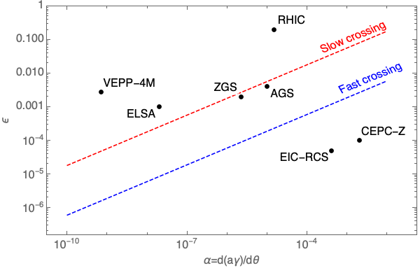
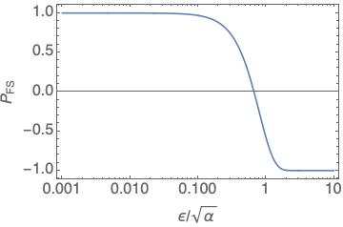
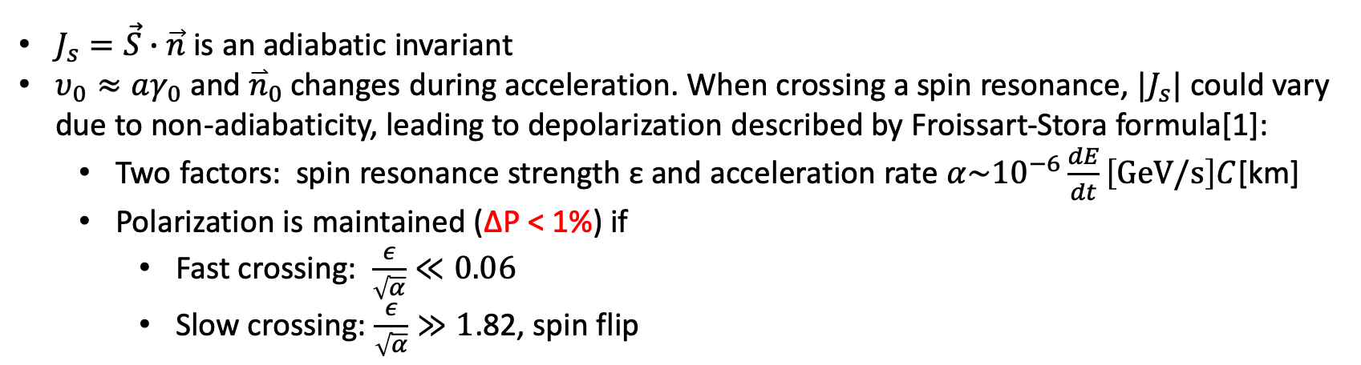
Polarization maintenance in synchrotron/booster
$J_{s}=\vec{S}∙\vec{n}$ is an adiabatic invariant
$υ_{0}≈aγ_{0}$ and ${\overset{⃑}{n}}_{0}$ changes during acceleration. When crossing a spin resonance, ${|J}_{s}|$ could vary due to non-adiabaticity, leading to depolarization described by Froissart-Stora formula[1]:
  Two factors: spin resonance strength ε and acceleration rate $α\sim {10}^{−6}\frac{dE}{dt}\left[GeV/s\right]C$[km]
  Polarization is maintained (ΔP < 1%) if
    Fast crossing: $\frac{ε}{\sqrt{α}}≪0.06$
    Slow crossing: $\frac{ε}{\sqrt{α}}≫1$.82, spin flip
[1] Froissart and Stora, NIM 7, 297 (1960) [2] A. K. Barladyan, et al., PRAB 22, 112804, (2019)
[3] S. Nakamura, et al., NIM A 411, 93 (1998) [4] T. Khoe et al., Part. Accel. 6, 213 (1975)
[5] Configuration Manual: Polarized Proton Collider at RHIC, 2006 [6] V. Ranjbar, et al., PRAB 21, 111003 (2018)

Slide 4
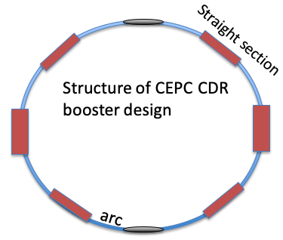
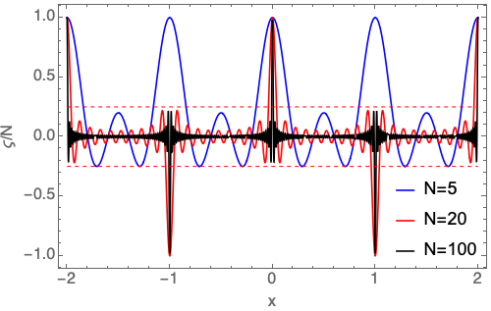
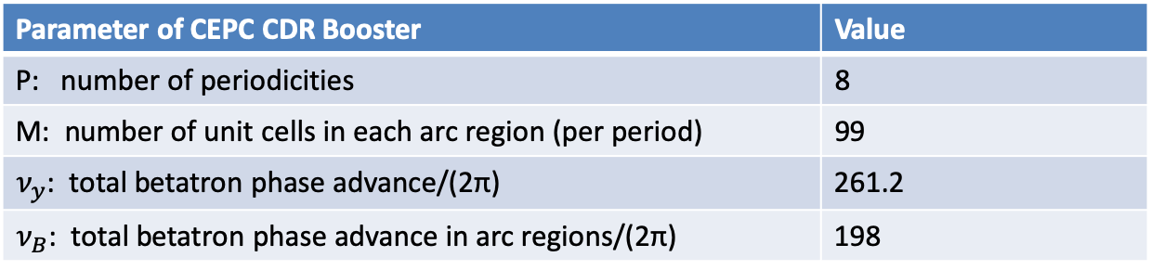
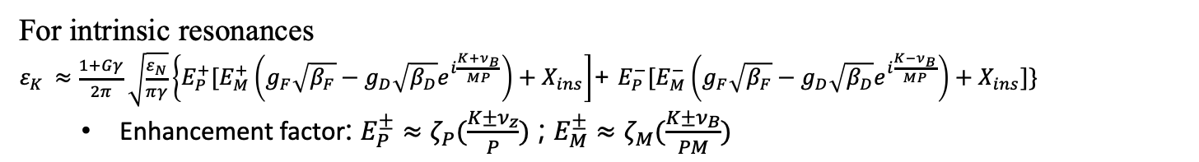
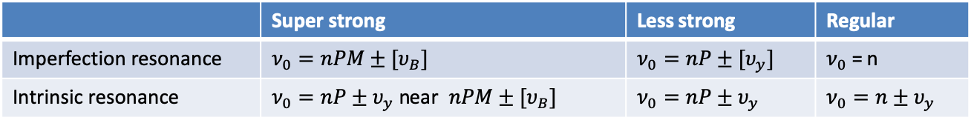
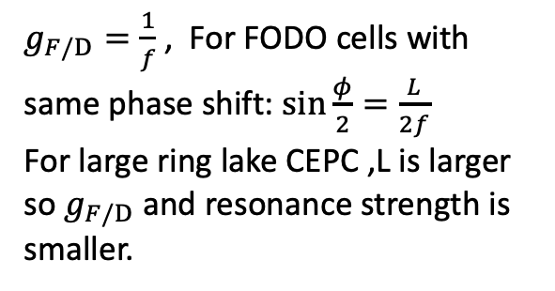
Spin resonance structure
Parameter of CEPC CDR Booster | Value
P: number of periodicities | 8
M: number of unit cells in each arc region (per period) | 99
$ν_{y}$: total betatron phase advance/(2π) | 261.2
$ν_{B}$: total betatron phase advance in arc regions/(2π) | 198
PM = 792, arc sections take up > 80% circumference
About k * 2π betatron phase advance in each straight section & arc section
 | Super strong | Less strong | Regular
Imperfection resonance | $$ν_{0}=nPM±[υ_{B}]$$ | $$ν_{0}=nP±[υ_{y}]$$ | $ν_{0}$ = n
Intrinsic resonance | $ν_{0}=nP±υ_{y}$ near $nPM±[υ_{B}]$ | $$ν_{0}=nP±υ_{y}$$ | $$ν_{0}=n±υ_{y}$$
ε_{RING} = Enhancement Factor * ε_{arc cell} + ε _{straight sections}
Enhancement Factor : $ζ_{M}\left(x\right)=\frac{\sin{Mπx}}{\sin{πx}}$ , when x = integer , $ζ_{M}\left(x\right)=M$
$g_{F/D}=\frac{1}{f}$ , For FODO cells with same phase shift: $sin\frac{φ}{2}=\frac{L}{2f}$
For large ring lake CEPC ,L is larger so $g_{F/D}$ and resonance strength is smaller.
One FODO
For intrinsic resonances
$ε_{K }≈\frac{1+Gγ}{2π}\sqrt{\frac{ε_{N}}{πγ}}\left\{E_{P}^{+}[E_{M}^{+}\left(g_{F}\sqrt{β_{F}}−g_{D}\sqrt{β_{D}}e^{i\frac{{K+ν}_{B}}{MP}}\right)+X_{ins}\right]$+ $E_{P}^{−}[E_{M}^{−}\left(g_{F}\sqrt{β_{F}}−g_{D}\sqrt{β_{D}}e^{i\frac{{K−ν}_{B}}{MP}}\right)+X_{ins}]\}$
  Enhancement factor: $E_{P}^{±}≈ζ_{P}(\frac{K±ν_{z}}{P})$ ; $E_{M}^{±}≈ζ_{M}(\frac{K±ν_{B}}{PM})$
[1] S. Y. Lee, Spin Dynamics and snakes in synchrotrons, World Scientific, 1997, [2] V. Ranjbar, et al., PRAB 21, 111003 (2018)

Slide 5















Intrinsic spin resonance structure
CEPC CDR Booster： $P=8;M=99;ν_{B}=198$
45.6GeV
$$ε_{K, intrinsic}\sim γ\sqrt{ε_{rms}}$$
Simulated with DEPOL [1]
$$ε_{N}=10 mm∙mrad$$
$$3PM+ν_{B}$$
$$5PM+ν_{B}$$
$$3PM−ν_{B}$$
$$5PM−ν_{B}$$
$$ν_{B}$$
$$PM+ν_{B}$$
$$4PM−ν_{B}$$
$$6PM−ν_{B}$$
$$PM−ν_{B}$$
$$4PM+ν_{B}$$
45.6GeV
80GeV
120GeV
$$2PM+ν_{B}$$
$$2PM−ν_{B}$$
$$ν_{B}$$
[1] E. Courant and R. Ruth, BNL-52170, 1980

Slide 6
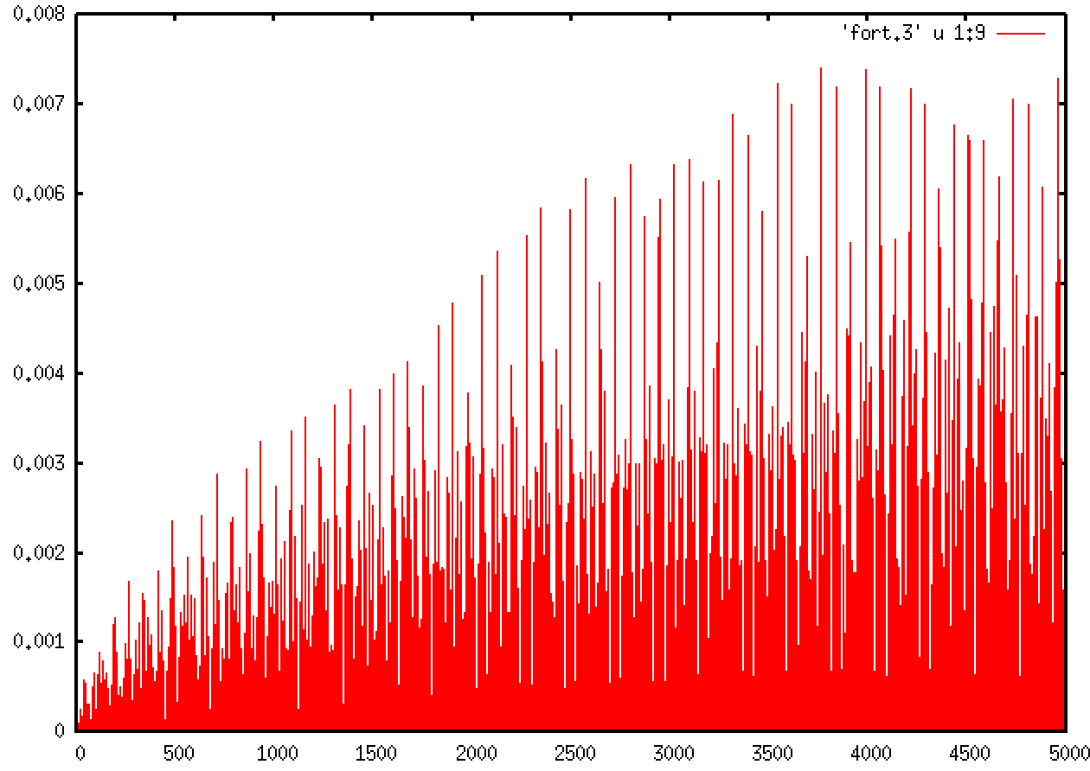
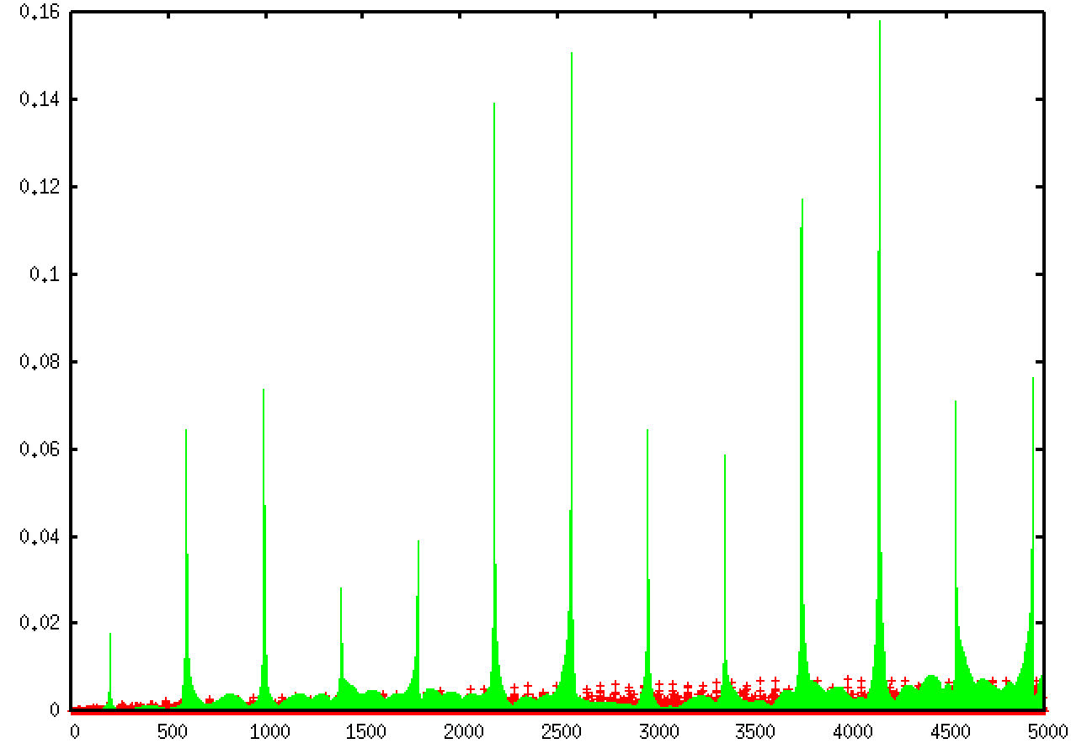
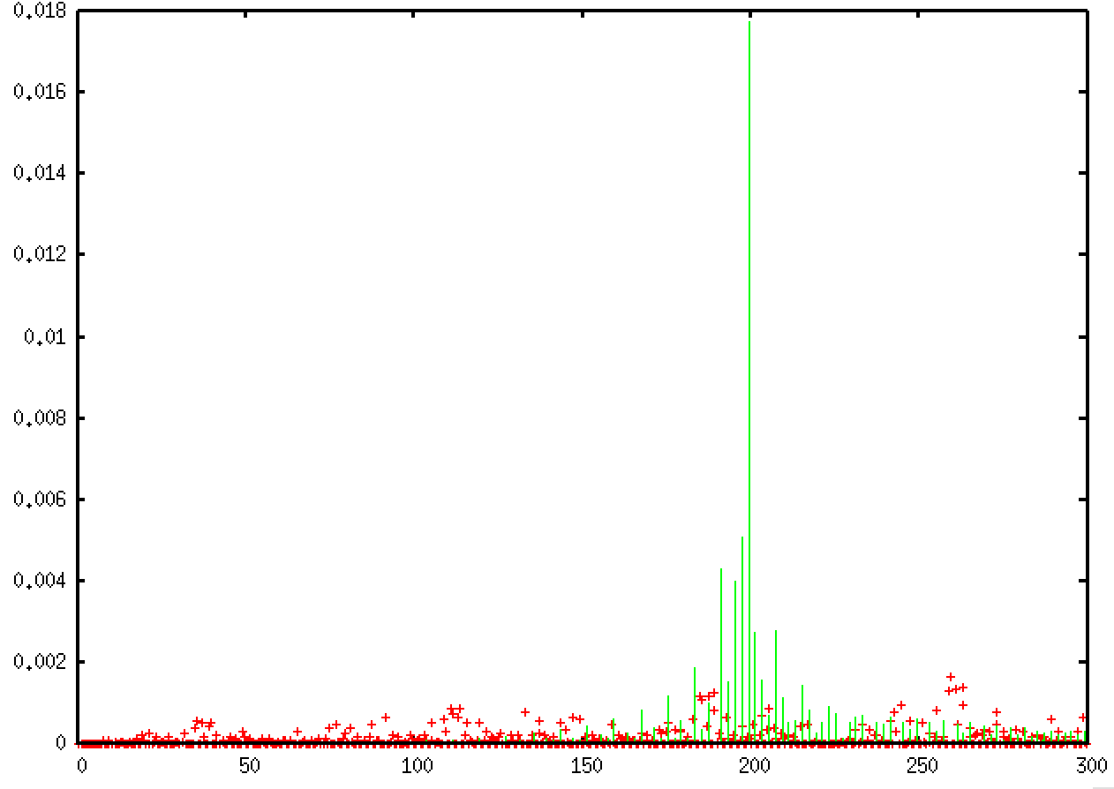
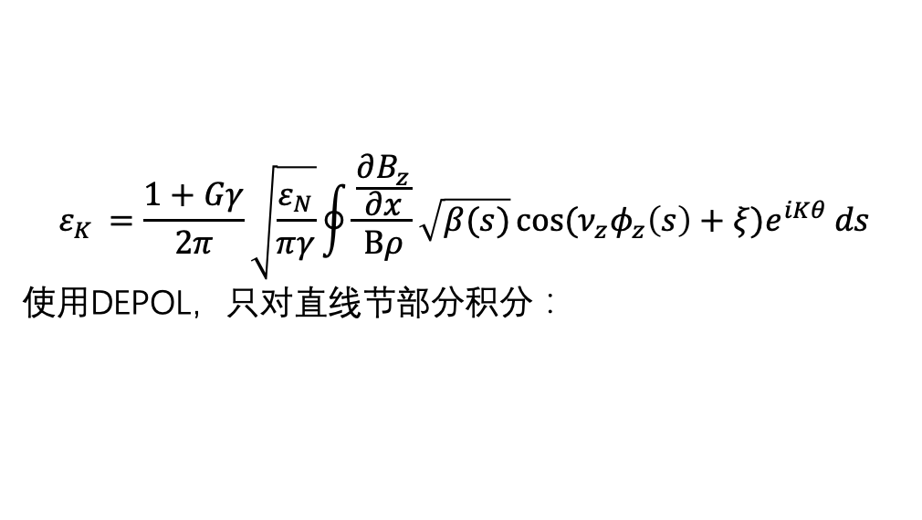
Contribution of straight section
$$ε_{K }=\frac{1+Gγ}{2π}\sqrt{\frac{ε_{N}}{πγ}}\oint{\frac{\frac{∂B_{z}}{∂x}}{Bρ}\sqrt{β(s)}\cos{(ν_{z}φ_{z}\left(s\right)+ξ)e^{iKθ}}ds}$$
使用DEPOL，只对直线节部分积分：

Slide 7


















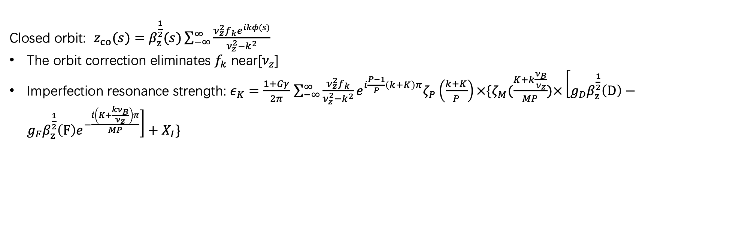




Imperfection spin resonance structure
Closed orbit: $z_{co}(s)=β_{z}^{\frac{1}{2}}(s)\sum_{−∞}^{∞}{\frac{ν_{z}^{2}f_{k}e^{ikφ(s)}}{ν_{z}^{2}−k^{2}}}$
The orbit correction eliminates $f_{k}$ near[$ν_{z}$]
Imperfection resonance strength: $ε_{K}=\frac{1+Gγ}{2π}$ $\sum_{−∞}^{∞}{\frac{ν_{z}^{2}f_{k}}{ν_{z}^{2}−k^{2}}}e^{i\frac{P−1}{P}\left(k+K\right)π}ζ_{P}\left(\frac{k+K}{P}\right)×\{ζ_{M}(\frac{K+k\frac{ν_{B}}{ν_{z}}}{MP})×\left[g_{D}β_{z}^{\frac{1}{2}}\left(D\right)−g_{F}β_{z}^{\frac{1}{2}}\left(F\right)e^{−\frac{i\left(K+\frac{kν_{B}}{ν_{z}}\right)π}{MP}}\right]+X_{I}\}$
When $k=nν_{z},K=nPM±nν_{B}$ , $ζ_{M}→M$
The position of the peak is shifted and the preceding and following peaks are coincident
Simulated with SAD
Before correction rms orbit ~5mm
after correction rms orbit ~ 100 μm
$$5PM+2ν_{B}$$
$$5PM+ν_{B}$$
$$4PM+2ν_{B}$$
$$3PM+ν_{B}$$
$$4PM−2ν_{B}$$
$$5PM−2ν_{B}$$
$$5PM−ν_{B}$$
$$3PM+2ν_{B}$$
$$3PM−ν_{B}$$
$$6PM+ν_{B}$$
$$2PM+2ν_{B}$$
$$3PM−2ν_{B}$$
$$4PM+ν_{B}$$
120GeV
$$2PM−2ν_{B}$$
$$PM+ν_{B}$$
$$PM+2ν_{B}$$
$$PM−ν_{B}$$
2$PM+ν_{B}$
$$ν_{B}$$
$$2PM−ν_{B}$$
$$PM−2ν_{B}$$

Slide 8
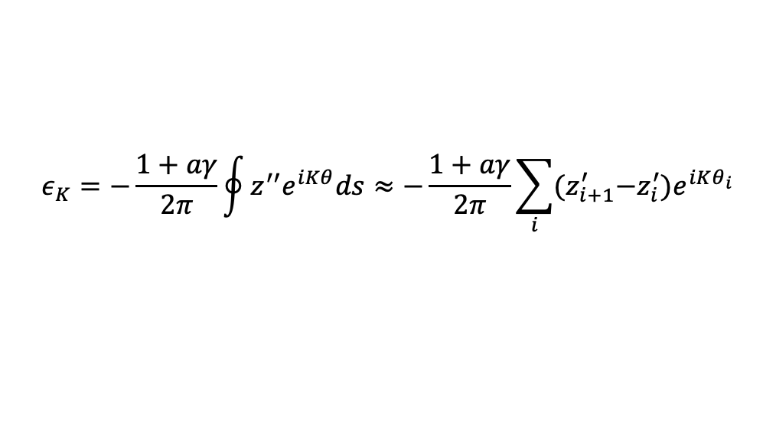

Imperfection spin resonance structure
Error setting in the lattice, rms vertical closed orbit is ~ 100 μm in this seed
 | Dipole | Quadrupole | Sextupole
Transverse shift X/Y (μm) | 100 | 100 | 100
Longitudinal shift Z (μm) | 100 | 150 | 100
Tilt about X/Y (mrad) | 0.2 | 0.2 | 0.2
Tilt about Z (mrad) | 0.1 | 0.2 | 0.2
Nominal field | 1e-3 | 2e-3 | 3e-3
Calculated using one corrected lattice with error
$$ε_{K}=−\frac{1+aγ}{2π}\oint{z^{′′}e^{iKθ}ds}≈−\frac{1+aγ}{2π}\sum_{i}{{(z}_{i+1}^{′}−z_{i}^{′}})e^{iKθ_{i}}$$
Simulated with SAD
45.6 GeV
CEPC energy range
45.6 GeV
80 GeV
120 GeV
$$ν_{B}$$

Slide 9
Simulation of polarization transmission to 45.6 GeV
Evolution of vertical rms emittance
Intrinsic resonance strength scaled with emittance
Imperfection resonance strength
Initial normalized emittance = 783 mm mrad
200 particles ,initial vertical emittance 40nm
On the closed orbit
200 particles ,initial vertical emittance 40nm
Bare lattice
Intrinsic resonances
Imperfect lattice
Imperfection resonances
w/o quantum excitation
<S_{y}>
Imperfect lattice
Both resonance sources
<S_{y}>
<S_{y}>
Notes:
The initial injected beam rms emittance is 40 nm @ 10 GeV, corresponding to a normalized emittance of 783 mm mrad.
If we use the 783 mm mrad initial normalized emittance to scale (without considering the radiation damping), the maximum intrinsic resonance up to 45.6 GeV would be 1e-4 * sqrt(78) = 9e-4, then the polarization loss crossing such a resonance is ~ 0.1%. Roughly in agreement with the Bmad simulation.
5. We chose 40 nm rms emittance in this study, because in the CDR parameter, this was the design value of the positron beam @ 10 GeV, in contrast, the electron beam rms emittance was 5nm rms @ 10 GeV.
6. In the latest parameters for TDR, the requirement for injected e+/e- beam rms emittance is < 10 nm rms @ 20 GeV, corresponding to a normalized emittance of 391 mm mrad. So we think our current simulations have some reservations.
7. I asked our electron source people, Xiaoping Li, he said he estimated a 150 kV polarized DC photo-gun could generate a normalized emittance of polarized electron beam @ 1nC on the order of 10~15 mm mrad. This could be further reduced if using a higher DV voltage (in the 300 kV polarized electron gun developed for EIC, they designed a normalized emittance of 3.4 mm mrad, DOI: 10.1103/PhysRevAccelBeams.25.033401) .

Slide 10
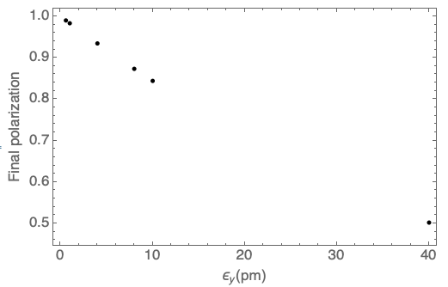
Simulation of polarization transmission to 120 GeV
Evolution of vertical rms emittance
Intrinsic resonance strength scaled with emittance
Imperfection resonance strength
Initial normalized emittance = 783 mm mrad
On the closed orbit
5000 particles, initial vertical emittance 40nm
Imperfect lattice
Imperfection resonances
w/o quantum excitation
<S_{y}>
Imperfect lattice
Both resonance sources
w/ quantum excitation
The equilibrium vertical emittance needs to be corrected to below 4 pm, to achieve 90% polarization transmission

Slide 11
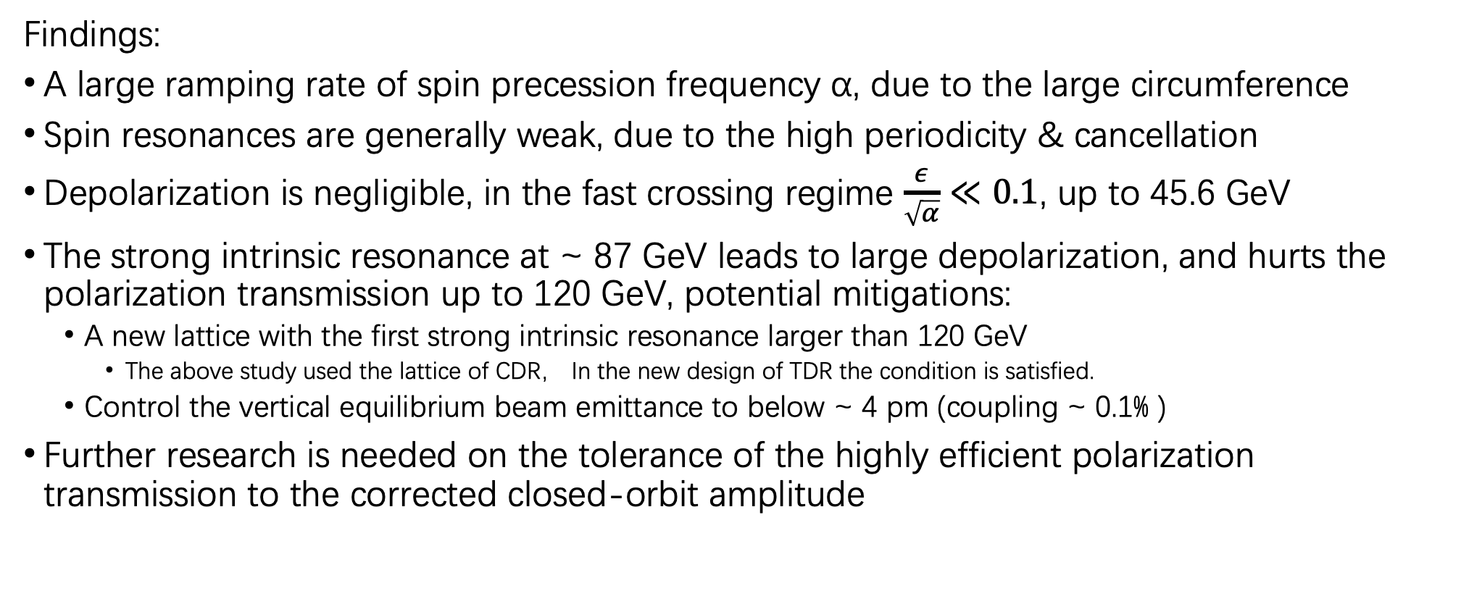
Short summary
Findings:
A large ramping rate of spin precession frequency α, due to the large circumference
Spin resonances are generally weak, due to the high periodicity & cancellation
Depolarization is negligible, in the fast crossing regime $\frac{ε}{\sqrt{α}}≪0.1$, up to 45.6 GeV
The strong intrinsic resonance at ~ 87 GeV leads to large depolarization, and hurts the polarization transmission up to 120 GeV, potential mitigations:
  A new lattice with the first strong intrinsic resonance larger than 120 GeV
    The above study used the lattice of CDR， In the new design of TDR the condition is satisfied.
  Control the vertical equilibrium beam emittance to below ~ 4 pm (coupling ~ 0.1% )
Further research is needed on the tolerance of the highly efficient polarization transmission to the corrected closed-orbit amplitude

Slide 12
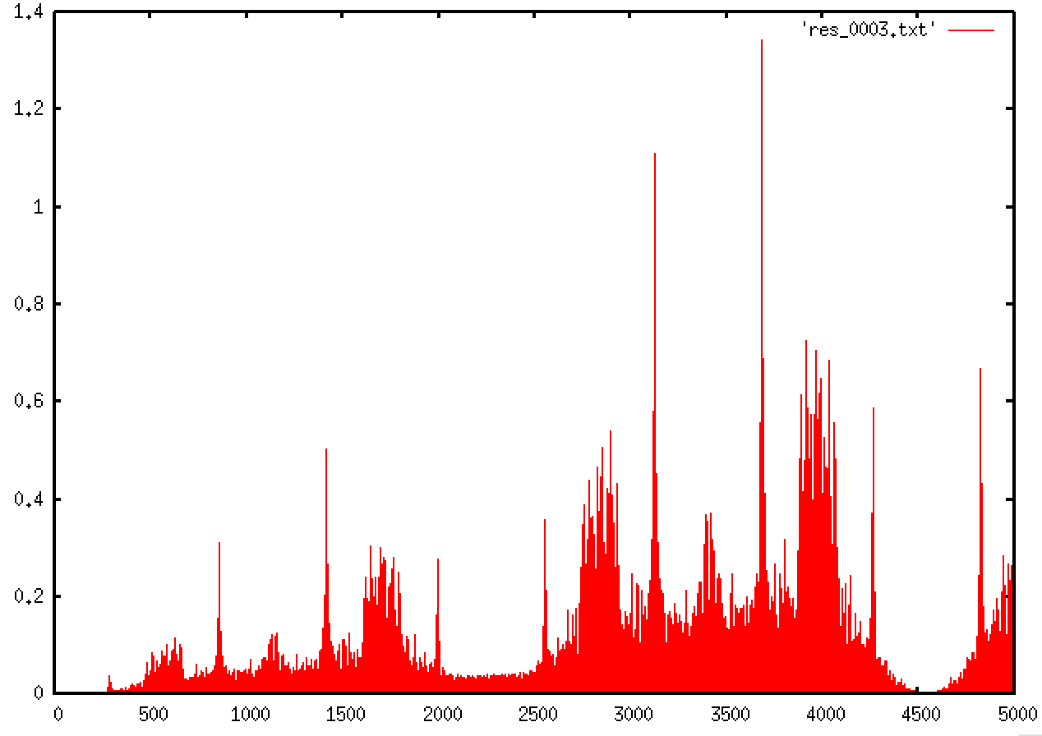
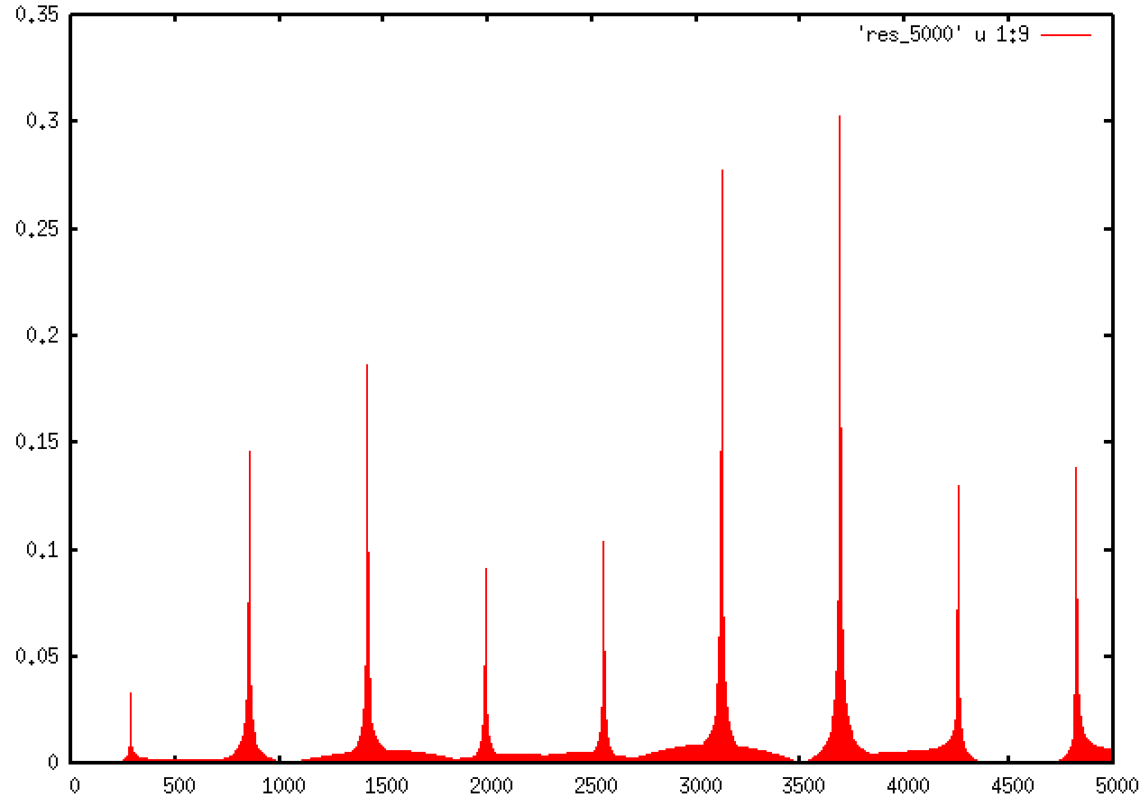







New tdr lattice
$ν_{B}$=281 , $ν_{z}$=353.28
Rms orbit=2mm
Imperfection resonance
Intrinsic resonance
$$PM+ν_{B}$$
$$PM−ν_{B}$$
$$PM+ν_{B}$$
$$PM−ν_{B}$$
$$PM+{2ν}_{B}$$
$$PM−2ν_{B}$$
281.28
280
aGamma
aGamma

Slide 13
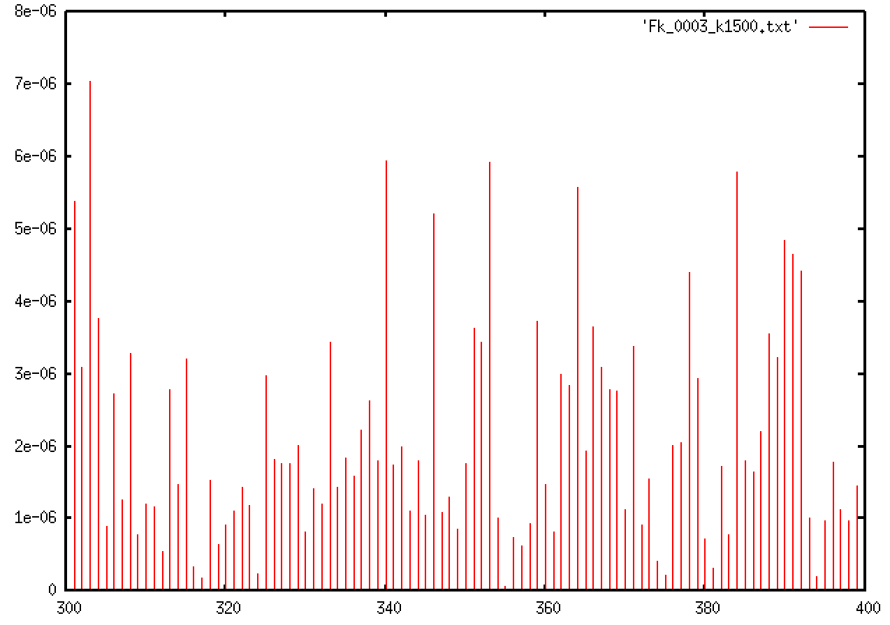
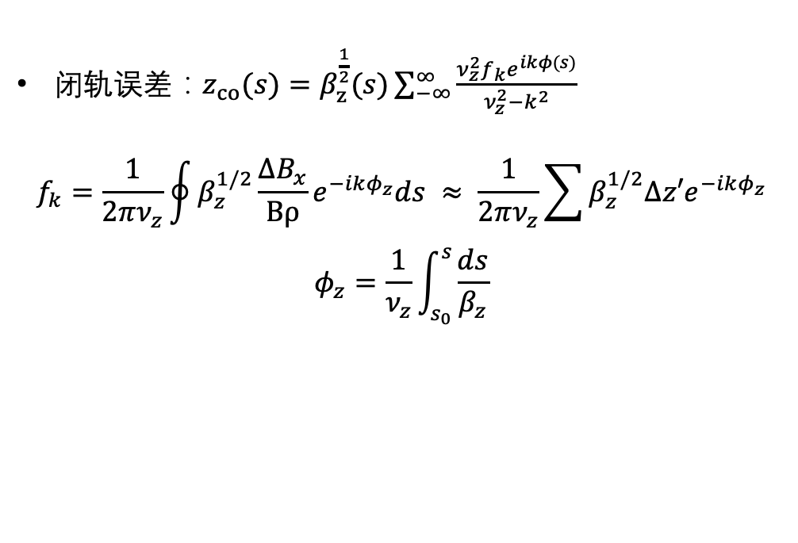
backup
闭轨误差：$z_{co}(s)=β_{z}^{\frac{1}{2}}(s)\sum_{−∞}^{∞}{\frac{ν_{z}^{2}f_{k}e^{ikφ(s)}}{ν_{z}^{2}−k^{2}}}$
$$f_{k}=\frac{1}{2πν_{z}}\oint{β_{z}^{1/2}\frac{ΔB_{x}}{Bρ}e^{−ikφ_{z}}ds} ≈ \frac{1}{2πν_{z}}\sum{β_{z}^{1/2}∆z′e^{−ikφ_{z}}}$$
$$φ_{z}=\frac{1}{ν_{z}}\int_{s_{0}}^{s}{\frac{ds}{β_{z}}}$$
fk
k
355,fk=7e-8

