Slide 1
Beta source test for TaichuPix3 chip S1
Tianya Wu, Wei Wang, Ziyue Yan
wuty@ihep.ac.cn

Slide 2
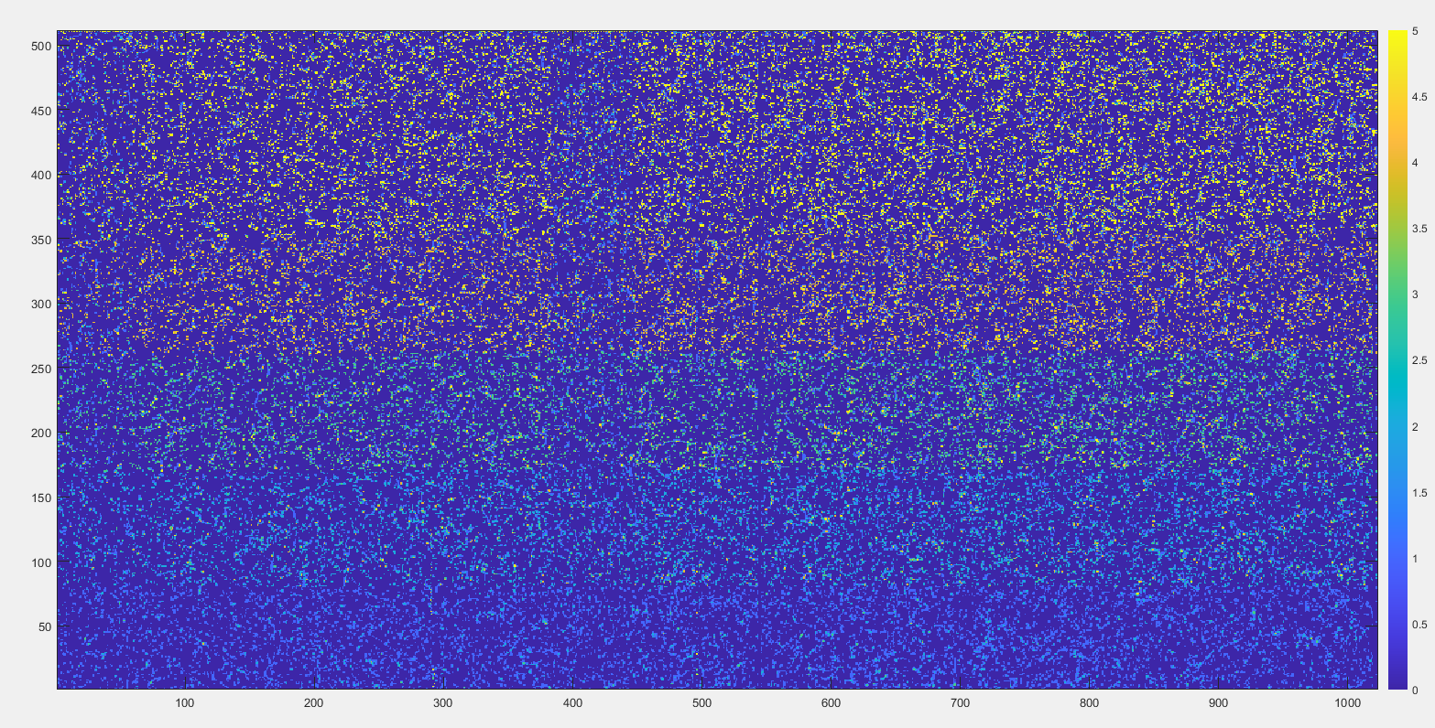
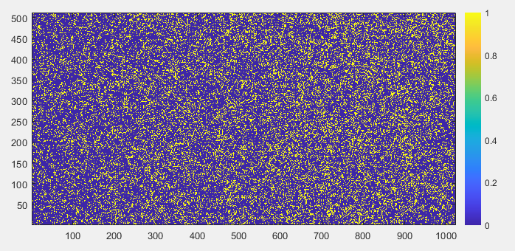
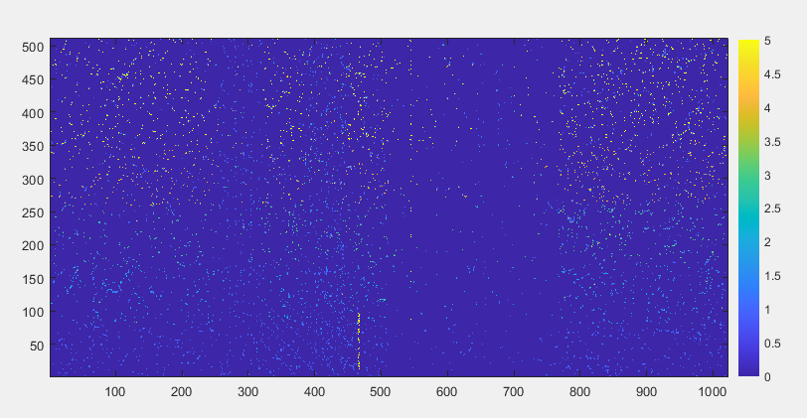
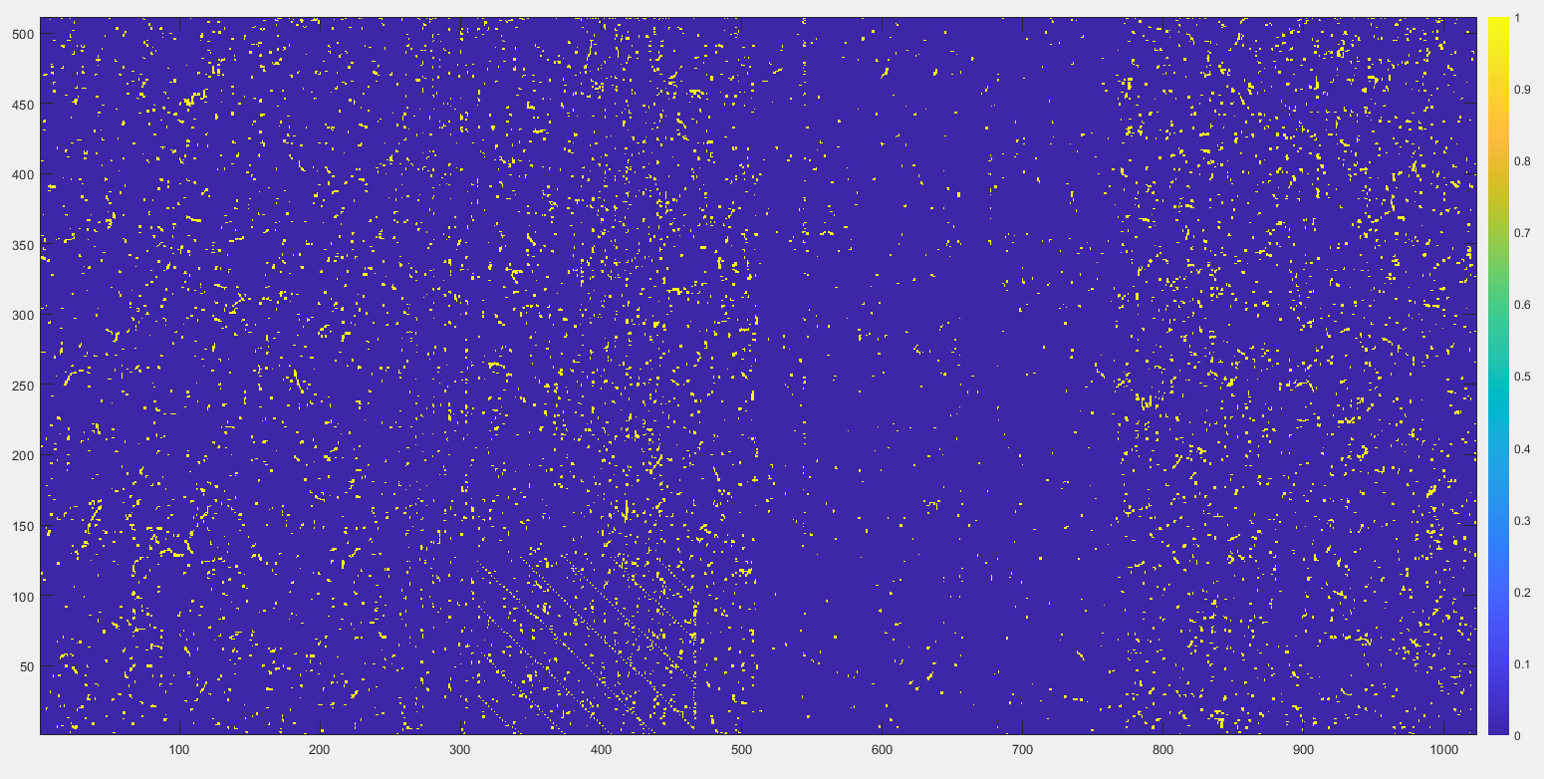
Inject bata source from the front
ITHR =100000, mask noisy pixels , it is almost no pixels recorded
When source was put on the top, new noisy pixels appeared
ITHR=11000
ITHR=100000
ITHR=10000000 with noisy pixels

Slide 3
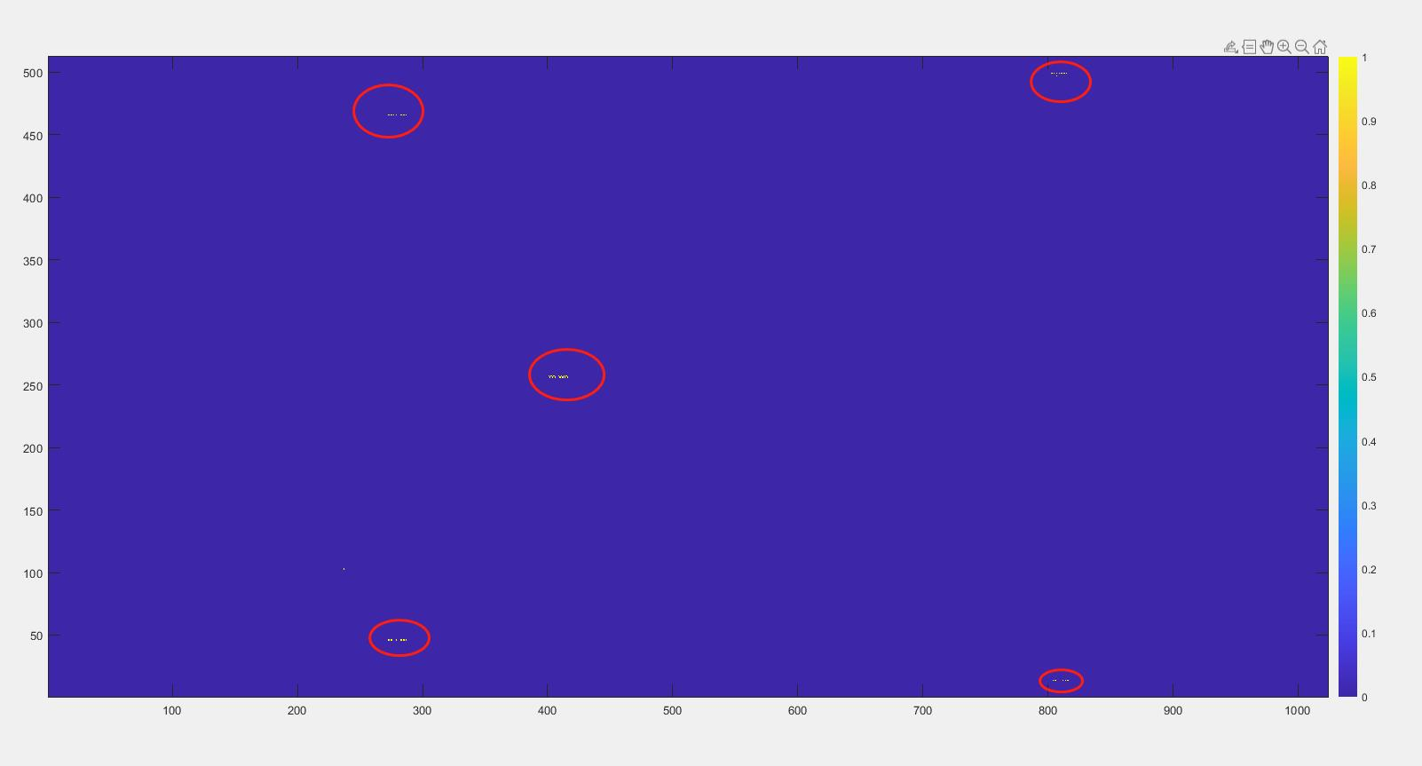
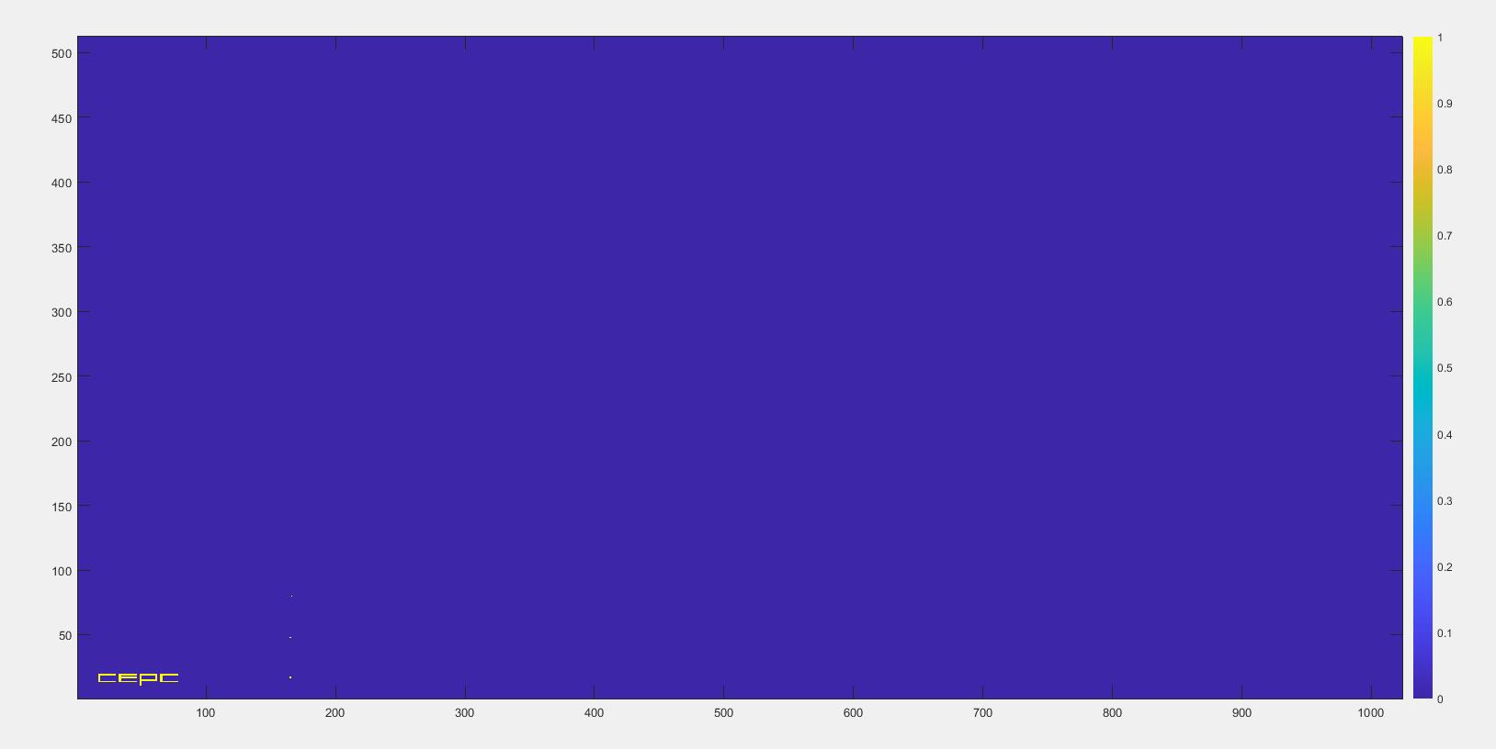
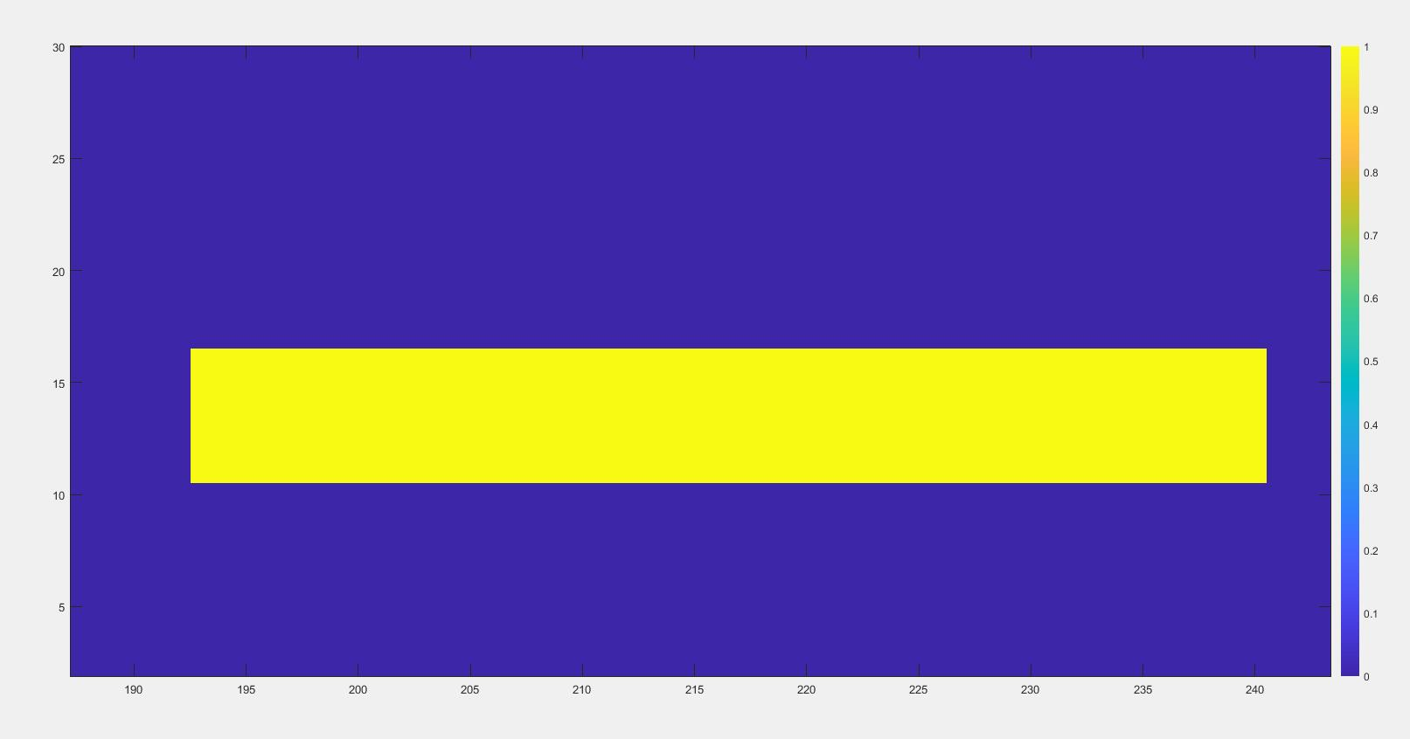
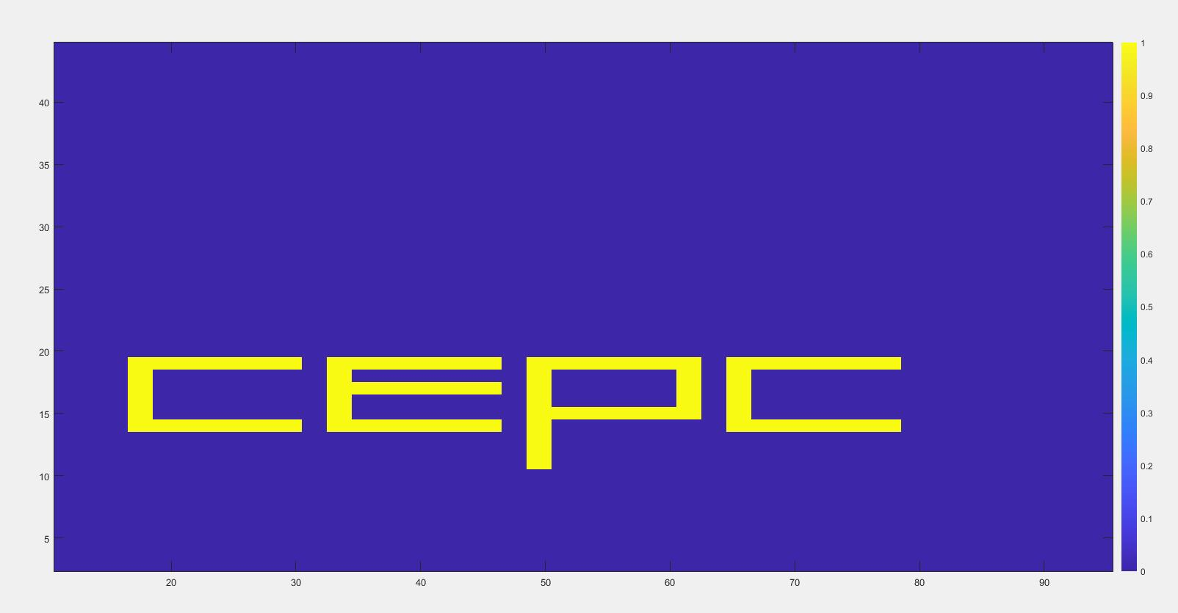
Inject apuse with a masking table

Slide 4
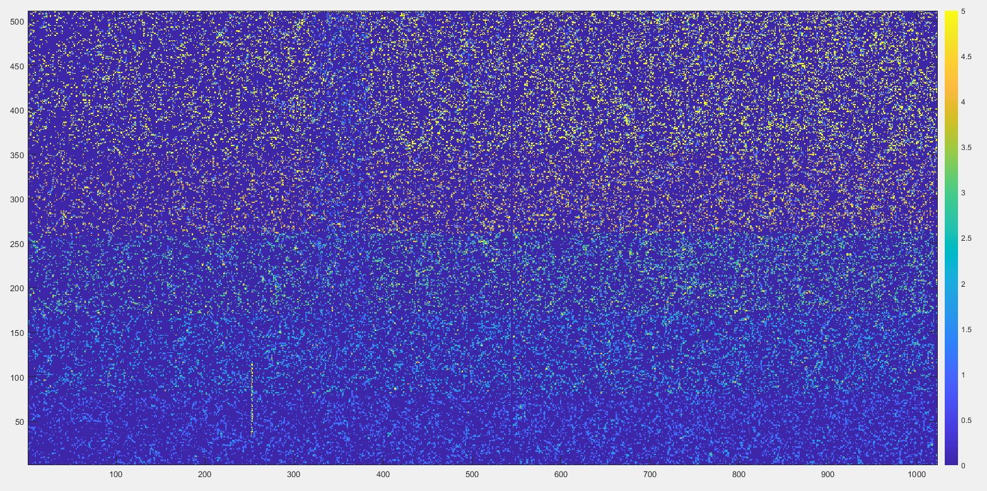
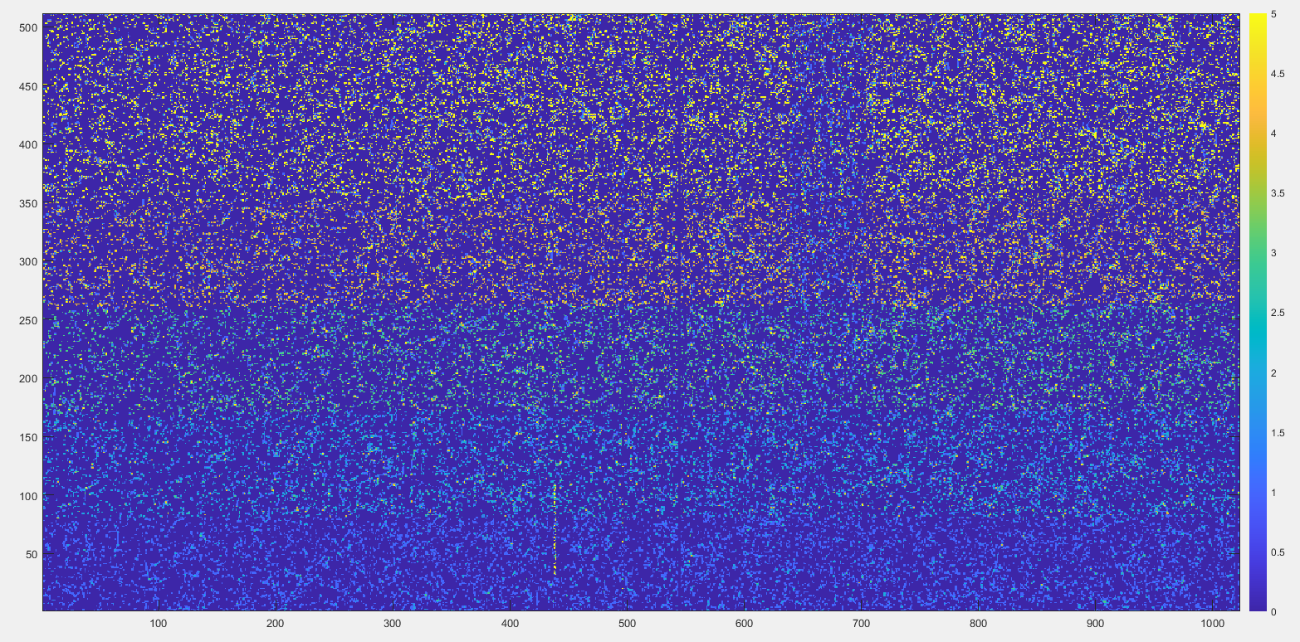
Different ITHR test
ITHR=10000000
Average cluster size: 2.83
ITHR=1000000
Average cluster:2.68
ITHR =100000, as a baseline ,clean some noisy pixels
The hitmap is more or less the same.
Preliminary cluster size is wired, more verification needs to be done.
ITHR=100000
Average cluster: 2.79

Slide 5
Thanks for your attention!

