Slide 1
DAQ progress
2022.09.29

Slide 2
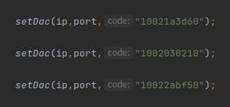
DAQ status
Found the cause of unstable configuration
The binary is read and written in reverse order
After the configuration is completed, we need to sleep for one second before making a TCP connection
otherwise

Slide 3
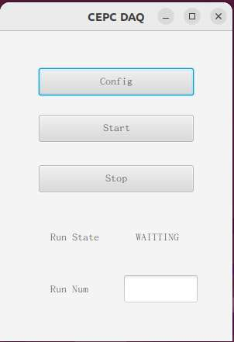
DAQ update
Simple operation control
One time configuration, multiple start and stop
Applicable to single board and multi boards
The configuration and data access of multiple chips on a single board need to be discussed to determine the details

Slide 4
NEXT
Determine the multi chips configuration process
During apulse, some data are duplicated, determine the reason and the solution
Test the function of multi boards

Slide 5
THANKS

