Slide 1
TTIM Firmware specification
Jianmeng Dong, Guanghua GONG
Tsinghua University, Beijing
21 June, 2019

Slide 2
Firmware design
RMU
GU
Trigger link: handle communication with the RMU. 1.25Gbps line rate.
Trigger logic: deliver trigger decision to SYNC links; calculate nhit of 48 channels and generate raw nhit data to trigger link.
SYNC links: handle communication with the GCUs. Fanout trigger decision and receive hit information.
Time and clock: generate clocks; keep time counter.
WR interface: communicate with WR network. Get timestamp and slow control commands.
Control registers: bridge between WR and control interface of other modules.
Monitors: board temperature, voltage, current.
MM trigger link: link with the MM trigger system
WR
Trigger link
MM Trigger link
Monitors
WR interface
Trigger
logic
Time
Clock
Control registers
SYNC links
. . .
GCU

Slide 3
Trigger link
nHit format to RMU:
15 8 | 7 0
nHit | x”BC”
单模光纤连接到RMU。
Lower 8 bits is encoded as comma every 1ms
TTIM received trigger info:
15 | 14 8 | 7 0
T | Trigger Type | x”BC”

Slide 4
Trigger logic
Threshold
mask
Local nhit
trigger
nhit
Trigger decision
period
Periodic
trigger
External、manual、CTU trigger
0

Slide 5
WR interface
Get PPS and timestamp.
Send and get data from mini-WR
LiteBus, an IPbus like protocol is developed. Using address to control corresponding registers.
8 bits address support 256 registers
从WR获得125MHz时钟，2分频系统时钟62.5M。
从WR获得时间戳为UTC时间，格式为40b的秒计数加28b的细时间计数（8ns）。
本地时间戳为48b，由20b秒计数*125M+28b细计数得到。
Request:
63 60 | 59 57 | 56 | 55 48 | 47 0
0100 | Trans ID | R/W | address | Payload data
Respond:
63 60 | 59 57 | 56 | 55 48 | 47 0
0100 | Trans ID | 0 | address | Payload data

Slide 6
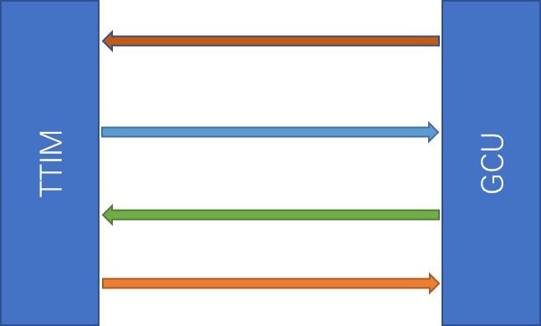
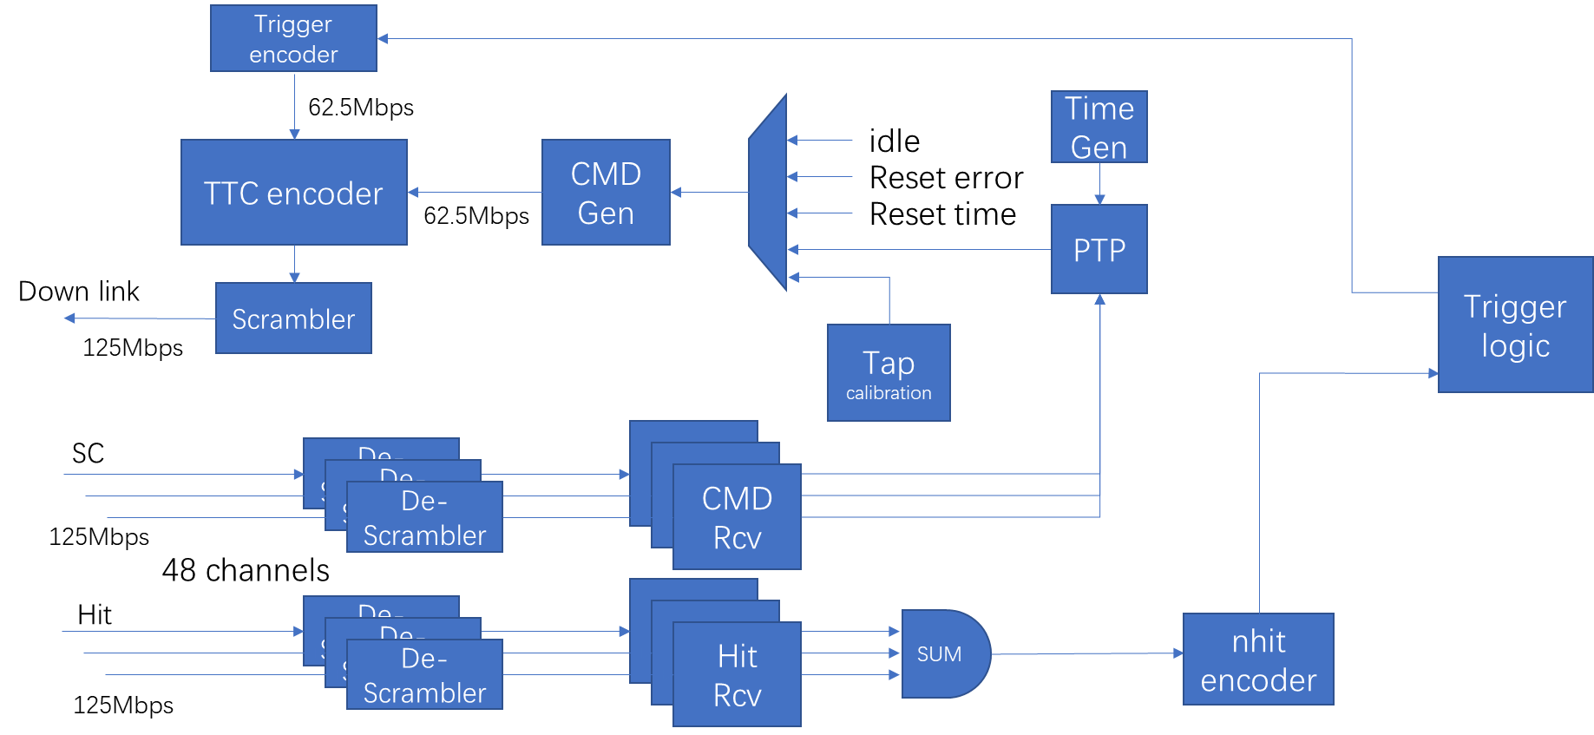
SYNC link definition and firmware
nhit
Firmware structure:
SC down
X
SC up
CLK
Orange: 62.5M clock to the GCU;
Green: slow control up link; 125Mbps, Biphase Mark Code(BMC);
Blue: trigger + slow control down link; 125Mbps, BMC;
Brown: 125M scrambled hit stream

Slide 7
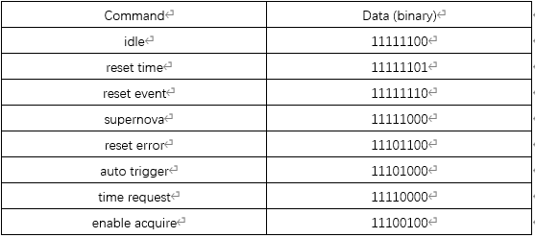
SC链路协议，修改版的TTC
广播帧格式
删除了TTC的a通道
b通道命令格式有广播帧和长帧两种
长帧通过address指定GCU_ID（1到48），sub-addr确定命令类型。
Address为0的长帧也是广播，所有GCU都会接收。
长帧格式

Slide 8
链路采样点设置
SC下行链路，GCU根据TTC解码错误计数器寻找合适的采样点。
SC上行链路，由BEC发出调整IODELAY指令，GCU调整延迟，BEC监测TTC解码错误计数器。重复该步骤直至扫描完124步（4个IODELAY ），选择眼的中间位置作为采样点。
Nhit链路，BEC先发指令使GCU在nhit链路发送PRBS，然后与SC上行链路步骤相同（使用PRBS错误计数器），扫描眼图然后选择采样点。

Slide 9
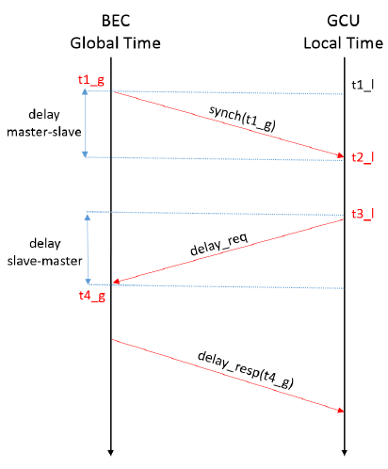
PTP procedure:
Initiate by BEC: send long-frame command (contain global time);
SYNC received by GCU: matched GCU ID, sub-addr of long-frame is x09;
Delay_req from GCU: long-frame with sub-addr x19;
Delay_rsp by BEC: send the timestamp when received the delay_req to GCU
Assume delay_ms = delay_sm
!
delay_ms = delay_sm $=\frac{\left(t_{4_g}− t_{3_l}\right)+(t_{2_{l}} − t_{1_g})}{2}$
delay_ms includes logic delay and cable delay.
Set the “total delay” as delay_t (constant), the coarse delay of GCU as delay_c, then:
delay_c = delay_t – delay_ms – delay_logic
The BEC will get each GCU’s hit information with same time-stamp.
Longest cable is around 100m while the shortest is longer than 30m, given the longest propagation difference around 350ns (5ns/m). Coarse delay has 8ns step-length. Set the delay_t as 352ns (44 steps of coarse delay) is reasonable.
Cable length from Lei Fan

Slide 10
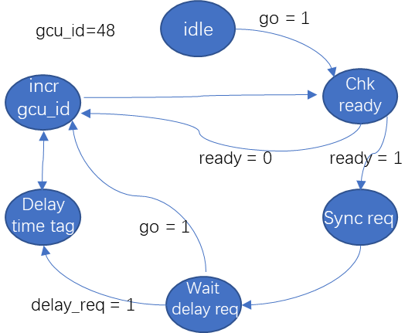
简化的PTP状态机
48个通道串行执行
通过配置channel_mask跳过未连接的通道。
使能后运行一次，未完成的通道会再次运行。

Slide 11
触发时间戳下发
BEC记录触发判选的时间戳并存入FIFO
FIFO非空时，从FIFO中读取一个时间戳通过SC下行链路发送。
使用TTC长帧命令发送，48b的时间戳共需6个TTC长帧。

Slide 12
温度、电压、电流监测
BEC板上有左、中、右3个温度传感器，一个电源监测芯片，均为I2C接口。
FPGA的温度、电压等，从FPGA内部的XADC读取。
各个检测值以寄存器形式，从慢控接口读取。

