Slide 1
Machine learning for Higgs physics at LHC
Jin Min Yang
ITP, CAS
第26届LHC Mini-Workshop
顺义 2022.10.29-30

Slide 2
Based on:
Ren, Wu, JMY, Zhao,
Exploring supersymmetry with machine learning,
e-Print: 1708.06615
Abdughani, Ren, Wu, JMY,
Probing stop pair production at the LHC with graph neural networks,
e-Print: 1807.09088
Ren, Wu, JMY,
Unveiling CP property of top-Higgs coupling with graph neural networks at the LHC,
e-Print: 1901.05627
Abdughani, Ren, Wu, JMY, Zhao,
Supervised deep learning in high energy phenomenology: a mini review,
e-Print: 1905.06047
Abdughani, Wang, Wu, JMY, Zhao,
Probing triple Higgs coupling with machine learning at the LHC,
e-Print: 2005.11086
Ren, Wang, Wu, JMY, Zhang,
Detecting an axion-like particle with machine learning at the LHC
e-Print: 2106.07018

Slide 3
Contents
Introduction to machine learning
Machine learning for CP property of top-Higgs coupling at LHC
Machine learning for triple-Higgs coupling at LHC
Machine learning for an ALP at LHC
Conclusion

Slide 4
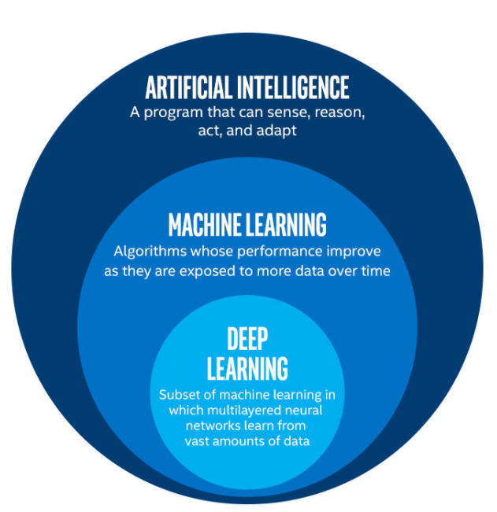
1 Introduction to machine learning

Slide 5
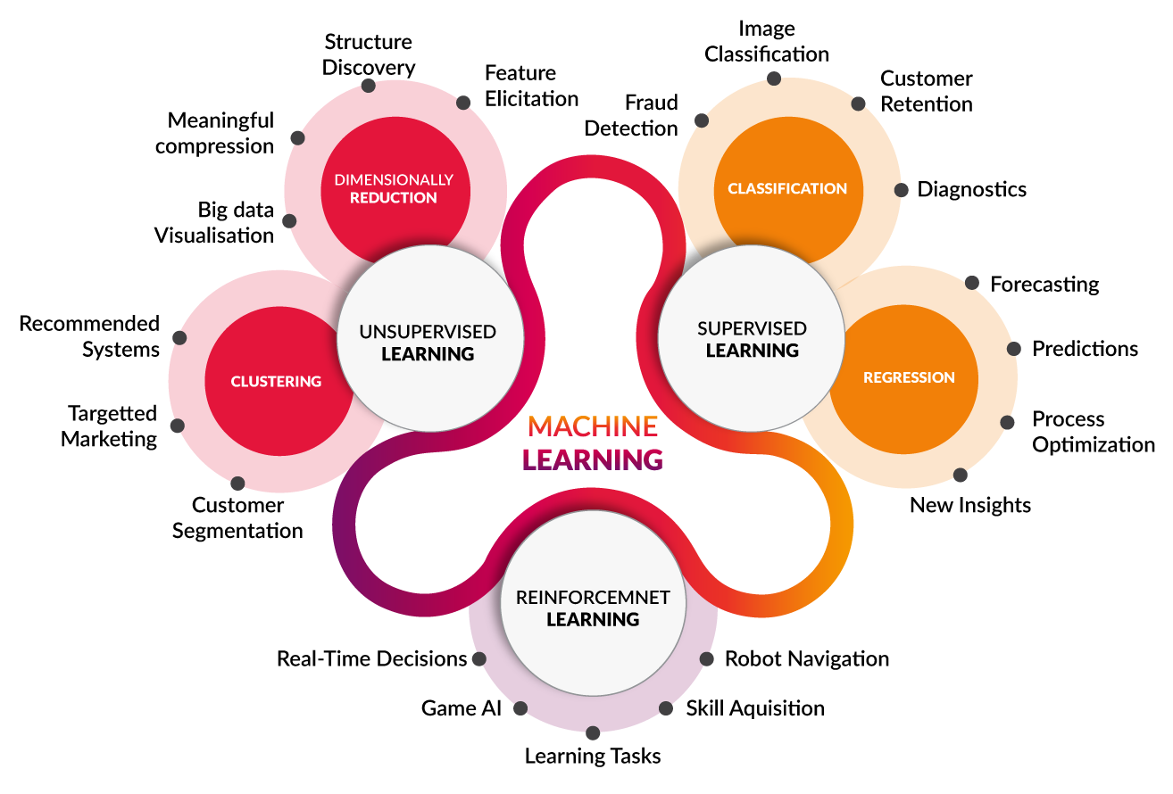

Slide 6
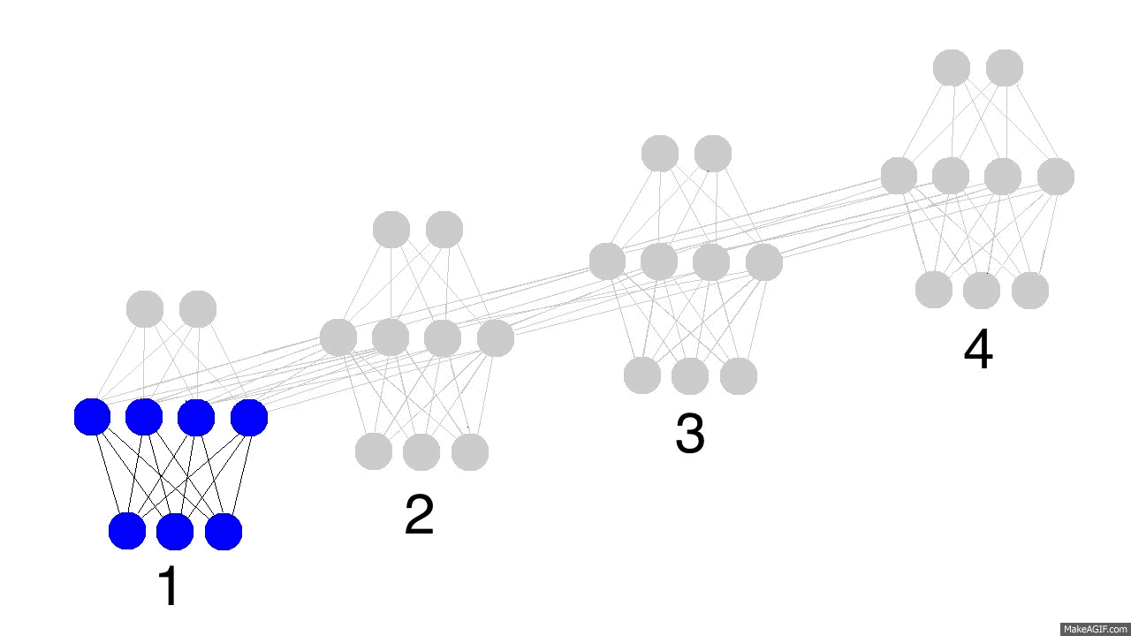
Neural Network
Warren McCulloch and Walter Pitts (1943) created the first neural network based on mathematics and algorithms called threshold logic.
The perceptron algorithm was invented in 1957 at the Cornell Aeronautical Laboratory by Frank Rosenblatt.
For multilayer perceptron (feed-forward neural network), where at least one hidden layer exists, more sophisticated algorithms such as backpropagation (Rumelhart, Hinton and Williams, 1986) must be used.

Slide 7
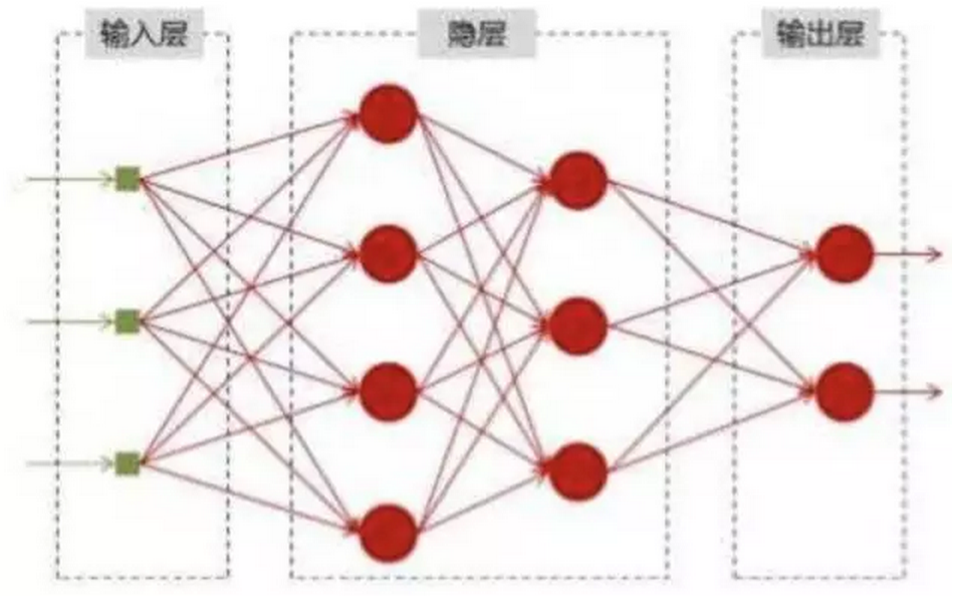


Neural Network
input
hidden
output
input $x$
output $y$

Slide 8
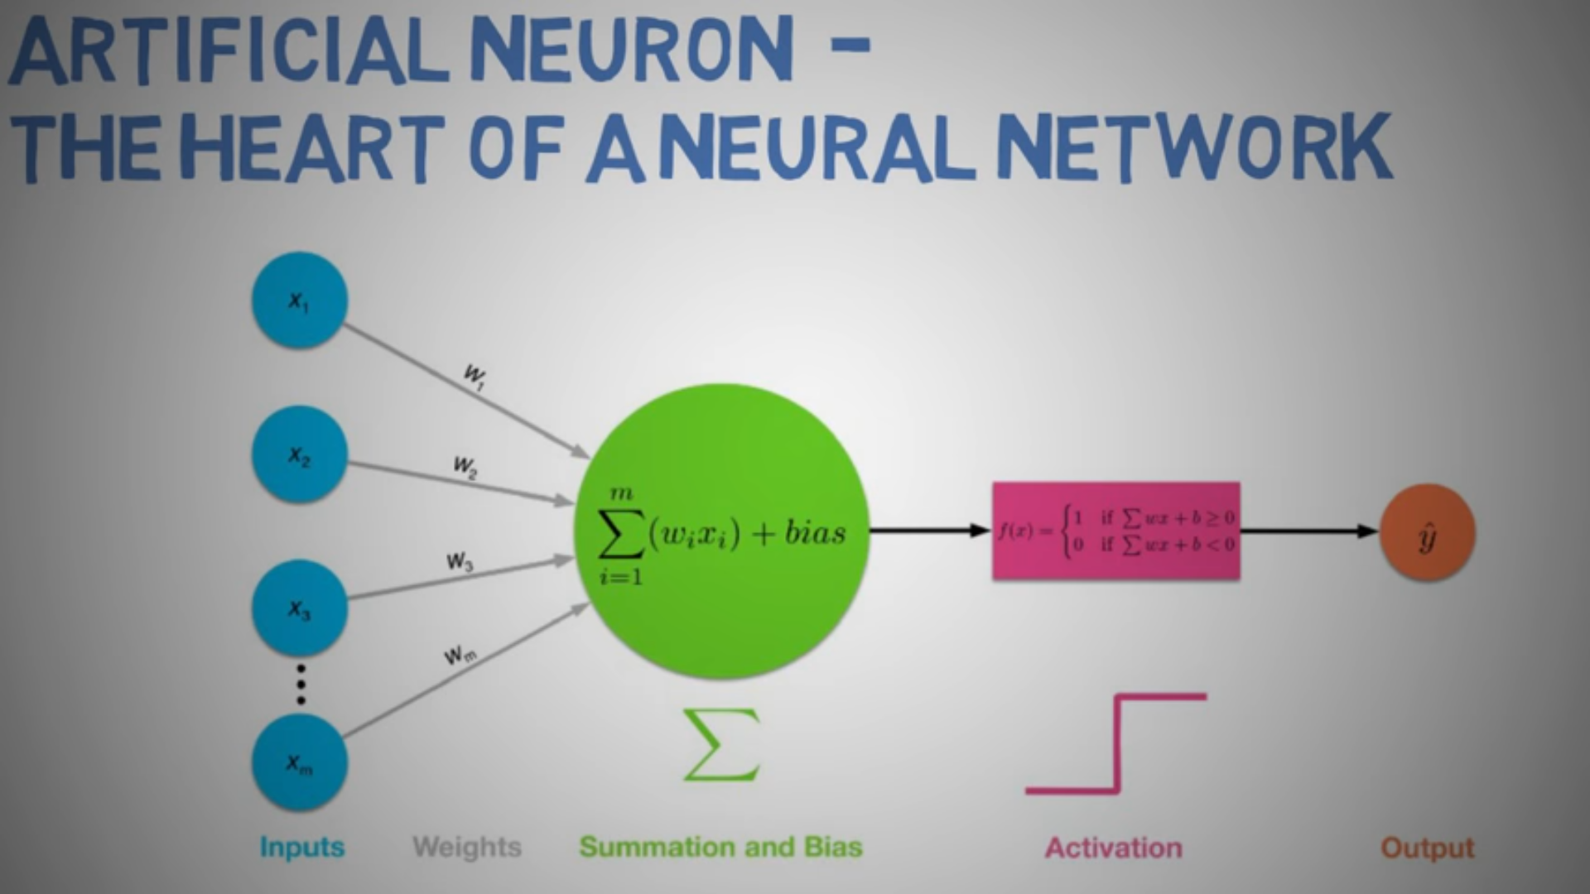

Slide 9
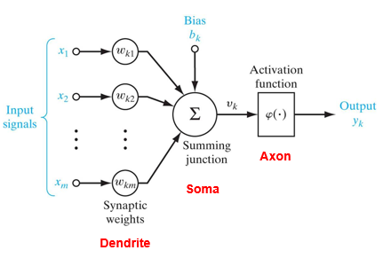
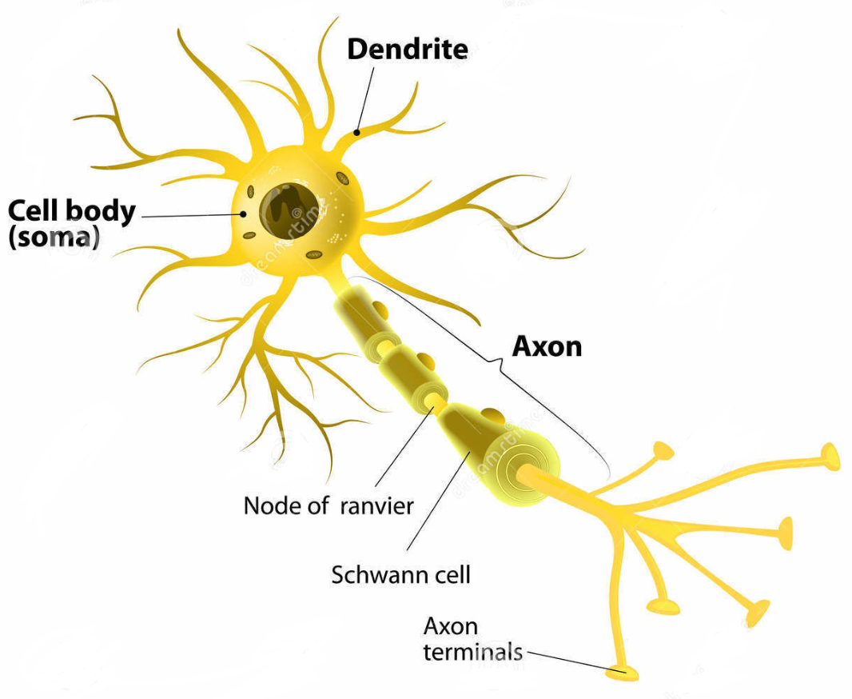

Slide 10
Machine Learning in HEP
Abdughani, Ren, Wu, JMY, Zhao, 1905.06047
Supervised deep learning in high energy phenomenology: a mini review
GOAL
  “Solve” HEP problems using DATA
EXAMPLE
  Physics model selection
    Scan (e.g. 1011.4306, 1106.4613, 1703.01309, 1708.06615)
  Collider
    Parton distribution function (e.g. 1605.04345)
    Object reconstruction (e.g. NIPS-DLPS)
    Pileup mitigation (e.g. 1512.04672, 1707.08600)
    Jet tagging (e.g. 1407.5675, 1501.05968, 1612.01551, 1702.00748)
    Event selection (e.g. 1402.4735, 1708.07034, 1807.09088)
    Decayed object reconstruction
    Anomaly event detection (e.g. 1807.10261)

Slide 11
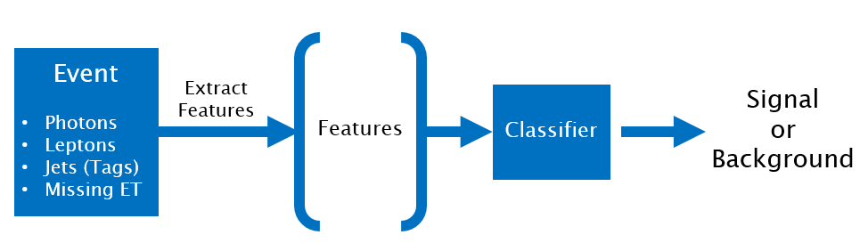
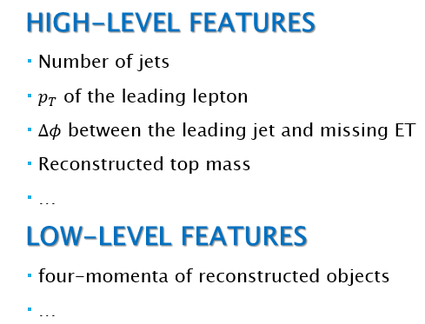
Machine Learning in HEP
An event is a signal or background ?

Slide 12
Methods for Event Selection
B
Cut-flow
S
Control Region
Signal Region

Slide 13
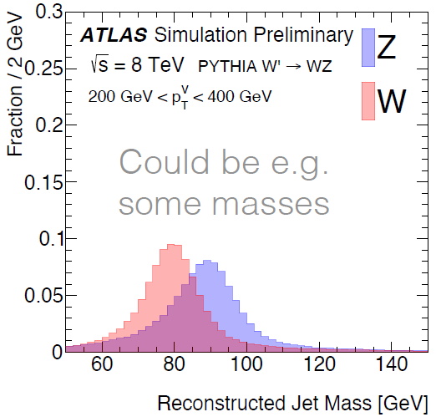
Methods for Event Selection
Cut-flow

Slide 14
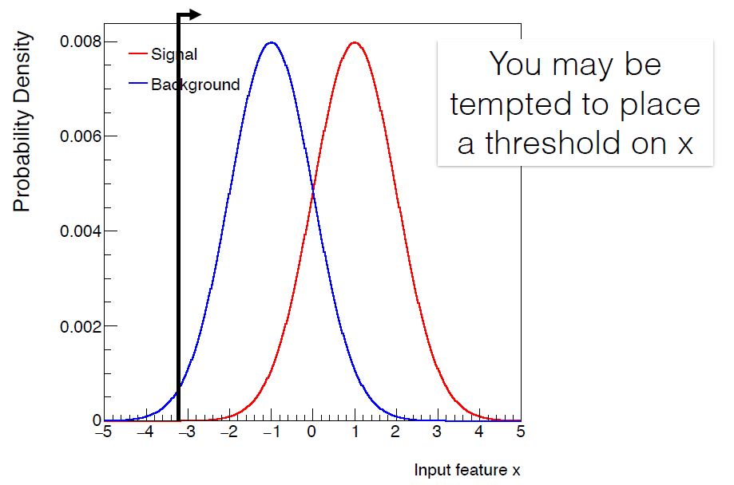
Methods for Event Selection
Cut-flow

Slide 15
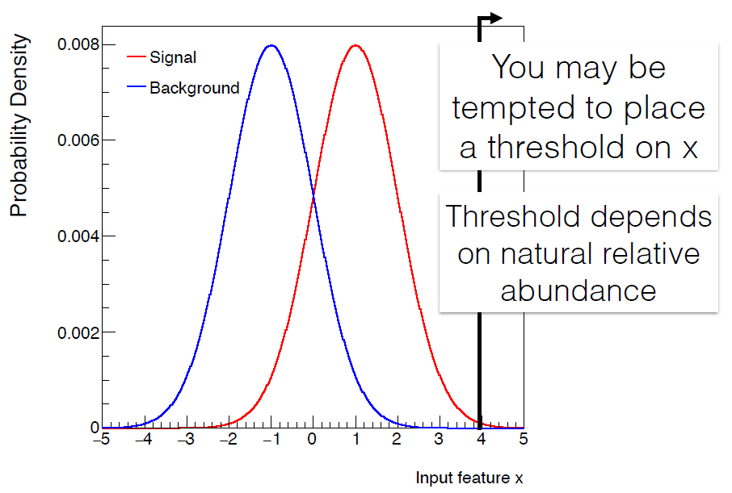
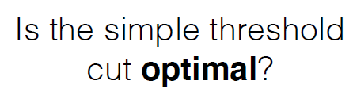

Methods for Event Selection
Cut-flow

Slide 16
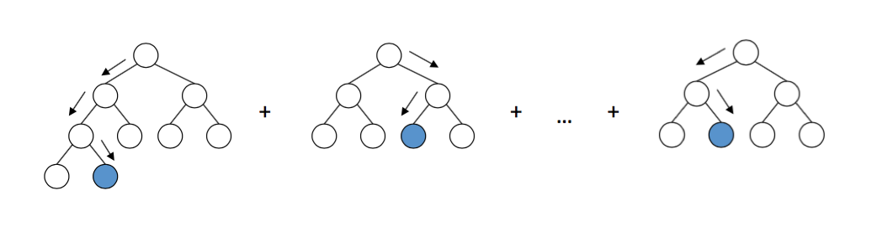
Methods for Event Selection
Cut-flow
Machine Learning
  Boosted Decision Tree (BDT)
a lot of trees → a forest
When an event comes, it passes each tree and is valued 1(signal) or 0(background). Finally, these values are averaged.

Slide 17
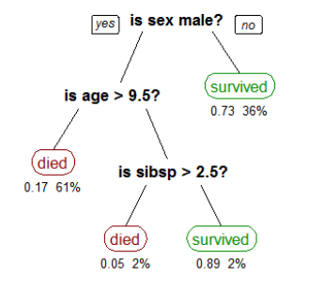
Methods for Event Selection
Cut-flow
Machine Learning
  Boosted Decision Tree (BDT)
泰坦尼克号乘客能否幸存的决策树

Slide 18
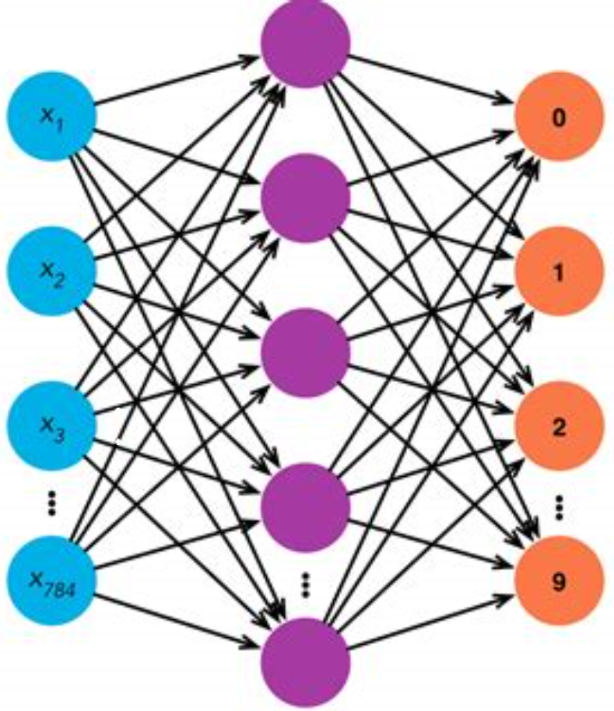
Methods for Event Selection
Cut-flow
Machine Learning
  Boosted Decision Tree (BDT)
  Neural Networks
    Shallow Neural Network (NN)

Slide 19
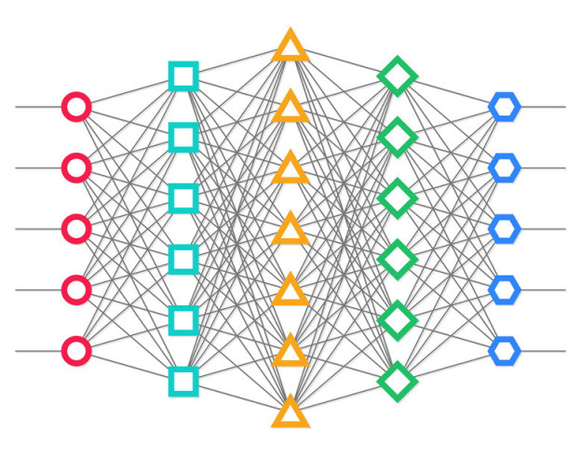
Methods for Event Selection
Cut-flow
Machine Learning
  Boosted Decision Tree (BDT)
  Neural Networks
    Shallow Neural Network (NN)
    Deep Learning
      Deep Neural Network (DNN) 1410.3469, 1402.4735, 1803.01550

Slide 20
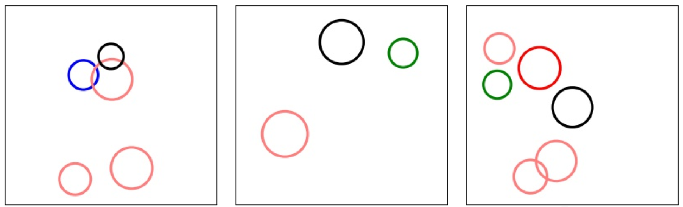

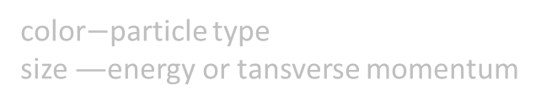

Methods for Event Selection
Cut-flow
Machine Learning
  Boosted Decision Tree (BDT)
  Neural Networks
    Shallow Neural Network (NN)
    Deep Learning
      Deep Neural Network (DNN) 1410.3469, 1402.4735, 1803.01550
      Convolutional Neural Network (CNN) 1708.07034
$$η$$
$$φ$$
color$−$particle type
size $—$energy or tansverse momentum

Slide 21
下面介绍两个神经网络
Convolutional Neural Network (CNN)
Graph Neural Network （GNN）

Slide 22
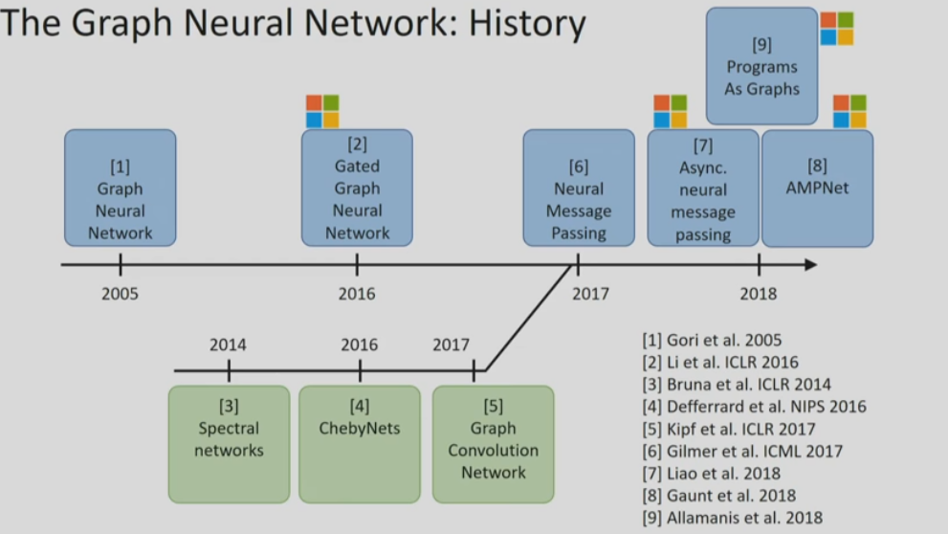
Graph Neural Network （GNN）

Slide 23
Graph Neural Network （GNN）

Slide 24
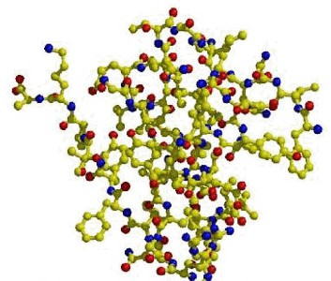
Graph Neural Network （GNN）

Slide 25

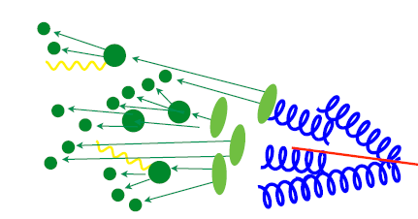



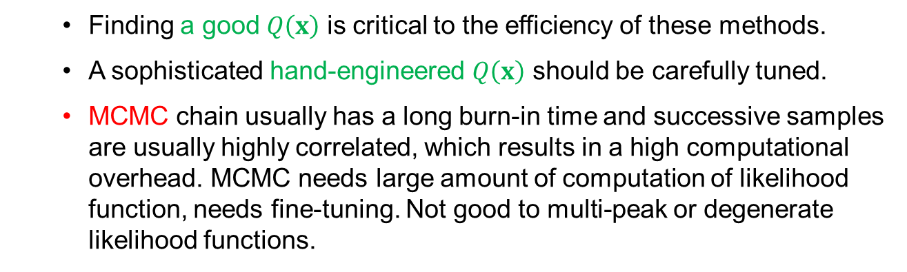




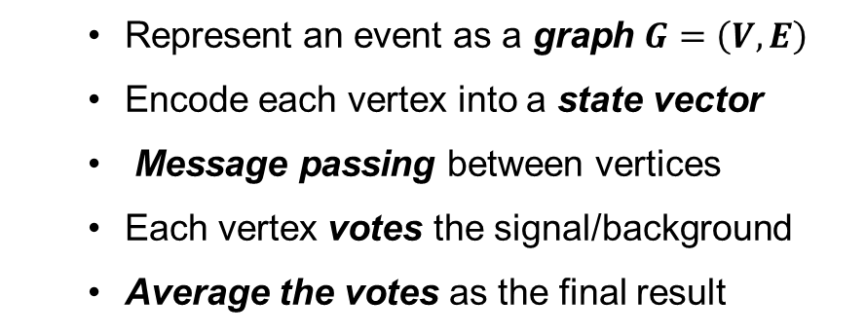


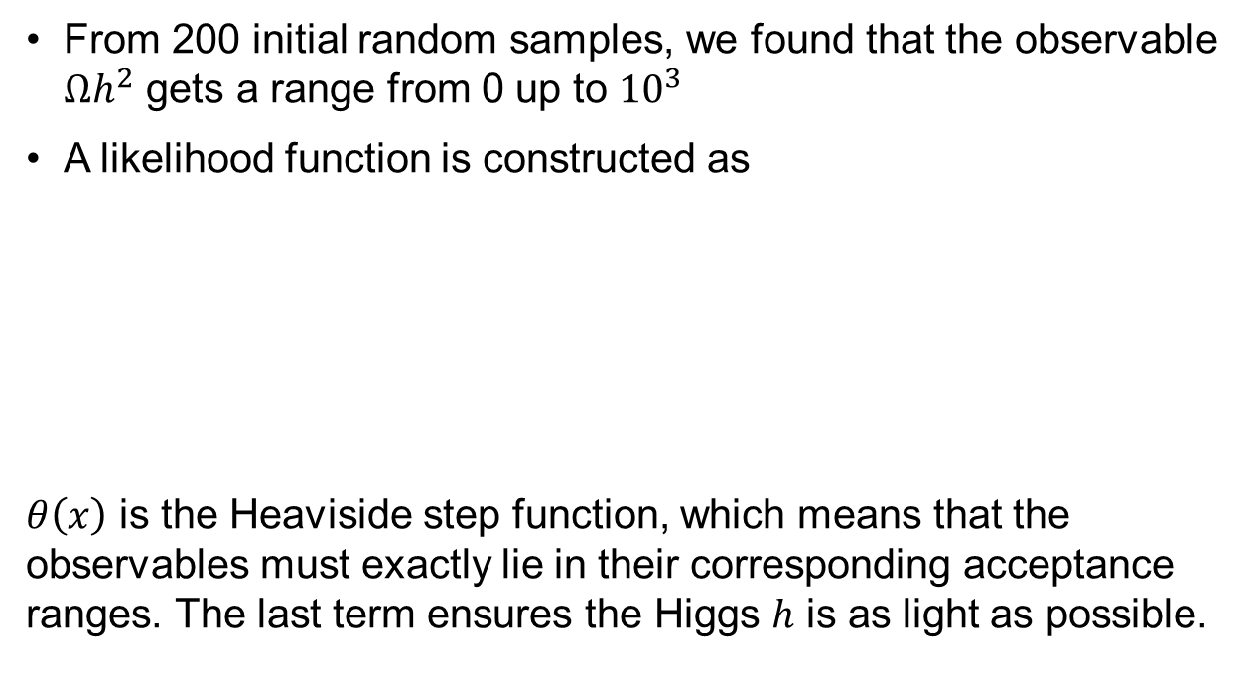





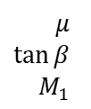

GNN applied to new physics search
Abdughani, Ren, Wu, JMY,
e-Print: 1807.09088
Our Idea
  Represent an event as a graph $G=\left(V, E\right)$
  Encode each vertex into a state vector
  Message passing between vertices
  Each vertex votes the signal/background
  Average the votes as the final result
$$E:$$
$V:$ $(0,0,1,0,m, E, P_{T})$
$$j$$
$$s_{2}$$
MP
$$s_{2}^{t}$$
encode
$$s_{1}$$
$$s_{1}^{t}$$
$$l$$
$$s_{3}$$
$$/$$
$$s_{3}^{t}$$
$$E$$
$$b$$
$$s_{4}$$
$$s_{4}^{t}$$
$$j$$
$$s_{5}$$
$$s_{5}^{t}$$
vote
S
average
S
signal or background
S
S
B

Slide 26
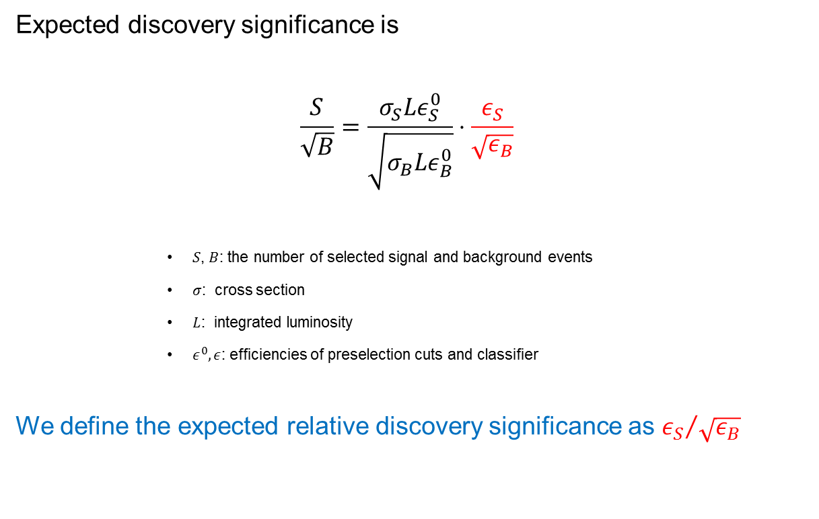
Performance Index
Abdughani, Ren, Wu, JMY,
e-Print: 1807.09088
Expected discovery significance is
  $$\frac{S}{\sqrt{B}}=\frac{σ_{S}Lε_{S}^{0}}{\sqrt{σ_{B}Lε_{B}^{0}}}⋅\frac{ε_{S}}{\sqrt{ε_{B}}}$$
      $S\text{, }B$: the number of selected signal and background events
      $σ$: cross section
      $L$: integrated luminosity
      $ε^{0},ε$: efficiencies of preselection cuts and classifier
We define the expected relative discovery significance as ${ε_{S}}/{\sqrt{ε_{B}}}$

Slide 27
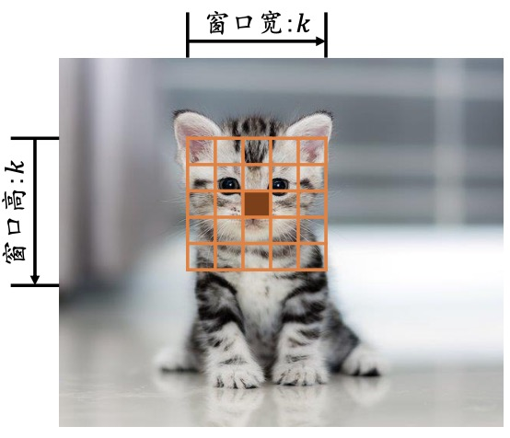
Convolutional Neural Network （CNN）
感受野(Receptive Field)
以位置或距离作为重要性分布衡量标准
图片每个像素点和周边像素点的关联度更大(位置相关)
当前位置的节点与大小为𝑘的窗口内的所有像素相连接，
与窗口外的其它像素点无关

Slide 28

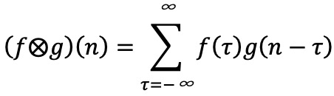
Convolutional Neural Network （CNN）
卷积的“卷”是指翻转平移操作，“积”是指积分运算
1D 连续卷积:
1D 离散卷积：

Slide 29


Convolutional Neural Network （CNN）
卷积的“卷”是指翻转平移操作，“积”是指积分运算
2D 离散卷积：
2D图片函数
2D卷积核(权值矩阵𝑾 )
𝑓(𝑖 𝑗) 和𝑔(𝑖 𝑗)仅在各自窗口有效区域存在值，其它区域视为0

Slide 30
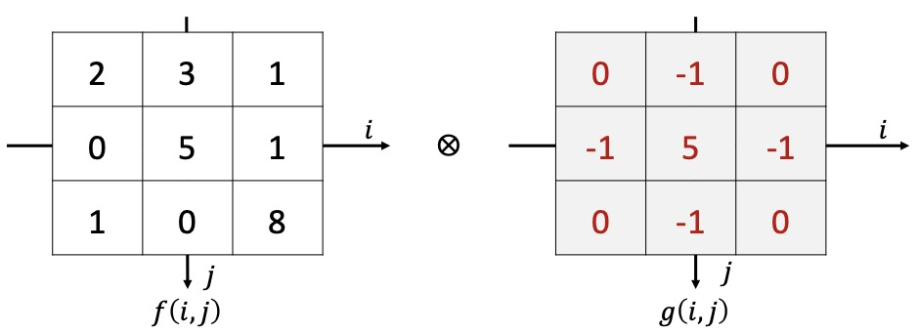

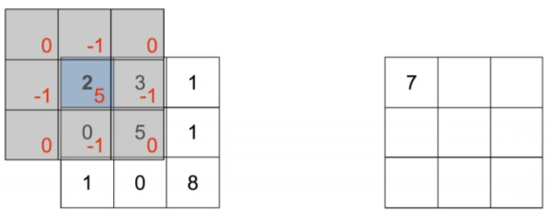
Convolutional Neural Network （CNN）
将卷积核𝑔(𝑖 𝑗)函数向左向上各平移一个单元

Slide 31
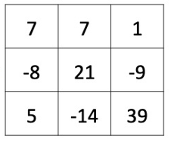

Convolutional Neural Network （CNN）
按照此种方式循环计算，
可以计算出函数𝑓⨂𝑔 (𝑚,n)
$$−1≤m, n≤1$$

Slide 32
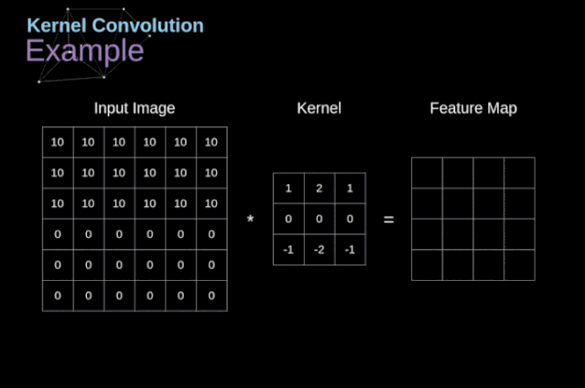
Convolutional Neural Network （CNN）

Slide 33
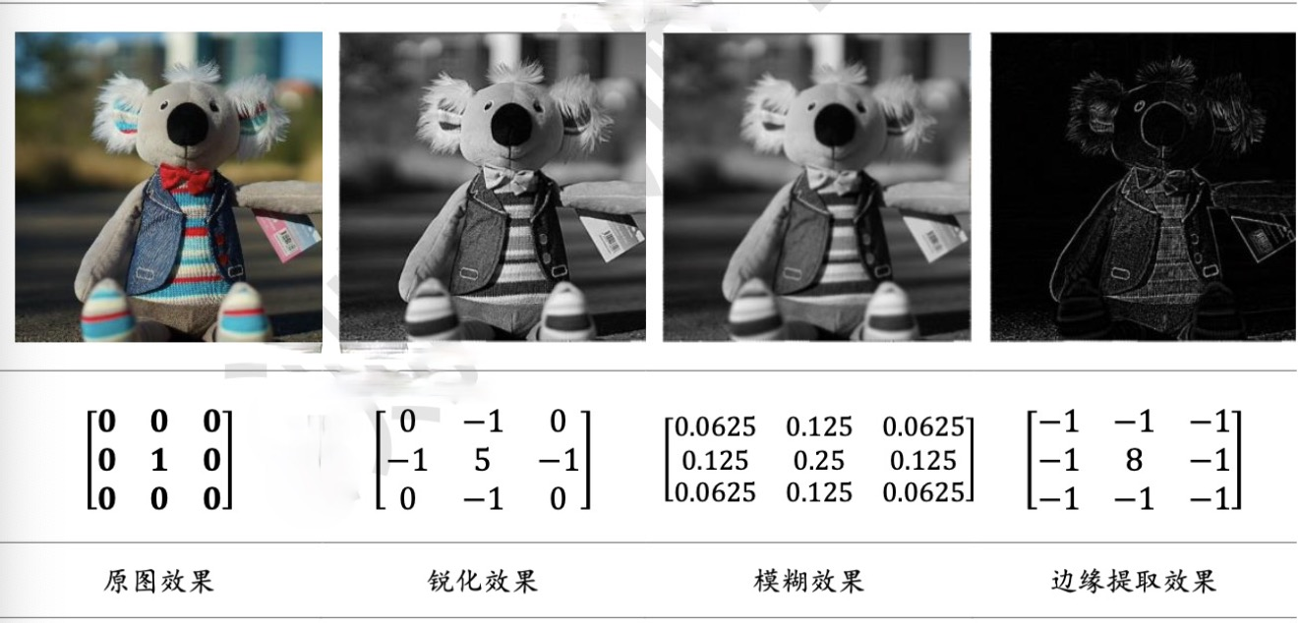
Convolutional Neural Network （CNN）

Slide 34
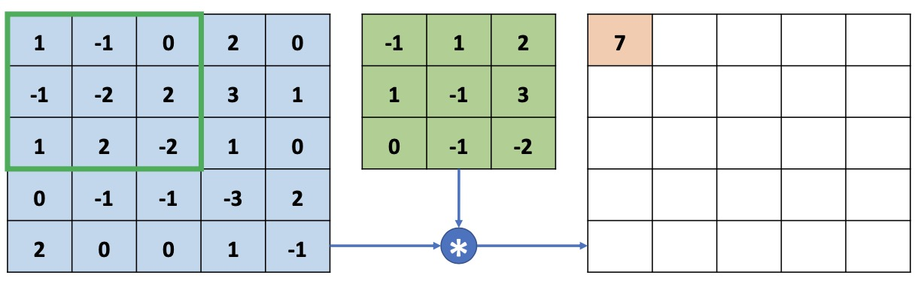
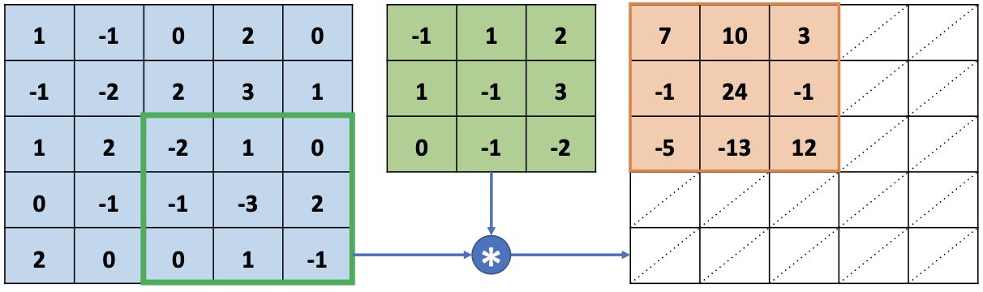
Convolutional Neural Network （CNN）
灰度图片，单个通道，单个卷积核
感受野窗口向下向右移动一个步长单位

Slide 35
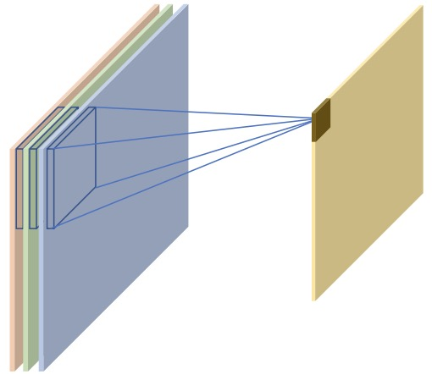
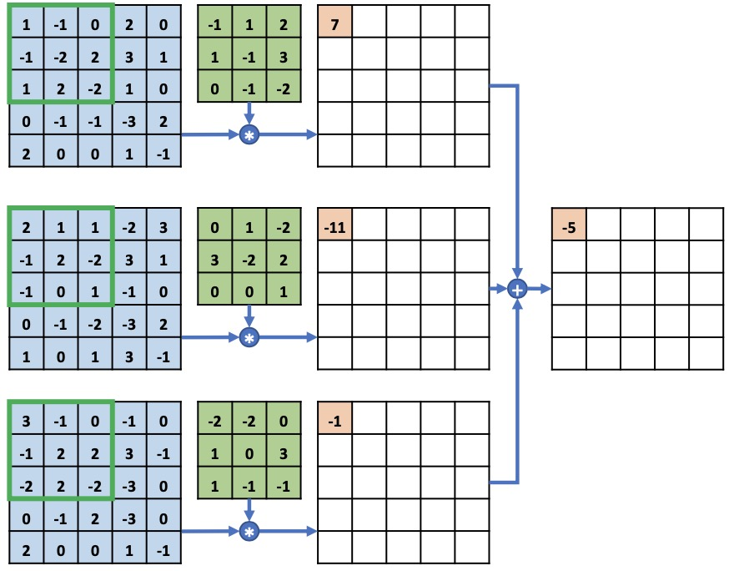
Convolutional Neural Network （CNN）
彩色图片，红绿蓝三个通道，单个3D卷积核
感受野窗口向下向右移动一个步长单位

Slide 36
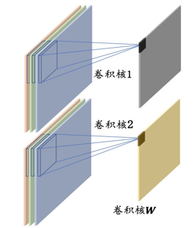


Convolutional Neural Network （CNN）
彩色图片，红绿蓝三个通道，两个3D卷积核

Slide 37
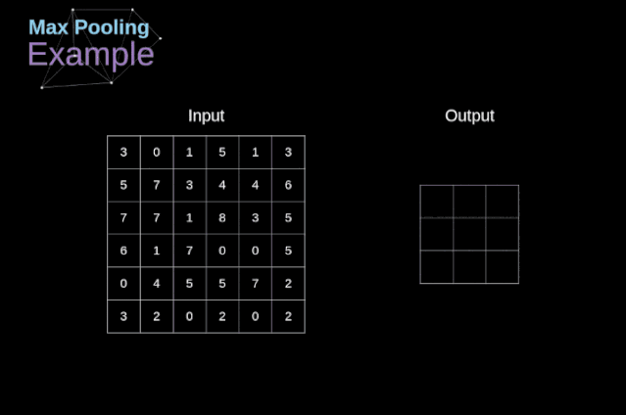
Convolutional Neural Network （CNN）
Pooling 池化 （最大Max, 平均Average） 比如 下面用一个$2×2$核进行Max Pooling

Slide 38
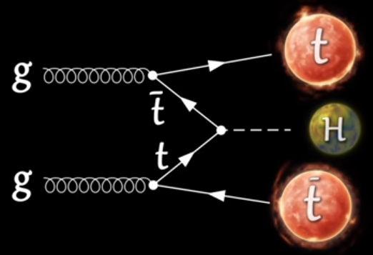
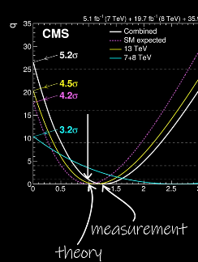
2 GNN for CP property of top-Higgs coupling at LHC
1901.05627 J Ren, L Wu, JMY

Slide 39
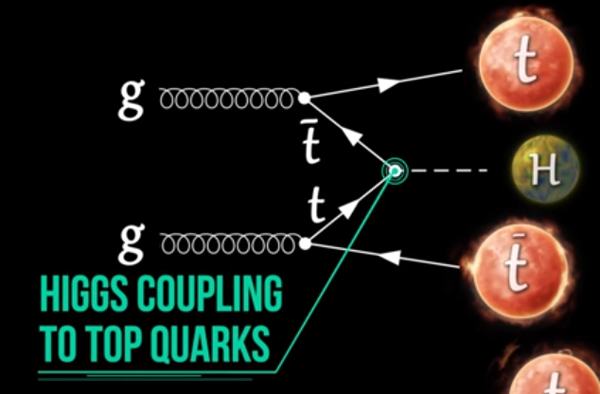
2 GNN for CP property of top-Higgs coupling at LHC

Slide 40
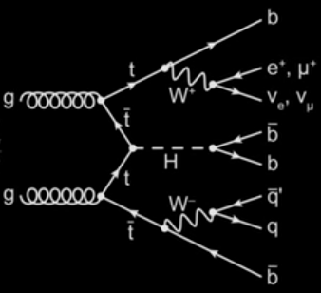
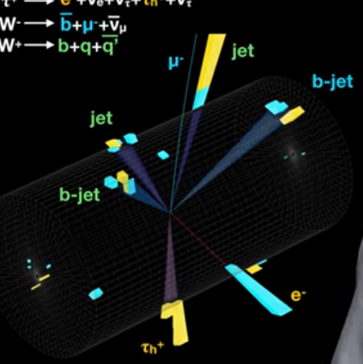
2 GNN for CP property of top-Higgs coupling at LHC

Slide 41

2 GNN for CP property of top-Higgs coupling at LHC
$$pp → t\overline{t}H \left(H=h\right) → \overline{t}t b\overline{b}$$
$$pp → t\overline{t}H \left(H=A\right) → \overline{t}t b\overline{b}$$
$pp → t\overline{t} b\overline{b}$ (background)

Slide 42
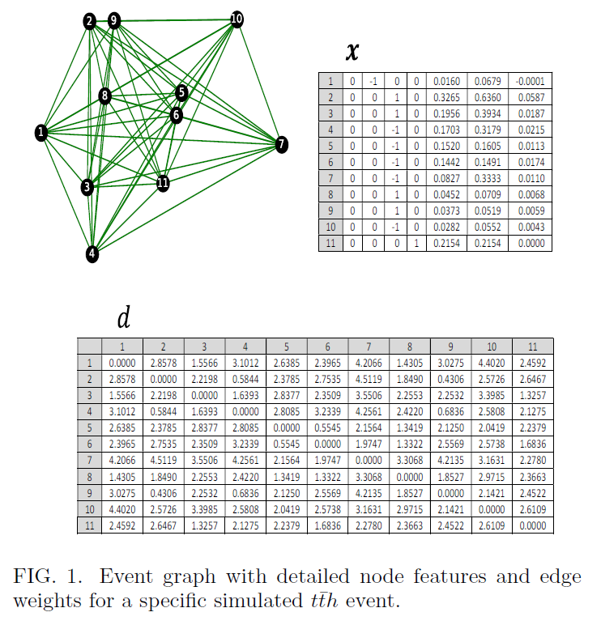
2 GNN for CP property of top-Higgs coupling at LHC

Slide 43
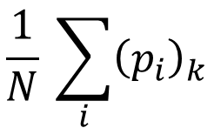




For each event:
each node $i$ gives 3 probabilities ${\left(p_{i}\right)}_{k}$ for $t\overline{t}h$, $t\overline{t}A$ and $t\overline{t}b\overline{b}$
average over all the nodes as the final output
$$p(h|e)$$
$$\frac{1}{N} \sum_{i}{{\left(p_{i}\right)}_{k}}$$
$$p(A|e)$$
$$p(b|e)$$
For each event sample $D$:

Slide 44
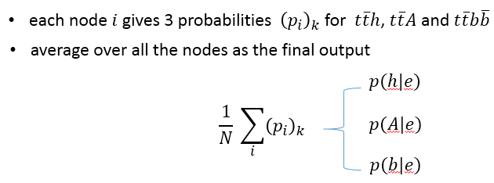
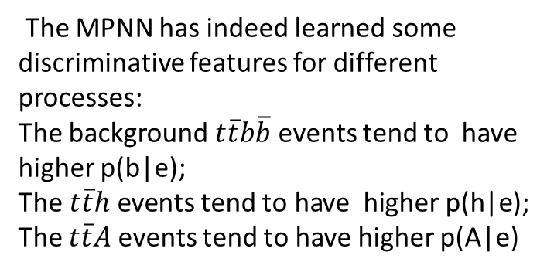
2 GNN for CP property of top-Higgs coupling at LHC
The MPNN has indeed learned some discriminative features for different processes:
The background $t\overline{t}b\overline{b}$events tend to have higher p(b|e);
The $t\overline{t}h$ events tend to have higher p(h|e);
The $t\overline{t}A$events tend to have higher p(A|e)

Slide 45
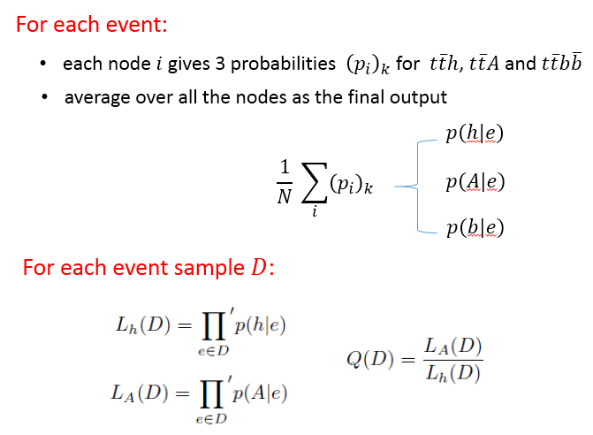

2 GNN for CP property of top-Higgs coupling at LHC
The overlap between the two distributions reduces with increasing luminosity.
When the luminosity is 300 ${fb}^{−1}$, the two distributions have nearly no overlap, which means that the CP nature of top-Higgs coupling can be determined.

Slide 46




3 GNN for triple-Higgs coupling at LHC
Abdughani, Wang, Wu, JMY, Zhao, 2005.11086

Slide 47



3 GNN for triple-Higgs coupling at LHC
图形网络用于LHC上的双希格斯产生，发现用模拟的信号和背景数据训练出来的图形网络可以提高信号的统计显著性，但是发现在高亮度的HL-LHC上信号的统计显著性还是达不到发现的标准而只能给出产生截面的上限（标准模型所预言截面的3.7倍）和自耦合的限制区域（自耦合大于-3小于11）

Slide 48

3 GNN for triple-Higgs coupling at LHC
The $2σ$ upper bounds on production cross section of the Higgs pair and triple Higgs coupling at 14 TeV LHC

Slide 49






4 CNN for an ALP at LHC
Ren, Wang, Wu, JMY, Zhang, 2106.07018
$$V = W,Z$$
photon-jet
highly boosted ALP
SM backgrounds: $Vγ, Vj，$ QCD-jets

Slide 50
4 CNN for an ALP at LHC
Ren, Wang, Wu, JMY, Zhang, 2106.07018
$$V = W,Z$$
photon-jet
highly boosted ALP
How to distinguish a photon-jet from a single photon or QCD jet ?
We use convolutional neural network (CNN) to identify photon-jet

Slide 51


Slide 52


32个
32个
32个
32个
1个核卷积4个图片
然后相加
1个核卷积1个图片
一一对应
1个核池化1个图片
一一对应
32个
32个
32个
双光子（信号）
的可能性
单光子（背景）
的可能性
1个核卷积1个图片
一一对应
1个核池化1个图片
一一对应
QCD-jet（背景）
的可能性
800个
128个
32个

Slide 53

4 CNN for an ALP at LHC
Ren, Wang, Wu, JMY, Zhang, 2106.07018

Slide 54

Conclusion
Machine learning is useful for Higgs physics
-- Graph neural network (GNN) for $Ht\overline{t}$ production at LHC
can help distinguish CP-even $h$ from CP-odd $A$
-- Graph neural network (GNN) for$HH$ production at LHC
can enhance signal significance
-- Convolutional neural network (CNN) for ALP production at LHC
can enhance signal significance

Slide 55
Thank you for your attention !

