Slide 1
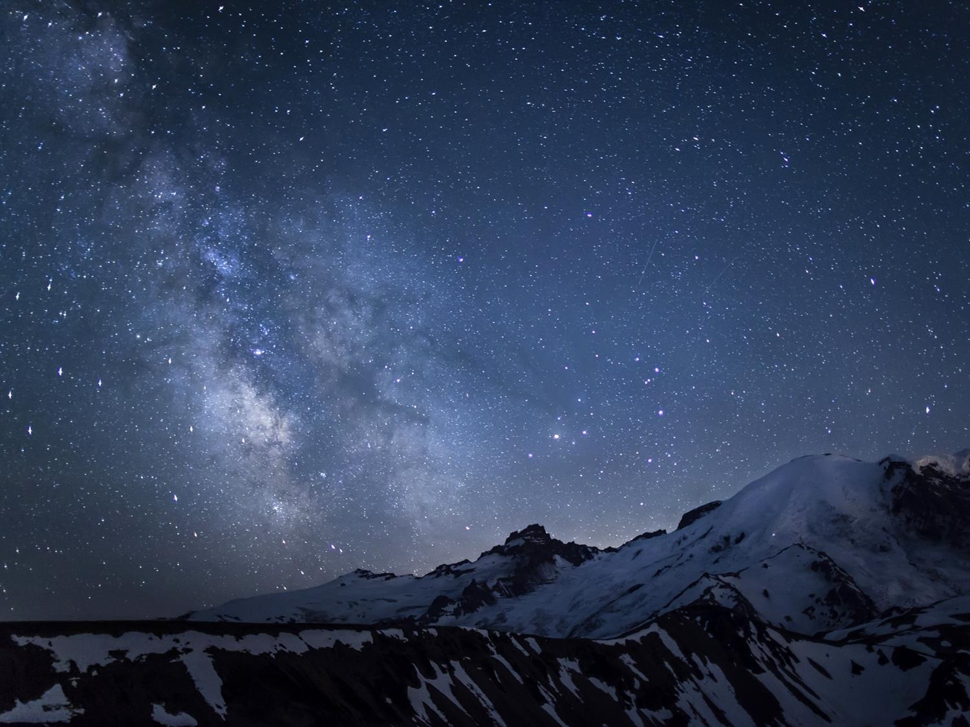
Spin-dependent Scattering of Boosted Dark Matter
王雯宇
北京工业大学
合作者：武雷、杨文娜、祝斌

Slide 2
目录
WIMP和轻暗物质
宇宙线暗物质（CRDM）
自旋依赖截面计算方法
原子结构因子修正及其在宇宙线暗物质中的应用
总结

Slide 3
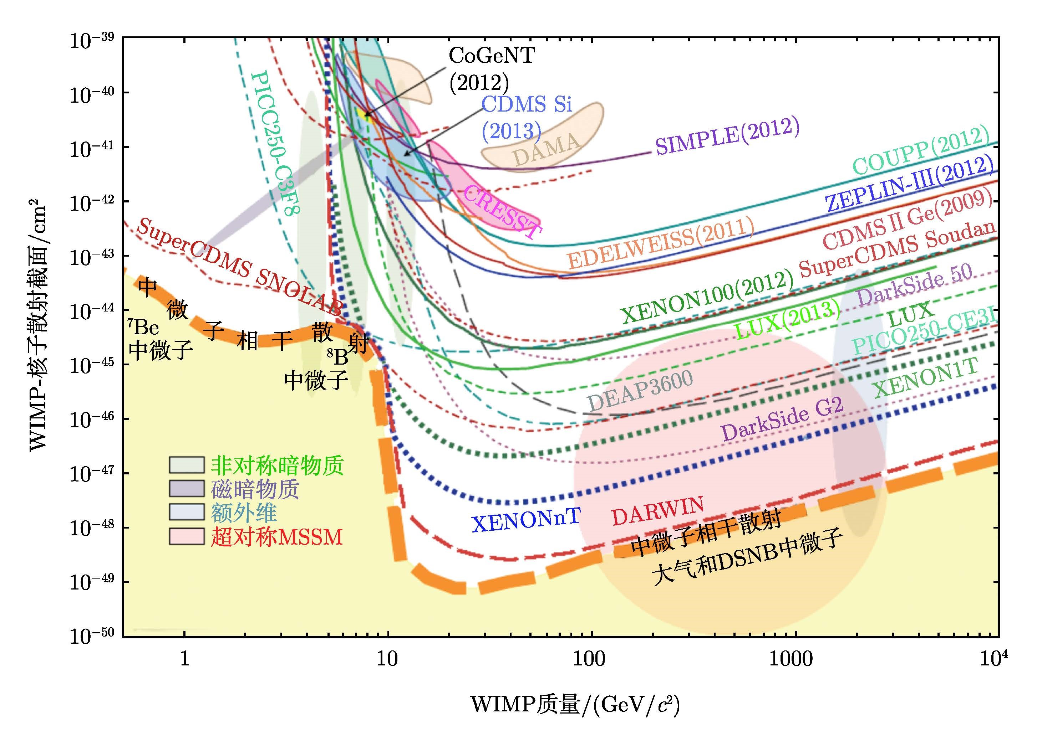
？
！

Slide 4
——某人的报告透明片

Slide 5
关注轻暗物质探测

Slide 6
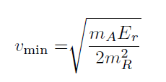
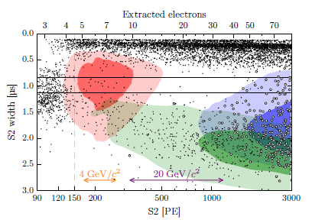
Sub-GeV区域困难的原因

Slide 7
WIMP探测信号中的轻暗物质
其它探测信号
1. 暗物质和电子散射
2. Migdal效应
3. 韧致辐射
奇异来源
1. 暗物质宇宙线
2. 宇宙线大气簇射暗物质
3. 暗物质衰变
4. 湮灭、……

Slide 8
轻暗物质物理非常丰富
以CRDM为例

Slide 9
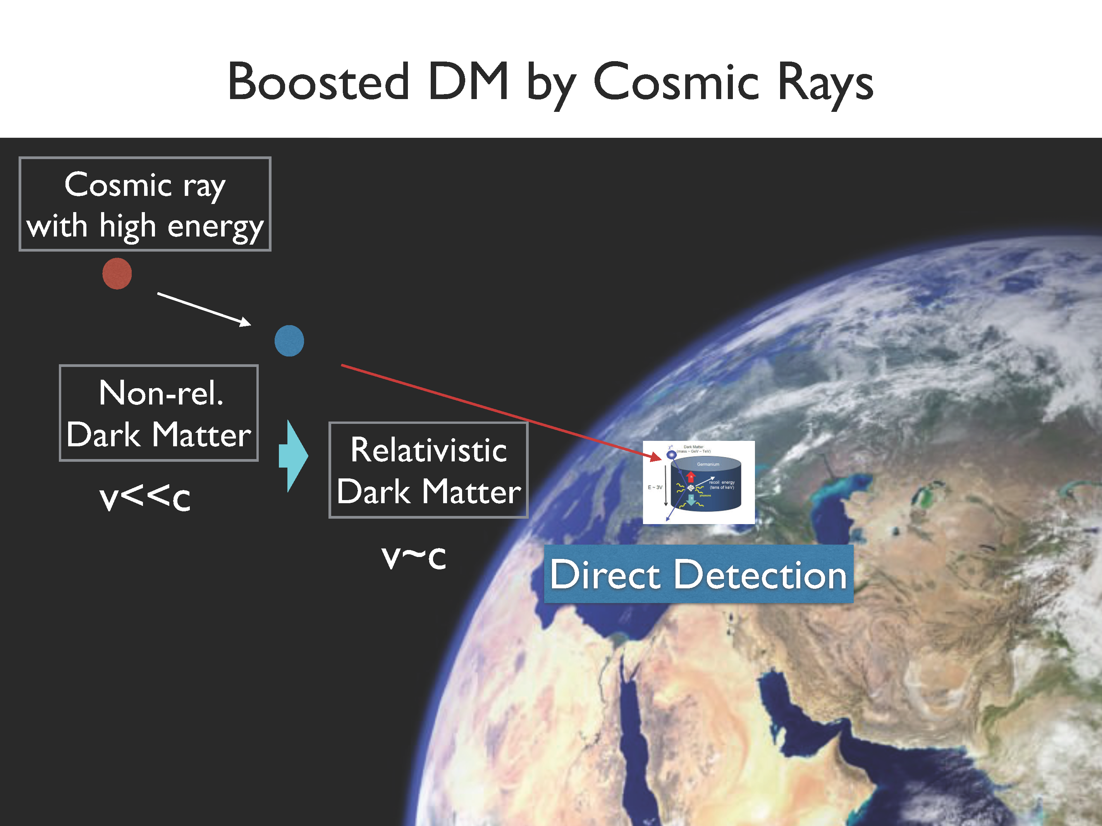

Slide 10
From CR to DM flux
CR i in a differential volume
Density of DM
Flux of CRs
Cross section between DM and CR
The CR induced DM flux
Effective scattering length
Integration in the sight

Slide 11
From T. Bringmann et. al. Phys. Rev. Lett.122.171801

Slide 12
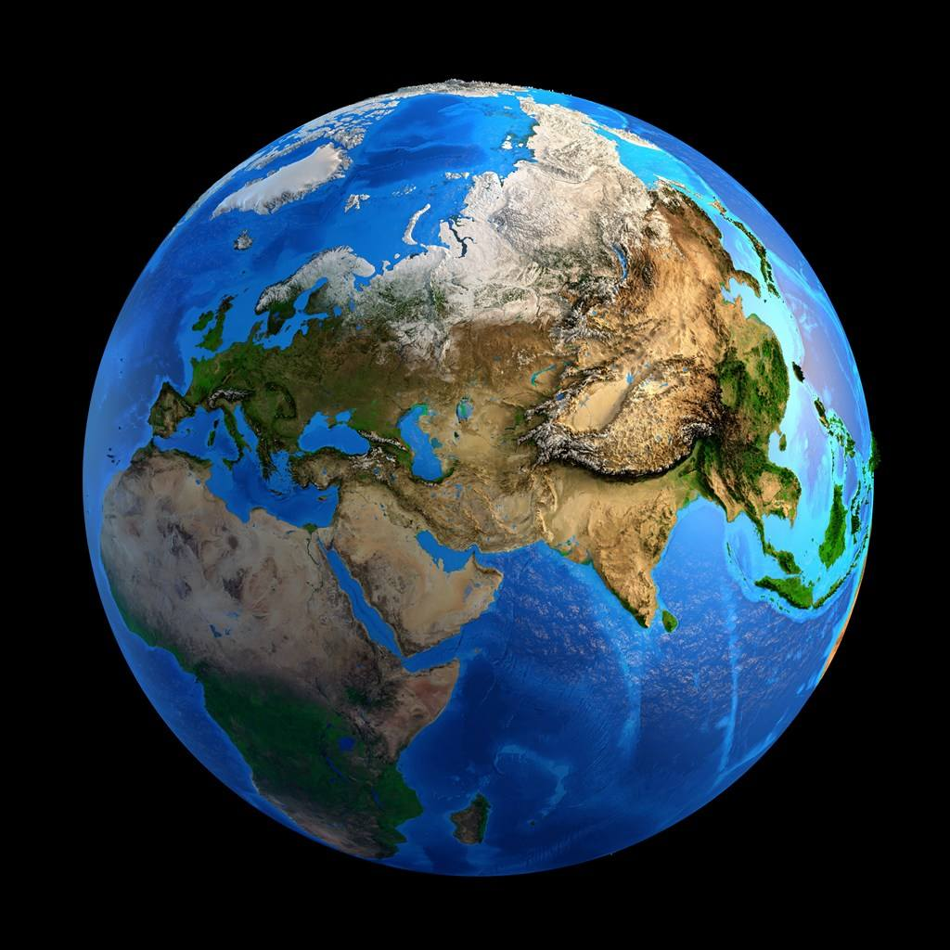
Attenuation of CRDM flux

Slide 14

DM flux at the depth z
in which
Cross section between DM and dense matter on earth
is the mean free path of a DM particle.

Slide 15

CRDM scattering in detectors
Cross section between DM and dense matter in detector
Recoil Energy of Target

Slide 16

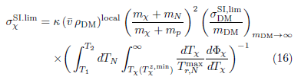
Comparison with the WIMP scattering
We can get

Slide 17
From T. Bringmann et. al. Phys. Rev. Lett.122.171801

Slide 18
Constraints on spin-independent cross section of DM-nucleon interactions from CDEX-10 (gray), XENON1T (purple) and MiniBooNE (blue) in the framework of CRBDM at a 90% C.L. The gray region enclosed by solid and dashed black lines stand for constraint from CDEX-10 under the ballistic trajectory approximation with and without considering the form factor, respectively.
From Z. Lei et. al. arXiv: 2008.07116

Slide 19
From JHEP 12 (2020) 072
From J. Dent et. al. Phys. Rev. D 101.116007

Slide 20
加上间接探测结果
If the ultralight DM particles reached chemical and kinetic equilibrium in the early Universe, very stringent constraints will arise from BBN and CMB. However, the conditions for reaching thermal equilibrium require more information on the cross section of DM annihilation and production process, which are in general model dependent. For ultralight DM particles, annihilating into most standard model particles are kinematically forbidden。
From C. Xia et. al. Nucl.Phys. B 969 (2021) 115470

Slide 21
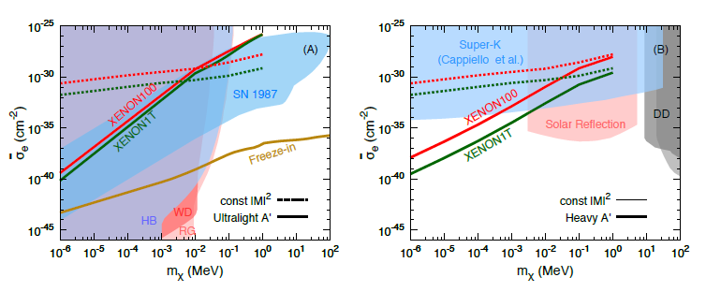
假如是和电子散射
The energy dependence in cross section plays a crucial role in improving the exclusion limits, e.g., the recoil spectra increase with recoil energy for heavy mediator case while decrease with recoil energy for ultralight mediator. Such opposite energy dependences imply that the neutrino experiments such as Super-K are more powerful for heavy mediator due to their much larger acceptance volume and higher energy coverage
From Q. Cao et. al. Chin.Phys.C 45 (2021) 4, 045002

Slide 22
CRDM（BDM）各向异性
Contours of CRDM and BDM flux. From C. Xia. Et. Al. arXiv:2206.11454

Slide 23
CRDM and BDM 的各向异性. From C. Xia. Et. Al. arXiv:2206.11454

Slide 25
CRDM的日调节效应
不同角度看到CRDM能谱. From S. F. Ge. Et. Al. PRL 126, 091804

Slide 26
CRDM观测事例的日调节. From S. F. Ge. Et. Al. PRL 126, 091804

Slide 27
自旋依赖截面计算方法

Slide 28
理论模型到探测事例
计算WIMP和夸克和胶子的有效耦合系数
基本粒子物理
基本粒子有效相互作用转化为暗物质和核子的有效相互作用
强子物理
利用核子波函数计算WIMP和原子核散射截面
原子核物理

Slide 29
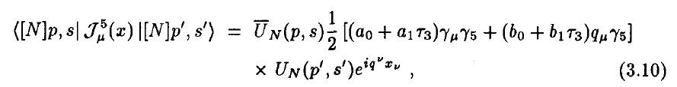
以Majorana粒子为例
轴矢量流
标量流
暗物质和核子相互作用

Slide 30
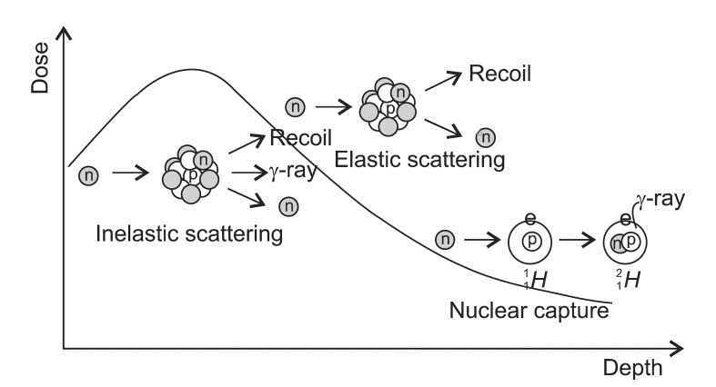
Impulse Approximation:
入射粒子仅与其中一个核子散射
整个原子核是透明的
核子束缚能基本上不变

Slide 31
微分截面的计算
换到球坐标

Slide 32
零转移动量
自旋依赖
自旋无关（相干散射）
标量流截面正比于原子数A平方，因此对重原子核更敏感

Slide 33
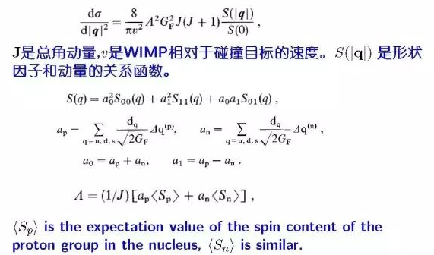
自旋相关截面的计算

Slide 34
原子结构因子修正及其在
宇宙线暗物质中的应用

Slide 35
自旋依赖结构因子的相对论效应
暗物质和核子相互作用
WIMP是低速运动的粒子，在计算散射截面时，忽略时间分量和速度的高阶项

Slide 36
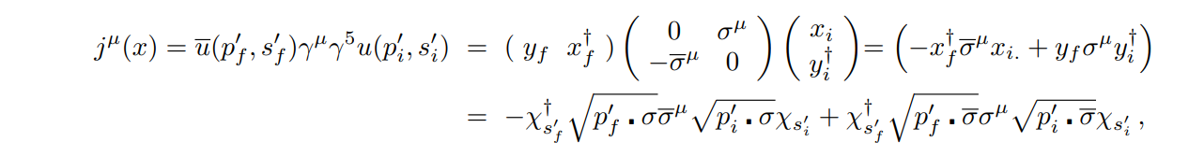
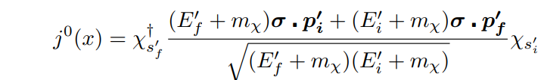
Dark matter current
In the non-relativistic limit: previous studies
In the relativistic : our studies

Slide 37
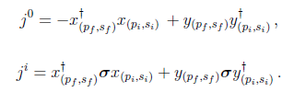
时间分量与空间分量正交
Verification:
New structure factor:

Slide 38
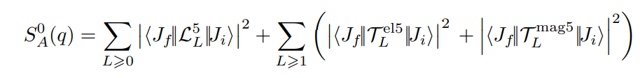
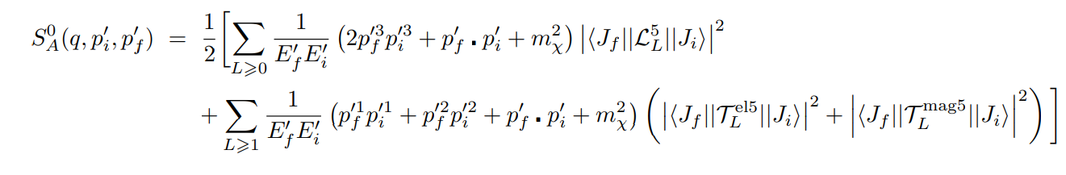
Calculation of structure factor
In the non-relativistic limit： arXiv：1304.7684v4
In the relativistic limit：arXiv:2111.04000

Slide 39

The electric longitudinal, electric transverse, and magnetic transverse multipole operators
Since

Slide 40
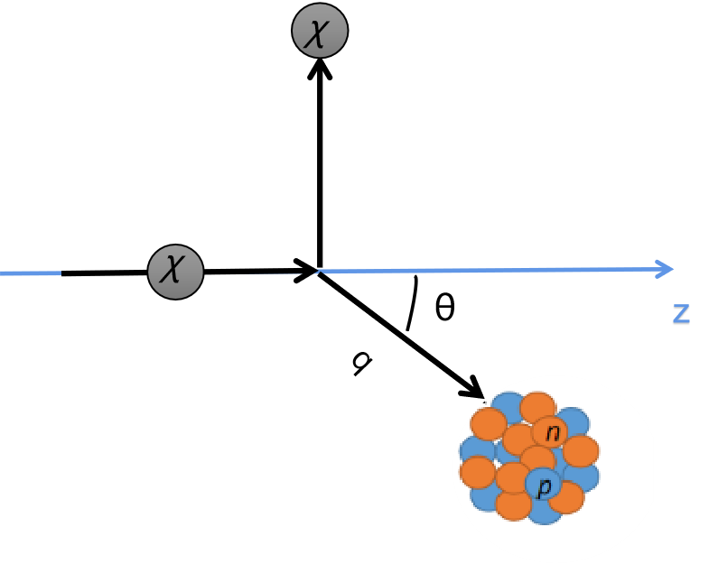
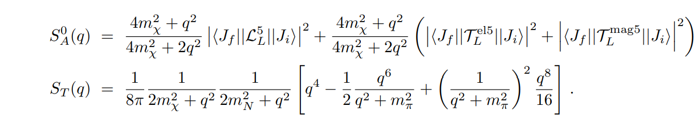
Choose a special collision process ：

Slide 41
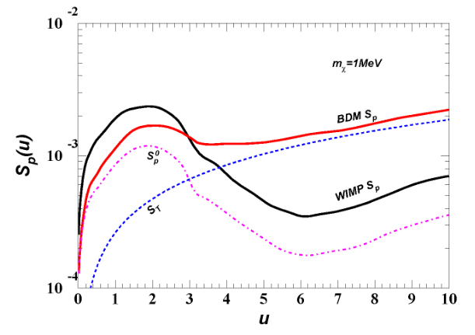
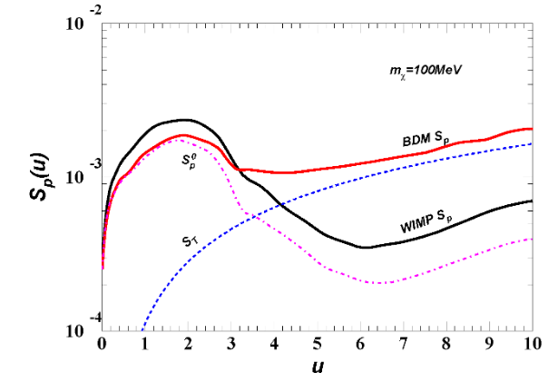
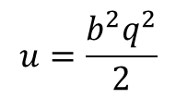
$$u=\frac{b^{2}q^{2}}{2}$$

Slide 42
$$u=\frac{b^{2}q^{2}}{2}$$

Slide 43
As for CRDM

Slide 44
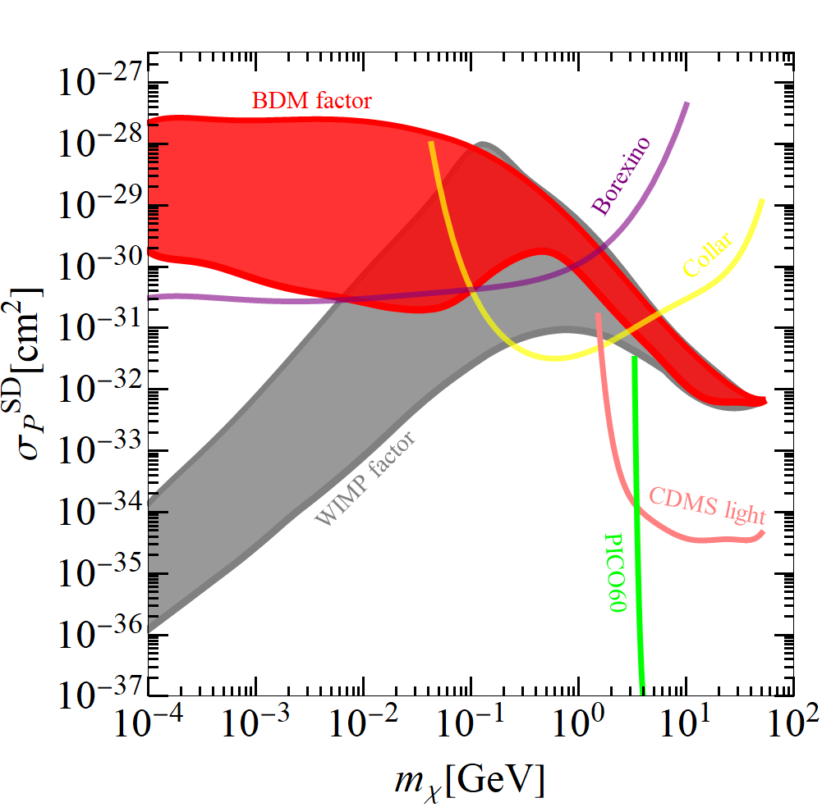

Slide 45
From JHEP 12 (2020) 072
From J. Dent et. al. Phys. Rev. D 101.116007

Slide 46
结论
轻于0.1GeV区域相对论效应对CRDM排除区域修正随着暗物质质量变轻，越来越显著。
从基本夸克相互作用来探究CRDM会发现自动存在这动量依赖效应，这是其实源于质子由强相互作用形成的尺寸效应。
亚GeV暗物质唯象有待深入研究

Slide 47
谢谢！

