Slide 1

Long-Lived Particles to Probe the EWPT
Wei Liu (刘威)
Nanjing University of Science and Technology
Arxiv:2205. 08205，Phys.Rev.D 105 (2022) 11, 115040
26th Mini-workshop on the frontier of LHC

Slide 2
Phase transition in electroweak theory
EW symmetry restoration in the early Universe
Current
W & Z bosons are massive;
Photon is massless,
Mexican-hat like
Phase transition
The early Universe
(Thermal effects)
SU(2)_{L} & U(1)_{Y} bosons are massless,
True vacuum

Slide 3
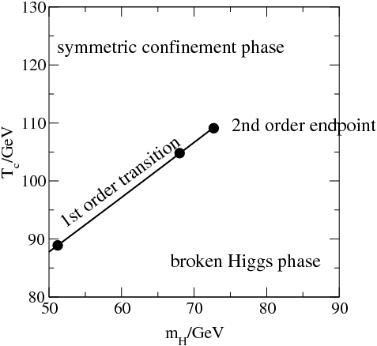
What is the pattern of EW phase transition (PT)?
It could be –
Lattice calculation shows the phase diagram ==>
Thus in the SM it is a crossover, since M_{h} = 125 GeV > 75 GeV;
However, a 1st-order EWPT is more interesting.
(Needs new physics)
Figure from L.-T. Wang’s talk in IHEP workshop
SM
or
New Phy.
hep-ph/0010275
EW-symmetric phase
EW-broken phase

Slide 4
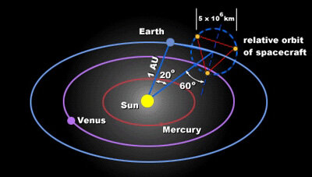
Why is a 1st-order EWPT interesting?
It’s the essential ingredient of the EW baryogenesis.
Acting as the background of very rich dark matter mechanisms
Sources of the stochastic GWs:
Collision of the bubbles
Sound waves in plasma
Turbulance in plasma
EWPT GWs typically peak in mHz.
LISA detector

Slide 5
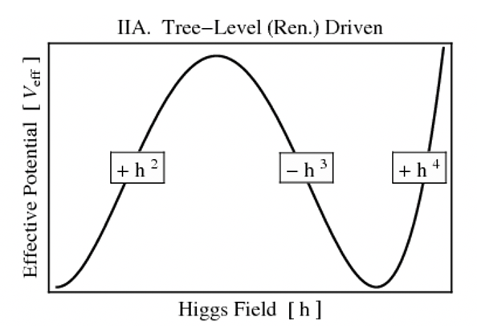
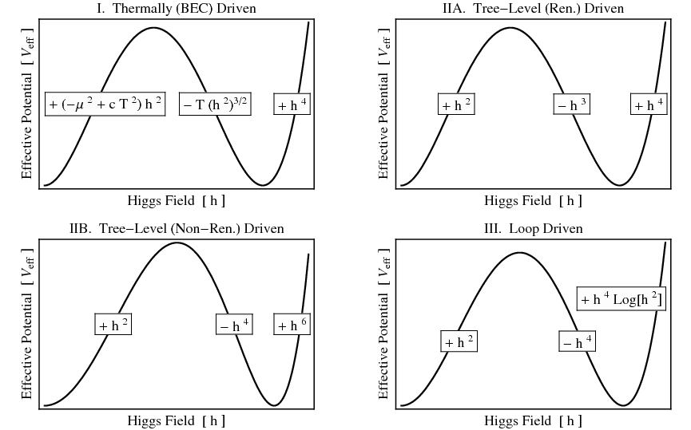
How to achieve a 1st-order EWPT?
Adding a barrier for the Higgs potential via new physics!
The decay between two vacua separated by a barrier.
The VEV of the Higgs field jumps.
Getting a barrier via the help of
additional scalar field(s):
SM + real singlet (xSM);
2HDM;
Georgi-Machacek model;
……
We choose the xSM as the benchmark model.
It’s simple, but has captured the most important feature of EWPT;
It can be treated as the prototype of many new physics EWPT models.

Slide 6
EWPT in the xSM (SM + real singlet)
We choose the xSM as the benchmark model.
It’s simple, but has captured the most important feature of EWPT.
The scalar potential of the xSM
8 input parameters:
1 unphysical, 2 fixed by Higgs mass & VEV; 5 free parameters.
Expansion around the VEV
Mass eigenstates & the mixing angle.

Slide 7
1st-order EWPT in the xSM
At finite temperature:
An Illustration --
Question:
Can collider experiments probe the 1st-order EWPT parameter space?

Slide 8
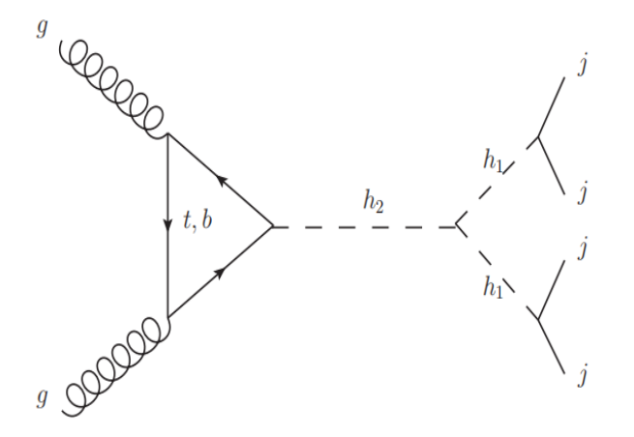
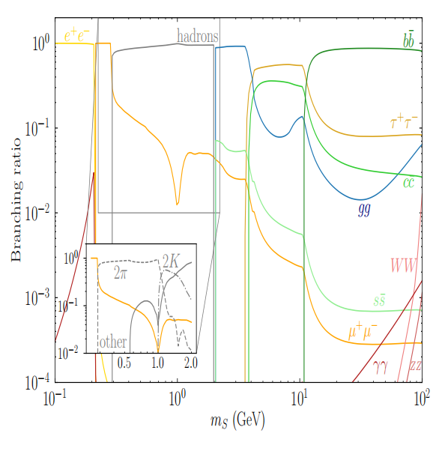

Production processes
$$gg→h_{2(SM)}→h_{1}h_{1}→4j$$
1st-order EWPT leads to large $BR(h_{2}→h_{1}h_{1})$.
$h_{1}$ decays into jets dominantly.

Slide 9
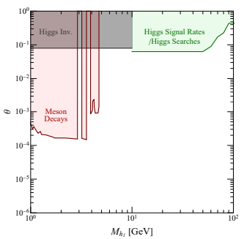
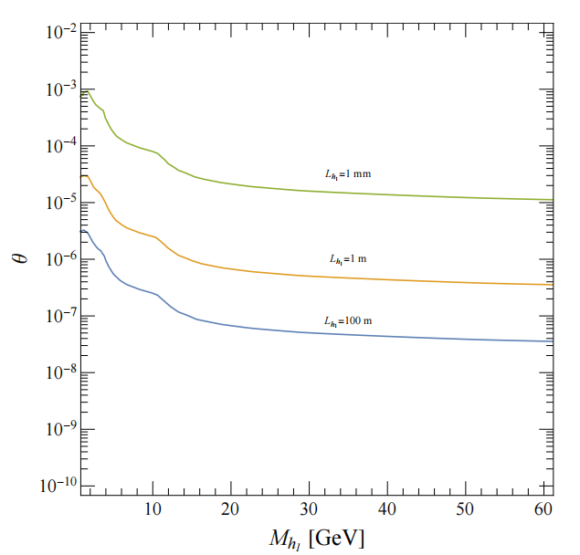

Long-lived Particles
The current limits on ($M_{h_{1}}$,$θ$)
For $M_{h_{1}}$< 10 GeV, the current limits from rare meson decays at the LHCb, leads to $h_{1}$ as a long-lived particle (LLP).

Slide 10
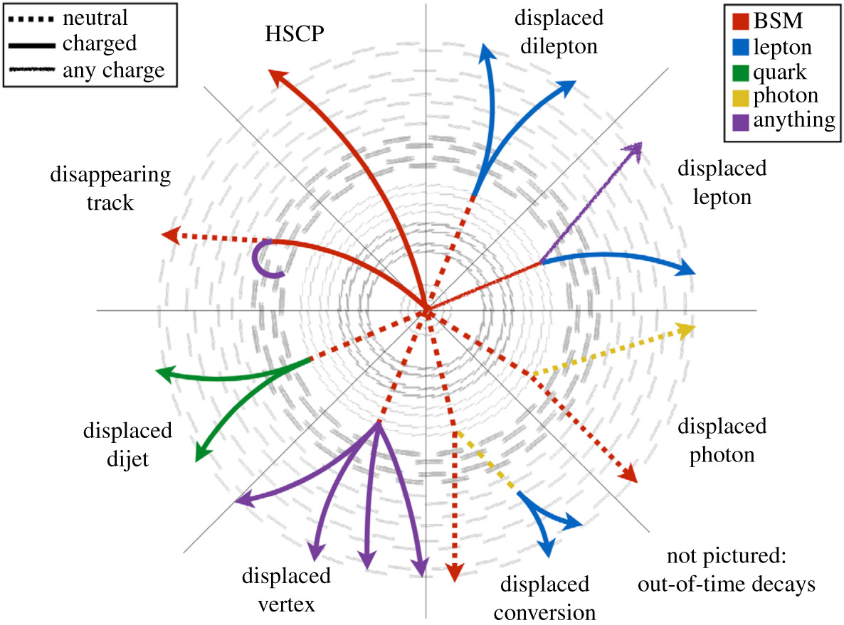
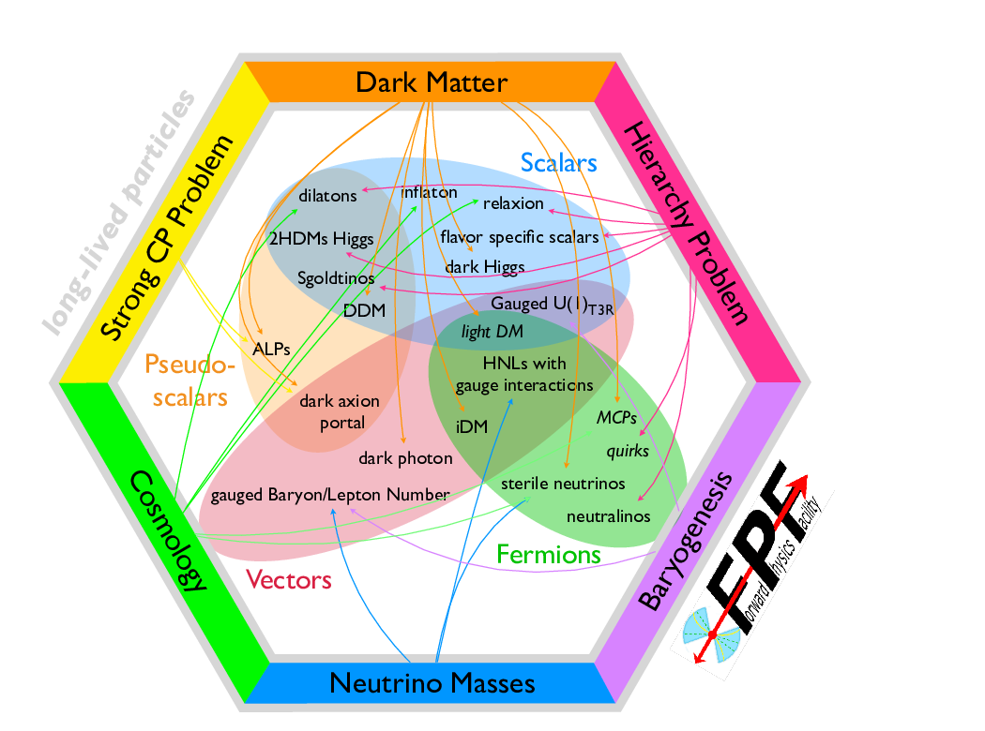
Long-lived Particles
LLP is widely searched, of great interests experimentally and theoretically.
Figure from Albert De Roeck. Figure from 2203.05090.
Light weakly-coupled particles as LLPs, are strongly motivated, including the light scalar responsible for 1st-order EWPT in the xSM.

Slide 11
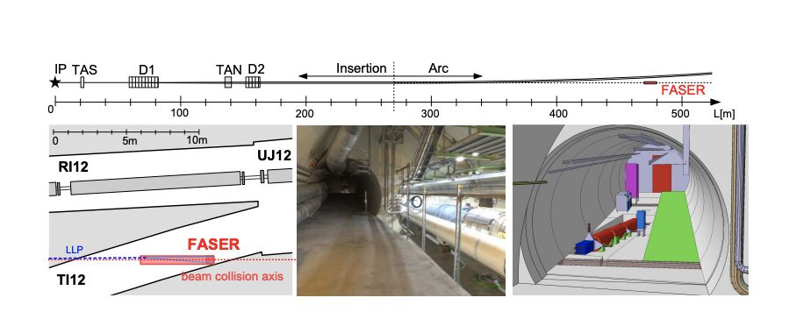
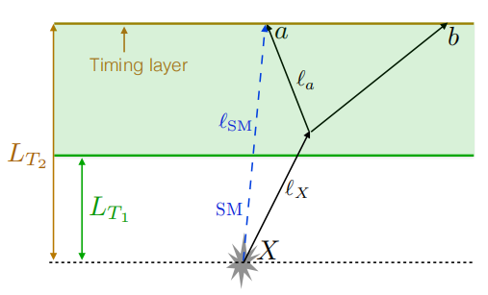
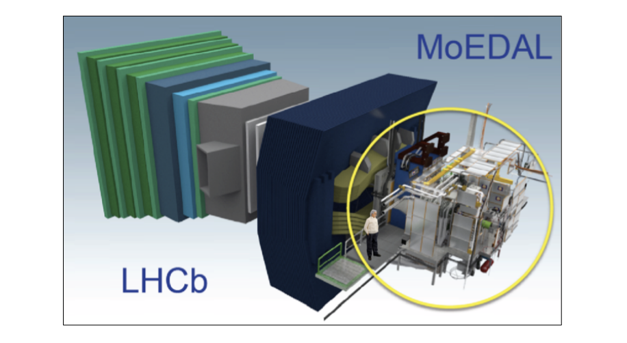
Detectors for LLPs
CMS-Timing, FASER, MoEDAL-MAPP are to be operated at Run 3.
Many others, e.g. MATHUSLA and CODEX-b are in discussions.
CMS-Timing detector using the time-delayed leptons/jets as signals, while the other detectors using displaced vertex.

Slide 12
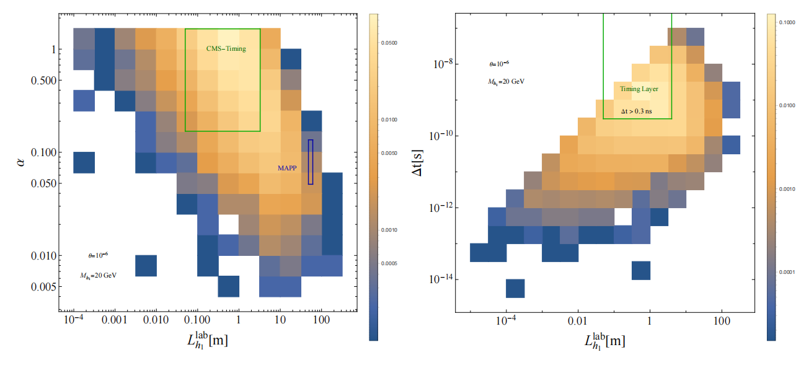
Detector efficiency
Detector efficiency is a function of geometrical coverage,
and resolution in time for timing detector.
CMS-Timing has large coverage, and good resolution.
MAPP has small coverage,
while negligible for FASER.

Slide 13
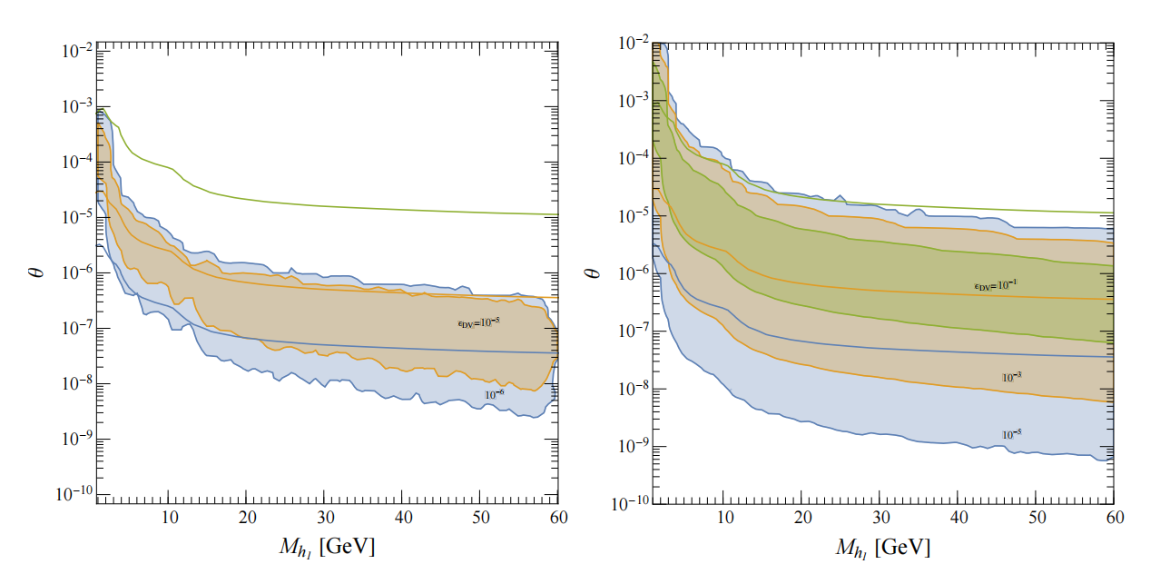

Detector efficiency
Detector efficiency is a function of geometrical coverage,
CMS-Timing has efficiency up to ${10}^{−1}$.
MAPP has ${10}^{−4}$,
while negligible for FASER.

Slide 14

Connects to 1st-order EWPT
Link between the number of events and 1st-order EWPT
$$N_{signal}=σ_{pp→h_{2}}×L×{BR}_{h_{2}→h_{1}h_{1}}\left(a_{2},M_{h_{1}}\right)×{{BR}_{h_{1}→jj}}^{2}(M_{h_{1}})×ε_{kin}(M_{h_{1}})×ε_{geo}(M_{h_{1}},θ)$$
${BR}_{h_{2}→h_{1}h_{1}}\left(a_{2},M_{h_{1}}\right)$=$\frac{Γ_{h_{2→}h_{1}h_{1}}}{{Γ_{h_{2}}}^{SM}+Γ_{h_{2→}h_{1}h_{1}}}$
$$Γ_{h_{2→}h_{1}h_{1}}∝{{(a}_{2}v)}^{2}$$
LLP events are sensitive to ${|H|}^{2}S^{2}$ couplings.

Slide 15
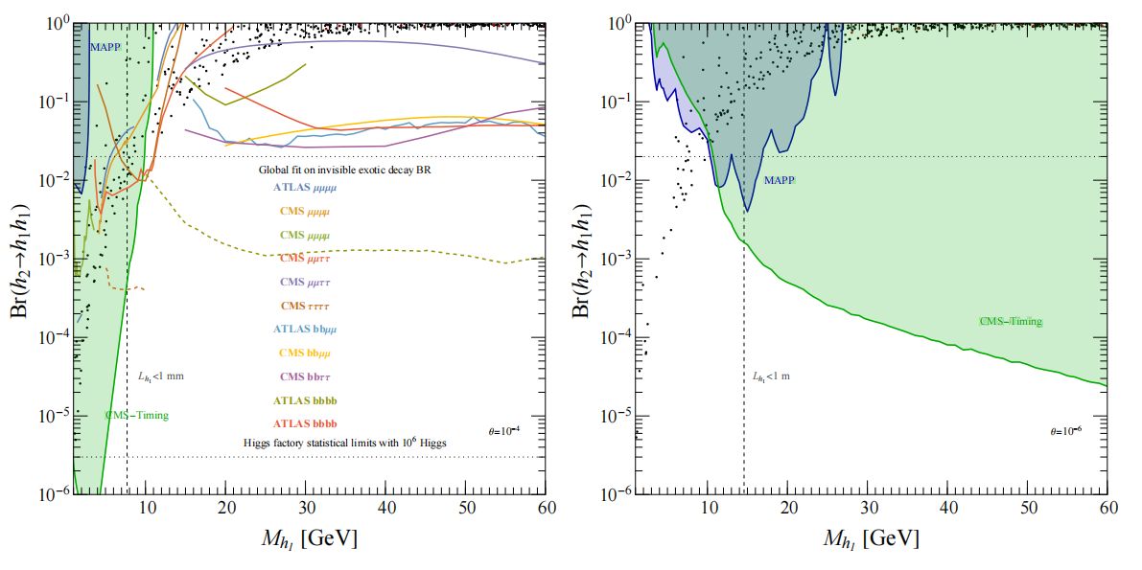

Sensitivity
Fixed $θ={10}^{−4}\left(left\right), {10}^{−6}\left(right\right).$
CMS-Timing can probe large parameter space where the searches for promptly exotic Higgs decays can not reach.
MAPP can only probe small parameter space, while none for FASER.

Slide 16
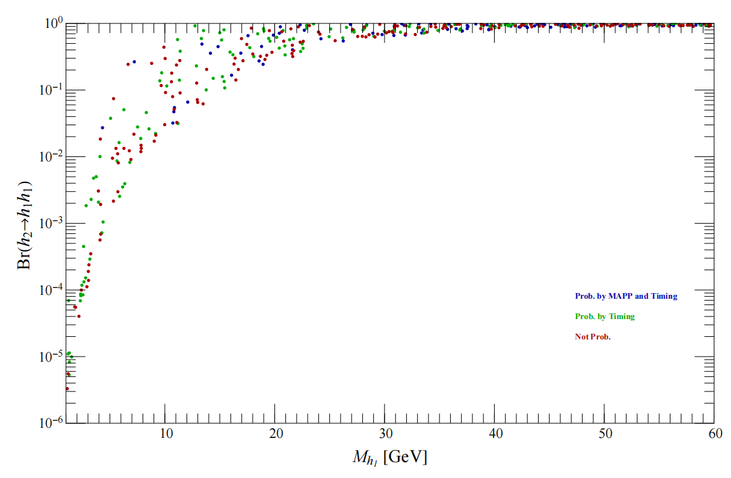

Signatures at Colliders
Running$θ$
Green points are probed by CMS-Timing, but not by MAPP.
CMS-Timing can probe a lot more 1st-order EWPT points. There are still appreciable points not probed by any of LLP detectors.

Slide 17
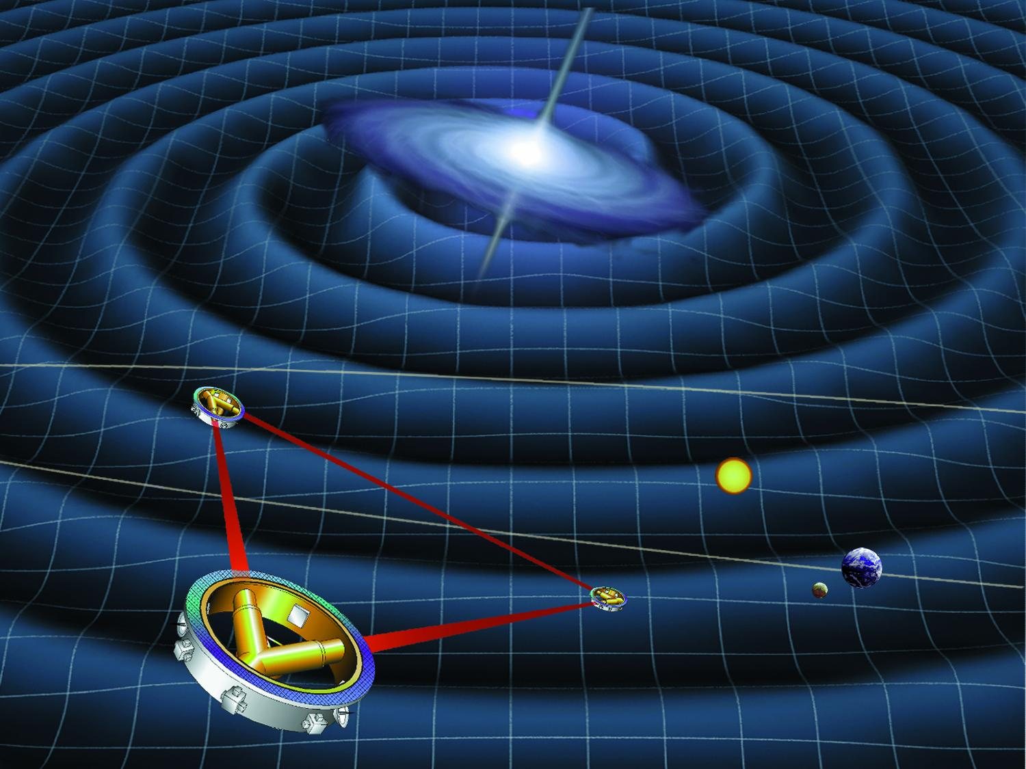
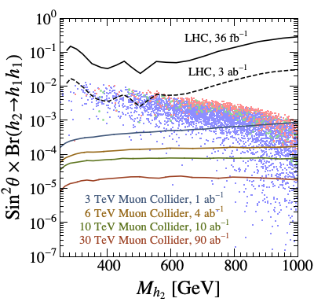
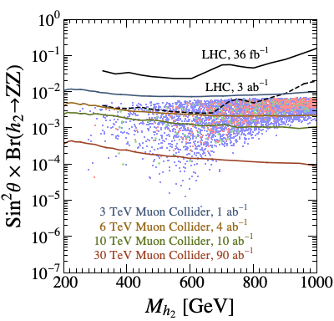
What if there is a TeV $h_{2}?$
1st-order EWPT can lead to gravitational wave, and diHiggs & diboson final states especially at muon colliders!
For the LISA detector, signal-to-noise ratio (SNR):
Wei Liu, Ke-pan Xie, JHEP 04 (2021) 015.
LISA

Slide 18
Conclusion
1st-order EW phase transition is interesting:
Theoretically, it is the essential ingredient of EW baryogenesis, and can trigger very rich dark matter mechanisms;
Experimentally, it yields detectable gravitational waves.
We propose strategies to probe 1st-order EWPT from LLP signatures at the HL-LHC.
For light, weakly coupled scalar corresponding to 1st-order EWPT, it can lead to LLP signatures, but no detectable gravitational waves.
LLP search is complementary to the searches for promptly exotic Higgs decays!

