Slide 1
Current status of TFPWA with helicity formalism
Yi Jiang

Slide 2
Outline
Helicity formalism
Implementation in TFPWA

Slide 3
Helicity formalism
$$z_{1}$$
$$p_{1}^{′},m_{1}^{′}$$
$$y_{0}$$
$$x_{1}$$
$$z_{0}$$
$$p_{1},m_{1}$$
$$p_{0},m_{0}$$
boost
$$y_{1}$$
$p_{0},m_{0}$,
$$x_{0}$$
$$p_{2},m_{2}$$
$$p_{2}^{′},m_{2}^{′}$$
$$\left|p_{0},m_{0}\right\rangle =A\left|p_{1},m_{1}\right\rangle ⊗\left|p_{2},m_{2}\right\rangle +other decays$$
$$\left|p_{0}^{′},δ\right\rangle =R(α,β,γ)\left|p_{0},m_{0}\right\rangle$$
$$\left|p_{0},m_{0}\right\rangle =\sum_{δ}{D_{m_{0},δ}^{J∗}\left(α,β,γ\right)|p_{0}^{′},δ⟩}$$
$$\left|p_{0}^{′},δ\right\rangle =\sum_{δ=m_{1}^{′}−m_{2}^{′}}{F_{m_{1}^{′},m_{2}^{′}}\left|p_{1},m_{1}^{′}\right\rangle ⊗\left|p_{2},m_{2}^{′}\right\rangle }+other decays$$
Independent of rotation angle
$$A=F_{m_{1}^{′},m_{2}^{′}}D_{m_{0},m_{1}^{′}−m_{2}^{′}}^{J∗}(α,β,γ)$$

Slide 4
Automatic angle calculation
Traverse though decay chain, then the process is automatic.

Slide 5
Alignment angle
$$L=L_{2}L_{1}L_{3}^{−1}L_{4}^{−1}$$
$$L_{4}$$
$$L_{2}$$
$$L_{3}$$
$$L_{1}$$
Alignment angle is required.

Slide 6
Alignment angle example
$p_{0}^{μ}→p_{1}^{μ}+p_{2}^{μ}+p_{3}^{μ}$
Chain1
$p_{0}^{μ}→p_{1+2}^{μ}+p_{3}^{μ},p_{1+2}^{μ}→p_{1}^{μ}+p_{2}^{μ}$
$φ_{1}^{1+2},θ_{1}^{1+2}, φ_{2}^{1+2 },θ_{2}^{1+2 }$
$L_{3}^{1+2 }=R_{x}(π)R_{y}(θ_{1}^{1+2})R_{z}(φ_{1}^{1+2})$
Chain2
$p_{0}^{μ}→p_{1+3}^{μ}+p_{2}^{μ},p_{1+3}^{μ}→p_{1}^{μ}+p_{3}^{μ}$
$φ_{1}^{1+3},θ_{1}^{1+3}, φ_{2}^{1+3 },θ_{2}^{1+3 }$
$L_{3}^{1+3}=R_{x}(π)R_{y}(θ_{2}^{1+3})R_{z}(φ_{2}^{1+3})B_{z}(p_{1+3})R_{y}(θ_{1}^{1+3})R_{z}(φ_{1}^{1+3})$
Alignment angle
$p_{3,1+2}^{μ}→p_{3,1+3}^{μ}$
$$A→B+C$$
Add $R_{x}(π)$ for opposite direction
$$R_{x}\left(π\right)=R_{y}\left(π\right)R_{z}\left(−π\right)$$
Satisfy $R_{x}\left(π\right)R_{y}\left(θ\right)R_{z}\left(φ\right)=R_{y}\left(π−θ\right)R_{z}\left(φ−π\right)$
$$L_{total}=R_{x}\left(π\right)R_{y}\left(θ_{2}^{1+3}\right)R_{z}\left(φ_{2}^{1+3}\right)B_{z}\left(p_{1+3}\right)R_{y}\left(θ_{1}^{1+3}\right)R_{z}\left(φ_{1}^{1+3}\right)R_{z}^{−1}(φ_{1}^{1+2})R_{y}^{−1}(θ_{1}^{1+2})R_{x}^{−1}(π)$$

Slide 7
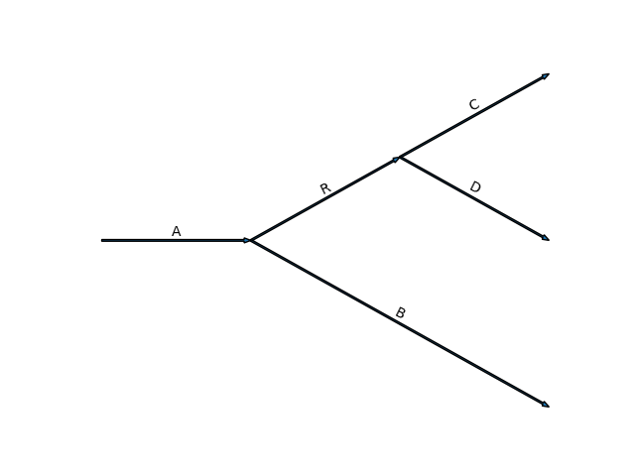
Helicity formalism
Feynman rules
User defined
Decay
Wigner-D matrix
Particle
=
alignment
Automatically calculated from decay structure

Slide 8
Work process
Data
Data
Config
No information from
amplitude model
$$p_{i}^{μ}$$
$$φ_{1},θ_{i},m_{i}$$
Restructured by amplitude model
$$R(m)$$
config.get_data()
Particle.get_amp(data2)
Decay
Topology
$$F_{m_{1}^{′},m_{2}^{′}}D_{m_{0},m_{1}^{′}−m_{2}^{′}}^{J∗}(φ,θ,0)$$
$$A_{1}(x;θ)$$
Decay.get_amp(data3)
config.yml
$$…$$
DecayGoup
DecayChain.get_amp(data1)
$$A(x;θ)$$
$$A_{1}(x;θ)$$
$$…$$
Amplitude

Slide 9
Customization
Data
register_data_mode(name)(class)
Used in config.yml:data:mode
implement class.get_data(idx) -> List[Data] method
Allow some process in reading data
For example, (other data format, Preprocess )
Amplitude
register_particle(name)(class)
Used in config.yml:particle:name:model
implement class.init_params() method, initialize parameters
implement class.get_amp(*args, **kwargs) -> Tensor method, calculate amplitude
Replace BW in to other model
register_decay(name, n_daught=2)(class)
Used in config.yml:decay:name:model
implement class.init_params() method , initialize parameters
implement class.get_amp(*args, **kwargs) -> Tensor method , calculate amplitude
Replace $F_{m_{1}^{′},m_{2}^{′}}D_{m_{0},m_{1}^{′}−m_{2}^{′}}^{J∗}(α,β,γ)$ in to other model
register_decay_chain(name)(class)
TBD
Rewrite rules of calculating amplitude (a[ij] b[jk] -> c[ik])
Total rewrite of DecayGroup ?

Slide 10
Possible implementation of Covariant Tensor
1. Preprocess of data
New class for get_data
2. Amplitude calculation
New decay chain
Covariant Tensor
Initialize fit parameters
Which data is required ?
How to combine Decay.get_amp and Particle.get_amp
New decay
Replace Helicity formula with Covariant Tensor
Possible just 1 for it
3. Difference between spin projection and helicity ?

Slide 11
Summary
Helicity formula used in TFPWA
Definition of angle
Amplitude calculation rules
Implementation for calculating amplitude
Work process
Interface for customization
Possible way to include Covariant Tensor
Future plan
Better support for large size of data
New models

Slide 12
Future plan
Support large size of dataset
Multiply GPU
Optimize performance
Implement more model
More function for analysis

Slide 13
Work process
1. Provide information of decay process (config.yml)
2 Amplitude
Likelihood (tf_pwa/model/)
Data
Input momentum (tf_pwa/config_loader/data.py)
Use decay topology to calculate angle (tf_pwa/cal_angle.py)
$φ,θ,m…$
Amplitude formula (Tree structure, tf_pwa/amp/)
DecayGroup (a = a1 + a2 + …)
DecayChain1 (a = a1 * a2 * …)
Particle1 (BW(m))
Decay1 ($F_{m_{1}^{′},m_{2}^{′}}D_{m_{0},m_{1}^{′}−m_{2}^{′}}^{J∗}(φ,θ,0)$)
…
DecayChain2
…
AmplitudeModel (initialize and interface)

