Slide 1
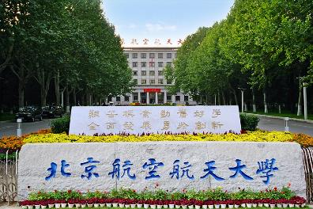
原子核结构与相对论重离子碰撞前沿交叉研讨会 ，大连,2023.08.01-05
协变手征有效理论最新进展
从强子-强 子相互作用到超子弱辐射衰变
Li-Sheng Geng（耿立升）@ Beihang U.
PRL101 (2008) 222002, PRL128 (2022)142002, Sci.Bull. 67 (2022) 2298-2304, PRL130 (2023)071902

Slide 2
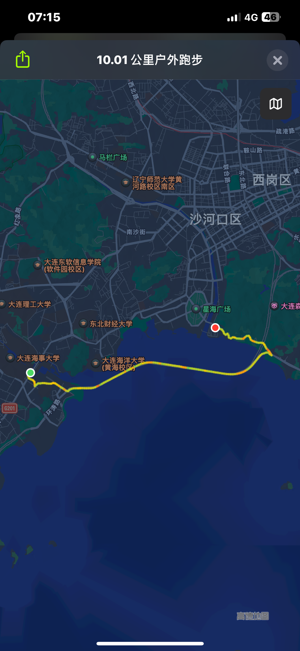
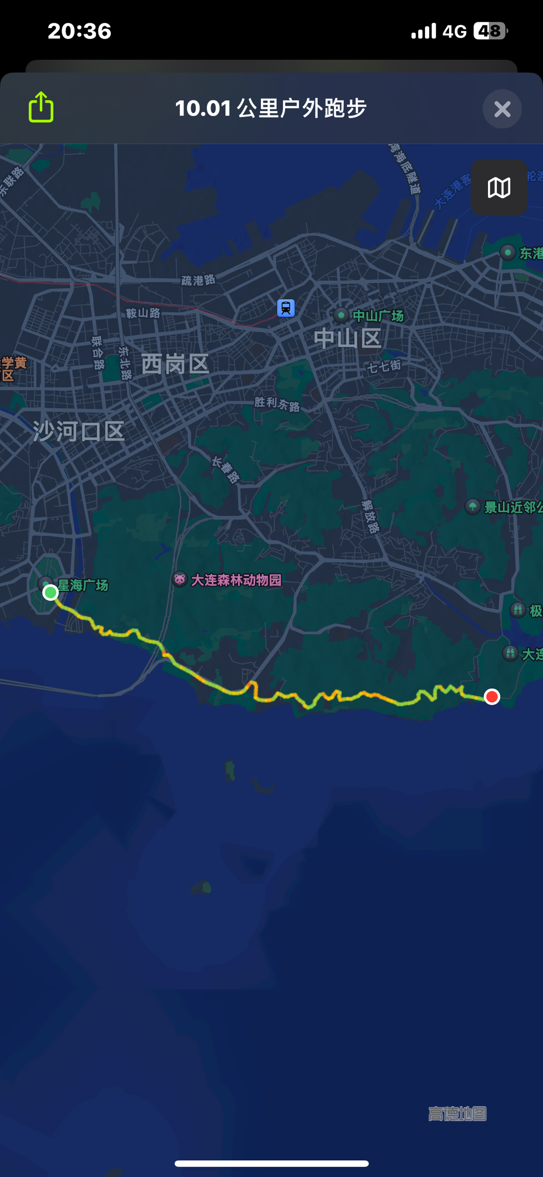
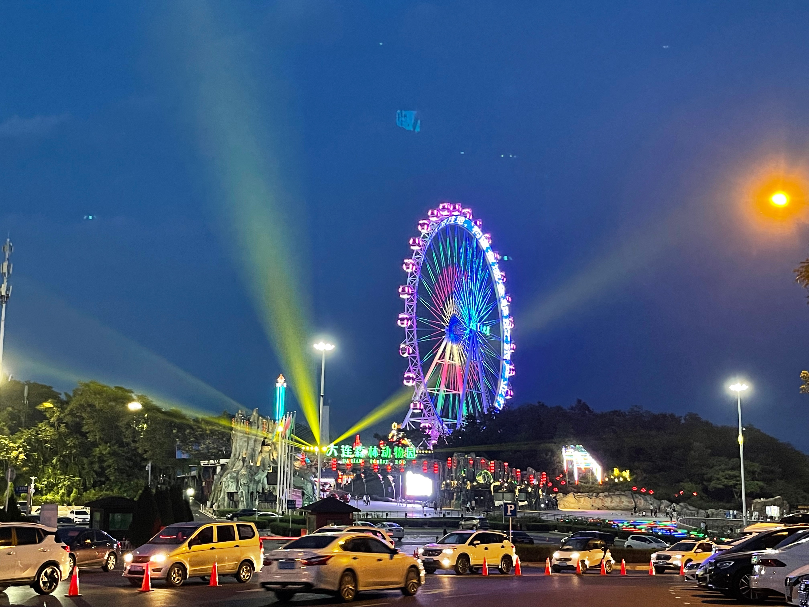
浪漫之都、时尚大连

Slide 3
Contents
Why covariant chiral effective field theories
Applications: (1) magnetic moments, (2)meson-baryon interactions, (3) nucleon-nucleon interactions, (4) weak hyperon radiative decays
Summary and outlook

Slide 4
Four fundamental interactions in Nature
F= $\frac{kq_{1}q_{2}}{r^{2}}$
F= $\frac{Gm_{1}m_{2}}{r^{2}}$
F=q$\vec{v}×\vec{B}$
F=……………
….
F=$G_{F}$

Slide 5
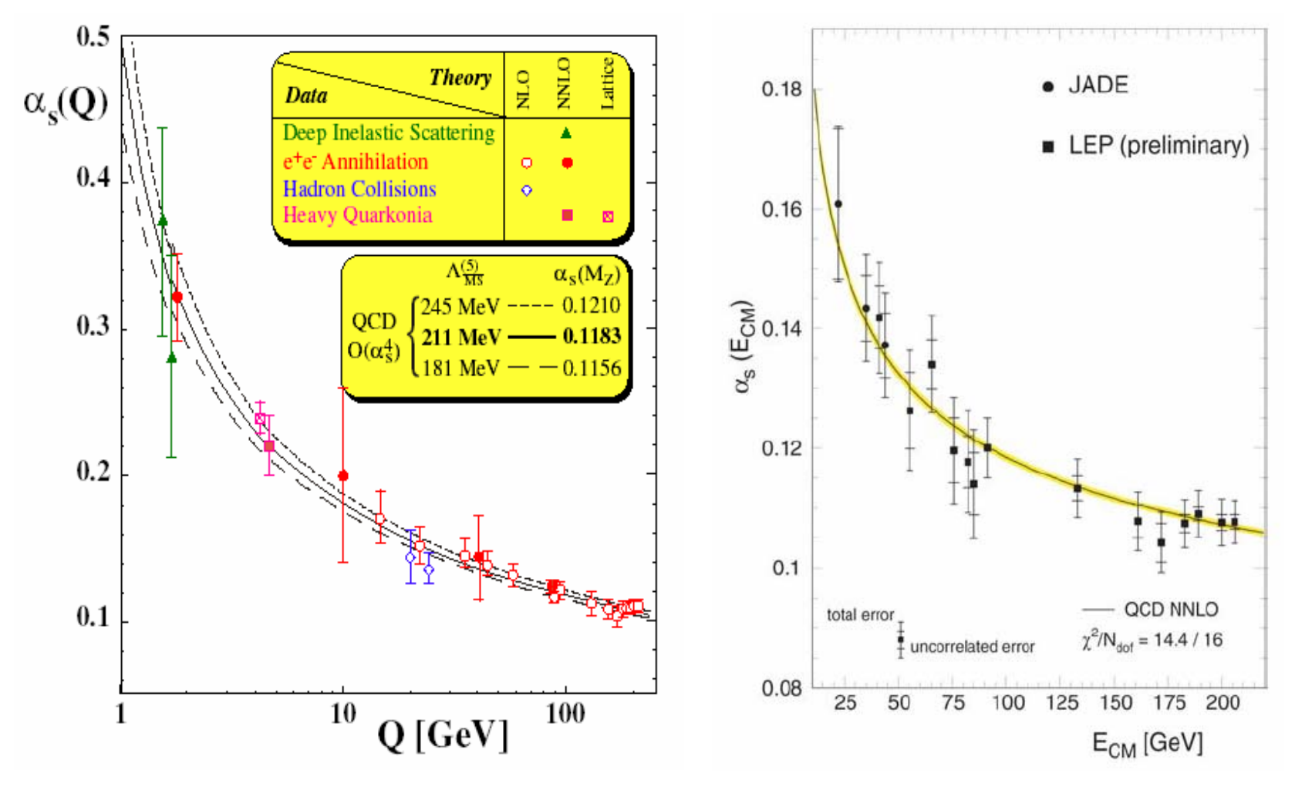
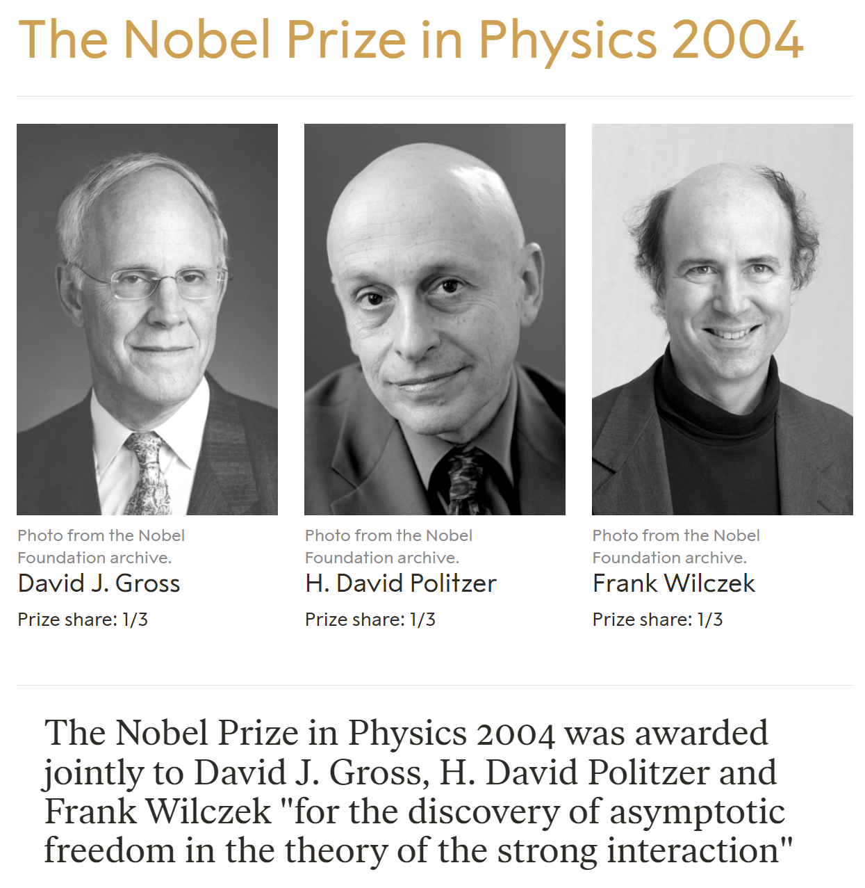
QCD: the theory of the strong interaction
Asymptotic Freedom
Color confinement
Millennium Problems
Yang–Mills and Mass Gap
Experiment and computer simulations suggest the existence of a "mass gap" in the solution to the quantum versions of the Yang-Mills equations. But no proof of this property is known.

Slide 6
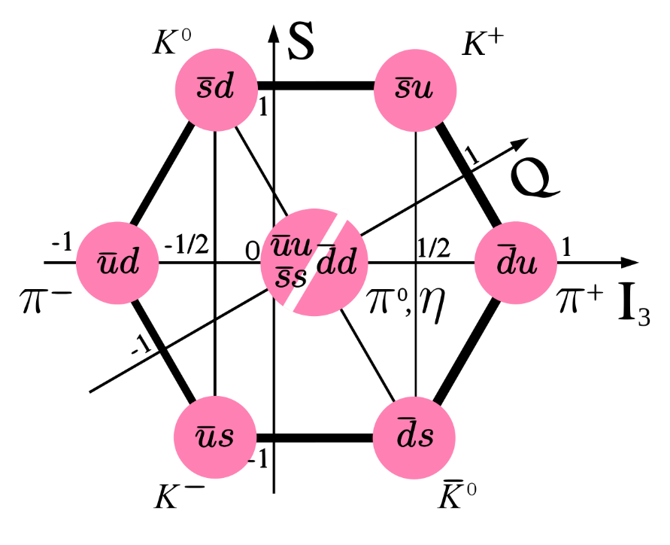
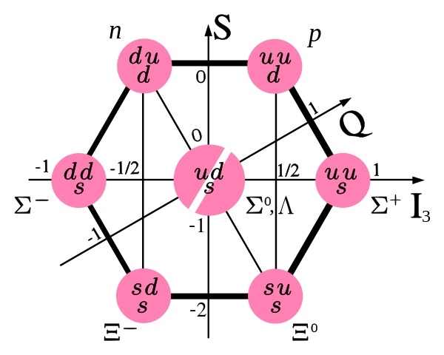
Color confinement: quarks confined into hadrons
meson-meson
$$π−π$$
𝜋−𝜋
meson-baryon
$$π−N$$
𝜋−𝑁
baryon-baryon
$$N−N$$
𝑵−𝑵
They can virtually contribute to other processes

Slide 7
(Covariant) chiral effective field theories
Because of quark confinement and asymptotic freedom,
low energy QCD can not be solved perturbatively
Chiral perturbation theory—low energy EFT of QCD
Maps quark (u, d, s) dof’s to those of the asymptotic states, hadrons
Allows a perturbative formulation of low energy QCD in powers of external momenta and light quark masses, by utilizing chiral symmetry and its breaking pattern (the third feature of QCD)
Development—Trilogy
1979, pion-pion, Weinberg
1989, to the one-baryon sector, Gasser, Sainio, Svarc
1990/91/92, to NN/NNN, Weinberg—very successful
Steven Weinberg
Nobel Prize in Physics in 1979
Rev. Mod. Phys. 81(2009)1773；Phys. Rept. 503(2011)1; Rev. Mod. Phys. 92 (2020) 025004

Slide 8
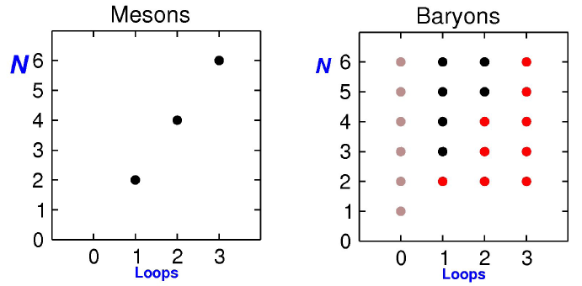
Power-Counting-Breaking in the baryon sector
ChPT very successful in the study of Nanbu-Goldstone boson self-interactions, at least in SU(2)
In the baryon sector, things become problematic because of the nonzero (large) baryon mass in the chiral limit, which leads to the fact that high-order loops contribute to lower-order results, i.e., a systematic power counting is lost!
red dots denote possible
PCB terms (pion-nucleon scattering)
J. Gasser et al.,
NPB 307, 779(1988)
Chiral order =
Notes:
It has been very successful in the mesonic sector. But its extension to the one-baryon system was welcomed by a surprise, the so-called PCB problem. Because of the non-vanishing baryon mass in the chiral limit, higher-order loop results contain lower-order analytic terms. That is to say, a systematic power counting is lost. As you can see from this figure in the mesonic sector, there is a one-to-one correspondence between the chiral order and the number of loops. While this correspondence is lost in the one-baryon sector. This figure is for pion-nucleon scattering and the red dots indicate power-counting-breaking terms.手征微扰理论在过去的三十年间获得了巨大的成功，特别是在介子系统。而当将手征微扰理论扩展到单重子系统时，由于重子质量在手征极限下并不消失，所以会导致所谓的计阶规则破坏的问题。也就是说，名义上的高阶圈图会含有低阶的解析项。而这些项破坏了传统的记阶规则。如这个图所示，在介子系统，手征阶数与圈图个数存在一一对应的关系。而在单重子系统，这个关系不复存在。这个图显示的是PI-N散射。红色的点表示的是破坏记阶规则的项。

Slide 9
Example: nucleon mass up to O(p³)
Chiral order =
Naively
(no PCB)
However
No need to calculate, simply recall that M0~O(p⁰)
Notes:
Let me use one simple example to explain what I just said. To calculate the nucleon mass up to order 3, one needs to calculate three diagrams. Schematically, the results can be written in the following way: The chiral limit value, plus a tree-level contribution, and plus the loop result. If the naïve power counting works, the loop result should start with something like mpi^3. However, a straightforward calculation shows that it actually starts with terms of order zero and two, which break the power counting.来看一个例子。利用手征微扰理论计算核子的质量到次次领头阶，需要计算这样三个费曼图。计算结果可以形式上写成三项之和。第一项是手征极限下的核子质量，第二项是树图的结果、第三项是这两个圈图的结果。如果不存在记阶规则破坏的项，圈图的结果应该只包含Mpi^3及高阶项，但是实际计算一下就会发现，圈图结果中含有红颜色表示的项，而这两项的手征阶数分别为0和2，从而破坏了记阶规则。

Slide 10
Power-Counting-Restoration methods
Heavy Baryon ChPT: baryons are treated “semi-relativistically” by a simultaneous expansion in terms of external momenta and $1/M_{N}$ (Jenkins & Manohar, 1991, 1121 citations). It converges slowly for certain observables!
Relativistic baryon ChPT: removing power counting breaking terms but retaining higher-order relativistic corrections, thus, keeping relativity.
Infrared baryon ChPT (T. Becher and H. Leutwyler, 1999, 608 citations)
Fully relativistic baryon ChPT-Extended On-Mass-Shell (EOMS) scheme One-Baryon: J. Gegelia et al., 1999; T. Fuchs et al.,2003
Two-Baryon: LSG et al., PRC99(2019)024004, PRC102(2020)054001
$$H=\frac{1}{ab}=\int_{0}^{1}{ }dz\frac{1}{[(1−z)a+zb]^{2}}≡I+R=\int_{0}^{∞}{ }…dz−\int_{1}^{∞}{ }…dz$$
Notes:
Of course, a systematic power counting is the most important thing for a perturbation theory. Therefore, over the years, many solutions to the PCB problem have been proposed. The most studied ones are the heavy baryon approach, the infrared approach, and the extended-on-mass-shell approach.
The HB approach removes the PCB terms by a simultaneous expansion in terms of external momenta and 1/mB, while the infrared approach achieves the same by extending the integration of the Feynman parameter from 1 to infinity. I will not go into details of these two approaches.
一个自洽的记阶规则对于一个微扰理论当然是至关重要的。因此，在过去的二十年间，人们提出了很多不同的方法来恢复记阶规则。被广泛使用的有三种方法。第一种办法是所谓的重重子手征微扰理论，通过将重子作准非相对论处理，同时展开外动量和1/MB的来实现。另外两种方法是相对论方法，即所谓的红外和EOMS方法。其中，红外方法通过改变费曼参数积分区间将整个圈图积分分为红外部分和一般部分，其中一般部分含有破坏记阶规则的项和高阶解析项，从而红外方法只保留红外部分。

Slide 11
Extended-on-Mass-Shell (EOMS)
“Drop” the PCB terms
+
⇓
Equivalent to redefinition of the LECs
+
ChPT contains all possible terms allowed by symmetries, therefore whatever analytical terms come out from a loop amplitude, they must have a corresponding LEC
⇓
Notes:
As for the EOMS approach, it recovers the power counting in the simplest way, that is to say, it just drops the PCB terms. Physically, this is equivalent to a redefinition of the low energy constants. This is always possible because ChPT, by construction, contains all possible terms allowed by symmetries, therefore whatever analytical terms come out from a loop amplitude, they must have a corresponding LEC。与重重子手征微扰理论及红外手征微扰理论不同，EOMS方法采用了最直接也最简单的方法来恢复记阶规则，即直接移除破坏记阶规则的项，物理上，这等价于重新定义理论中的低能常数。因为手征微扰理论本身包含了所有对称性允许的解析项，因此圈图中可能出现的任何解析项都一定有与之相对应的低能常数，所以这个方法总是可行的，

Slide 12
HB vs. Infrared vs. EOMS
LSG, Front.Phys.(Beijing) 8 (2013) 328
Extended-on-mass-shell (EOMS) BChPT
satisfies all symmetry and analyticity constraints
converges relatively faster--an appealing feature
Heavy baryon (HB) ChPT
non-relativistic
breaks analyticity of loop amplitudes
converges slowly (particularly in three-flavor sector)
strict PC and simple nonanalytical results
Infrared BChPT
relativistic
breaks analyticity of loop amplitudes
converges slowly (particularly in three-flavor sector)
analytical terms the same as HBChPT
Notes:
This slide compares the advantages and limitations of three approaches. Among them, the EOMS formulation seems to be the most promising, because it converges relatively faster, and satisfied all the symmetry and analyticity constraints. 这张幻灯片比较了前面提到的三种不同方法的优缺点，可以看到，与重重子手征微扰理论及红外手征微扰理论相比，EOMS手征微扰理论具有满足所有对称性及圈图解析性质的优点，并且收敛速度相对较快，特别是在u\d\s三味空间。

Slide 13
Contents
Why covariant chiral effective field theories
Applications: (1) magnetic moments, (2)meson-baryon interactions, (3) nucleon-nucleon interactions, (4) weak hyperron radiative decays
Summary and outlook

Slide 14
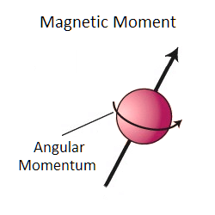
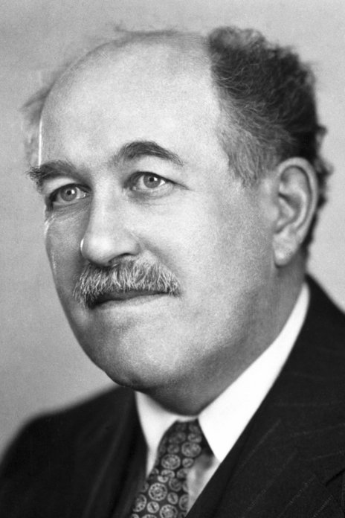
Baryon Magnetic Moments
Magnetic moments of proton and neutron:
1933，Otto Stern
Dirac pointlike particles:
$g_{p}=+2$
$$g_{n}=0$$
Exp. $g_{p}=+5.586,$
$g_{n}=−3.826$
1943 Nobel Prize
It remains challenging to understand the magnetic moments of composite particles at a quantitative level.

Slide 15
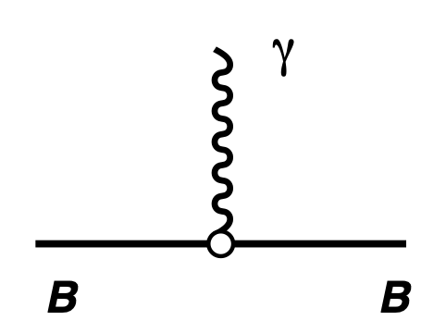
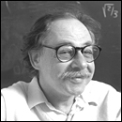
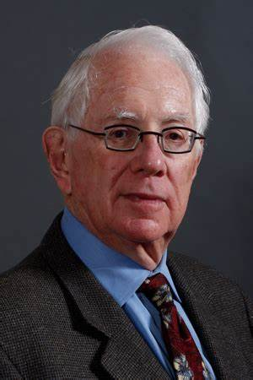
Baryon Magnetic Moments
At tree level, two contact terms
From SU(2) to SU(3)
$$κ_{B}^{\left(2\right)}=α_{B}b_{6}^{D}+β_{B}b_{6}^{F}$$
Coleman-Glashow relations
Sidney R. Coleman, Sheldon Lee Glashow, PRL6(1961)423

Slide 16
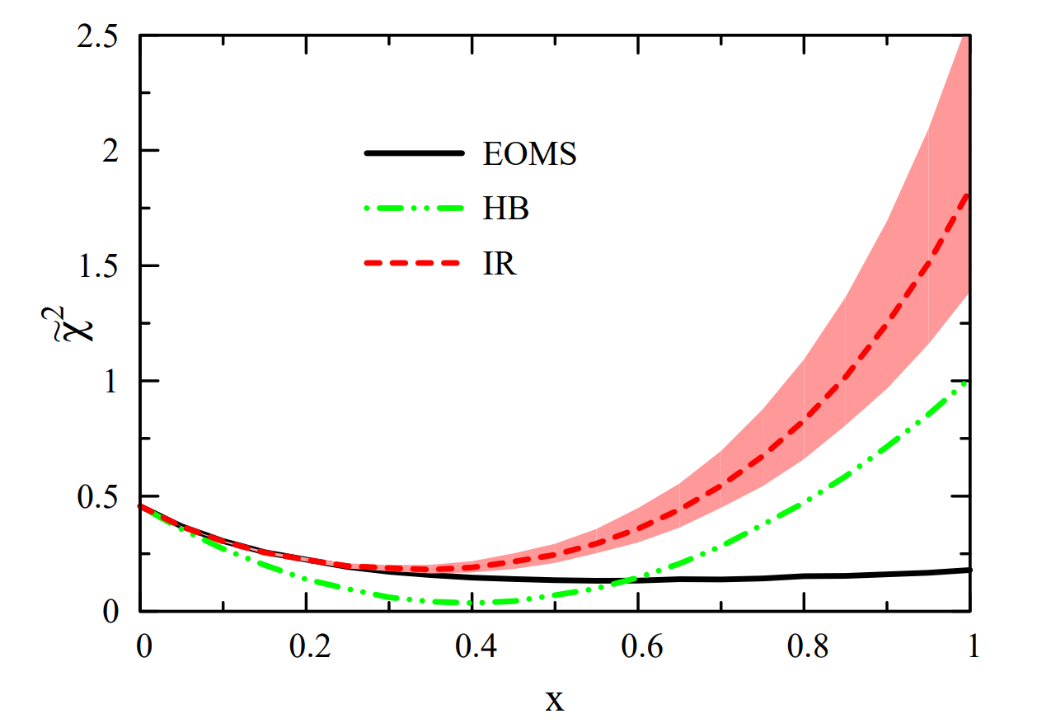
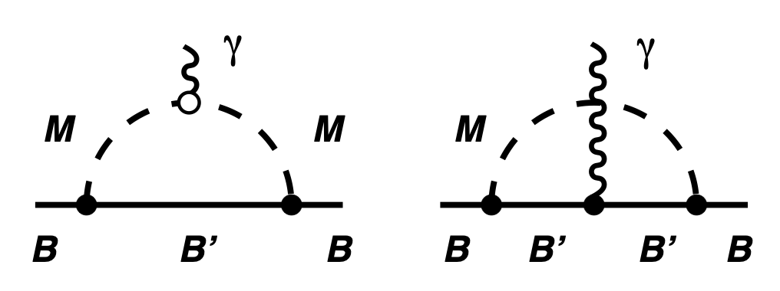
Baryon Magnetic Moments
At loop level: vacuum polarization
chiral limit physical
LSG et al., PRL101 (2008) 222002
Only EMOS works

Slide 17
Contents
Why covariant chiral effective field theories
Applications: (1) magnetic moments, (2)meson-baryon interactions, (3) nucleon-nucleon interactions, (4) weak hyerpon radiative decays
Summary and outlook

Slide 18
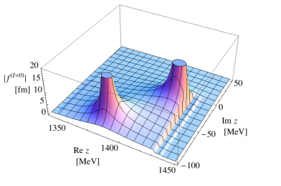
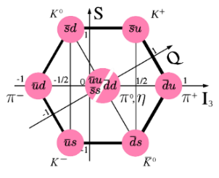
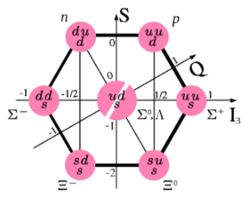
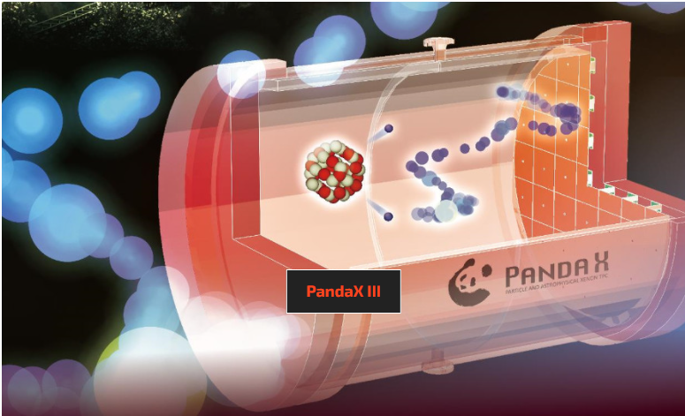
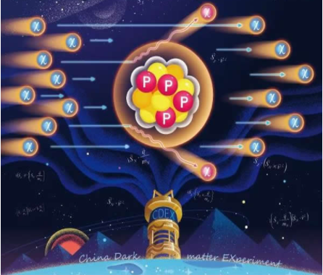
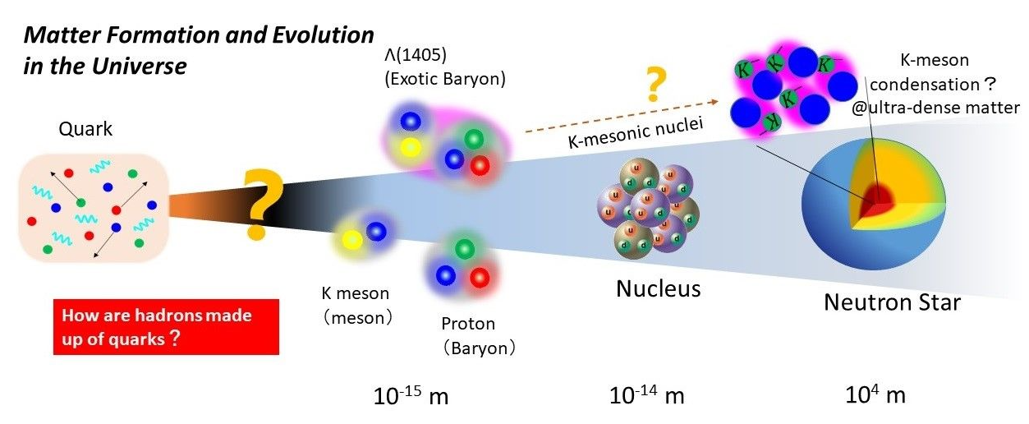
Meson-baryon (MB) interactions—rich physics
$Λ$(1405)双峰结构
Spectroscopy
N(1440), N(1535), Λ(1380), Λ(1405), Σ(1385)…
“PandaX”
“CDEX”,“盘古”实验
Baryon sigma terms
Inputs to baryon-baryon interactions
n
p
n
p
n
p
n
p
n
Λ
K

Slide 19
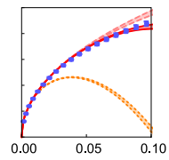
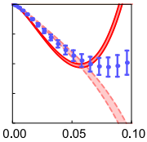
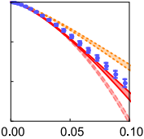
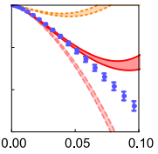
Unsatisfactory theoretical situation (I)
SU(2): πN elastic scattering needs at least NNLO
NLO
S11
NNNLO
P11
P31
P13
EXP
NNLO
SU(2) πN partial-wave phaseshifts at NLO，NNLO，NNNLO
Siemens et al. PRC94.014620
SU(3)： S=0 πN & S=1 KN EOMS much better than HB ChPT
HB SU(3) NNLO
Huang et al. PRD96,016021
EXP
EOMS SU(2) NNLO
Chen et al. PRD87,054019
EOMS SU(3) NNLO
Lu et al. PRD99, 054024
SU(3) HB、EOMS ChPT NNLO partial wave phaseshifts
Notes:
在重子手征有效场论的基础上，人们期望能够统一给出SU3味空间下的重子-介子相互作用。但在实际的研究中，遇到了很大的困难。首先，人们在SU2也就是piN的弹性散射过程的研究中发现，手征有效场论需要直到到NNLO才能描述实验得到的散射相移。下面四张图中，黄色的区域就是次领头阶的结果。很显然的，黄色的曲线显著的偏离了实验值，特别是是在P11分波，黄色曲线已不在作图范围内。这预示着手征有效场论相对论较慢的收敛速度，也说明，要想实现统一描述，至少需要计算至NNLO。第二个问题在于重整化方案。这张图展示了HB手征微扰理论以及EOMS在SU3味空间对piN弹性散射过程的描述。图中红色的虚线是HB SU3 次次领头阶的结果，蓝色实线则是EOMS SU3 NNLO的结果。显然HB的结果只能描述能量较低的区域的实验数据。这说明其收敛速度明显慢于EOMS。这就要求我们实现统一描述应尽量采取协变的EOMS重整化方案。

Slide 20
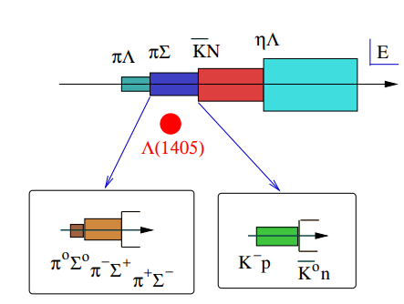
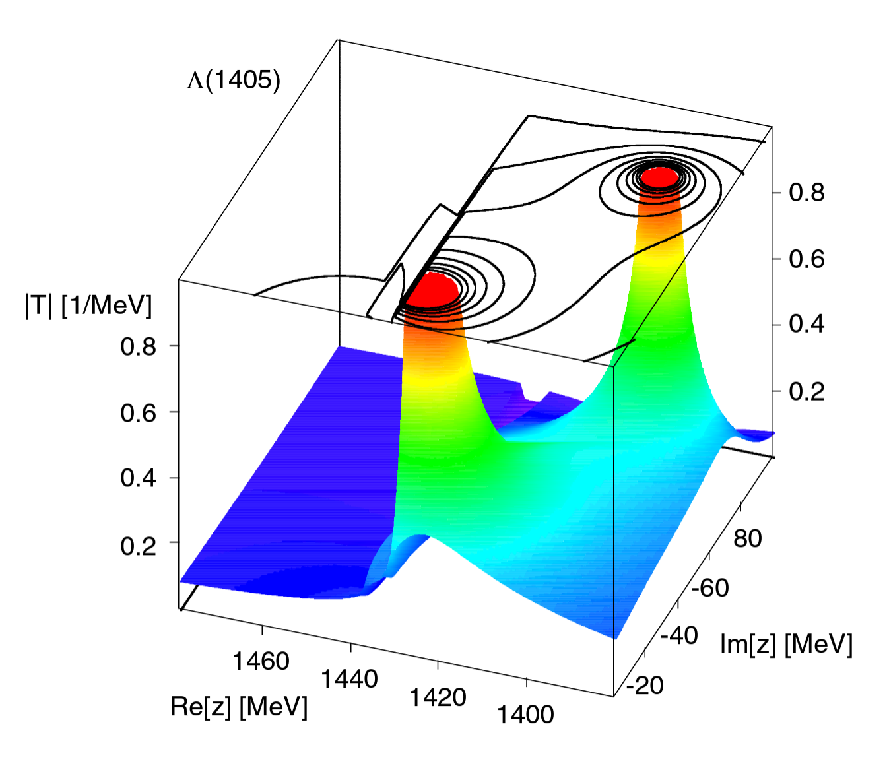
Unsatisfactory theoretical situation (II)
SU(3): S=-1 $\overline{K}$N scattering：non-perturbative $Λ$(1405) only at NLO
First exotic baryon: $\overline{K}N$
Two-pole structure
Jia-Ming Xie, Jun-Xu Lu, LSG, Bing-Song Zou, 2307.11631
John Bulava et al., 2307.10413
LO&NLO, Kaiser, Siegel, Weise, NPA594, 325(1995), 718 citations
LO, Oset and Ramos, NPA635, 99(1998), 835 citations
NLO, Oller and Meissner, PLB500, 263(2001), 874 citations
Notes:
最后一个困难在于KbarN道的非微扰效应。Lambda1405位于piSigma以及KbarN耦合道中间，共振态的存在表明散射过程中显著的非微扰效应，我们需要将散射振幅重求和到无穷阶。另外，因1405位于KbarN阈下，而目的实验数据几乎都位于KbarN阈值以上。这使得不同理论计算得到的1405的性质有很大的不同。右图标出了部分工作中得到1405的位置。黄色区域为较低共振态1380，绿色区域为高能共振态1405，不确定度非常大。
针对以上三点问题，为了实现对SU3味空间重子-介子散射过程的统一描述，我们必须采用协变EOMS重整化方案，至少计算至NNLO并考虑KbarN道的非微扰效应。同时，为了尽可能的减少对1405描述的不确定度，应尽可能多的考虑实验数据，包括不同奇异数散射过程的数据进行全局拟合。

Slide 21
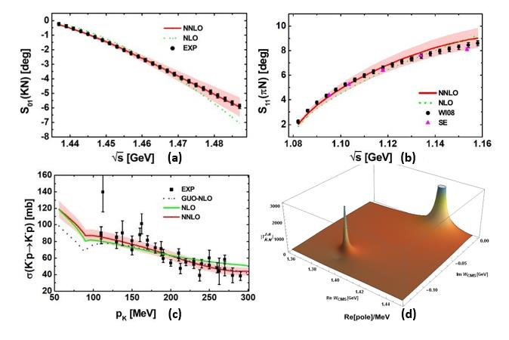
First simultaneous description of MB scattering
First simultaneous description of $S=−1,0,+1$ meson-baryon scattering data
Confirmation of the two-pole structure of $Λ(1405)$—confirmed by lQCD 2307.10413
Predicted I=1 counterparts—confirmed by BeLLe PRL130 (2023)151903
Validity of baryon chiral perturbation theory verified
Jun-Xu Lu, LSG*, and et al., PRL130 (2023)071902

Slide 22
Contents
Why covariant chiral effective field theories
Applications: (1) magnetic moments, (2)meson-baryon interactions, (3) nucleon-nucleon interactions, (4) weak hyerpon radiative decays
Summary and outlook

Slide 23
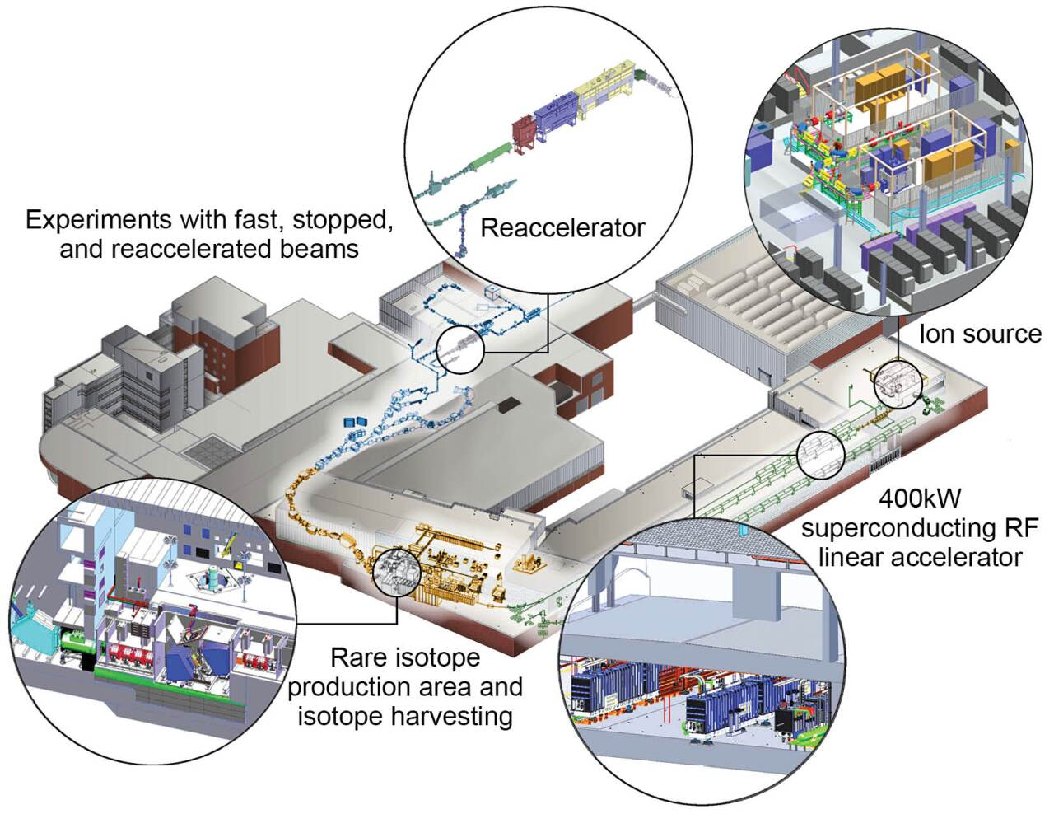
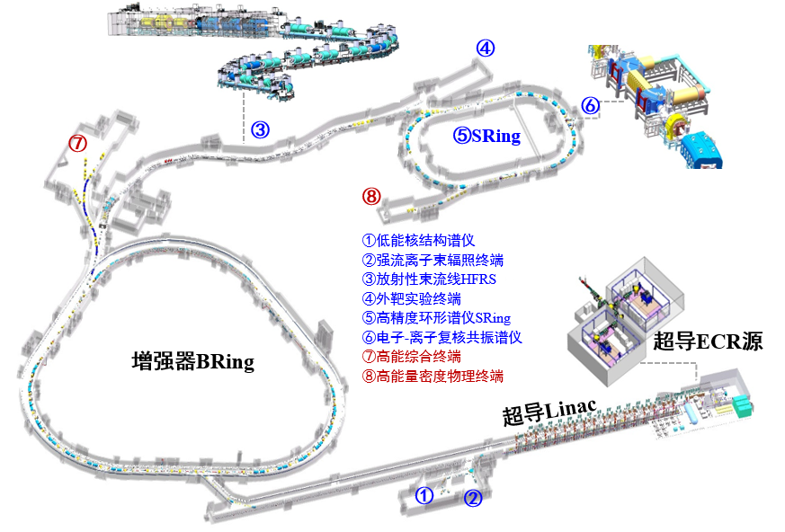
Nuclear force—always at the frontiers of nuclear physics
十二五”国家重大科技基础设施
“强流重离子加速器装置“|impcas.ac.cn)
Facility for Rare Isotope Beams at Michigan State University
Experimental nuclear physics
map the nuclear landscape,
understand the forces that bind nucleons into nuclei,
answer questions about the astrophysical origin of nuclear matter,
address societal needs related to nuclear science and technology.
认识原子核内有效相互作用。
探索宇宙中从铁到铀元素的来源
粒子辐照应用研究
Notes:
High Intensity Heavy-ion Accelerator Facility

Slide 24
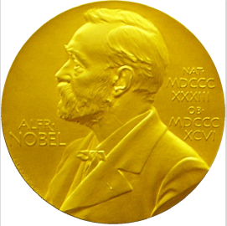
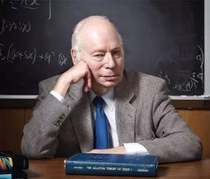
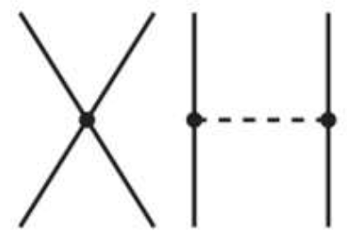
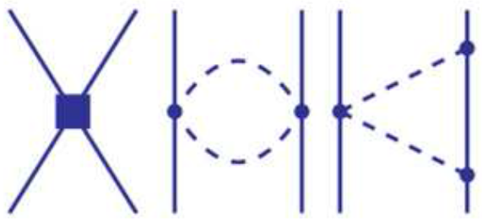
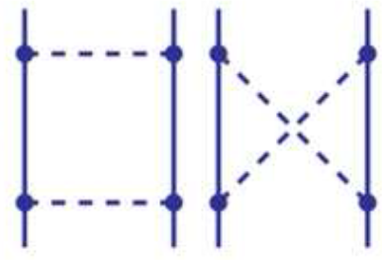
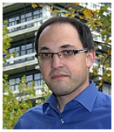
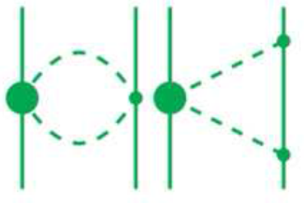
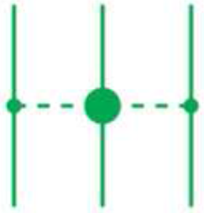
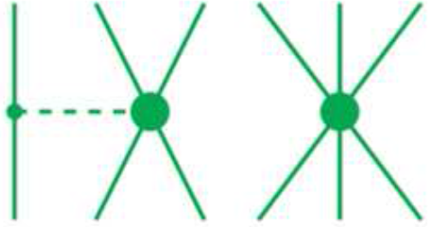
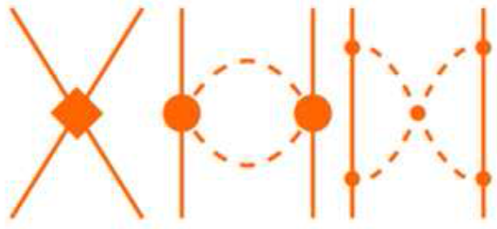
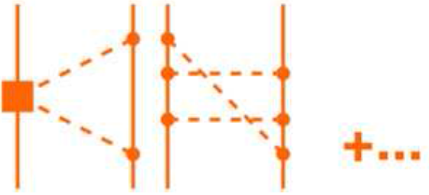
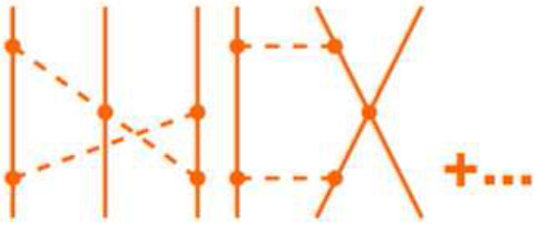
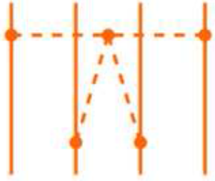
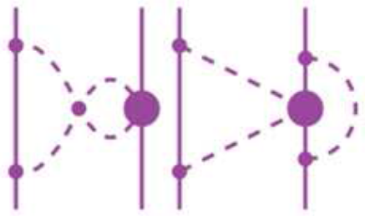
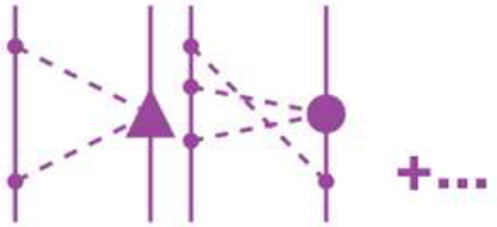
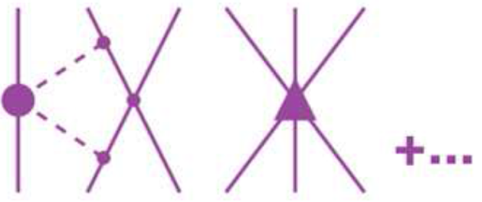
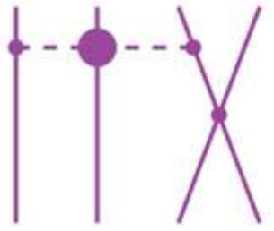
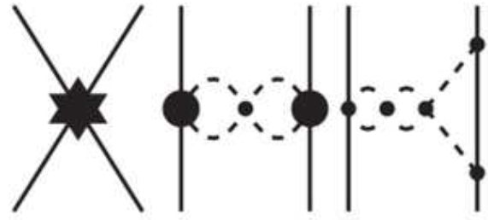
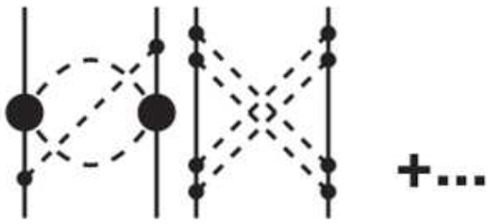
非相对论手征核力—核力发展史的里程碑
Modern de facto standard: chiral nuclear force
2NF
1990 2N LO
$LO$($Q^{0}$)
S. Weinberg, PLB1990, NPB1990
1994 3N LO
1997 2N $NLO$
$NLO$($Q^{2}$)
Steven Weinberg
van Kolck
Kaiser
U. Van Kolck et al, PLB1992, PRL1994
3NF
N. Kaiser et al, NPA1997
2000 2N $N^{2}LO$
Key issuges：non-relativisitic（others ： slow convergence，non-renormalizable，etc）
$N^{2}LO$($Q^{3}$)
U. Van Kolck et al, PRC1994
U. Van Kolck et al, PRC1994
4NF
2003 2N $N^{3}LO$
E. Epelbaum et al, NPA1998,2000
2007 3N $N^{3}LO$
$N^{3}LO$($Q^{4}$)
R. Machleidt et al. PRC2003
S. Ishikwas et al. PRC2007
E. Epelbaum EPJA2007
Epelbaum
Machleidt
E. Epelbaum et al. NPA2005
V. Bernard et al. PRC2007
2015 2N $N^{4}LO$
$N^{4}LO$($Q^{5}$)
R. Machleidt et al. PRC2015
H. Krebs et al, PRC2012,2013
5NF
E. Epelbaum et al. PRL2015
NOT COMPLETE
…
$N^{5}LO$($Q^{6}$)
R. Machleidt et al. PRC2015
NOT COMPLETE
Philipps
Savage
Adopted from Front.in Phys. 8 (2020) 57
Notes:
1990年前后，诺奖得主Weinberg提出利用非相对论手征微扰理论构建核力，获得巨大成功。随后，经过一大批理论物理学家长达30余年的发展与完善，手征核力已成为目前核物理第一性原理研究的重要输入量。但传统手征核力不满足洛伦兹对称性，无法用于相对论第一性原理计算。

Slide 25
A systematic study from scratch 2 PRL, 9 PRC/D, 2 PLB, 5CPC/CPL
Nucleon-nucleon interaction in the 3S1-3D1 coupled channel for a pion mass of 469 MeV
PLB833(2022)137347
Relativistic high precision chiral nuclear forces
PRL128(2022)142002
u
d
Renormalizability of leading order covariant chiral NN interaction
CPC45(2021)054101
Non-perturbative two-pion exchange contributions
PRC105(2022)014003
NN
Relativistic Chiral Description of the 1S0 NN Scattering CPL38(2021)062101
Perturbative two-pion exchange contributions
PRC102(2020)054001
Pion-mass dependence of the NN interaction
PLB809(2020)135745
Meson-baryon scattering up to one-loop
PRD99(2019)054024
PRL130(2023) 071902
Leading order relativistic chiral NN interaction
CPC42(2018)014103
Covariant chiral NN contact
Lagrangians up to N3LO
PRC99(2019)024004
leading order
next-to-next-to-leading order
Strangeness S= − 2 BB interactions and femtoscopic correlation functions
CPC47(2023)024108
u
d
Test of the YN interaction of the leading order covariant ChEFT
PRC105(2022)035203
s
Strangeness S = − 3 and S = − 4 BB interactions
PRC103(2021)025201
YN&YY
Strangeness S = − 2 BB interactions PRC98(2018)065203
Strangeness S = − 1 YN interactions
PRC98(2018)065203
Leading order relativistic YN interactions
CPC42(2018)014105
Strangeness S = −1 YN scattering in covariant ChEFT
PRD94(2016) 014029

Slide 26
How to become relativistic/covariant
Dirac spinors and algebra (instead of non-relativistic wave functions and Pauli matrices)
$$u(p,s)=N_{p}\left(\begin{matrix}1 \\ \frac{σ⋅p}{ε_{p}}\end{matrix}\right)χ_{s}, N_{p}=\sqrt{\frac{ε_{p}}{2M_{N}}}$$
Covariant scattering equation (instead of Lippmann-Schwinger eq.)
$𝒯\left(p^{′},p∣W\right)=𝒜\left(p^{′},p∣W\right)+∫\frac{d^{4}k}{\left(2π^{4}\right)}𝒜\left(p^{′},k∣W\right)G(k∣W)𝒯(k,p∣W)$
$$G(k∣W)=\frac{i}{{\left[γ^{μ}{(W+k)}_{μ}−m_{N}+iε\right]}^{\left(1\right)}{\left[γ^{μ}{(W−k)}_{μ}−m_{N}+iε\right]}^{\left(2\right)}}$$
Covariant power counting (vs. the Weinberg PC)

Slide 27
NNLO high precision relativistic chiral force
Contact contributions: 19 LECs fitted to the phase shifts of all the 12 partial waves with $J≤2$ at $E_{lab}=1,5,10,25,50,100,150,200 MeV$ (96 data points in total)
Pion-exchanges: TPE fixed from pion-nucleon scattering, OPE fixed from pion decay and nucleon beta decay—parameter free (chiral dynamics)
Y.-H. Chen, D.-L. Yao, and H. Q. Zheng, Phys. Rev. D 87, 054019 (2013)

Slide 28
Fit results for $J≤2$ partial waves
NR-N3LO-Idaho: Machleidt and D. R. Entem, Phys. Rept.503, 1 (2011); NR-N3LO-EKM: E. Epelbaum, H. Krebs, and U. G. Meißner, Eur. Phys. J.A51,53 (2015)

Slide 29
Fit results for $J≤2$ partial waves
NR-N3LO-Idaho: Machleidt and D. R. Entem, Phys. Rept.503, 1 (2011); NR-N3LO-EKM: E. Epelbaum, H. Krebs, and U. G. Meißner, Eur. Phys. J.A51,53 (2015)

Slide 30
Better for higher partial waves
 | Total | $${}^{3}D_{3}$$ | $${}^{1}F_{3}$$ | $${}^{3}F_{3}$$ | $${}^{3}F_{4}$$ | $${}^{3}G_{3}$$ | $$ε_{3}$$ | $${}^{1}G_{4}$$ | $${}^{3}G_{4}$$
NNLO | $$0.98$$ | $$0.03$$ | $$0.03$$ | $$0.21$$ | $$0.70$$ | $$0.00$$ | $$0.01$$ | $$0.00$$ | $$0.00$$
NR-$N^{3}$LO-EKM | $$3.00$$ | $$0.56$$ | $$1.44$$ | $$0.28$$ | $$0.54$$ | $$0.01$$ | $$0.01$$ | $$0.03$$ | $$0.13$$
Notes:
为了更好地展示相对论效应，我们来看一下高阶分波，他们完全由单pi和两pi交换给出，没有任何参数。我们发现，相对论计算尽管是次次领头阶，但比非相对论次次次领头阶对这些分波相移的描述还要好，展示了相对论效应的贡献

Slide 31
Three essential features of the relativistic force:
Relativistic
/Covariant
Faster convergence
More renormalizable
More
natural

Slide 32
The first high-precision relativistic chiral nuclear force
Beihang-Munich
2022
1990/91 Weinberg
1994, Van Kolck
2003, Machleidt
2015, Epelbaum
非相对论手征核力
相对论手征核力
LO NN, Weinberg, PLB251 (1990) 288
NN potential with Delta at N2LO, Ordonez, Ray, U. van Kolck, PRL72 (1994) 1982
Relativistic NN potential at N2LO,Lu, Wang, Xiao, Geng*, Meng, Ring, PRL128 (2022) 142002
Accurate NN potential at N3LO,
Entem and Machleidt,PRC68(2003)041001
Precision NN potential at N4LO, Epelbaum, Krebs, Meißner, PRL115 (2015)122301

Slide 33
Contents
Why covariant chiral effective field theories
Applications: (1) magnetic moments, (2)meson-baryon interactions, (3) nucleon-nucleon interactions, (4) weak hyperon radiative decays
Summary and outlook

Slide 34
What are weak radiative hyperon decays
Weak radiative hyperon decays (WRHDs) are interesting physical processes involving the electromagnetic, weak, and strong interactions
$s→d γ$ transitions at the quark level
Six WRHDs channels of the ground-state octet baryons

Slide 35
What are weak radiative hyperon decays
The effective Lagrangian describing the $B_{i}→B_{f} γ$ WRHDs
a: partity-conserving amplitude b: partity-violating amplitude
Observables for the WRHDs
$α_{γ}$: the asymmetry parameter
$θ$: the angle between the spin of the initial baryon $B_{i}$ and the 3-momentum $\vec{k}$ of
the final baryon $B_{f}$

Slide 36
Why to study WRHDs--$Λ→nγ$
New BESIII measurement for the $Λ→n γ$ decay [PRL129, 212002(2022)]
PDG2022
The branching fraction is only about one half of the current PDG average
The asymmetry parameter $α_{γ}$ is determined for the first time

Slide 37
Why to study WRHDs--$Λ→nγ$
None of the existing predictions can describe the new BESIII measurement for the $Λ→n γ$ decay， in particular ChPT
Data：BESIII, PRL129, 212002(2022)
HB χPT : E. E. Jenkins et al, NPB 397, 84 (1993)
BχPT: H. Neufeld, Nucl. Phys. B 402, 166 (1993)
NRCQM：Qiang Zhao et al, CPC45, 013101 (2021)
PM1: M. B. Gavela et al, PLB 101, 417 (1981)
PM2: G. Nardulli, PLB 190, 187 (1987)
VDM: P. Zenczykowski, PRD 44, 1485 (1991)
χPT: B. Borasoy et al, PRD 59, 054019 (1999)
BSU(3): P. Zenczykowski, PRD 73, 076005 (2006)
QM: E. N. Dubovik et al, Phys. Atom. Nucl. 71, 136 (2008)

Slide 38
WRHDs in the EOMS BχPT
Feynman diagrams
Lagrangians

Slide 39
$α_{γ}$ of the $Λ→n γ$ decay as a function of $\sqrt{{|a|}^{2}+{|b|}^{2}}$
Data：BESIII, PRL129, 212002(2022)
HB χPT : E. E. Jenkins et al, NPB 397, 84 (1993)
NRCQM：Qiang Zhao et al, CPC45, 013101 (2021)
PM1: M. B. Gavela et al, PLB 101, 417 (1981)
PM2: G. Nardulli, PLB 190, 187 (1987)
VDM: P. Zenczykowski, PRD 44, 1485 (1991)
χPT: B. Borasoy et al, PRD 59, 054019 (1999)
BSU(3): P. Zenczykowski, PRD 73, 076005 (2006)
QM: E. N. Dubovik et al, Phys. Atom. Nucl. 71, 136 (2008)
Interestingly, only EOMS BχPT agrees with latest BESIII measurement
The vector dominance model (VDM) and the pole model (PM II) are disfavored by the BESIII data

Slide 40
$α_{γ}$ of other WRHDs as a function of $\sqrt{{|a|}^{2}+{|b|}^{2}}$
For $Σ^{0}→n γ$, our result contradicts the predictions of PM I and NRCQM
For $Ξ^{−}→Σ^{−}γ$, our prediction agrees better with Exp., and PDG disfavor the results of PM II and tree-level χPT
For $Σ^{+}→p γ$, the results predicted in all the χPT deviate from the PDG average but our prediction is closer
Hara’s theorem: $α_{γ}$ for $Ξ^{−}→Σ^{−}γ$ and $Σ^{+}→p γ$ should not be too large.

Slide 41
$α_{γ}$ of $Ξ^{0}→Σ^{0} γ$ and $Ξ^{0}→Λ γ$ as a function of $\sqrt{{|a|}^{2}+{|b|}^{2}}$

Slide 42
Contents
Why covariant chiral effective field theories
Applications: (1) magnetic moments, (2)meson-baryon interactions, (3) nucleon-nucleon interactions, (4) weak hyperon radiative decays
Summary and outlook

Slide 43
Summary and Outlook
We have developed covariant chiral effective field theories for various systems, ranging from the one baryon sector to the two-baryon sector.
We showed that covariant ChEFTs are capable of solving a number of long-standing problems for which non-relativistic theories were not successful.
These studies not only deepened our understanding of the non-perturbative strong interaction but also provided necessary inputs for further applications.

Slide 44
Collaborators
Beihang University: Jun-Xu Lu, Yang-Xiao, Chun-Xuan Wang, Kai-Wen Li, Xiu-Lei Ren, Zhi-Wei Liu, Jing Song, Qian-Qian Bai, Pavon Valderrama
Peking University: Jie Meng
Sichuan University: Bing-Wei Long
Institute of Modern Physics: Ju-jun Xie
Technical University of Munich: Peter Ring
Funding agencies

Slide 45
Faster convergence
Relativistic and non-relativistic description of scattering phaseshifts
$(0≤j≤4,T_{lab}≤200 MeV$)
Forces | Relativistic N2LO Geng et al. | NR N3LO Epelbaum et al
$$χ^{2}$$ | 17.57 | 19.08

Slide 46
More renormalizable: non-trivial 3P0
TLAB = 10 MeV
TLAB = 50 MeV
³P₀
Nogga et al, PRC(2005)
B. W. Long et al, PRC(2011)
M. P. Valderrama, PRC(2011)
M. C. Birse, PoS CD(2009)
C.X. Wang et al. CPC45,054101

Slide 47
More natural: non-trivial 1S0
U. van Kolck
APS fellow
Member of Academia Europaea
2020 Herman Feshbach Prize
Large variance of phase shifts from ${60}^{∘}$ to $−{10}^{∘}$
Scattering length $(a=23.7fm)$ much larger than the pion Compton wave length
Zero amplitude around $k_{0}∼340$ $MeV$
Virtual bound state around $iγ=−i10MeV$
Chin.Phys.Lett. 38 (2021) 062101

Slide 48
Power counting rules
NR: simply count the (even) number of three-derivatives
$N_{d}$ is the number of ,$\overset{⃡}{∂}=\vec{∂}−\overset{⃖}{∂}$
Nucleon field: $ψ= \left({p \atop n}\right)\sim O\left(p^{0}\right),$ Nucleon mass: $m\sim O\left(p^{0}\right),$
Dirac matrices: $Γ∈\left\{1, γ_{μ}, γ_{5}γ_{μ}, σ_{μν}\sim O\left(p^{0}\right),γ_{5}\sim O\left(p^{1}\right)\right\}$
Covariant derivative: $∂\left(\overline{ψ}Γψ\right)\sim O(p^{1})$, $\left(\overline{ψ}\overset{⃡}{∂}ψ\right)\sim O\left(p^{0}\right)$, except $\left(\overline{ψ}σ_{μν}ψ\right)\left(\overline{ψ}{\overset{⃡}{∂}}^{μ}Γψ\right)\sim O\left(p^{1}\right),(\overline{ψ}γ_{5}γ_{μ}ψ)(\overline{ψ}{\overset{⃡}{∂}}^{μ}Γψ)\sim O(p^{1})$
Treatment for covariant derivative:
-Expansion of such structure:
-up to $O\left(q^{2}\right) :n=0,1$;
-up to $O\left(q^{4}\right) :n=0,1,2.$
1
2
4
3

Slide 49
Highly nontrivial
Non-Relativistic leading order box diagram
Relativistic leading order box diagram
$$𝒜=$$
Loop integral
$$×$$
Bilinear
Bilnear (114 项)
and more...
Loop integrals—— scalar and tensor (29 terms)
$$A_{0},B_{0},B_{00},C_{0},C_{1},C_{2},C_{00},C_{11},C_{12},C_{22},D_{0},D_{1},D_{2},D_{00},D_{11},D_{12},D_{22},D_{23}$$
Numerical accuracy and singularity
$D_{11},D_{12},D_{22},D_{23}$ coefficients diverge
$\frac{1}{1−{\cos{θ}}^{2}}$
Hardware accuracy
${(\frac{p_{off}}{M_{N}})}^{n}≈{10}^{−3n}$
$$θ$$

Slide 50
Why relativistic/covariant
Lorentz invariance is one of the most important symmetries in Nature.
Both kinematical and dynamical relativistic corrections self-consistently included
Relativistic approaches successful in explaining fine structures
Atomic and molecular systems: why gold is yellow
Nuclear system：spin-orbit splitting, pseudospin symmetry，covariant DFT
One-baryon sector：magnetic moments、masses、sigma terms
Meson-baryon scattering:
Einstein
Dirac
Mayer
Jensen
Arima

Slide 51
From Schroedinger Eq. to Dirac Eq.
1926
It has to be covariant
(satisfies special relativity)
1928
Notes:
我来举两个例子，来解释一下我刚才的论断。1926年，薛定谔写下了薛定谔方程来描述微观粒子的运动。人们立刻意识到薛定谔方程不满足狭义相对论的要求，因而开始寻找满足协变性的薛定谔方程。1928年，Dirac得到了正确的方程，即Dirac方程。

Slide 52
From Schroedinger Eq. to Dirac Eq.
Important implications
1932 Exp.
Electrons have spin ½ if they satisfy SR.
Electrons have antiparticles – positrons
…

Slide 53
From Schroedinger Eq. to Dirac Eq.
威斯敏斯特教堂
Notes:
1933年，薛定谔和狄拉克分享了当年的诺贝尔物理学奖，狄拉克方程也被刻在了威斯敏斯特教堂的地面上

Slide 54
Why Gold is golden, and Silver is white
Notes:
接下来我们来看另外一个例子：金和银属于元素周期表的同一族，按理说化学性质应该一样，为什么一个是金黄色，一个是银白色？

Slide 55
Sliver
银
Only Quantum
Gold
金
+ Relativity
5s
6s
+ Relativity
3.7eV
(335nm)
2.4eV
(516.5nm)
Should be the same color!
4d
5d
(Z=47)
(Z=79)
Optical wave length (可见光)
335nm
380nm
516.5nm
750nm
Absorbed
Reflected (Gold，金)
Reflected (Sliver，银)
Notes:
确实，如果只考虑量子力学，金和银外层的电子壳层非常相似，而考虑相对论效应后，银的能级差变为335nm, 而金的变为516.nm。我们知道可见光的波长在380到750nm之间，因此银不吸收可见光，而金吸收可见光的蓝光波段

Slide 56
Sliver
银
Only Quantum
Gold
金
+ Relativity
5s
6s
+ Relativity
3.7eV
(335nm)
2.4eV
(516.5nm)
Should be the same color!
4d
5d
(Z=47)
(Z=79)
Gold shines golden, and sliver is dark white due to both effects of Quantum Mechanics and Relativity.
Blue is absorbed.
No Absorption.
White
Golden yellow
Notes:
从而根据三原色原理，金显示为金黄色，银显示为银白色

