Slide 1

中子皮与对称能
Lie-Wen Chen (陈列文)
School of Physics and Astronomy, Shanghai Jiao Tong University, China
The symmetry energy (Esym)
Neutron skin (NSkin)
Nskin vs Esym
Summary and outlook
“原子核结构与相对论重离子碰撞前沿交叉研讨会”
大连理工大学，2023年8月3日

Slide 2
Outline
The symmetry energy (Esym)
Neutron skin (NSkin)
Nskin vs Esym
Summary and outlook

Slide 3
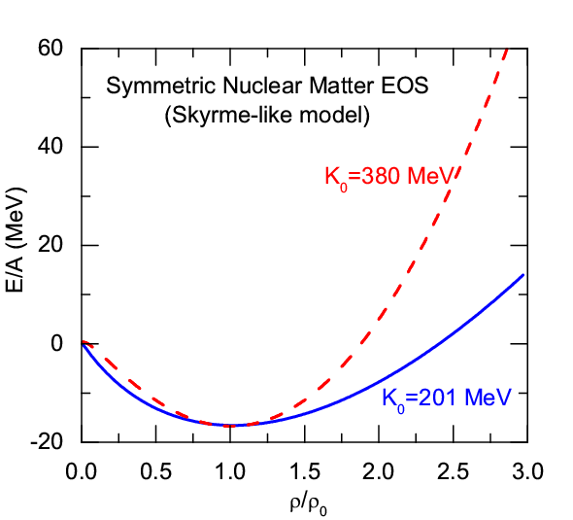
The Symmetry Energy of Nuclear Matter
EOS of Isospin Asymmetric Nuclear Matter
(Parabolic law)
Symmetric Nuclear Matter
(relatively well-determined)
Isospin asymmetry
Symmetry energy term (largely uncertain)
Nuclear Matter Symmetry Energy
LWC, EPJ Web of Conf. 88, 00017 (2015)
对称能是回答以下两个重大科学问题的关键量
中子星和致密核物质的性质是什么?
宇宙中的元素是怎样产生的?
《美国核科学前沿长期规划》
确定对称能已成为一些核物理大科学装置的重要物理目标，比如：中国兰州CSR/惠州HIAF、日本RIBF/RIKEN、美国FRIB/MSU和德国FAIR/GSI
p. 1

Slide 4
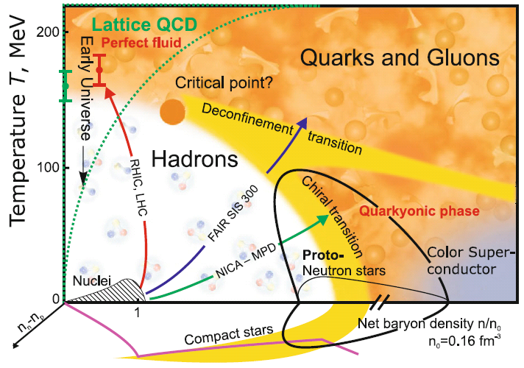

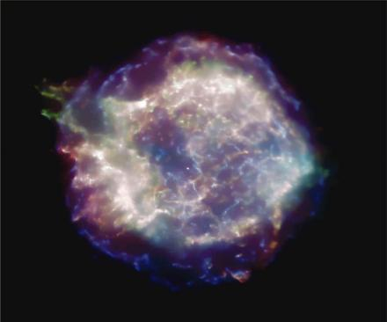

QCD Phase Diagram
V.E. Fortov, Extreme States of Matter – on Earth and in the Cosmos, Springer-Verlag, 2011
Probing QCD phase diagram in Nuclei and Heavy Ion Collisions in terrestrial labs
Holy Grail
of
Nuclear
Physics
and in NS Merger, SN, and Nstar in heaven?
Nuclei
HIC
SN
NStar
NS Merger
Small baryon chemical potential:
Smooth Crossover Transition
Large baryon chemical potential:
First-order Phase Transition
QCD Critical Endpoint (CEP):
where the first-order phase transition ends
NS Mergers/NStar/CCSNe:
Ideal and unique site to probe QCD phase diagram at low T and high densities (and large isospin )!
Quark Matter Symmetry Energy?
M. Di Toro et al., NPA775 (2006); P.C. Chu (初鹏程)/LWC, ApJ780 (2014); LWC,《原子核物理评论》34, 20 (2017) [arXiv:1708.04433]
p. 2

Slide 5
Esym: Many-Body Approaches
L.W. Chen, Nucl. Phys. Rev. (原子核物理评论) 34, 20 (2017)
[arXiv:1708.04433]
p. 3
Notes:
5

Slide 6
Esym: Experimental Probes
Promising Probes of the E_{sym}(ρ)
(an incomplete list !)
Pigmy/Giant resonances
Nucleon optical potential
B.A. Li, L.W. Chen, C.M. Ko
Phys. Rep. 464, 113(2008)
[arXiv:0804.3580] (Citations: 1173+)
p. 4

Slide 7
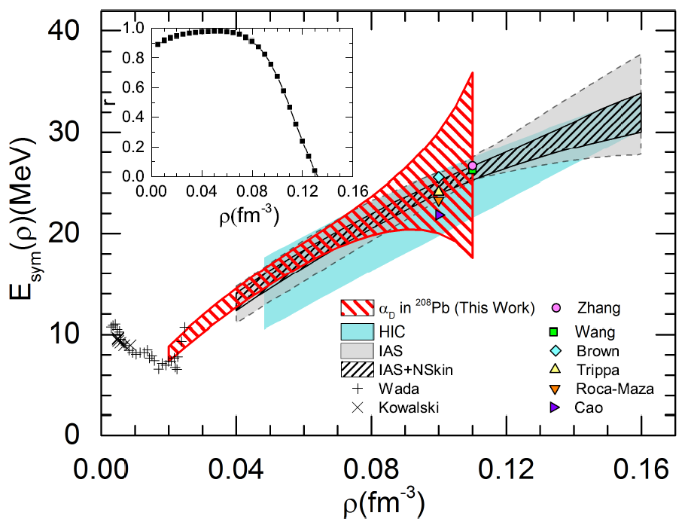
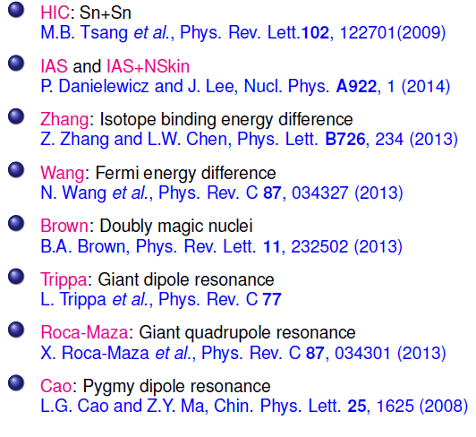

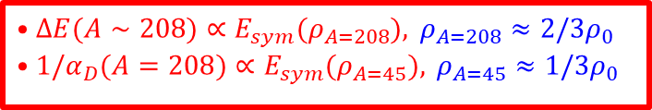
E_{sym}: Subsaturation densities
Z. Zhang (张振) and LWC, PRC92, 031301(R) (2015)
$$•ΔE(A∼208)∝E_{sym}(ρ_{A=208}),​ ρ_{A=208}≈2/3ρ_{0} \\ •1/α_{D}(A=208)∝E_{sym}(ρ_{A=45}),​ ρ_{A=45}≈1/3ρ_{0}$$
$$∼ρ_{0}/3$$
Wada and Kowalski: experimental results of the symmetry energies at densities below 0.2$ρ_{0}$ and temperatures in the range 3 ~11 MeV from the analysis of cluster formation in heavy ion collisions.
Wada et al., Phys. Rev. C85, (2012) 064618; Kowlski et al., Phys. Rev. C75, (2007) 014601. Natowitz et al., Phys. Rev. Lett. 104, (2010) 202501.
p. 5

Slide 8
E_{sym}: Subsaturation densities
Clustering effects on Esym within NL-RMF
for n, p, t, h, α matter
Alpha BEC effects on Esym within NL-RMF for cold npα matter
Zhao-Wen Zhang (张肇文) and LWC, PRC95, 064330 (2017)
Zhao-Wen Zhang (张肇文) and LWC, PRC100, 054304 (2019)
See also: S. Typel, G. Röpke, T. Klähn, D. Blaschke, and H. H. Wolter, Phys. Rev. C 81, 015803 (2010).
p. 6

Slide 9

E_{sym}: Around saturation density
LWC et al., Invited Review
58 analyses of terrestrial nuclear experiments and astrophysical observations
E_{sym}(ρ₀) = 31.7±3.1
L = 57.5±24.5 MeV
Similar conclusion has been obtained in:
B. A. Li and X. Han, Phys. Lett. B727, 276 (2013);
M. Oertel, M. Hempel, T. Klahn, and S. Typel, Rev. Mod. Phys. 89, 015007 (2017).
Assuming all the constraints are equally reliable !!!
Very recent PREX-II data suggest stiff Esym around saturation density! (But has strong tension with CREX. This Talk)
p. 7

Slide 10
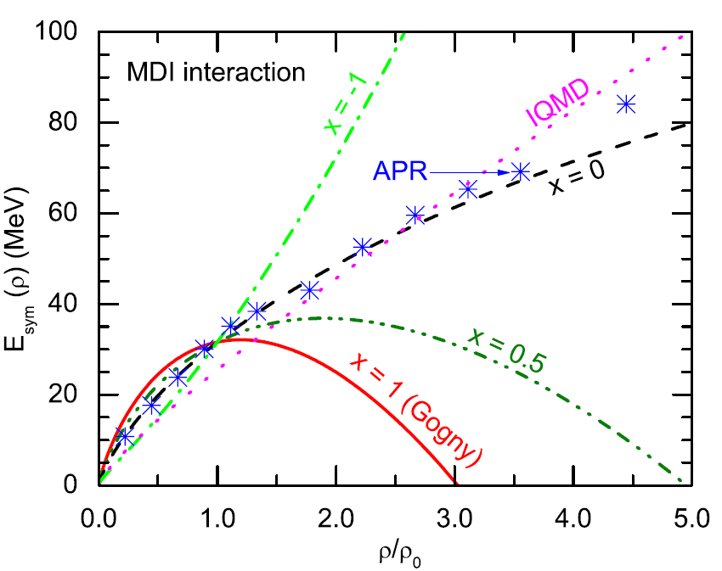
E_{sym}：Supra-saturation density
A Soft or Stiff Esym at supra-saturation densities ???
Tong-Gang Yue (岳侗钢)， LWC, Z. Zhang (张振), and Y. Zhou (周颖),
PRResearch 4, L022054(22)
pion ratio (FOPI): ImIQMD, Feng/Jin, PLB683, 140(2010)
Stiffer
n/p v2 (FOPI):
Russotto/Trauntmann/Li et al.,
PLB697, 471(2011) (UrQMD)
PRC94, 034608 (2016)
PREX-II
Cozma/Trauntmann/Li et al.,
PRC88, 044912 (2013) (Tubingen QMD - MDI)
Softer
pion ratio (FOPI):
IBUU04, Xiao/Li/Chen/Yong/Zhang, PRL102,062502(2009)
ImIBLE, Xie/Su/Zhu/Zhang, PLB718,1510(2013)
B.A.Li, B.J. Cai, W.J. Xie, and N.B. Zhang, Universe 7, 187 (2021)
p. 8

Slide 11

E_{sym}：Current Status
There are MANY constraints on E_{sym} (ρ₀) and L, and the world average values are:
E_{sym}(ρ₀) = 31.7±3.1 MeV
L = 57.5±24.5 MeV
Very recent PREX-II/CREX makes the situation elusive !!! (This Talk)
The symmetry energy at subsaturation densities have been relatively well-constrained
Based on the GW multimessenger measurements, the high density Esym cannot be too stiff or too soft but still with large uncertainty!!!
(This Talk)
Z. Zhang(张振)/LWC,
PLB726, 234 (2013);
PRC92, 031301(R)(2015)
Y. Zhou (周颖), LWC,
ApJ886, 52(2019) [arXiv:1907.12284]
p. 9

Slide 12
Outline
The symmetry energy (Esym)
Neutron skin (NSkin)
Nskin vs Esym
Summary and outlook

Slide 13
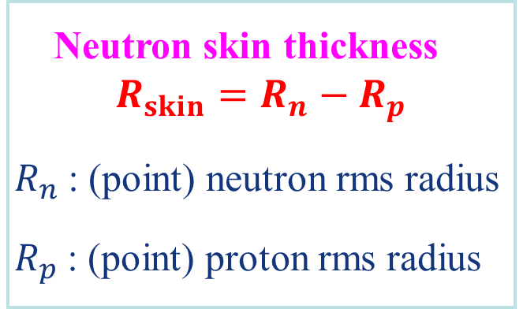
Neutron Skin
M. Thiel et al., JPG (2019)
Neutron skin thickness
$$R_{skin}=R_{n}−R_{p}$$
$R_{n}$: (point) neutron rms radius
$R_{p}$: (point) proton rms radius
p. 10

Slide 14
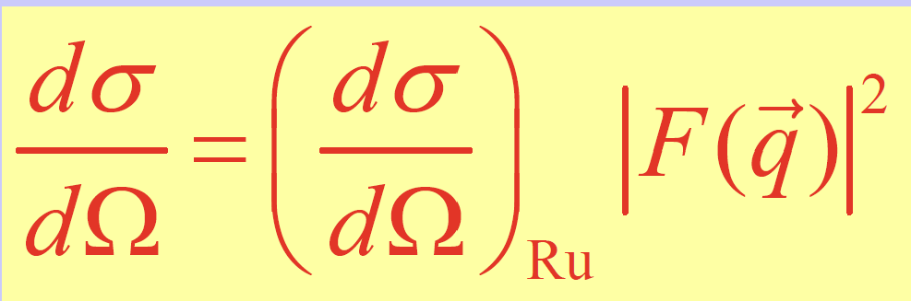
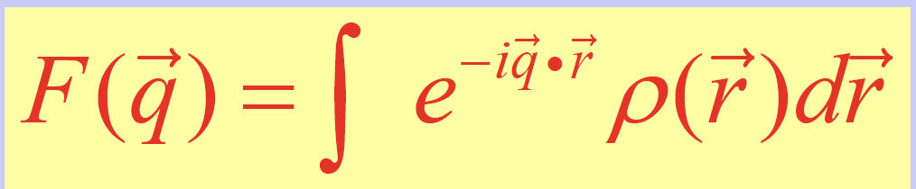
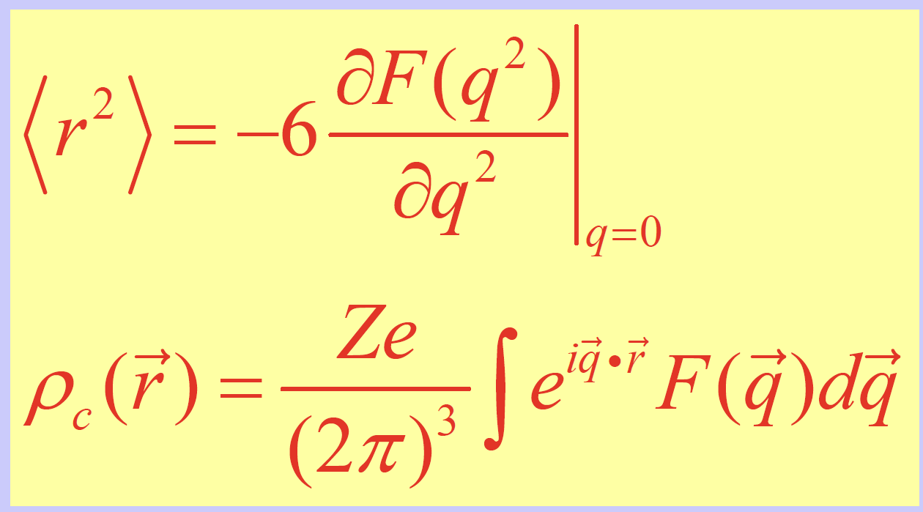
Neutron Skin
M. Thiel et al., JPG (2019)
Experimentally measured is Form Factor
Shown with the dashed lines are the ‘point’ proton (red) and neutron (black) density distributions. Folding these point densities with single nucleon electromagnetic and weak form factors yields the electromagnetic charge (solid red line) and weak-charge (solid black line) distributions. Note that whereas the charge distribution follows closely the proton density, the weak-charge density is mostly sensitive to the distribution of neutrons. The blue circles represent the experimental charge distribution.
p. 11

Slide 15
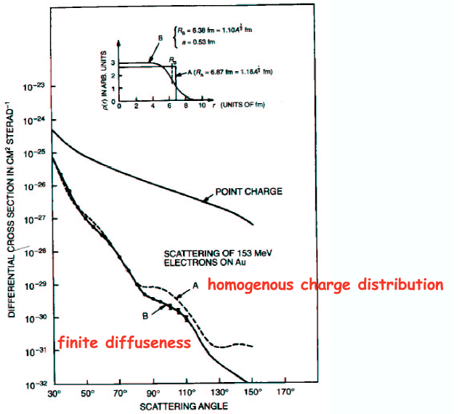
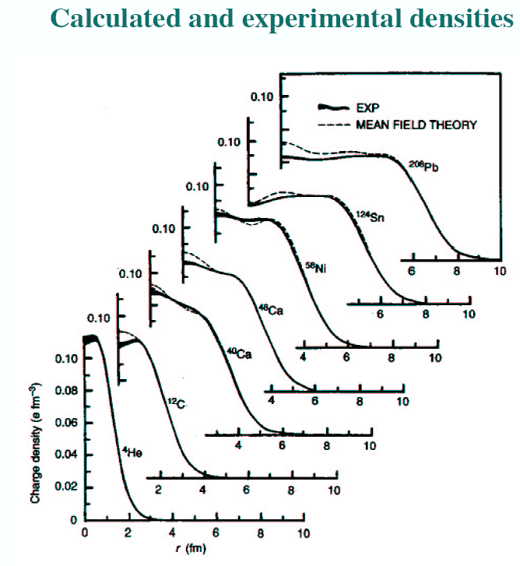

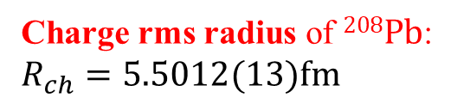
Neutron Skin
Charge rms radius of $208Pb$: $R_{ch}=5.5012(13)fm$
(high precision: ~ 0.02 %)
Weak charge rms radius of $208Pb$: $???\sim 1\%$
p. 12

Slide 16
Outline
The symmetry energy (Esym)
Neutron skin (NSkin)
NSkin vs Esym
Summary and outlook

Slide 17
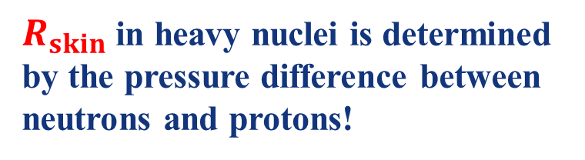
NSkin vs PNM
18 SHF + 6 RMF
at 0.1 fm⁻³
$R_{skin}$in heavy nuclei is determined by the pressure difference between neutrons and protons!
p. 13

Slide 18

NSkin vs Esym
R.J. Furnstahl, NPA (2002)
$$208Pb$$
$R_{skin}$in heavy nuclei is strongly correlated with E_{sym}(rho₀) and L (~p₀)!
p. 14

Slide 19
NSkin vs Esym
LWC/Ko/Li, PRC (2005) (Citations: 262+)
Establish the quantitative relationship between Rskin and L
Constraining Rskin by using the L value constrained by isospin diffusion data in HICs
p. 15

Slide 20
NSkin vs Esym
LWC/Ko/Li, PRC (2005) (Citations: 262+)
p. 16

Slide 21
NSkin vs Esym
LWC/Ko/Li, PRC (2005) (Citations: 262+)
Isospin difusion in HICs: LWC/Ko/Li, PRL (2005) (Citations: 472+); Li/LWC, PRC (2005) (Citations: 301+)
p. 17

Slide 22
NSkin vs Esym
LWC/Ko/Li/Xu, PRC82, 024321 (2010) (Citations: 258+)
Constraining the E_{sym}(rho₀) and L by using the existing data on Rskin of Sn isotopes
Anti-correlation is found between the E_{sym}(rho₀) and L
Pb208 Rskin (0.175+/- 0.02 fm) and core-crust transition density can be obtained
p. 18

Slide 23
NSkin vs Esym
Zhang(张振)/LWC, PLB726, 234 (2013) (Citations: 165+)
Pb208 Rskin is essentially determined by the L(2/3rho₀)
Binding energy difference is essentially determined by the E_{sym}(2/3rho₀)
p. 19

Slide 24
NSkin in ²⁰⁸Pb : PREX-II
PREX:
The Lead (Pb) Radius EXperiment
PREX-II: Rskin = [0.212, 0.354] fm for Pb208
Huge Nskin!
In PREX, the neutron density distribution in 208Pb is determined by measuring the parity-violating electroweak asymmetry in the elastic scattering of polarized electrons off 208Pb and thus is free from the strong interaction uncertainties
(See 张金龙’s Talk)
RMF: Inconsistent with GW170817: Λ_{1.4} <580 !!!
δ meson may be important in the RMF model !!!
Fan Li (李帆)/Cai/Zhou/Jiang/LWC, ApJ 929, 183 (2022)
p. 20

Slide 25
NSkin in ²⁰⁸Pb : PREX-II
What determines the Nskin thickness? ---The density slope parameter L, especially Lc at ρ_{c} ~ 2ρ₀/3 (average density of nuclei)!!!
B. A. Brown, PRL85, 5296 (2000); R. J. Furnstahl, NPA706, 85 (2002); L.W. Chen et al., PRC72, 064309 (2005); M. Centelles et al., PRL102, 122502 (2009); L. W. Chen et al., PRC 82, 024321 (2010); X. Roca-Maza et al.,PRL106, 252501 (2011), ……
SHF
eSHF
Nskin is determined by Lc !!!
T.G. Yue (岳侗钢), , LWC*, Z. Zhang (张振), and Y. Zhou (周颖), PRReseach 4, L022054(22)
Z. Zhang (张振) and LWC*, PLB726, 234 (2013) (Citations: 165+)
p. 21

Slide 26
NSkin in ²⁰⁸Pb : PREX-II
Implications of Rskin from PREX-II
T.G. Yue (岳侗钢), , LWC*, Z. Zhang (张振), and Y. Zhou (周颖), PRReseach 4, L022054(22)
Lc cannot be too big!!! Lc < 73 MeV and then set an upper limit on Rskin: <0.27 fm for Pb208
eSHF provides a single unified framework to simultaneously describe the finite nuclei (Eb, Rc, GMR, Nskin-PREX-II) + Flow data in HIC+NStar (e.g., NICER)+GW170817
E_{sym}(ρ₀) =34.5±1.5 MeV and L=85.5±22.2 MeV
p. 22

Slide 27
NSkin in ²⁰⁸Pb : PREX-II
Fan Li (李帆), B.J. Cai, Y. Zhou, W.Z. Jiang, and LWC, ApJ 929, 183 (2022)
δ meson and its coupling to σ meson may play an important role in the RMF model !!!
FSUGold + δ-σ mixing provides a single unified framework to simultaneously describe the finite nuclei (Eb, Rc, GMR, Nskin-PREX-II) + Flow data in HIC+NStar (e.g., NICER)+GW170817
p. 23

Slide 28
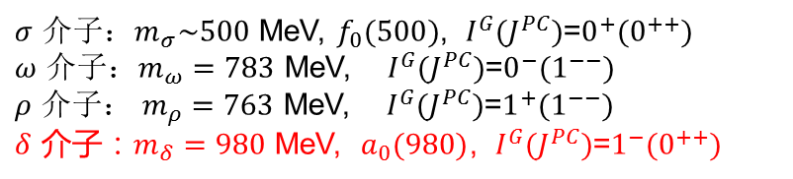
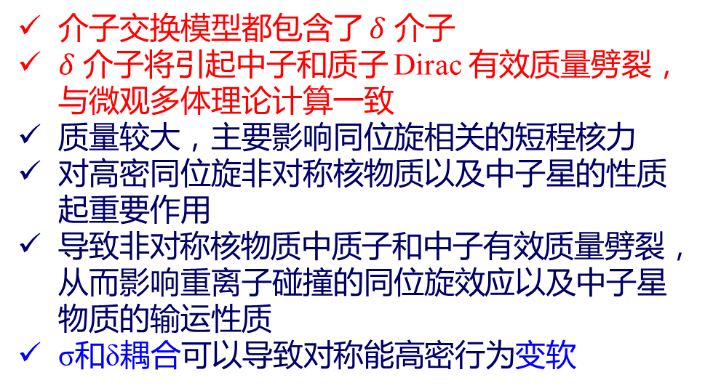
NSkin in ²⁰⁸Pb : PREX-II
相对论协变的能量密度泛函-相对论平均场(RMF)模型
传统的RMF模型只包括σ、ω、ρ三种介子
δ介子的重要性：
Kubis/Kutschera, PLB(97)
介子交换模型都包含了 $δ$ 介子
$δ$ 介子将引起中子和质子 Dirac 有效质量劈裂，与微观多体理论计算一致
质量较大，主要影响同位旋相关的短程核力
对高密同位旋非对称核物质以及中子星的性质起重要作用
导致非对称核物质中质子和中子有效质量劈裂，从而影响重离子碰撞的同位旋效应以及中子星物质的输运性质
σ和δ耦合可以导致对称能高密行为变软
$σ$ 介子：$m_{σ}\sim 500$ MeV, $f_{0}(500)$, $I^{G}(J^{PC})$=$0^{+}(0^{++})$
$ω$ 介子：$m_{ω}=783$ MeV, $I^{G}(J^{PC})$=$0^{−}(1^{−−})$
$ρ$ 介子： $m_{ρ}=763$ MeV, $I^{G}(J^{PC})$=$1^{+}(1^{−−})$
$δ$ 介子：$m_{δ}=980$ MeV, $a_{0}(980)$, $I^{G}(J^{PC})$=$1^{−}(0^{++})$
Fan Li (李帆), B.J. Cai, Y. Zhou, W.Z. Jiang, and LWC, ApJ 929, 183 (2022)
p. 24
Notes:
28

Slide 29
NSkin in ²⁰⁸Pb : PREX-II
S. Wang, H. Tong, Q. Zhao, C. Wang, P. Ring, and J. Meng, PRC106, L021305(2022)
Fan Li (李帆), B.J. Cai, Y. Zhou, W.Z. Jiang, and LWC, ApJ 929, 183 (2022)
The isospin splitting of the nucleon Dirac mass in FSUGold + δ-σ mixing framework is in surprisingly good agreement with the microscopic RBHF calculations in the Full Dirac Space !!!
p. 25

Slide 30
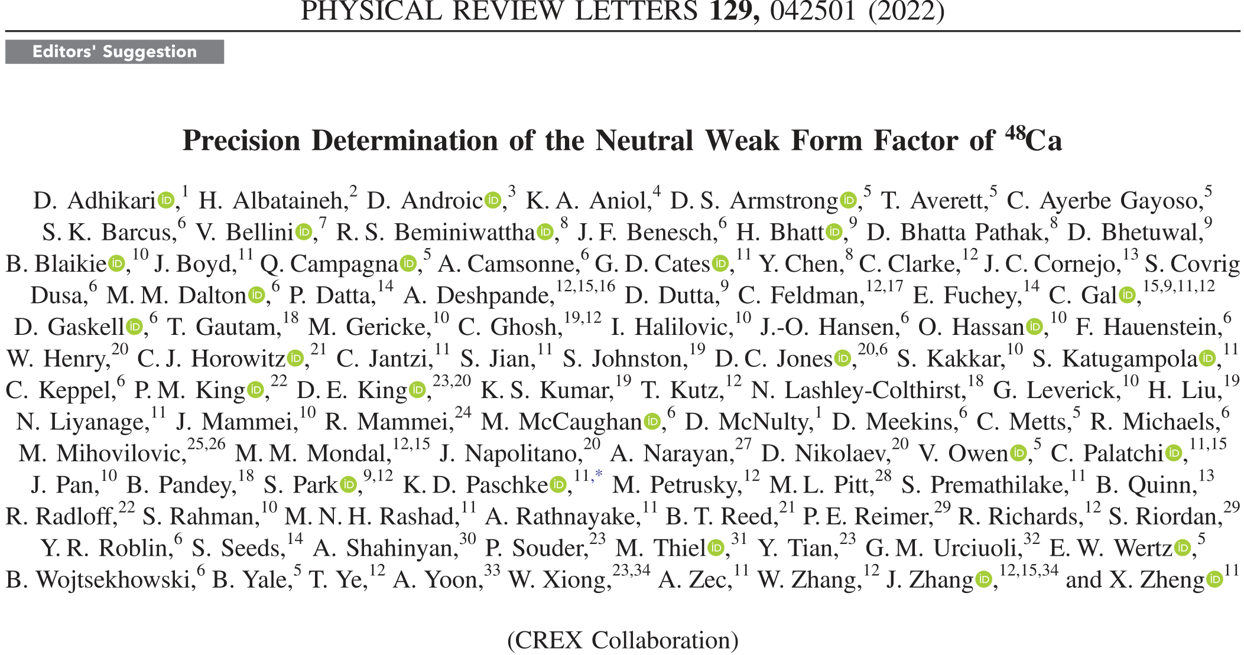
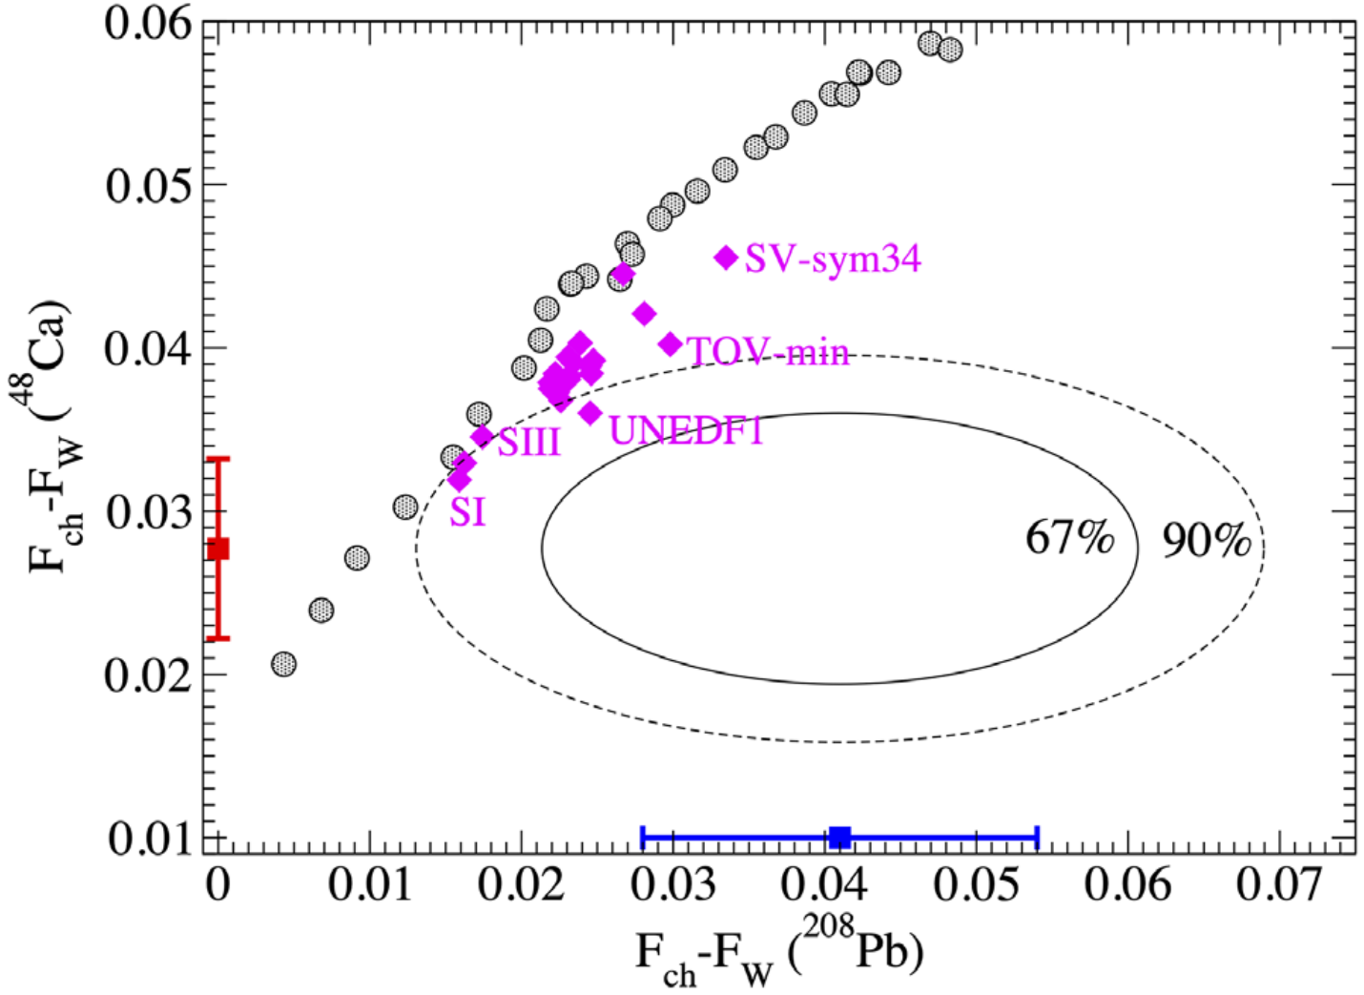
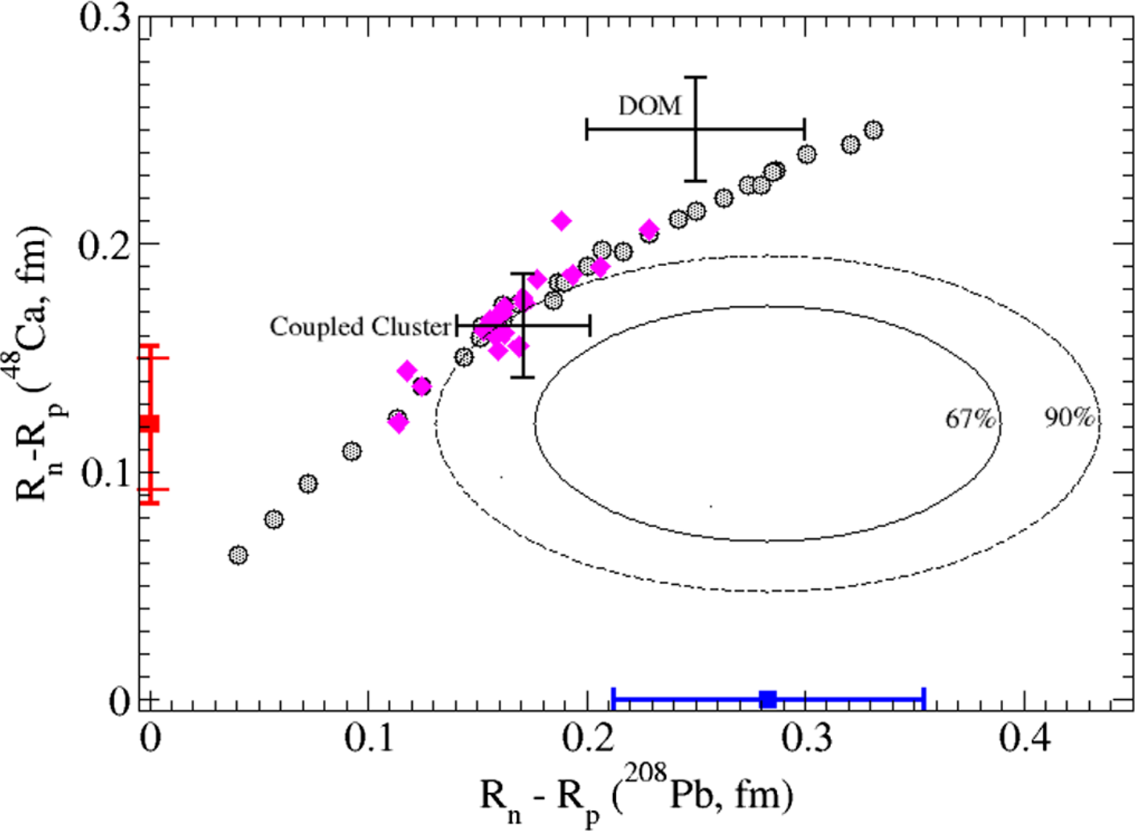
NSkin in ⁴⁸Ca : CREX
CREX, PRL129, 042501 (2022)
Strong tension between CREX and PREX?
With too small Nskin of ⁴⁸Ca or too large Nskin of ²⁰⁸Pb
p. 26

Slide 31
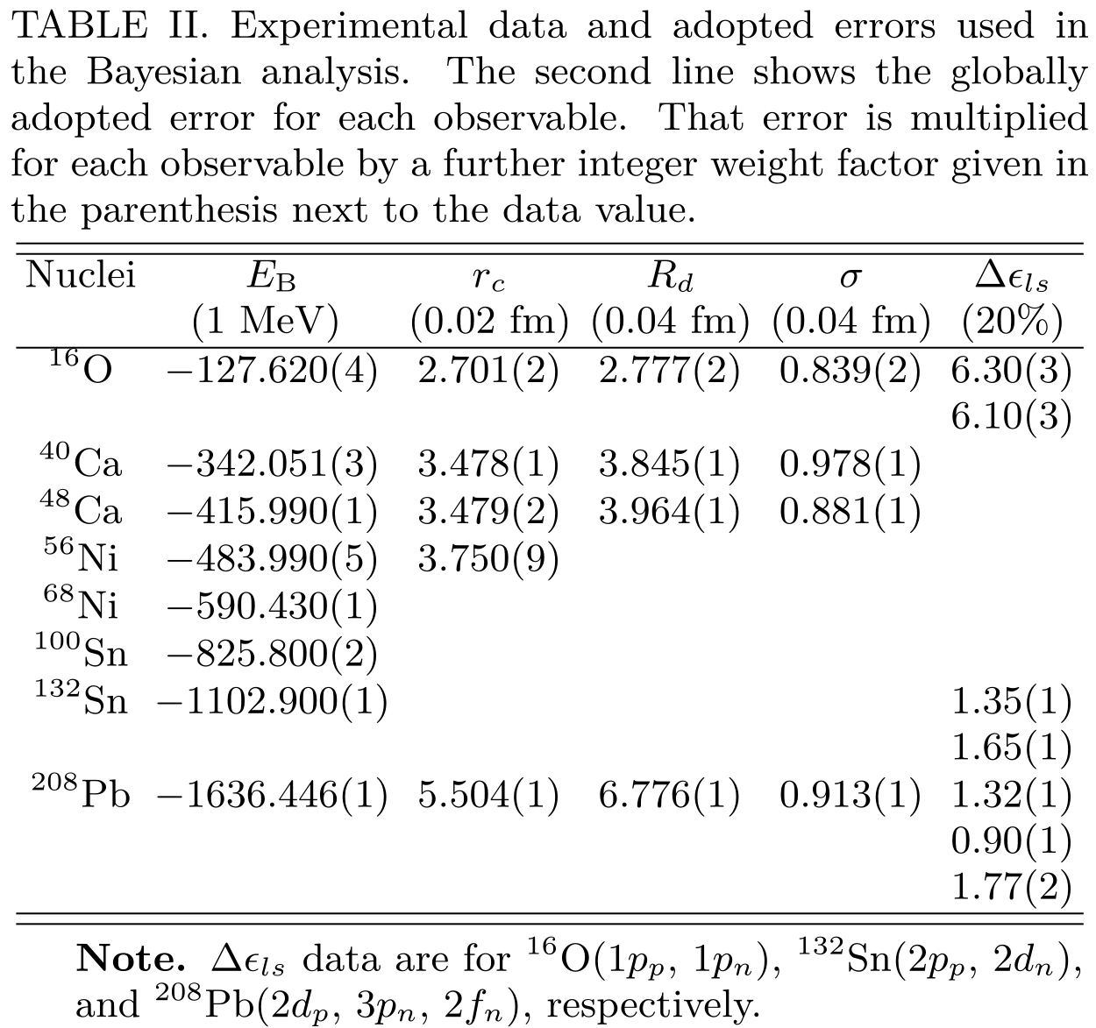
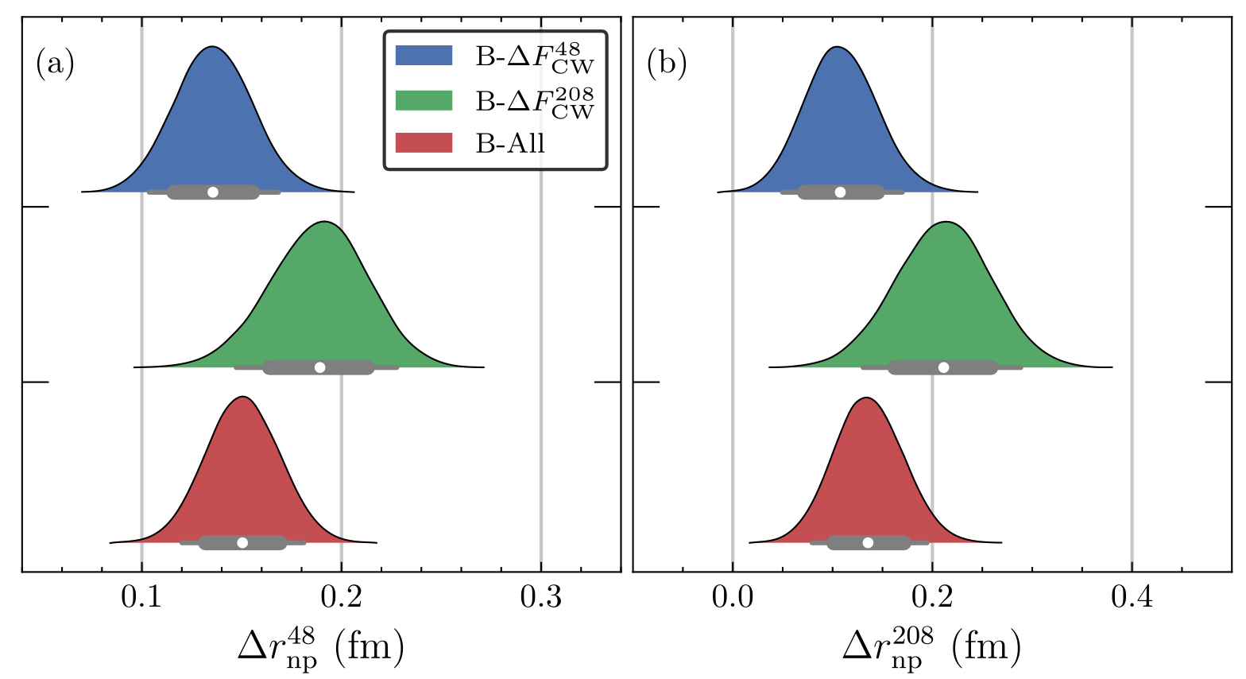
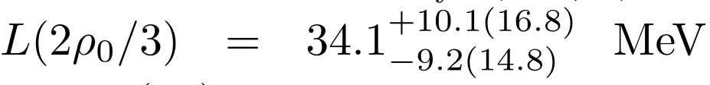
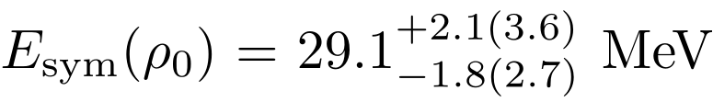

PREX and CREX: A Bayesian analysis
Zhang/Chen, arXiv: 2207.03328
SHF
base data of nuclei
Also n-p Fermi energy difference of ¹⁶O, ^{40,48}Ca, ⁵⁶Ni, ¹³²Sn, ²⁰⁸Pb and GMR of ²⁰⁸Pb
CREX and PREX are compatible in 90% C.L.
PREX is less effective to constrain Esym due to its lower precision compared to CREX
Combining CREX+PREX favor mildly soft Esym around saturation density!
p. 27

Slide 32
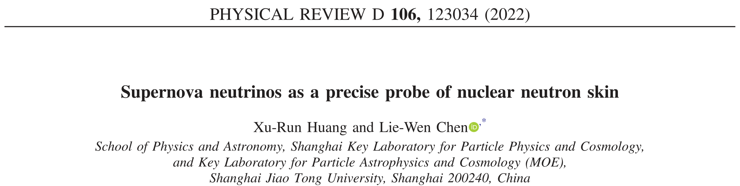
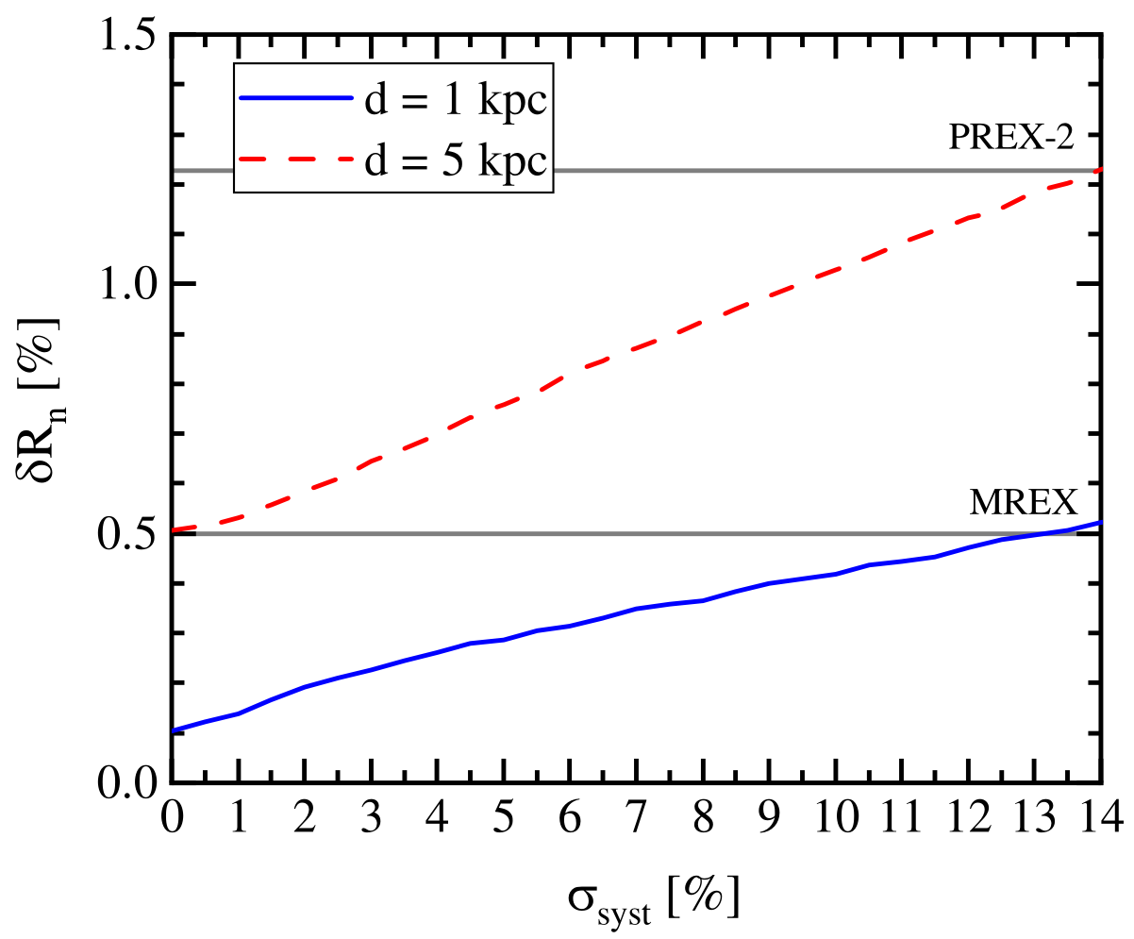
NSkin in ²⁰⁸Pb : RES-NOVA/SNv
X.R. Huang(黄旭润)/LWC, PRD(22)
利用超新星中微子来精确确定原子核的中子皮
RES-NOVA是利用考古铅低温探测器阵列 (archaeological Pb based cryogenic detectors)来探测超新星中微子的一个实验项目。我们提出可以利用核塌缩型超新星中微子与铅原子核的弹性相干散射来测量铅原子核的弱荷形状因子，从而精确确定铅原子核的中子分布半径及中子皮厚度。结果表明，核塌缩型超新星如果足够近(~1kpc)，则测得的中子皮精度可以远高于地面实验(包括下一代实验MREX)的测量精度，理想情况下可以达到~0.1%。
图：利用RES-NOVA探测器和理论预言的近距离(1kpc和5kpc)核塌缩型超新星中微子束流得到的铅原子核中子半径的相对误差随实验系统误差的变化关系。图中指出了PREX-2以及未来MREX实验精度。
p. 28

Slide 33
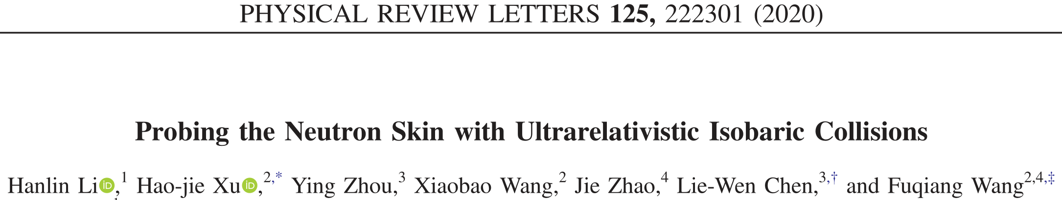
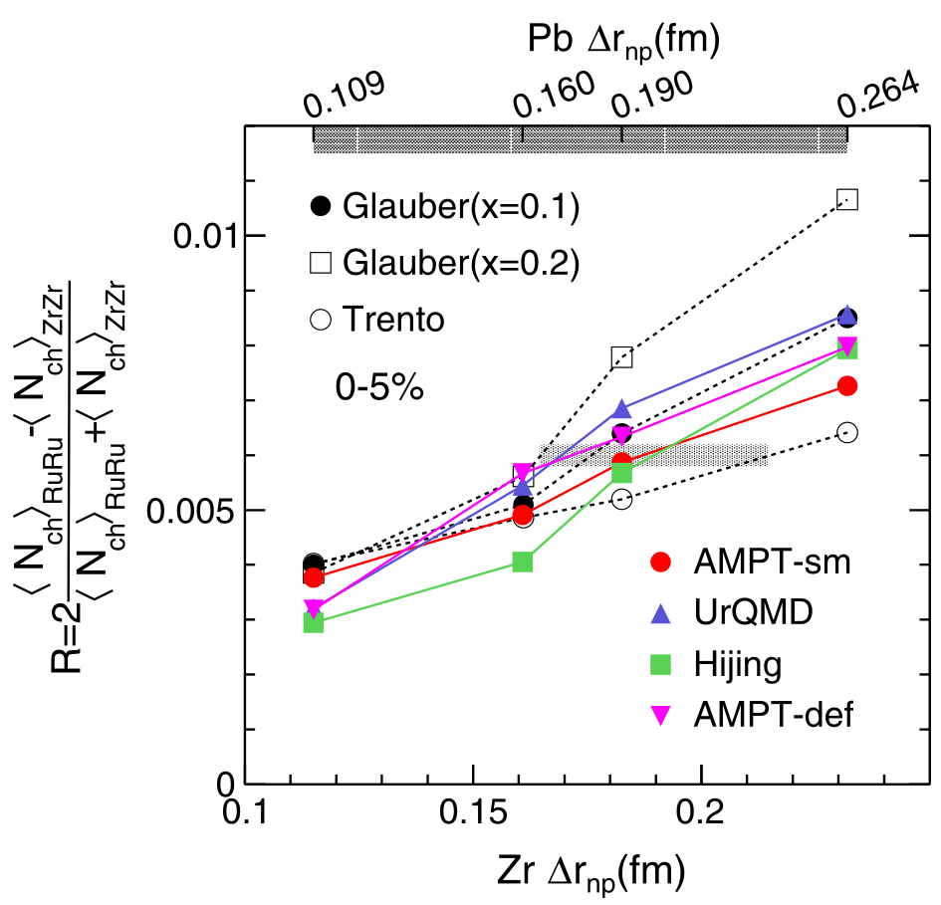
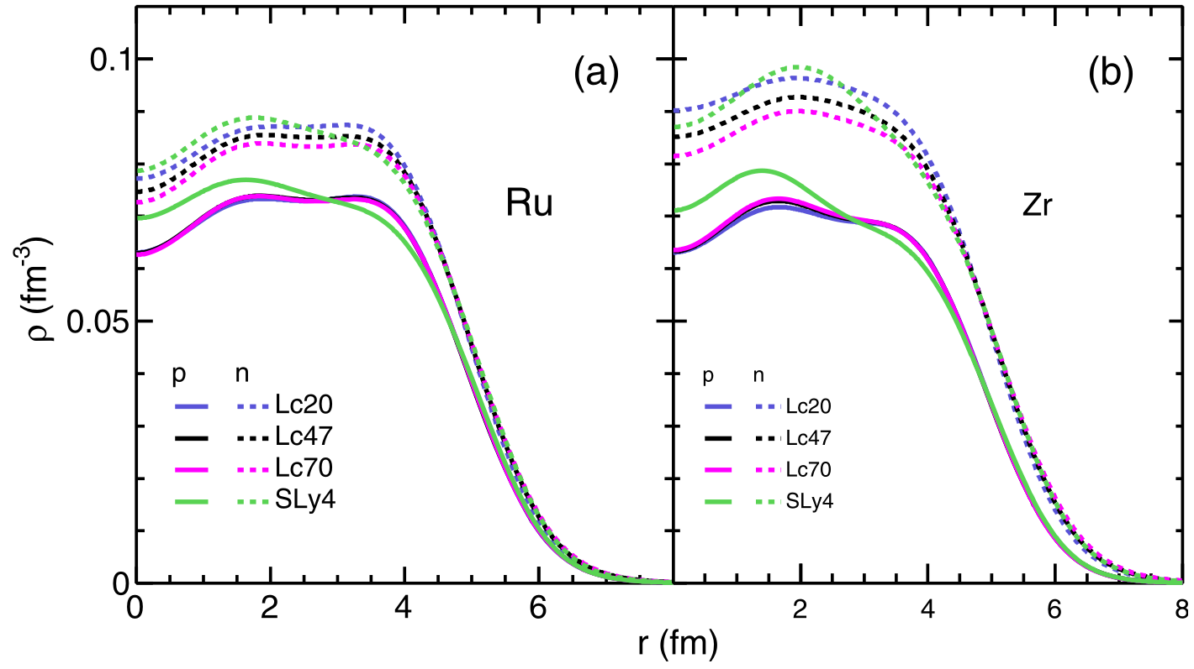
Nskin, Esym and RHIC’s
Li/Xu/Zhou/Wang/Zhao/Chen/Wang, PRL(20)
RuRu/ZrZr荷电粒子产额比敏感于“中子皮厚度”
相对论重离子碰撞为确定中子皮和对称能提供了一种独特的途径
(See 徐浩洁’s Talk)
p. 29

Slide 34
Outline
The symmetry energy (Esym)
Neutron skin (NSkin)
NSkin vs Esym
Summary and outlook

Slide 35
Summary and Outlook
通过重离子碰撞，原子核结构性质(mass, neutron skin, GR/PG…),
以及核子光学势的研究，我们已经对亚饱和密度以及饱和密度附近
核物质对称能有了比较好的认识：
    亚饱和密度区的核物质对称能 – 比较精确
    饱和密度附近的核物质对称能:
World Average: E_{sym}(ρ₀) =31.7±3.1 MeV and L=57.5±24.5 MeV
But REX-II/CREX data make the situation quite elusive!!!
New Physics? New mechanisms beyond the traditional EDFs?
更精确的约束需要更精确的实验数据和更可靠的理论方法!
相对论重离子碰撞/近邻超新星中微子提供了崭新的方法来确定
原子核的中子皮及对称能

Slide 36
谢 谢！
Thanks!

