Slide 1
DAQ progress
2022.10.13

Slide 2
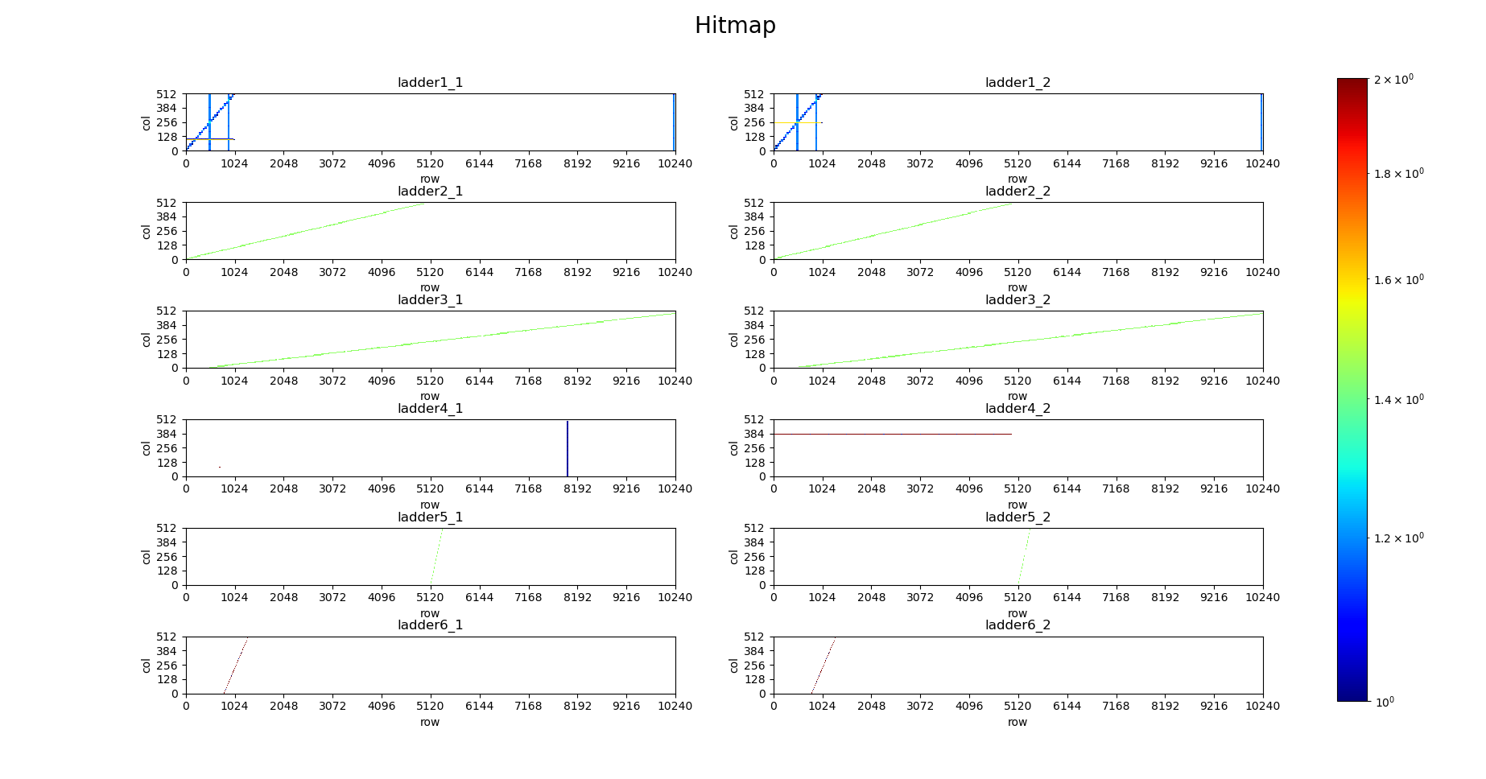
DAQ status
New function
multi ladder online drawing function
The function is relatively basic.
Some details may need to be adjusted
And new improvements?

Slide 3
Need to discuss
the multi chips configuration process
generate the corresponding configuration file according to the selected pixels
I hope we can test the multi-chips’ DAQ function

Slide 4
THANKS

