Slide 1
Discussion on spin resonances of TDR lattice
ChenTao
22-10-18

Slide 2
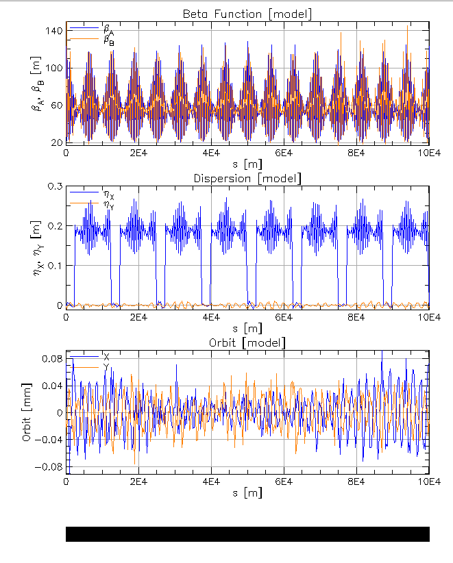
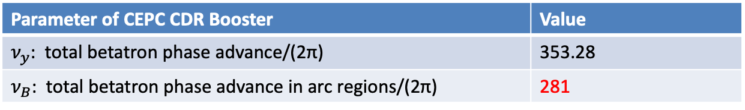
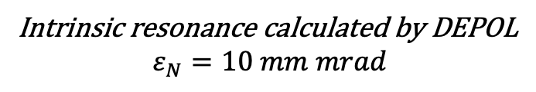
CEPC TDR FODO Booster Lattice
Parameter of CEPC CDR Booster | Value
$ν_{y}$: total betatron phase advance/(2π) | 353.28
$ν_{B}$: total betatron phase advance in arc regions/(2π) | 281
281.28
Intrinsic resonance calculated by DEPOL
$$ε_{N}=10 mm mrad$$
120GeV

Slide 3
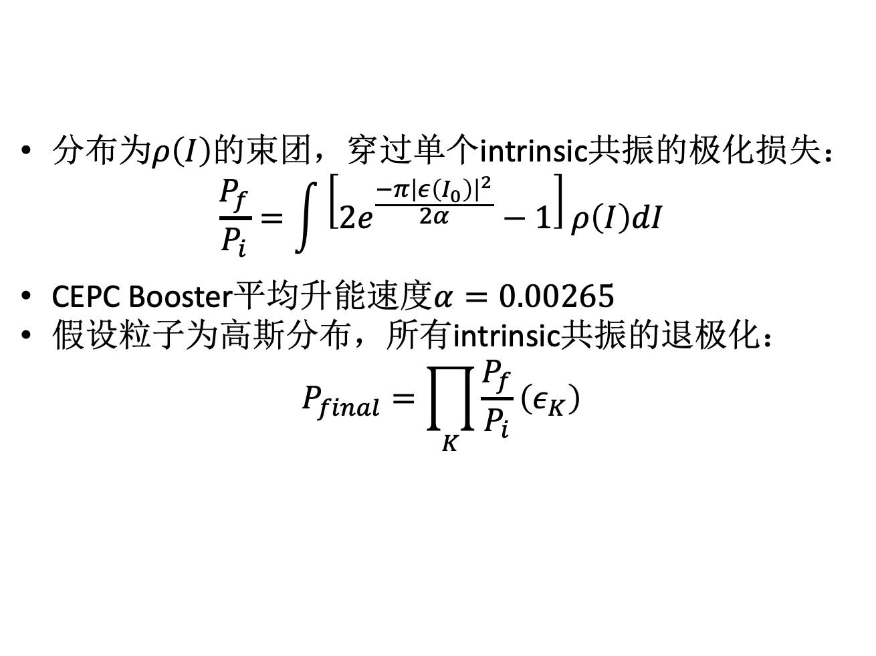
Intrinsic resonance depolarization analysis
分布为$ρ\left(I\right)$的束团，穿过单个intrinsic共振的极化损失：
$$\frac{P_{f}}{P_{i}}=\int{\left[2e^{\frac{−π{\left|ε\left(I_{0}\right)\right|}^{2}}{2α}}−1\right]ρ\left(I\right)dI}$$
CEPC Booster平均升能速度$α=0.00265$
假设粒子为高斯分布，所有intrinsic共振的退极化：
$$P_{final}=\prod_{K}{\frac{P_{f}}{P_{i}}\left(ε_{K}\right)}$$
升能至120GeV由intrinsic resonance导致的退极化和平衡发射度的关系：
发射度 | 最终极化度（只考虑intrinsic resonance）
0.15nm | 0.784
0.1nm | 0.85
0.065nm | 0.90
0.05nm | 0.922
0.01nm | 0.984
0.001nm | 0.998

Slide 4
Imperfection resonance in TDR lattice
预期在100微米闭轨水平下，由imperfection resonance导致的退极化程度不会太大
不同闭轨误差下的最强共振强度
不同闭轨误差下共振谱比较
5% polarization loss

Slide 5
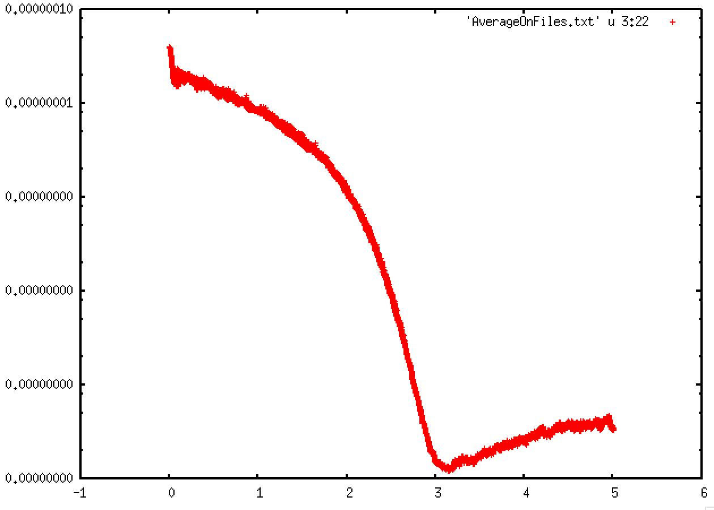
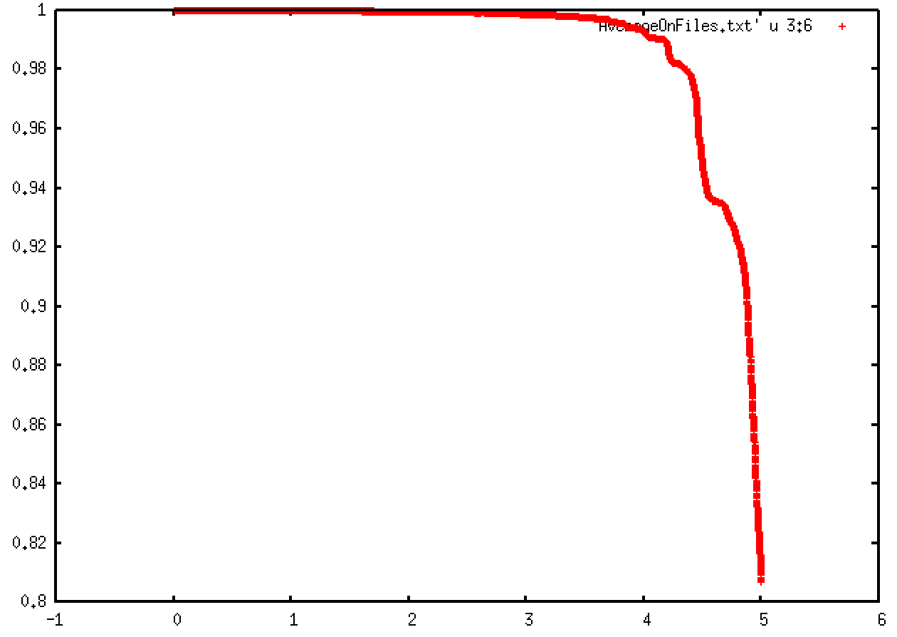
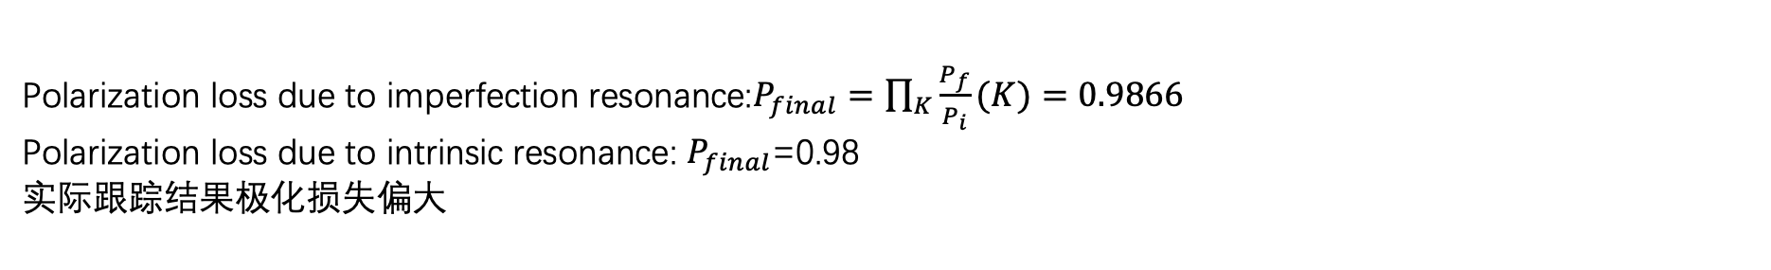
Simulation result
Seed 0004 , rms orbit =20um
Polarization loss due to imperfection resonance:$P_{final}=\prod_{K}{\frac{P_{f}}{P_{i}}(K)}=0.9866$
Polarization loss due to intrinsic resonance: $P_{final}$=0.98
实际跟踪结果极化损失偏大
Vertical emittance(m)
Sy
4.5e-12
Time(s)
Time(s)

Slide 6
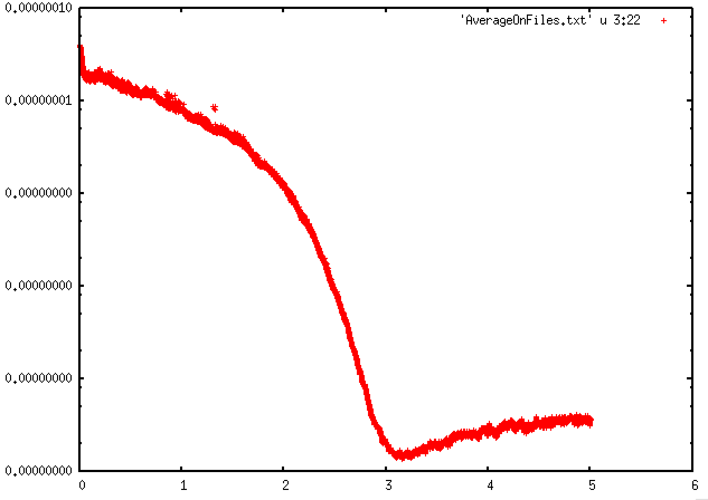
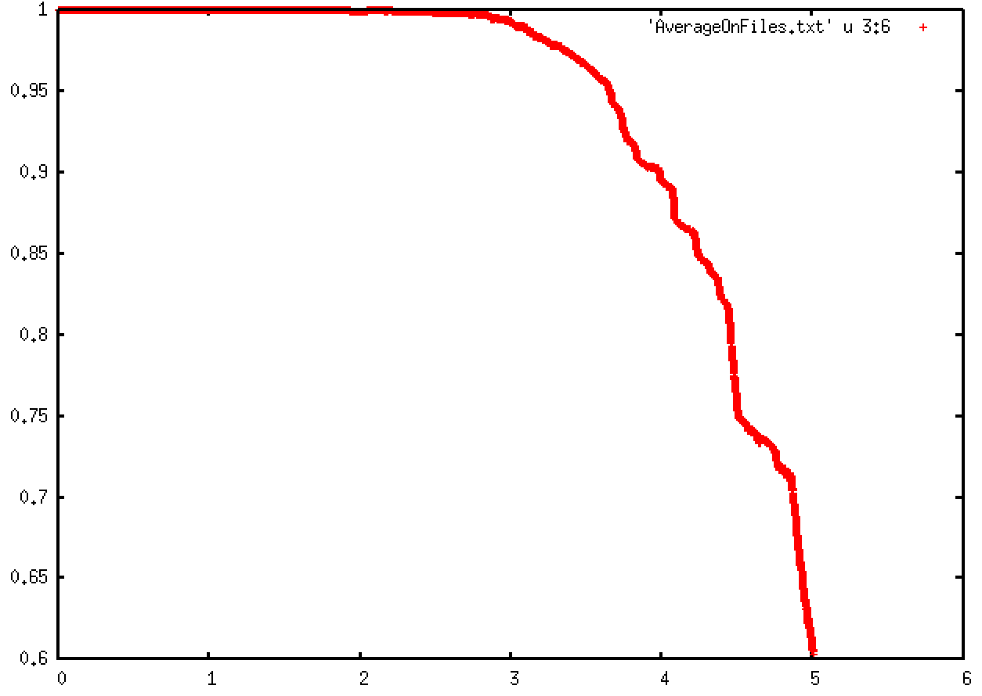
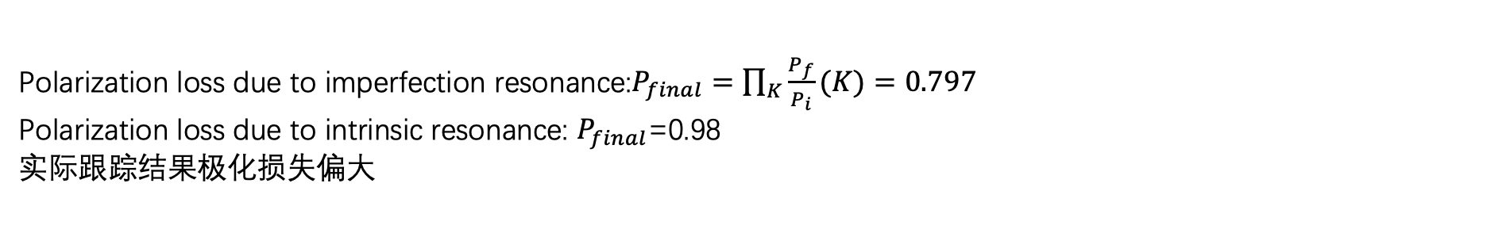
Simulation result
Seed 0055,rms orbit =60um
Polarization loss due to imperfection resonance:$P_{final}=\prod_{K}{\frac{P_{f}}{P_{i}}(K)}=0.797$
Polarization loss due to intrinsic resonance: $P_{final}$=0.98
实际跟踪结果极化损失偏大
Vertical emittance(m)
Sy
4e-12
Time(s)
Time(s)

Slide 7
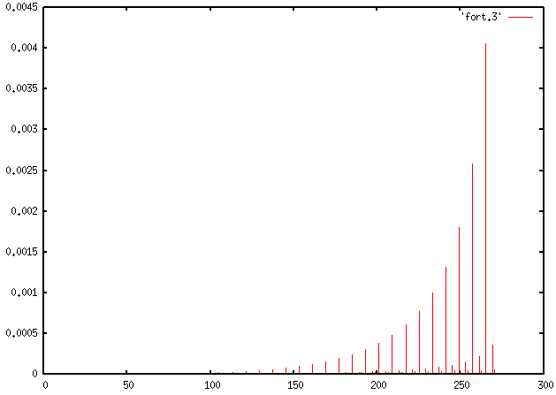
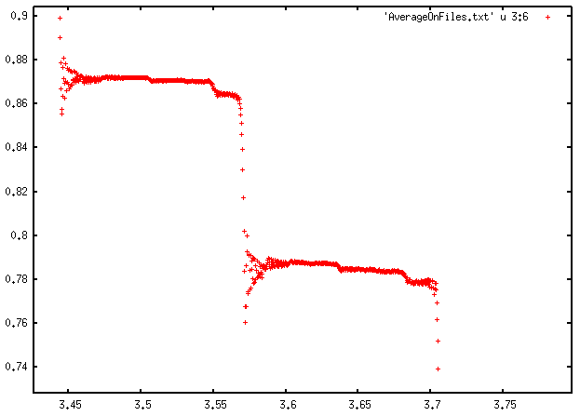
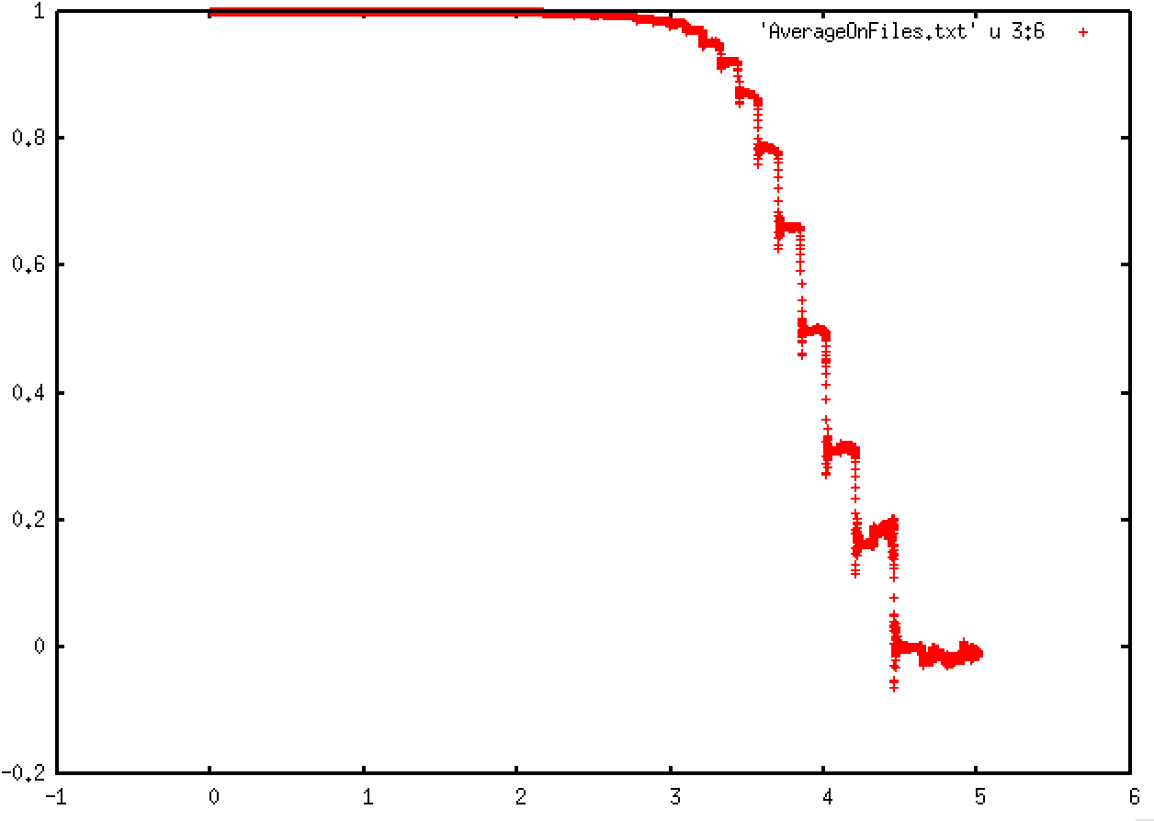
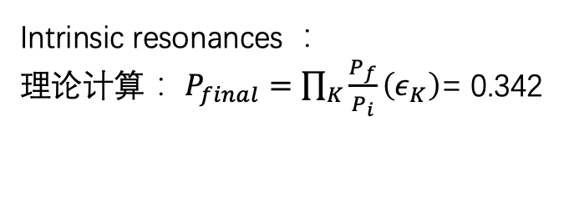
Seed 0004 damping off fluctuation off
Intrinsic resonances ：
理论计算： $P_{final}=\prod_{K}{\frac{P_{f}}{P_{i}}\left(ε_{K}\right)}$= 0.342
Intrinsic resonance
221.28
224
221.28
224
225.28
225.28
P_FS(225.28)=0.989
229.28
232
229.28
233.28
232
233.28

Slide 8
Resonance strength benchmark-barelattice
Radiation off
alpha | DEPOL scaled by emittance | Long_term_tracking
0.0205 | 0.0934 | 0.0948714
0.0306 | 0.09337 | 0.094057
281.28
alpha | DEPOL scaled by emittance | Long_term_tracking
0.02126 | 0.0215 | 0.02134
0.02916 | 0.0217 | 0.02187
273.28

