Slide 1
DAQ progress
2022.10.20

Slide 2
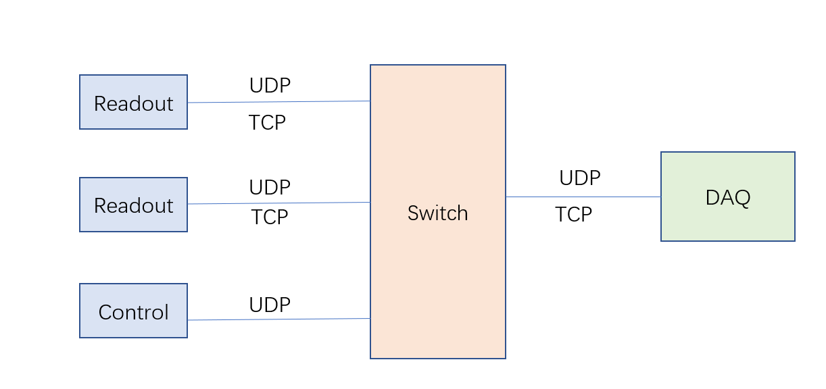
DAQ status
The configuration and readout of multiple readout boards have been completed
To be solved
overload (need safe config file)

Slide 3
Next
multi-chip-readout Electronic board
when is available?
need multi-chip config file
Electronic board only have 8 MAC SiTCP IP core
Possible solutions : ① Router
② Dual network card
③ Multi computer 2 or 3 PC

Slide 4
Next
Electronics needs to provide buffer protection
FIFO 70% is full？
Some components of electronics are too high or too large
The boards can't be stacked
laser test

Slide 5
THANKS

