Slide 1
Status of the Aerogel RICH Readout
S. Nishida
KEK
Belle II Trigger DAQ Workshop in Beijing
Jan 25, 2011

Slide 2
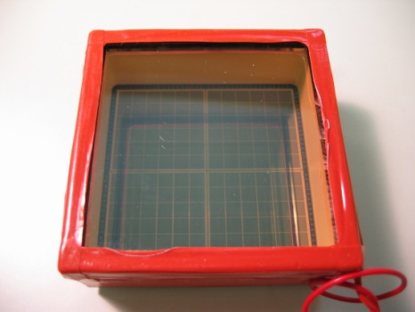
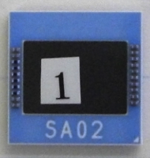
Introduction
Aerogel RICH Readout (Front end electronics)
ASIC (SA)
Readout
(Digital Part)
L1
buffer
HAPD (144ch)
Preamp
Shaper
Comparator
DAQ
group
Belle2Link
Total ~ 500 HAPDs.
ASIC: 36ch per chip (i.e. 4 chip / HAPD).
Quite limited space (~5cm) behind HAPD.
~500 Belle2Link is too many : need Merger.
50mm
30mm
73mm

Slide 3
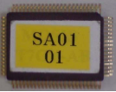
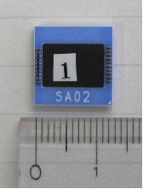
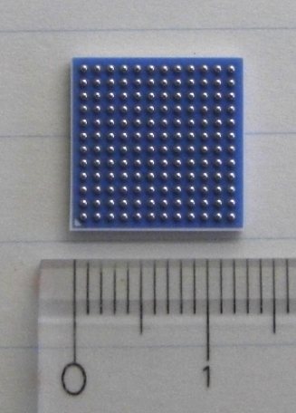
ASIC History
4 series of test productions for evaluation (S01-S04) at VDEC (2002-2005).
New series of ASIC for the real application at Belle2: SA01-SA03.
SA01 (2007)
12 ch / chip; QFP package.
Good performance. Succeeded to detect Cherenkov ring at the beam test.
Minor problem: gain too high.
SA02 (2009)
36 ch / chip; LTCC package.
Good performance (at the test bench).
Gain = 1/4 of SA01.
SA03 (2011)

Slide 4
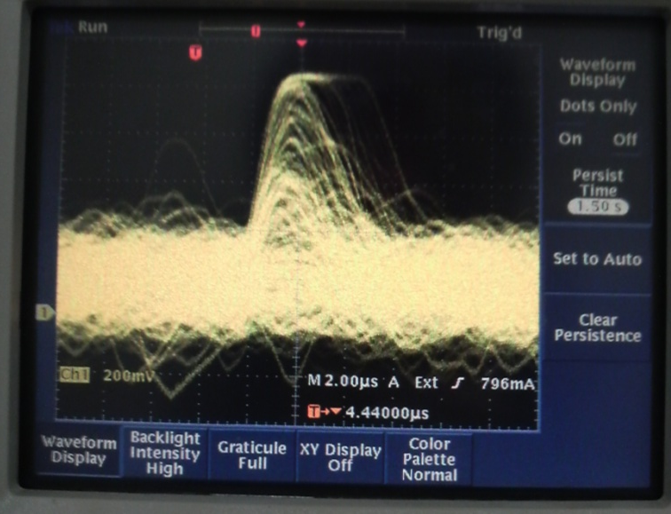
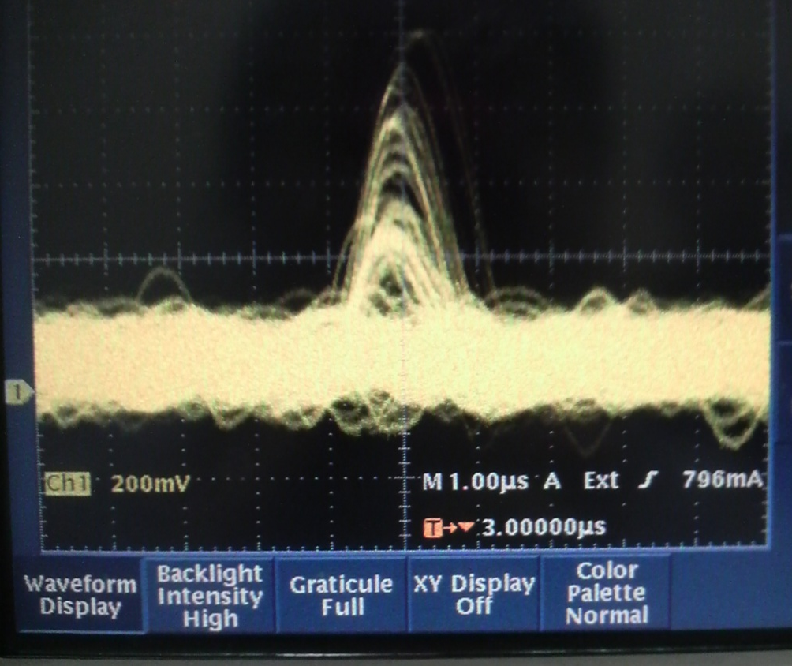
SA03
SA03 (2011) : (hopefully) the final version, pins compatible with SA02.
Modification from SA02:
Shorter shaping time : 250-1000ns (SA02) → 100-250ns (SA03)
Radiation (Single Event Effect) torellance.
  SEE tolerant control register by DICE (Dual interlocked cell).
  Parameter (non-destructive) readout.
One concern in HAPD is radiation.
shaping time 1000ns
Leakage current → ~10 μA.
250ns shaping time is necessary for HAPD after 10¹² n/cm² (~10year) neutron irradiation.
Target ~100ns.
after 5×10¹¹ neutron/cm² (~ 5 years) irradiation
shaping time 250ns

Slide 5
SA03
Simulation
O.K.
ST 0 : ~100nsec
ST 1: ~110nsec
ST 2: ~130nsec
ST 3: ~200nsec
Plan
[Takagaki (TMU)]
Layout (@ Digian-technology) : Feb / Mar.
Test production @ TSMC : next fiscal year.
Mass production (bare chip) ~2000 chips.
  At TSMC or X-FAB: depends on the cost.
  Rough estimation 6M yen.
LTCC Packaging.

Slide 6
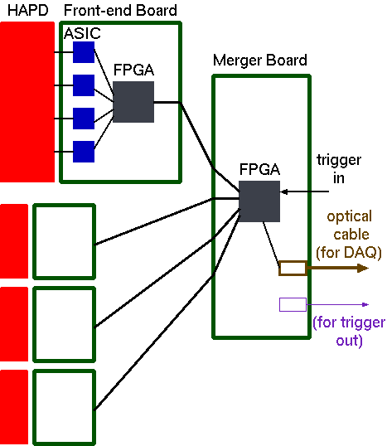
Aerogel RICH Electronics
Front-end (FE) board : 4 ASICs and 1 FPGA to read out 1 HAPD.
Merger board collects hit data from ~ 4 HAPDs (FE boards).
Merger board has the interface to Belle2Link (i.e. Merger board is the “front-end” board in terms of unified DAQ).
Conservative raw data rate
= 100 Mb/HAPD.
  16 b/ch is assumed.
  Zero-suppression is requested at merger board (or FE board).

Slide 7
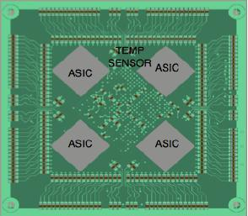
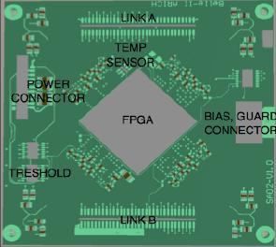
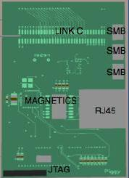
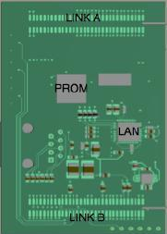
Front-end Board
Prototype FE board is developed at Ljubljana (by A. Seljak).
  Main board with 4 SA02 ASICs and 1 FPGA (Spartan6).
    12 layer board.
  Piggy board for SiTCP (for standalone readout).
  Production at Elgoline (Slovenia).
main board
piggy board
75mm
top
bottom
top
bottom
Originally, planned to produce last year, but delayed.

Slide 8
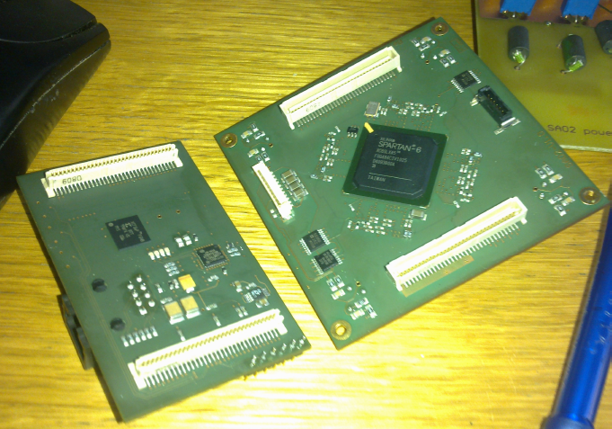
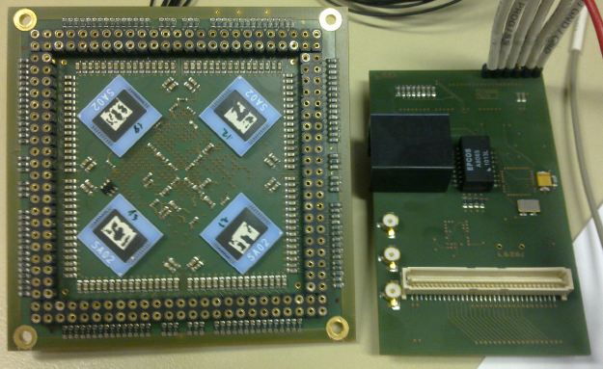
Front-end Board
Finally produced!!

Slide 9
Front-end Board
Status (by A. Seljak)
Analog currents were high, but the problem is fixed.
FPGA download successful; however PROM cannot be loaded.
  Xilinx support confirmed the correctness of the schematics.
  Maybe due to the use of virtual machine?
Functionality of peripherals (multiplexer, digital resistors) is being tested.
SiTCP part will be tested in February. Without SiTCP, it is hard to test the front end. Iwata-san (TMU) and S.N. will visit Ljubljana for debugging.

Slide 10
Merger Prototype
SA02
board
piggy
SiTCP
SA02
board
piggy
Prototype
Merger
Belle2Link
SiTCP
First prototype board is to establish the scheme.
  Big board; do not try to fit the small space.
Connection to SA02board+piggy.
  In the final version, piggy will be replaced by the merger.
Merger 4 HAPDs.
Target: March 2011.

Slide 11
Merger Prototype
Xilinx Virtex5
(XC5VLX50T-FF665)
Only for the FPGA in merger (In the final design, FPGAs in the FE board is also configured by this line)

Slide 12
Merger Prototype
FPGA XC5VLX50T is probably O.K. from simple estimation of the logic size. Larger one will be used in the next version if necessary.
Still designing the board.
Discussing interface between the SA02 board and the merger.
  SA02 board: 64 pin molex, but no good cable.
  Probably 34 pin (2.54mm pitch) headers for merger.
The prototype is connected to more HAPDs, but considering the possibility to connect with more HAPDs.
Specification on the interface between FE and Belle2Link is necessary
  List of signals, writing clock speed, ….
  Slow control.

Slide 13
Summary and Plan
ASIC SA03: design started.
Front-end board: debugging
Merger prototype board: still in design.
ASIC mass production.
  How to test ? Cost ?
HAPD readout using front-end board.
System test with protytpe ARICH + FE board + prototype merger.
Next round: design of the entire readout system.
  Modification of the front-end boards.
  Merger board to fit in the small space.

Slide 14
Backup

Slide 15
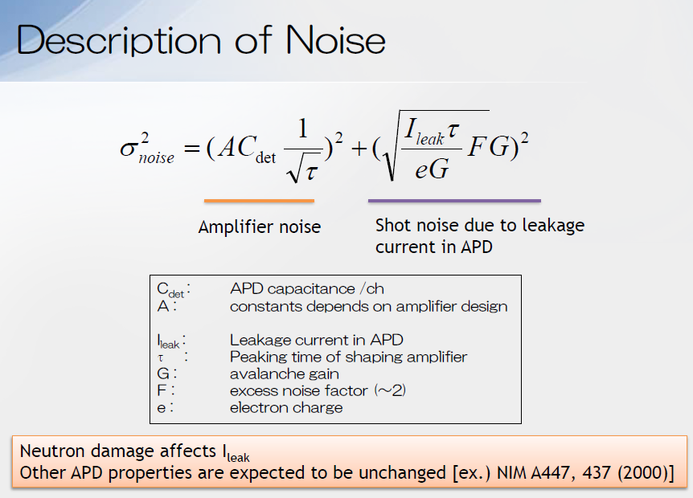

Slide 16
Front-end Board
tmp. monitor
Vth, testpulse
FPGA
1st version of FPGA logic is ready, but not tested.
pmt_ad5235
init
tmp100
selctl2
rbcp_
sa02
parameter
prmset2
SA02
SiTCP
Wrapper
(WRAP_SiTCP_
GMII_XC6S_32K)
tcpsender
hdsr144
hitdata
trigctl

Slide 17
SiTCP
FPGA
SiTCP
User
Logic
TCP FIFO I/F
Ethernet
PHY
Ethernet
MII
RBCP
Remote Bus
Control Protocol

Slide 18
Merger Prototype
IHEP (China) people will prepare the specification on interface btw FE and Belle2Link (list of signals, writing clocks etc.).
  In principle, no flow control exists btw FE and Belle2Link. From detector side, we can just continue writing data.
  L1 buffer is in the detector side.
Slow control (parameter setting / read back) need to be considered. It seems there is no concrete scheme yet.
Belle2Link probably requires one on-board clock. The clock frequency will be determined this year.

