Slide 1
Demo system of Belle2link
Sun Dehui , Zhao Jingzhou ,Liu zhen’an
Trigger Lab
IHEP

Slide 2
Outline
Belle2Link
Demo system
Hardware
Firmware
Driver and Software
Implementation of slow control
Discussion

Slide 3
Belle2Link
Belle2Link is a unified high speed link which connect Front-End Electronics (FEE) and Trigger and DAQ system for signal and data transmission. For system simplicity and reliability, It features as:
unification in hardware design
unification in firmware design
provides electrical isolation
provides high speed transmission rate
can work at different input data rate
home brew transmission protocol
I/F_FE
d
SVD FEE
I/F_COPPER
COPPER
CDC FEE
Belle2Link
Slow control
………
Data
PID
I/F_TTC
TTC
KLM
RF ClocK

Slide 4
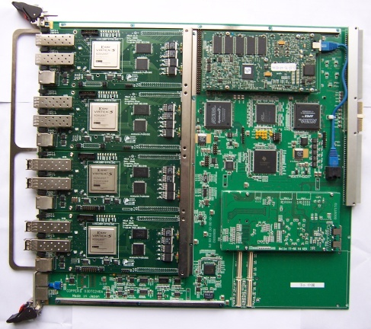
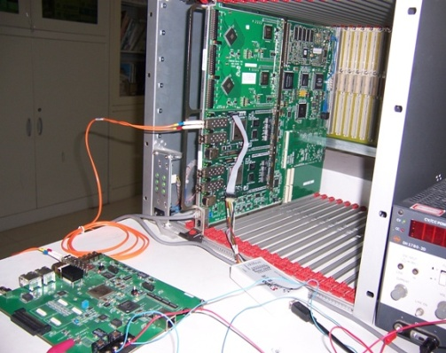
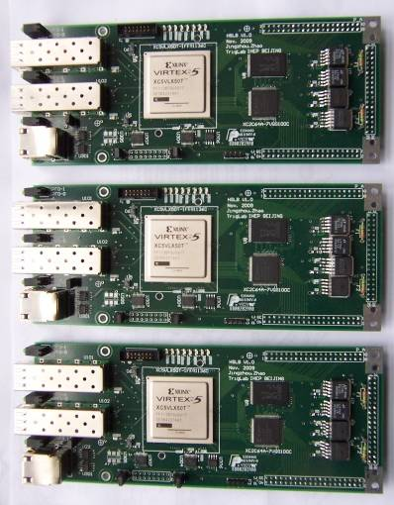
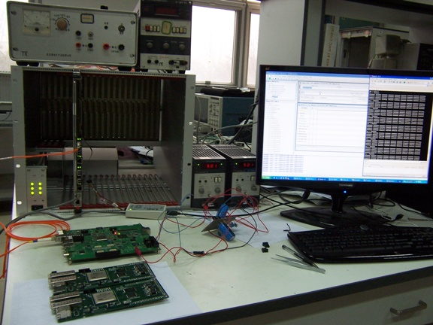
Demo system
Hardware
COPPER board
High Speed Link Board (Plugged to COPPER)
FEE boards, such as CDC board (Linked to HSLBs with optic fibers)
Server PC (file system server)
CDC board linked to HSLB
COPPER board
HSLB
COPPER plugged in VME crate with a File server

Slide 5
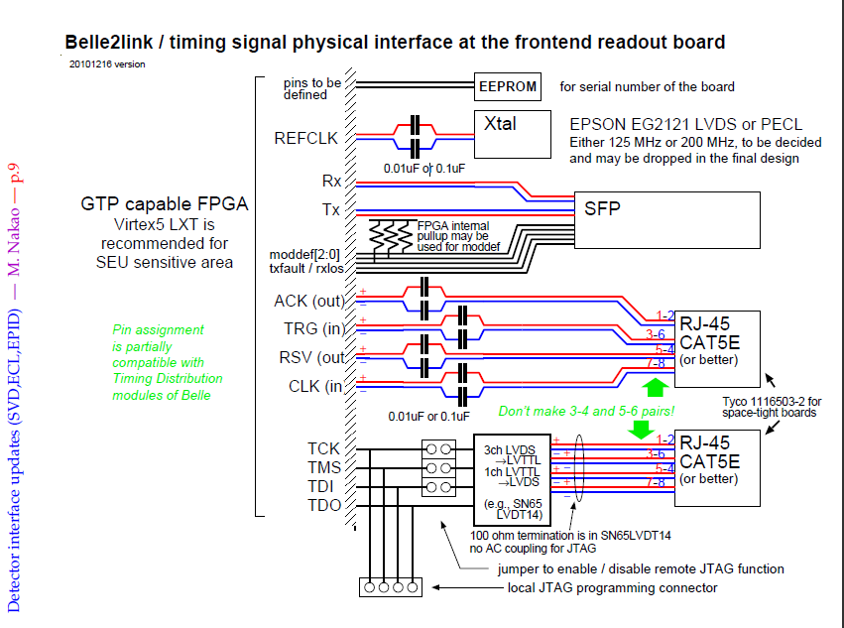

Slide 6
Demo system
Firmware
HSLB
Virtex 5 Firmware ( Belle2link in HSLB board)
CPLD Firmware ( online downloading )
FEE
Belle2Link in FEE

Slide 7
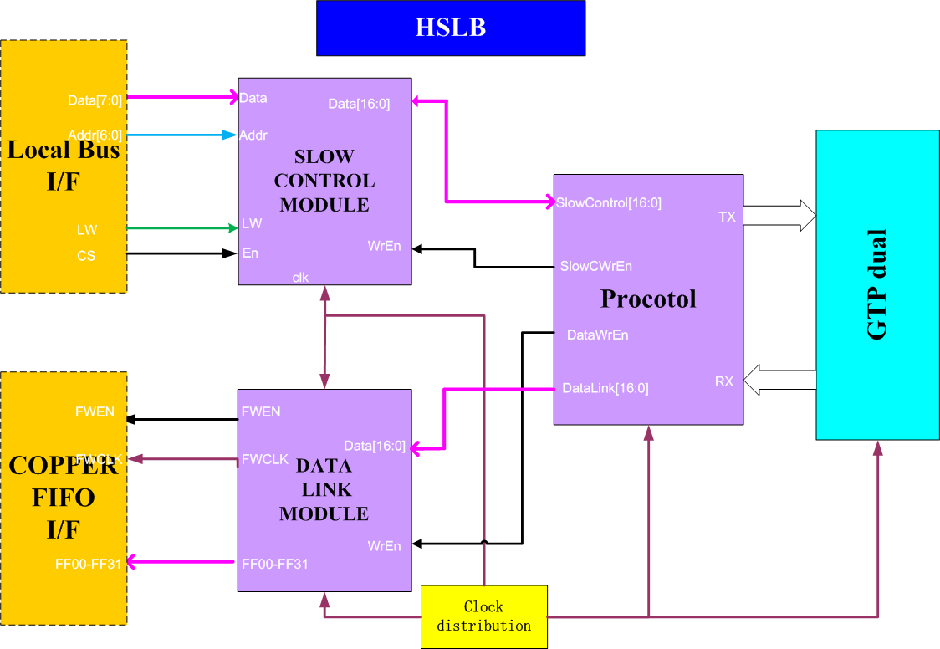
Demo system Firmware —Structure of HSLB firmware
Slow Control module
Receive or transfer the slow control message from Local bus
Data Link module
Receive the data of FEE, transmit the data and the clock to the COPPER FIFO
Protocol
Receive the package from GTP module
Check the packages and unpack them
Separate the data and transfer them to slow control module or data link module

Slide 8
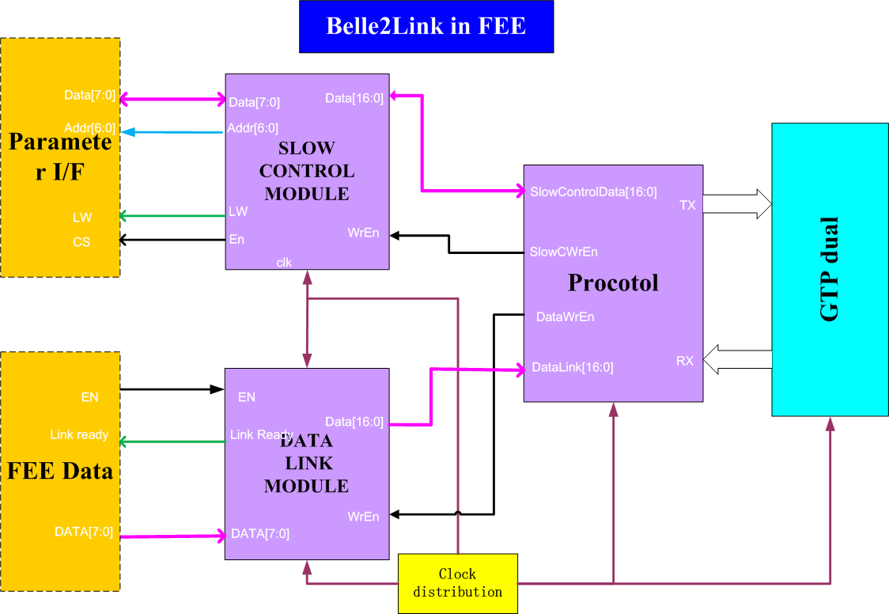
Demo system Firmware —Structure of Belle2lin firmware in FEE
Slow Control module
Configure or read the slow control message from FEE register
Data Link module
Receive the data from FEE. Pack the data
Protocol
Receive the package from GTP module, check the packages and unpack them
Transfer the data form FEE, and arbitrate the priority between slow control module and data link module

Slide 9
Demo system
Software
Data processing
readhslb : read the data of FEE from the COPPER;
Slow control
paraconf : read or configure the register of HSLB and FEE
fileconf : transfer file to FEE, such as a DSP ROM file
Driver
Inherit from Higuchi-san’ Finesse general driver

Slide 10
Implementation of Slow Control
General Consideration
Task for Belle2link
Parameter setting only
Aim
Unification suitable for all systems, not system dependent
Easy implementation for FEE as was with Belle FINESSE
Provide CDC implementation as an example for FEE

Slide 11
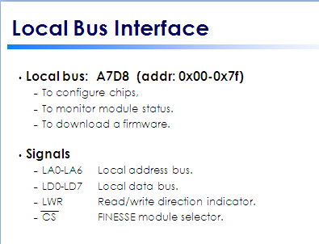
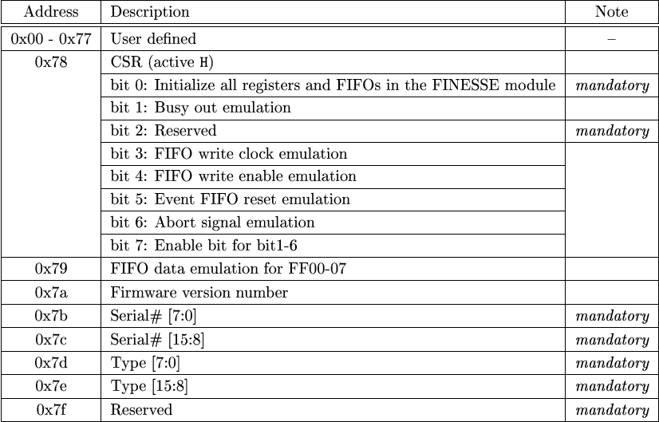
Local Bus Interface
Difficulties
Larger parameter data size(>128byte) needed
How to make the belle2link transparent to FEE and local buss
New scheme has to be defined

Slide 12
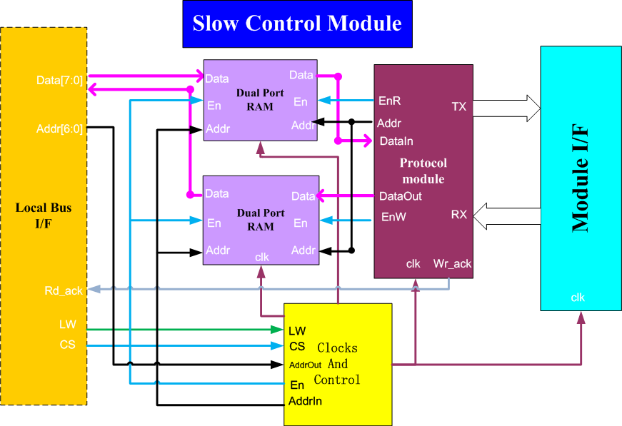
How to transfer a file
HSLB/FINESSE side(Two approaches)
First approach
Large stream(>128B)
Address 0X00: for this approach
Length up to the maximum allowed
Address/Data meaning definition by system
The data will also be written to the address 0x00 on the interface between the FEE and Belle2link

Slide 13
How to configure register
HSLB/FINESSE side(Two approaches)
Second approach
Large stream(<128B or individual setting )
Address 0X00-0x74: Length up to 127B
Address/Data meaning definition by system
Control module synchronies the control signal and control the reading or writing of the RAMs.
One RAM records the value from system, used for configuration .
Another Ram records the value form FEE, used for read-back.
TWO CSRs are used as signal of acknowledge ,reading ,configuration.

Slide 14
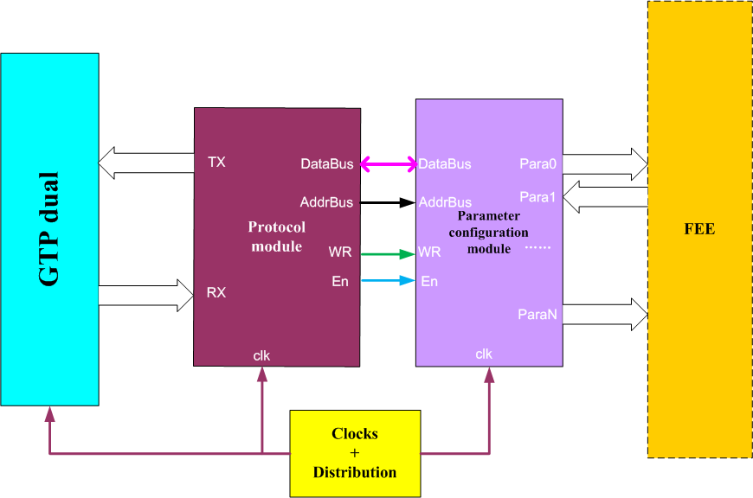
Implement on FEE side
FEE side(Parameter Bus)
Keep the definition of local bus of COPPER.
AB0-AB6 Local address bus.
DB0-DB7 Local data bus.
LWR Read/write direction indicator.
EN ready signal.
If COPPER write a value on address 0x41 of the Local bus, the value will be send to the same address on FEE after a few nanoseconds.
If a ROM file is transferred , the file will be written on address 0x00 on front end serially. There are no buffer in Belle2Link .
The Belle2link is transparent to the COPPER and FEE register.

Slide 15
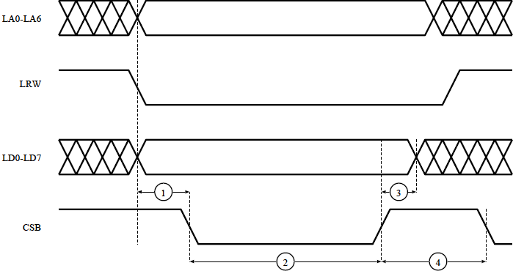
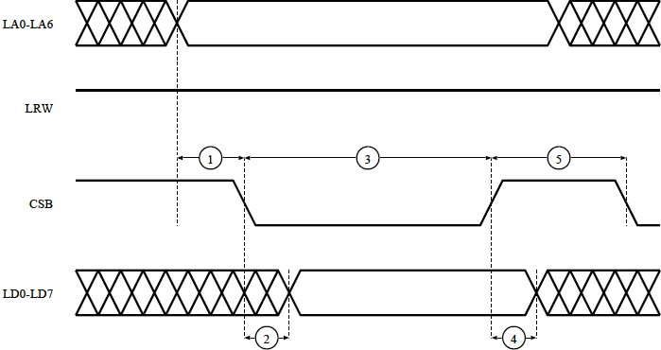
Parameter bus: Timing Chart
AB0-AB6
read cycle
RW
DB0-DB7
EN
At least
3 cycles
one cycle
At least
4 cycles
AB0-AB6
write cycle
RW
At least One cycle
One cycle
At least 1 cycle
EN
DB0-DB7
0 ns

Slide 16
How to read
How to read the register is not so straightforward.
The program must inform the HSLB which register to be read, and wait for some time until the value was sent to the local bus interface from the FEE.
A CSR is used as acknowledge signal. When the value of the FEE register come , the value of CSR will be set to 0x11 .
Slow control message and the data from FEE are both transferred by fiber with different package.

Slide 17
How to read
The program must inform the HSLB which register to be read and wait.
The HSLBS sends the address to FEE through Belle2Link
The FEE receives the address , read the value and send the address and the value back.
A CSR is used as acknowledge signal. When the HSLBS read the value of the FEE register completely , the value of CSR will be set to 0x11 .
Program check the CSR, and print the result on screen.
PMC CPU
Protocol
GTP
PCI bus
Bridge
local bus
COPPER
HSLBS
Optic Fiber
Parameters
Protocol
GTP
Config
Para bus
FEE
HSLBR

Slide 18
New Sending link layer state machine
reset
Priority 1
FEE data buffer almost full
Belle2link need to transfer the data and the slow control message at the same time . So priority level is necessary .
New link layer protocol was designed
priority 2
Slow control buffer not empty
FEE Data buffer not empty
Priority 3
Send
slow control
message
Send
FEE Data
CRC

Slide 19
New receiving link layer state machine
reset
idile
The receiving protocol must separate the slow control message and the FEE data.
SOP = 0x95FB
SOP = 0x951c
Unpack the data and
Transfer to Datalink module
Unpack the data and
Transfer to SC module
EOP = 0x95FD
EOP = 0x95FD
Check error

Slide 20
Conclusion
Slow Control over Belle2link is predefined for CDC and works
For other system, we provide the design between the local bus and the FEE parameter Bus and the examples of the Linux program and configuration module .
Unification on SC in consideration and need further discussion

Slide 21
Discussion
Address | Description | Note
0x00-0x74 | User defined
0x75 | HSLB CSR
0x76 | FEE FW Ver. # | Mandatory
0x77 | FEE HW Ver. # | Mandatory
0x78 | FEE Type | Mandatory
0x79 | Belle2link FEE FW ver. # | Mandatory
0x7a | HSLB Download Flag2
0x7b | HSLB Download Flag1
0x7c | Belle2link HSLB CPLD Ver.
0x7d | Belle2link HSLB FW ver. # | Mandatory
0x7e | Belle2link HSLB HW ver. # | Mandatory
0x7f | Reserved | mandatory
Upper-left: Belle
Lower-right: Belle II
HSLB/Finesse info need to be defined
FEE side also need to be defined
Not fully discussed yet, latest at the coming workshop

