Slide 1
10/24 several changes & digitalization
Small changes:
1. Only about 20 microns depth of chip should be considered when referring to charge collection, signal generating and so on.
2. Seperate the chip into two part, let simulation hits only occurs
in 0-20um depth from surface
chip_thickness
20*um

Slide 2
Digitalization
Statics from G4 simulation are continous, while the real statics from chip are discrete.
Transform the statics by pixel size, which is 25um*25um, take chip center as the position after transformation.

Slide 3
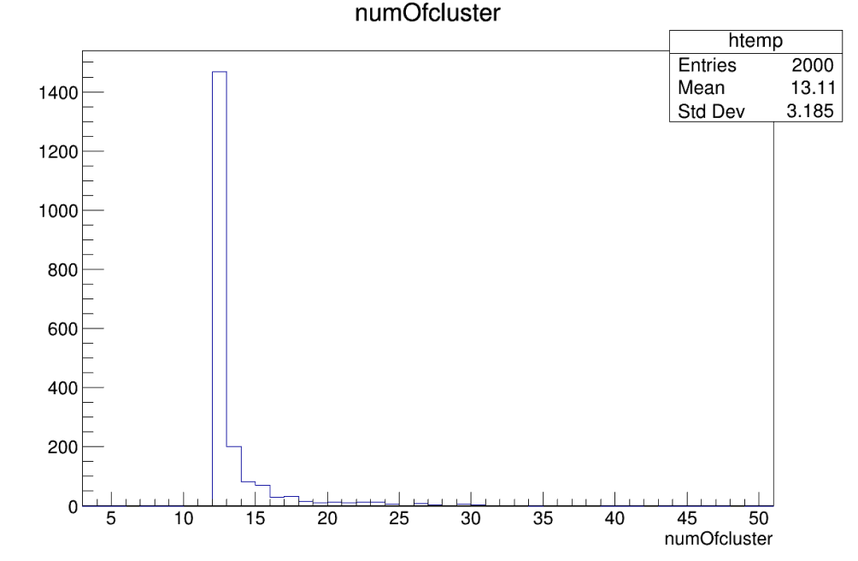
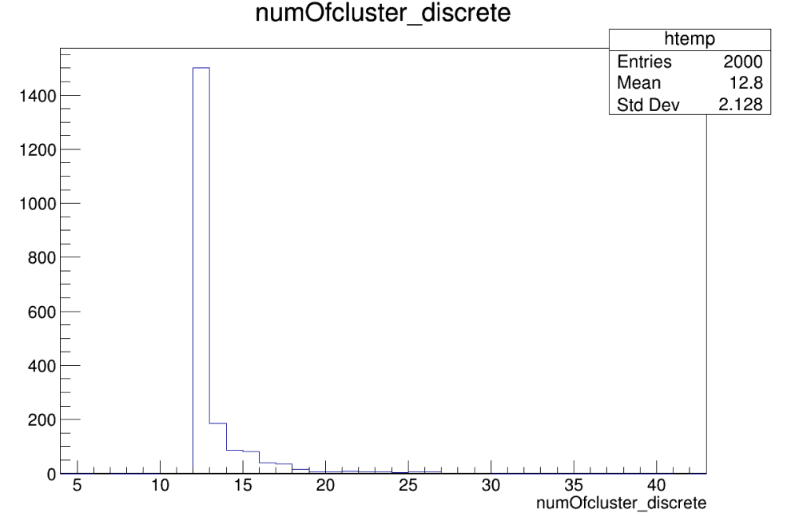
Mutiple hits after changes
Comparison between digitalized data and continuous data:
1. Count the numbers of hits of Events: discrete nums surely smaller
2. Draw scatter of plane hits
num of hits in one event

Slide 4
Scatters:Take same event&plane for example
Before digitalization 26 hits counted

Slide 5
After digitalization 7 hits counted

Slide 6
Find cluster
After we have discrete data:
We can make hits to cluster:
One simple way to confirm the cluster’s center is that:
1. choose the close points as part of cluster. Which means if two points’ distance is less than specific criterion, they are in one cluster.
2. take charge of hit as its weight. here we only have hit positions, take weight as 1.

Slide 7
Example
x,y:-0.0125,-1.4875
x,y:24.8375,5.8625
x,y:24.8625,5.8625
x,y:24.8625,5.8375
x,y:-3.8625,-2.0375
x,y:-3.8375,-2.0375
x,y:-3.8625,-2.0625
3 cluster in the plane
Pixel: 25um*25um

Slide 8
Continuous hit’s criterion
Use the length between 2 hits as our criterion
1. R<pixel_size
2. R<pixel_size*√2
②
①

Slide 9
Cluster

