Slide 1
DAQ and electronic process
2022/11/3
Zhou Jia
Yan Ziyue

Slide 2
Laser beam test
The test system consists of three FMC boards, two fanout boards and one single chip loaded board .
It functions as shown as blow.
Laser
Clock
PC
CHIP
SPI
Readout
TCP/IP
IO
UDP
Control

Slide 3
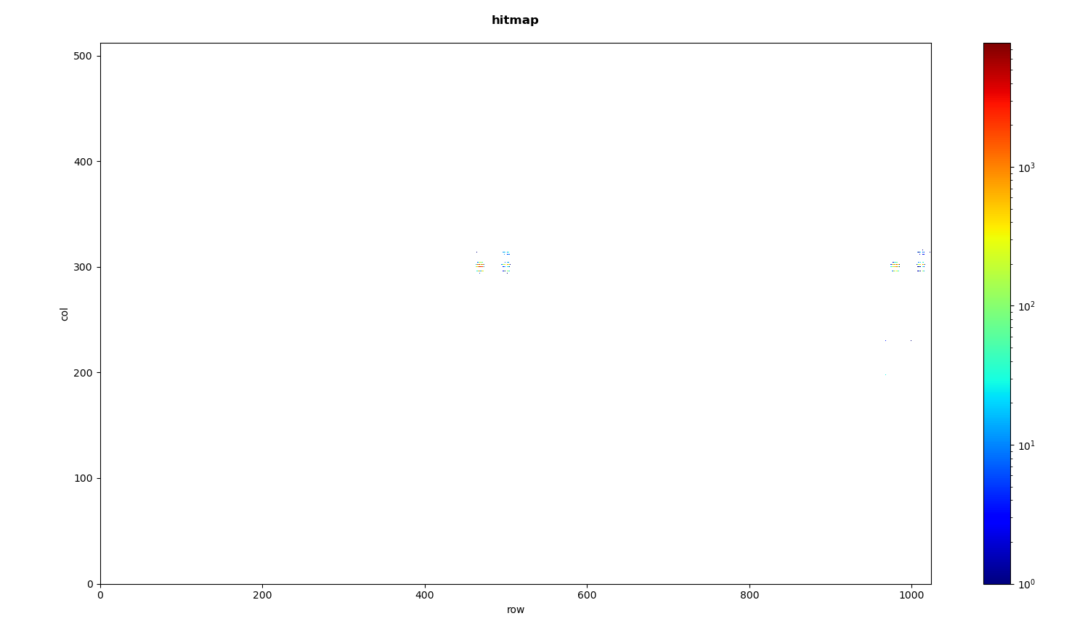
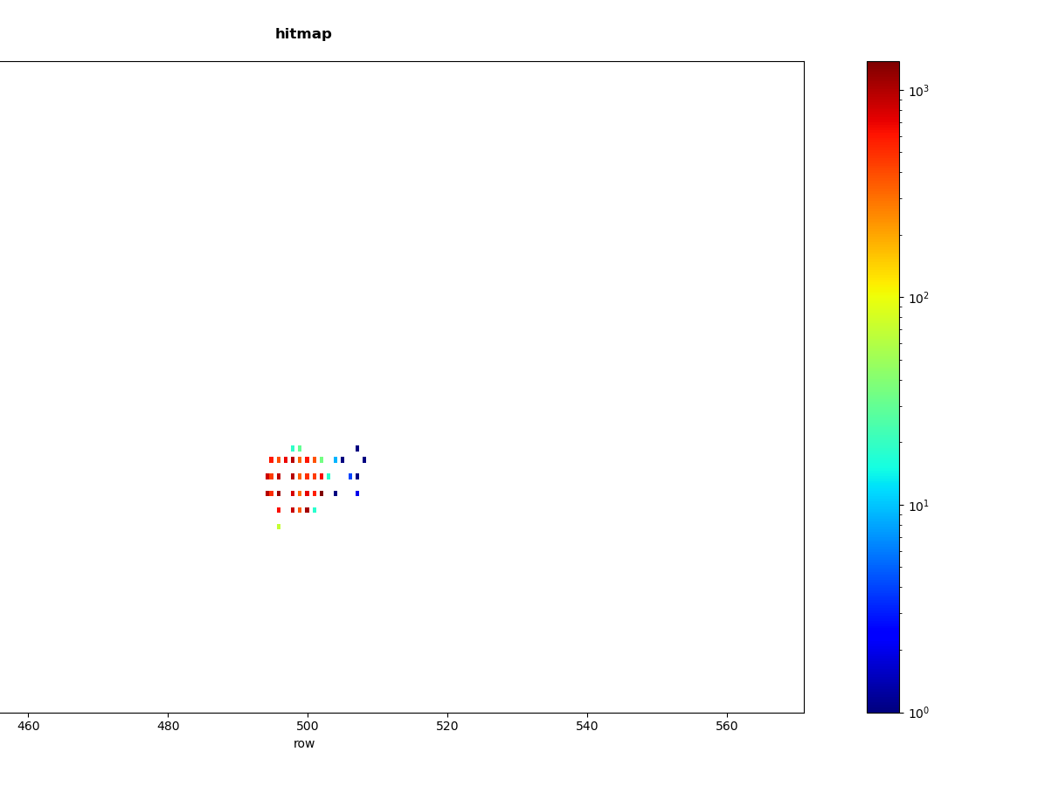
Laser beam test
When we configured the chip with 40MHz clock, it would give back a bunch of ‘ghost’ data which could throw a ‘shadow’ on the hitmap picture.
The shadow under the 50Hz laser
2022/10/26
The shadow under the 500Hz laser
2022/10/27

Slide 4
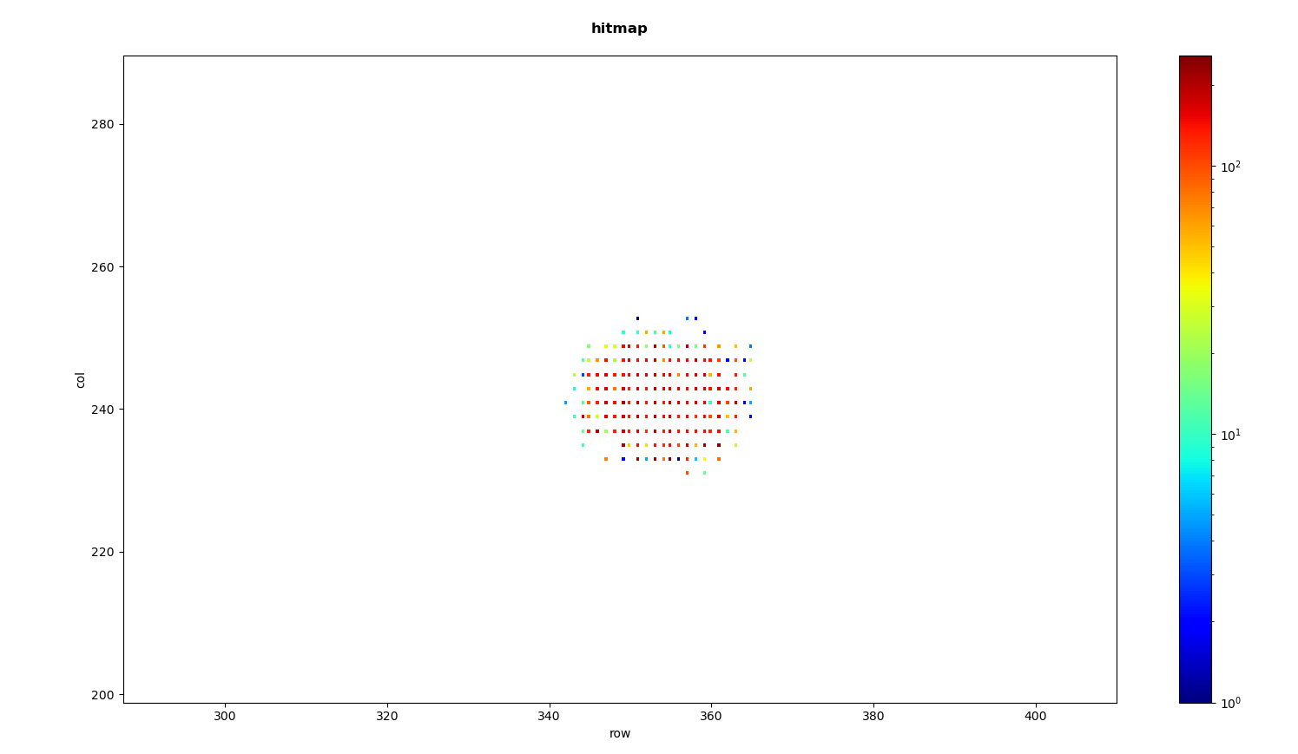
Laser beam test
Then we lowered the clock frequency to 20MHz as recommended which really improved the test outcome as the ‘shadow’ just gone.
Under the 10kHz laser, cost 30s
2022/10/28

Slide 5
Data acquisition
When acquiring data from the readout board we found the data structure was broken and the mistakes spread over the whole acquiring process.
After quite a search with different adjustments applied, we found it was due to the relatively small TCP receiving buffer size set by PC.
There are still a few remaining problems left to be debugged.
Online analysis
Offline analysis

Slide 6
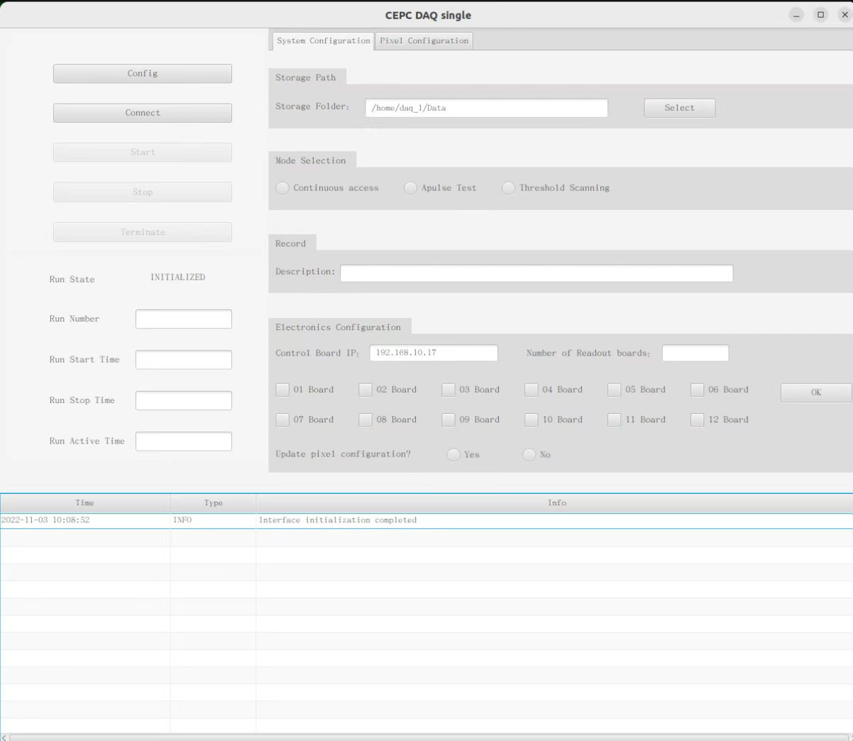
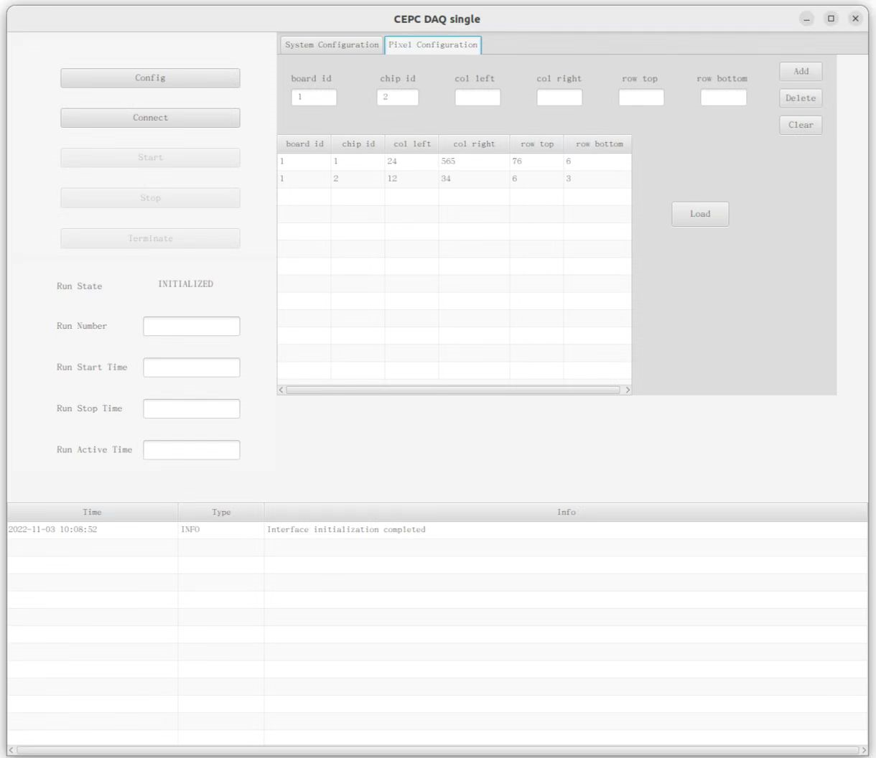
Data acquisition
New DAQ software has been launched and prepared for multiple boards test.
New software’s UI

Slide 7
Flex test
We also tested three flex boards recently assembled which are loaded with several chips.
There is no readback data from the readout which could possibly result from the configuration by SPI did not function.
No SPI readback

