Slide 1
国家重点研发计划
R&D and Verification of Key Technologies for a High Energy Circular Electron-Positron Collider
Zhijun Liang for CEPC MOST2 vertex detector team

Slide 2
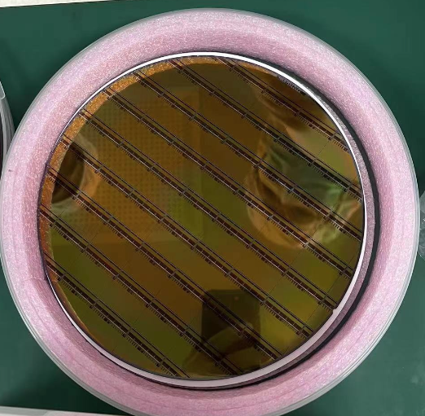
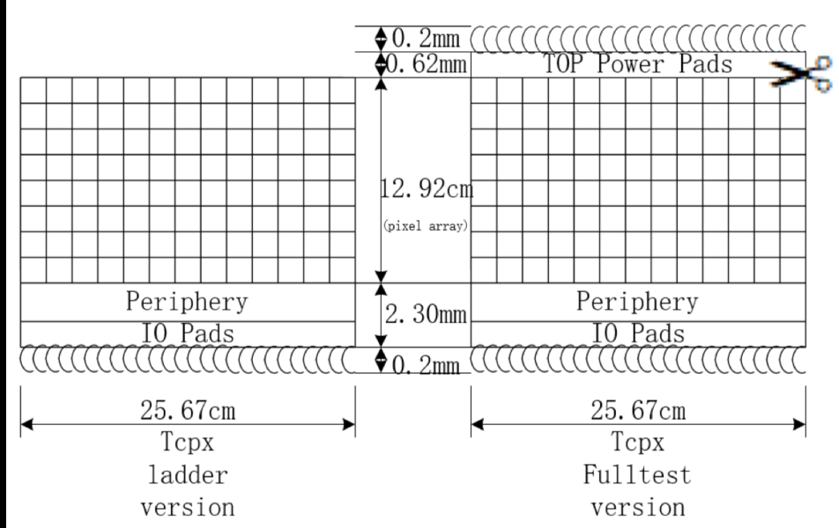
News about Taichupix3 production
6 Taichu3 wafers are ready.
Wafer arrival at IHEP in 5th July 2022
Send 1 wafers for thinning (150um) and dicing (done!)
IR drop is not a big problem ?
Low resistance → after power on, resistance become normal ?
Send 5 wafers to NCAP for wafer testing , thinning and dicing
Another wafer just diced this week
Need to test two chip with new dicing scheme

Slide 3
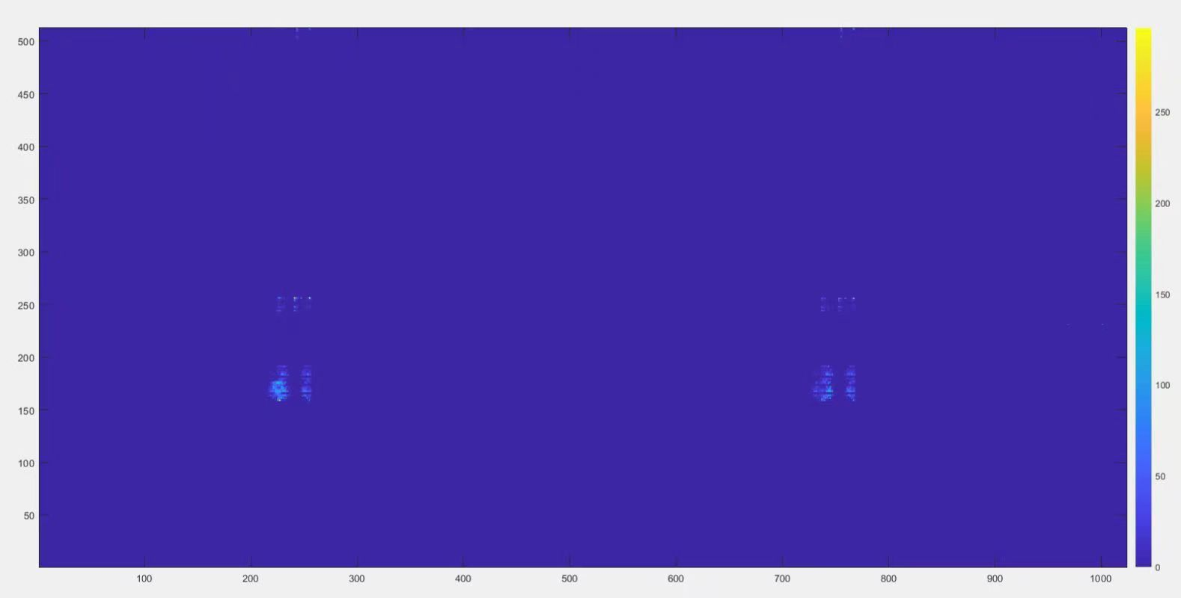
Ghost hits in laser testing
Observe ghost hits in 40MHz clock during laser testing
Disappear using 20MHz clock

Slide 4
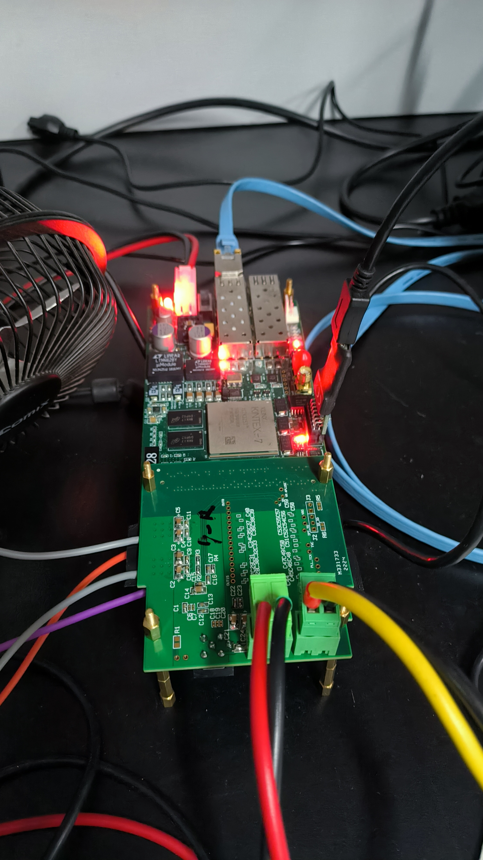
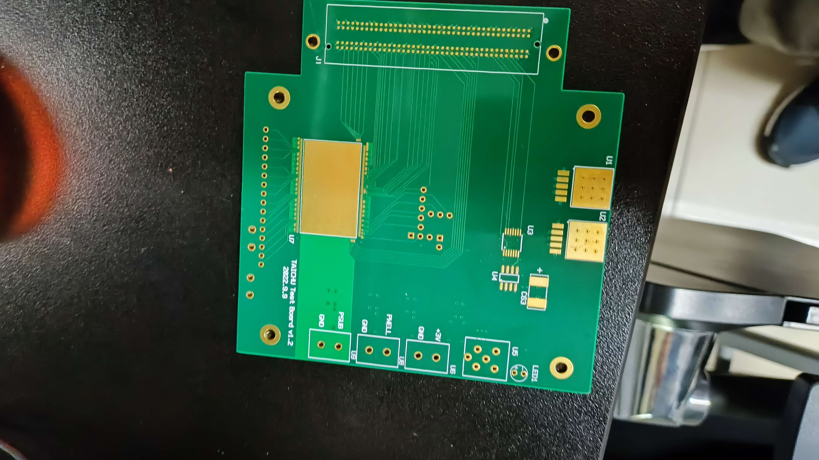
Electron beam test in BEPC BSRF in Nov
Electron beam test in BSRF from Nov (Nov 8th， 4W1A station )
Test electron beam going through multiple test boards (Nov 8^{th. ~} Nov 15th )
Test of ladder (Nov 15th ~27st )
Test of prototype (Nov 27th – Dec 5rd )
The current version of single chip board can be used ?
1st version of
single chip board
2nd version of single chip board

Slide 5
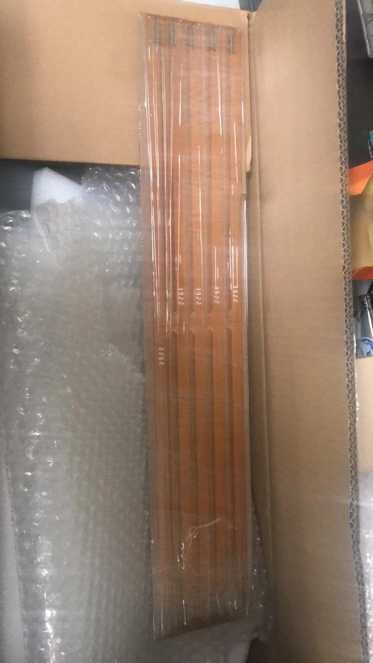
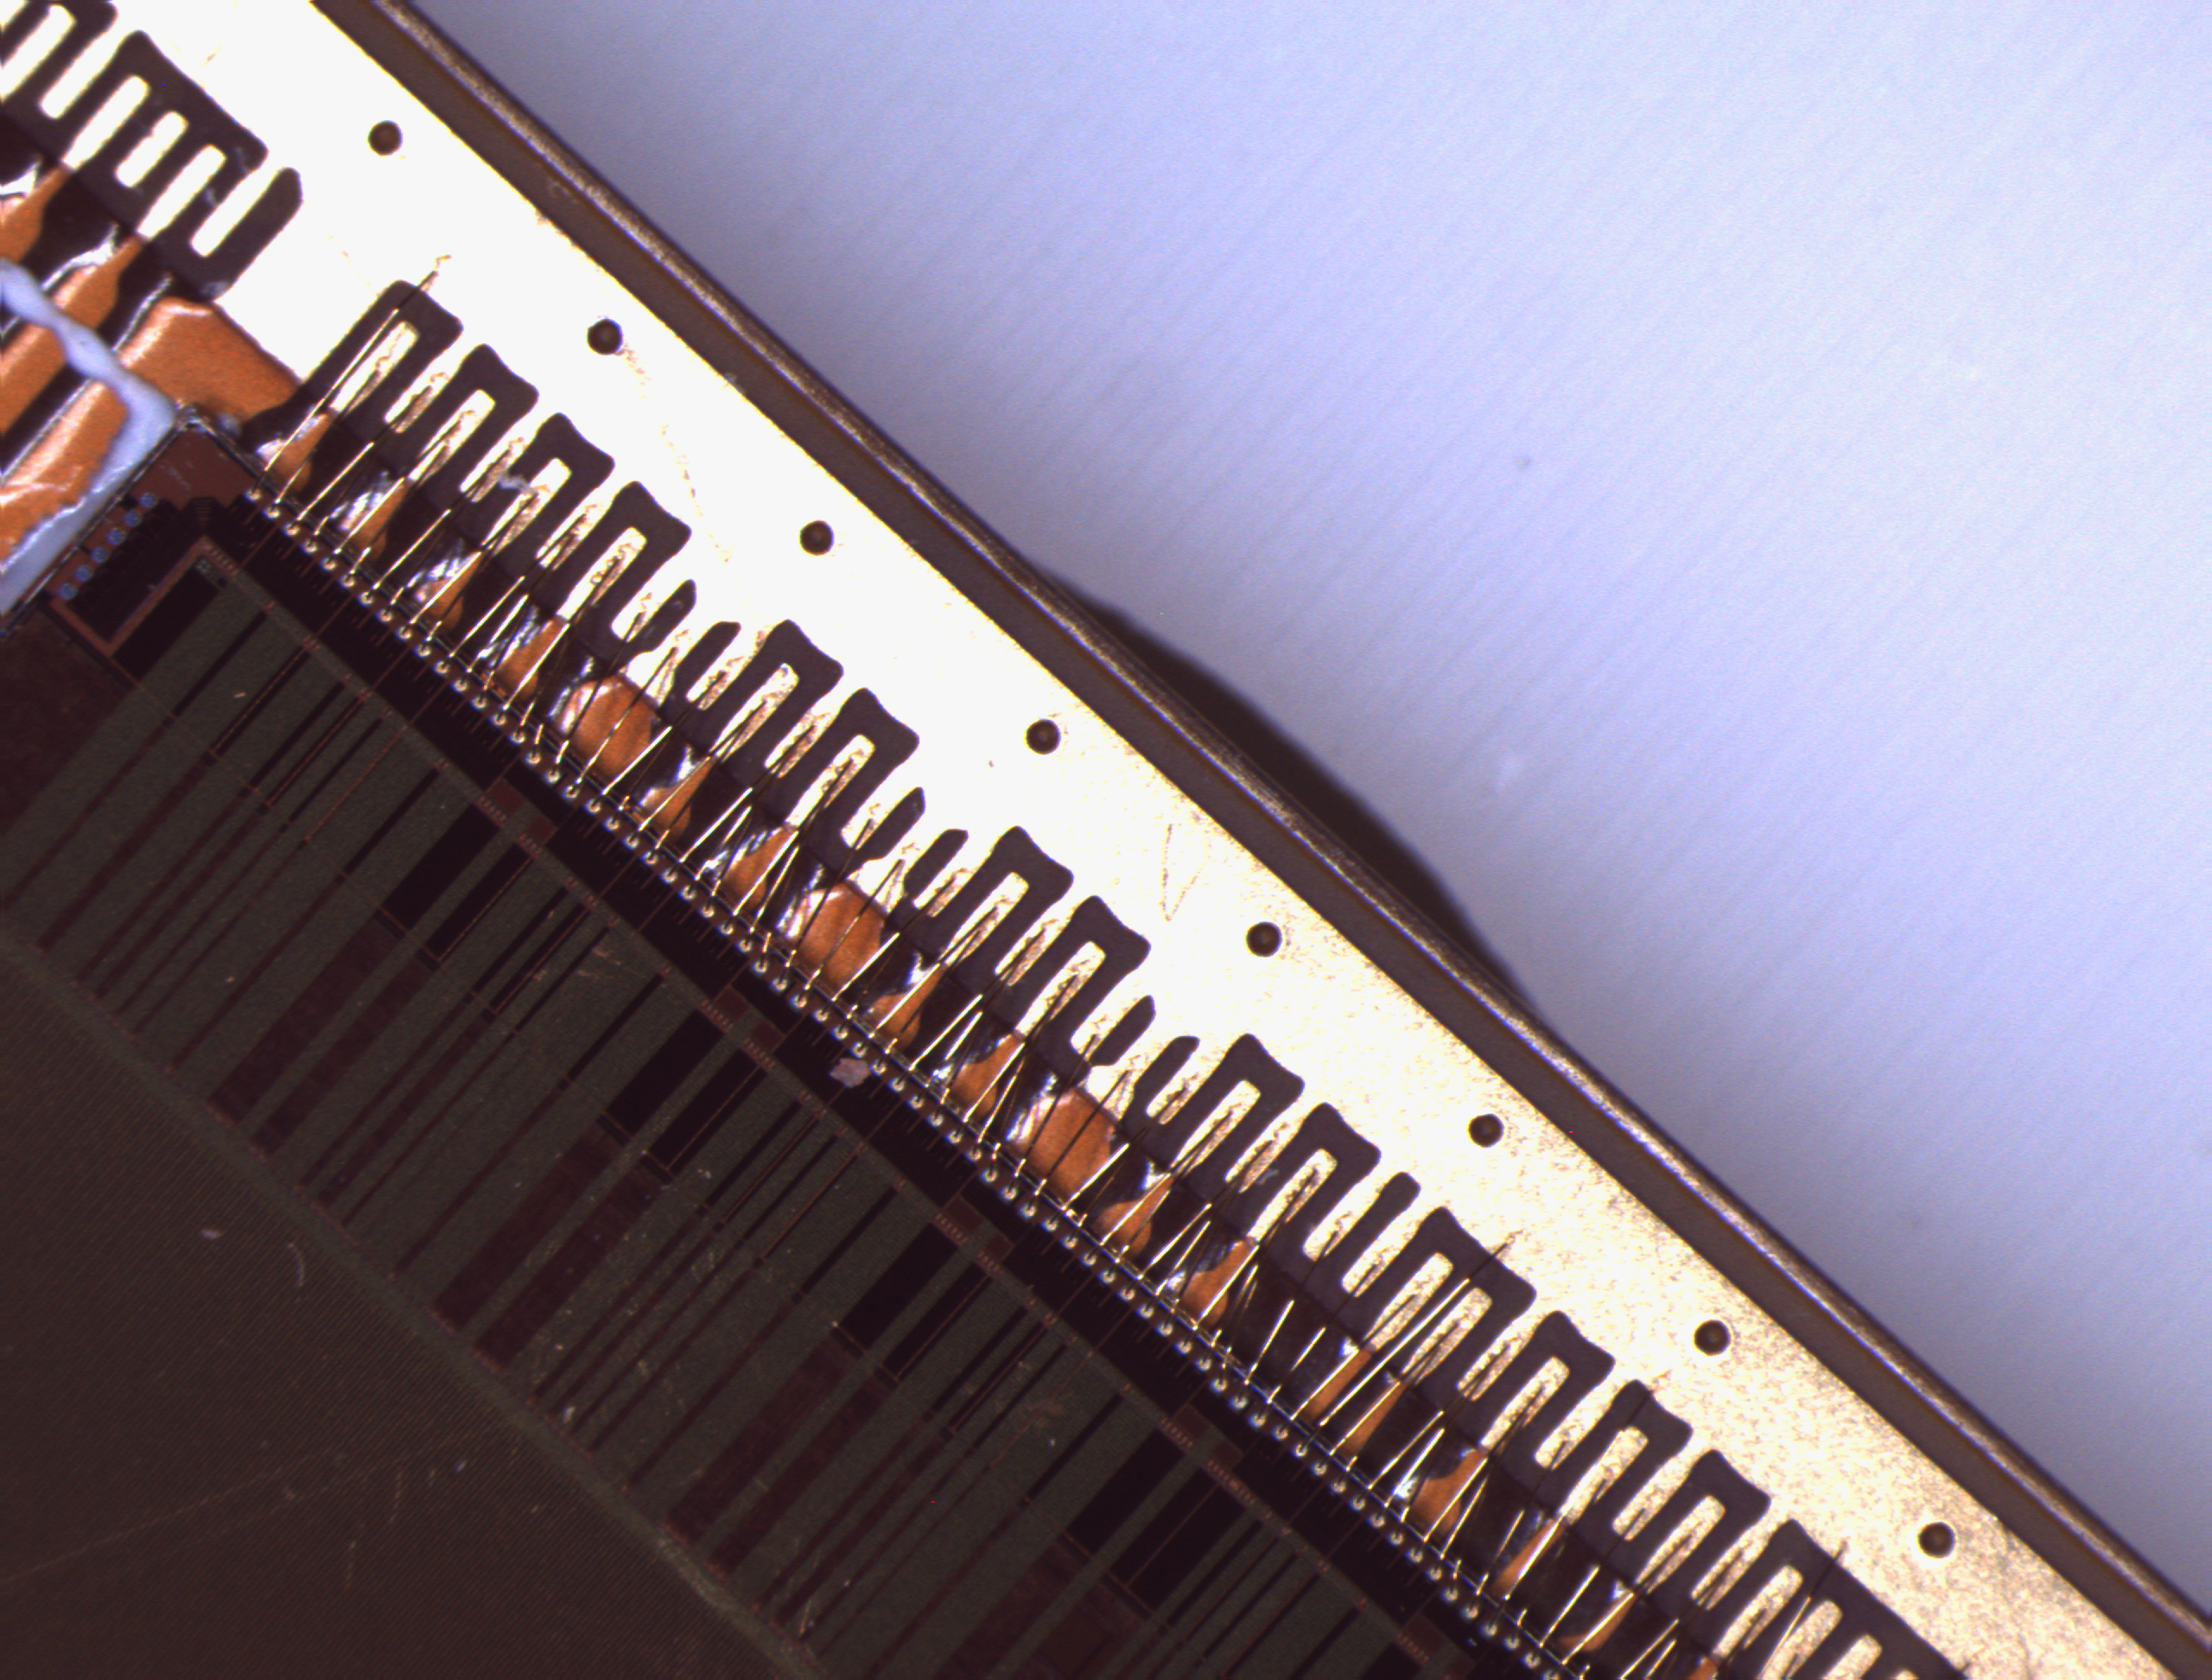
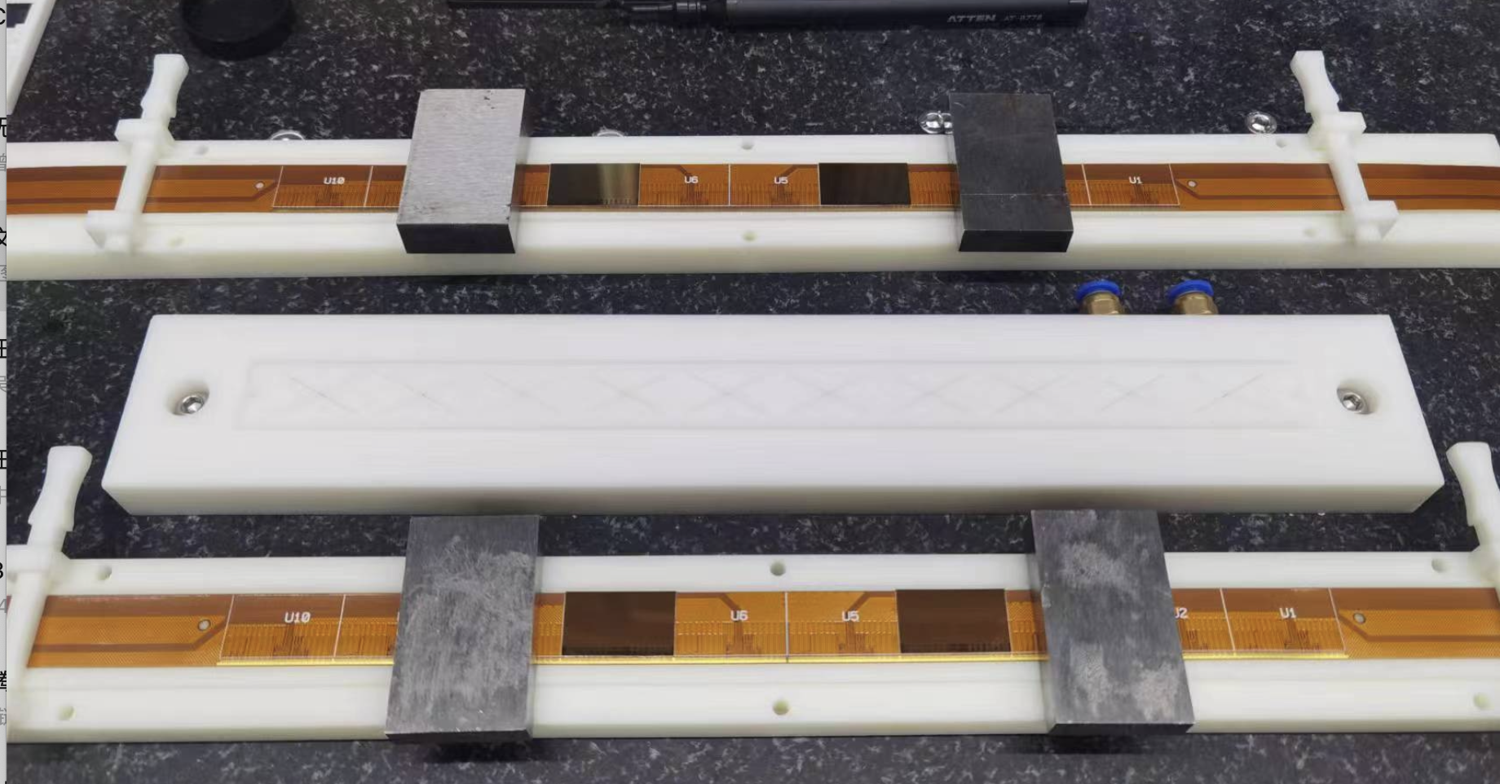
Flex and interface board
2nd version of the flex received. (2 metal layer version)
5 flex available
Single chip testing on flex (on-going)
5 flex received
Wirebonding
Single chip testing on flex

Slide 6
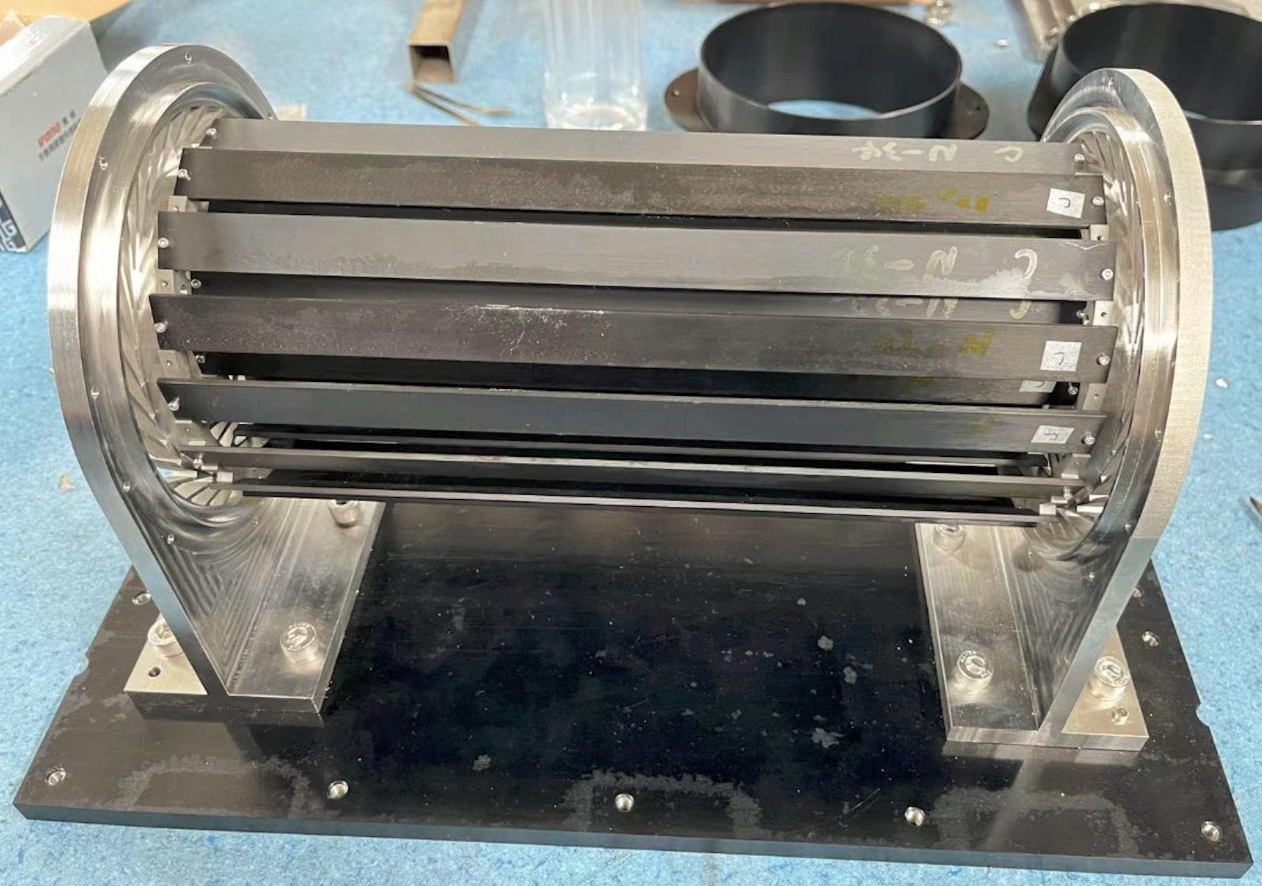
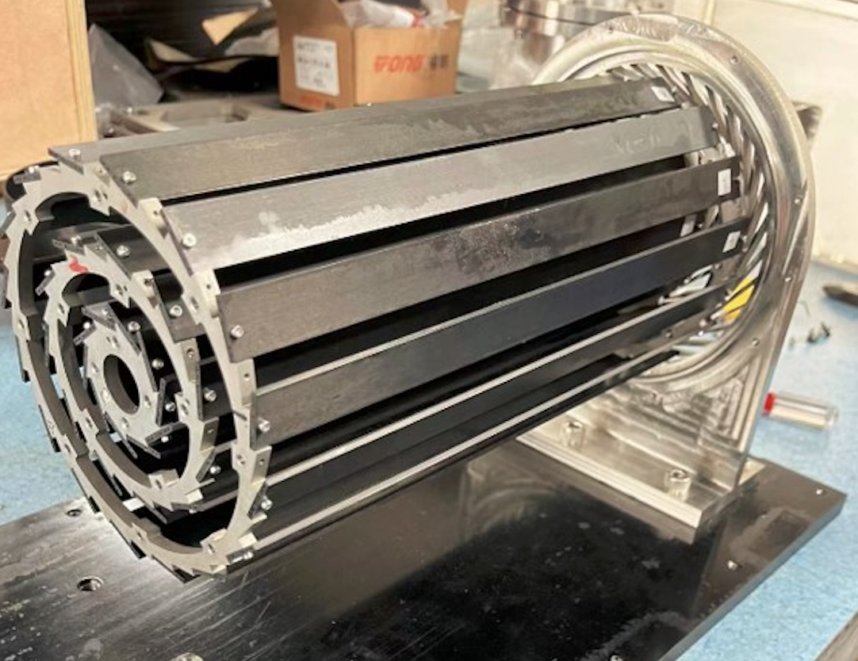
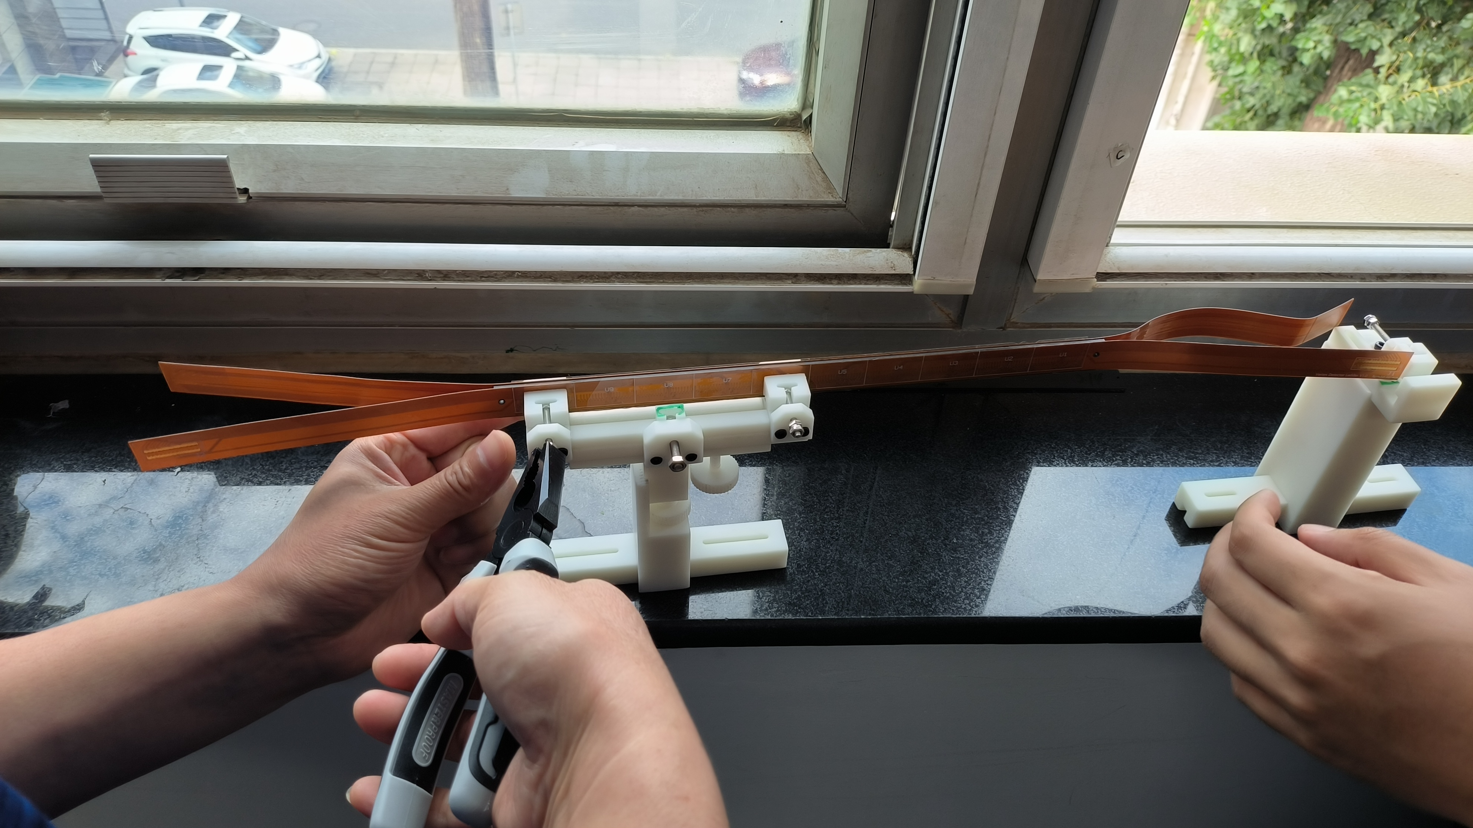
Vertex detector prototype assembly procedure
Prototype support ready
Mounting a dummy ladder with glass (done)
Mounting dummy chip ladder with wire bond (Early Nov)
Mounting real ladders ( End of Nov)
Prototype support with aluminum machining

Slide 7
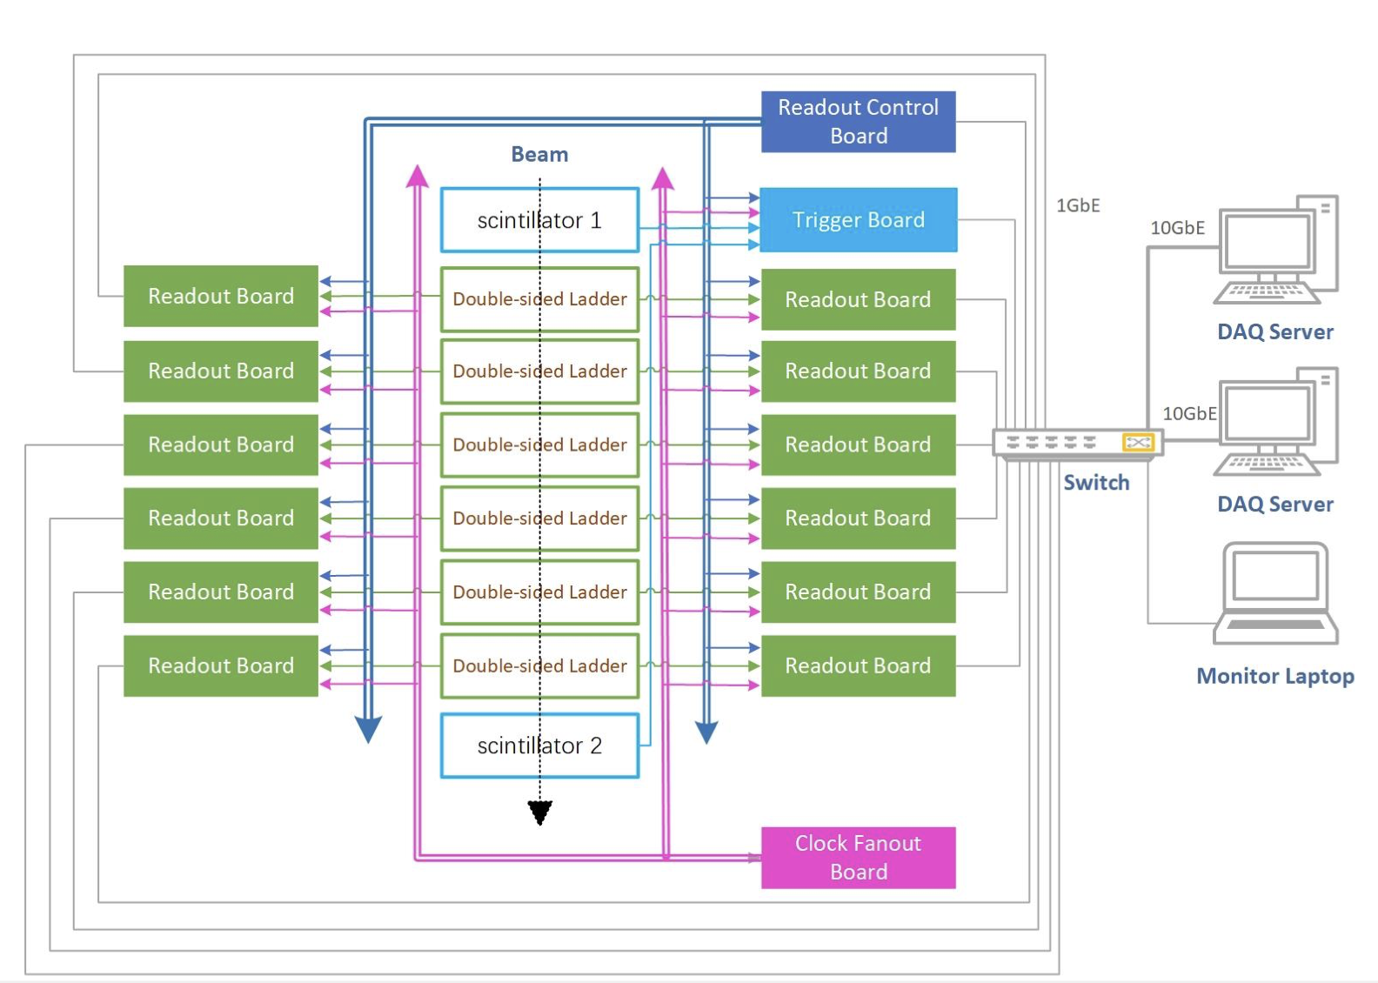
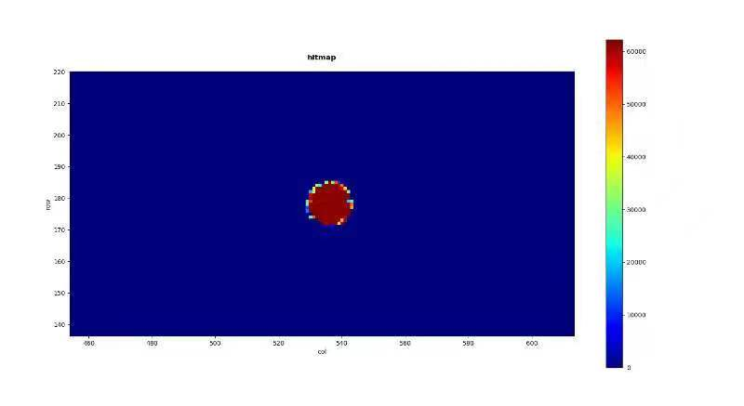
DAQ Architecture development
Correct Chip Configuration and Laser tests data taking with DAQ software (done)
Matlab and DAQ software are getting the same results
Purchase DAQ PC for data taking (done)
Long-term tests with laser (done)
Threshold scan
Parallel processing multi-chip (ongoing)
Key task before Nov test beam in BSRF
DAQ

Slide 8
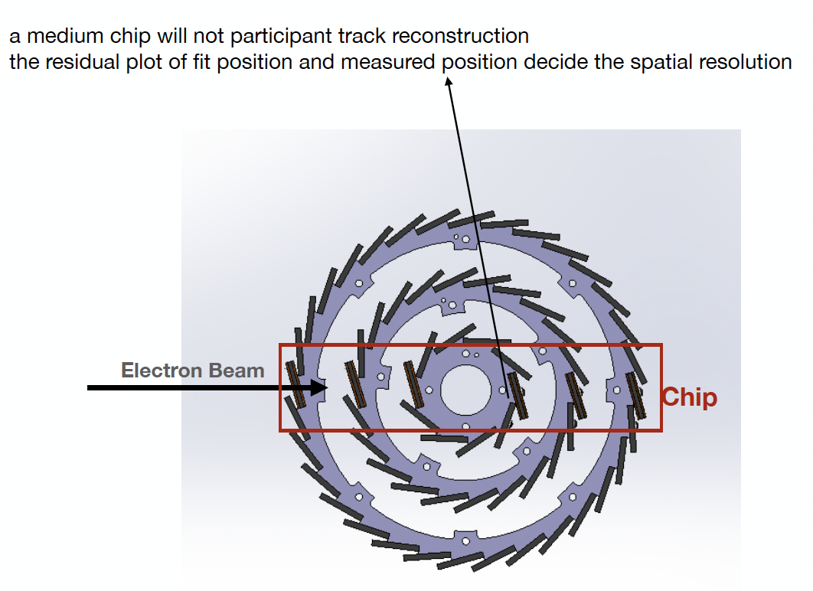
offline reconstruction
Alignment strategy ready
Clustering has the first version
Offline data handling are still needed, to be test in Nov BSRF beam test

Slide 9
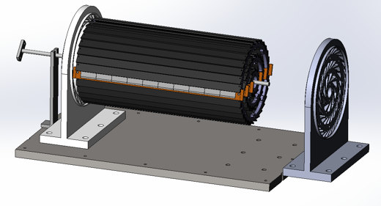
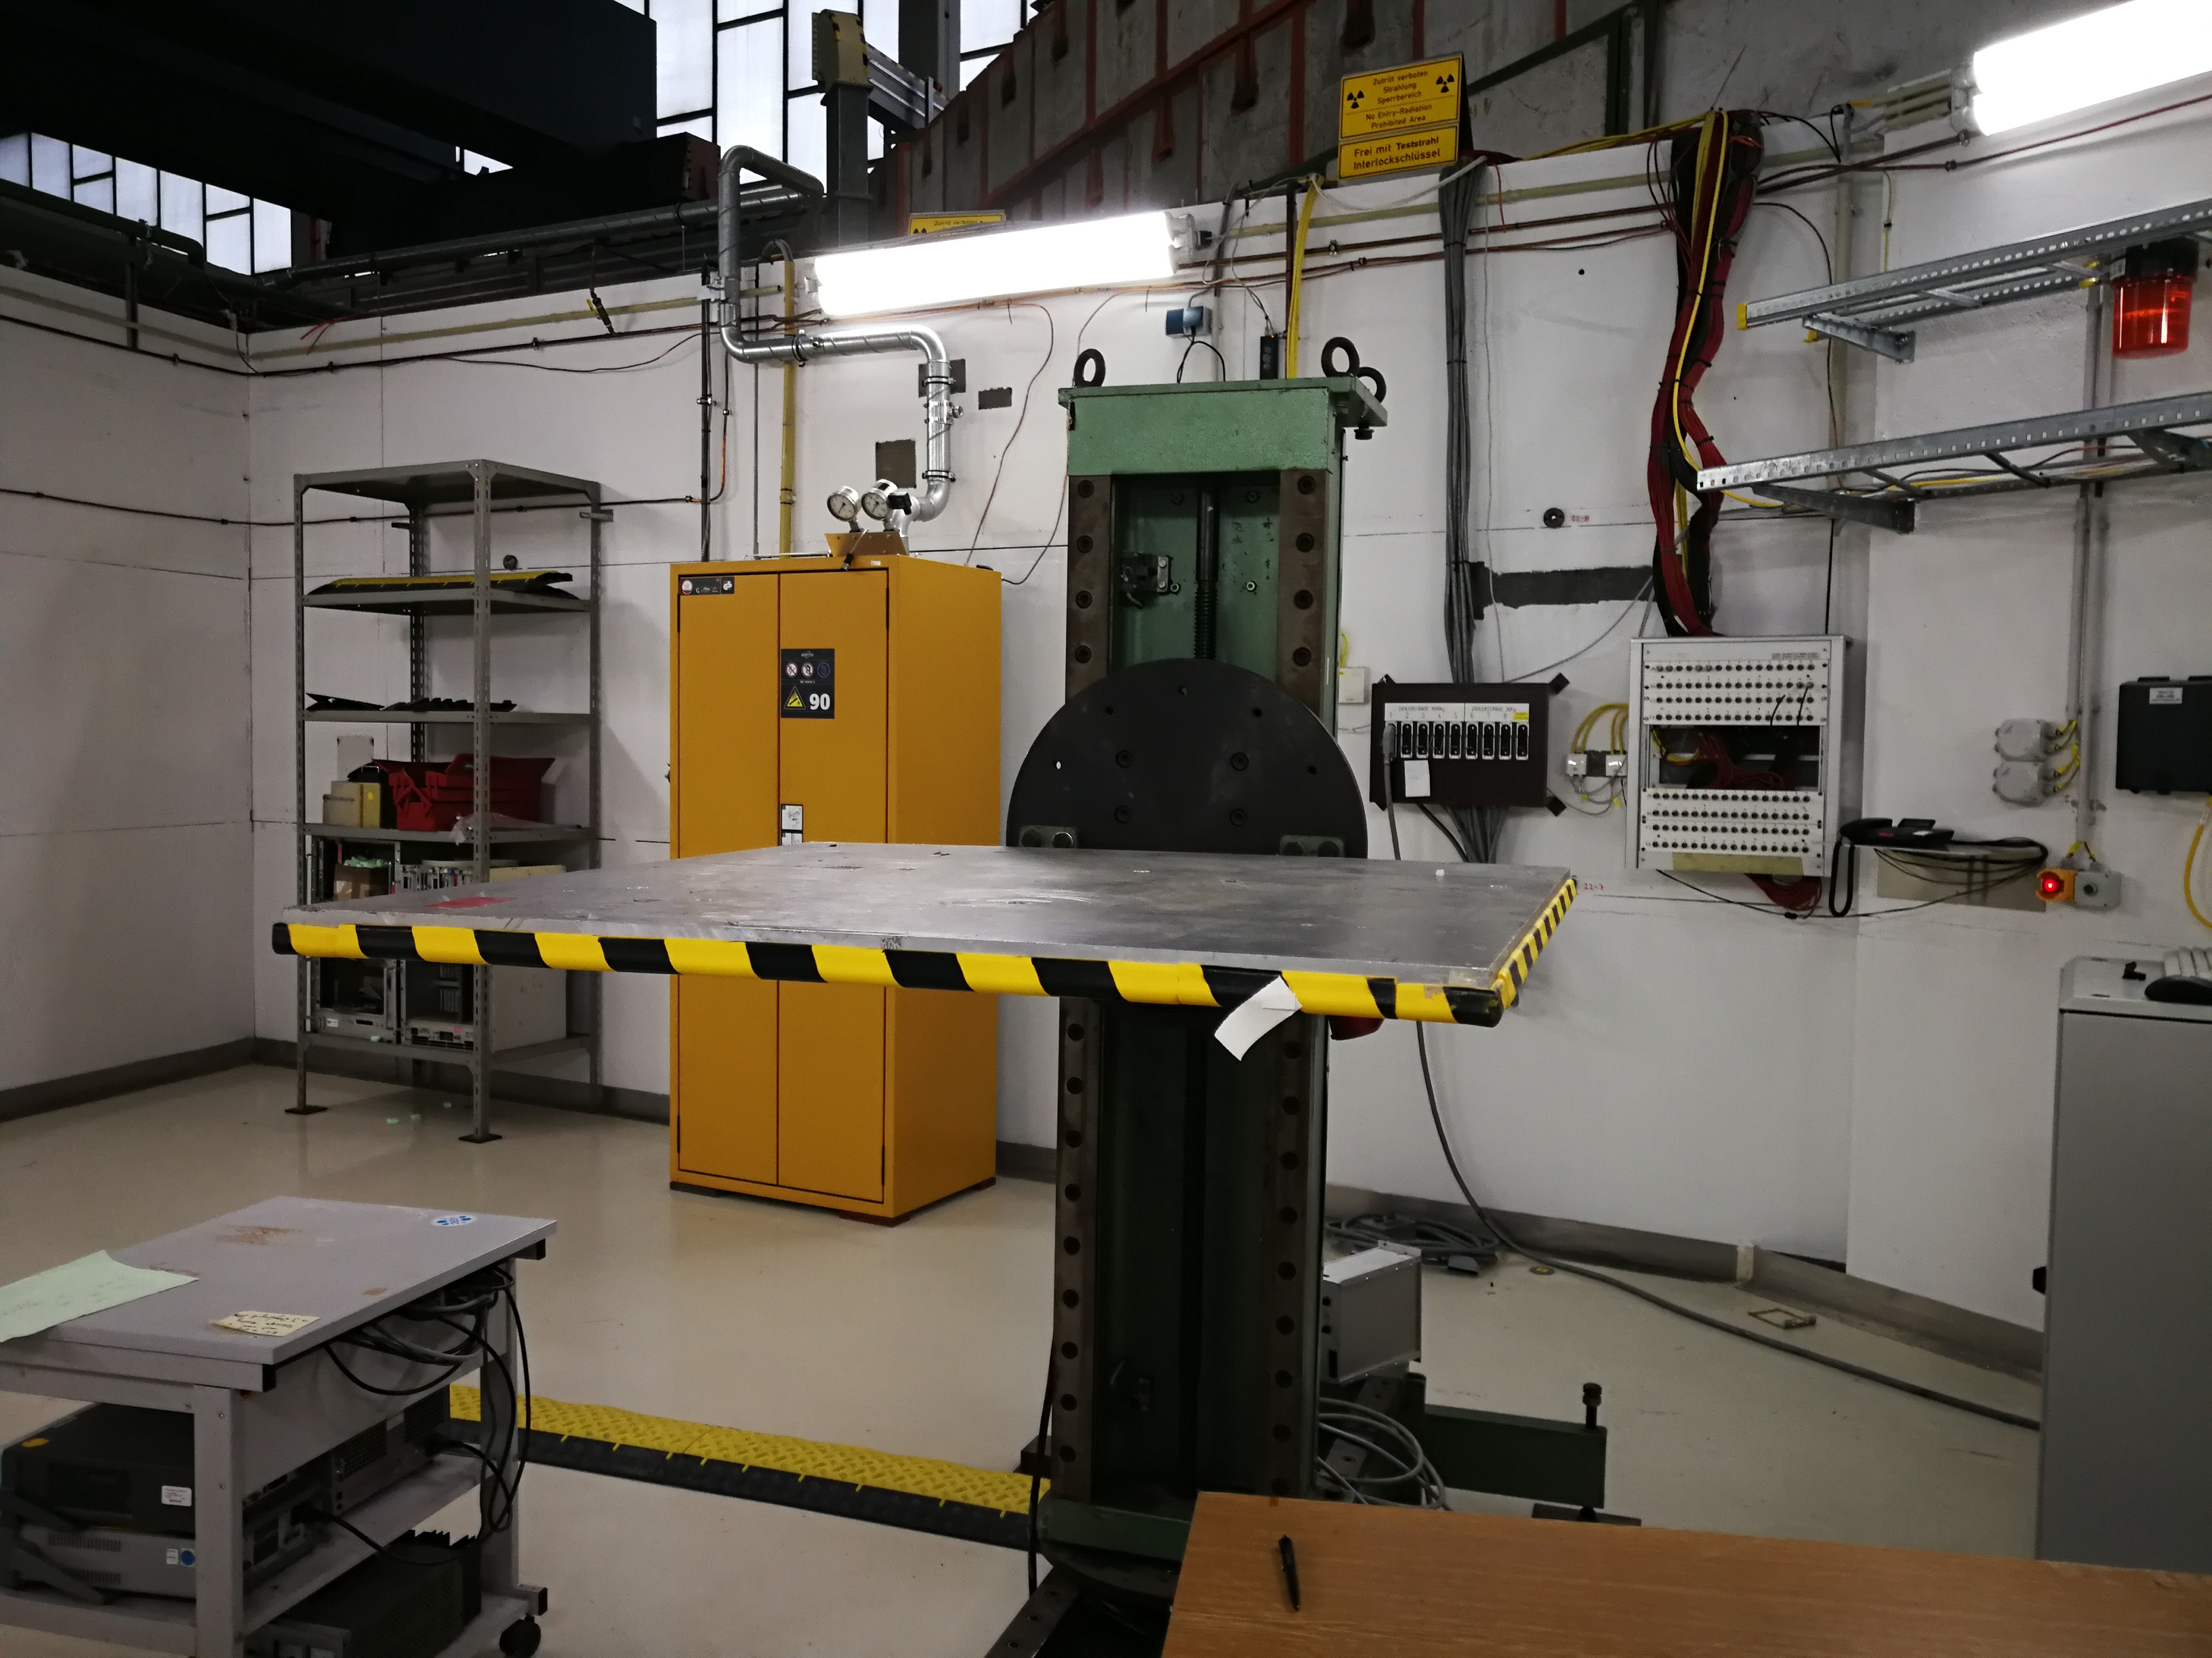
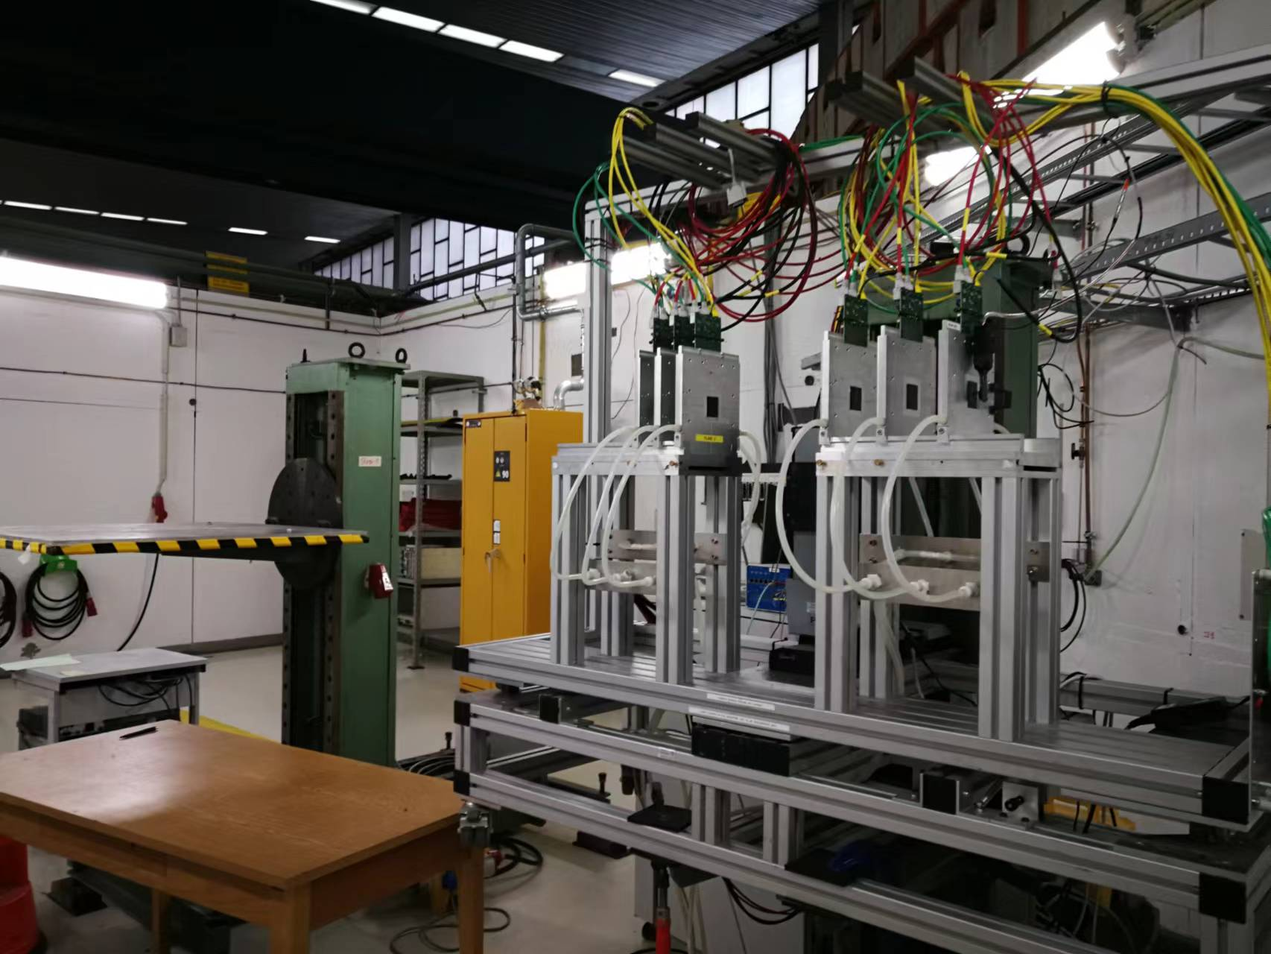
Plan for test beam
beam test in DESY in Dec 12nd (3 - 7GeV electron beams)
Enclosure for detector with air cooling is developed for beam test
Beam is shooting at one sectors of vertex detectors
News about people :
Tianya, Xinhui, Shuqi, Zhou jia got Visa
List of equipment : will be listed after BSRF test beam
DESY test beam
Beam
Electron beam

Slide 10
backup

Slide 11
Plan for test beam
Person power, expertise
Ming Qi (NJU, overall)
Joao (IHEP, overall)
Zhijun Liang (IHEP, overall)
Tianya Wu(IHEP, ASIC)
Xiaomin Wei(NWPU, ASIC )
Jia Zhou (IHEP ,DAQ)
Ziyue Yan (IHEP ,firmware)
Xinhui Huang (IHEP, mechanism)
Shuqi Li (IHEP, offline)
Requesting Invitation letters (almost ready)
Application Passports

Slide 12
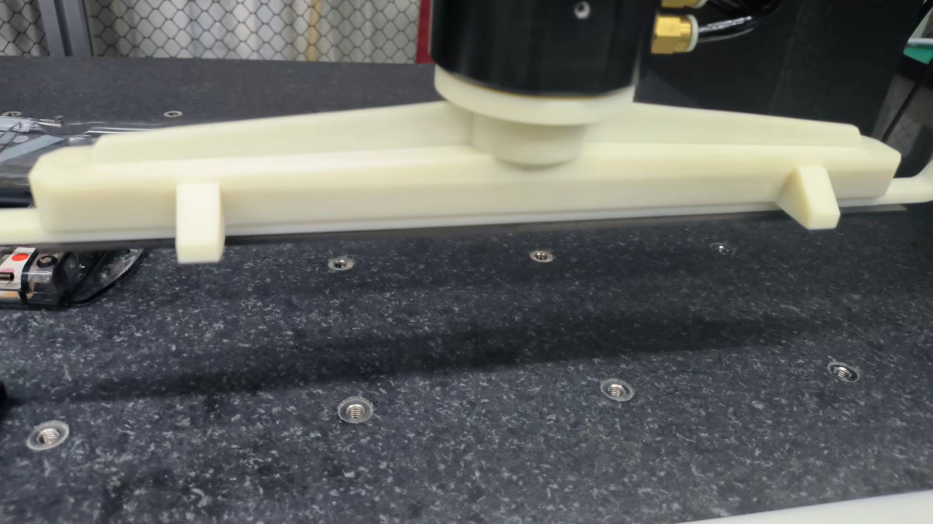
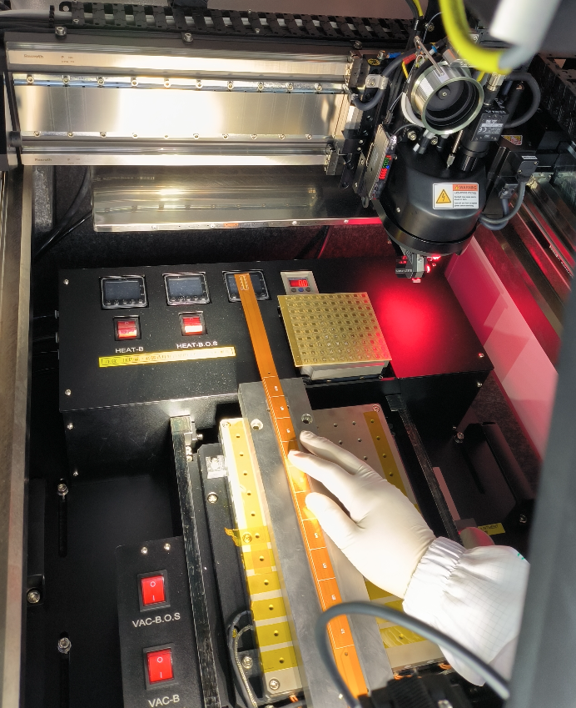
Detector module(ladder) assembly
New pickup tools
Progress in assembly in ladder
Dummy
2 flex with 10 glass dummy ASIC assembly
Automatic glue dispensing using gantry
Real chip
Setting up wire bonding station
For full-size detector module( ladder)
Wire bonded one Taichu3 on flexible PCB
Jun and Ziyue are testing it with interface board

Slide 13
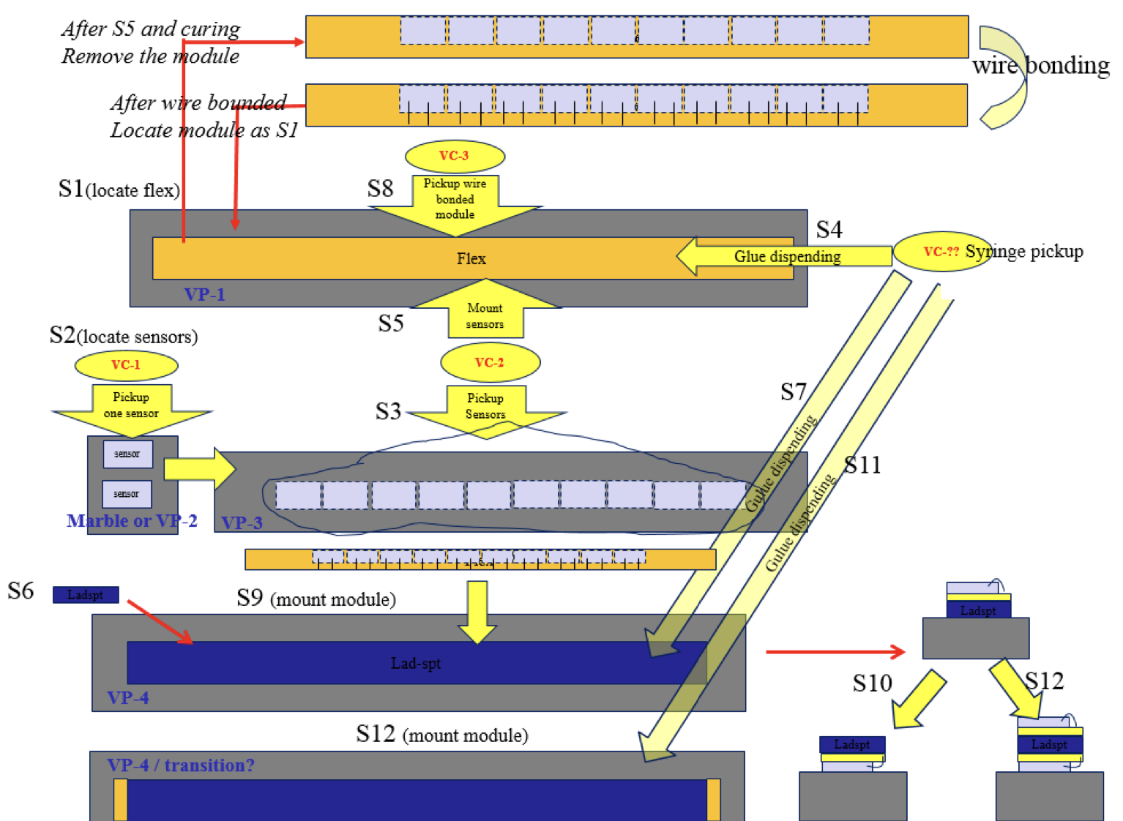
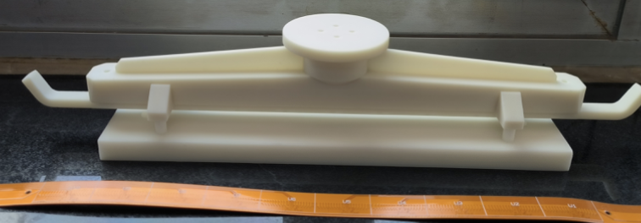
Ladder assembly
Ladder (double side)= 20 ASIC chips + two flexible PCB + carbon fiber support
Ladder assembly procedure verified with dummy ASIC (glass)

Slide 14
Plan for test beam

Slide 15
Equipment for Test beam
Instrumentations
1. vertex detector prototype
2. FPGA boards (15 boards including JTAG adapter)
3. Test PC (2 personal computers. one for test one for backup)
3 PC for DAQ, electronics , offline ?
2T harddisk , 交换机switcher (24 channels, 8 channels …),
temp monitoring slow control (PC needed)
Power adaptors …, 4-5 DC power supply ?
4. Several DC power supply (borrow it from DESY?): 12 channels DC power supply
5. Several network cables and other cables.
6. Borrow one oscilloscope for debug

Slide 16
Timeline
ASIC
ASICs arrive to IHEP (June)
Dicing and Thinning (one wafer dicing before wafer-level tests) (June)
Single ASIC testing
PCB under production ( Done)
Wire-bonding on test PCB … (Done)
Laser tests, Functional Tests … (on-going)
Beta source test (on-going)
Irradiation test (done)
Wafer level testing
Wafer level test of ASICs (on-going)
Dicing , (on going )

Slide 17
Timeline
Ladders Mechanics:
Now: Carbon support samples available
Pre-production carbon support ladders available
September: Production of final carbon support ladders (done )
Ladders Assembly:
May: Flex cable available
May: Test of wire bonding and gluing on carbon support
Tooling design and production (June)
Dummy sensor (Glass) assembly on flex (JUNE)
Jig tool , Wire bonding tests on flex (done)
Assembly of ladders with dummy chips (done )
Assembly of ladders with real chips (Nov, developing )

Slide 18
Time line
Barrel Prototype:
Oct: Assembly first Barrel with ladder support only (done)
Oct: mounting dummy ladders (done)
Nov: mounting real ladders
December 12nd -22nd : DESY test beam

