Slide 1
Possible MRPC detector for CEPC-TOF
王义
清华大学工程物理系

Slide 2
PID of CEPC
Gent4 simulation:
TPC resolution: <2.5%
TOF: <50ps
PID of K: >98%
From Manqi’s summary @ 2022 CEPC workshop

Slide 3
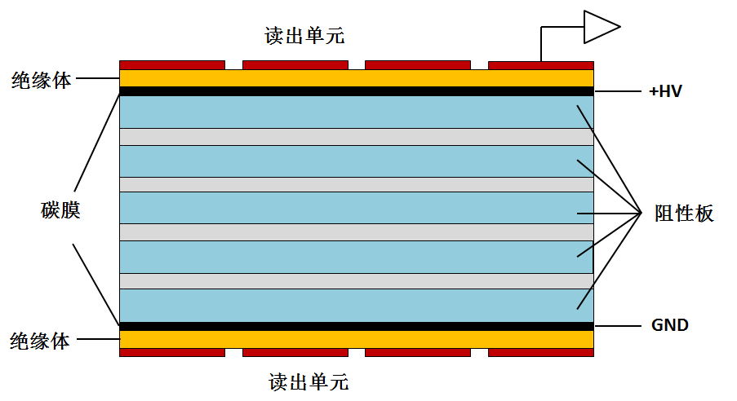
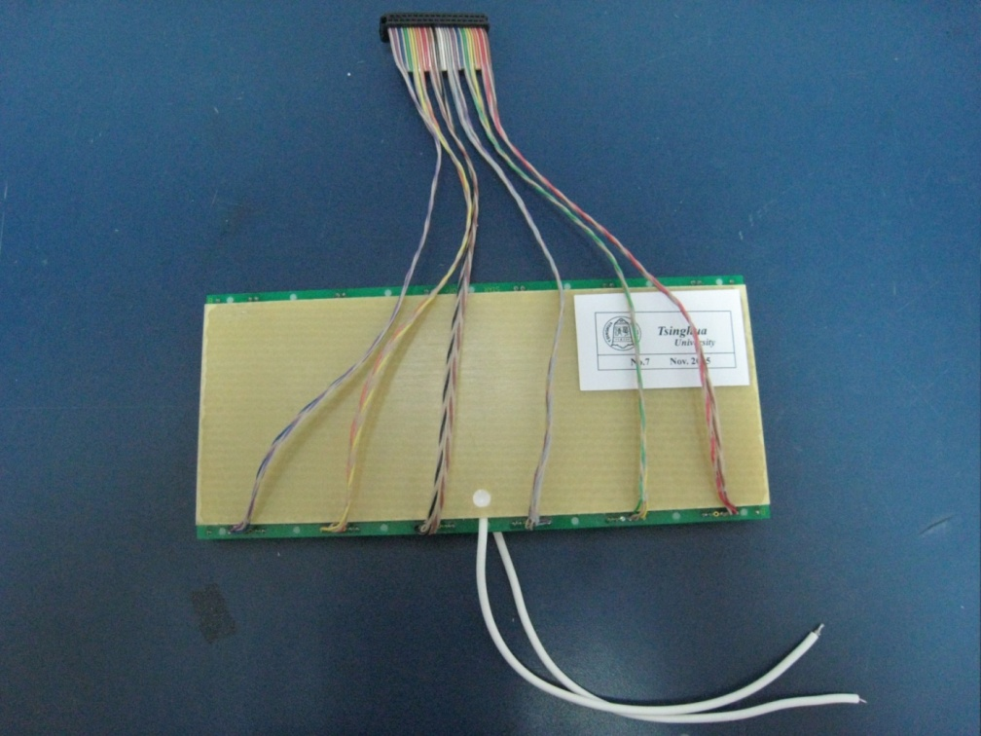
A good choice-MRPC
Standard parameters:
Resistivity of glass: ~10¹² Ω.cm
Working gas: 90%Freon+5%iso-butane+5% SF6
Time resolution <100ps
Efficiency >95%
Charge: a few PC
Dark current: a few nA
Noise ~1Hz/cm²
Rate <100 Hz/cm²
Large area, low cost
Read out
Insulator
Carbon
Resistive
plate
Insulator
Read out
MRPC structure
MRPC application：
Application in nuclear physics experiments
Application in industry（Muon tomography)
Application in medicine（TOF-PET）

Slide 4
MRPC in TOF system
 | ALICE | STAR | FOPI | BESIII | CBM | SoLID
Active area per detector (cm) | 120 x 13 | 22 x 8.4 | 90 x 4.6 | 0.5x(9.2+14.8)x32.8 | 33 x 27.6 | --
Total active area (m²) | 141 | 50 | 5 | 1.33 | 120 | 10
Pad size (cm) | 3.7 x 2.5 | 6.3 x 3.1 | 90 x 0.3 | (9.1~14.1) x 2.4 | 27 x 1.0 | (16~28) x 2.5
Gap×thickness(mm) | 10 x 0.25 | 6 x 0.22 | 6 x 0.3 | 12 x 0.22 | 10 x 0.25 | 32 x 0.128
Gas mixtures (C₂H₂F₄/ C₄H₁₀/SF₆) | 90/5/5 | 95/5/0 | 85/5/10 | 90/5/5 | 90/5/5 | 90/5/5
Operating field (kV/cm) | 96 | 107 | 110 | 109 | 110 | 150
Efficiency | 99.9% | 95-97% | 97±3% | 99% | 97% | 98%
Time resolution(ps) | 40 | 60 | 73±5 | 60 | 60 | 20 ps
Max rate (Hz/cm²) | 50 | 10 | 50 | 50 | 30k | 20k
higher counting rate and time precision.

Slide 5
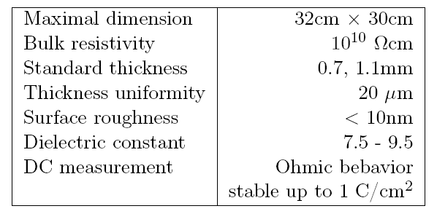


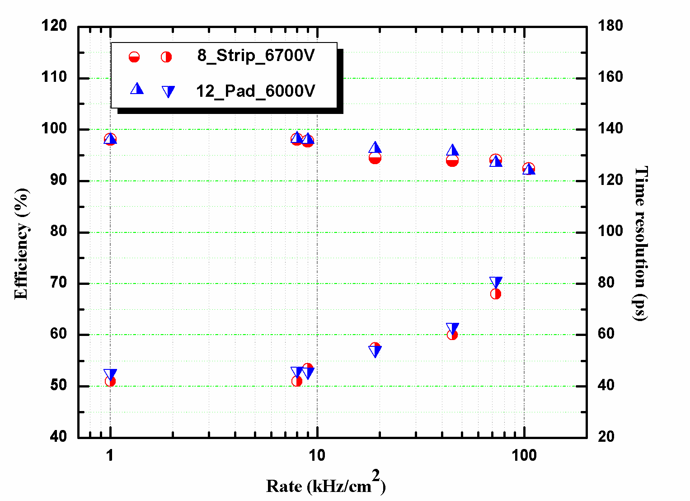
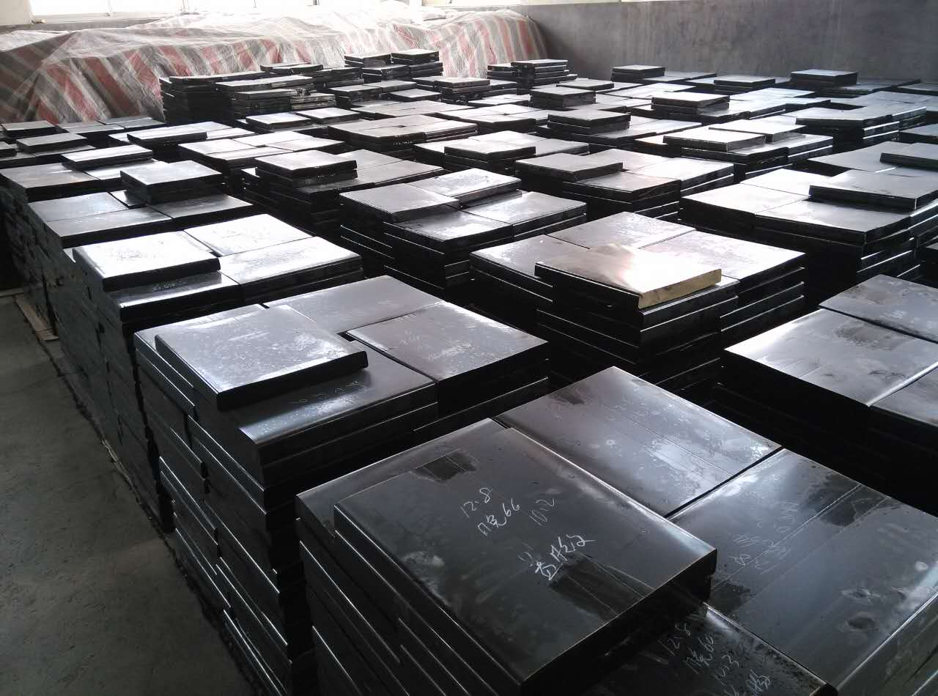
Low resistive glass for high rate detector
low-resistive glass control the voltage drop (efficiency loss) when incident flux goes up by Decrease the resistivity of the electrodes
Specifications of low resistive glass
Low-resistive glass has been operating at FAIR-Phase 0 programs like STAR-eTOF and mCBM
It will be applied in CBM-ToF Wall
Beam test result:
93%, 80ps ,70kHz/cm²

Slide 6
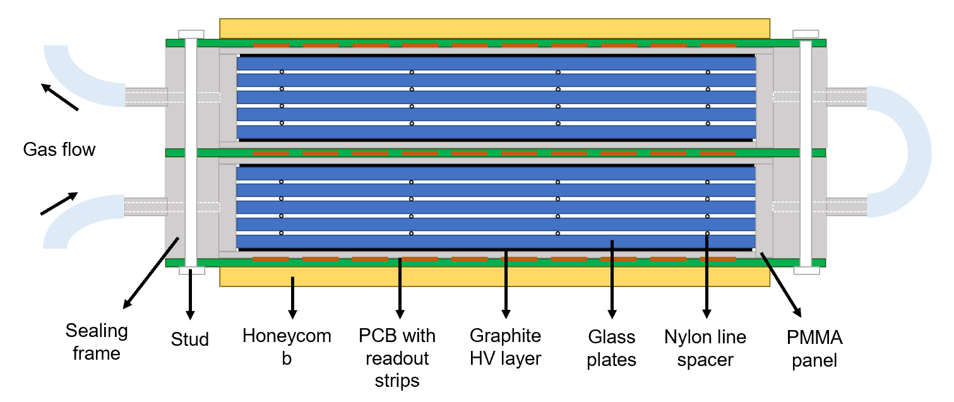
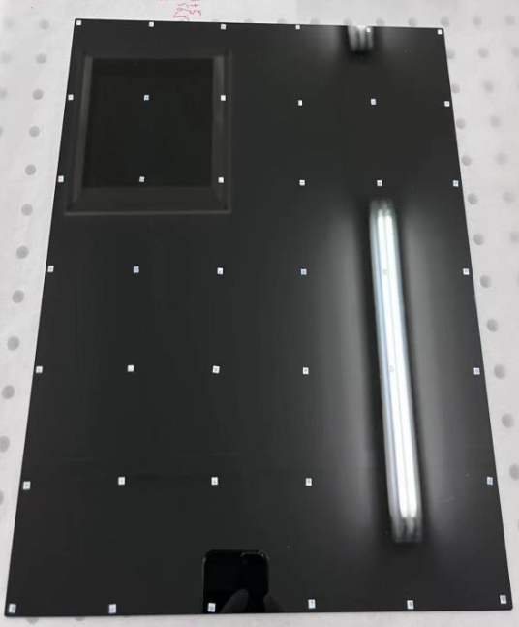
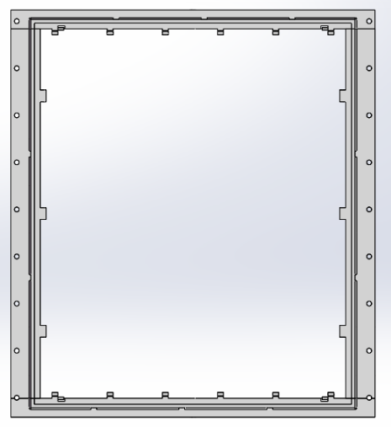
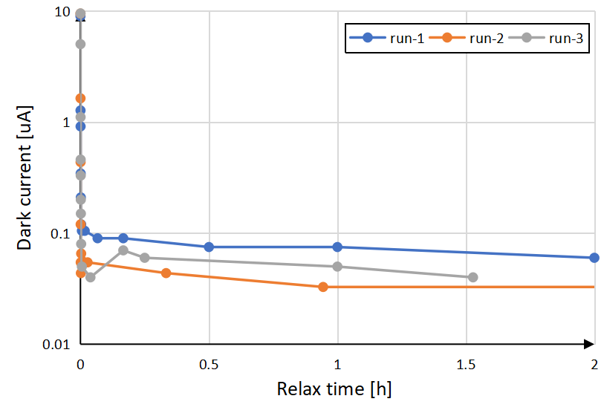
Sealed pad spacer MRPC for CBM-TOF
Gas outlet
Gas flow
Gas inlet
Sealed pad spacer MRPC
Speed up gas exchange and can reduce to 1sccm/m² flush rate at cosmic experiment!
Prevent creepage on fishing line at high rate (>7kHz/cm²)
Save working gas and environmentally friendly.

Slide 7
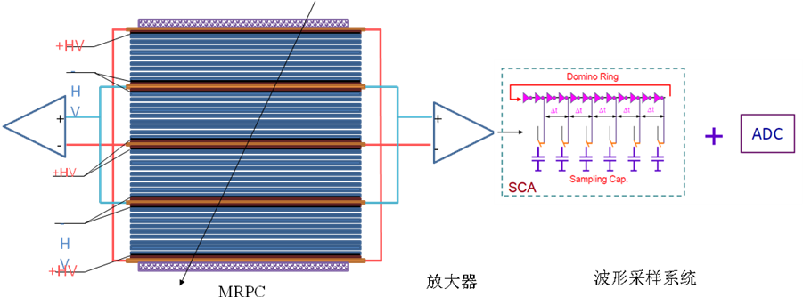
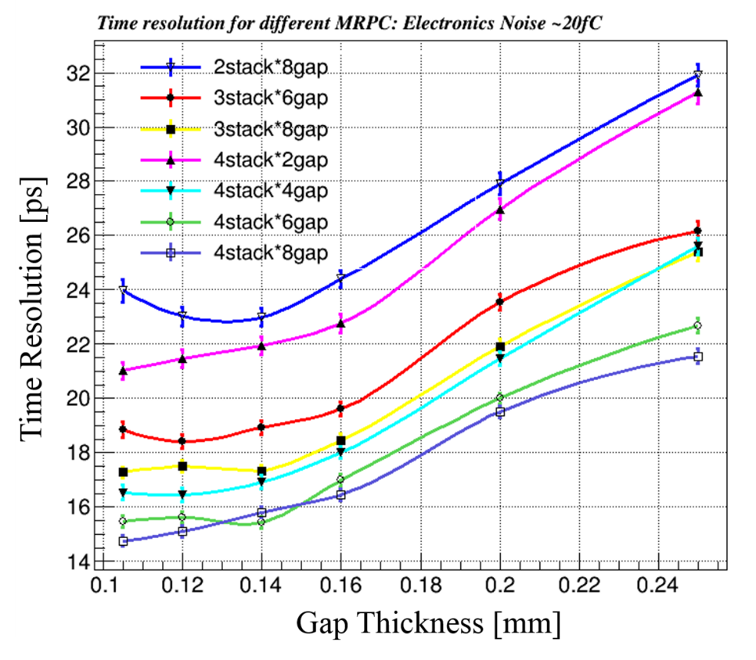
20ps MRPC for SoLID-TOF
Simulation indicates proper ways to design the gap thickness and arrange the stacks
Narrower gap thickness required
σ_{TOF} <20 ps， the intrinsic resolution of narrow gaps MRPC is around 15ps，so the time jitter of readout electronics <13~15 ps。
σ_{MRPC} <20 ps，the gas gap: <0.18mm
gap number: >16

Slide 8
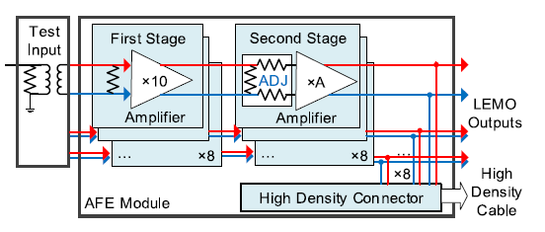
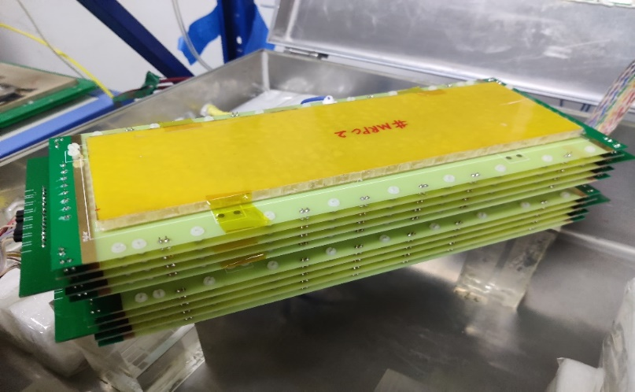
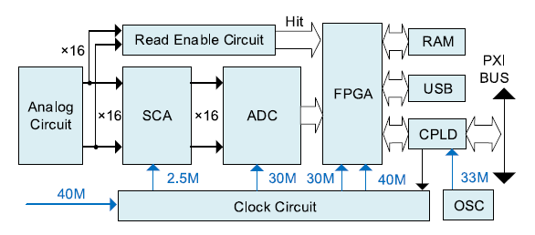
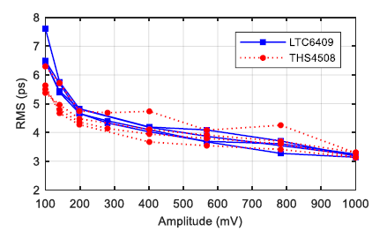
MRPC and electronics
Fast amplifier
Bandwidth=1.4GHz
 | MRPC prototype
gas gap thickness | 128 μm
number of gas gaps | 4 chambers × 8 gaps
glass material | low resistivity glass
glass thickness | 400
readout strips | 5 mm in width (2 mm clearance)
Waveform sampling
Based on DRS4
Sampling freq=5 GS/s

Slide 9
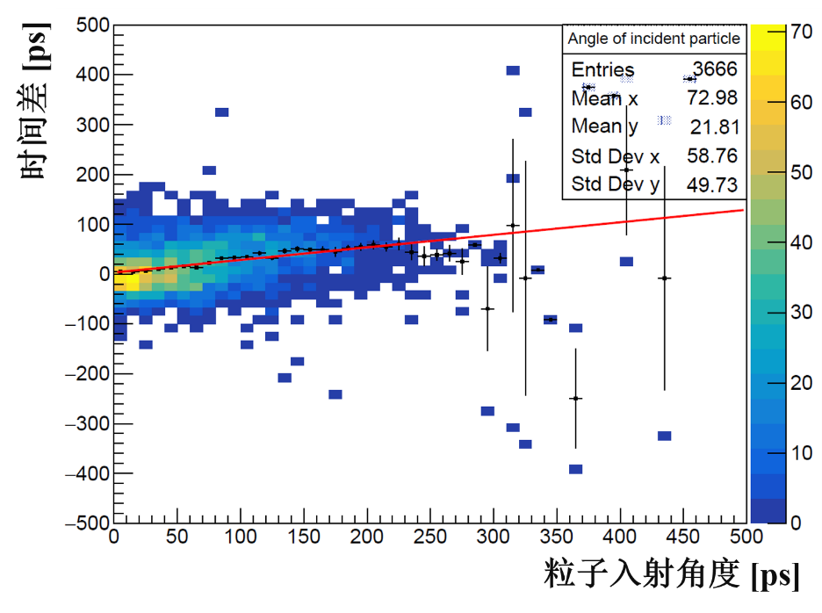
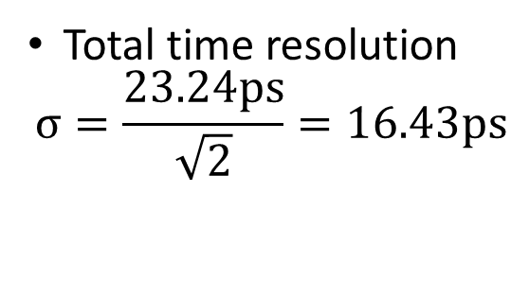
Test results
MRPC + fast amplifier + DRS4
Timing：CFD
Event choose：Vertical cosmic ray
Total time resolution
$$σ=\frac{23.24ps}{\sqrt{2}}=16.43ps$$

Slide 10
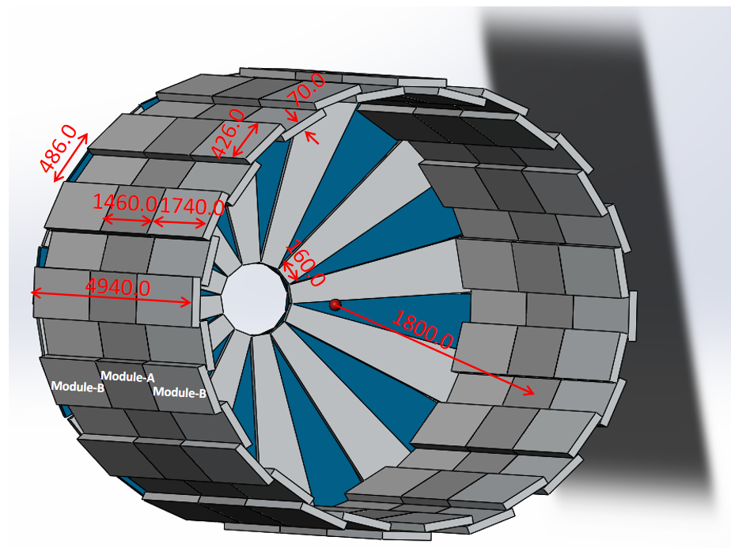
CEPC-TOF总体构造
性能：
1、时间分辨：<35ps
2、PID of π/k: 2.5GeV @3σ
3、TOF面积：~77m²
4、电子学道数：37632
5、电子学功耗：17mW/道
6、造价估算：3420万RMB (MRPC 784万元）
桶部：
绕筒圆周方向两层tower overlap，每层16个tower，每个tower包含1个module-A和2个module-B，覆盖角度为360°，沿筒轴向放置tower（tower长4.9m）。
Module-A、Module-B中两相邻的MRPC之间2条读出条重叠，读出条为10+2.5mm，4室6气隙单个探测器厚3.02cm。
端部：
一端共24个module，分两层overlap；每个module中有5个探测器，两相邻的MRPC之间1-2条读出条重叠，每个探测器有24个读出条，读出条为10+3.5mm

Slide 11
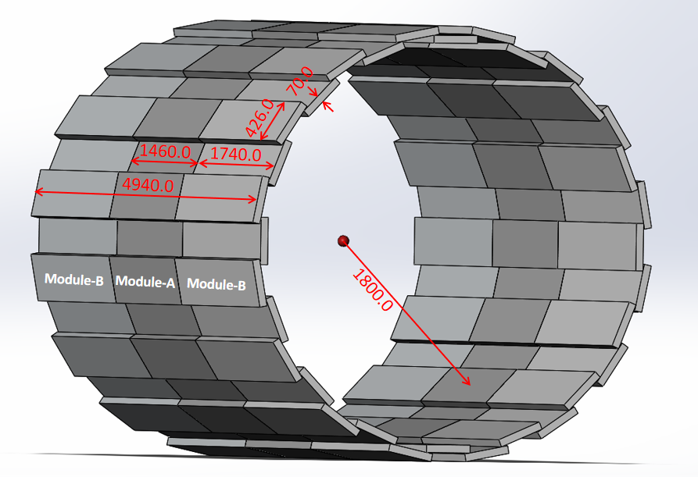
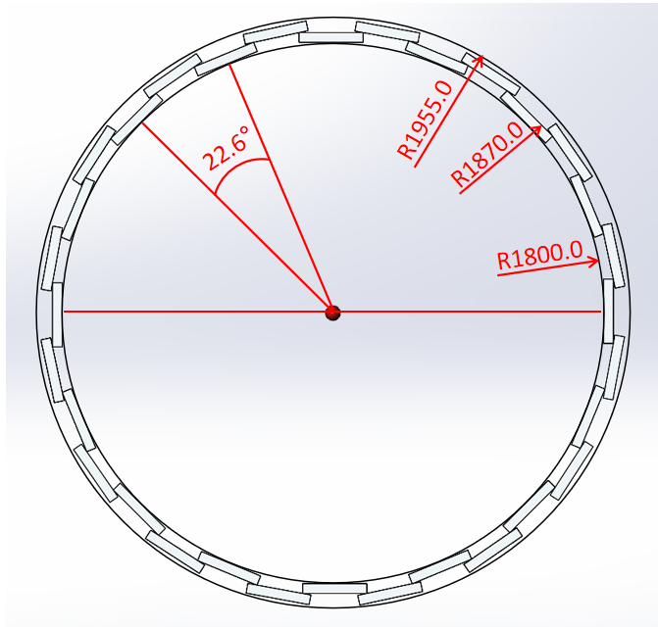
Figure 1.1 Main sizes of the TOF barrel.

Slide 12
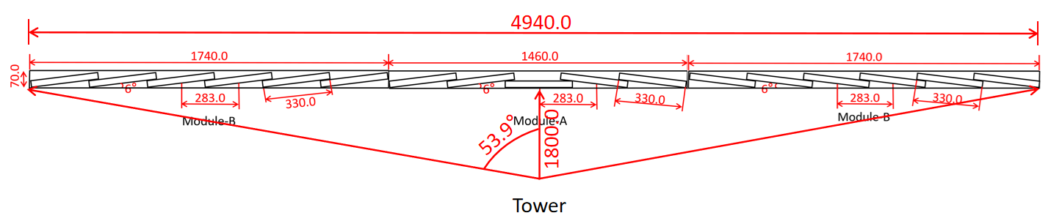
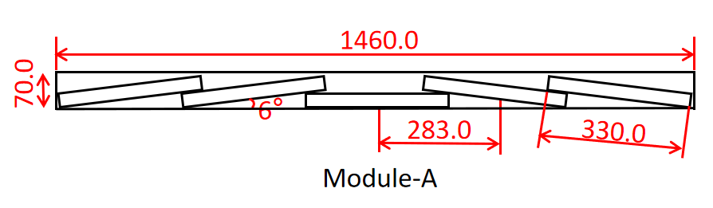
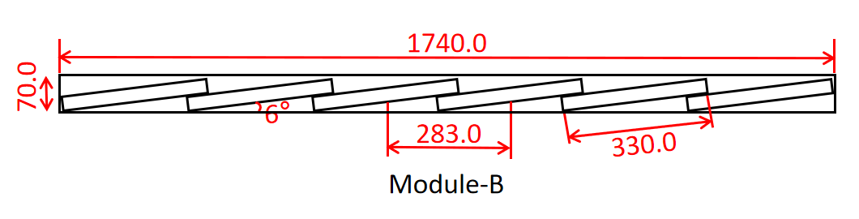
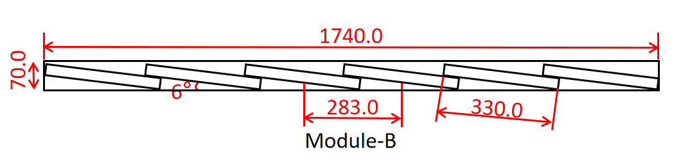
Figure 1.2 Arrangement of MRPCs inside the box along the beam direction.

Slide 13
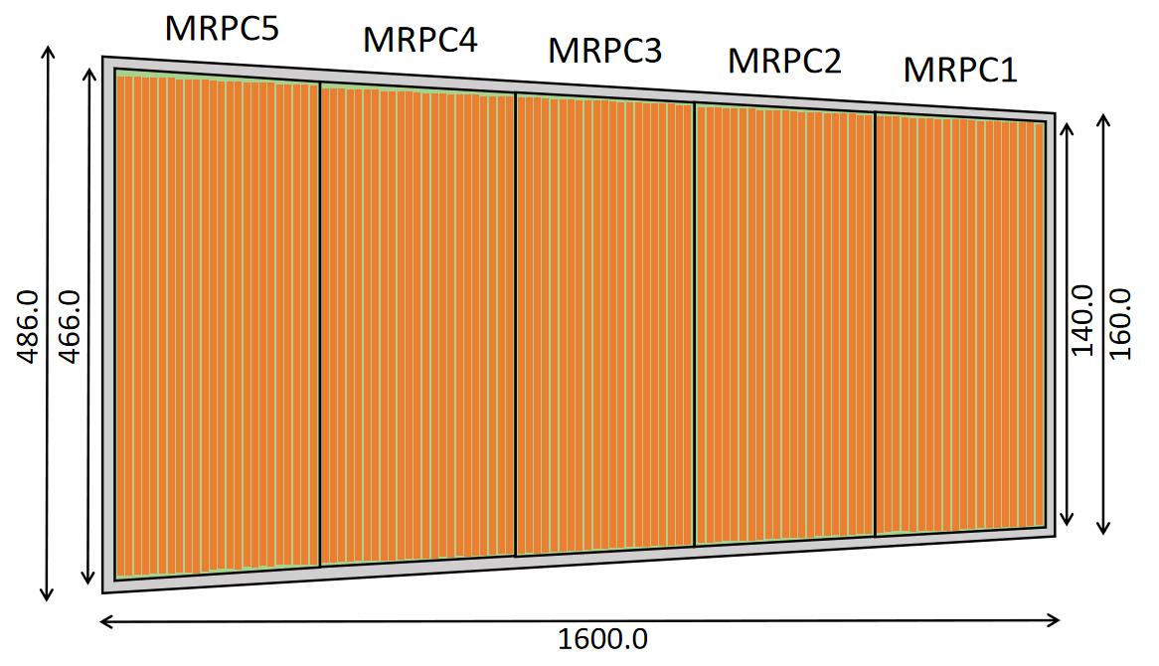
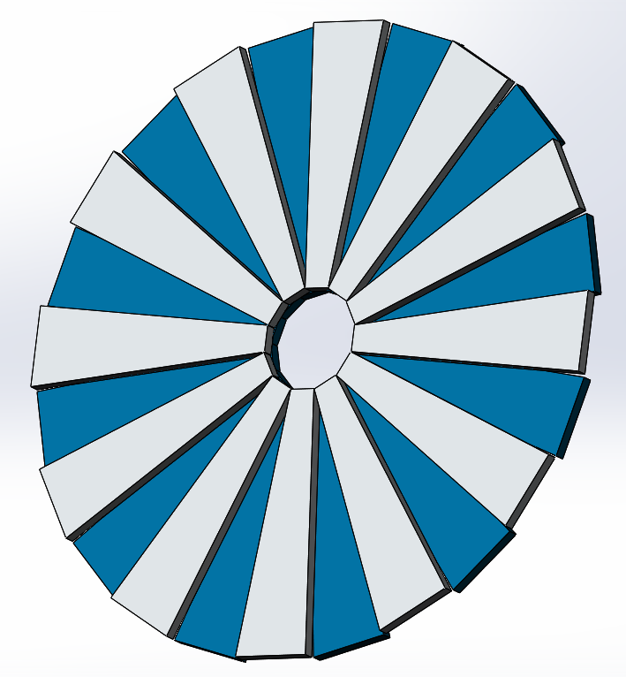
Figure 1.3 Arrangement of MRPCs inside the box in the End-cap.
Figure 1.4 Diagram of the End-cap.

Slide 14
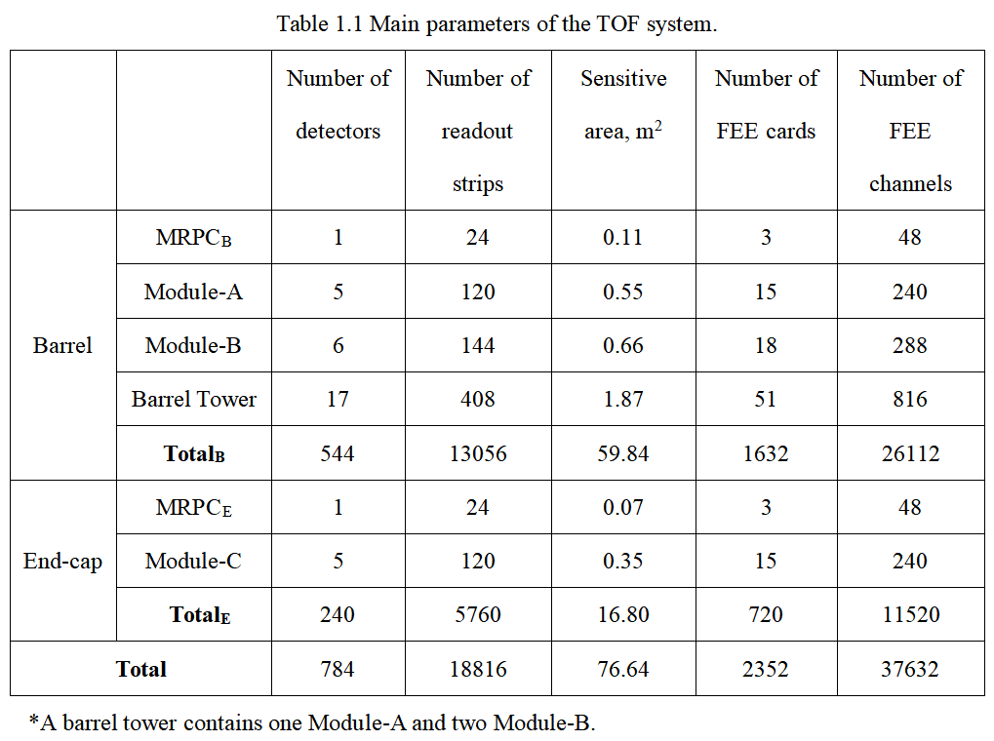
电子学通道设计：

Slide 15
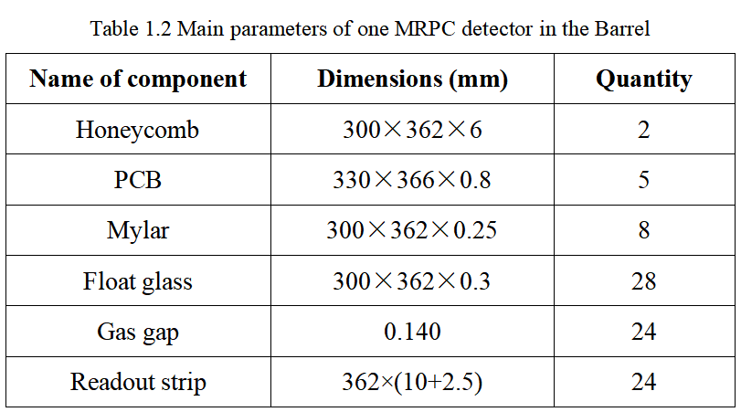
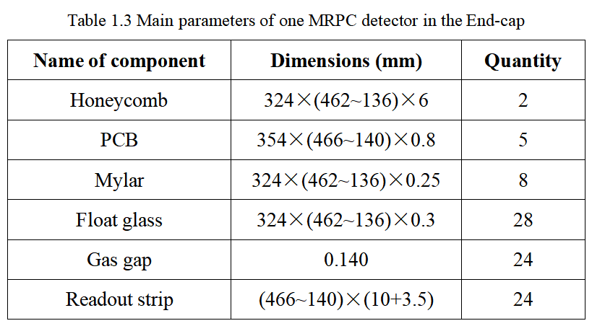
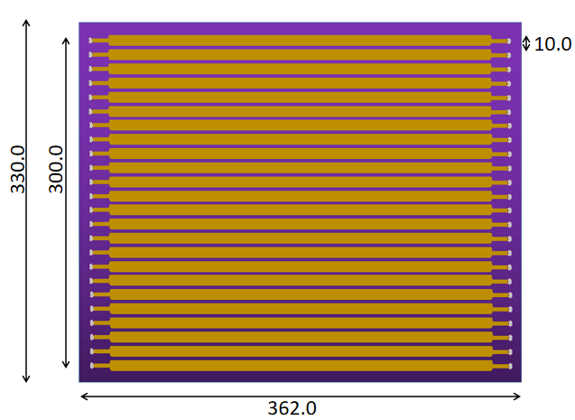
MRPC采用4室6气隙结构，气隙厚度0.14mm，单个探测器厚3.02cm

Slide 16
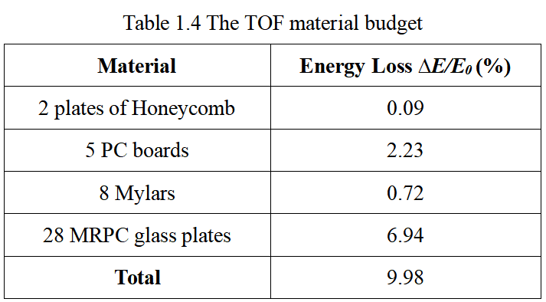
能量损失
谢谢！

